Slide 1
4-Dimensional (4-D) Interpolator 101
March 23, 2026
Kaylyn S. Gootman (EPA)
CBP team and developers:
Peter Tango (USGS), Rebecca Murphy (UMCES),
Breck Sullivan (USGS), Kaylyn Gootman (EPA), Allison Welch (CRC),
Elgin Perry (statistics consultant), Jon Harcum (Tetra Tech)

Slide 2
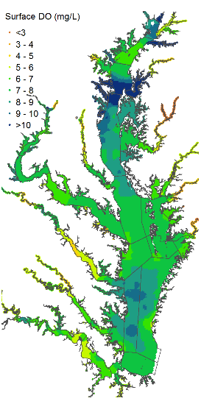
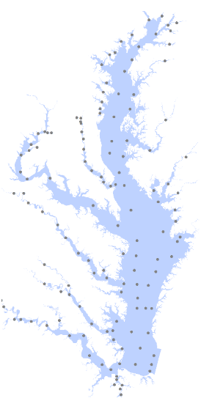
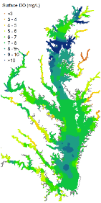
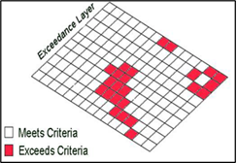

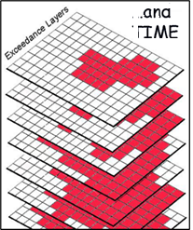
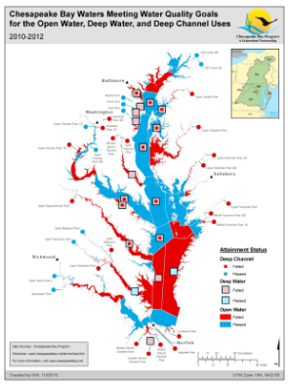
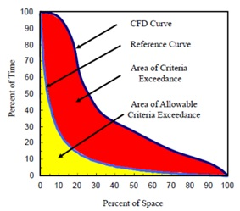
1. Collect bi-weekly to monthly data at each monitoring station
2. Interpolate bay-wide for a single cruise
3. Conduct interpolations for a season over the 3-year period
4. Average monthly if 30-day criterion, and compare the interpolated values with appropriate criterion values
WQS Criterion Assessment
…
The 3D Interpolator is an important tool for this process for 1) annual assessments with monitoring data and 2) usage in the Phase 6 modeling suite.
5. Repeat Step 4 throughout the 3-year period
6. Calculate the cumulative frequency distribution (CFD) for extent of exceedance in space and time
7. Quantify attainment status (attaining or not) for the 3-year period
From Peter Tango

Slide 3
Partnership Uses of the 3D Interpolator
1) Developing planning targets as part of the CBP partnership suite of modeling tools
  Develop Planning Targets to achieve Water Quality Criteria
  Support effective Watershed Implementation Plans
2) One Step In the Analysis for Annual Assessments
  Helps us answer how are we doing towards meeting our water quality goals
  E.g., Water Quality Standards Attainment Indicator
3) Support Jurisdictions’ development of 303(d) lists
  Cycle is every two years
4) Other Applications
  Research applications
  Hypoxic volume and spatial habitat analyses by state partners

Slide 4
Why Are We Developing a New Method?
The current interpolator (developed 20+ years ago) was not designed to interpolate through time or work effectively with unstructured data that have mixed time scales and sampling patterns and are sourced from multiple monitoring programs.
  3D Interpolator was designed for discrete bi-monthly data
  Cannot produce uncertainty estimates.
There is more high frequency data now to fill in temporal gaps.
A new interpolation will use all the data to fill in the gaps between data based on observed patterns to help accurately assess high frequency DO criteria.
  Chesapeake Bay Program interest in 4D Interpolation started because there are water quality criteria that require assessments at finer space and time scales than current methods can support.
  Needed for the Phase 7 suite of models.

Slide 5
What makes the tool 4-D?
Notes:
I am going to start with answering what makes the tool 4D?

Slide 6
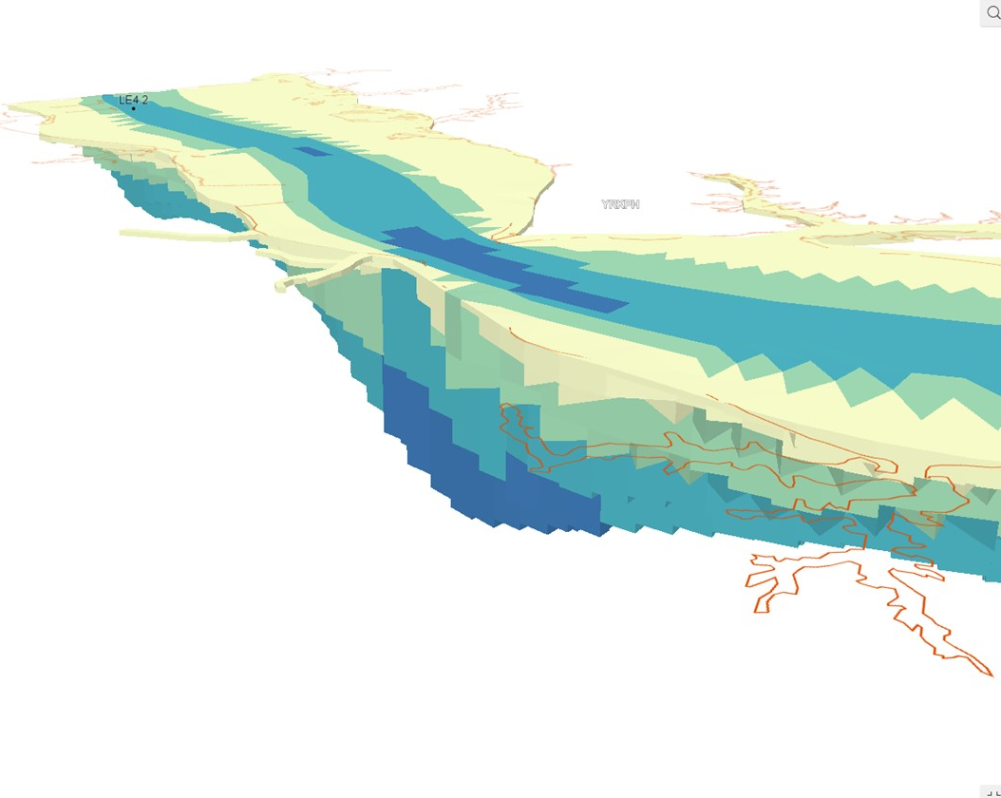

Volume
Time
Spatial & Temporal
3-D
1-D
4-D
Notes:
We start with space which is 3D (ie volume)
We add Time which is 1 dimensional
To get us spatial and temporal interpolation tool or 4D tool

Slide 7
Create a 3D representation of DO through time (4D)
3/1/2024 Midnight
3/1/2024 1am
…
8/01/2025 11pm
Notes:
To show this process a bit more visually, we are developing a tool to create a 3D representation of DO through time. For example, We will now be able to interpolate the DO on March 1st in 2024 at midnight across the bay, then at 1 AM across the bay, and continue on to 2025.

Slide 8

Interpolation makes a prediction inside your data to fill gaps
3/1/2024 Midnight
3/1/2024 1am
…
8/01/2025 11pm
Notes:
Interpolation makes a prediction inside your data to fill gaps. In our visual example, we may have dissolved oxygen data for March 1st and August 1st but we don’t have data on July 1st, so we need to use the monitoring data we have available to make a prediction of what the dissolved oxygen would be on July 1st when we don’t have data.

Slide 9
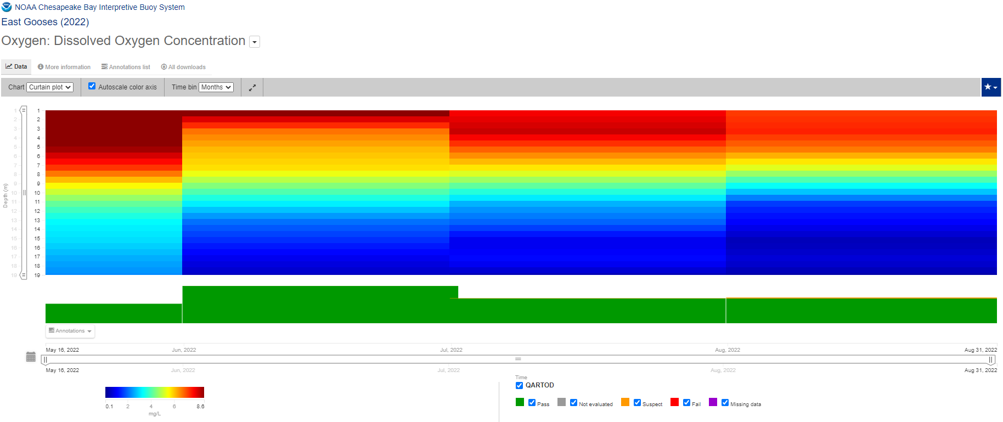
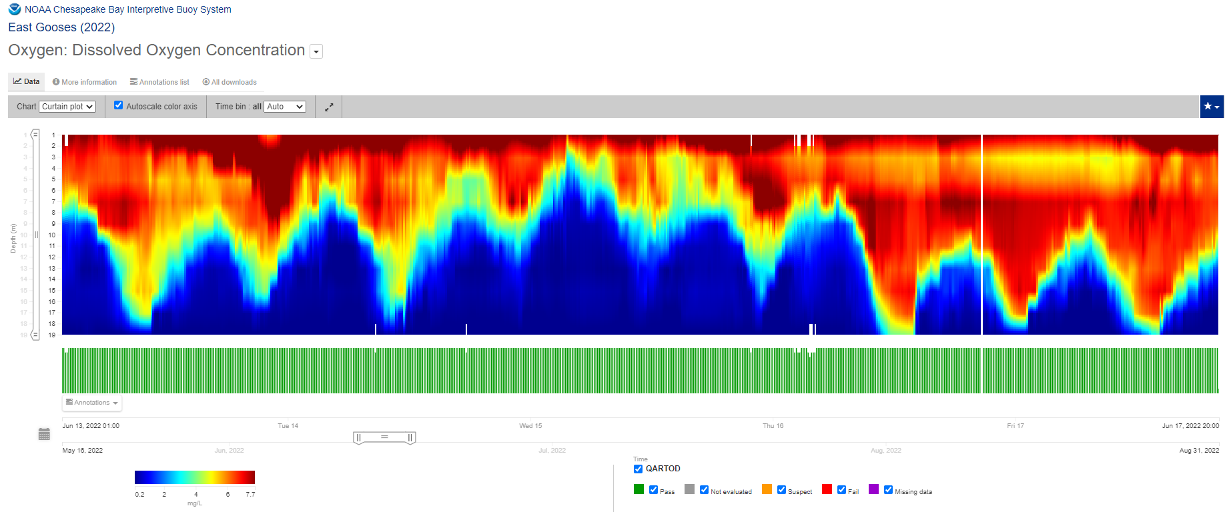
What’s the difference between the 3D and 4D Interpolators? Data Inputs as an Analogy
~2 mg/L threshold
Surface
Depth
19m
Hypoxia
Hypoxia
May
June
July
August
2022
June 13-17, 2022
Traditional Bay monitoring
3.5 months
1x per month water column
data collection
Continuous dissolved oxygen 5 days,
10-minute data collection intervals

Slide 10
What Improvements are Gained by Moving to a 4D Interpolator?
We have more knowledge of the system from decades of monitoring investment, and it’s currently not being used by the 3D Interpolator.
  We need updated analysis tools to maximize this monitoring investment.
Ingestion of continuous data.
Using of all data results in more accurate condition estimates.
  This means more accurate determination of impairment and attainment.
Ability to assess all criteria.
Ability to compute uncertainty.

Slide 11
Partnership History with the 3D and 4D Interpolators
2001
2003
2021-2022
3D Interpolator published, built on methods from the 1980s
USEPA (2003a,b) sets up the basis for 3D Interpolator to be used for CBP assessment of WQ
2014
Further development of interpolation to measure WQ criteria attainment assessment
2007-2008
STAC Workshop on 4D
2010
Refinements/additions to the procedures for assessing the previously published criteria
2014 Watershed Agreement Water Quality Goal includes the language “maintain and grow monitoring and assessment capacity”
PSC Monitoring Report recommendation to invest in 4D Interpolator
Bay Oxygen Research Group/4D Team start work on developing the 4D Interpolator

Slide 12
Goal Statement
To develop a spatial-and-temporal interpolation tool for water quality monitoring data collected in the tidal waters of the Chesapeake Bay, thus enabling the evaluation of both long- and short-duration water quality criteria.
Statement Developed by the Bay Oxygen Research Group

Slide 13
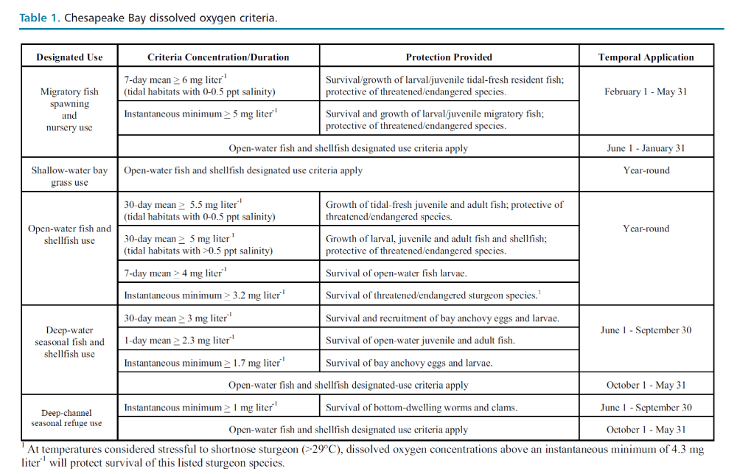
Purpose: Build a Tool for More Complete Criteria Assessment
DO criteria that currently can be evaluated with existing approaches and data
*
*Note a 30-day mean 6 mg/L MSN value is evaluated for purpose of the WQ indicator.
From EPA 2003 Ambient Water Quality Criteria

Slide 14
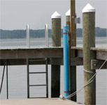
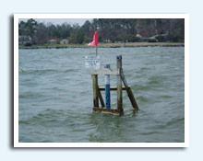
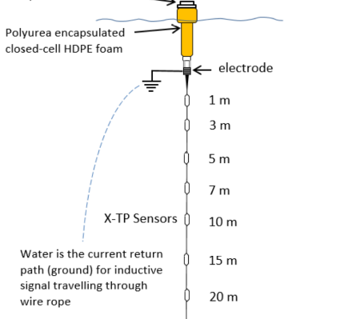
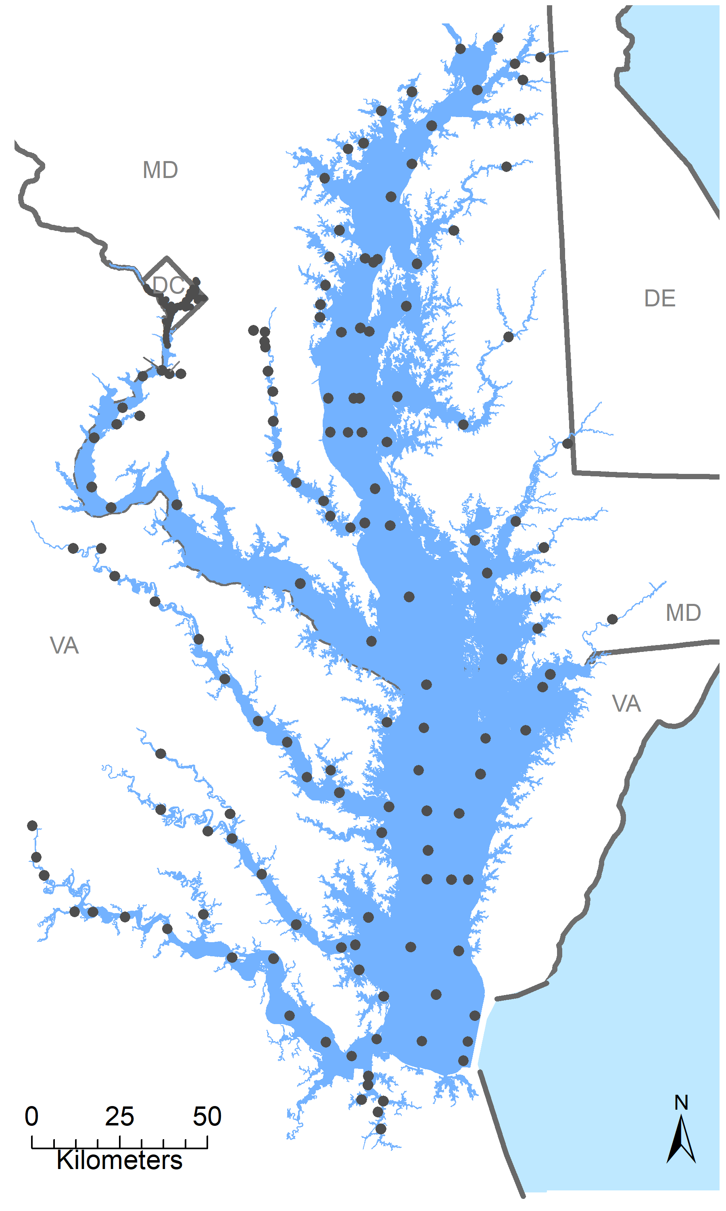
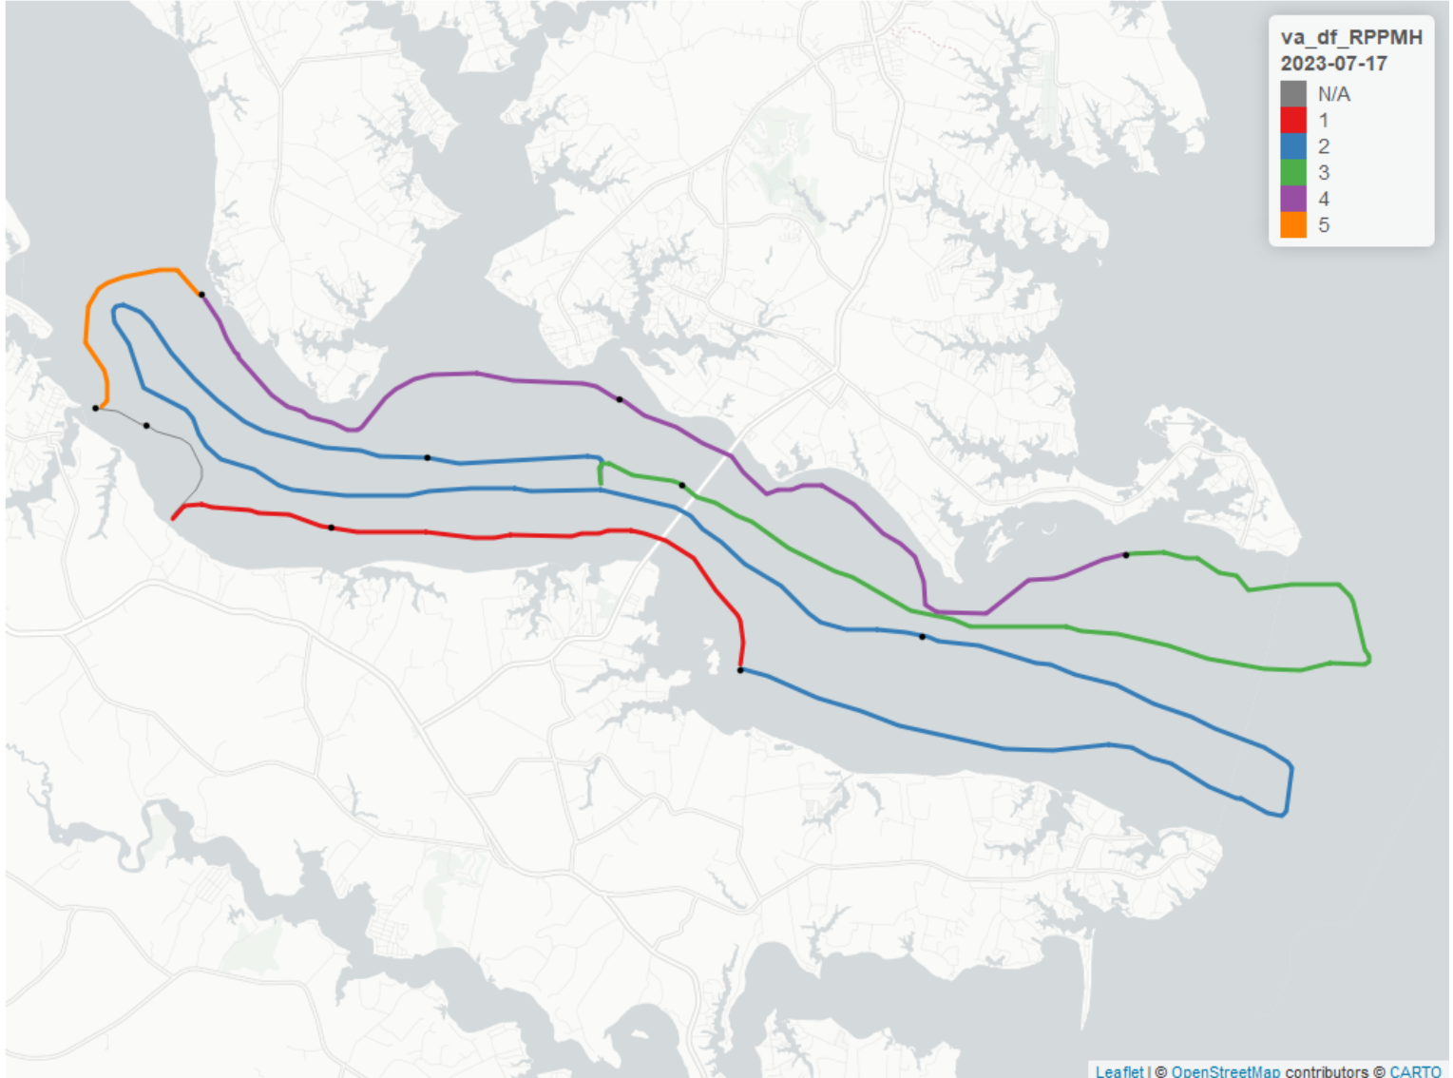
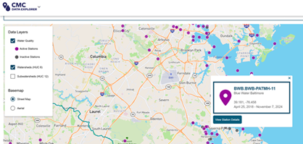
Multiple Types of Data Being Used
New continuous vertical arrays (NOAA & CBP)
Shallow water continuous monitoring (MDDNR and VECOS)
Bi-weekly long-term sampling (DOEE, MDDNR, VADEQ, ODU, CBP)
From http://vecos.vims.edu/
From https://eyesonthebay.dnr.maryland.gov/
https://www.chesapeakebay.net/who/group/hypoxia-collaborative-team
Dataflow (MDDNR and VECOS)
Citizen monitoring (CMC and multiple community groups)
From http://vecos.vims.edu/
Chesapeake Monitoring Cooperative: https://www.chesapeakemonitoringcoop.org/
+Additional State Agency Collected Data (MDE, VADEQ)

Slide 15
Key Features for the 4D Interpolator
Advanced analytical techniques that allow use of all data (of any monitoring frequency) to assess all criteria, including continuous data
Developed so it can run on a typical laptop
Uses patterns in observed DO to estimate hourly DO every 1km at 1m incremental depths
Retain uses of 3D Interpolator
Annual Assessment, Support Jurisdictions with 303(d) reporting, CBP Modeling Suite and Developing Planning Targets, Research Applications
Quantifiable uncertainty in condition estimate

Slide 16

4-D Interpolator Development Timeline
January 1, 2028
CBPO Planning Target Development Kicks Off
Planning/prototype
Development
Documenting/Review
Training
Goal of approved method by
2028*
2022
2023
2024
2025
2026
Through 2026:
Working 4-D tool,
Collaboration ongoing with CAP on criteria assessment methods.
In 2026-2027:
Documenting,
Additional functionality as needed for linking to criteria assessment,
Preparing for training & review.
*with 2030 goal of reporting on all criteria
Notes:
Here is the timeline for completing the tool and incorporating it into criteria reporting.
While the ramping up of meetings and project development started in 2022, the want and request for a 4D tool goes back to even before 2003.
We are closing up on the development for this phase of the tool and starting to work more on documentation.
In 2026, we will focus more on the documentation and start training staff and partners to use the tool along with additional functionality adjustments as needed so that we can have a fully approved method by 2028 and 2030 goal of reporting on all criteria.

