Slide 1
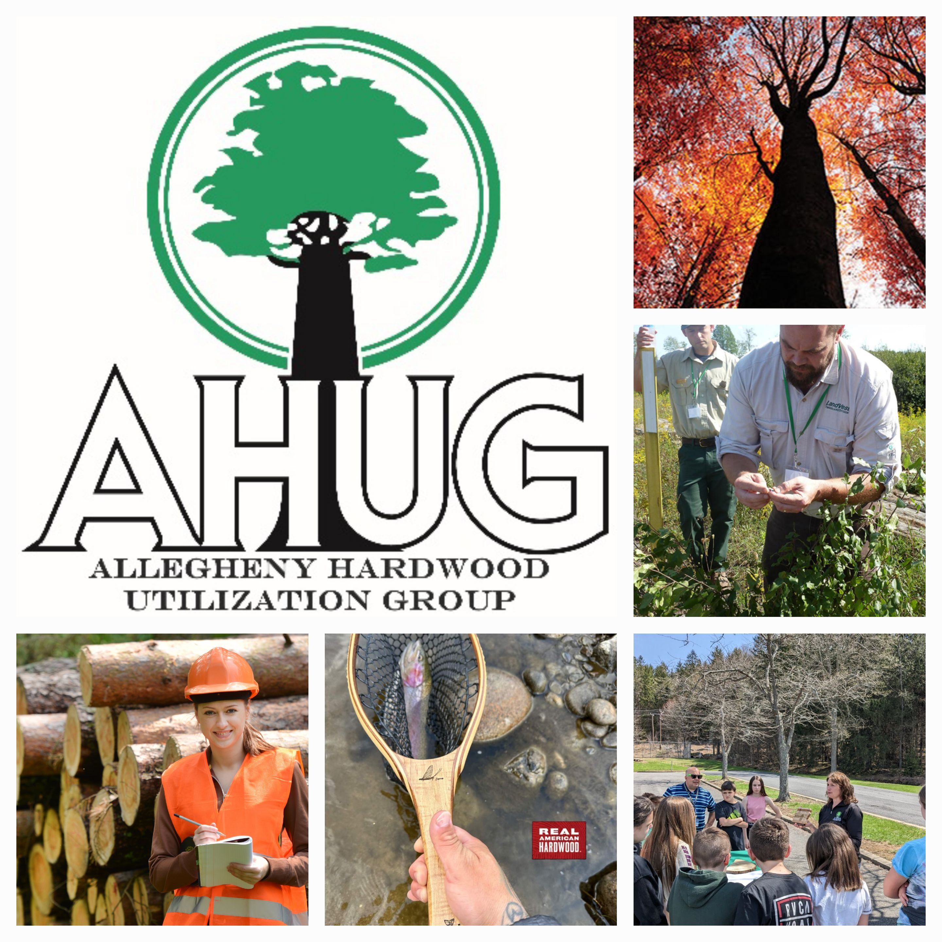
Collaborative Forest Health Across the Allegheny Plateau
Cross‑Boundary Stewardship & Private‑Land Buckthorn Treatment
Presenter: Amy Shields, Executive Director, AHUG

Slide 2
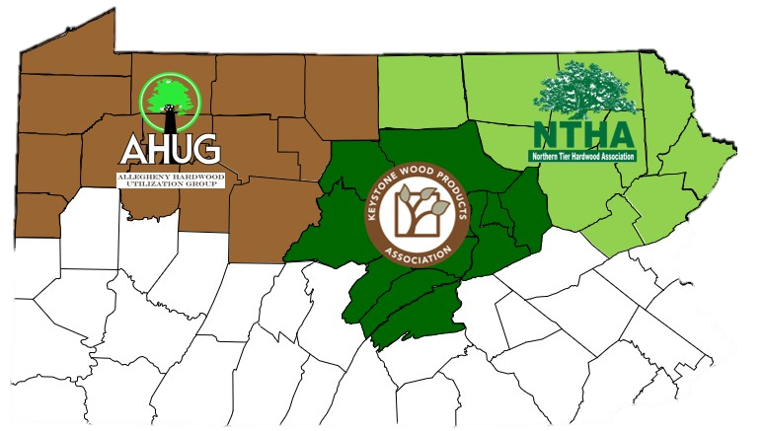
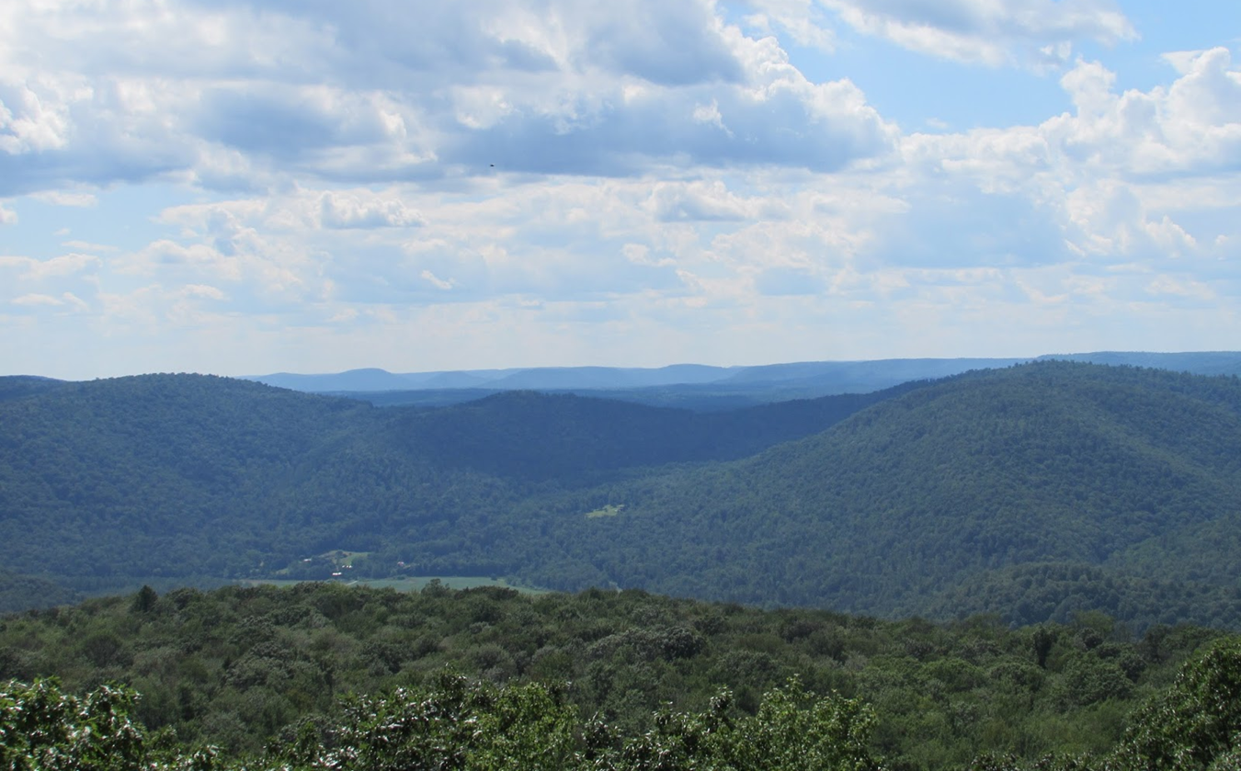

HDC & HUGs
Promotion, Workforce Development, Market & Industry Expansion, & Education & Outreach

Slide 3
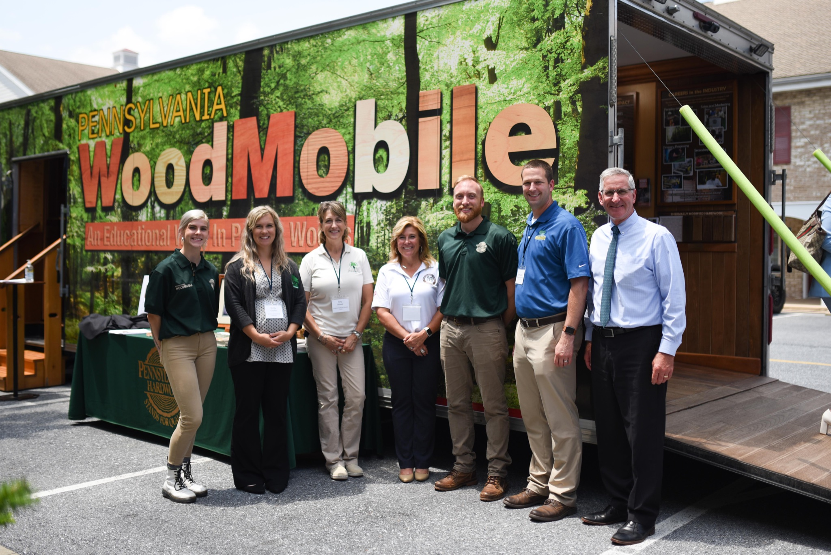
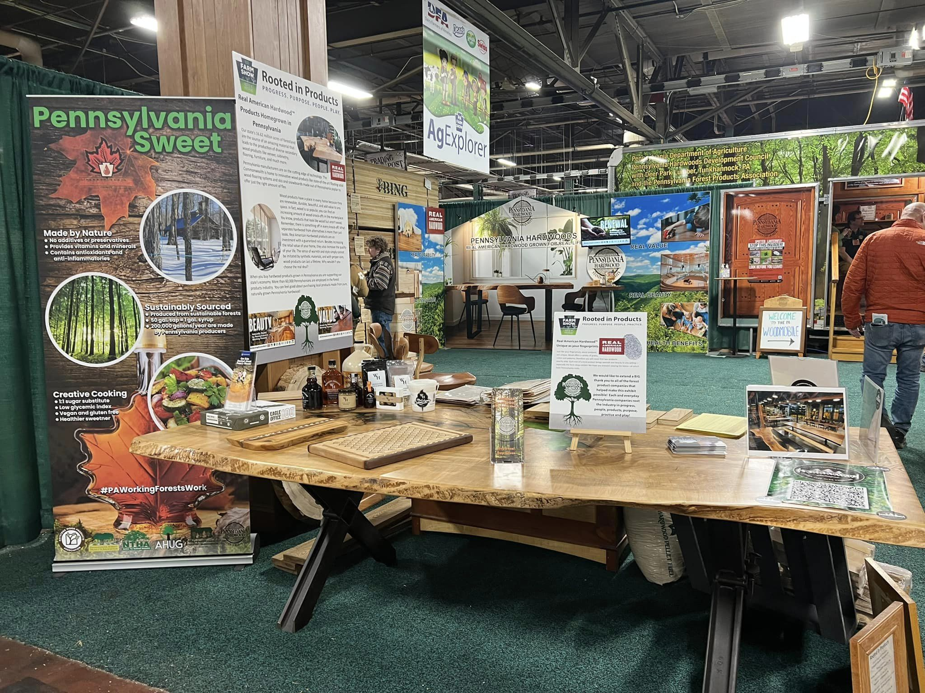
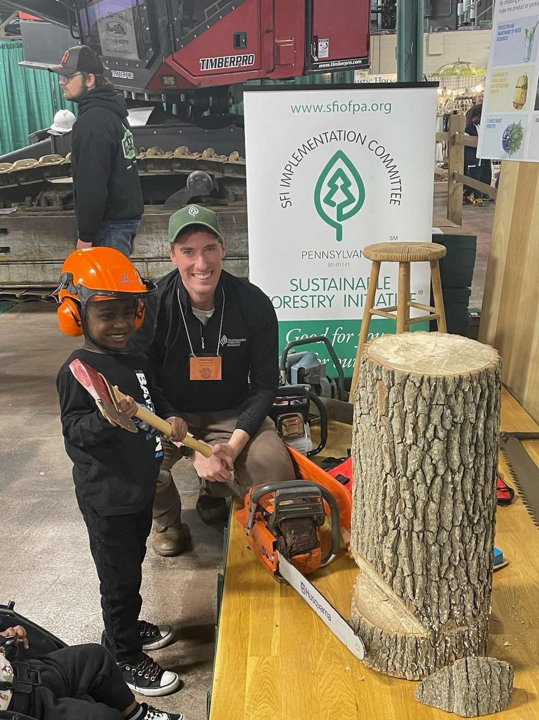
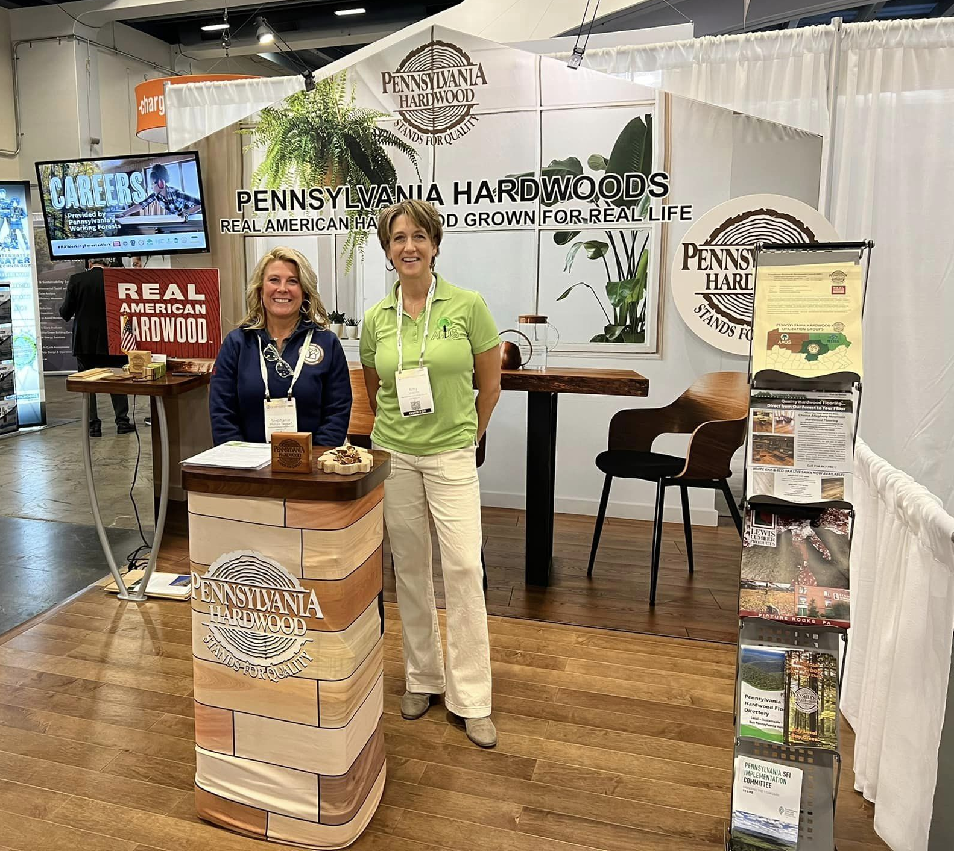
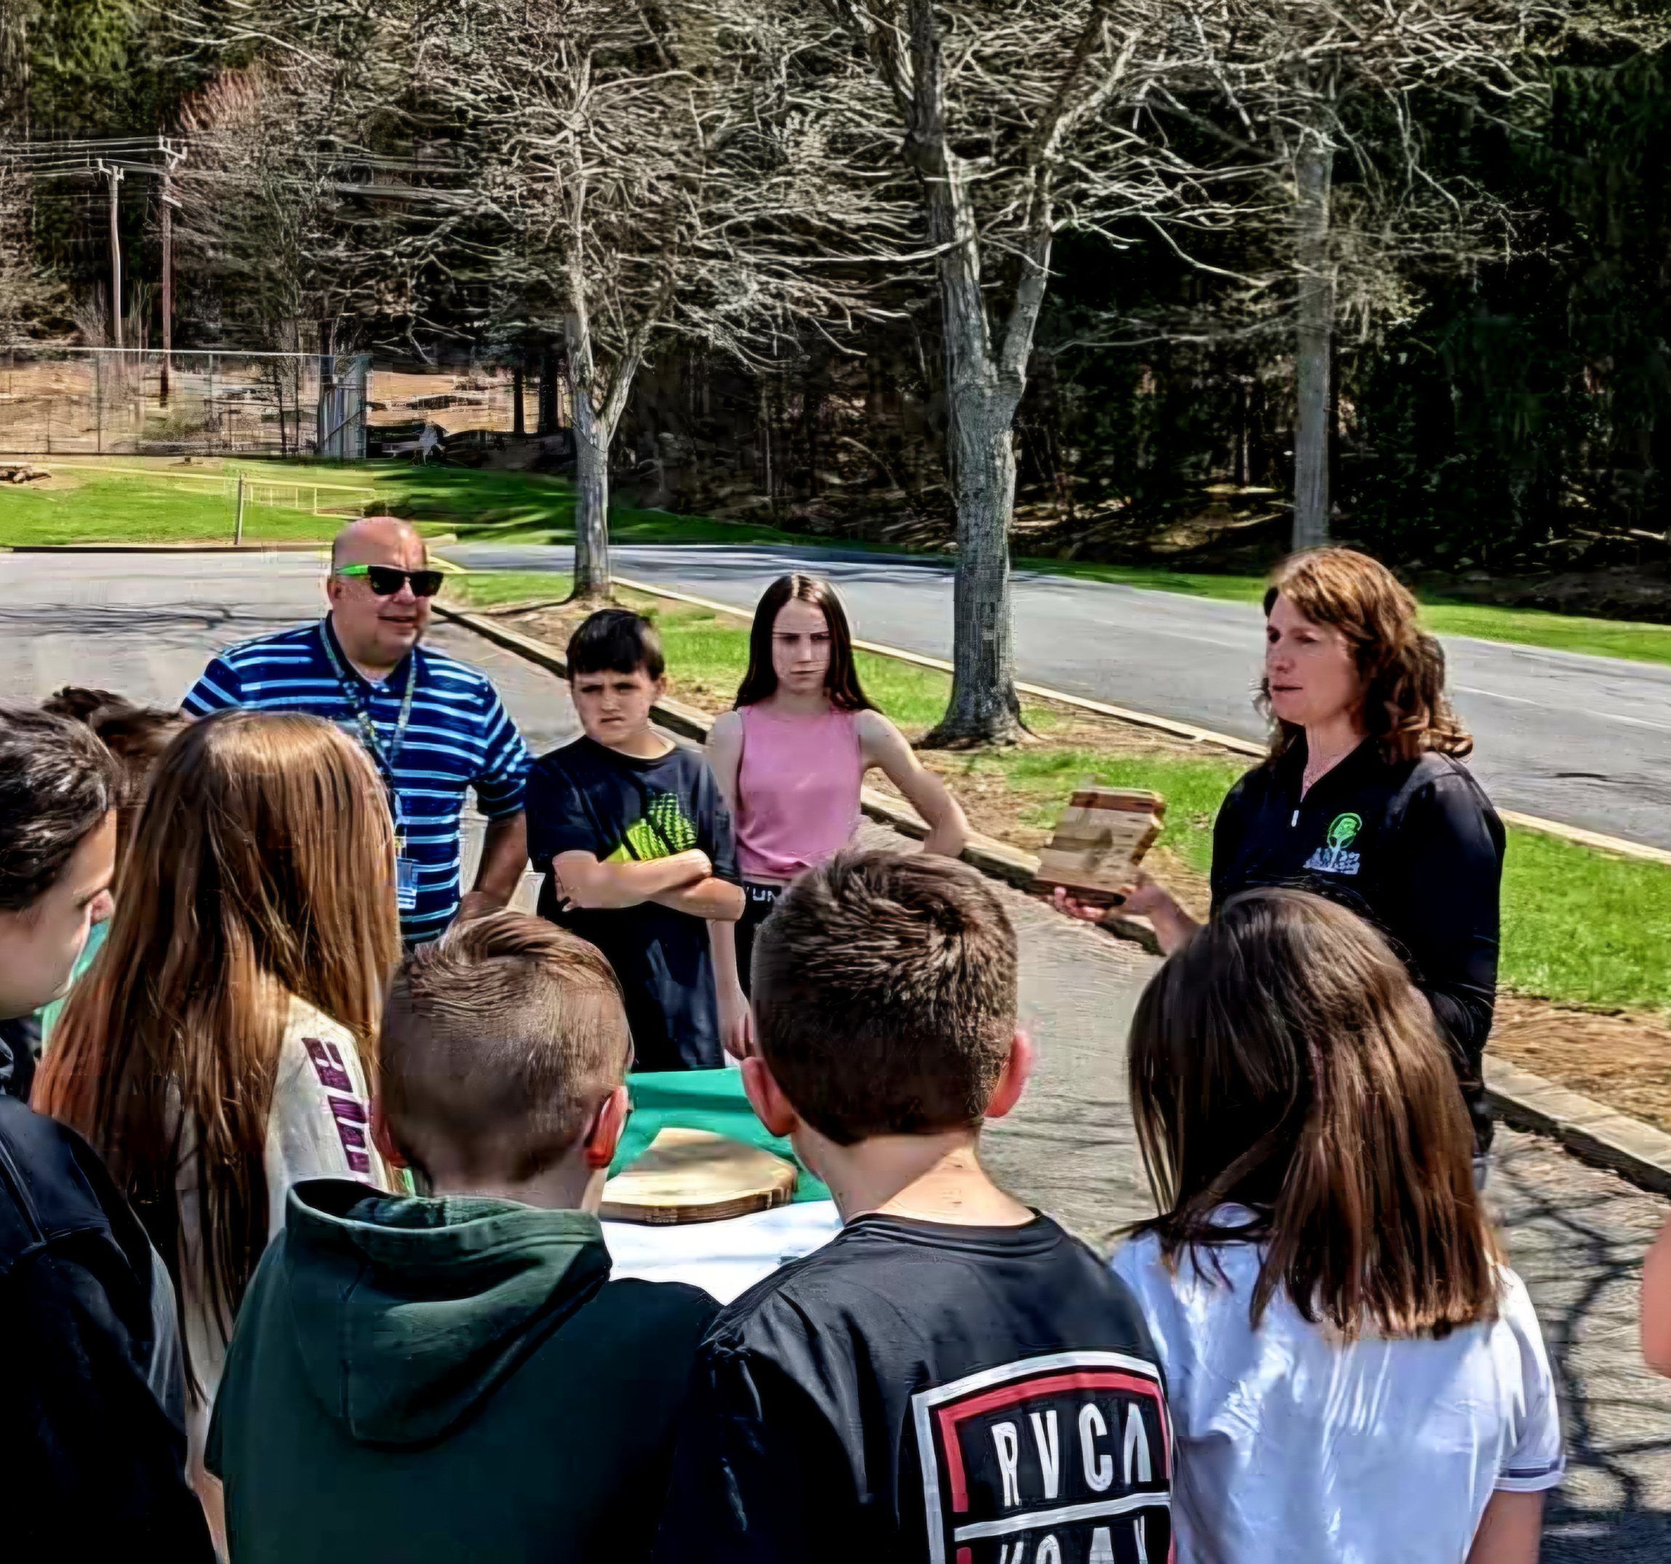

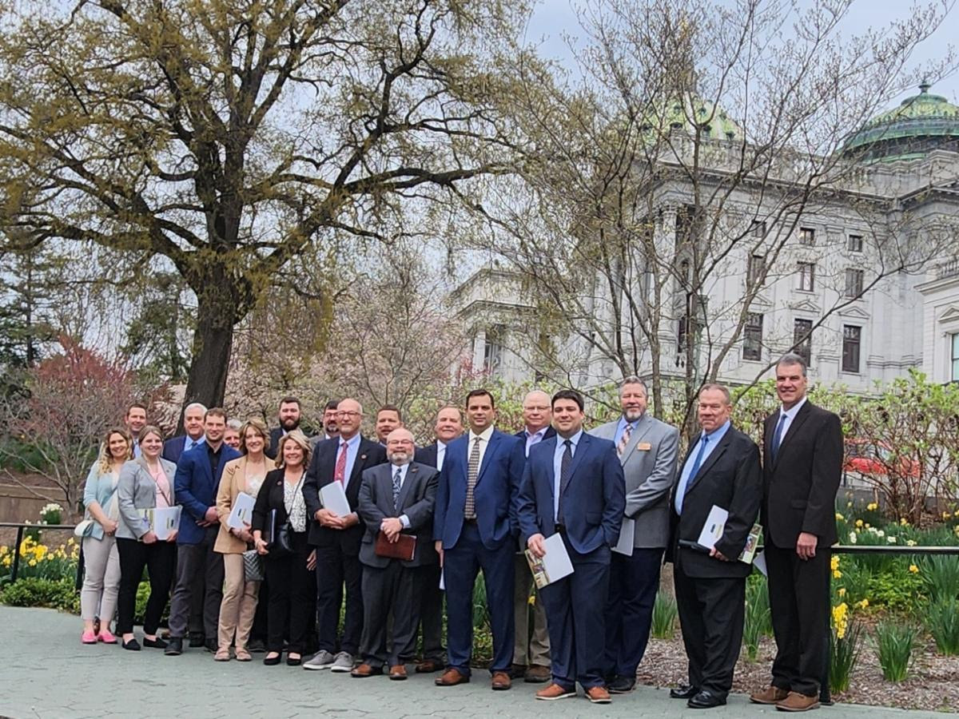
Hardwood Utilization Groups
Promotion, Public Education, Workforce/Economic Development, R&D Support

Slide 4
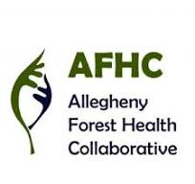
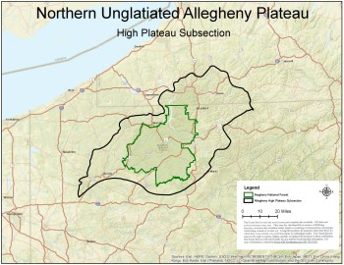
Allegheny Forest Health Collaborative
Landscape‑scale collaborative
Formed in 2017 to address shared threats across ownerships
Co‑led by AHUG & the Allegheny National Forest
60+ participating entities: agencies, NGOs, industry, academia, landowners
Built on facilitated, consensus‑driven priority‑setting
Recognized in the PA Forest Action Plan & Advancing PA Forest & Wood Industry Strategy

Slide 5
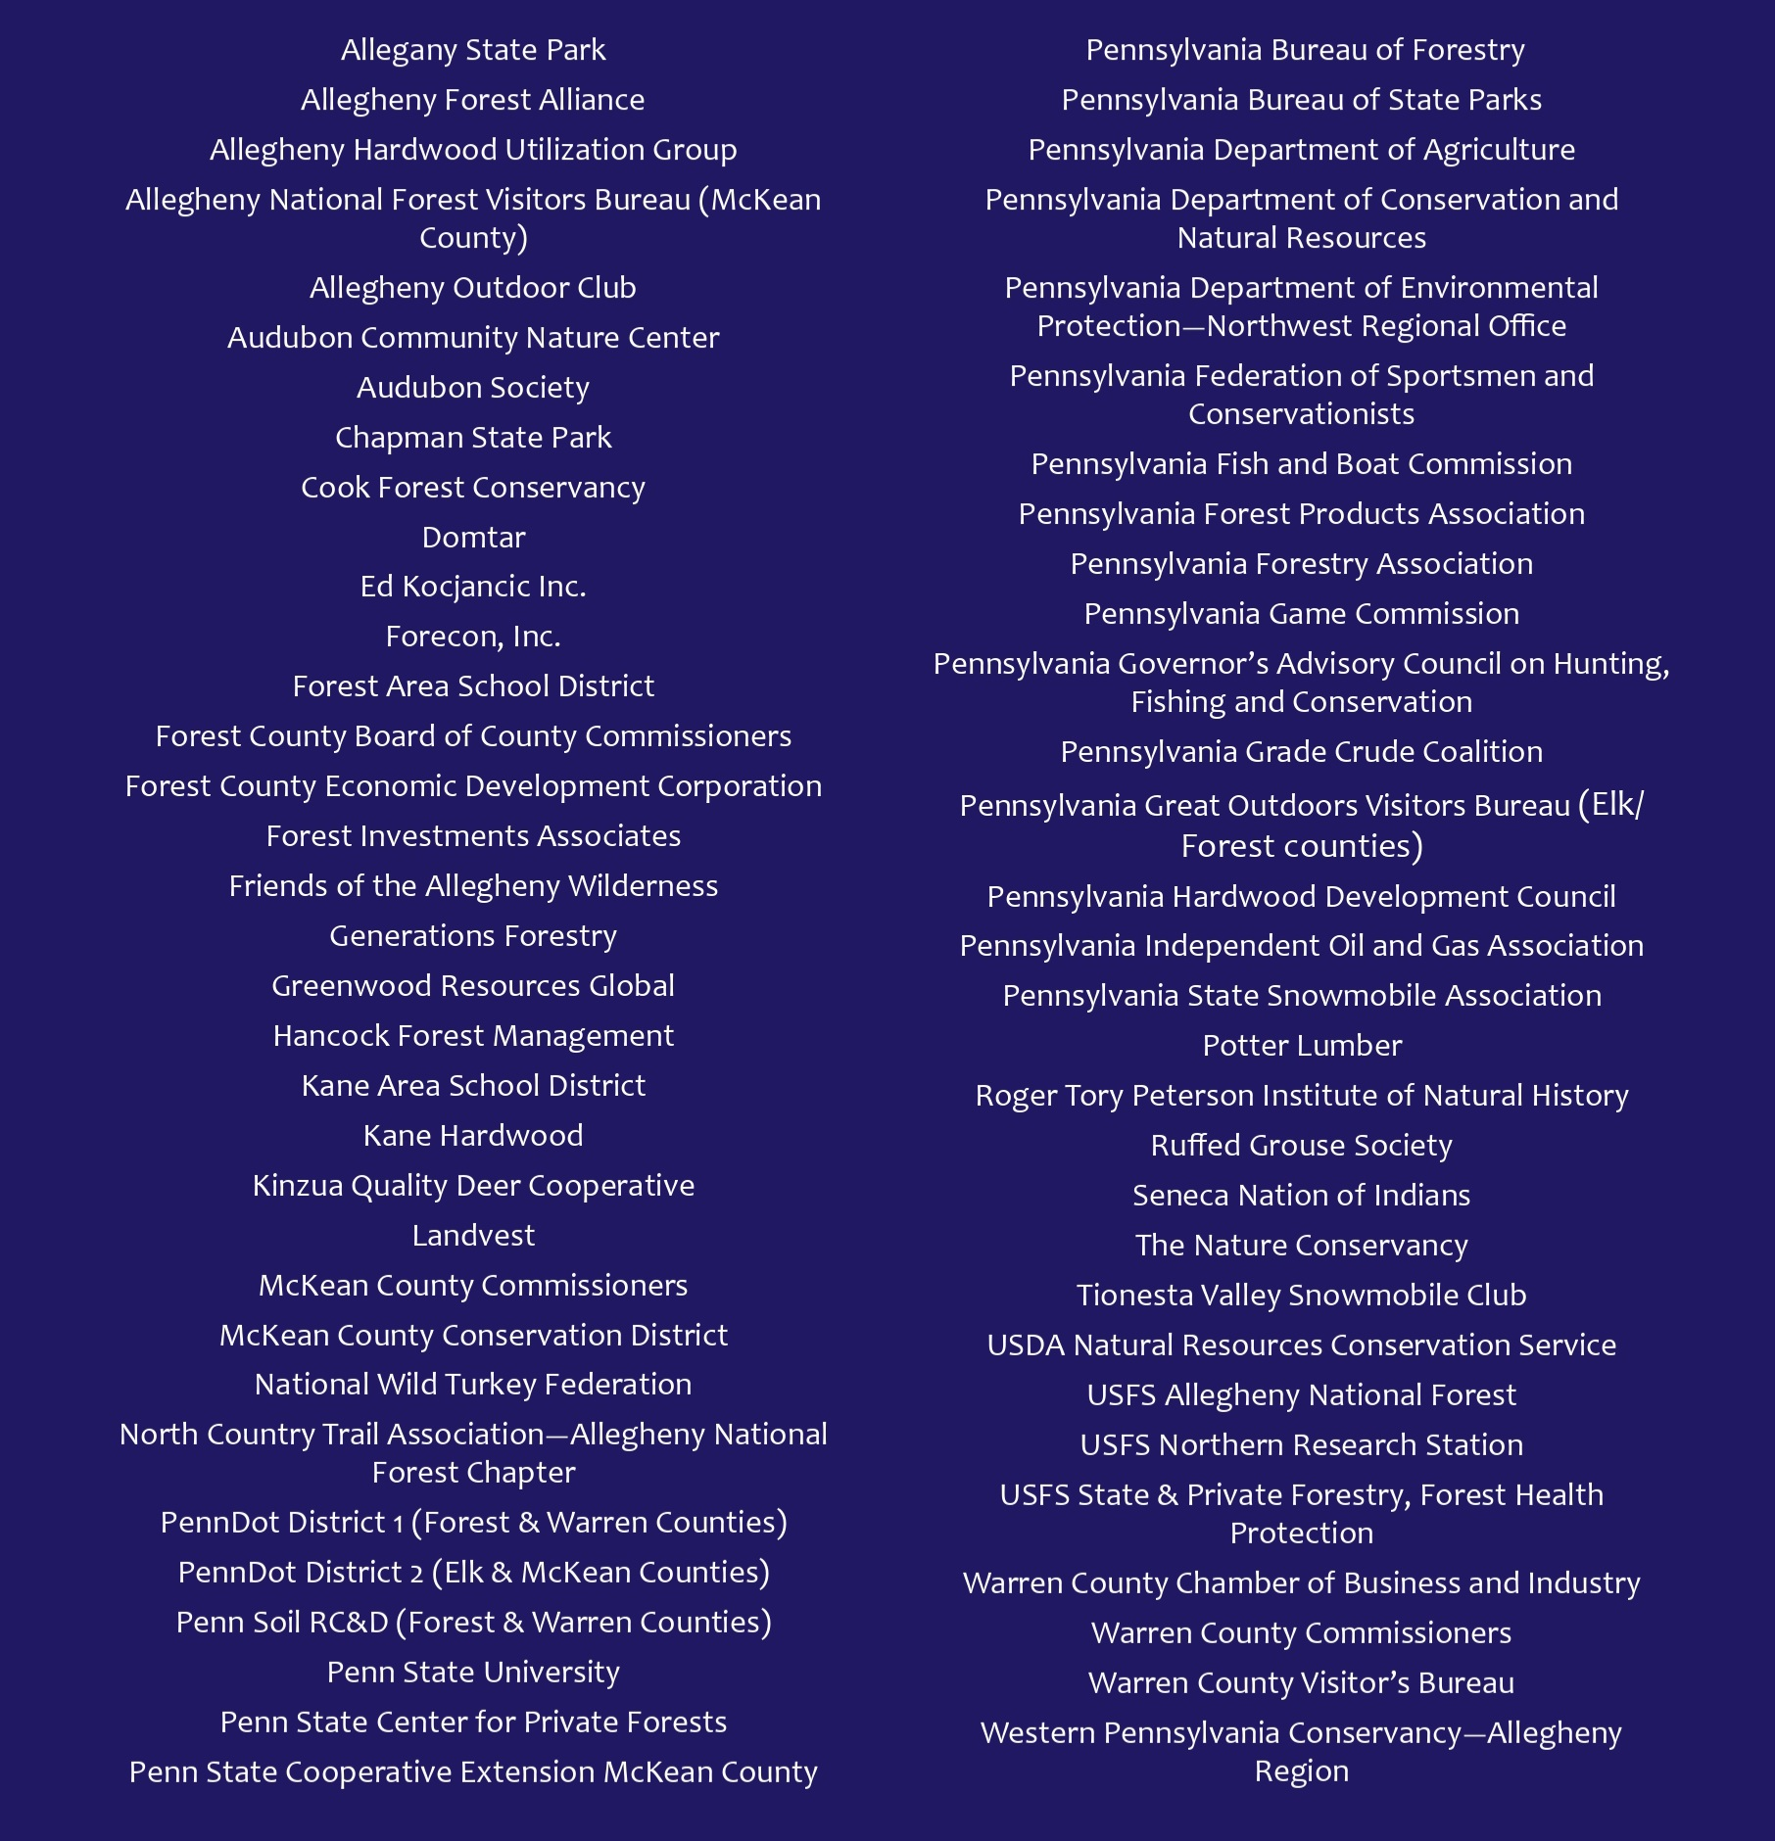
60+ participating entities: agencies, NGOs, industry, academia, landowners

Slide 6
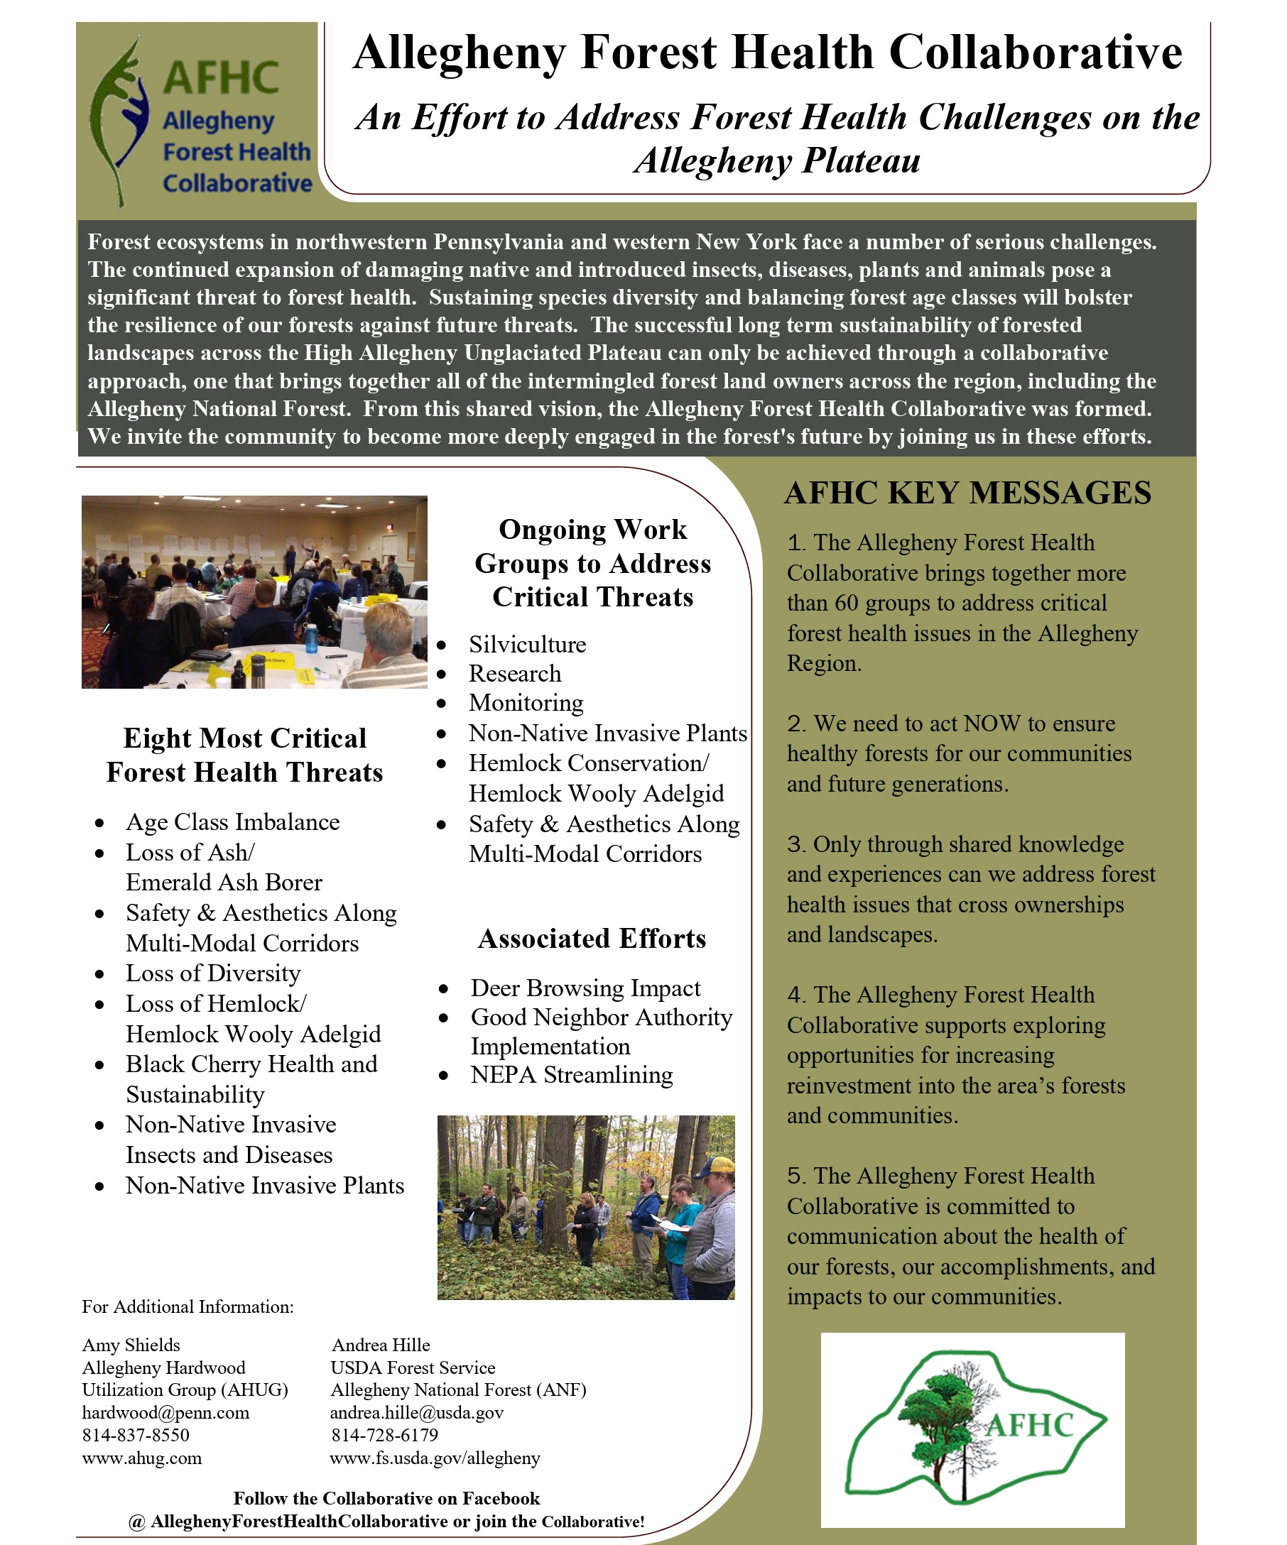
Built on facilitated, consensus‑driven priority‑setting

Slide 7
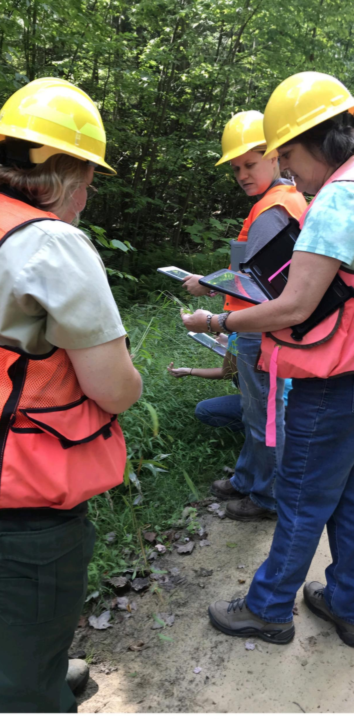
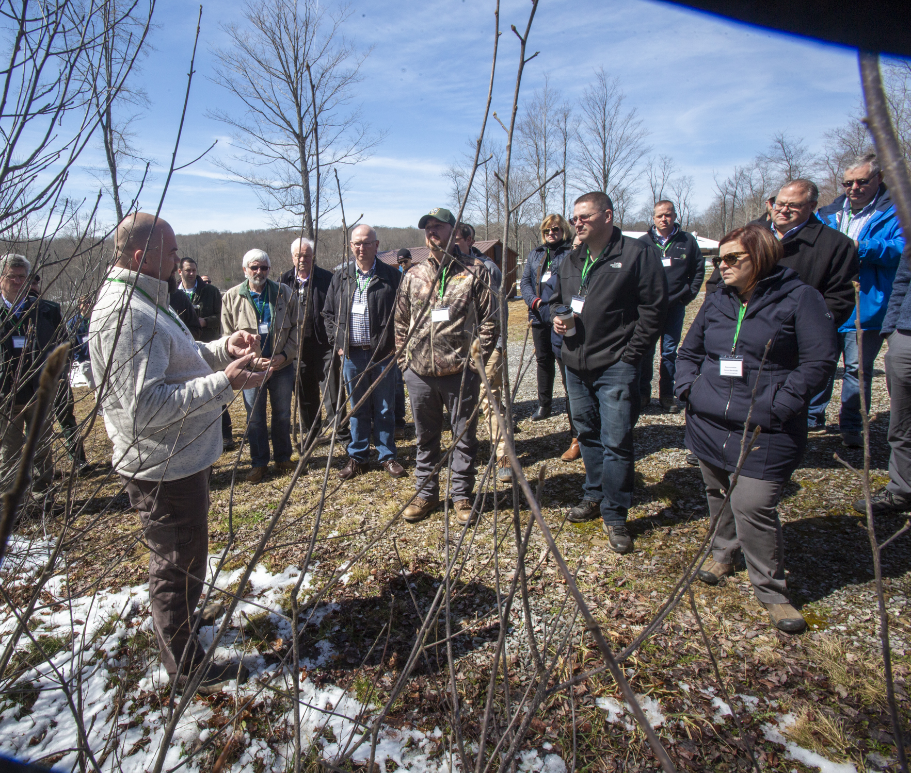
AFHC Working Groups / Accomplishments
Silviculture
  Treatment Priority Index
  Interim Seed Source Index
  SILVAH
Research
  Birch Proliferation
  Cherry Health
Monitoring
Hemlock Wooly Adelgid
Emerald Ash Borer
Invasive monitoring and treatment (APIPMA)
  Japanese Knotweed
  Japanese Stiltgrass
  Goatsrue
Communications
  Legislative / community officials tours
  Annual Reports
  News Articles / Presentations
  Letters of Support

Slide 8
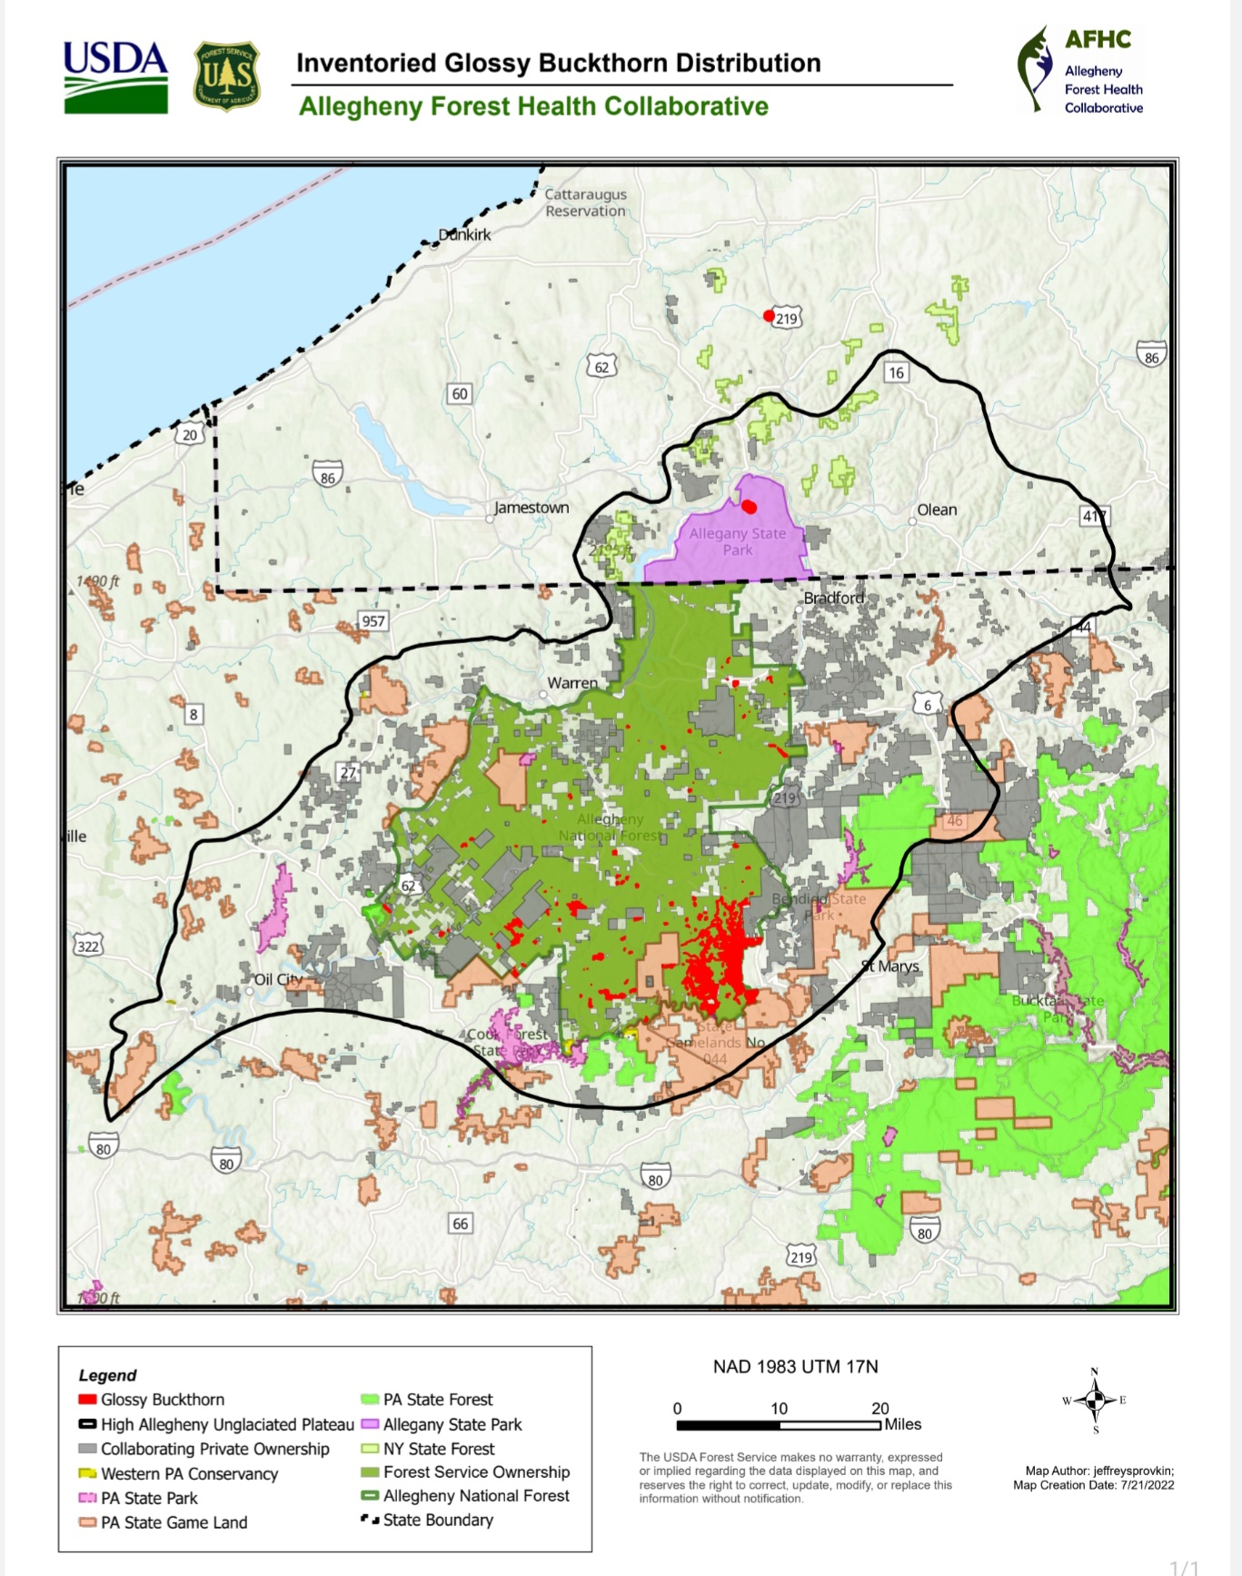
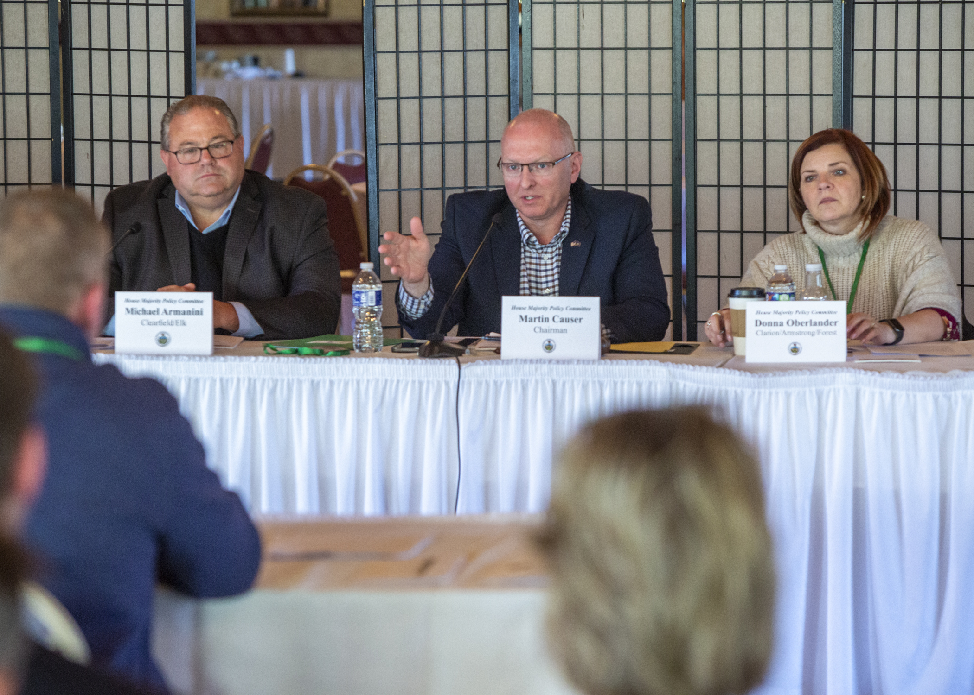
Enter Glossy Buckthorn
How it Became a Priority
Early Detection/Rapid Response species in PA Forest Action Plan
AFHC convened to share maps, outline known populations
5,000 acre outbreak had grown to 50,000 acres by 2022
Impedes regeneration and succession
Alters soil chemistry and hydrology
Reduces wildlife habitat quality
Spreads rapidly across ownership boundaries
Control what we can control!

Slide 9
AHUG’s Role in the
AFHC
Buckthorn Program
Non-profit applicant w/industry connections
LSR + Challenge Cost Share funding
Education & outreach to rural, underserved landowners
Mapping & inventory (iMapInvasives, ANF)
Contracted treatment — work that would not occur without this funding
Post‑treatment monitoring
2025 impact:
  874 participating acres
  556 treated acres
  318 monitored acres
Total treatment acres w/ANF, CD’s, AHUG, PAGC & Muni’s = 8,000+

Slide 10
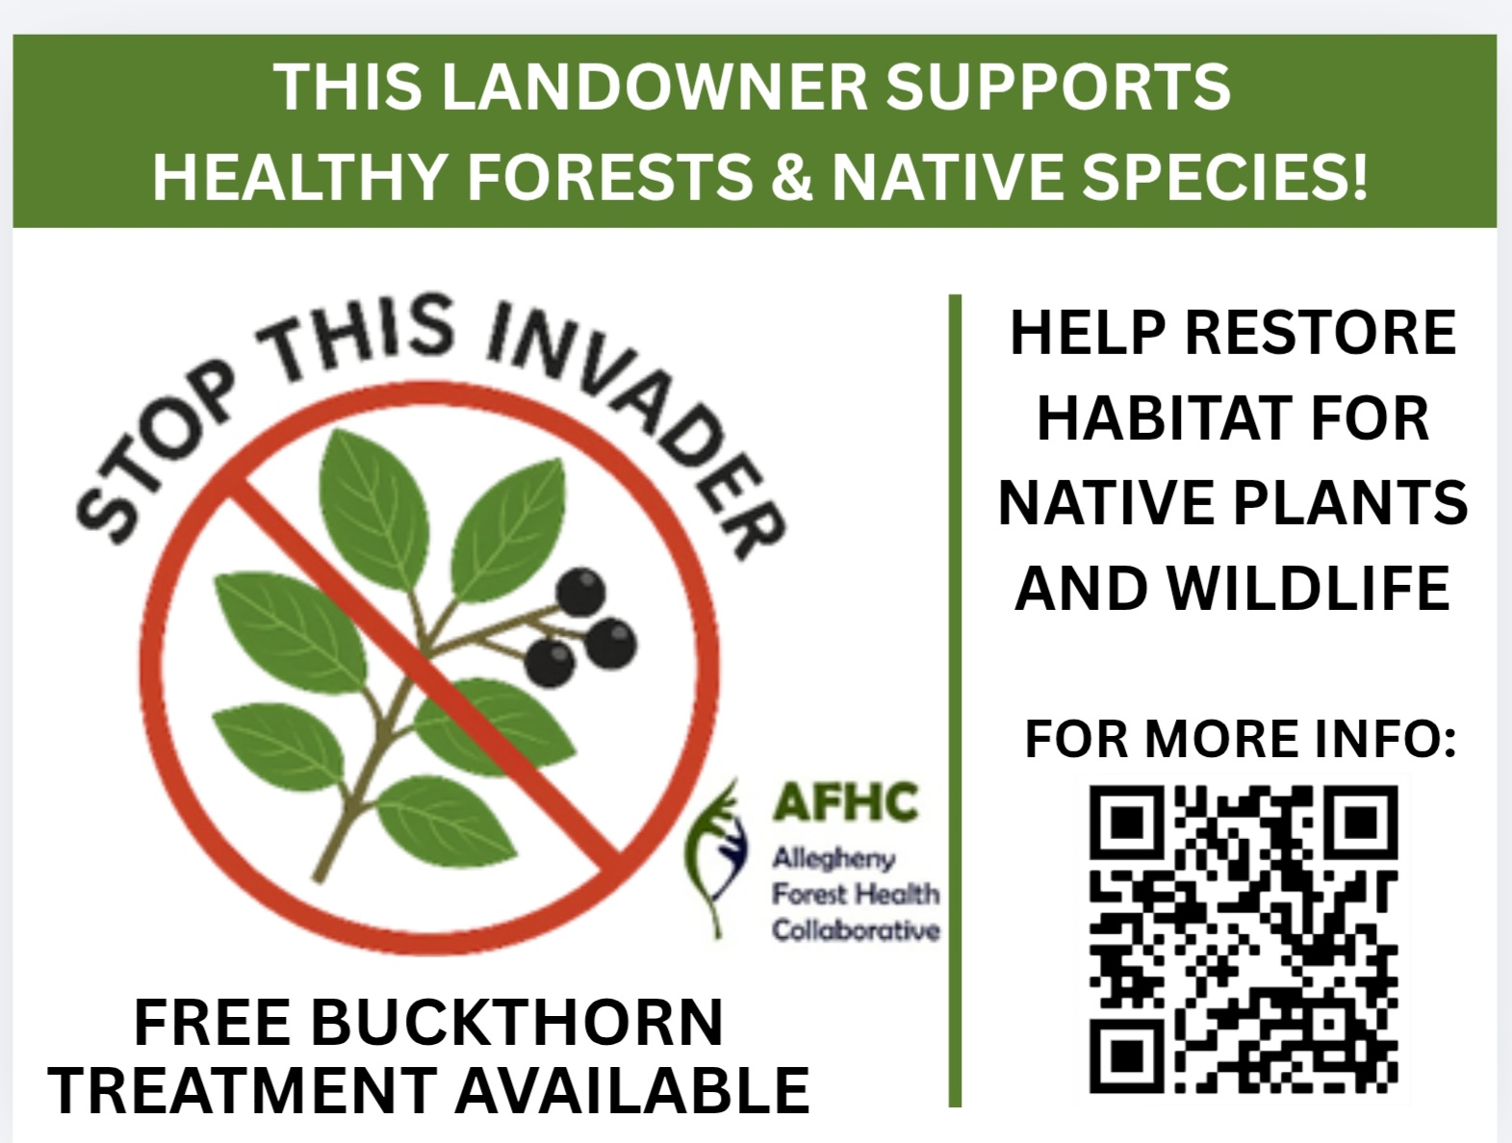
Building Capacity for Long‑Term Success
Summer interns trained in mapping, inventory, landowner engagement and treatment (observation / support)
Contractor capacity for invasive plant treatment (+ Forest contracting WFD efforts)
Tools & technology: OnX / Avenza / iMapInvasives mapping, monitoring protocols
Research & Development: Drones, early/late season treatments
Outreach coordinators and education materials
Creates a replicable model for future forest health priorities

Slide 11
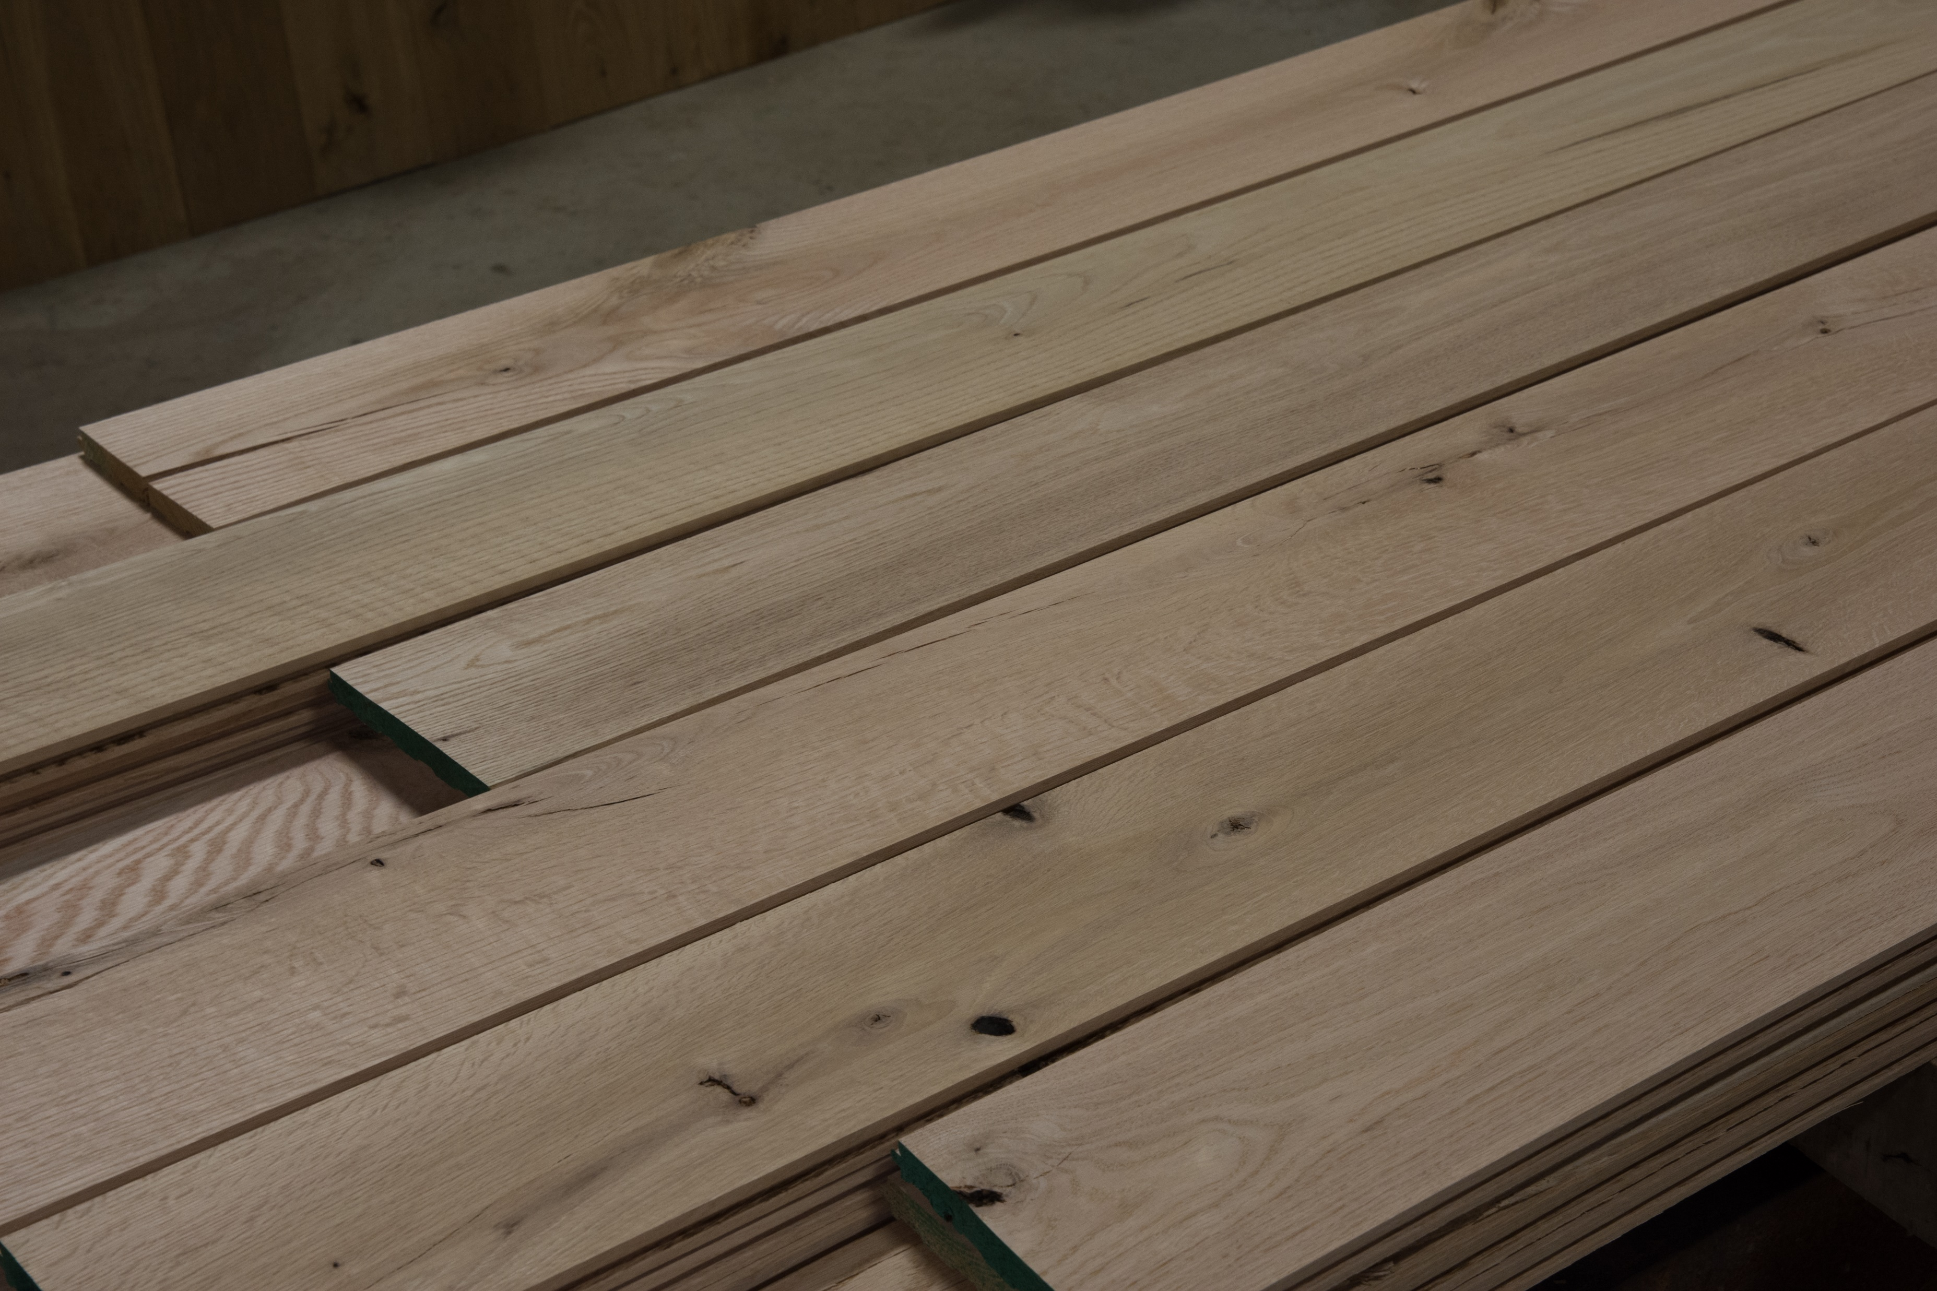





Pennsylvania Hardwoods
Jonathan Geyer, Executive Director
PA Hardwoods Development Council (HDC)
PA Department of Agriculture
2301 N. Cameron Street, Room 308
Harrisburg, PA 17110
717-787-3699
jongeyer@pa.gov
Amy Shields, Executive Director
Allegheny Hardwood Utilization Group, Inc. (AHUG)
PO Box 133
Kane, PA 16735
814-837-8550
ashields@ahug.com
ahug.com
Stephanie Phillips-Taggart, Executive Director
Keystone Wood Products Association (KWPA)
303 Chestnut Street, Suite 102
Harrisburg, PA 17101
570-974-8946
steph@keystonewoodpa.org
whypahardwoods.com
Shelby Chorba. Program Manager
Northern Tier Hardwood Association (NTHA)
PO Box 7
Tunkhannock, PA 18657
570-265-7753
nthapa@nthardwoods.org
nthardwoods.org

