Slide 1
Forest Landowners and the Decision Process:
A Constantly Changing World
Nancy G.W. Baker
Healthy Forests: Proactive Strategies for Managing Threats and Promoting Conservation
Chesapeake Bay Program’s Scientific and Technical Advisory Committee (STAC)
24 February 2026
Notes:
I want to help you understand how landowners make decisions and how we can use that process to encourage management
Let me talk a little bit about how decisions were made on my own land, and then speak to a more general process.

Slide 2
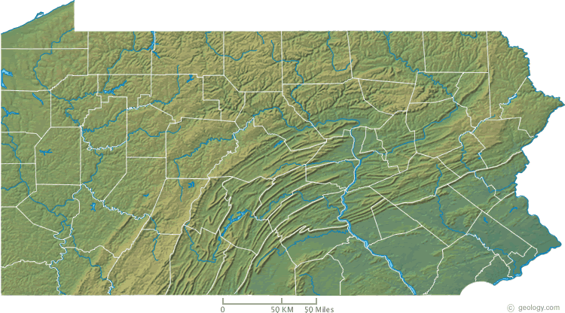
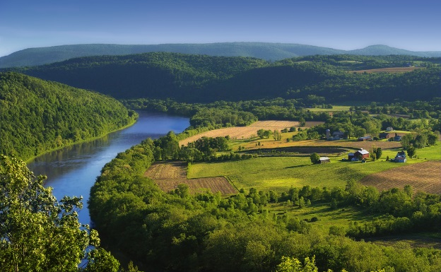
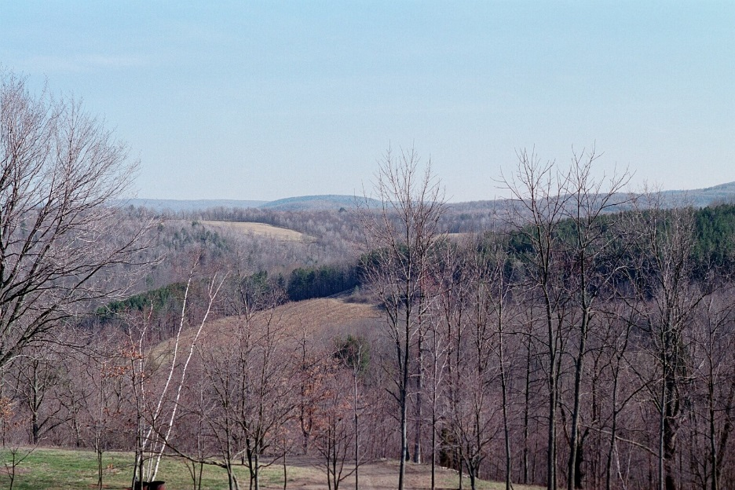
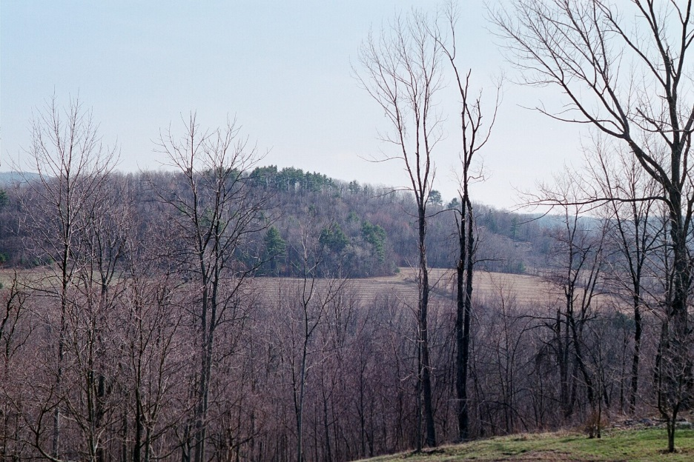
Place: The Panther Lick
Notes:
163 acres in Bradford County, Pennsylvania (the Northern Tier about 45 miles from the New York State border. Low glaciated plateau about 2miles back from the Susquehanna River. At the confluence of two streams: Crane Creek and the Panther Lick. Elevation from 900 to 1260 feet above sea level.

Slide 3
Adaptive Management in Context
Harvest original timber 1861-1887 Resource Rich/High Demand, Skilled Workforce
Subsistence Farming with a working woodlot 1887-1948 Resource Poor, retain wood for personal use.
Reforestation 1949-1971 Careful Economic Management to improve Value, Government Assistance, Expectation of Timber & Pulpwood Market.
No management 1971-1987 Health & Time Challenges
Ecological Integrity Functioning Forest 1988-2026+ Climate Informed Management with Assisted Migration, Carbon Inventory, Altruistic Management plus Government Assistance and Creative Financing, Stewardship Outreach
Notes:
When my husband and I inherited the land in 1988, we walked the perimeter on January 1, (cold, blue sky snow on the ground) and were thrilled to begin as it’s caretakers.
Hire a consulting foester
Get a plan
Erosion Control on Internal Roads
Trail Layout and Construction
Rekgeneration for Red Oaks 500
Assisted Migration for more southerly species (500)
Aspen Regen for Grouse Habitat
Widening Hedgerows as Wildlife Corridors
Invasive Control
Emerald Ash Borer Treatment
Deer Management Assistance Program
Replacing Elm with disease resistant grafted stock

Slide 4
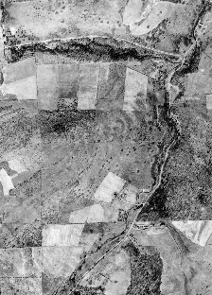
1939
Notes:
This is the Gamble Farm in 1939. See the “Big Woods” in the southwestern corner.

Slide 5
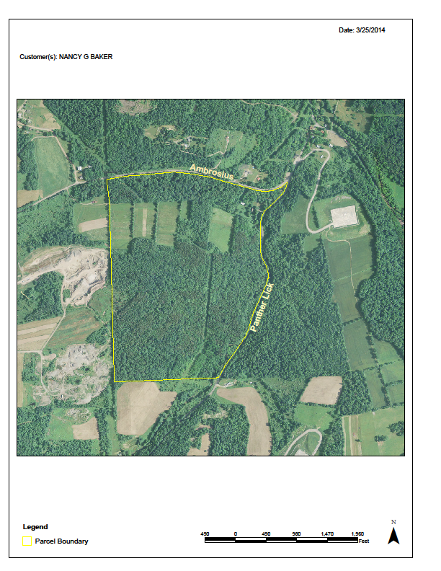
2024
Notes:
This is not the same forest that my great grandfather saw in 1861, but it has supported the Gamble family thru 150 years of changing objectives.

Slide 6
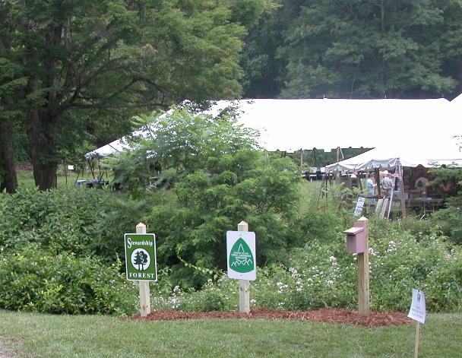
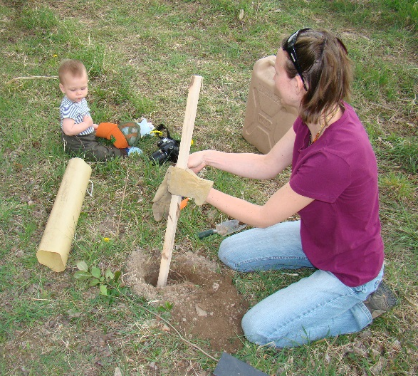
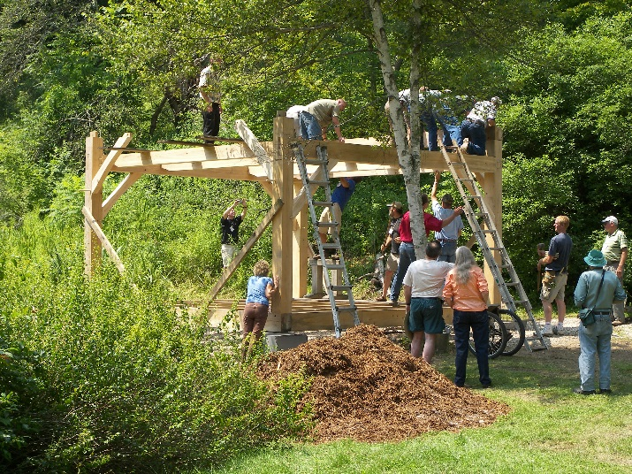
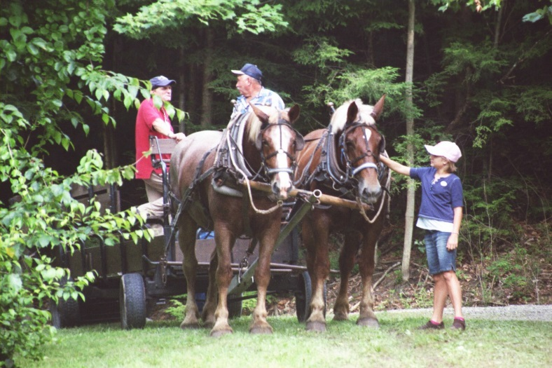
Extending the Reach of Stewardship
With Peer-To-Peer Volunteers
Pennsylvania Forest Stewards
Women and Their Woods
Woodland Owner Associations
Notes:
What is the greatest outcome of this work on the land:
Many stewardship meetings, in-service trainings, demonstrations, and workshops have occurred on this property. We’ve entertained groups from 10 to more than 150. We are glad to share both our successes and our mistakes!

Slide 7
What Drives Stewardship Action?
One’s Personal Cognitive Map (Individual Decisions)
  Your Passion motivates what you do
  Channel that passion into Making Informed Decisions
Framed by Societal and Cultural Values (In Common Decisions)
  Subject to Evolving Peer Pressure
  Recent Trends from an Extractive Mind-set to a “Put Back In” Mind-set
Approaches:
  Listening Skills
  Interpreting Skills
  Connecting Skills
  An EQUAL member of a TEAM! (Not top-down advice)
Notes:
A cognitive map is like a dream, a doodle, it’s driven by gut rather than logic. It’s not a physical map, it’s a Mind Map.
It’s INTUITIVE rather than rational;
It’s what RESONATES with you;
It’s your HOME rather than your house

Slide 8
What Constraints Affect Stewardship
The idea that one plan/solution fits all
The idea that passive rather than active management is effective.
The idea that we will “restore” a former forest; we are instead building a novel new one
Thoughts on Framing the Economics of Stewardship
  Celebrate Altruistic Management
  Reformat the return on investment as the positive rather than emphasize the idea that active management costs money
  Removing Barriers to participation in cost-share programs
    PWREN as an example of demand
Notes:
You will need foresters with new skill sets!
PWREN: Pennsylvania Woodland Resillience enhancement Network

Slide 9
What is the Current Framework of Landowner Decision Making:
Lifestyle and Amenity Values: Most private owners value their land for privacy, beauty, nature protection, and recreational uses like hunting, fishing, and hiking. Many live on their land or use it for family recreation.
Conservation and Stewardship: A strong desire to protect the land from development, preserve nature, and act as a steward is a primary motivator.
Legacy: Many owners inherit land or intend to pass it down to future generations.
Privacy and Buffering: Owning forestland provides a necessary, quiet buffer between the owner and nearby developed areas.
Financial Investment: Land is often viewed as a hedge against inflation and a way to diversify portfolios. While some harvest timber for income, many others hold it for long-term appreciation rather than immediate, active production.
Notes:
Note: While some owners (often larger, commercial, or timber investment management organizations) focus on timber production, the majority of family forest owners prioritize non-timber amenities.

Slide 10
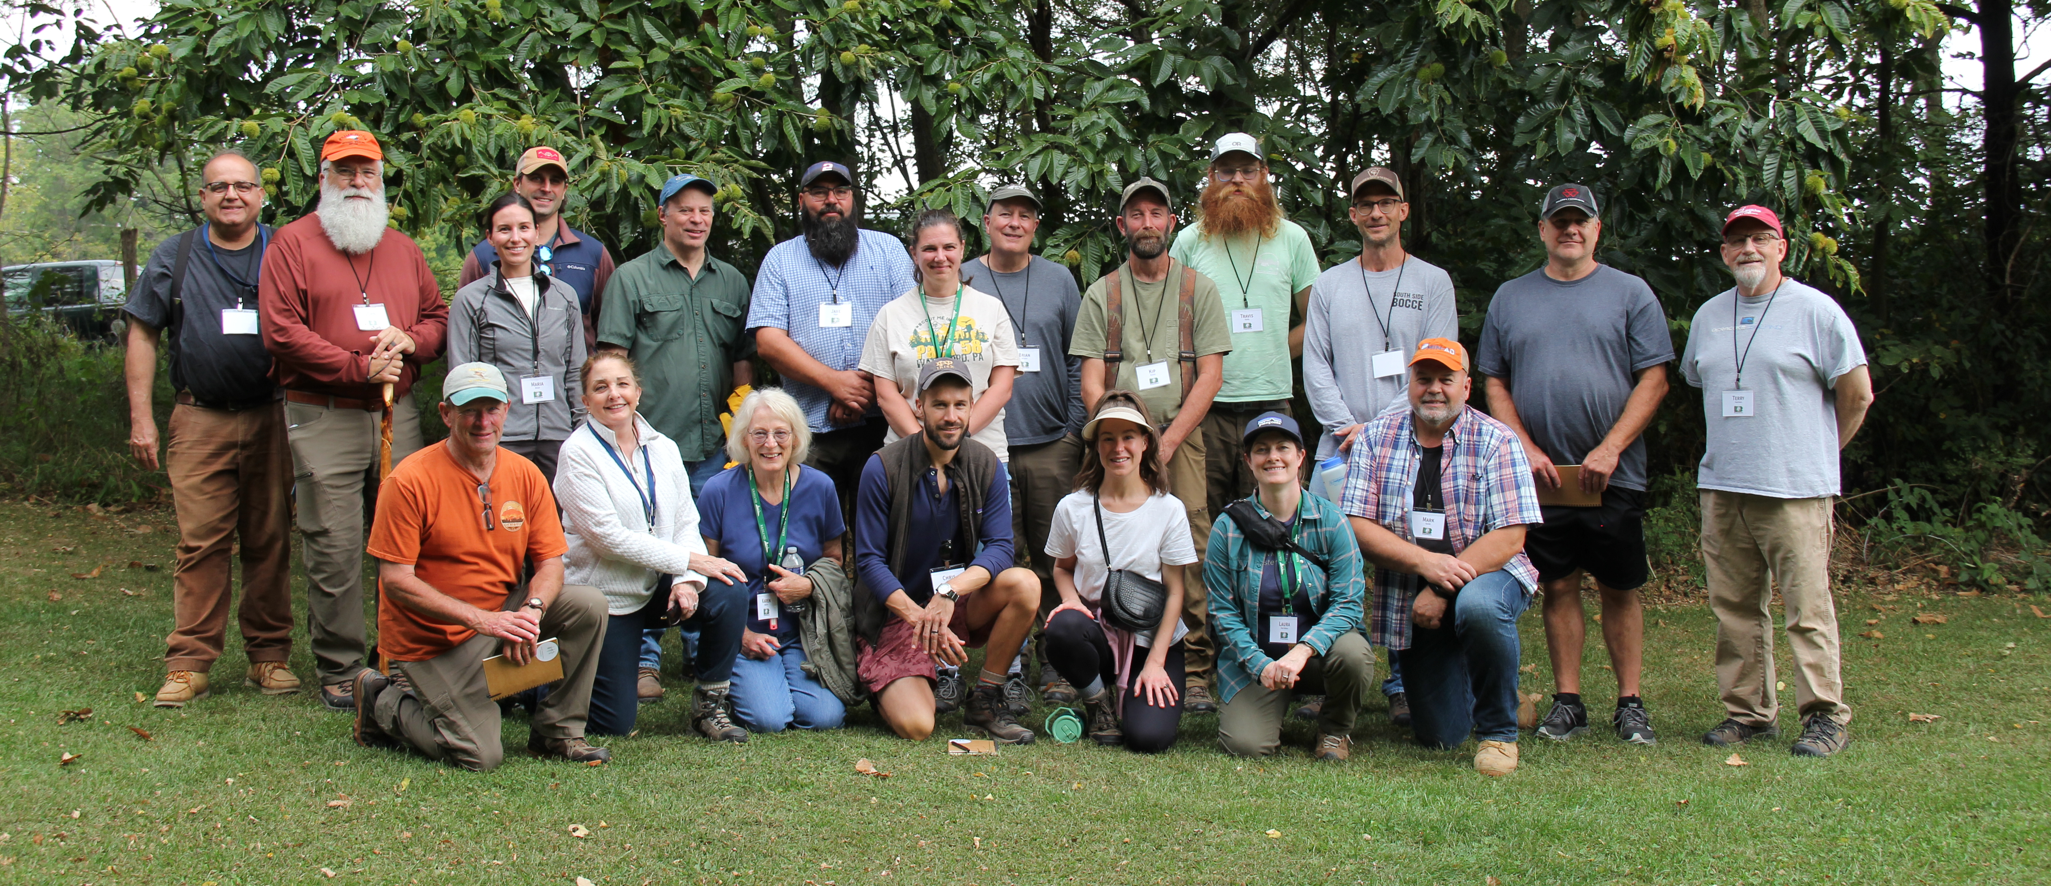
How Can We Make Good Management Decisions Happen?
These Trained Peer-to-Peer Educators are the individuals who can make your plan for Healthy Bay Forests happen.
Notes:
2023 Survey: PaFSs Volunteered 10,376 hours; equivalent to 5 full time employees at 40 hours a week for 50 weeks: VALUE $330,000.00
Reached 21,765 people
Online 8 part guided course plus 4 day retreat that also includes outreach skills, inservice opportunities, annual/regional meetings, newsletter

Slide 11
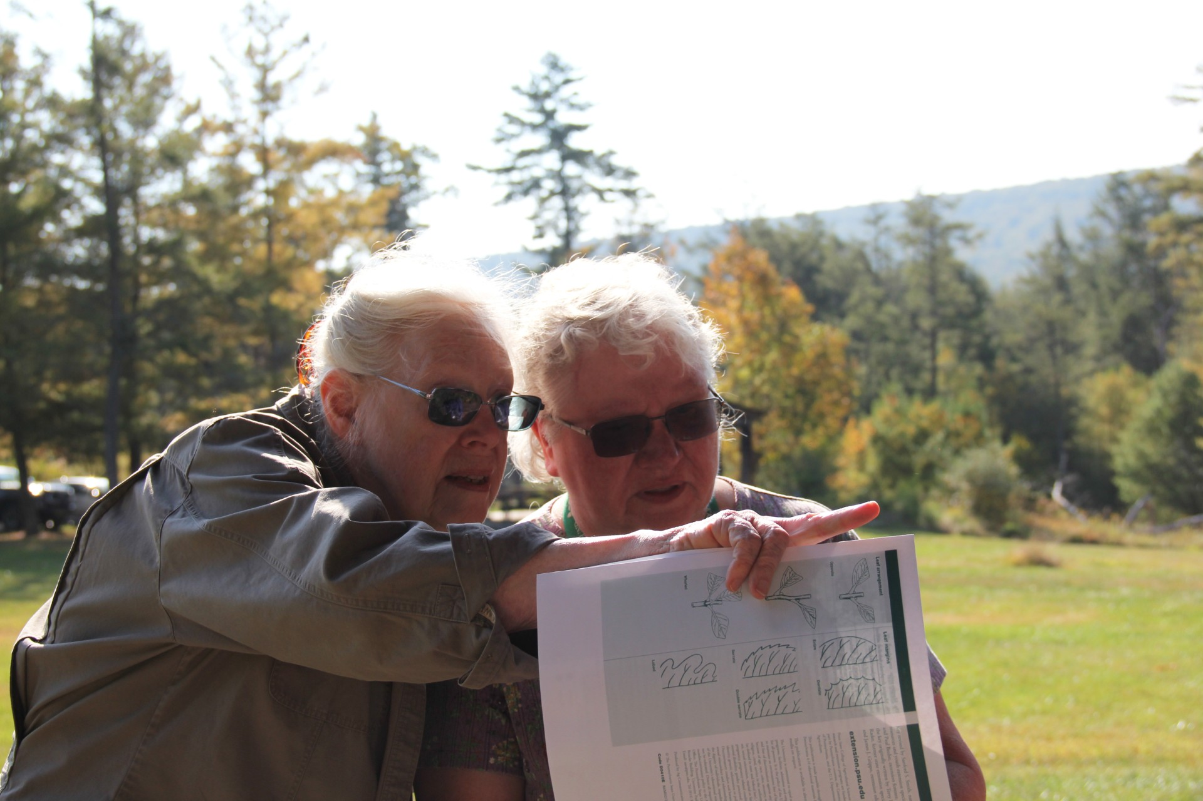
They work individually to explain concepts, consequences and opportunities

Slide 12
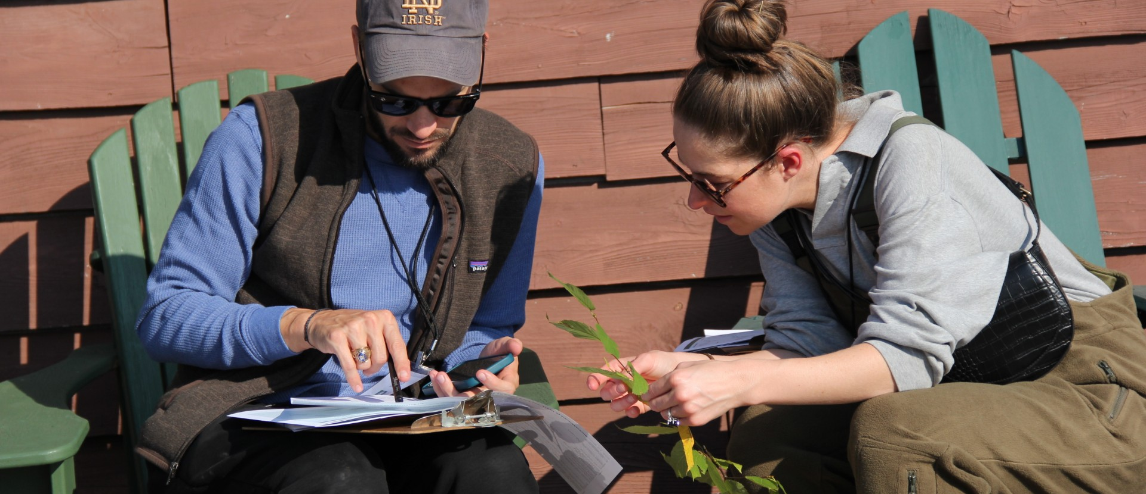
They work collaboratively to help landowners make management happen

Slide 13
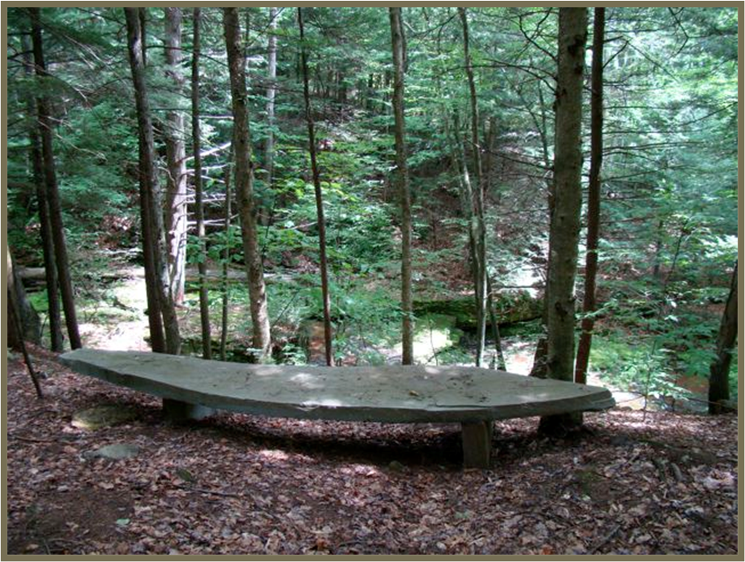
Nancy GW Baker
bakerii@epix.net
570-746-1844 Home
570-721-5074 Cell

