Slide 1


Agriculture’s Role in the Chesapeake Bay Restoration
Kurt Stephenson
Advancing Market-Based Approaches in the Agricultural Sector to Support Chesapeake Bay Watershed Restoration, STAC Workshop
July 8, 2025
Notes:
“Market based strategies for Chesapeake Bay policies

Slide 2
Ag and Chesapeake Bay Restoration
3 objectives:
Role of agriculture in “Bay restoration”
Progress and challenges
Accelerating progress: Role of market-based approaches
Notes:
Agriculture’s progress
Remaining Challenges
Innovative approaches to accelerate progress (partnerships and funding models)

Slide 3
What Restoration? 2014 Chesapeake Bay Agreement
10 Restoration Goals
Sustainable Fisheries
Vital Habitat
Water Quality
Toxic Contaminates
Heathy Watershed
Climate Resiliency
Land Conservation
Stewardship
Public Access
Environmental Literacy
31 Outcomes
Blue crabs, fish habitat, forage fish, oysters
Black duck, brook trout, fish passage, forest buffers, stream health, SAV, wetlands, tree canopy
WIPs for N,P, & S; Water quality standards/attainment.
Toxic contaminates research, policy&prevention
Healthy watershed outcome
Adaption, climate monitoring/assessment
Land use methods/metrics, lands use options, protected lands
Stewardship, diversity, local leadership
Public Access
Environmental literacy planning, student outcomes, sustainable schools

Slide 4
What Restoration? 2014 Chesapeake Bay Agreement
10 Restoration Goals
Sustainable Fisheries
Vital Habitat
Water Quality
Toxic Contaminates
Healthy Watershed
Climate Resiliency
Land Conservation
Stewardship
Public Access
Environmental Literacy
31 Outcomes
Blue crabs, fish habitat, forage fish, oysters
Black duck, brook trout, fish passage, forest buffers, stream health, SAV, wetlands, tree canopy
WIPs for N,P, & S; Water quality standards/attainment
Toxic contaminates research, policy & prevention
Healthy watershed outcome
Adaption, climate monitoring/assessment
Land use methods/metrics, lands use options, protected lands
Stewardship, diversity, local leadership
Public Access
Environmental literacy planning, student outcomes, sustainable schools

Slide 5
Role of Agriculture to Bay Nutrient Reduction Goals
Sources of nitrogen loads to Bay
Sources of phosphorus loads to Bay
Septic
Wastewater
Wastewater
Agriculture
Agriculture
Natural
Natural
Urban Nonpoint
256 million lbs/yr of Nitrogen entering the Chesapeake Bay (estimated by CAST 23)
Goal: 210 mil lbs/yr
13.2million lbs/yr of phosphorus entering the Chesapeake Bay (estimated by CAST 23)
Goal: 12.7 mil lbs/yr
Notes:
The future is the “nonpoint challenge” and ag is the critical

Slide 6
Progress and Challenges
Nitrogen
Annual rate of change in nonpoint source N loads
1985-2009 2009-2023
Agriculture - 1.45 mil/lbs/yr - 0.14 mil/lbs/yr
Urban Nonpoint + 0.45 mil/lbs/yr + 0.10 mil/lbs/yr
Net change in NPS -1.00 mil/lbs/yr - 0.04 mil/lbs/yr
Data Source: CAST23
Notes:
How have things changed?

Slide 7
Progress and Challenges
Nitrogen
Annual rate of change in nonpoint source N loads
1985-2009 2009-2023
1985-2009 2009-2023
Agriculture - 1.45 mil/lbs/yr - 0.14 mil/lbs/yr
Agriculture
Urban Nonpoint + 0.45 mil/lbs/yr + 0.10 mil/lbs/yr
Net change in NPS -1.00 mil/lbs/yr - 0.04 mil/lbs/yr
Urban nonpoint
Data Source: CAST23
Notes:
Historical levels of funding… state, federal… why?

Slide 8
Progress and Challenges
Nitrogen
Annual rate of change in nonpoint source N loads
1985-2009 2009-2023
1985-2009 2009-2023
Agriculture - 1.45 mil/lbs/yr - 0.14 mil/lbs/yr
Agriculture
Urban Nonpoint + 0.45 mil/lbs/yr + 0.10 mil/lbs/yr
Net change in NPS -1.00 mil/lbs/yr - 0.04 mil/lbs/yr
Urban nonpoint
Estimated additional N reductions to achieve the TMDL target: 46 mil/lb
Data Source: CAST23
Notes:
Why?
Is this a quirk with the model? Are we actually doing better?

Slide 9
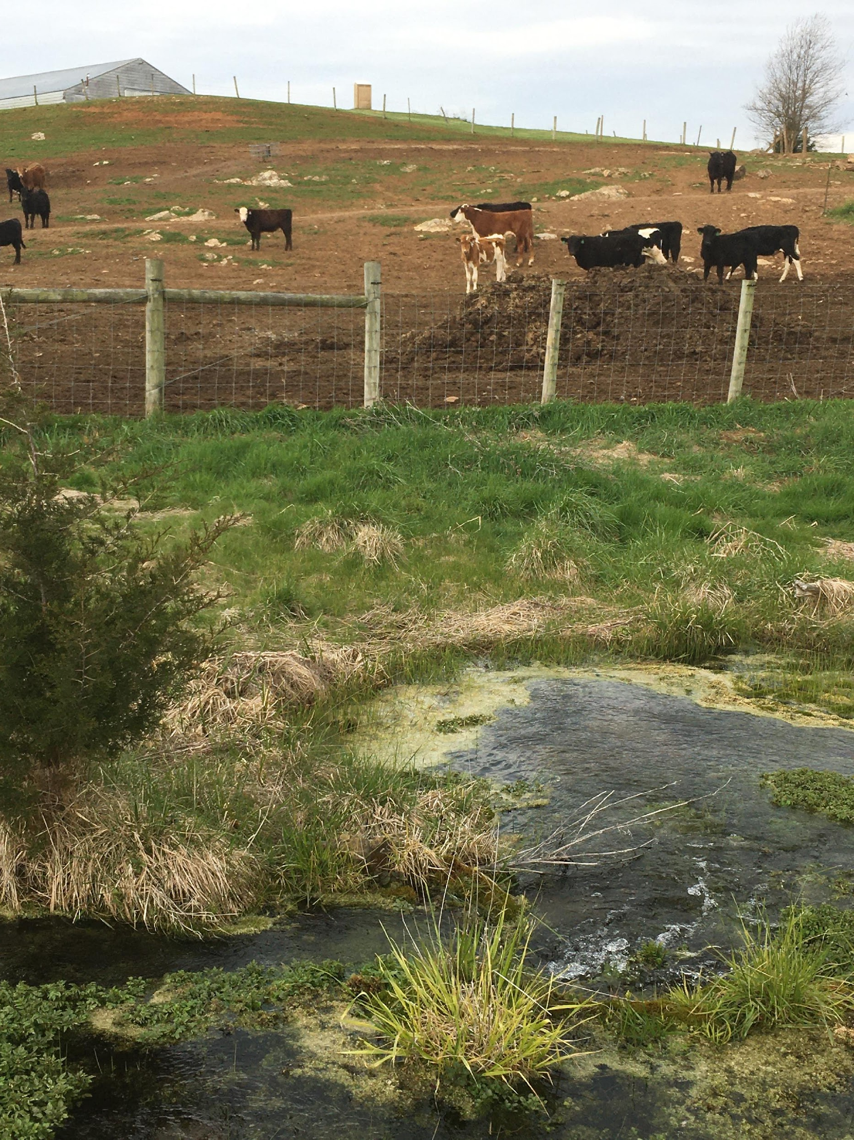
Smith Creek VA
Showcase watershed
4x increase in BMPs in last 2 decades
Increase in animal units

Slide 10
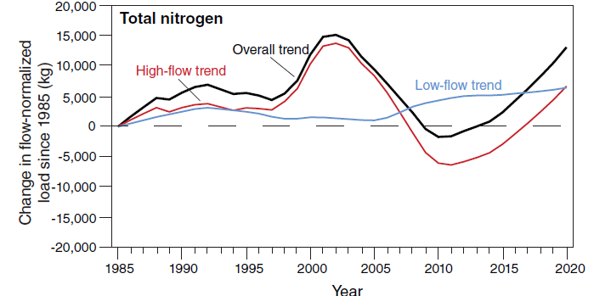
Smith Creek VA
Showcase watershed
4x increase in BMPs in last 2 decades
Increase in animal units
Source: Webber et al, 2024, Evaluating Water-quality Trends in Agricultural Watersheds prioritized for best management practice implementation, J of the Amer. Water Resources Association.
Notes:
What causes this pattern?
Could be that BMPs “don’t work”
1. Mass balance… Net imports of nutrients… overwhelming bmp efforts.
2. If nutrients are a focus, need to consider BMPs…. Realistic expections for BMPs that do not alter the mass balance…buffers, conservation tillage, potentially cover crops.

Slide 11

Progress and Challenges:
Nitrogen

Slide 12
Progress and Challenges:
Nitrogen
BMP funding increasing
BMP adoption increasing
Yields increasing
Animal numbers increasing

Slide 13
Progress and Challenges:
Phosphorus

Slide 14
Progress and Challenges:
Phosphorus
Annual rate of change in nonpoint source P loads (CAST estimates)
1985-2009 2009-2023
Agriculture - 130k lbs/yr - 40k lbs/yr
Urban Nonpoint + 20k/lbs/yr - 20k lbs/yr
Net change in NPS -110k lbs/yr - 60k lbs/yr
Data Source: CAST23

Slide 15
Progress and Challenges:
Phosphorus
Annual rate of change in nonpoint source P loads (CAST estimates)
1985-2009 2009-2023
Agriculture - 130k lbs/yr - 40k lbs/yr
Urban Nonpoint + 20k/lbs/yr - 20k lbs/yr
Net change in NPS -110k lbs/yr - 60k lbs/yr
Estimated additional N reductions to achieve the TMDL target: 450k/lb/yr
Data Source: CAST23

Slide 16
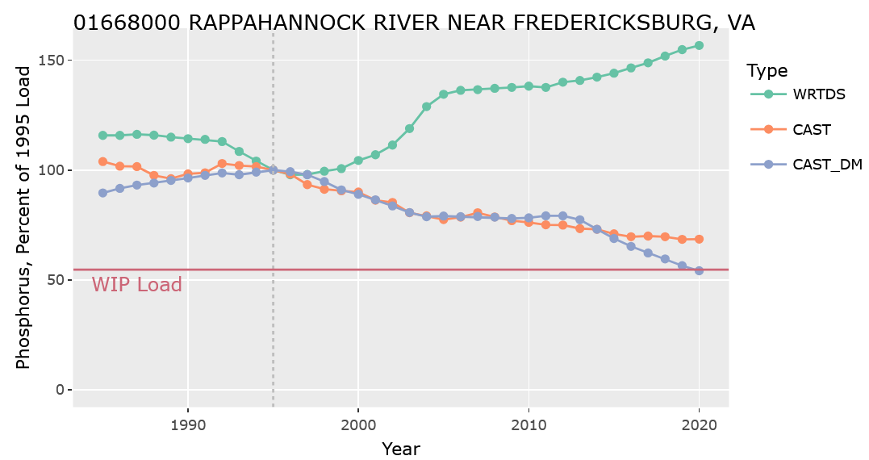
Progress and Challenges:
Phosphorus
monitored
model
Data Source: METRIC (Monitored and Expected Total Reduction Indicator for the Chesapeake) https://wqs.chesapeakebay.net/metric/

Slide 17
Progress and Challenges:
Phosphorus
monitored
Response Gap
model
Data Source: METRIC (Monitored and Expected Total Reduction Indicator for the Chesapeake) https://wqs.chesapeakebay.net/metric/

Slide 18
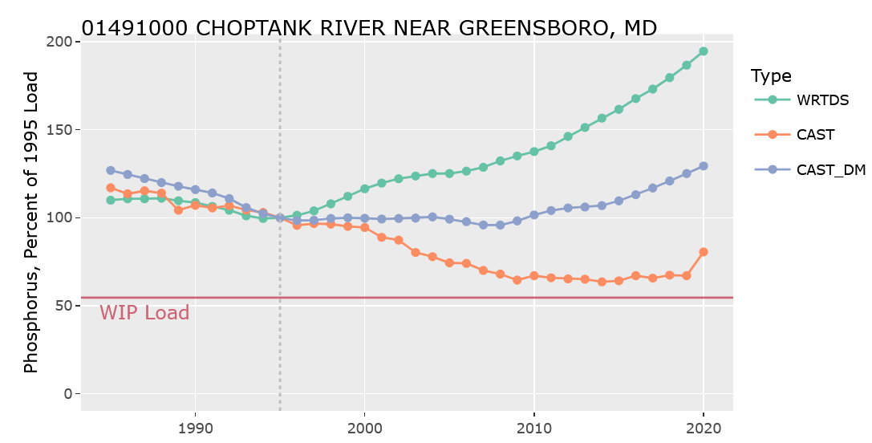
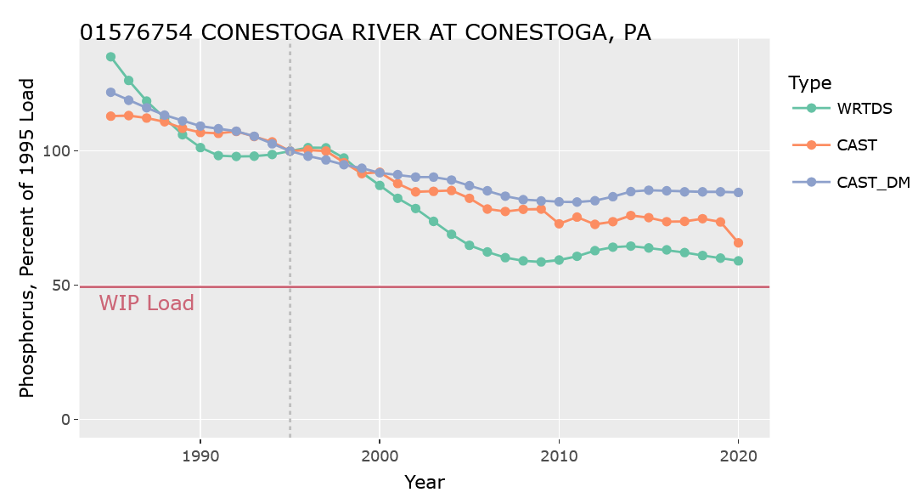
Progress and Challenges:
Phosphorus
monitored
Response Gap
model
Doing better than expected here
Data Source: METRIC (Monitored and Expected Total Reduction Indicator for the Chesapeake) https://wqs.chesapeakebay.net/metric/

Slide 19
Phosphorus Response Gap
Long term Trends in Total Phosphorus Loads
Increasing Loads | Decreasing Loads

Slide 20
Progress and Challenges
Conclusions
Reducing pollutants while increasing ag production is a major accomplishment, but
STAC concluded that current programs were insufficient to meet TMDL targets
Data Source: CAST23

Slide 21
Accelerating Progress
For continued progress, need to add new approaches to implementation in addition to sustained/increasing funding

Slide 22





Conventional Approach
StateWIPs
Public
Implementation Programs
$ offer
Cost share
(% of BMP cost)
Adoption
BMP
Predictions of N, P, & sediment reductions
CAST
State reporting
Notes:
Points: This is the “primary” system we use to accomplish our conservation goals. This system is producing the outcomes above.
Offer “cost share” payments to farmer to adopt specific practices.
Farmers self select into the program
BMPs that tend to be selected….low upfront costs, some private benefits.
CAST

Slide 23
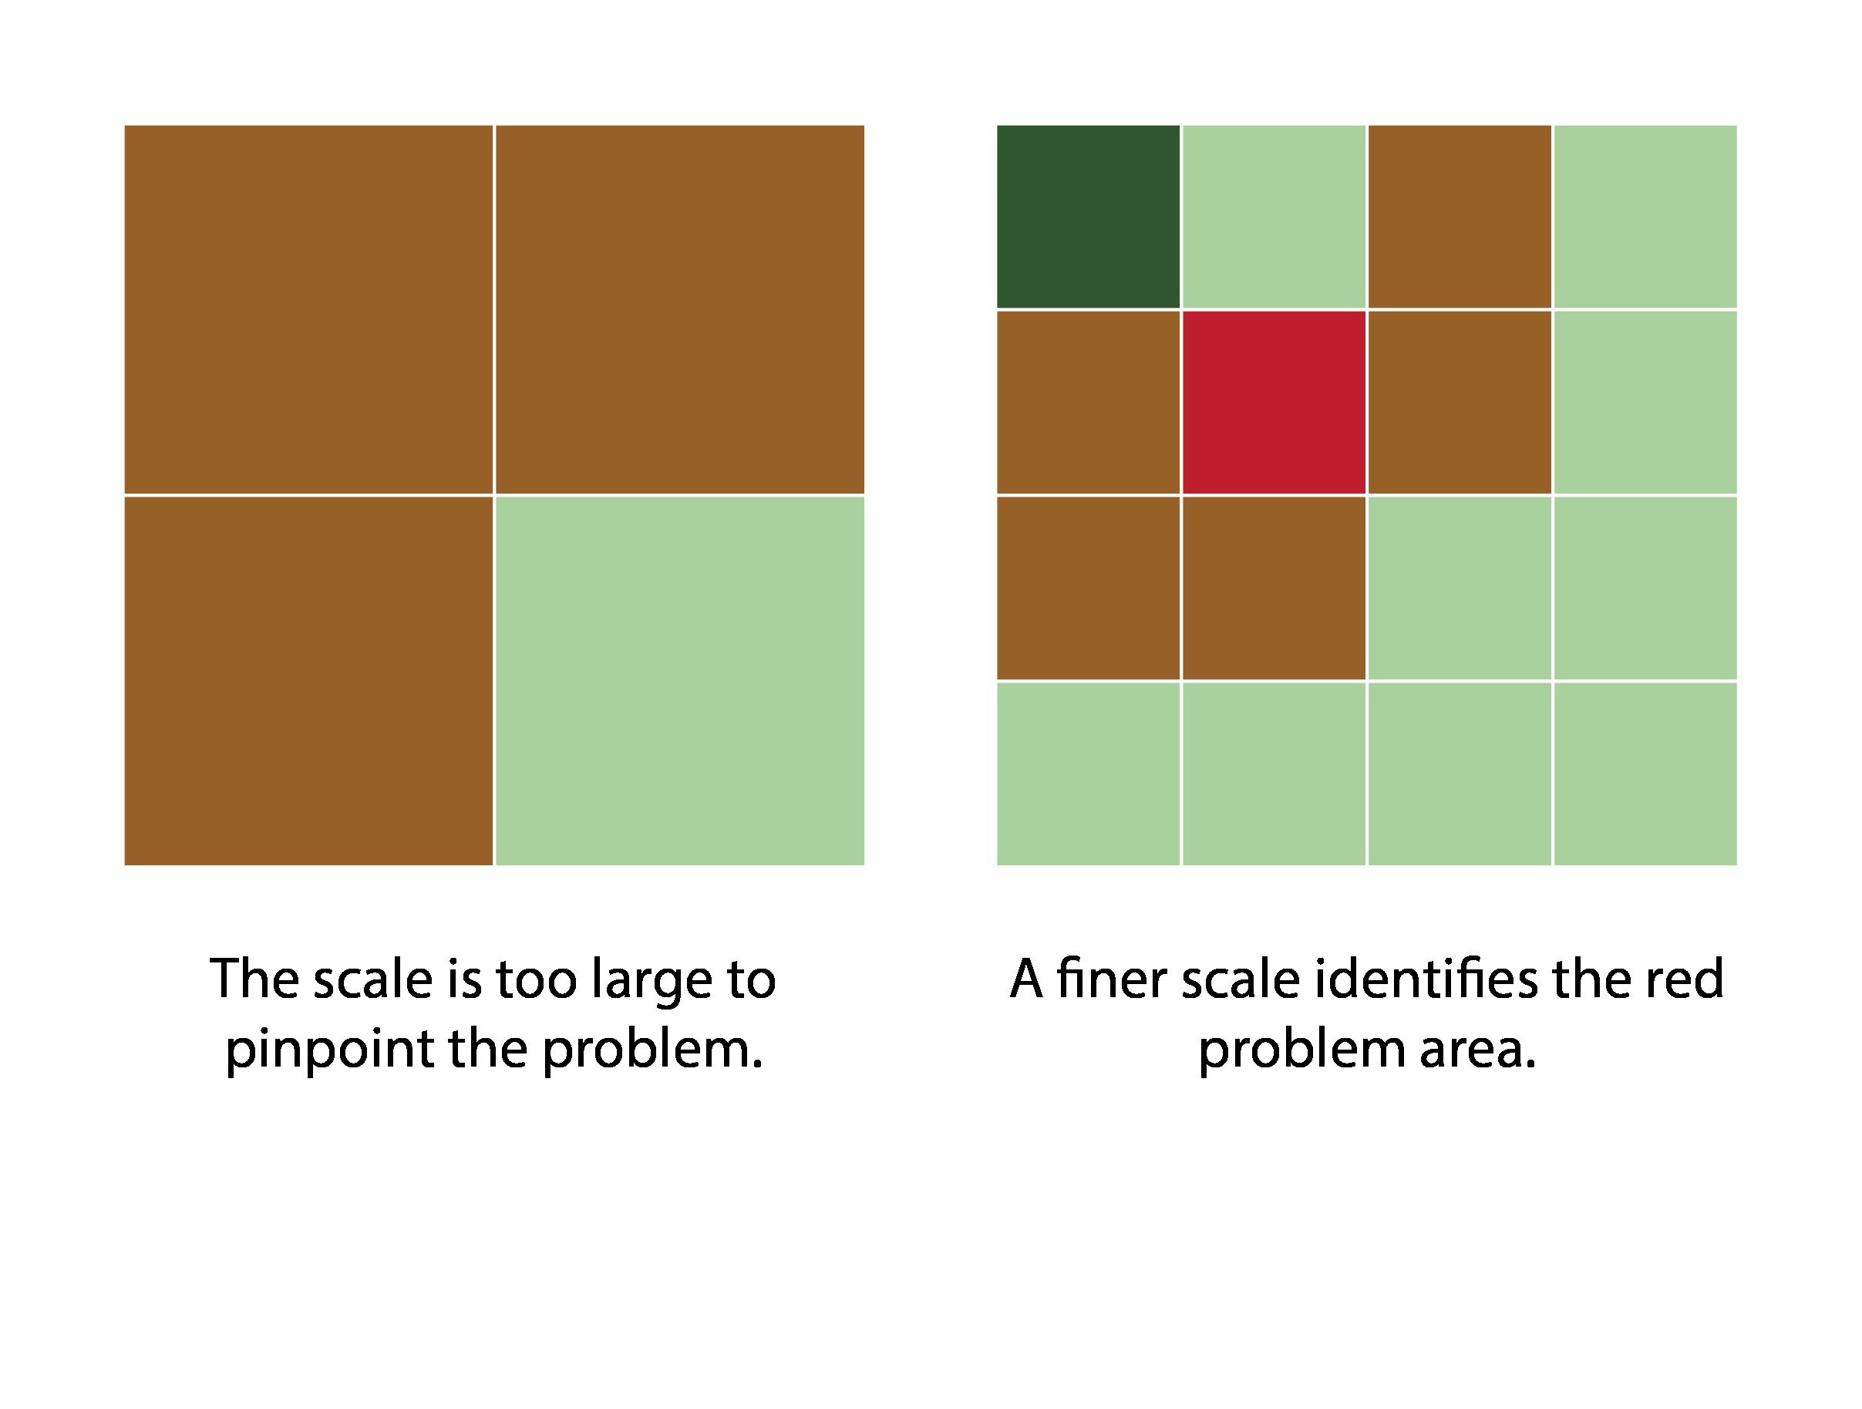
Conventional Approach
StateWIPs
Public
Implementation Programs
$ offer
Cost share
(% of BMP cost)
Adoption
BMP
Predictions of N, P, & sediment reductions
CAST
State reporting
The way CAST “sees” the landscape
Brown are high load areas
Notes:
Points: This is the “primary” system we use to accomplish our conservation goals. This system is producing the outcomes above.
Offer “cost share” payments to farmer to adopt specific practices.
Farmers self select into the program
BMPs that tend to be selected….low upfront costs, some private benefits.
CAST

Slide 24
Conventional Approach
StateWIPs
Public
Implementation Programs
$ offer
Cost share
(% of BMP cost)
Adoption
BMP
Predictions of N, P, & sediment reductions
CAST
State reporting
The way CAST “sees” the landscape
The actual
landscape
Red and brown are high load areas
Notes:
Points: This is the “primary” system we use to accomplish our conservation goals. This system is producing the outcomes above.
Offer “cost share” payments to farmer to adopt specific practices.
Farmers self select into the program
BMPs that tend to be selected….low upfront costs, some private benefits.
CAST

Slide 25

Accelerating Progress
Innovation
Not just technical solutions
Need new ways of motivating people
Technology
Knowledge Institutions

Slide 26
Accelerating Progress
Market-based policies
Public
Goals
Private Means
Environmental objectives
Financial incentives
Flexibility to respond
(Financial incentives)
Notes:
Using market-type incentives to align private decision-making with environmental goals by making it financially beneficial to reduce pollution or conserve resources.

Slide 27



Accelerating Progress
Market-based Opportunities
StateWIPs
Implementation Programs
BMP
$ offer
BMP
for outcomes
BMP
outcomes
CAST
Notes:
How might incentive systems be changes to make them more market-based?

Slide 28
Accelerating Progress
Market-based Opportunities
StateWIPs
Implementation Programs
BMP
$ offer
BMP
for outcomes
BMP
outcomes
CAST
Examples: Flemming et al. 2021

Slide 29
Accelerating Progress
Market-based Opportunities
Consumers
Buyers
Stakeholders
Public
Private
$
StateWIPs
Implementation Programs
BMP
$ Support
BMP
BMP
outcomes
CAST

Slide 30
Final Thoughts
Notes:
Not easy. No silver bullets
Requires change and experimentation…
Occurring in time of rapid change…
but… there is opportunity … willing to admit limitations and try new things.

Slide 31
Draft 2025 Chesapeake Bay Agreement
4 Restoration Goals
Thriving Habitat and Wildlife
Clean Water
Healthy Landscapes
Engaged Communities
21 Outcomes
Blue crabs, oysters, fish habitat, wetlands, stream health, brooke trout, fish passage, SAV.
Water quality standards and attainment
Reducing excess nitrogen, phosphorus, & sediment
Toxic contaminant migration
Protected lands, land use decision support, healthy forests and trees, adapting to changing environmental conditions.
Stewardship, local leaders, workforce, public access, student experiences, school district planning.

Slide 32
High
Conservation for what?
Effectiveness of BMPs to produce water quality outcomes
BMP
Trade-offs
“Win-win”
Soil Health/Soil Carbon
Aquatic Habitat,
Bacteria, etc
Inferior
Trade-offs
Low
Low
High
Nutrient Reduction Effectiveness

Slide 33
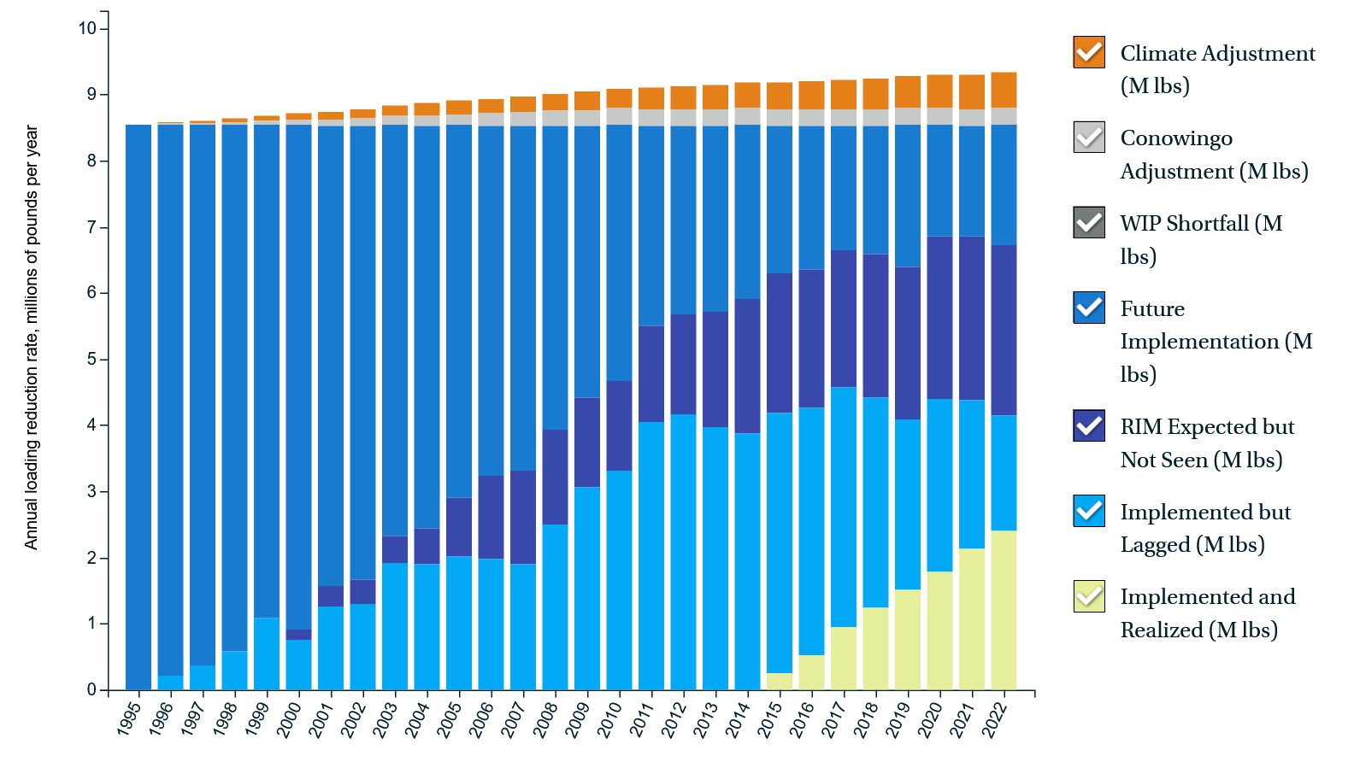
CBP’s estimate of watershed P response gap
https://www.chesapeakeprogress.com/clean-water/water-quality

