Slide 1
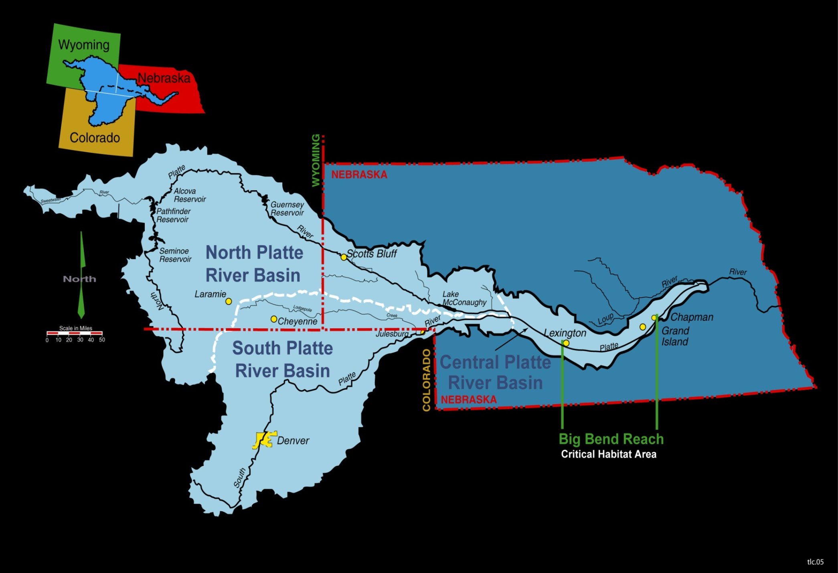
Notes:
Program Introduction

Slide 2
PARTNERSHIP STRUCTURE
Governance
  DOI (Reclamation & USFWS)
  States
  Water Users
  Conservation Organizations
Consensus Decision Making
Independent Implementation
  Executive Director & Staff
  Financial Management and Land Holding Entity
GOALS
Defined benefits for T&E species
Past & future ESA compliance
Prevent future listings
COMPLIANCE IS MILESTONE-BASED
Water acquisition (130,000 af)
Land acquisition (10,000 ac)
State & Federal depletions offsets
Implement adaptive management plan

Slide 3
Touchpoints for Progress (Platte & elsewhere)
Governance Structure and Function
  Everybody matters or nobody matters
Science-Policy Framing (uncertainty reduction vs resource allocation)
  Clarify role of adaptive management
  Identify uncertainties that matter to decision makers
  Be brutal - need to know vs. nice to know
Models (Pareto Principle)
  As complexity increases confidence decreases (tension w/ science incentives)
Structured Decision Making
  Quantitative AND qualitative objectives (giving weight to values)

Slide 4
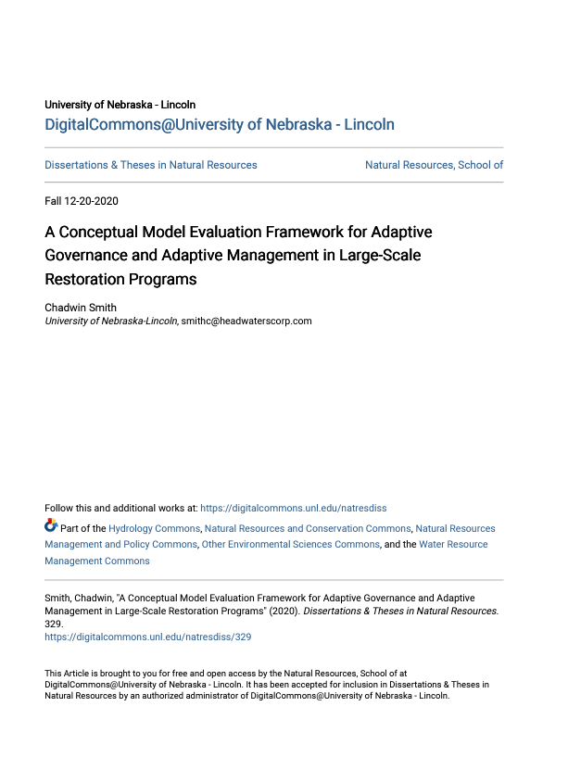
Smith, Chadwin, “A Conceptual Model Evaluation Framework for Adaptive Governance and Adaptive Management in Large-Scale Restoration Programs” (2020) Dissertations & Theses in Natural Resources. 329.

Slide 5
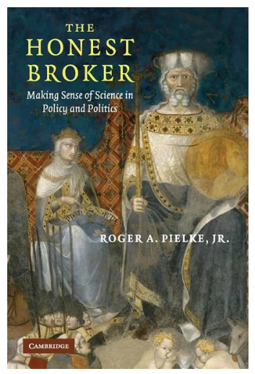
Pielke Jr, Roger A. The honest broker: making sense of science in policy and politics. Cambridge University Press, 2007.

Slide 6
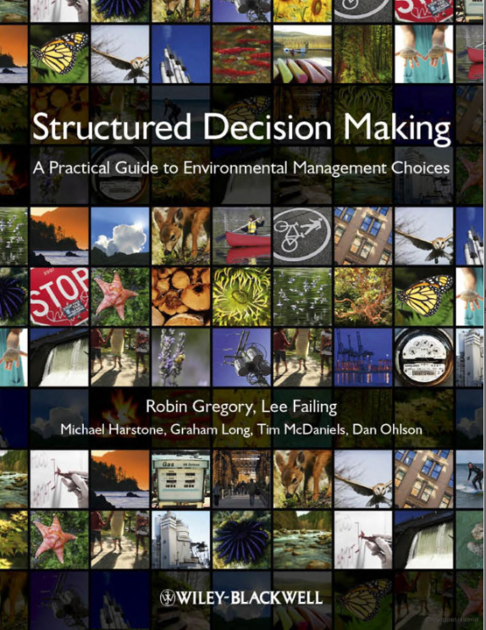
Gregory, Robin, et al. Structured decision making: a practical guide to environmental management choices. John Wiley & Sons, 2012.

