Slide 1

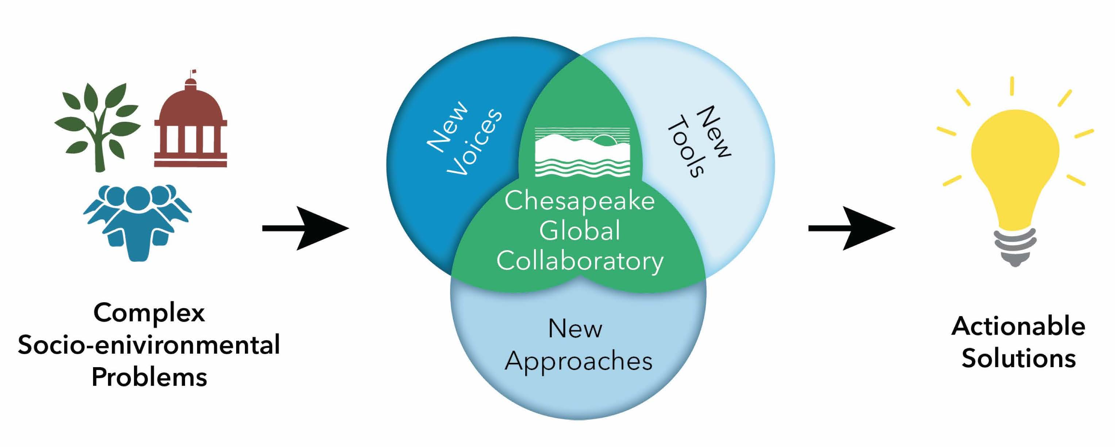
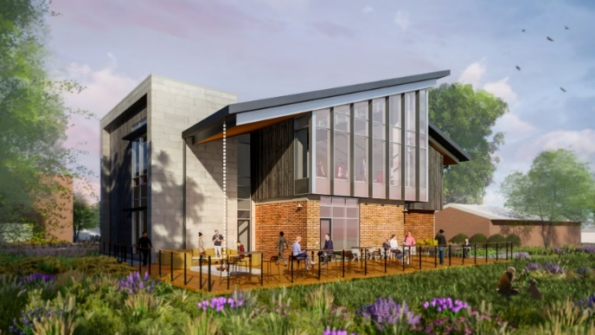
Cyberinfrastructure Data Science
Communication Education/Training
Stakeholder engagement

Slide 2


category goes here and here
CESR, Living Resources, and Climate Change
CBP Climate Change Modeling III: Post-2025 decisions
Kenneth Rose
France-Merrick Professor in Sustainable Ecosystem Restoration
Horn Point Lab, UMCES

Slide 3
CESR
Executive Summary, Policy Brief
Main report
Three supplemental reports
  Watershed
  Estuary
  Living Resources

Slide 4
Easton, Z., Stephenson, K., Benham, B., Böhlke, J. K., Brosch, C., Buda, A., Collick, A., Fowler, L., Gilinsky, E., Hershner, C., Miller, A., Noe, G., Palm-Forster, L., & Thompson, T. (2023). Evaluation of watershed system response to nutrient and sediment policy and management.
Testa, J. M., Dennison, W. C., Ball, W. P., Boomer, K., Gibson, D. M., Linker, L., Runge, M. C., & Sanford, L. (2023). Knowledge gaps, uncertainties, and opportunities regarding the response of the Chesapeake Bay estuary to proposed TMDLs.
Rose, K., Monaco, M. E., Ihde, T., Hubbart, J., Smith, E., Stauffer, J., & Havens, K. J. (2023). Proposed framework for analyzing water quality and habitat effects on the living resources of Chesapeake Bay.

Slide 5
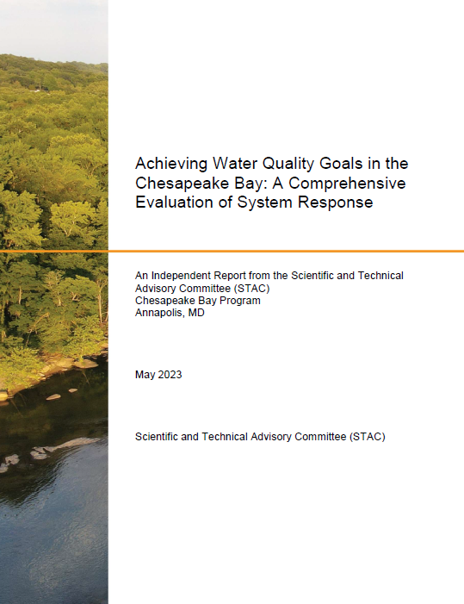
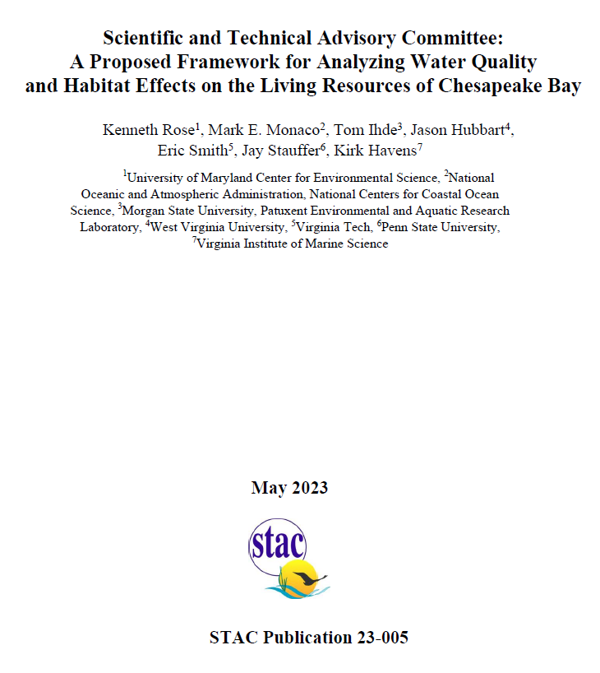

Slide 6
CESR
FINDING: It might not be possible to meet the all TMDL and WQ goals but this may not be necessary to meet and support living resource goals.
CWA diverts attention from consideration of LR responses
Opportunities exist to adjust water quality goals to prioritize management actions that improve LR
Water quality improvements in shallow water may have more of a benefit to living resources than elsewhere.
Water quality alone does not guarantee improvements in Living Resources. There are other factors!

Slide 7
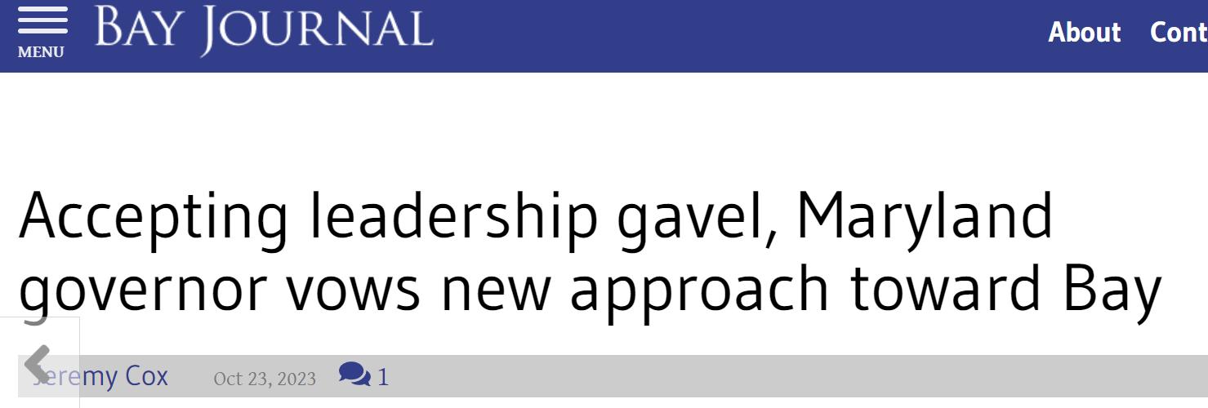
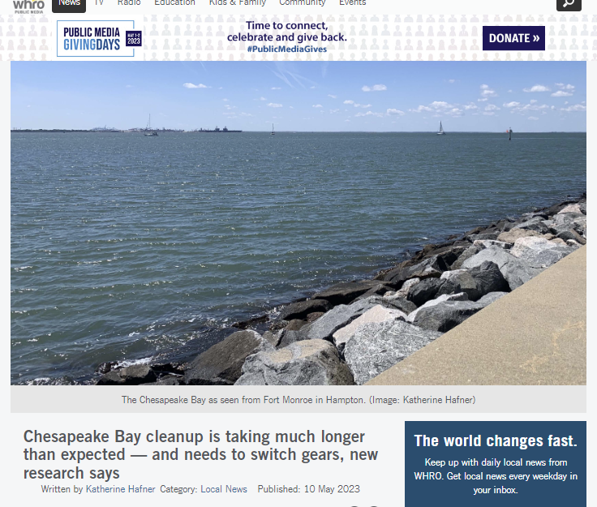
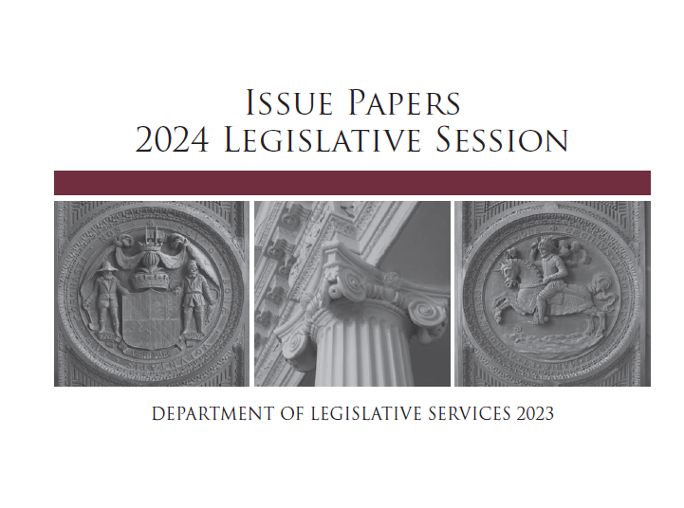
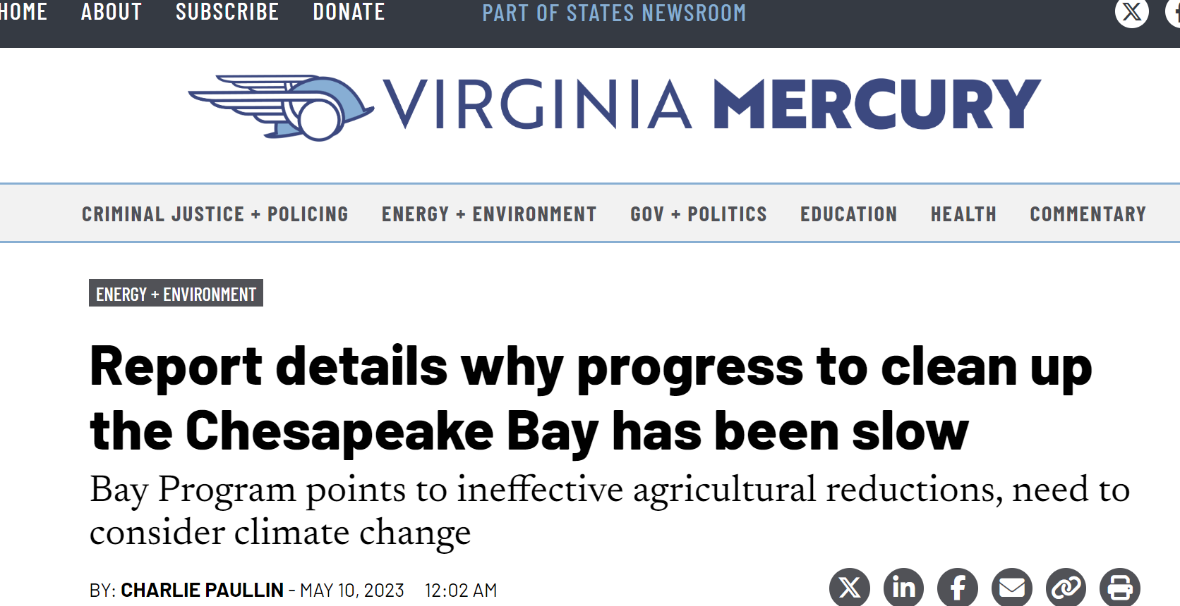
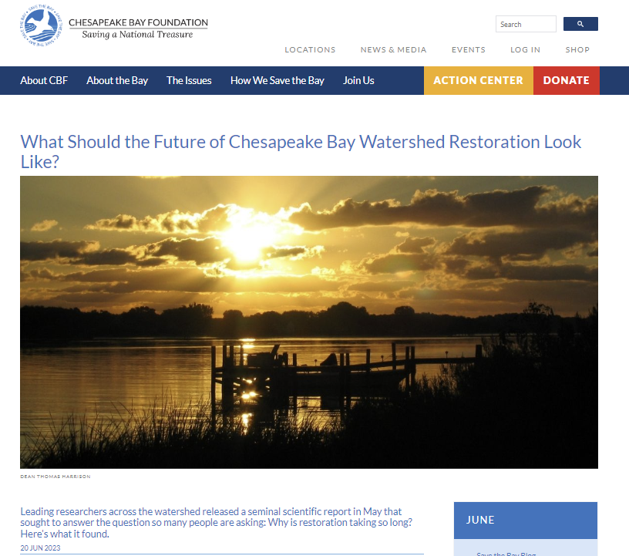

Slide 9
1 Introduction
2 Why now?
3 Management Questions that Could Be Answered
4 Existing Links Between WQ/Habitat & LR
4.1 Assessing Progress of Restoring LR of the CB
4.2 Example of Analyses for CB Living Resources
4.2.1 Habitat-based Assessment
4.2.2 Statistical Analysis of LR Monitoring Data
4.2.3 Living Resource Models
5 LR and Other Large-scale Restoration Efforts

Slide 10
6 Going Forward
7 Proposed Framework
7.1 Complex Life cycles and life history strategies
7.2 Variability, uncertainty, and stochasticity
7.3 Model complexity
7.4 Vital rates
7.5 Habitat suitability and capacity
7.6 Biological organization
7.7 Nonequilibrium theory and baseline
7.8 Multiple Influencing Factors
7.9 Tradeoffs (win-lose), Win-win, and Lose-lose
7.10 Power to detect responses
7.11 Explicit and implicit representations
7.12 Relative versus absolute predictions

Slide 11
8 Strategic determination of an analysis plan
8.1 Selecting species
8.2 Available Data
8.3 Response and explanatory variables
8.4 Biological, temporal, & spatial scales
8.5 Analytical approaches
8.6 Coordination and combining results
9 Final comments
10 Acknowledgements
11 References

Slide 12
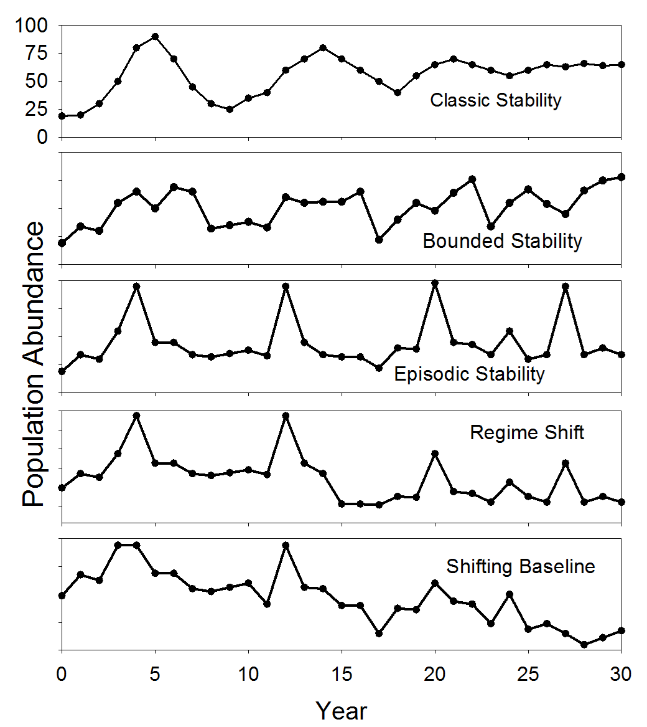
Foundational Concepts – Nonequilibrium Theory

Slide 13
Context
Many reasons to relate water quality and habitat changes to living resources
Valued by stakeholders and society
Restoration is costly
Realistic and feasible targets and goals
Ecological and economic efficiency (“reckoning”)
Expectations
Adaptive management
Winner and losers

Slide 14
Management Questions
What is the expected (projected) response of living resources to water quality and habitat conditions in the Bay:
  without the TMDL and habitat targets
  (b) present TMDL and habitat attainment continued
  (c) under full TMDL and habitat goals

Slide 15
Management Questions
Given the current state or condition, how can the analyses inform what types and magnitude of changes in water quality and habitat are needed to evoke an agreed-upon target set of the desired living resources’ responses?
What are the certainties and critical uncertainties of the analyses and how can they help guide future monitoring and modeling efforts?

Slide 16
Feasibility – Chesapeake Bay
Historical focus on water quality
Productivity and highly valued
Information and data rich
Many scientists = a lot of past and ongoing activities
Done at other large-scale restoration efforts
Q: How would we go about doing this task?

Slide 17
Different Situation to “WQ”
Many critters move
Affected by many factors in a complex life cycle
Responses are on longer time scales
Ability to isolate responses to actions decreases

Slide 18
Different Situation to “WQ”
Questions change
Not specific targets for many living resources
Not an established set of data or models
Greater uncertainties

Slide 19
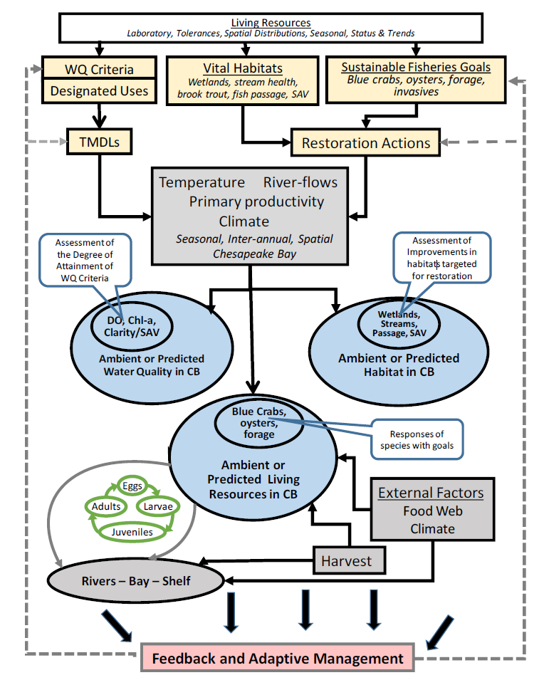

Slide 20


Slide 21
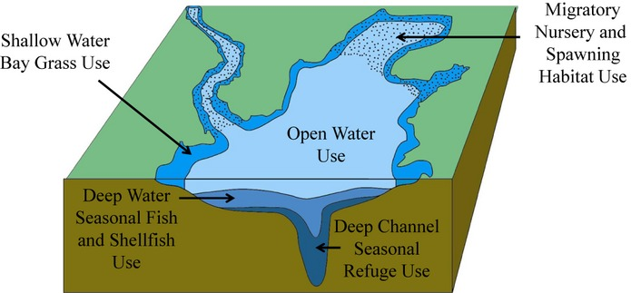
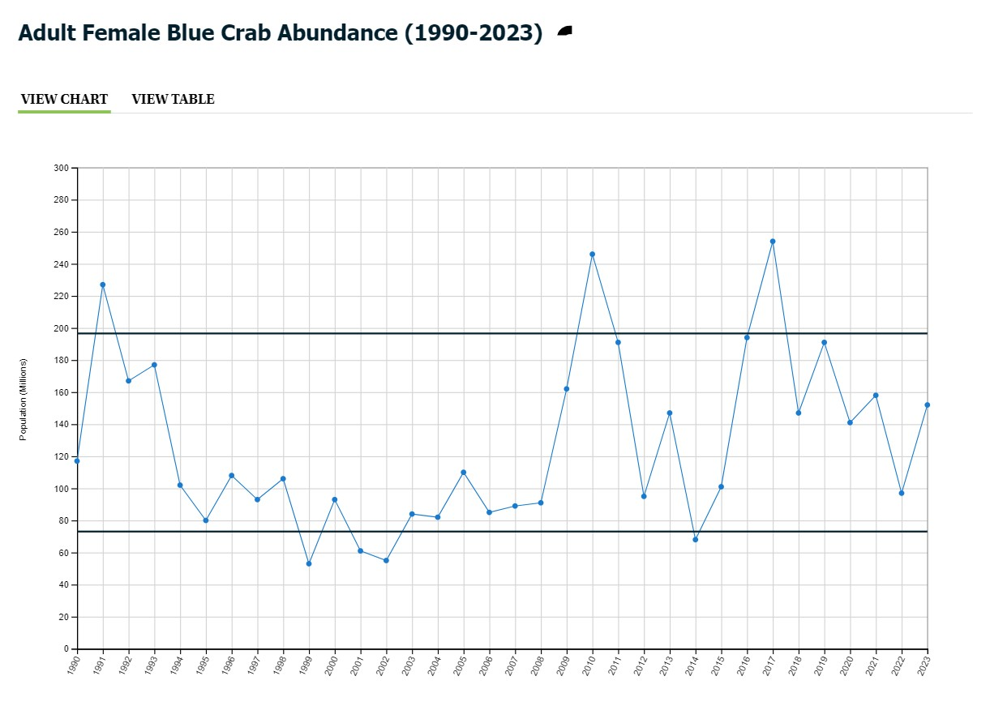
(1) TMDL ignores fish! False
Bottom up approach – very well done
WQS
Agreement indicators
Report cards
Others
Tango, P.J. and R.A. Batiuk. 2013. Journal of the American Water Resources Association 49: 1007-1024
https://www.chesapeakeprogress.com/abundant-life/blue-crab-abundance

Slide 22
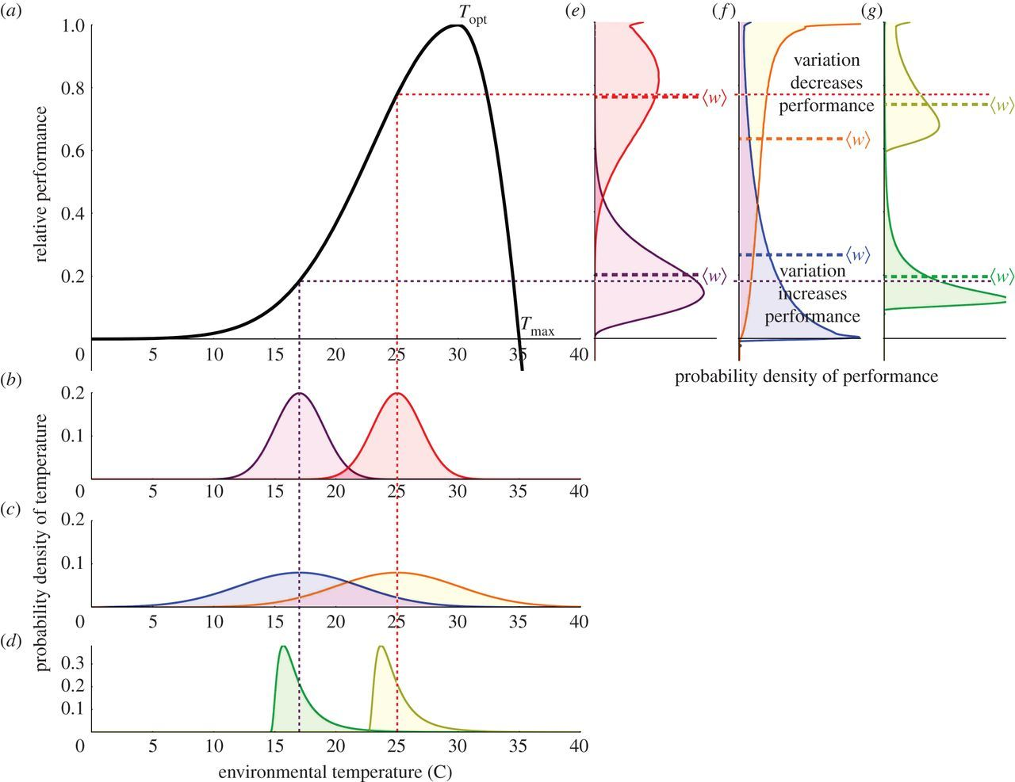
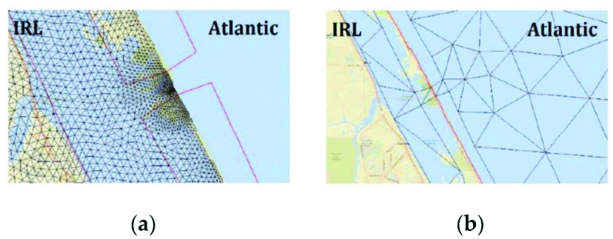
(2) WQ Predictions for TMDL are the same as for living resources! False
Vasseur et al. 2014. Increased temperature variation
poses a greater risk to species than climate warming.
Proc. Royal Society B, 281, p.20132612.
Lodge and Weaver (2022) Journal of Marine
Science and Engineering 10(8):1117

Slide 23
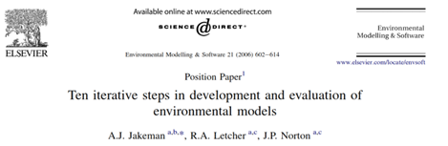
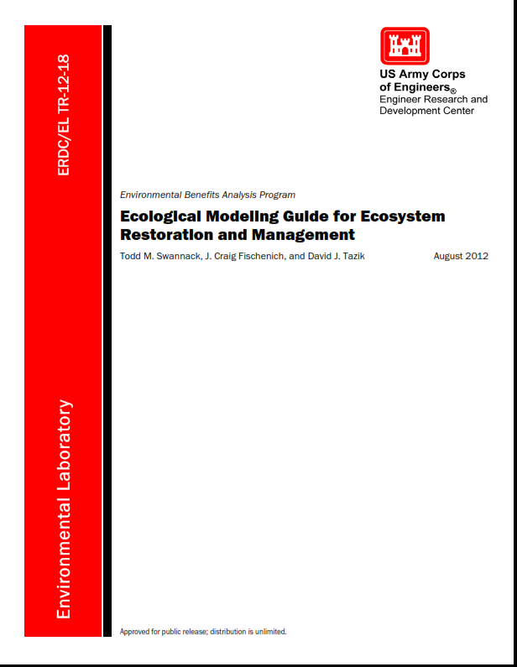
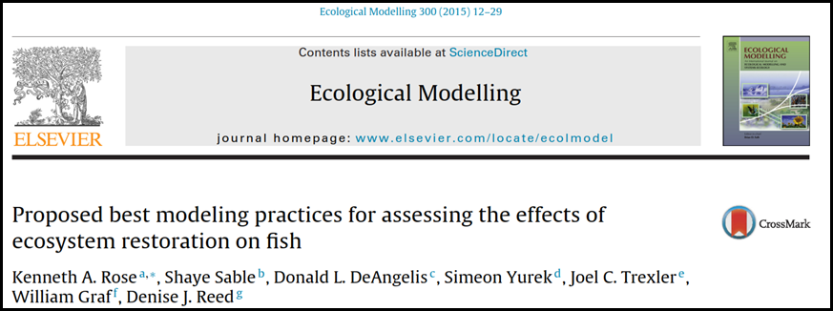
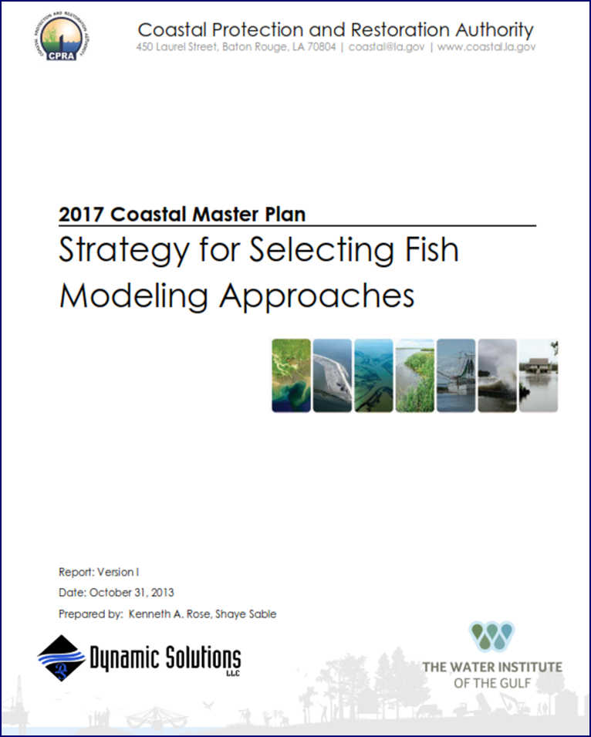
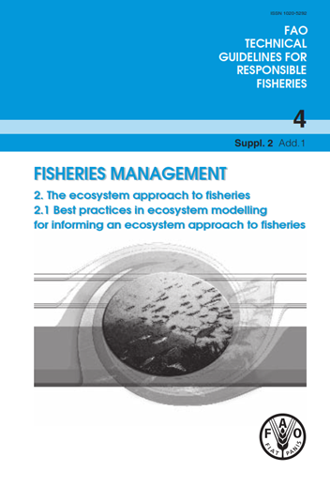
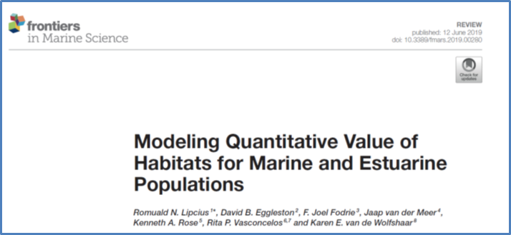
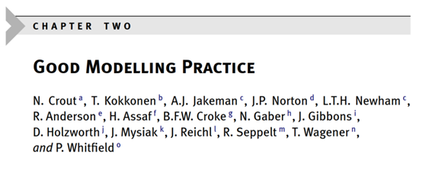
(3) We cannot do this! False

Slide 24
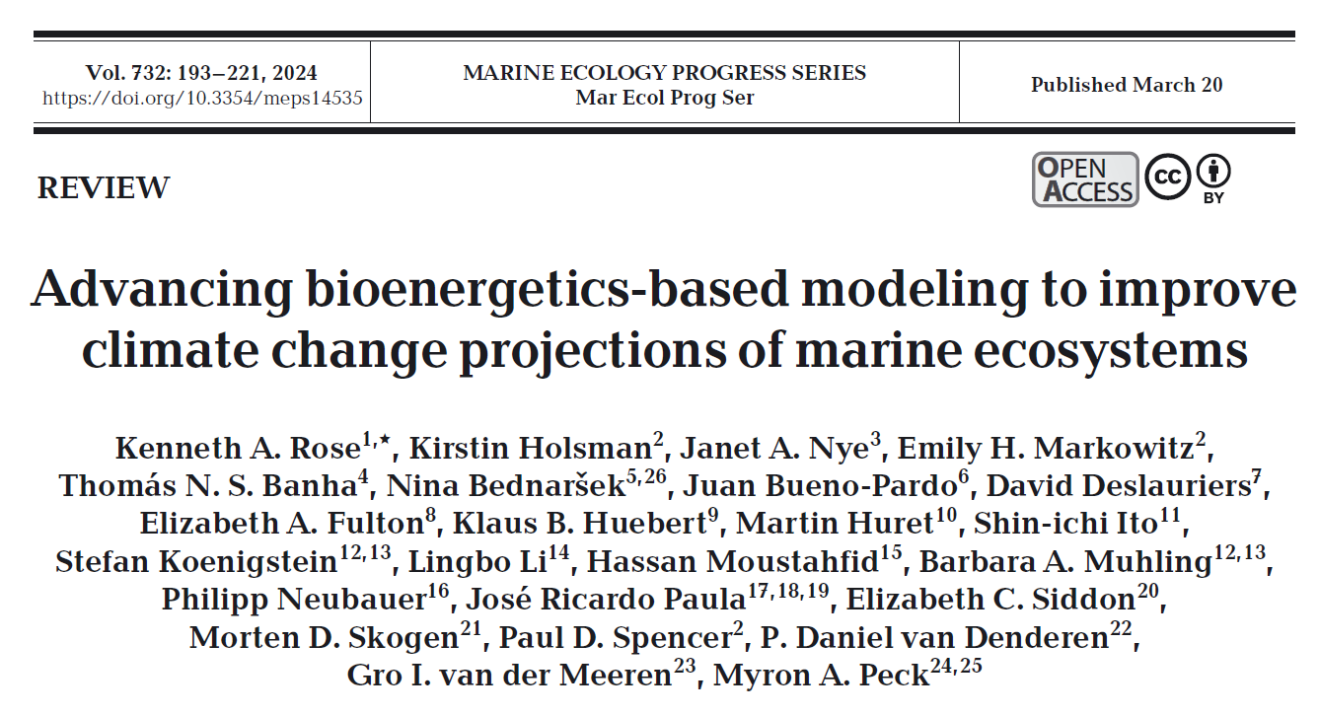

Slide 25
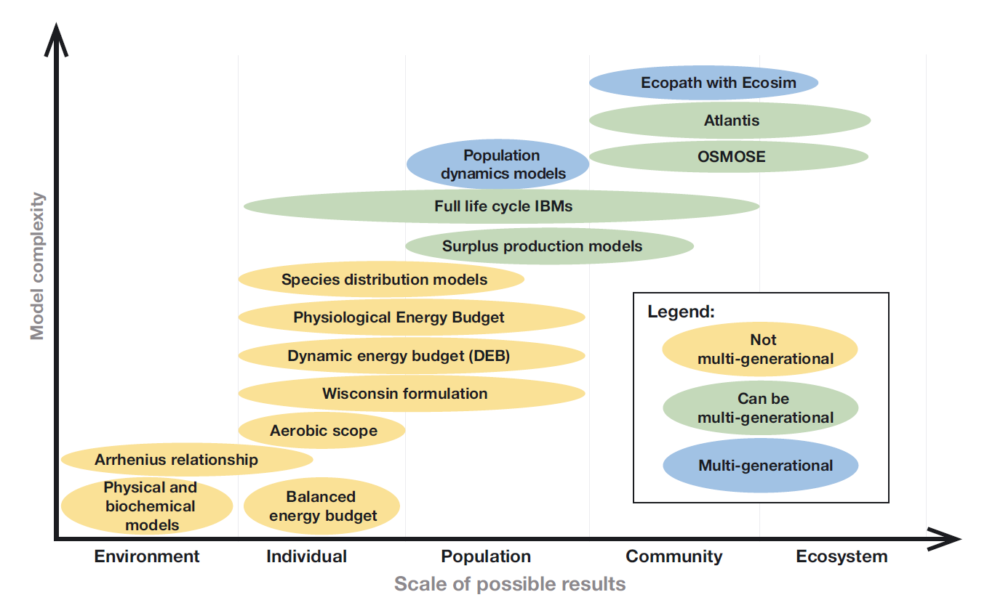

Slide 26
Existing links WQ/Habitat to LR
Many completed analyses
  Excellent
  Independent
Species, methods, spatial/temporal coverage vary
Addressed study-specific questions
  Not “TMDL” and CBP habitat restoration

Slide 27
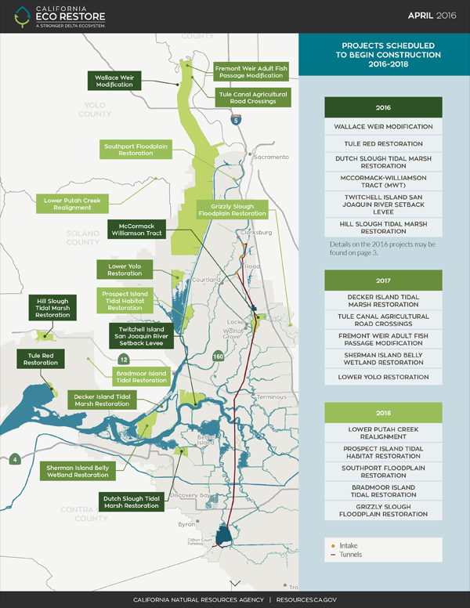

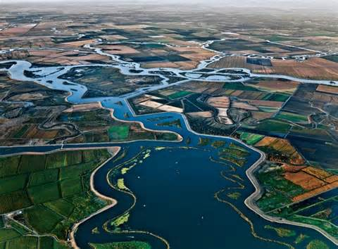
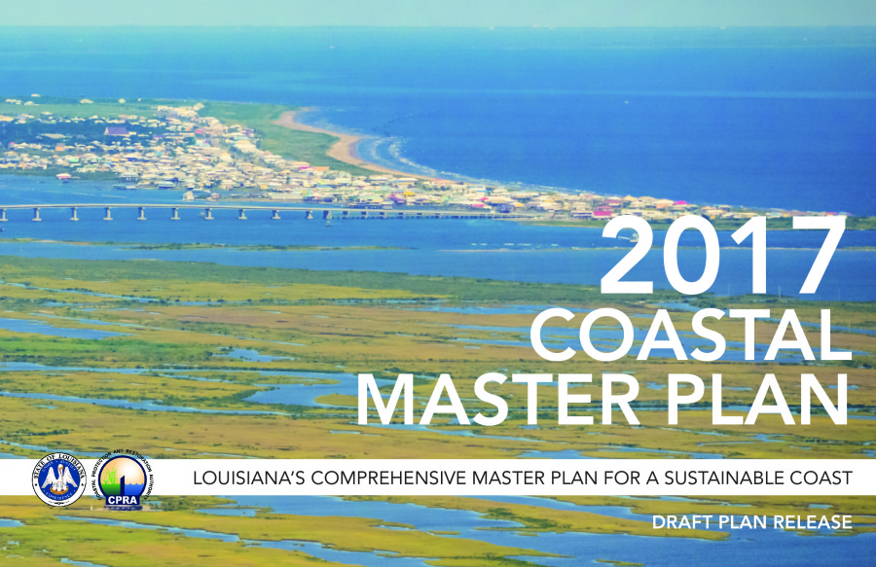
(4) Chesapeake Bay is unique! False

Slide 28
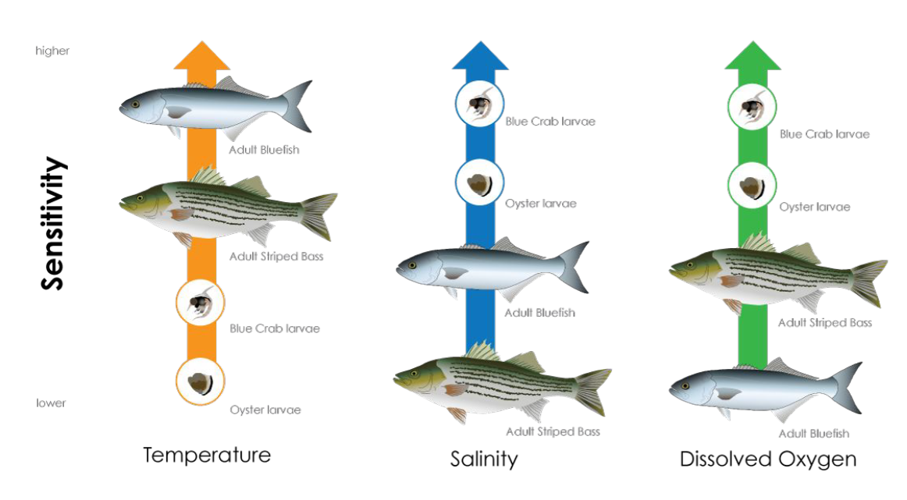
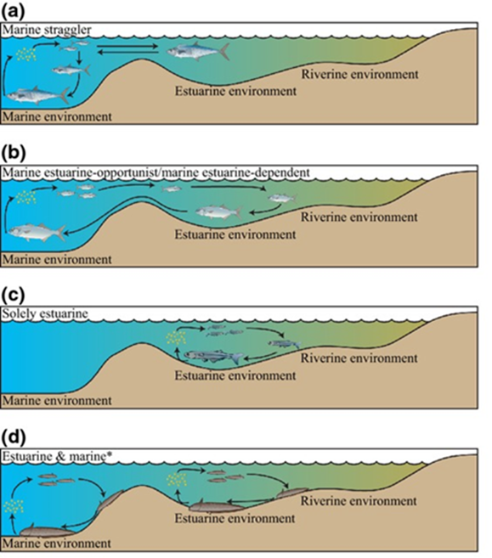
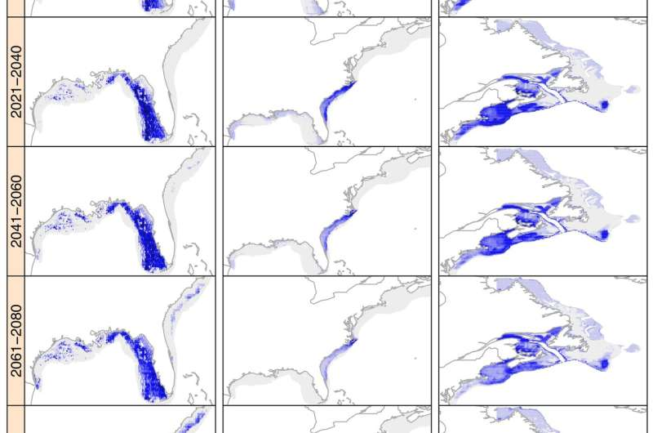
(5) A universal fish response! False
https://phys.org/news/2018-05-climate-shift-fish-species-north.html

Slide 29
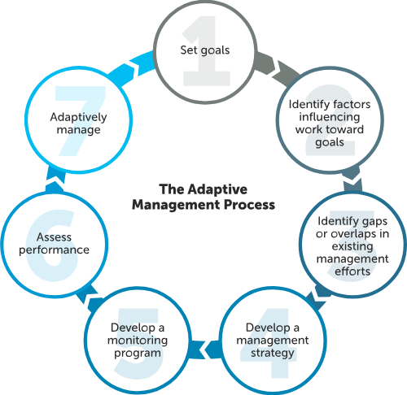
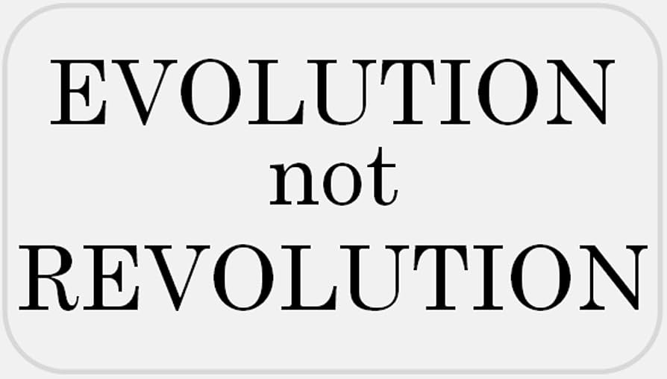
(6) CESR said to abandon the deep
trench, TMDL, etc.! False
https://www.chesapeakebay.net/what/what-guides-us/decisions

Slide 30
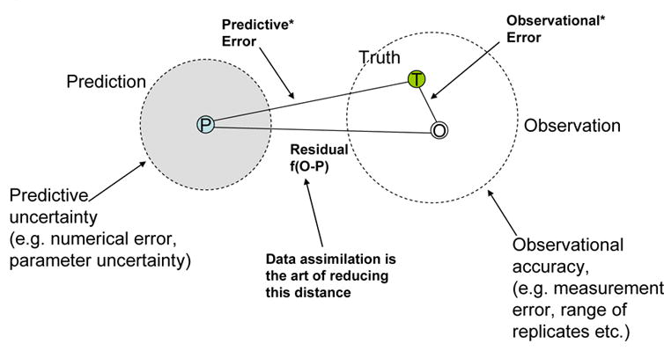
(7) Data are truth! False
Stow et al. 2009

Slide 31
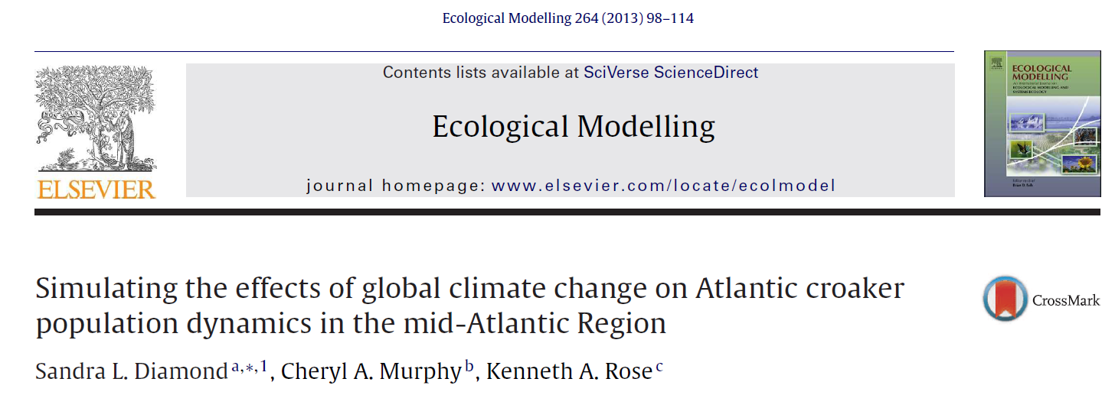
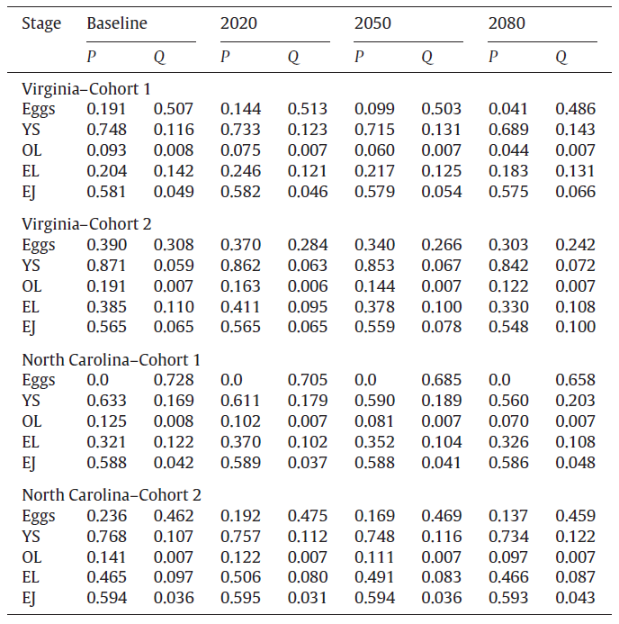
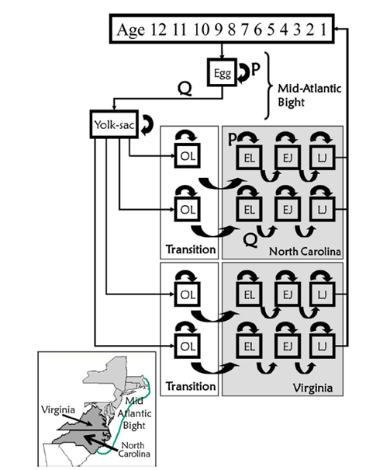

Slide 32
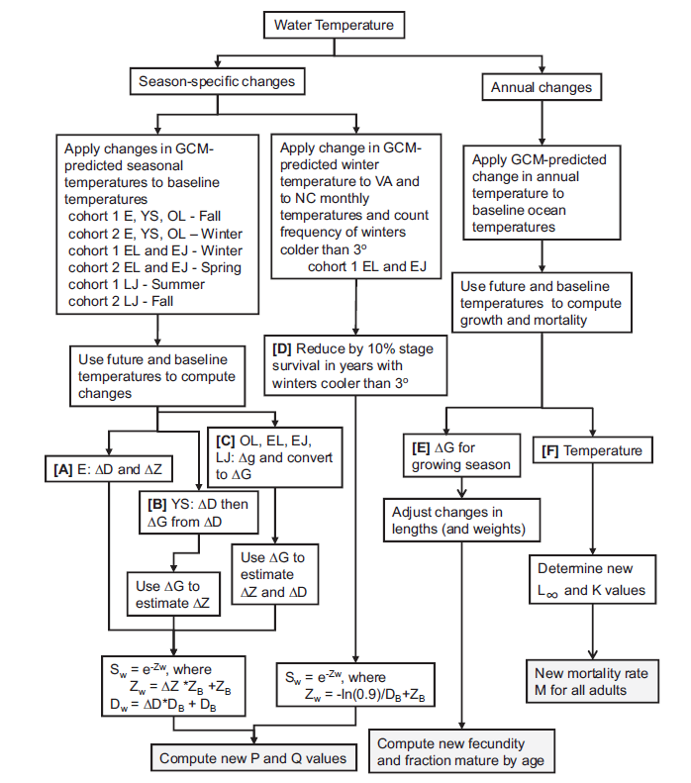

Slide 33
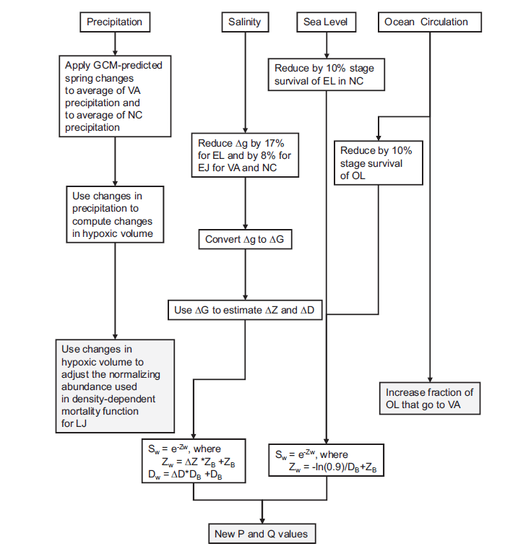

Slide 34
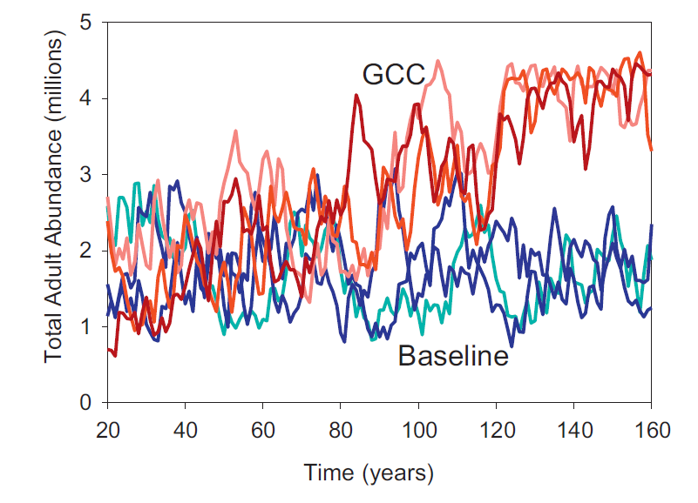

Slide 35
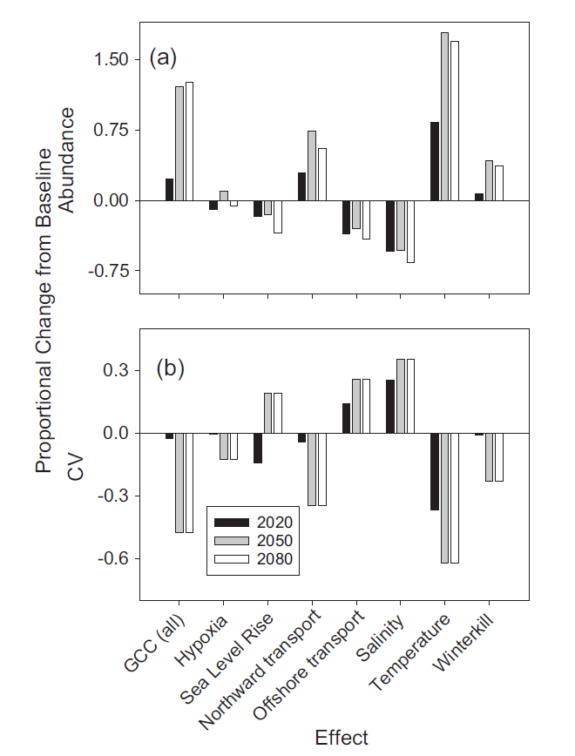

Slide 36
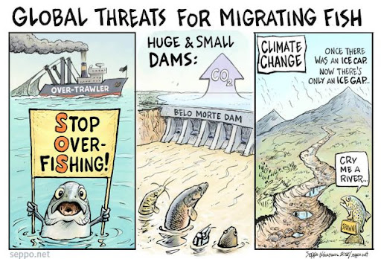

Slide 37
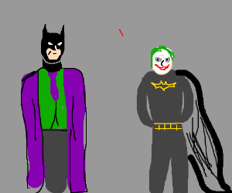
This Workshop: Reverse the Situation
https://drawception.com/game/CLL92bSp5m/batman-and-joker-swap-roles/

Slide 38
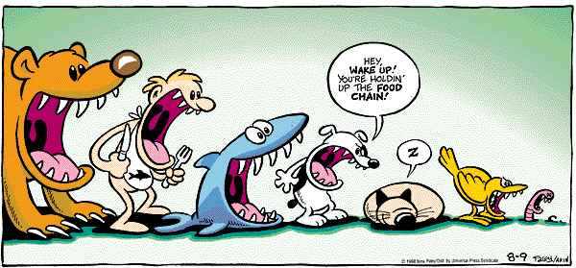
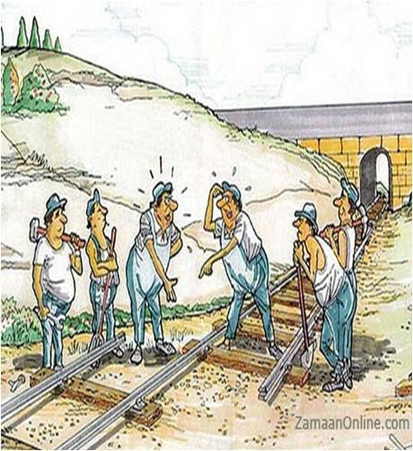
Challenge: Thought Experiment
http://be-sciencetaskcards.weebly.com/digital-task-card-3.html

Slide 40

https://stock.adobe.com/search?k=train+station+cartoon

Slide 42
A typical thermal performance curve (TPC) for relative performance (fitness or a proximate
biological rate; black line) as a function of environmental temperature (equation (2.1)). T_{opt} marks
the temperature at which performance is greatest and T_{max} marks the critical transition to negative
values at high temperatures. Owing to the nonlinearity of this curve, species that experience temporal
variation in temperature will have a mean long-term performance 〈w〉 that differs from the value
predicted by the mean of their environment (owing to Jensen's inequality). The distribution of instantaneous
performance and long-term performance means are shown for nominal ‘cold’ and ‘warm’ temperature
distributions (b,e), distributions with increased variance (c,f) and distributions with positive skewness (d,g).
In ‘cold’ conditions, increasing the variance leads to an increase in long-term performance, whereas
positive skewness has little effect. In ‘warm’ conditions, increasing variances and positive skewness both
lead to reductions in long-term performance.
The mean temperatures of ‘cold’ and ‘warm’ distributions are equal [17,24] across (b)–(d); variance is equal for (b) and (d).

