Slide 1
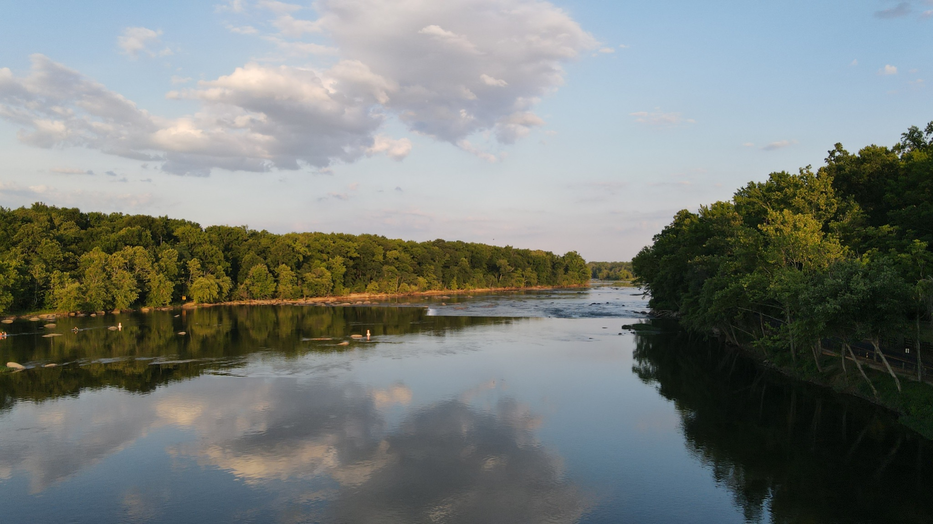

Achieving Water Quality Goals in the Chesapeake Bay:
Comprehensive Evaluation of System Response (CESR)
Kurt Stephenson (VT) and Denice Wardrop (CRC)
July 21, 2023
Presentation to Principals’ Staff Committee

Slide 2
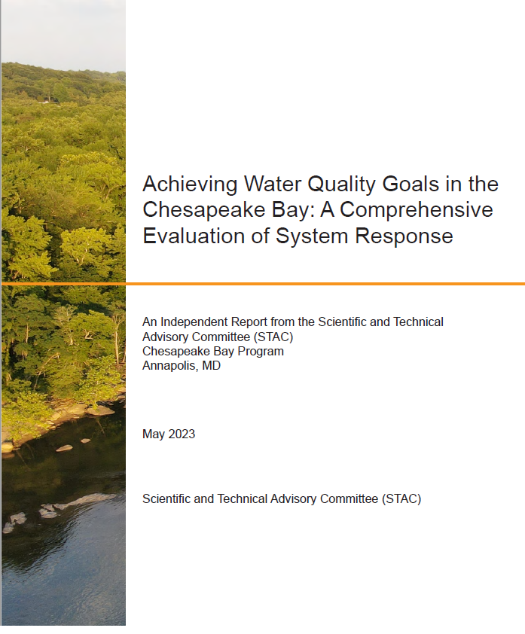
CESR Report
Self-initiated
Inclusive of STAC Membership
  Multiple levels of internal and agency review
  Over 50 contributors with unanimous STAC inclusion
  Main report (Co-editors and Steering Committee) plus 3 “Resource Documents”

Slide 3
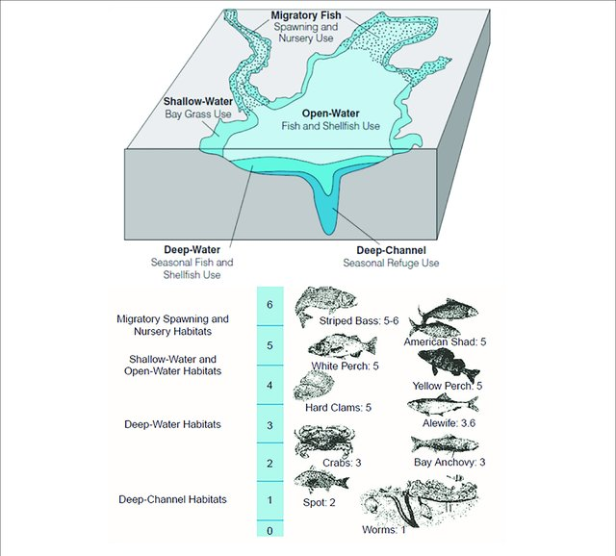
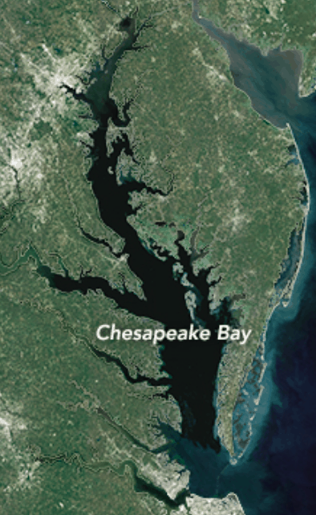
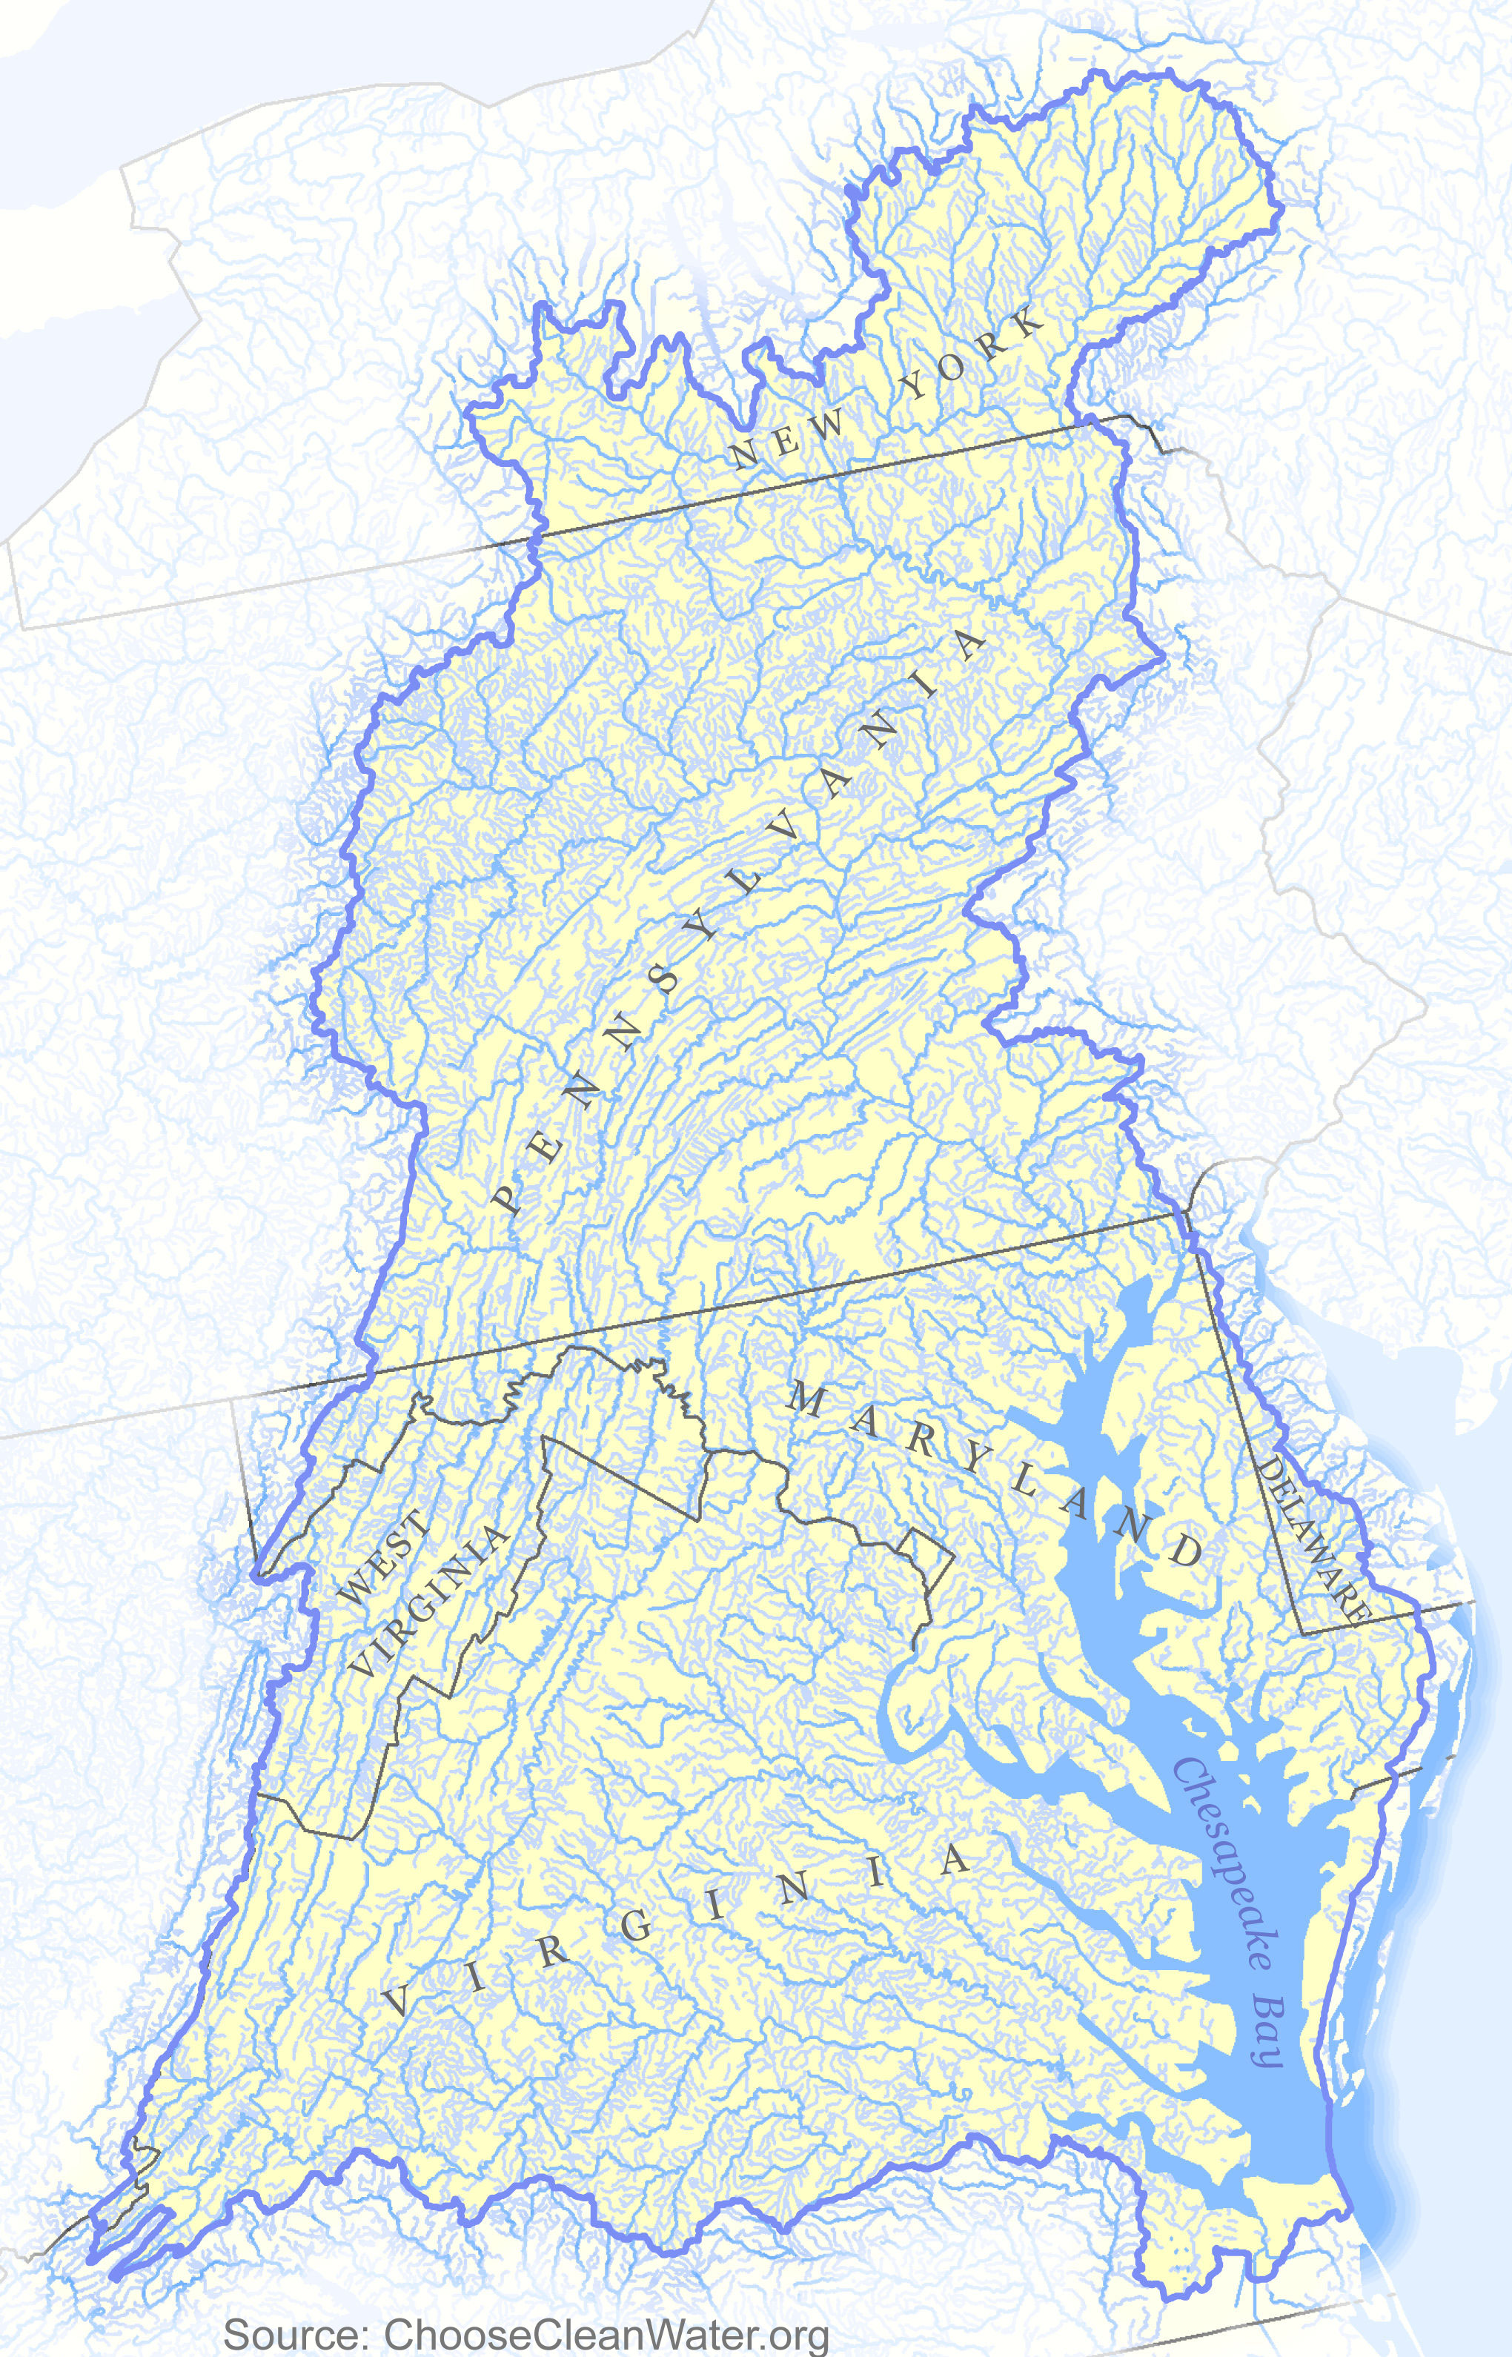
Public Policy
Chesapeake Bay Agreement: Restoration Goals
Sustainable Fisheries
Vital Habitat
Water Quality
Toxic Contaminants
Heathy Watershed
Climate Resiliency
Land Conservation
Stewardship
Public Access
Environmental Literacy
Water Quality Standards
TMDL: Stressor Reduction Goals
Targets: Nitrogen, phosphorus, sediment
TN: 214.6 m/lbs/yr
TP: 13.4m lb/yr
TSS: 18,587m lb/yr
Implementation Policies
Designated Uses
Federal permitting
Fed/State nonpoint programs
Funding
Water Quality Criteria
Dissolved Oxygen, Water clarity/SAV,
& Chl-a
across 5 habitats
TMDL accounting & accountability
Biological, Physical, and Social System Response
Living Resource Response
How are living resources responding to changing water quality conditions?
Achieving Water Quality Standards
Are nutrient & sediment reductions producing expected water quality response?
Achieving TMDL
Are implementation policies and management actions sufficient to achieve nitrogen, phosphorus and sediment goals in the TMDL?

Slide 4
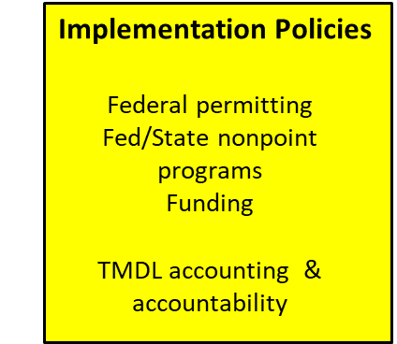
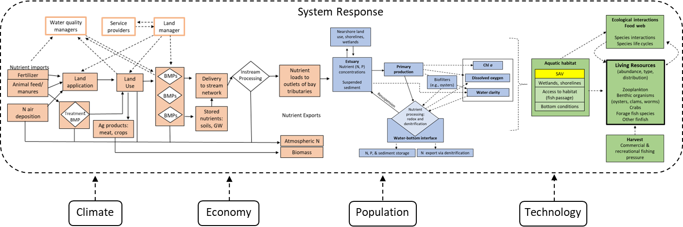
System Response to Meeting Bay Water Quality Standards
Designated Use
WQ Criteria & Assessment
SAV
wetlands, shorelines
Access to habitat
(fish passage)
Bottom conditions
External Factors

Slide 5
Summary of CESR Findings and Implications
Living Resource Response
Achieving Water Quality Standards
Achieving TMDL
Finding: The impact of WQ improvements on living resources depends on where WQ improvements occur and antecedent conditions; impact varies across species.
Implication: Potential to increase the living resource response to our WQ and restoration investments.
Finding: Bay water quality is improving, but the magnitude of the improvement appears to be lagging behind expectations
Implication: Water quality criteria may be unattainable in some regions of the bay under existing technologies
Finding: Nonpoint source programs are not generating the scale of reductions needed to achieve TMDL
Implication: Substantial improvement in nonpoint source outcomes will require new programs and approaches
Overarching Finding: Challenging problem with tradeoffs, uncertain outcomes, and no single “silver bullet” answer
Overarching Implication: Recognize tradeoffs and uncertain outcomes, accelerate innovation, and learn

Slide 6
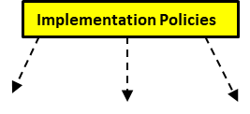
Achieving TMDL:
Findings and Implications

Slide 7
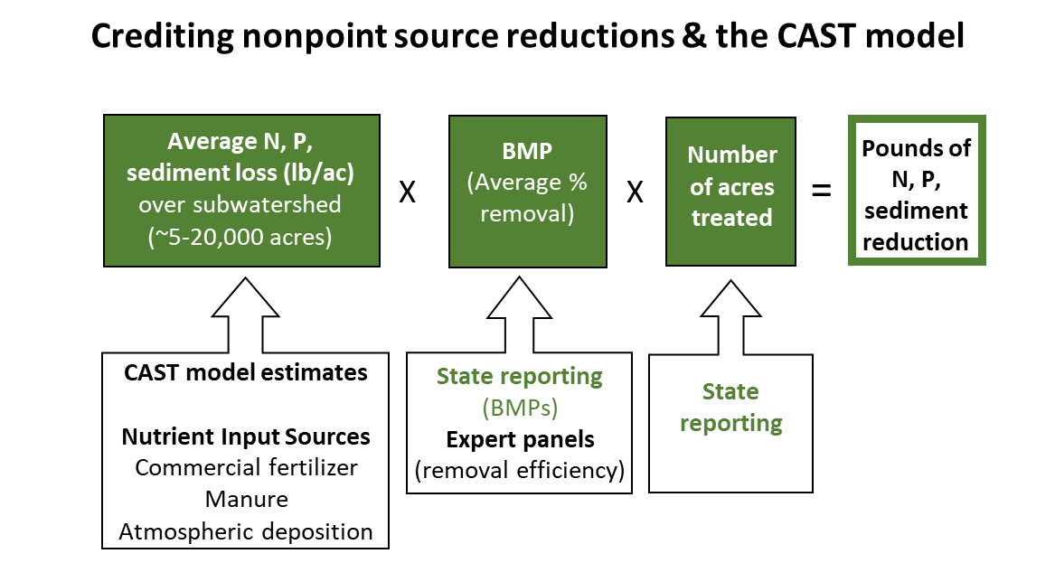
Nonpoint Source Implementation Policy
Voluntary Financial Assistance: Cost-Share
Offer $ based on portion of installation cost of a practice
$
Land Manager
Cost
BMP

Slide 8
Finding:
Nonpoint source programs are not generating the scale of reductions needed to achieve TMDL
Two Challenges
1) Nonpoint source programs are not generating sufficient levels of adoption/behavior change
2) The actions/practices being implemented may not be as effective as expected in producing pollutant reductions

Slide 9
Nonpoint source programs are not generating a sufficient level of implementation
Controllable N Loads to the Chesapeake Bay, 2021
(estimated by CAST Model)
Total nonpoint source reduction achieved from 2009-2021
Urban
Millions of lbs/yr
Ag
+50 million lb/yr N reduction needed

Slide 10
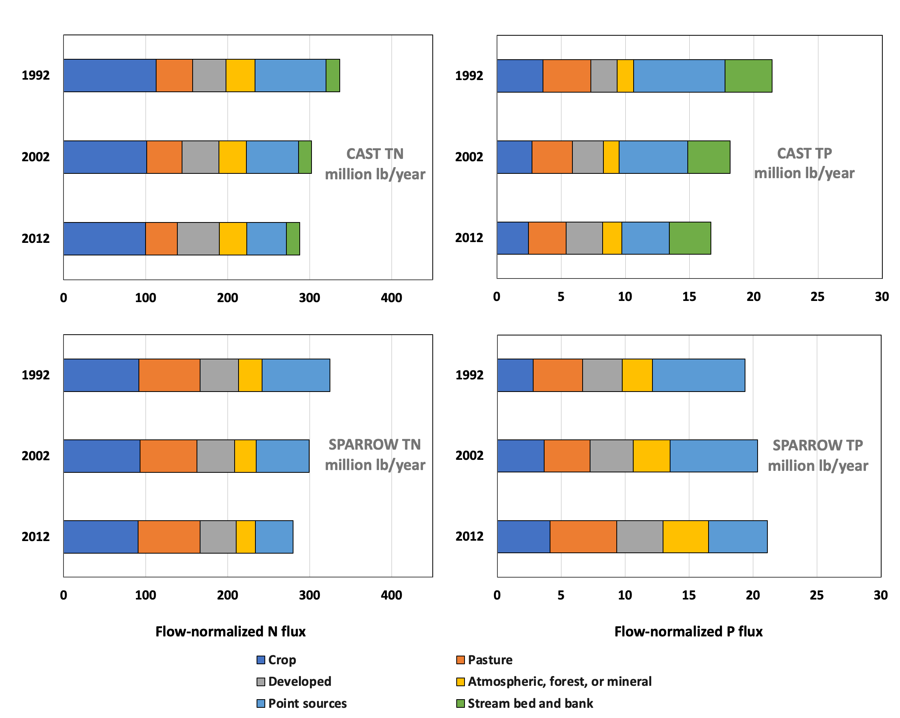
Nitrogen
Phosphorus
Nonpoint sources
Nonpoint source programs may not be as effective as expected
Estimated flow-normalized total and source sector TN and TP fluxes to the Chesapeake Bay for the CAST and SPARROW models
Ator et al. 2020
Notes:
The nonpoint source challenge
NPS control efforts (BMPs) are effective, but response has not (yet) been detected
i) Legacy Nutrients and Lag Times Mask BMP effectiveness
ii) NPS BMPs and NPS policies are not as effective as predicted
a) BMP Performance Effectiveness Estimates
b) Spatial distribution of BMPs with respect to pollutant sources
c) Uncertainty both in behavioral response to nonpoint source control measures and in BMP effectiveness

Slide 11


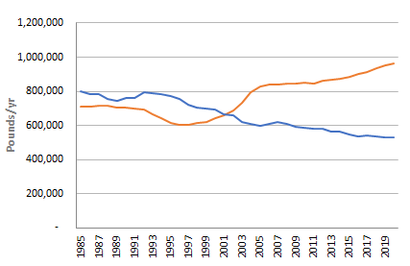
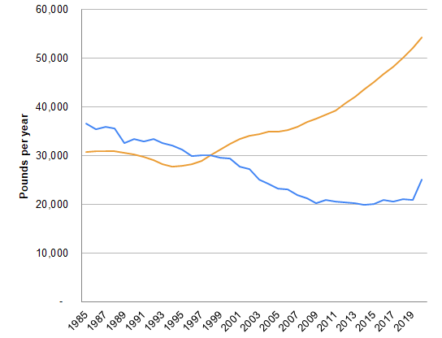
Difference between expected and observed outcomes
Flow normalized Load
Flow normalized Load
Response gap
CAST
CAST
Notes:
There is a disconnect….
Many in the CBP believe that CAST under credits BMPs. Adding more BMPs to CAST will only make the response gap larger… Adding more BMPs to CAST will make it easier on paper to meet TMDL and further from achieving outcomes in the real world.

Slide 12
Implications:
To substantially improve nonpoint source outcomes will require new programs and approaches
Ideas to improve nonpoint source program effectiveness

Slide 13
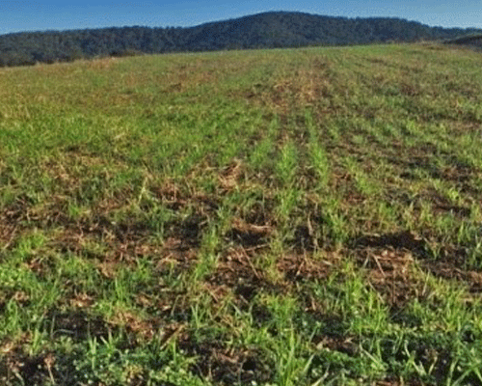
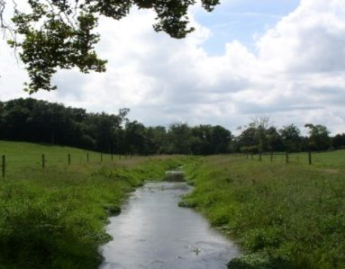
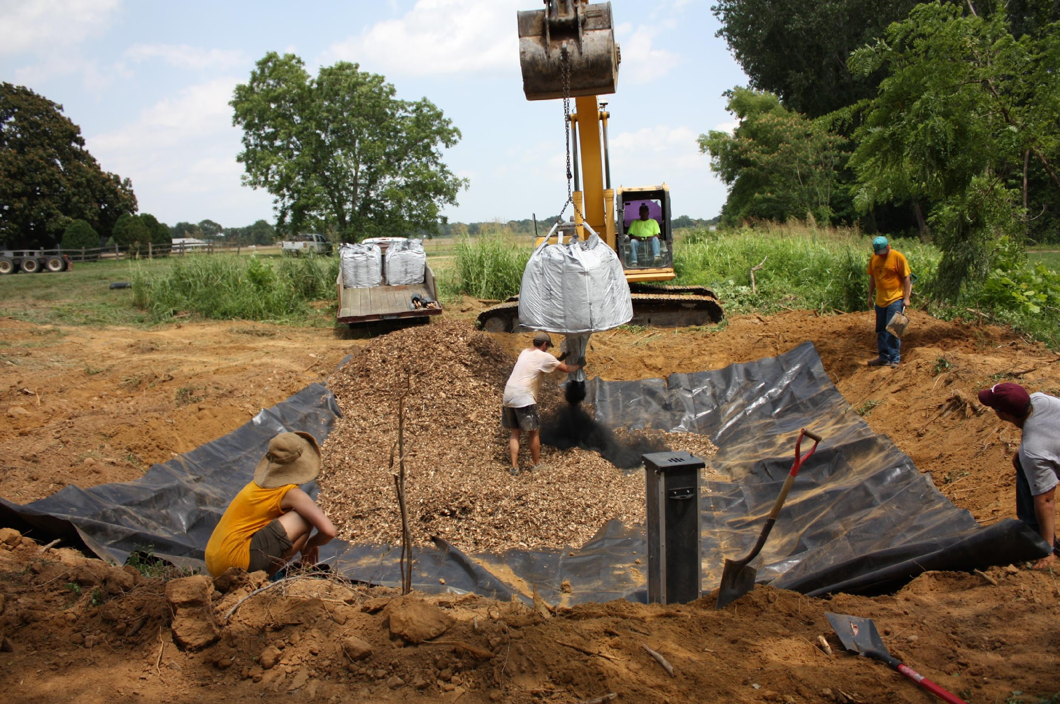
Incentivize Outcomes
Cover crops
Livestock Exclusion Fencing
Denitrifying Bioreactor
Low upfront installation costs
Private benefits
High up front installation costs
No private benefits
Under voluntary cost-share programs, adoption rates fall from left to right
Which is the most cost-effective ($/lb) at reducing pollutants?
Which practice provides most assurances of delivering reductions?

Slide 14
Incentive Programs
Voluntary Financial Assistance: Cost-Share
Offer $ based on portion of installation cost of a practice
$
Land Manager
Cost
BMP
Payment for outcomes/success
Offer $ based on producing an outcome
Revenue $
Land Manager
Cost
Behavior change
Outcome

Slide 15
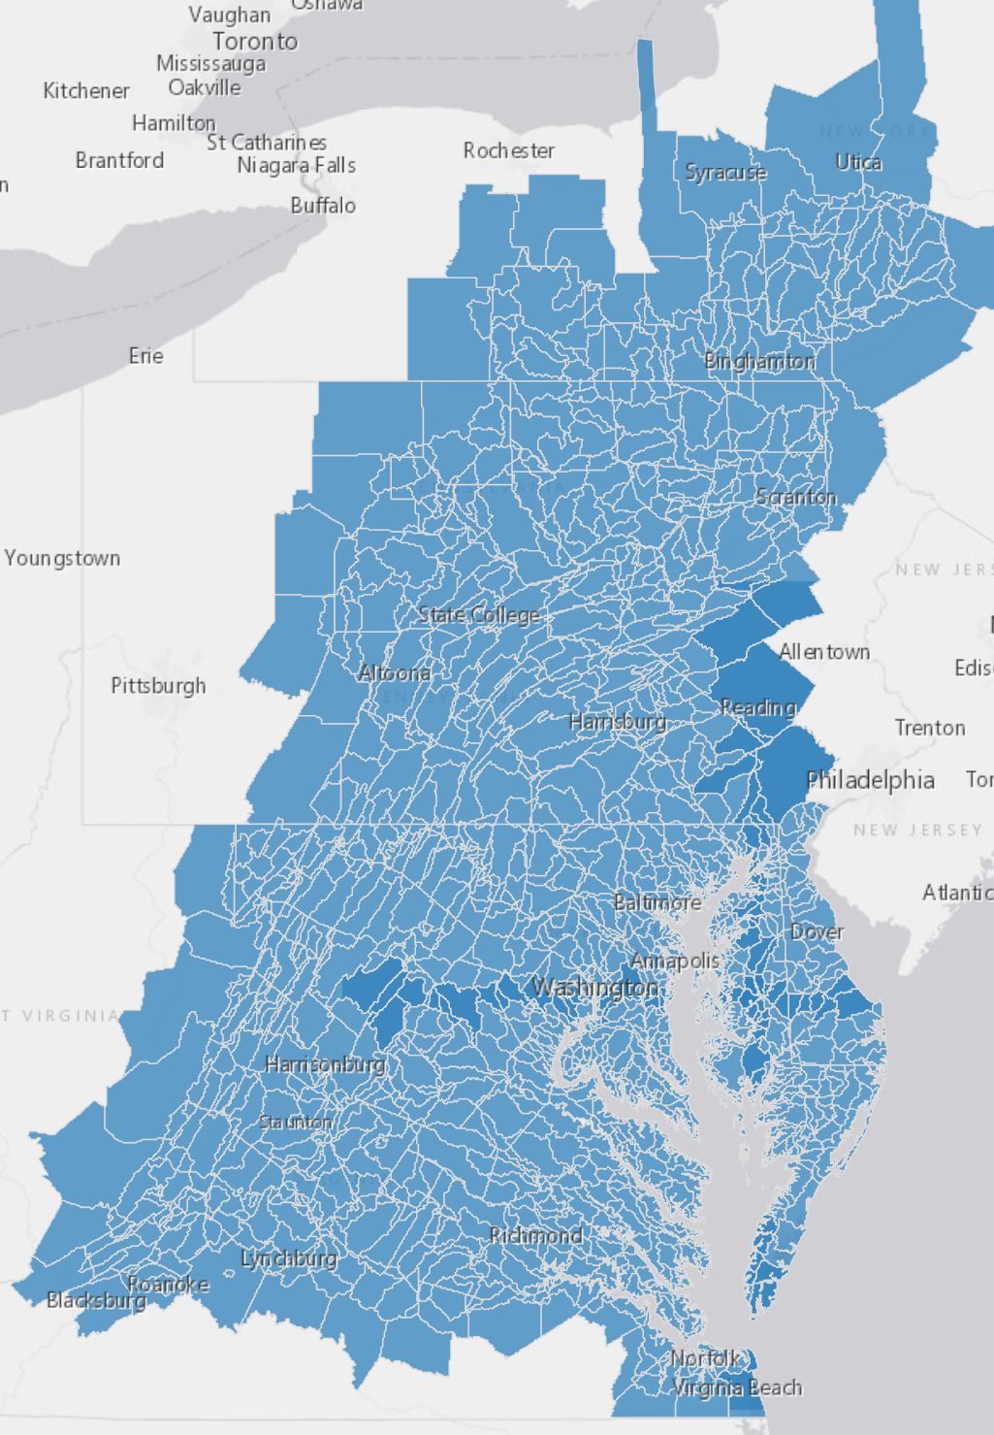
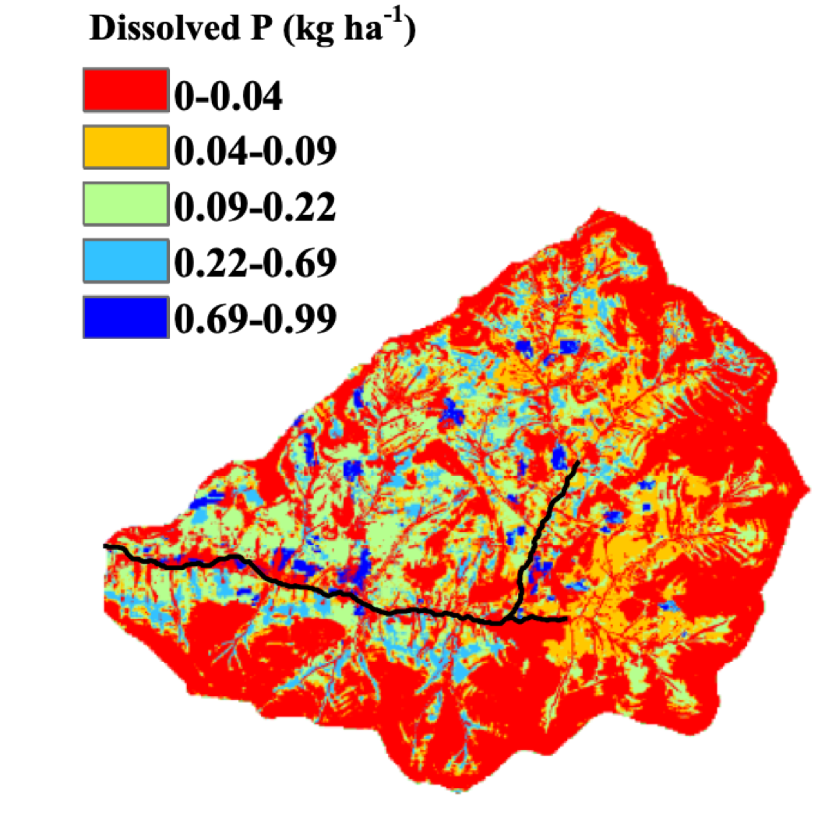
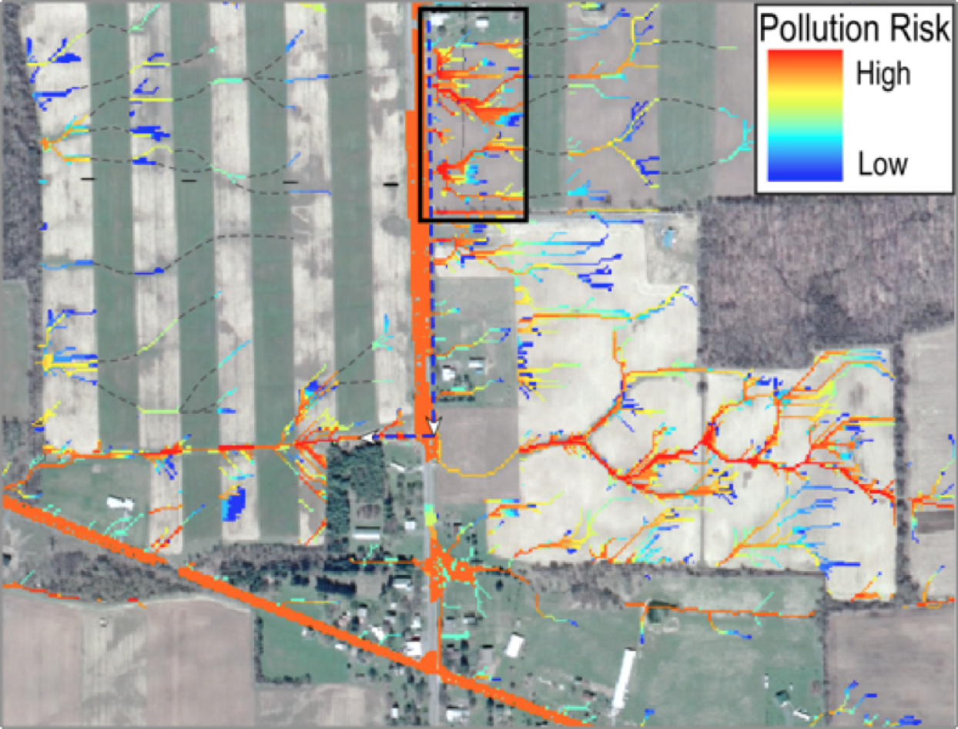
Basin
9,000 acre sub-watershed
Improve tools and incentives for targeting
Nutrient loads are highly variable across the landscape across multiple scales and across land managers).
Our accounting and incentive systems only provide limited opportunity to target.
Total phosphorus balance across 58 dairy farms in Shenandoah Valley Virginia, 2018
25 acre parcel
Quartile | Total P balance (kg/ha)
Minimum | -30.9
1st Quartile | 1.5
Median | 12.4
3rd Quartile | 18.7
Maximum | 97.6
(Source: Pearce & Maguire 2020)
Notes:
Studies suggest 5-20% of the land area generates 50-90% or more of runoff and nonpoint source loads
Within fields, nutrient losses may be confined to relatively small areas that with the correct targeting and incentives may be easily treated.
Others have found that targeting BMPs to sites with higher pollution potential can improve cost effectiveness of pollution reduction efforts

Slide 16
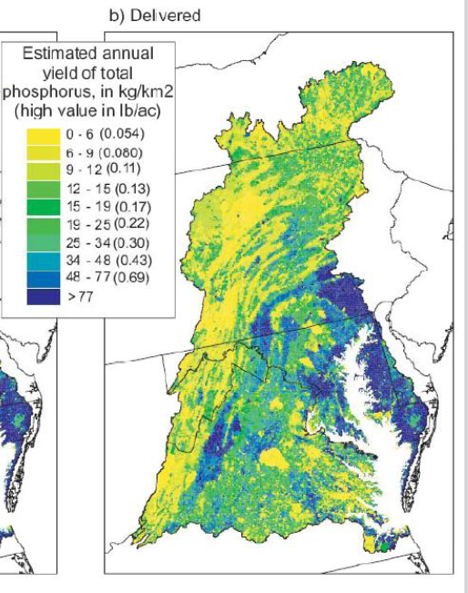
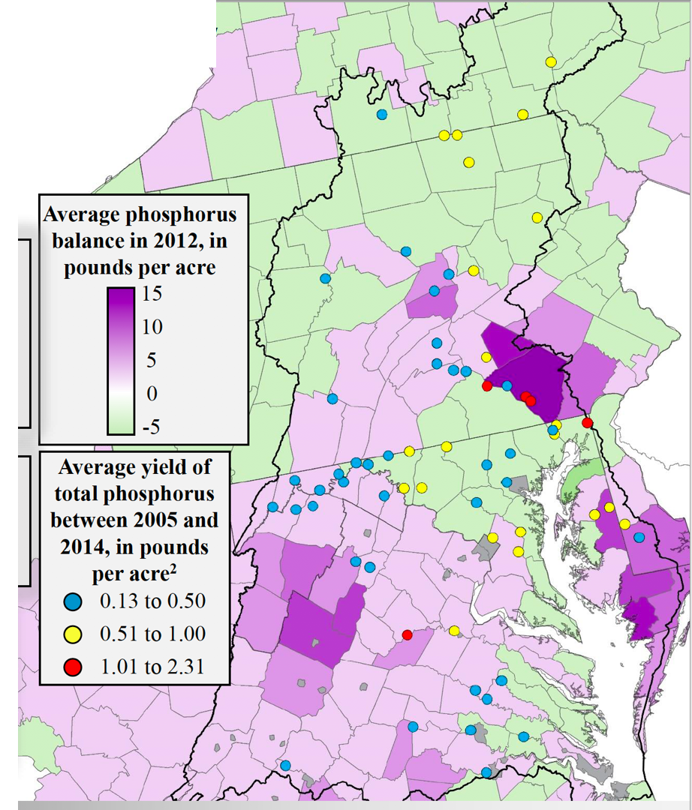
Improve efforts to address mass balance
Source: USGS Sparrow Model Output
Moyer et al. 2017, Webber, 2017

Slide 17
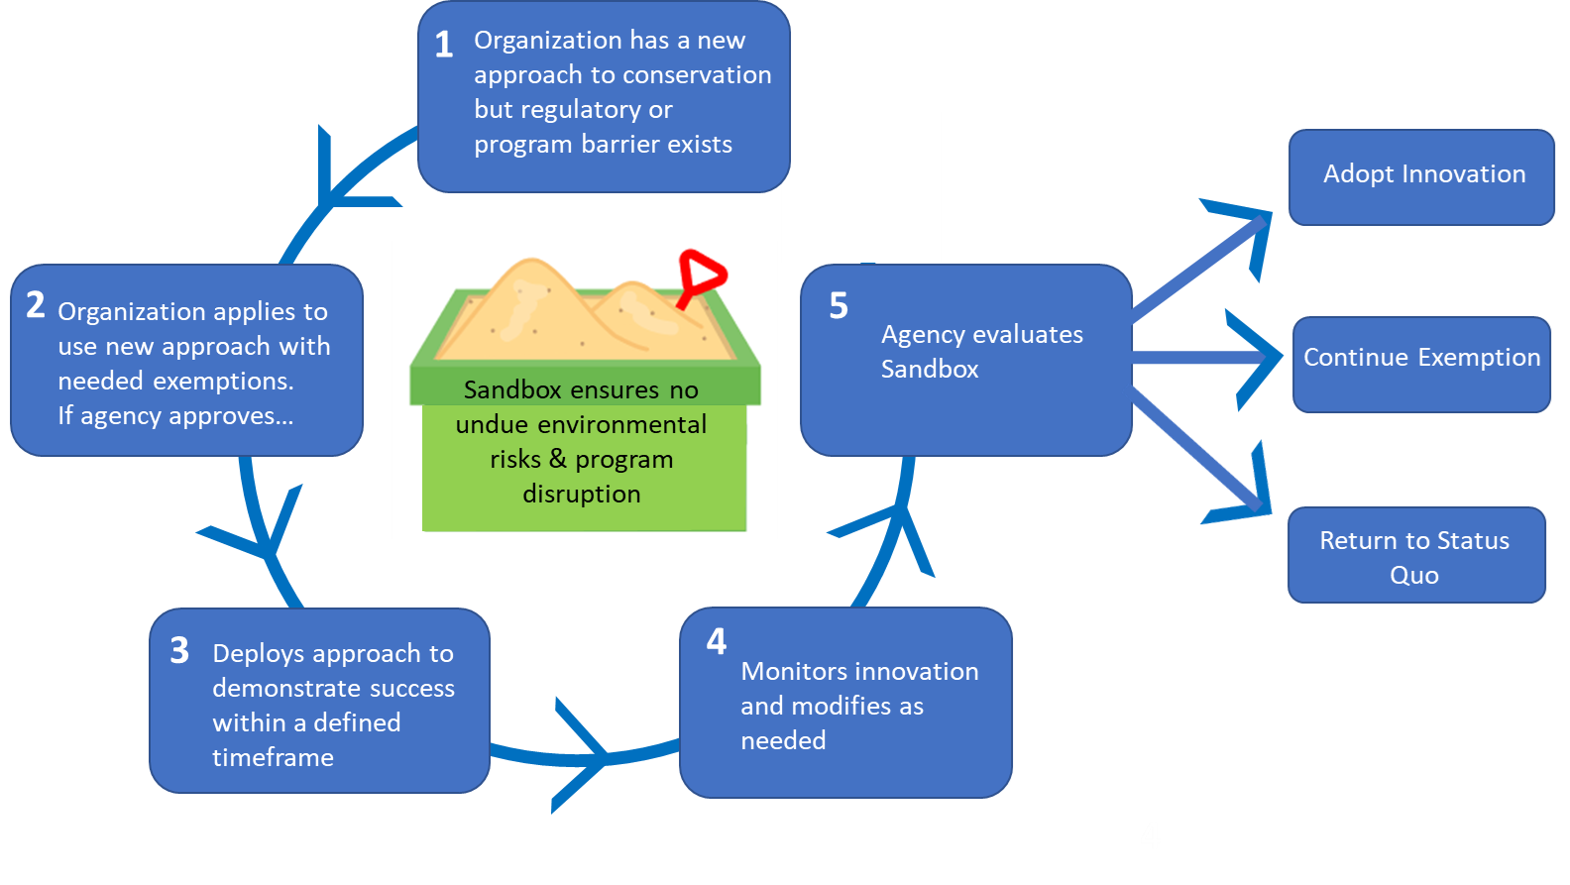
Encourage Institutional/policy Innovation
Sandboxing
Ideas for what to “Sandbox”
TMDL accounting & accountability (alternative to CAST)
Types of outcome-based incentive programs
The Sandboxing Process (Figure adapted from Higgins and Male, 2019)

Slide 18
Achieving Water Quality Standards:
Finding: Bay water quality is improving, but the magnitude of the improvement appears to be lagging behind expectations

Slide 19
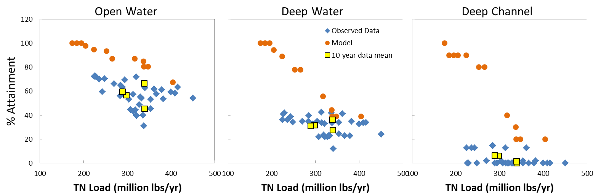
Finding: DO Response across Habitats
Response gap
Response gap
Expected and realized relationships between TN loads and DO criteria attainment for open water, deep water, and deep channel habitat, calculated as 3-year running mean observed values (blue diamonds) and expected responses from estuary model (orange dots) for the same time periods. Yellow squares are 10-year means of the observed data.
Notes:
Explain orange dots
Blue dots and yellow squares are observed response
Blue dots improve as loads decrease in open waters… not as much in deep waters.
Response gap between two in all habitats, particularly large in deep water habitats
Shallow water is missing…No expected response.

Slide 20
Why response gaps?
Climate change (ex. warming waters)
“Tipping points”
Notes:
.

Slide 21
Achieving Water Quality Standards:
Costs of Achieving TMDL and Water Quality Criteria
Implementation Cost
(w response gaps)
Implementation Cost (expectations)
Costs to meet WQS ($)
Implication: Water quality criteria may be unattainable in some regions of the bay under existing technology
Full Attainment
20% 40% 60% 80% 100%
% Achievement of Water Quality Standard

Slide 22
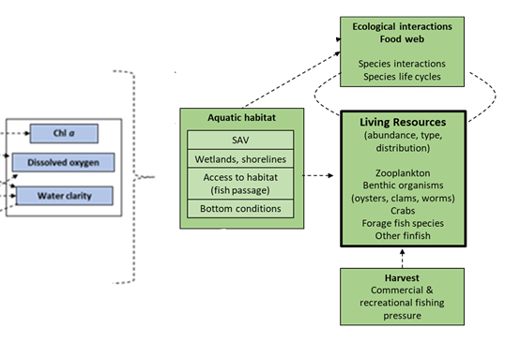
Living Resource Response

Slide 23
Living Resource Response
Living resource response to attainment of water quality standards
Finding: The impact of WQ improvements on living resources depends on where WQ improvements occur and antecedent conditions; impact varies across species.
Indicator of living resource abundance
Full attainment
20% 40% 60% 80% 100%
% Attainment of WQS

Slide 24
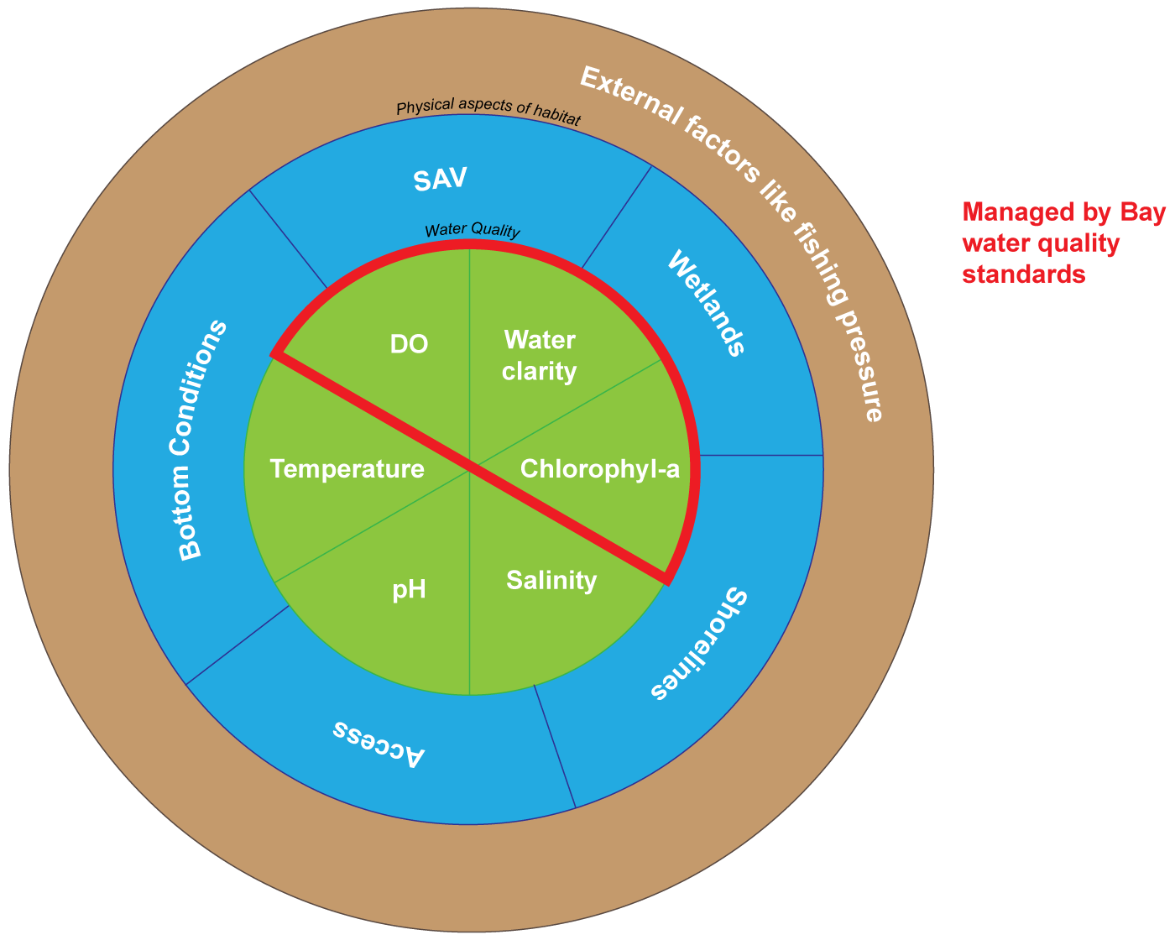
Living Resource Response
Findings: The impact of WQ improvements on living resources depends on where WQ improvements occurs, antecedent conditions, & impact varies across species.

Slide 25
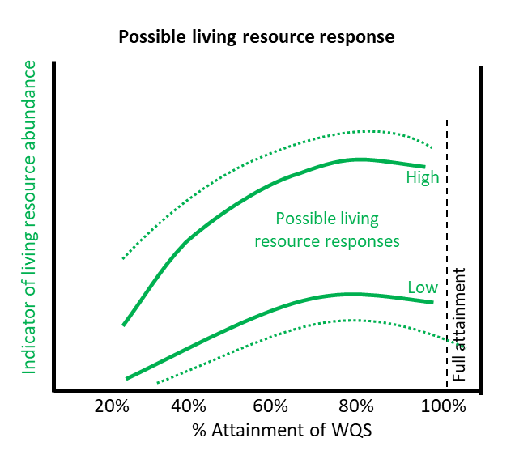
Living Resource Response
Implication: Potential to increase the living resource response to our WQ and restoration investments.

Slide 26
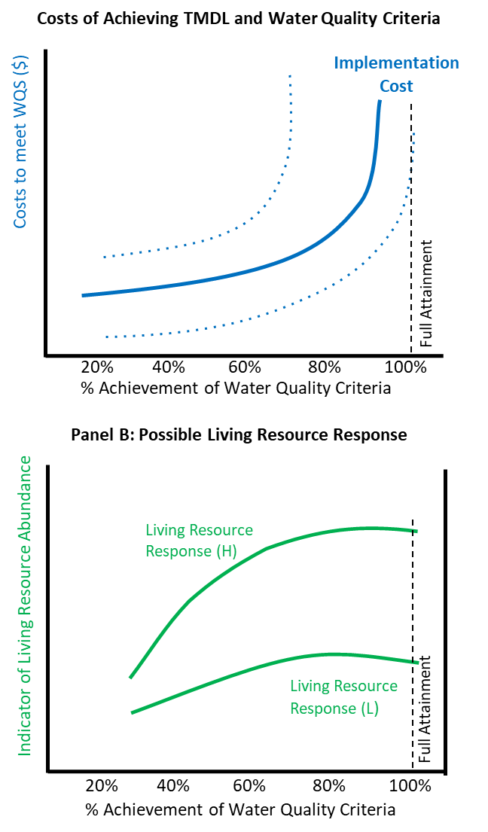
Implications
Tradeoffs & Uncertainties
Full attainment may not be necessary to improve and support living resources goals
Notes:
Gaps are shifting the cost of attainment curve
Costs expected to increase rapidly
May never intersect full attainment.

