Slide 1
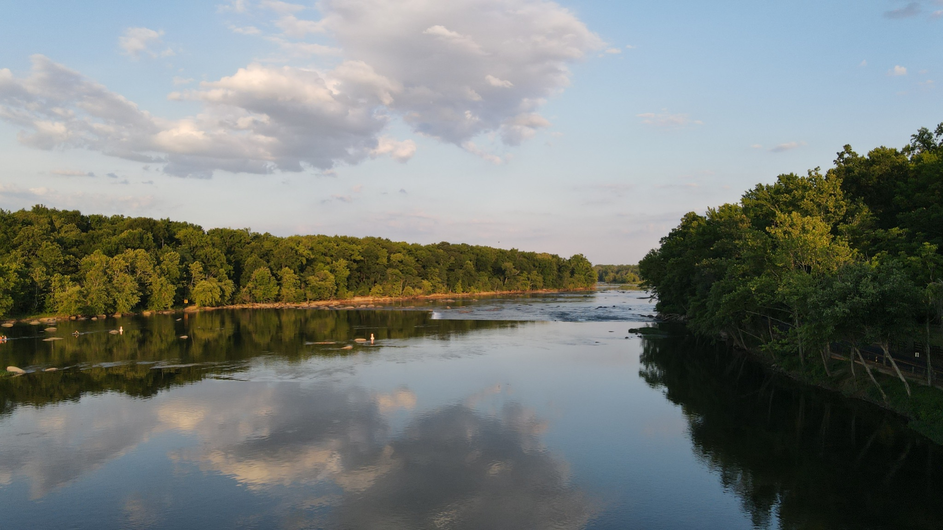

Comprehensive Evaluation of Chesapeake Bay Response to Water Quality Efforts: Gaps, Uncertainties, and Policy Implications
Dept of Geography & Environmental Systems Seminar
UMBC
Kurt Stephenson & Denice Wardrop
May 3, 2023

Slide 2
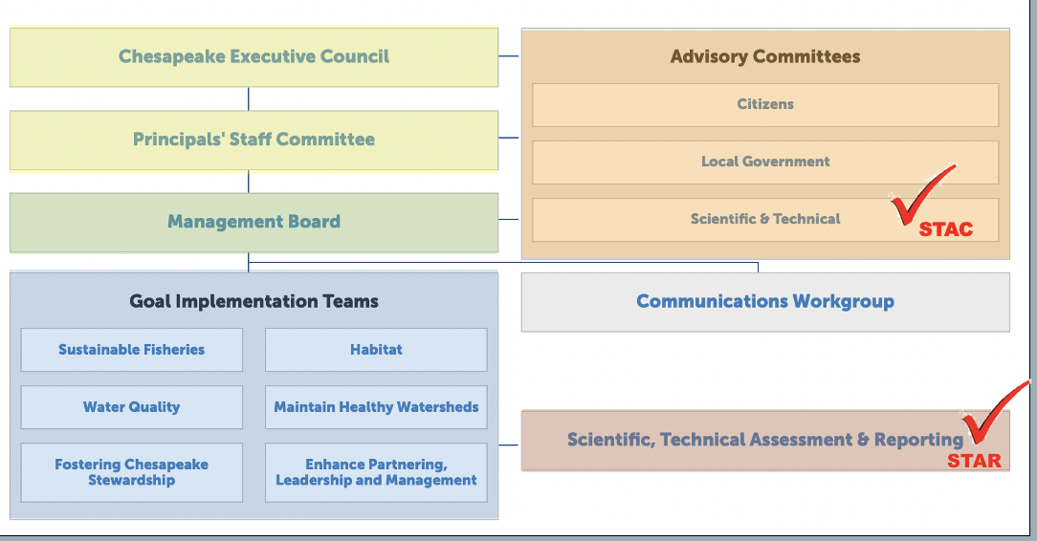
ad·vice noun guidance or recommendations offered with regard to prudent future action.
What is the job of an advisory committee?
38 experts from various research, academic, federal, and private institutions in the watershed
Provides advice
Transdisciplinary, able to synthesize, independent, consensus

Slide 3
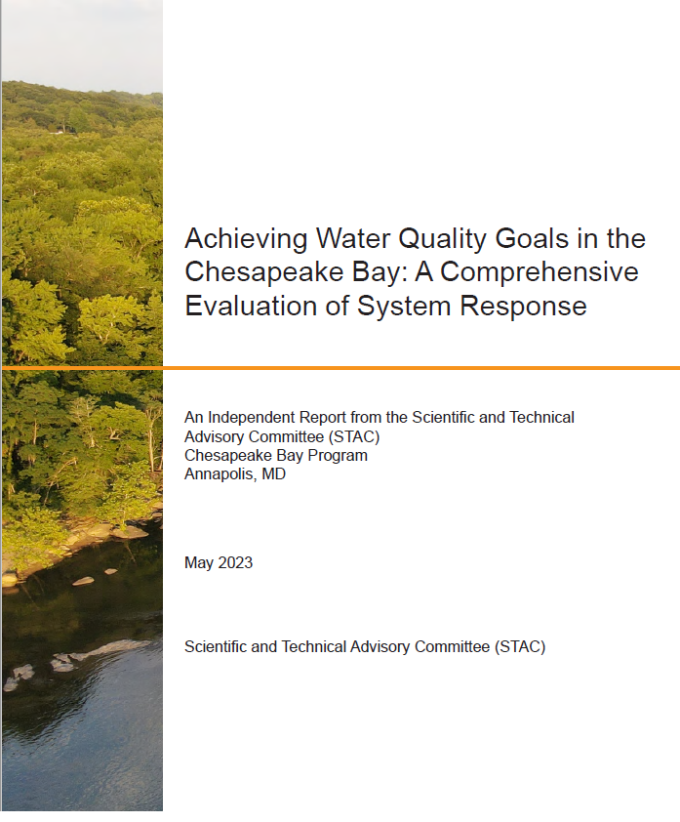
“CESR” Report
Joint STAC effort (2019-2023)
Inclusive of STAC Membership
Census-based process
Synthesis
  Multiple levels of review

Slide 4
Report Editors
Kurt Stephenson, Virginia Tech
Denice Wardrop, CRC & Penn State
Steering Committee
Brian Benham, Virginia Tech
Anthony Buda, USDA, ARS
Bill Dennison, UMCES
Zachary Easton, Virginia Tech
Ellen Gilinsky, Ellen Gilinsky LLC
Andy Miller, UMBC
Mark Monaco, NOAA
Kenny Rose, UMCES
Leonard Shabman, Resources for the Future
Kurt Stephenson, Virginia Tech
Jeremy Testa, UMCES

Slide 5
CESR Related Documents
Easton, Z., Stephenson, K., Benham, B., Böhlke, J. K., Brosch, C., Buda, A., Collick, A., Fowler, L., Gilinsky, E., Hershner, C., Miller, A., Noe, G., Palm-Forster, L., & Thompson, T. (2023). Evaluation of watershed system response to nutrient and sediment policy and management. STAC Publication Number 23-003, Chesapeake Bay Program Scientific and Technical Advisory Committee (STAC), Edgewater, MD
Testa, J. M., Dennison, W. C., Ball, W. P., Boomer, K., Gibson, D. M., Linker, L., Runge, M. C., & Sanford, L. (2023). Knowledge gaps, uncertainties, and opportunities regarding the response of the Chesapeake Bay estuary to proposed TMDLs. STAC Publication Number 23-004, Chesapeake Bay Program Scientific and Technical Advisory Committee (STAC), Edgewater, MD.
Rose, K., Monaco, M. E., Ihde, T., Hubbart, J., Smith, E., Stauffer, J., & Havens, K. J. (2023). Proposed framework for analyzing water quality and habitat effects on the living resources of Chesapeake Bay. STAC Publication Number 23-005, Chesapeake Bay Program Scientific and Technical Advisory Committee (STAC), Edgewater, MD.

Slide 6
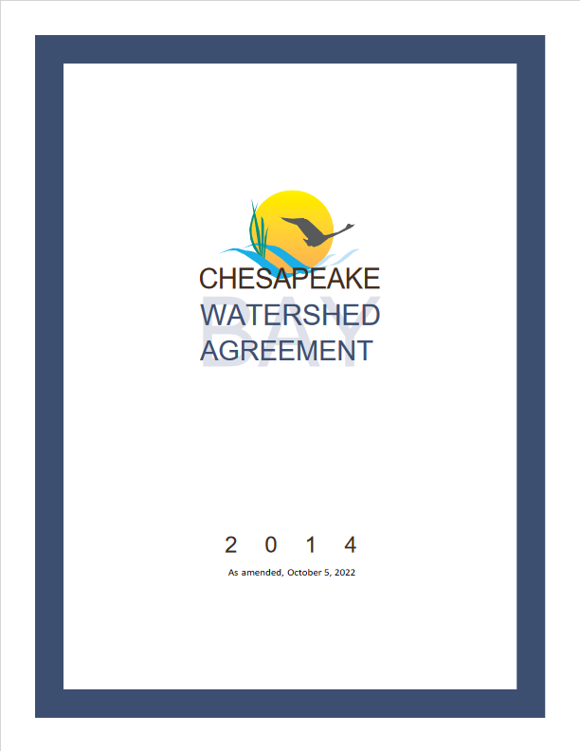
Focus of CESR
10 Goals
1. Sustainable Fisheries
2. Vital Habitats
3. Water Quality
4. Toxic Contaminants
5. Healthy Watersheds
6. Land Conservation
7. Stewardship
8. Public Access
9. Environmental Literacy
10. Climate Resiliency

Slide 7

First Chesapeake Bay Agreement, 1983
The one--page agreement acknowledged the “historical decline in the living resources of the Chesapeake Bay” and committed to addressing a major cause of the decline by pledging “to fully address the extent, complexity, and sources of pollutants entering the Bay.” Nitrogen and phosphorus were identified as the two key pollutants.
Notes:
Why this goal…. It has been the corner stone of the program
CBP turns 40 this year.
At its birth, water quality has been a central focus.
First bay agreement. 1 page. Only said a few things 1) noted the historical decline in Bay living resources. And 2) stated that a major reason for the decline was due to pollution, specifically excess nitrogen and phosphorus.
Years since: added numeric targets, brought those numeric targets under a legal framework and enforceable…
Remained Central to program (because history and legal setting tends to draw resources and people’s attention)

Slide 8
CESR: Why now?
1983
1st CBay
Agreement
2000
3rd CBay
Agreement
2009
CBay
TMDL
2014
4th CBay Agreement
2025
All pollution control measures needed to fully restore the Bay & its tidal rivers are in place
1987
2nd CBay Agreement
2003-4
Revision of water quality standards
Notes:
Why now?
We have been at this a long time
and have a major deadline approaching. .

Slide 9
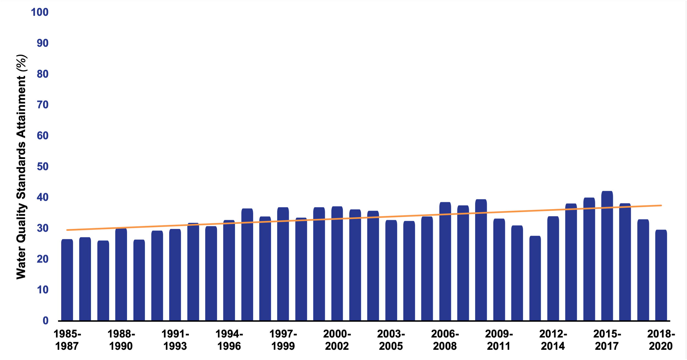
Objective of CESR
Why?
Notes:
Introduce graph
We see progress! Direction of change is correct. Upward trend in WQ attainment. Significant achievement. More people, more ag, more development, more animals, changing climate. WQ didn’t get worse.
CESR really focused on the magnitude of response, specifically why isn’t it larger? Afterall, of the 3 main pollutants, CB Program says we have achieved sediment goals, we are close on phosphorus, and we’ve made significant reductions in N, including reducing N loads by 100+ million pounds since 1985.

Slide 10
Approach of CESR

Slide 11
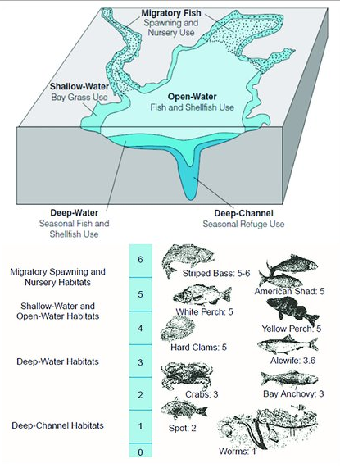
Public Policy
Chesapeake Bay Agreement: Restoration Goals
Sustainable Fisheries
Vital Habitat
Water Quality
Toxic Contaminants
Heathy Watershed
Climate Resiliency
Land Conservation
Stewardship
Public Access
Environmental Literacy
Water Quality Standards
TMDL: Stressor Reduction Goals
Targets: Nitrogen, phosphorus, sediment
TN: 214.6 m/lbs/yr
TP: 13.3m lb/yr
TSS: 18,587m lb/yr
Implementation Policies
Designated Uses
Federal permitting
Fed/State nonpoint programs
Funding
Water Quality Criteria
Dissolved Oxygen, Water clarity/SAV,
& Chl-a
across 5 habitats
TMDL accounting & accountability
Notes:
Speak to decreasing strength of connection to the TMDL as you go from watershed to estuary to LR. Also that ability to specify the blue line decreases in the same manner.

Slide 12
Public Policy
Chesapeake Bay Agreement: Restoration Goals
Sustainable Fisheries
Vital Habitat
Water Quality
Toxic Contaminants
Heathy Watershed
Climate Resiliency
Land Conservation
Stewardship
Public Access
Environmental Literacy
Water Quality Standards
TMDL: Stressor Reduction Goals
Targets: Nitrogen, phosphorus, sediment
TN: 214.6 m/lbs/yr
TP: 13.4m lb/yr
TSS: 18,587m lb/yr
Implementation Policies
Designated Uses
Federal permitting
Fed/State nonpoint programs
Funding
Water Quality Criteria
Dissolved Oxygen, Water clarity/SAV,
& Chl-a
across 5 habitats
TMDL accounting & accountability
Biological, Physical, and Social System Response
Living Resource Response to WQ
WQ Response to N,P and Sediment
N,P, and Sediment Response to Mgt
100% Achievement of WQC
Expected Response
100% Achievement of TMDL Goals
Expected Response
Nutrient/Sediment Reductions Achieved
% Achievement of WQ Criteria (ex DO)
Expected existing condition
Expected existing condition
Living Resource Abundance
% Achievement of WQ Criteria
Nutrient/Sediment Reductions
    Management Actions
(ex BMPs installed , land treated, etc)
Notes:
Our lane: the bottom graphics
The bottom three graphs form the basis/focus of the report.
Causal connections… Pollutant control, water quality, living resource response.
Walk through animation…. Management actions –expected response – Nutrient…

Slide 13
Gaps & Uncertainties
Biological, Physical, and Social System Response
Living Resource Response to WQ
WQ Response to N,P and Sediment
N,P, and Sediment Response to Mgt
100% Achievement of WQC
Expected Response
100% Achievement of TMDL Goals
Expected Response
Nutrient/Sediment Reductions Achieved
% Achievement of WQ Criteria (ex DO)
Expected existing condition
Possible Response (H)
Expected existing condition
Living Resource Abundance
Uncertainty
Uncertainty
Response Gap
Possible Response (L)
Response Gap
Possible Response
Possible Response
% Achievement of WQ Criteria
Nutrient/Sediment Reductions
Implementation Gap
    Management Actions
Notes:
Conceptual framing we use help identify and describe system response…Uncertainty, response gaps, implementation gaps.

Slide 14
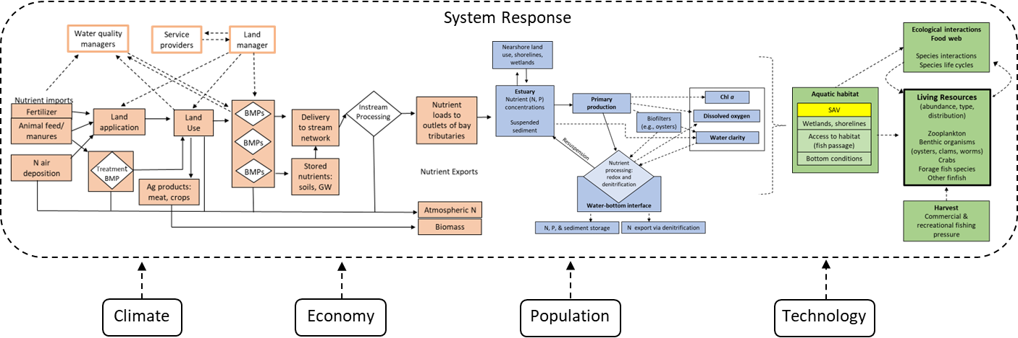
Approach to Evaluating System Response
Implementation Policies
WQ Assessment
SAV
wetlands, shorelines
Access to habitat
(fish passage)
Bottom conditions

Slide 15
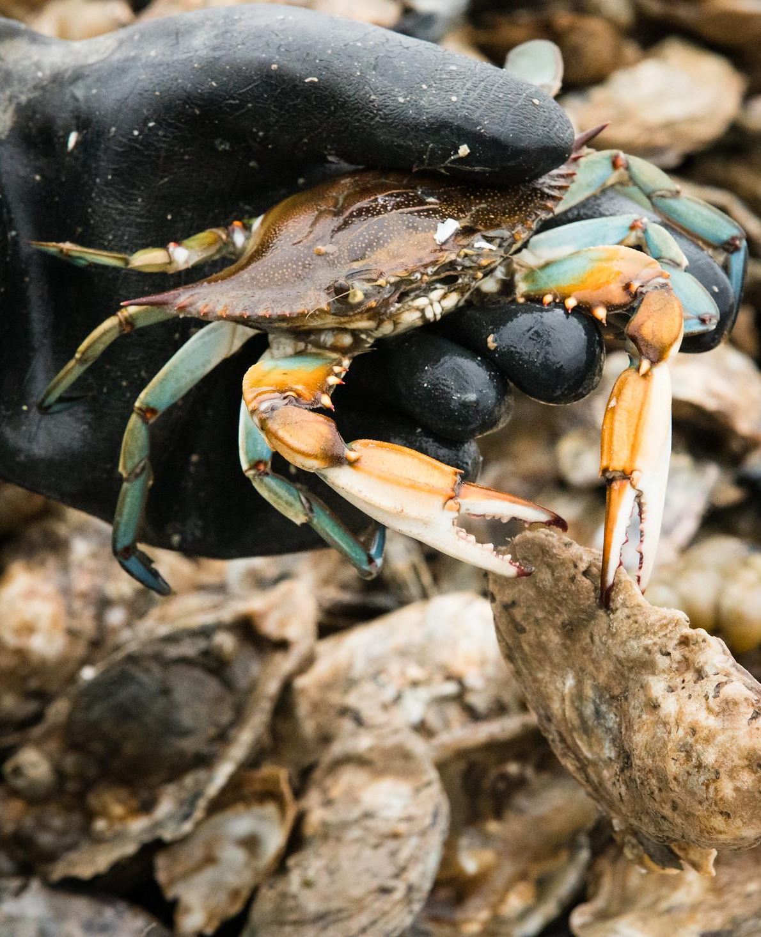
Gaps & uncertainties present major challenges to achieving water quality goals & improving living resource response.
There are opportunities to improve program effectiveness but will require change in thinking & approach.
CESR Conclusions
Photo by Will Parson/Chesapeake Bay Program

Slide 16
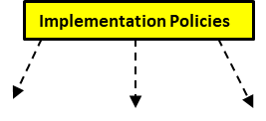
Findings and Implications:
Pollutant Response to Management

Slide 17
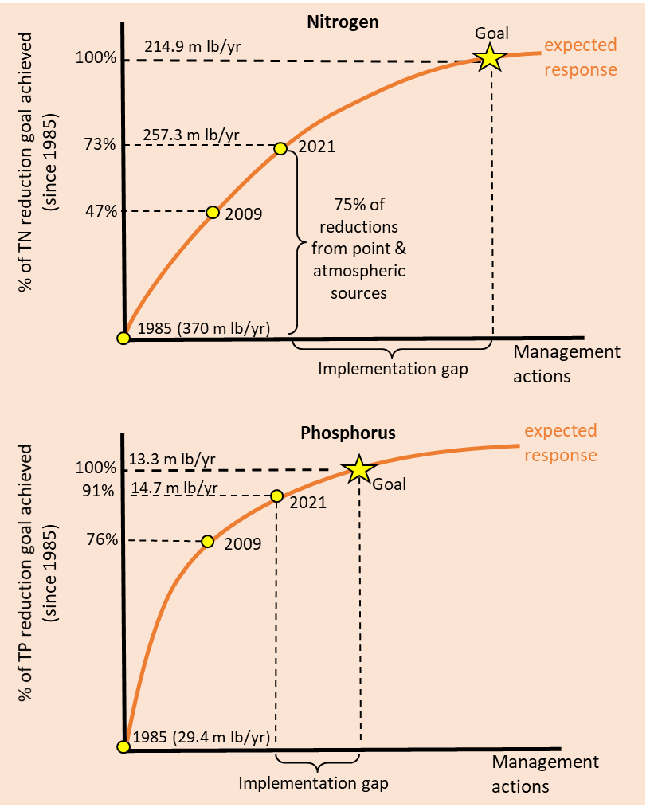
Implementation Gap
Need N Reductions
Annual rate of NPS N reductions achieved as estimated by CAST model since the TMDL
(2009-2021)
0.3 mil lbs/yr

Slide 18
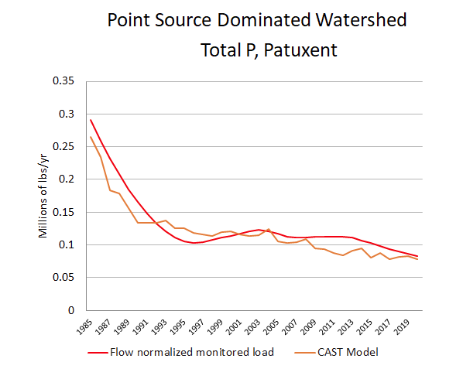
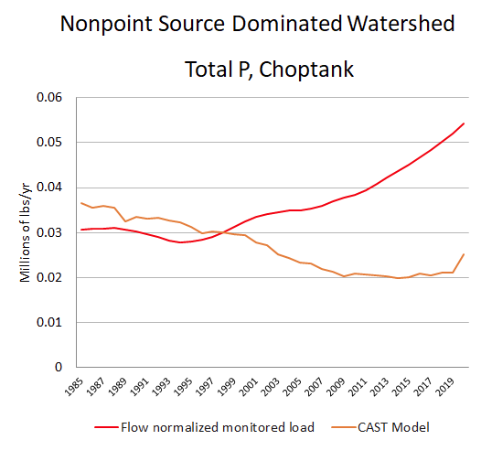
NPS Response Gap:
Effectiveness of Nonpoint Source Management Efforts

Slide 19
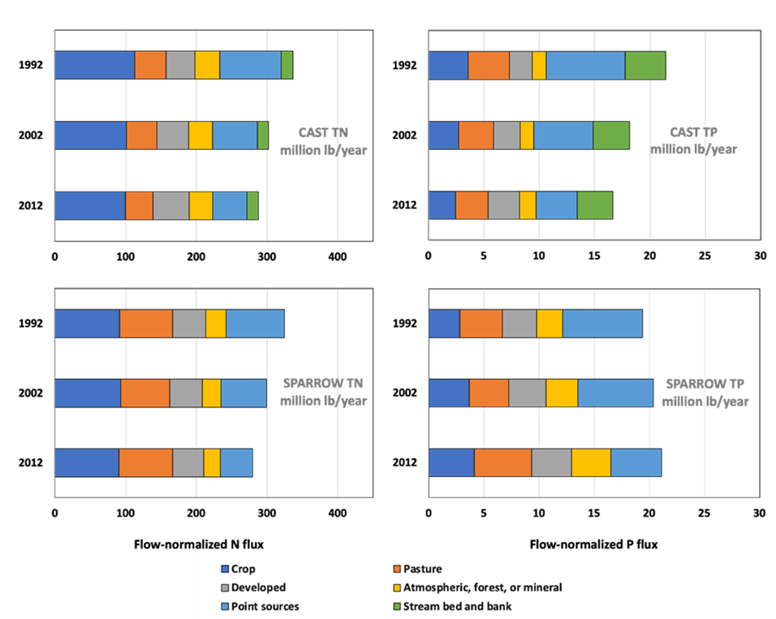
Response Gap
Monitoring data shows mixed signals of NPS management effectiveness. Several studies have found relatively little change in NPS loads between 1990 and today. Keisman et al 2018; Ator et al. 2019; 2020
Ator et al 2020

Slide 20
Why Implementation Gaps
Limits to Adoption (under existing programs)
Mass Nutrient Imbalances

Slide 21
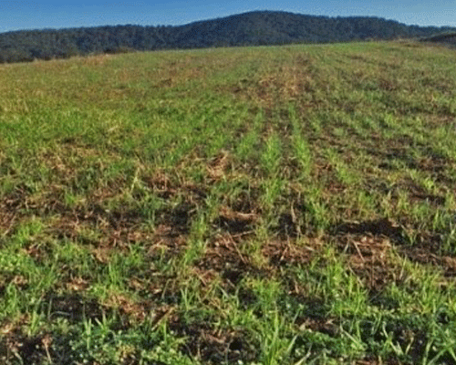
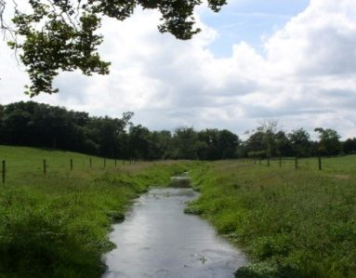
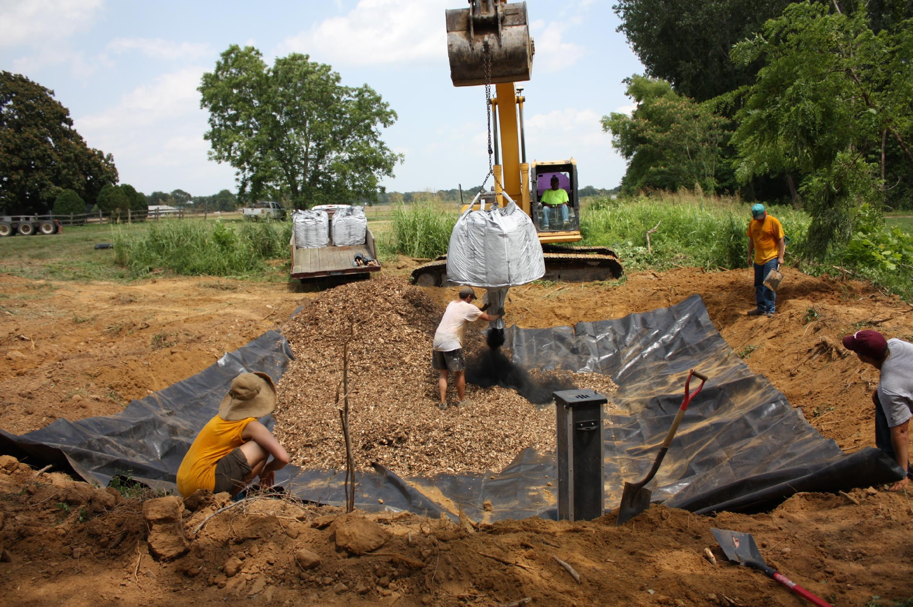
Implementation Gap
Limits to Adoption (practice-based cost share)
Cover crops
Livestock Exclusion Fencing
Denitrifying Bioreactor
Low upfront installation costs
Private benefits
High up front installation costs
No private benefits
Notes:
The predominate way we motivate land managers to reduce pollutants is through practice-based cost share… We offer people a payment to cover part of the costs to install a practice. Ex.. cover crops, stream fencing, ditch bioreactors

Slide 22
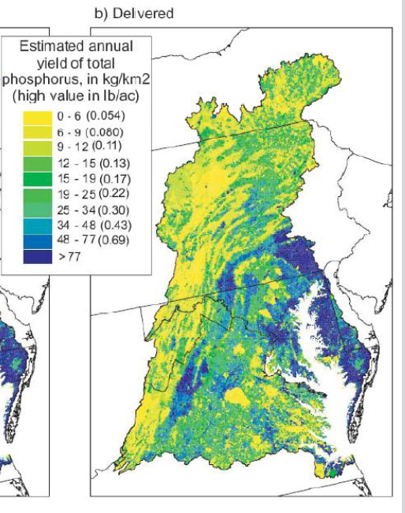
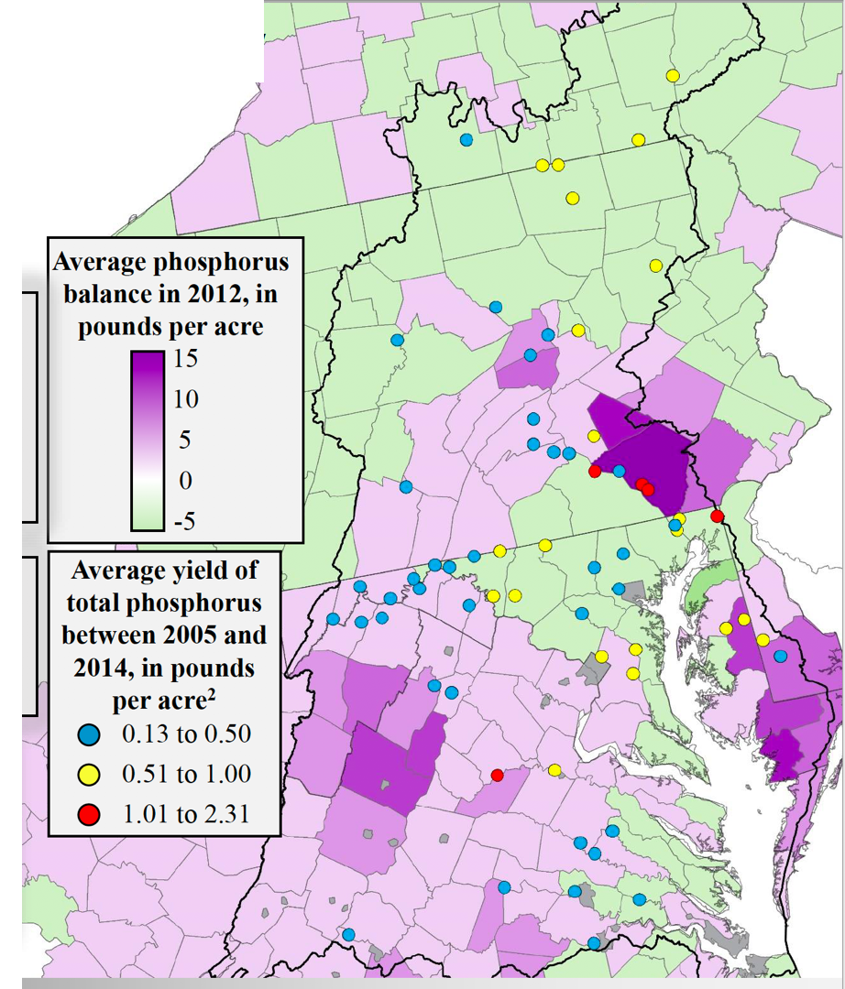
Nutrient Mass Balance
Moyer et al. 2107, Webber, 2017
Source: USGS Sparrow Model Output

Slide 23
Nonpoint Source Response Gap
What is responsible for divergence between expected and observed NPS loads?
Lag Time/Legacy Pollutants
BMP Effectiveness
Behavior/Implementation
Data/Monitoring Limitations

Slide 24
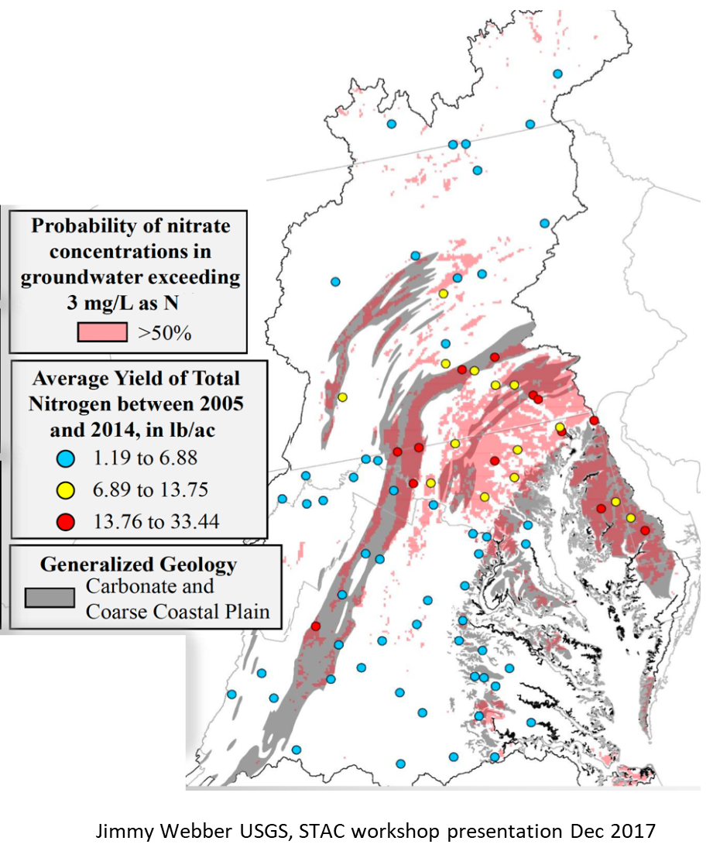
Legacy Nutrients
Large stores of legacy N and P in soils and groundwater may mask signal from NPS BMPs

Slide 25
Response Gap & BMP Effectiveness
BMPs may not be as effective as expected
(as assigned in CAST model)
Uncertainty surrounds estimates of BMP effectiveness
Generalized over diverse situations
Long-term effectiveness over BMP lifepsan
Maintenance

Slide 26
Additional Explanations for Response Gaps
Behavior and Implementation
Nutrient use: actual vs assumed behavior
Complex systems/behavior
Differential/selective adoption (“who, does what, where” may not match the “average” condition)
Data Issues
Model inputs may not adequately reflect nutrient inputs, BMPs, etc.
Monitoring may be insufficient to detect response
Notes:
We don’t have a great idea of how people actually apply nutrients. Research indicates that most farmers do not follow NMPs.
Complex: we have to make simplifying assumptions that cannot capture complexity on the ground. Example conservation tillage, particularly P…..Modifying drainage in coastal plain…
80/20 rule… 80% of load comes from 20% of land.
Mass P balance on 58 livestock operations can differ by an order of magnitude across farms

Slide 27

FINDING: Existing nonpoint source water quality programs are insufficient to achieve the nonpoint source reductions required by the TMDL

Slide 28
Implications for Nonpoint Source:
Shift the focus to achieving outcomes and away from counting practices.
  Improved targeting of investments (identification of high loss areas)
  Shift incentives toward outcomes rather than practices
Additional attention on mass imbalances
Willingness to reform and experiment with incentives and TMDL accounting: Consider “Sandboxing”
Great attention to uncertainty

Slide 29
Findings and Implications:
Water Quality Response

Slide 30
Water Quality Response
As we approach 2025, we aimed to reflect on the following questions:
  a) Has the recovery trajectory of Bay water quality criteria in response to reduced loads matched our expectations in both direction and magnitude?
  and if not
  b) Why is there a gap in the response between what we have measured and that which we expected?

Slide 31
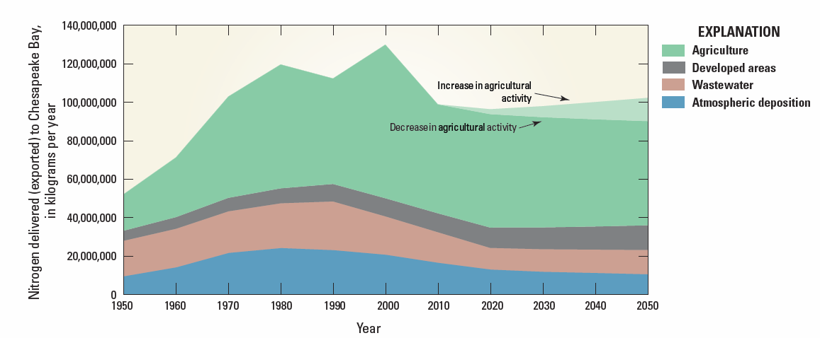

How Has Nutrient Load Changed Over Time?

Slide 32
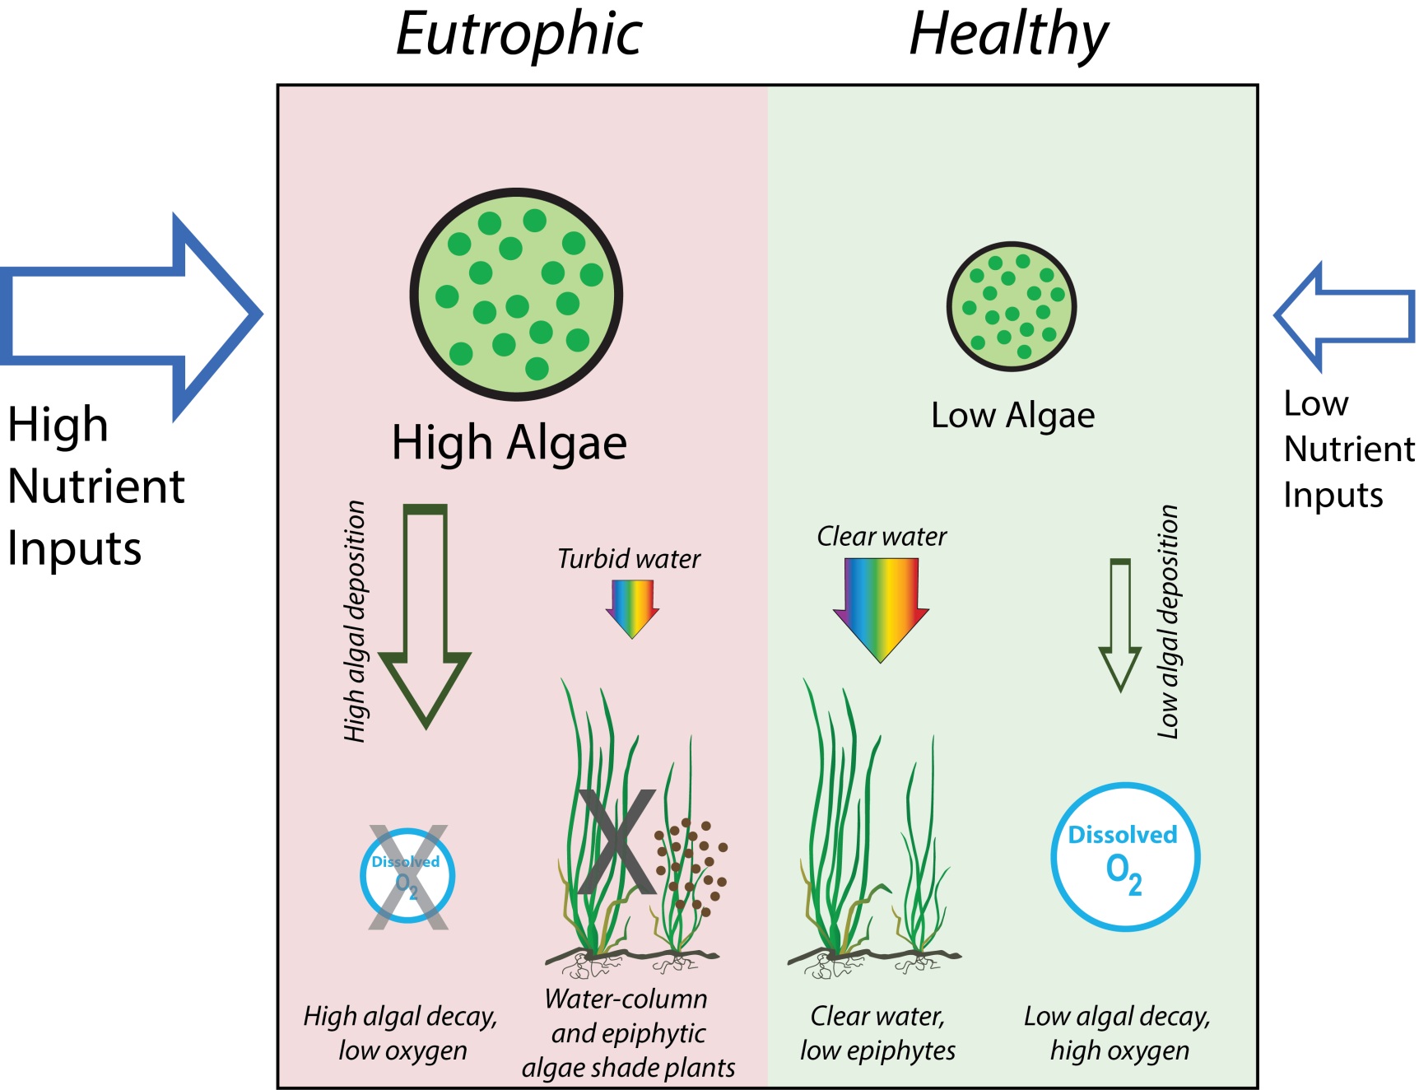
Our Most Basic Model of Bay Water Quality
Notes:
Sets up expectations for slide order: first is whether “food” for algae is going down, then response
Habitat for finfish, crustaceans, and their prey is the goal
Each of these features represent complex interactions between species, bio-physical-chemical processes
Note fish habitat loss

Slide 33
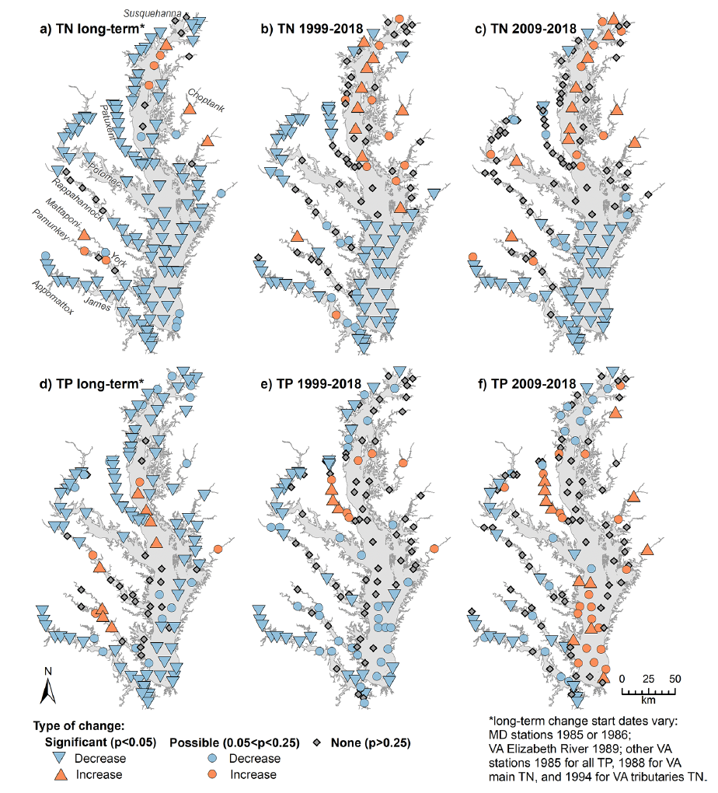


Water Quality Response at Bay Scale; TN and TP Responding
Chesapeake Bay tidal station categorical results for mean change in surface TN (a−c) and TP (d−f) over three time periods computed using temporal GAM fits. From Murphy et al., 2022.
Notes:
“Food” for algae is going down, long term trends

Slide 34
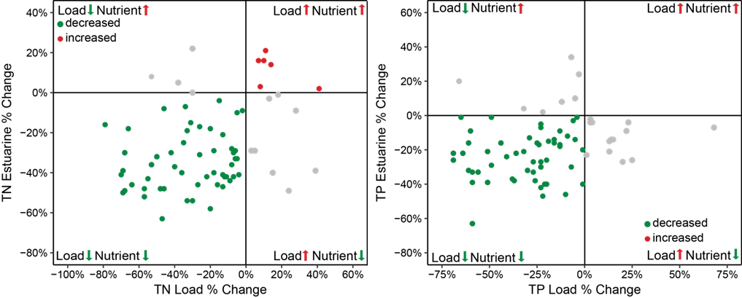
Loads and Nutrient Concentrations
Figure 4.6.—Percent change in estuarine TN and TP loads and concentrations, late 1980s to mid-2010s, where each dot represents a Bay segment (Source: Testa et al., 2018).
Notes:
“Food” for algae is going down, long term trends

Slide 35
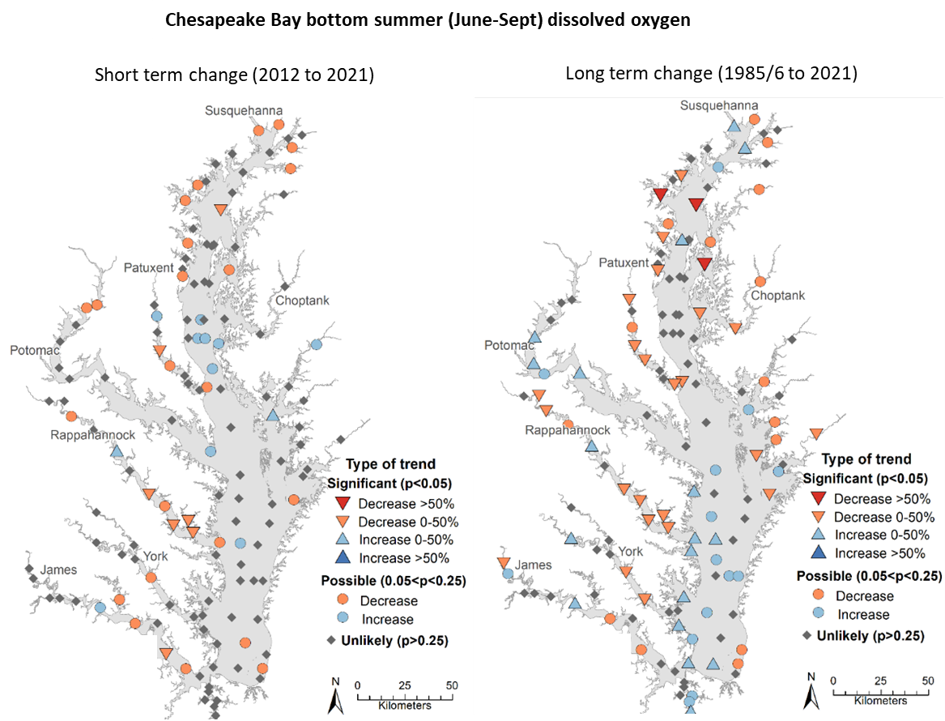
Water Quality Response at Bay Scale; DO
Changes in DO in bottom water layer measured during June–September, short-term (left panel) and long-term (right panel); starting dates for long-term measurements vary (Source: CBP, n.d.-b).
Notes:
“Food” for algae is going down, long term trends

Slide 36
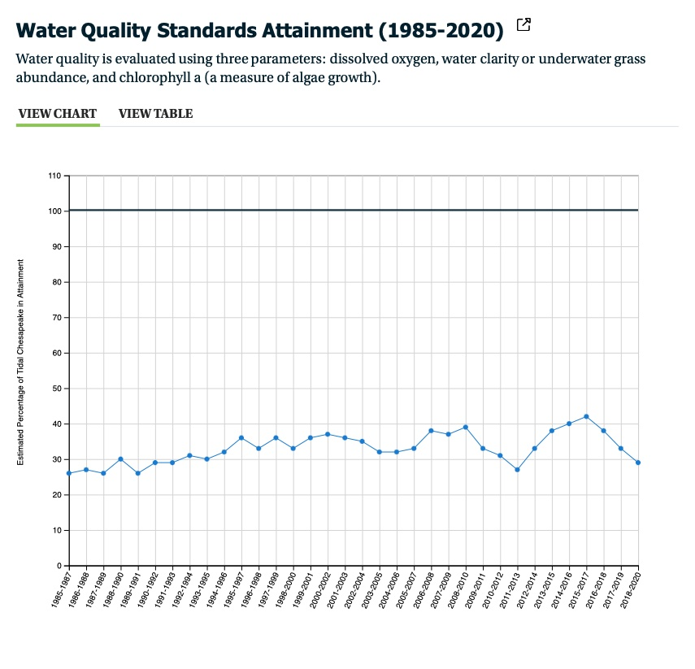

Slide 37
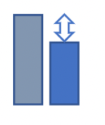
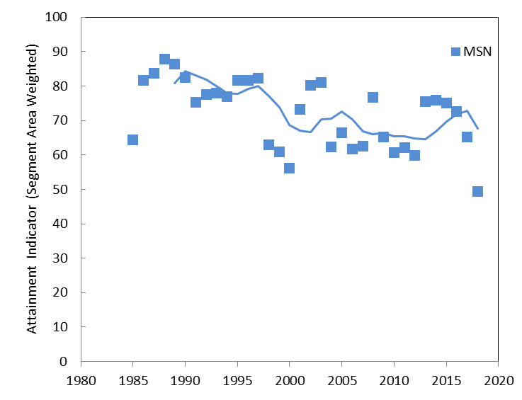
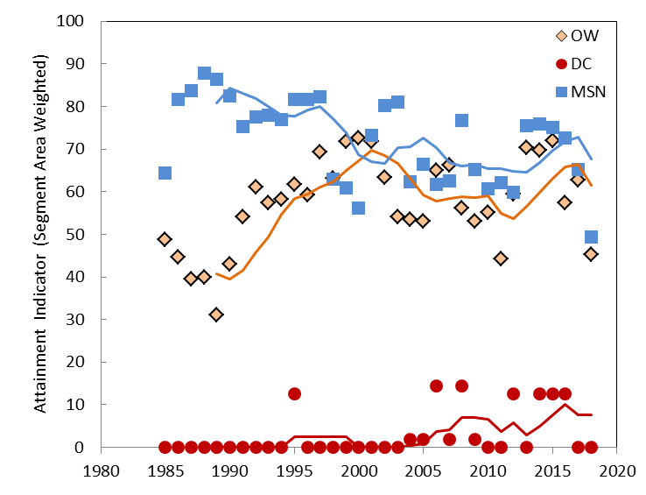
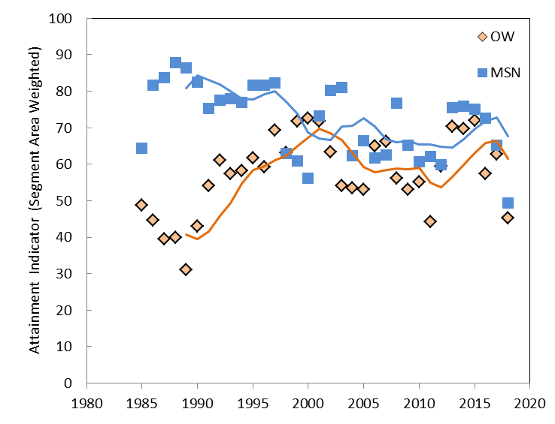
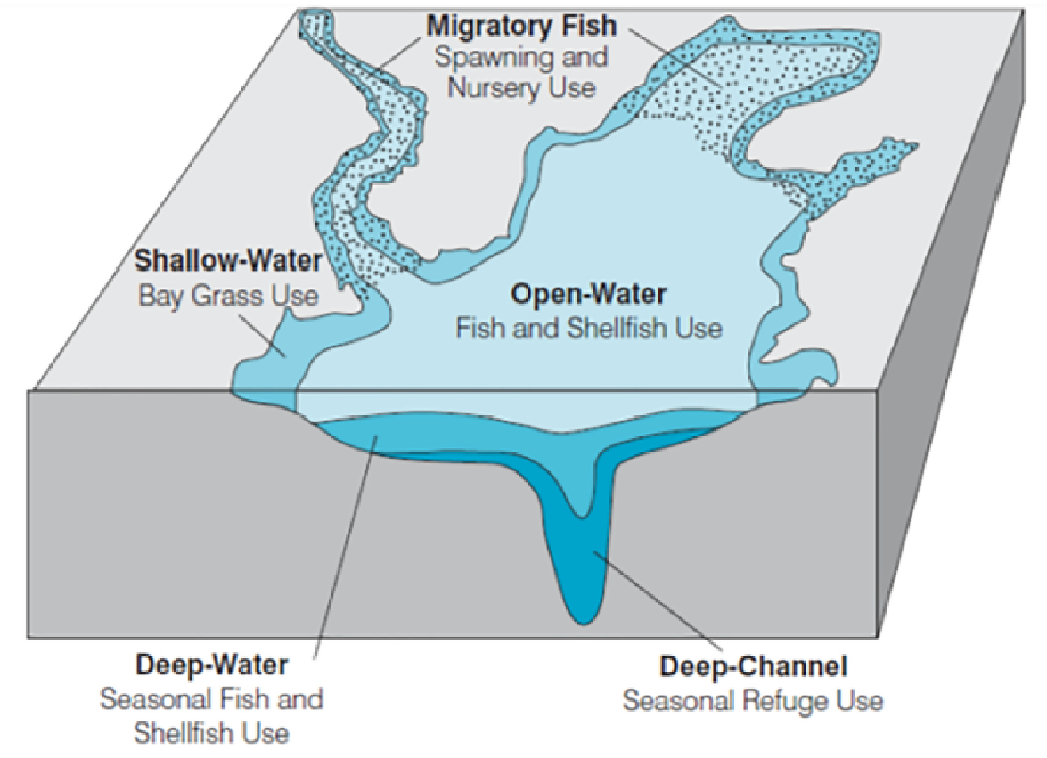
Breaking Down WQC Attainment
We have estimates of Baywide water quality criteria over the period in which nutrient load
reductions have been made; these estimates show high attainment in some habitats, but negative trend
AND low attainment in other habitats, but positive trend

Slide 38
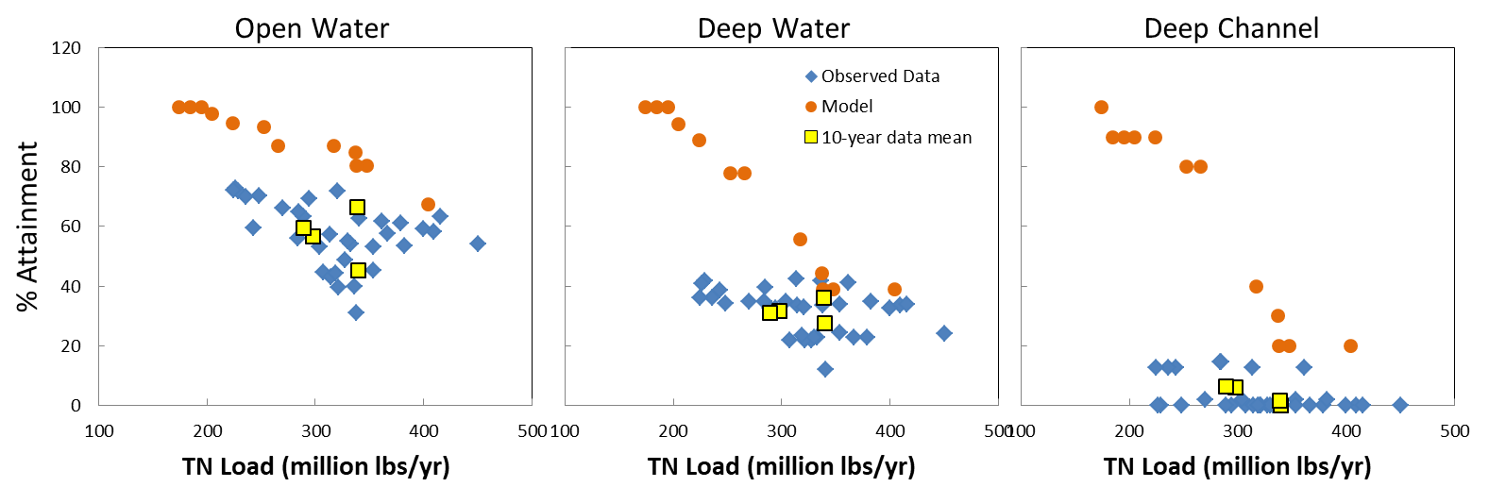
Response Gap for DO across Habitats
Expected and realized relationships between TN loads and DO criteria attainment for open water, deep water, and deep channel habitat, calculated as 3-year running mean observed values (blue diamonds) and expected responses from estuary model (orange dots) for the same time periods. Yellow squares are 10-year means of the observed data.

Slide 39
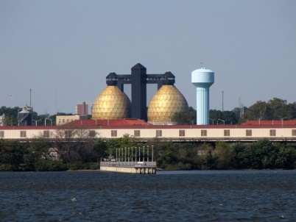
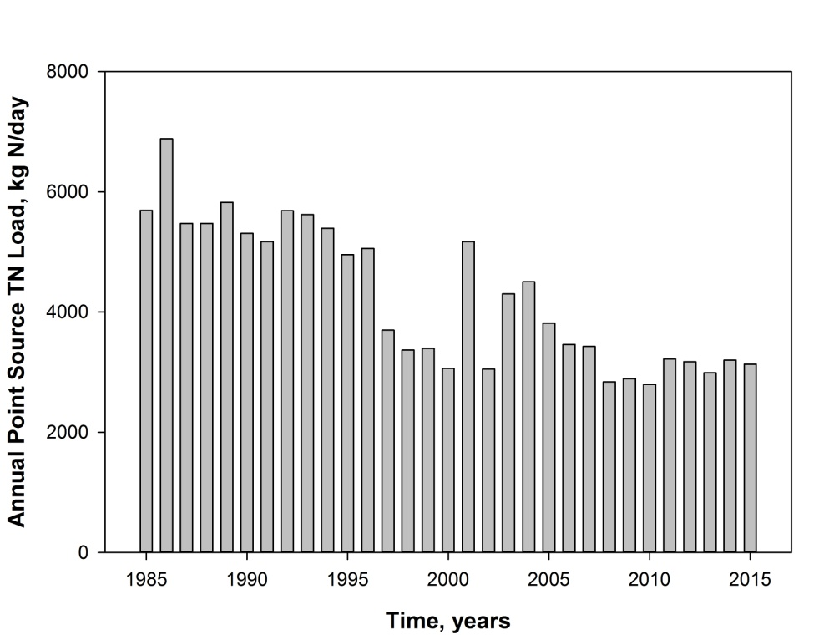
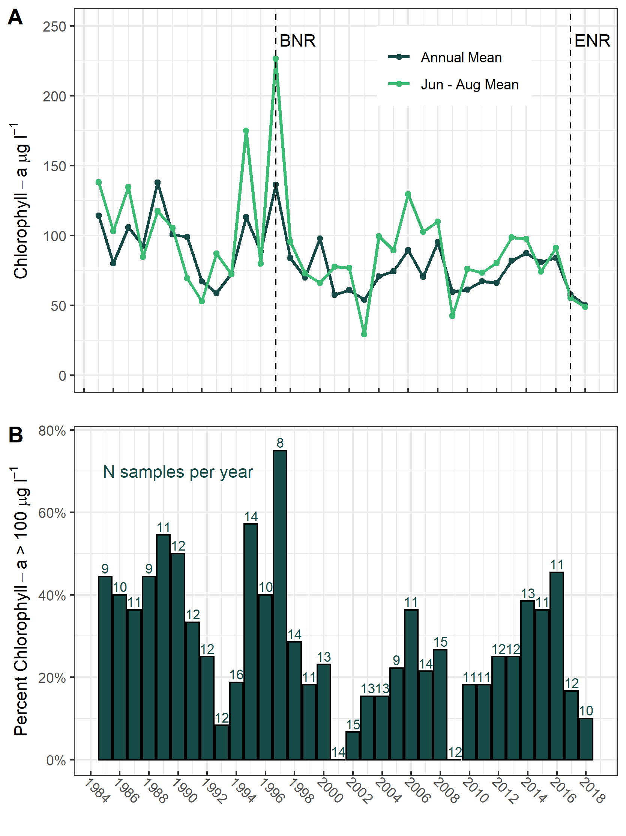
Water Quality Response at Local Scales:
Back River
2018
Notes:
Where significant declines were managed, water quality improved; trajectory is expected, but is magnitude matching expectations?
Local scales help us clearly link major nutrient reductions and water quality responses

Slide 40
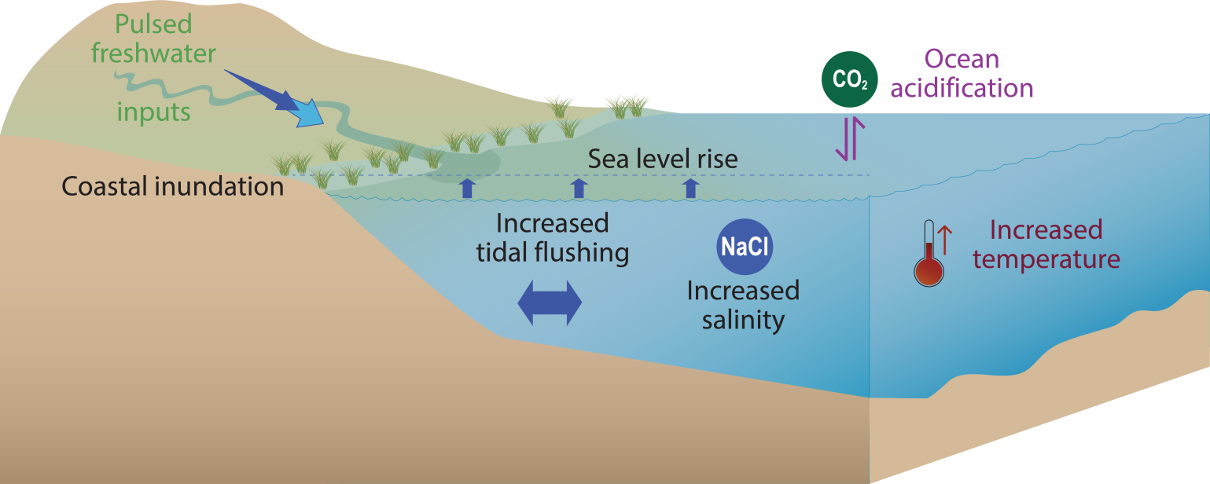
Some Answers (all have uncertainties):
(a) Climate change: warming, sea level rise, precipitation
(b) Tipping points, feedbacks, and trajectories of response: Features that make Bay changes not always immediately available
Why Do We have Response Gaps?

Slide 41
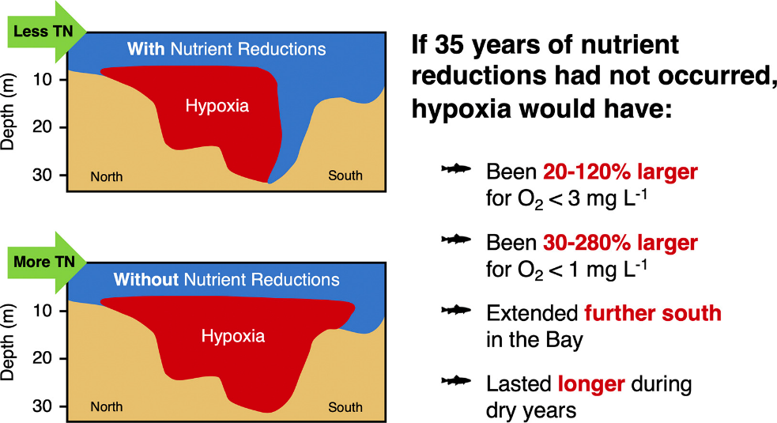
Climate Change
Figure 4.13.—Estimated extent of Chesapeake Bay hypoxia with and without 35 years of nutrient reductions (Source: Frankel et al., 2022).

Slide 42
Trajectories of Response
Recovery
Degradation
Hypoxia Intensity
Increasing Nutrient Loads
Nutrient loading at which system will reach attainment
Nutrient loading at which system fell short of attainment

Slide 43
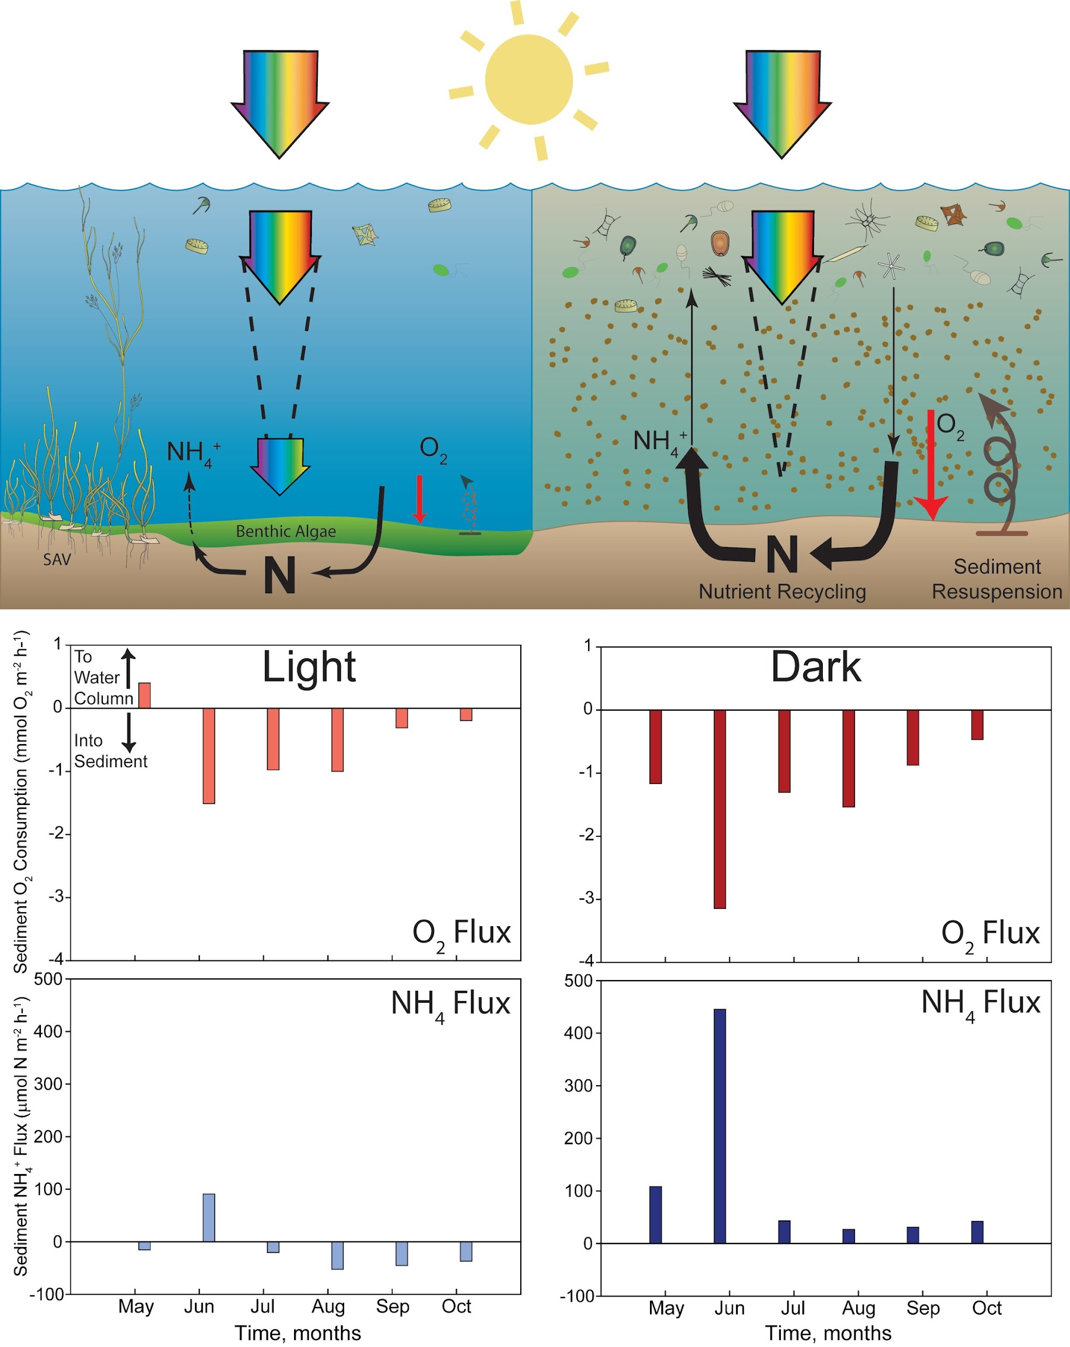
Sediments That Receive Light Trap Nutrients
Notes:
(a) are located where many people use and interact with tidal waters,
(b) are poorly understood relative to the overall Bay ecosystem, and
(c) have natural features of nutrient retention and biogeochemical feedbacks that may cause tipping points in ecosystem recovery.
(d) Are habistats for critical living resources, such as SAV, marshes, and nursery areas

Slide 44
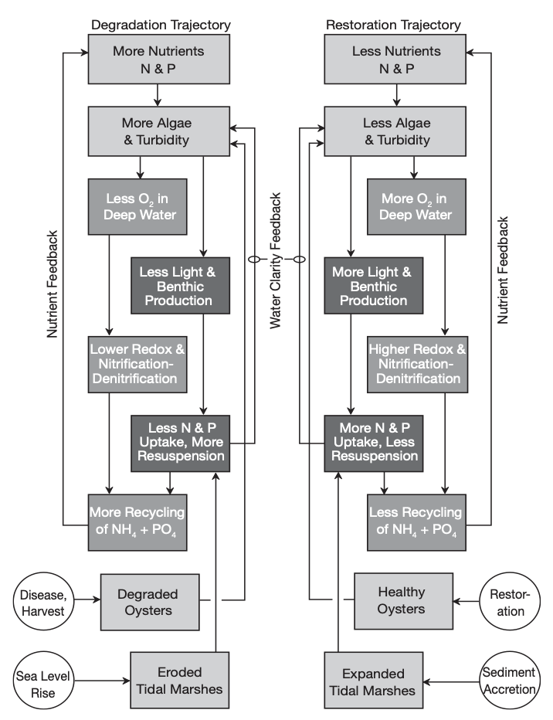
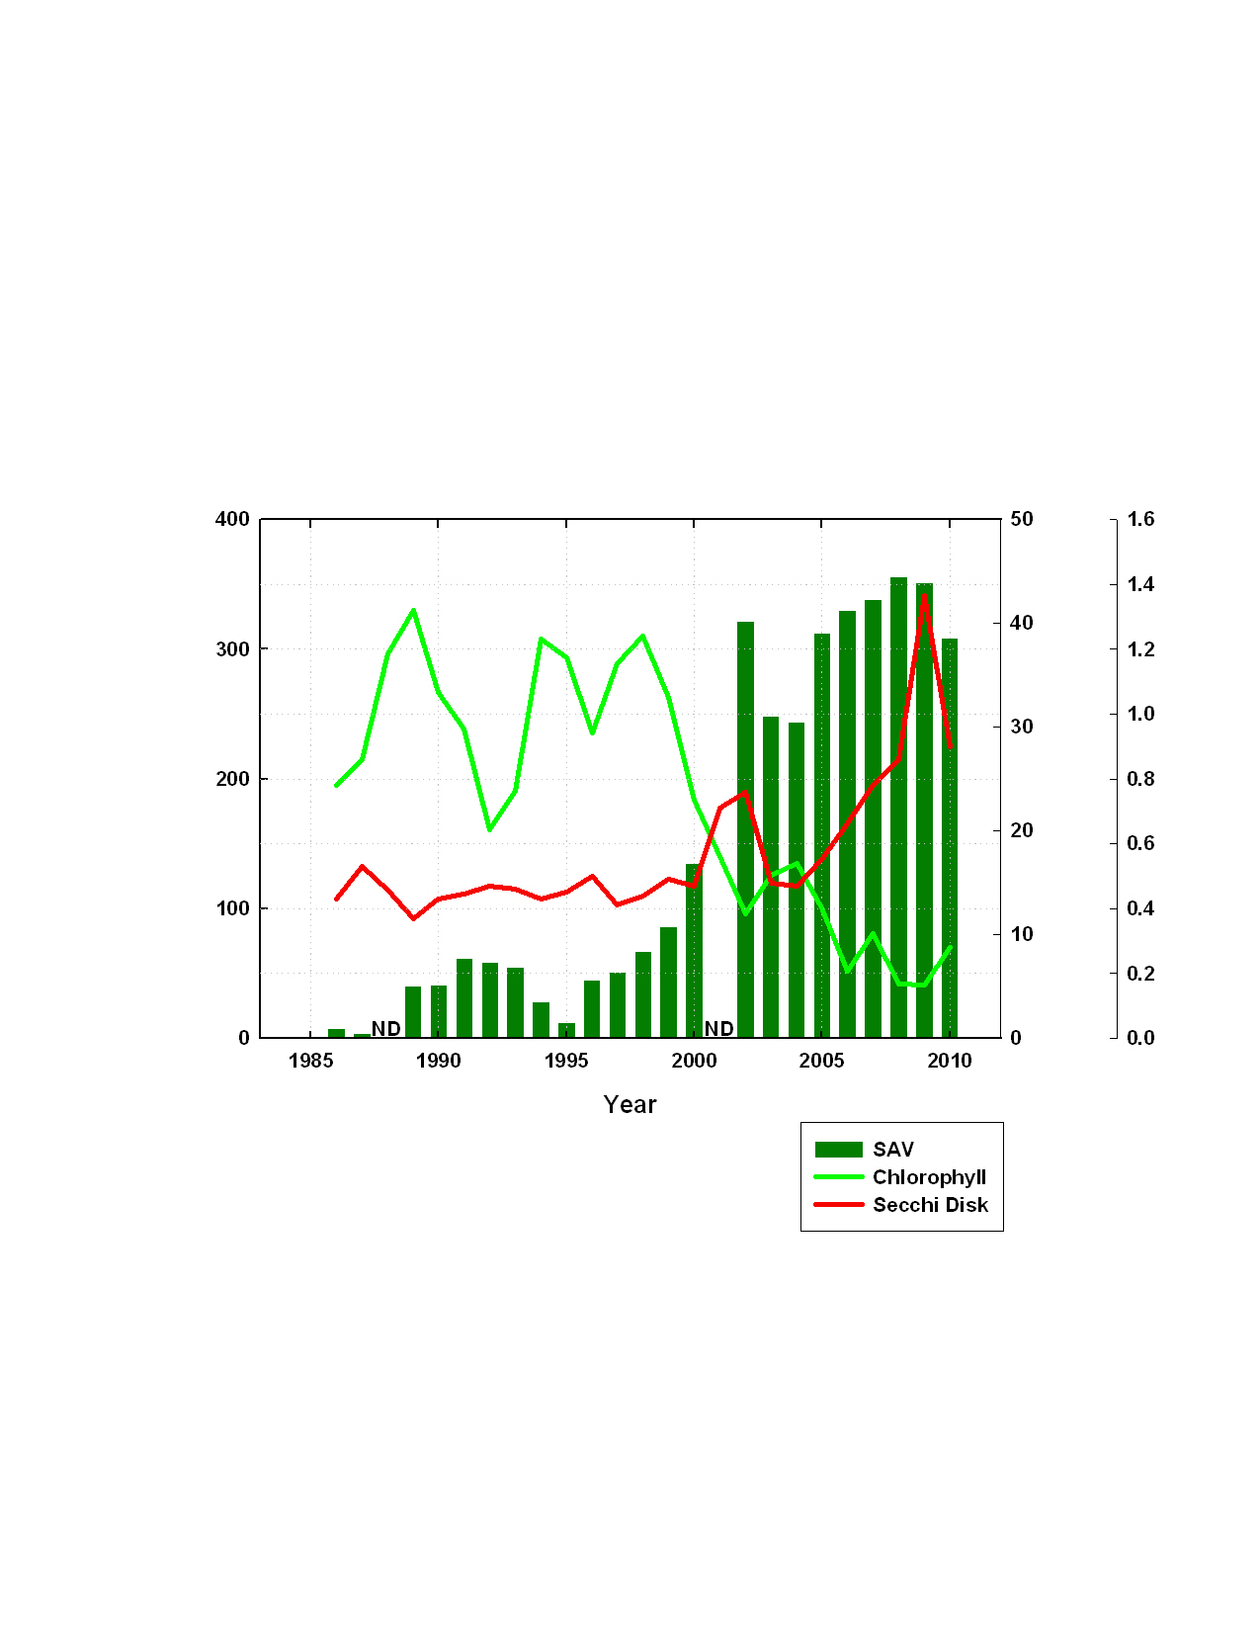
Tipping Points and Feedbacks:
Where Restoration Stalls, or Takes off
Mattawoman Creek
Major WWTP load reduction completed
Effects of N and P additions on physical, chemical, and biological elements of the estuarine system, including algal biomass, bottom water oxygen, and nutrient recycling. (Source: Kemp et al., 2005).
Notes:
One conclusion of tipping points is: patience
This can be seen in the data, and we have examples of it
There are changes in the Bay that are not as fast as the load reduction is. This includes lags in when BMPs put into place and when that effect is felt in the load. There are also biological communities that take time to recover, and some of these communities can accelerate recovery (tipping points)

Slide 45
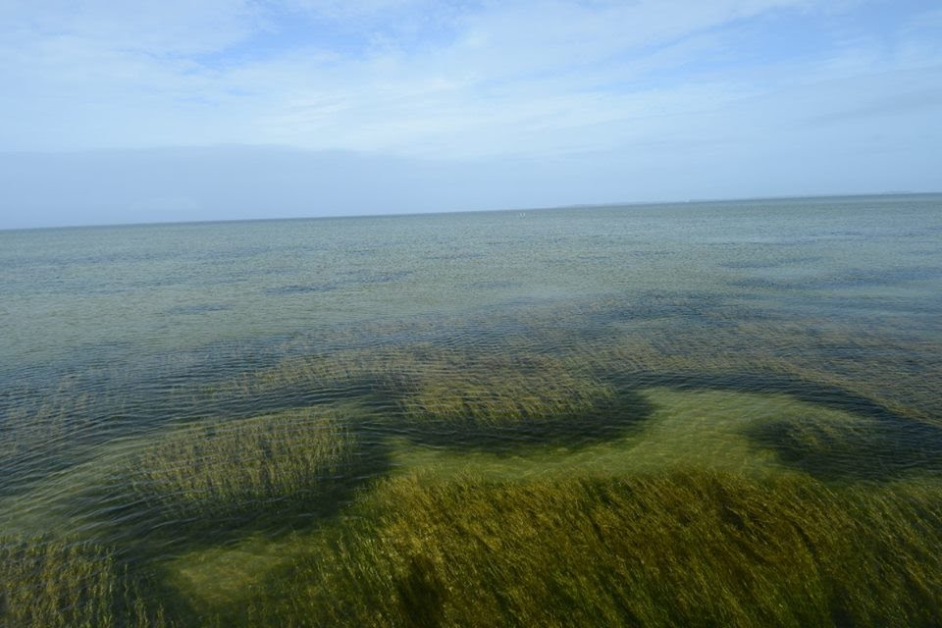
SAV off Poplar Island in late summer 2015
Notes:
And this picture from 2015 off of Poplar Island, just north of the Choptank River mouth, gives you an idea of what Hungerford must have seen, albeit in much shallower water

Slide 46

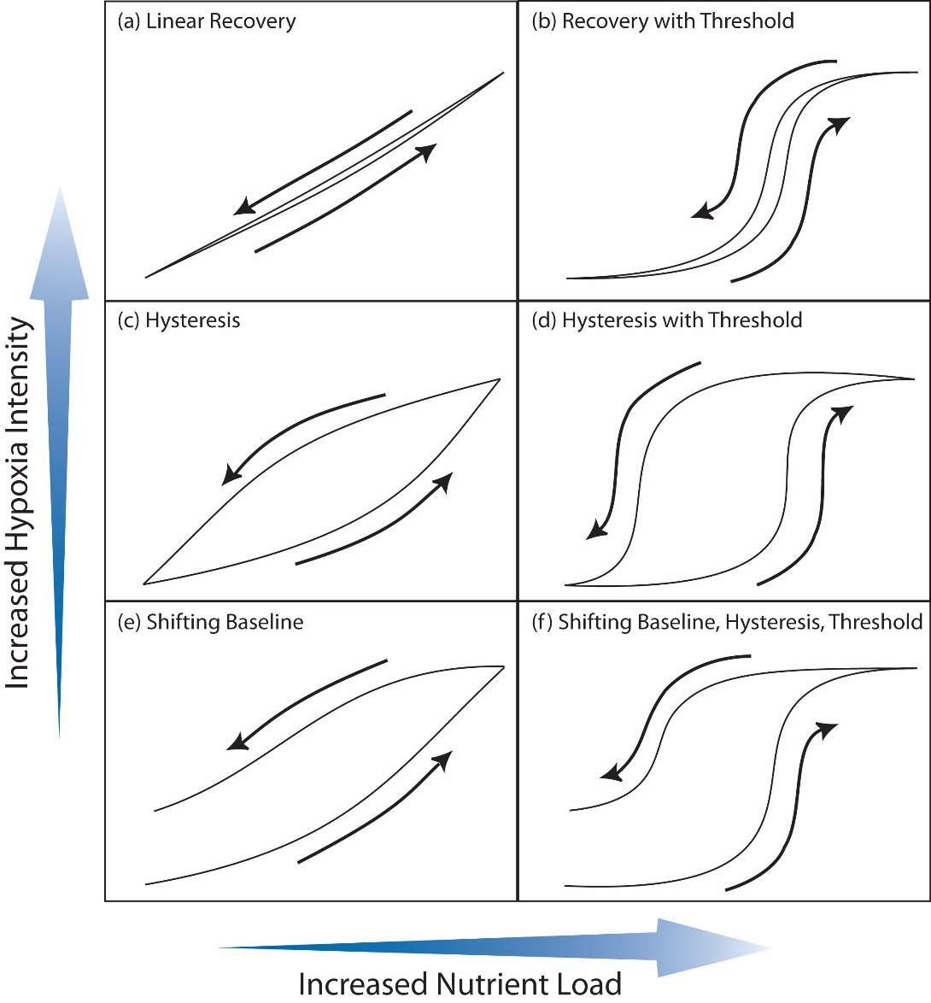

FINDING: Uncertain if it is possible to achieve water quality criteria (DO, SAV), but efforts have stemmed further declines in water quality.
The modest reductions in nutrient loads we have achieved Baywide, which are substantial in some locales, have initiated a recovery.
Water quality response to nutrient reductions is less than expected.
In the deeper waters of the Bay, progress towards attainment has been slow.
There are tipping points in the Bay ecosystem that can slow recovery in early stages but potentially accelerate recovery down the road.
Some Bay conditions are changing, permanently altered, and irreversible.
Notes:
The modest reductions in nutrient loads we have achieved Baywide, which are substantial in some locales, have initiated a recovery.
Oxygen conditions have a response gap, which is clearly associated with warming, but is also due to lags in ecosystem response
There are tipping points in the Bay ecosystem that can slow recovery in early stages but potentially accelerate recovery down the road
Many of these tipping points are active in the shallow Bays, tributaries, and inlets of the Bay, and are associated with high nutrient removal, and if crossed would supercharge local water quality but also keep nutrients from going downstream
These shallow environments and their behavior can be better understood, and restored, with monitoring and targeted restorations

Slide 47
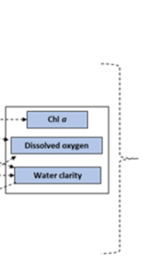
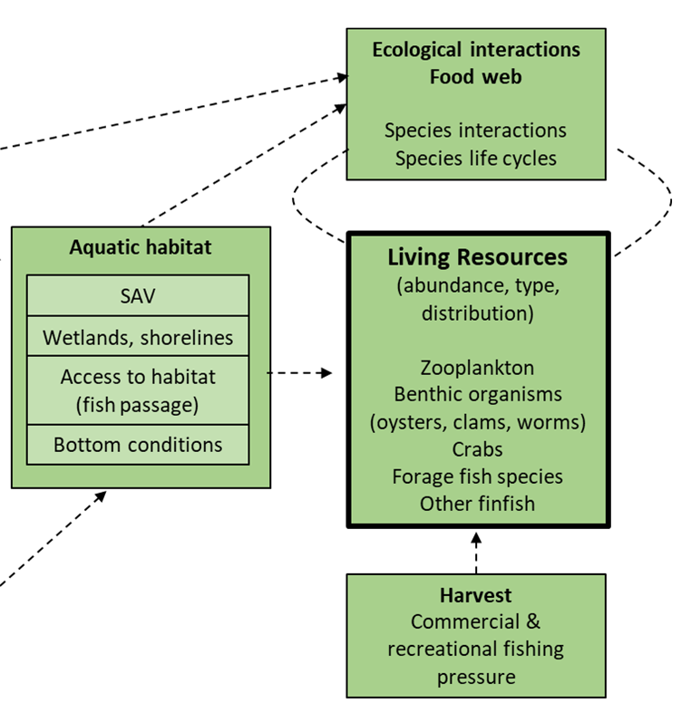
Findings and Implications:
Living Resource Response

Slide 48
Living Resources Response
As we approach 2025, we aimed to reflect on the following question:
  To what extent are Bay living resources improving as a result of efforts to improve water quality conditions (particularly the identified water quality criteria DO, water clarity, and Chl-a)?

Slide 49
Possible Response (H)
Living Resource Abundance
Possible Response (L)
20% 40% 60% 80% 100%
% Achievement of WQ Criteria

Slide 50
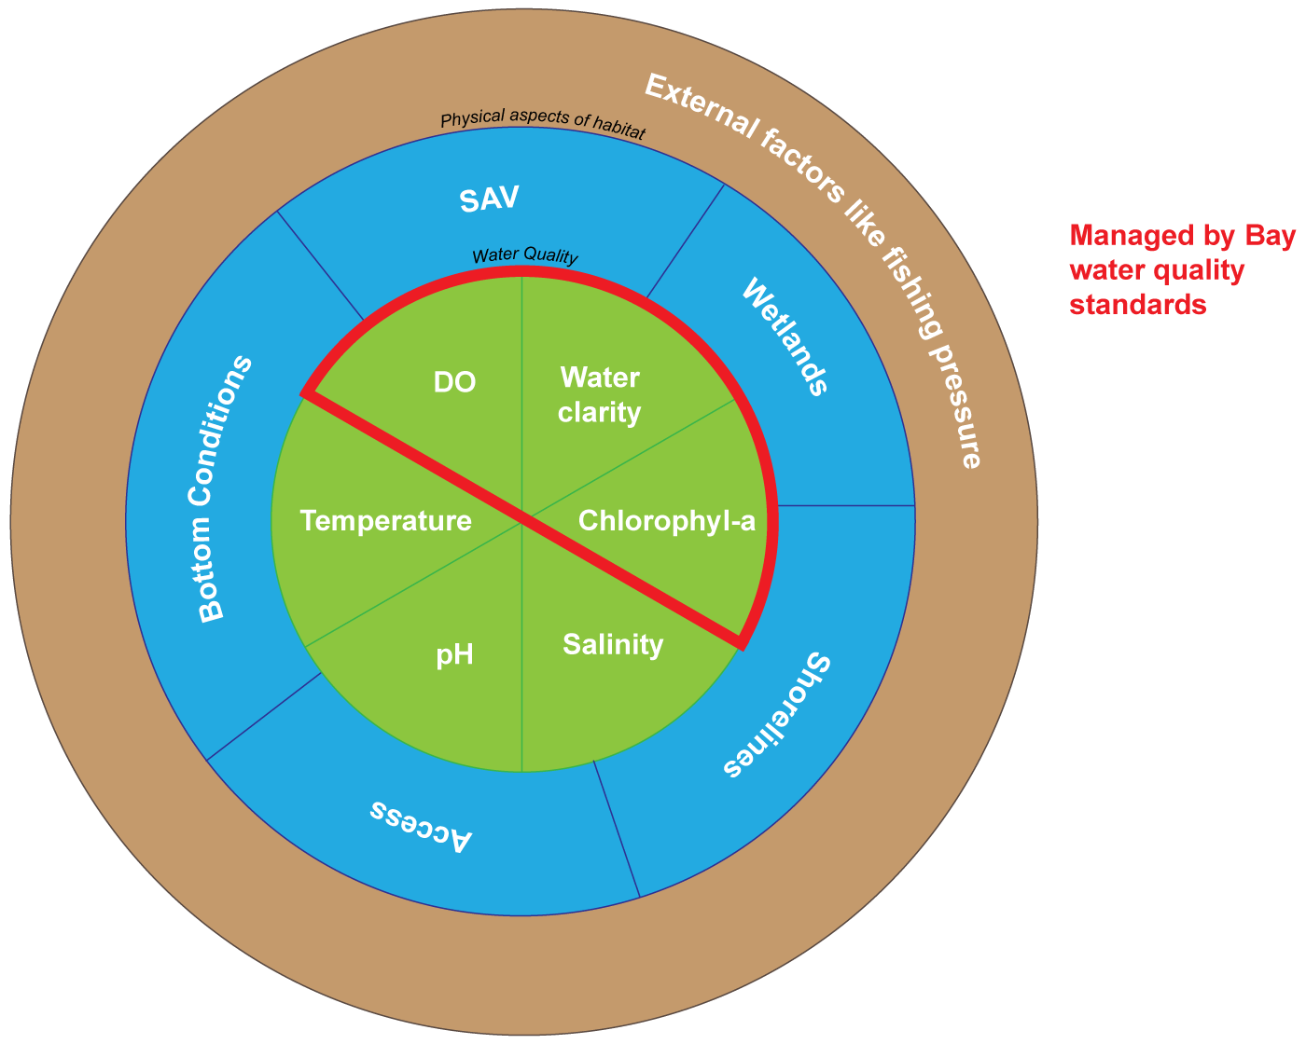
Many Knobs of Living Resource Response

Slide 51
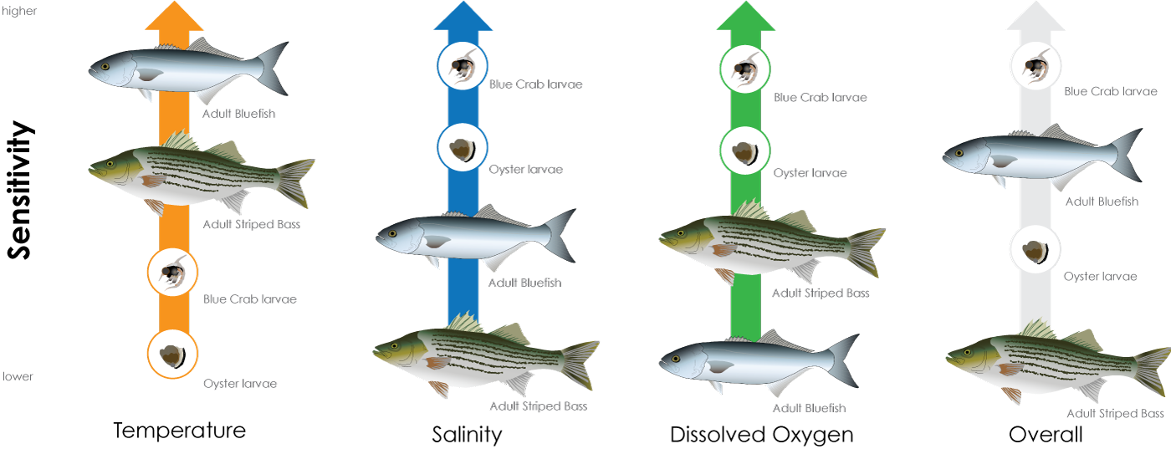
Many Knobs of Living Resource Response
Reinterpreted from Schelnger et al., 2022
Notes:
Also where

Slide 52


FINDING: It might not be possible to meet the all TMDL and WQ goals but this may not be necessary to meet and support living resource goals.
Water quality improvements in shallow water may have more of a benefit to living resources than elsewhere.
Water quality alone does not guarantee improvements in Living Resources. There are other factors!

Slide 53

Improving Living Resource Response to Water Quality management Efforts
Implication: Opportunities exist to adjust water quality goals to prioritize management actions to improve living resource response.
Prioritize nutrient reduction where you will get a living resource response sooner.
Bay Program should be willing to shift investments to efforts that increase Living Resources for the water quality gains that are achieved.

Slide 54
Achieving our desired outcomes is proving more challenging than we expected.
There are opportunities to improve our effectiveness, but they will require a significant change in our thinking and our programs.
Notes:
Story Flow
As we approach the 2025 milestone, STAC undertook a multi-year effort to examine how the CB system has responded to the last 30-40 years of management efforts. The results of our Comp Evaluation of System Response- or CESR- are presented here.
Our findings shed light on what has worked (somethings worked really well, others not so well), highlight that our singular focus on wq translates to many missed opportunities for living resource restoration, and provide scientific insight on where we go from here.
The whole reason we (collectively) are here is to protect our home, the Chesapeake Bay. It is the largest ecosystem restoration project in the world, it as complex and challenging as the 18 million people who live in our watershed. And it remains our challenge, our home, and our commitment to get right.
Today we will review:
How has water quality in the Bay responded to management actions, and
How have living resources (the CBP Outcomes) responded to those changes in water quality,
And what these answers may mean for future actions.

Slide 55
Panel A: Costs of attaining WQS
Implementation cost
Costs increase rapidly as nutrient reductions approach TMDL goals.
May not be able to achieve all water quality criteria even at high cost (particularly deep waters)
Costs to attain WQS ($)
Full attainment
20% 40% 60% 80% 100%
% Attainment of WQS
Panel B: Possible living resource response
The improvements in living resources from improvements in targeted water quality conditions (DO, SAV) depends on:
1) location, timing, magnitude of Bay water quality improvements;
2) the status of all other factors that influence living resource abundance (habitat, harvest, etc)
Living resource response (High)
Indicator of living resource abundance
Full attainment
Living resource response (Low)
20% 40% 60% 80% 100%
% Attainment of WQS

Slide 56
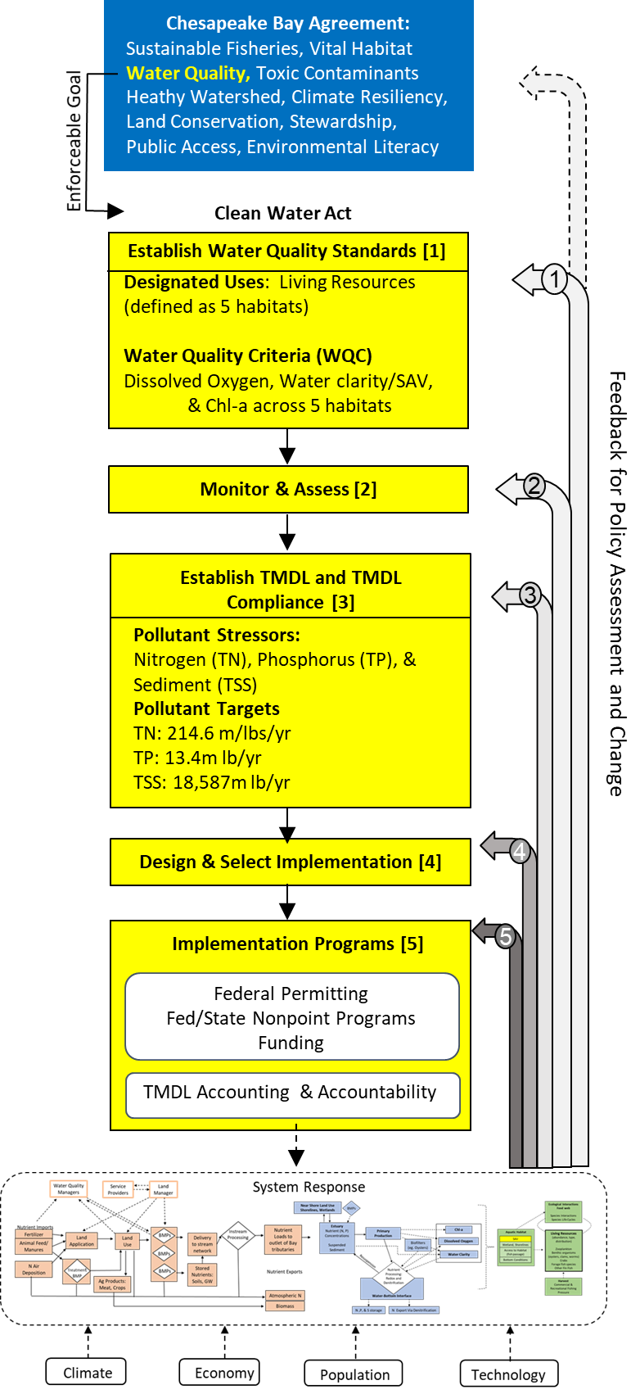
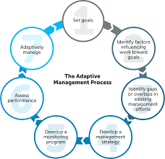
How to translate this into decision-making?
Will need to include all levels of policy feedback and learning in the existing CWA approach (arrows 1 through 4).
  Who?
  How?
Now is an opportunity to developed expanded adaptive management processes
Notes:
Need long term commitment, not fixed next legislative session
Who? More than just the folks tasked with implementing progrmas.. .people in this room.
How? How to involve people authorized new programs & public goals with the technical analysis needed those decisions
#1 Revision to the existing water quality criteria. #1 and #2
#2 Targeted monitoring for AM
#3Consider a tiered approach to structuring the TMDL #3; Alternatives to Demonstrate TMDL Compliance #3
#4Addressing Mass Imbalance, Incentives and Capacity for Improving Who Does What and Where; Closing the Implementation Gap by Requiring More #4
#5 differential BMP crediting within the model.

Slide 57
What are your thoughts?
Notes:
h

Slide 58
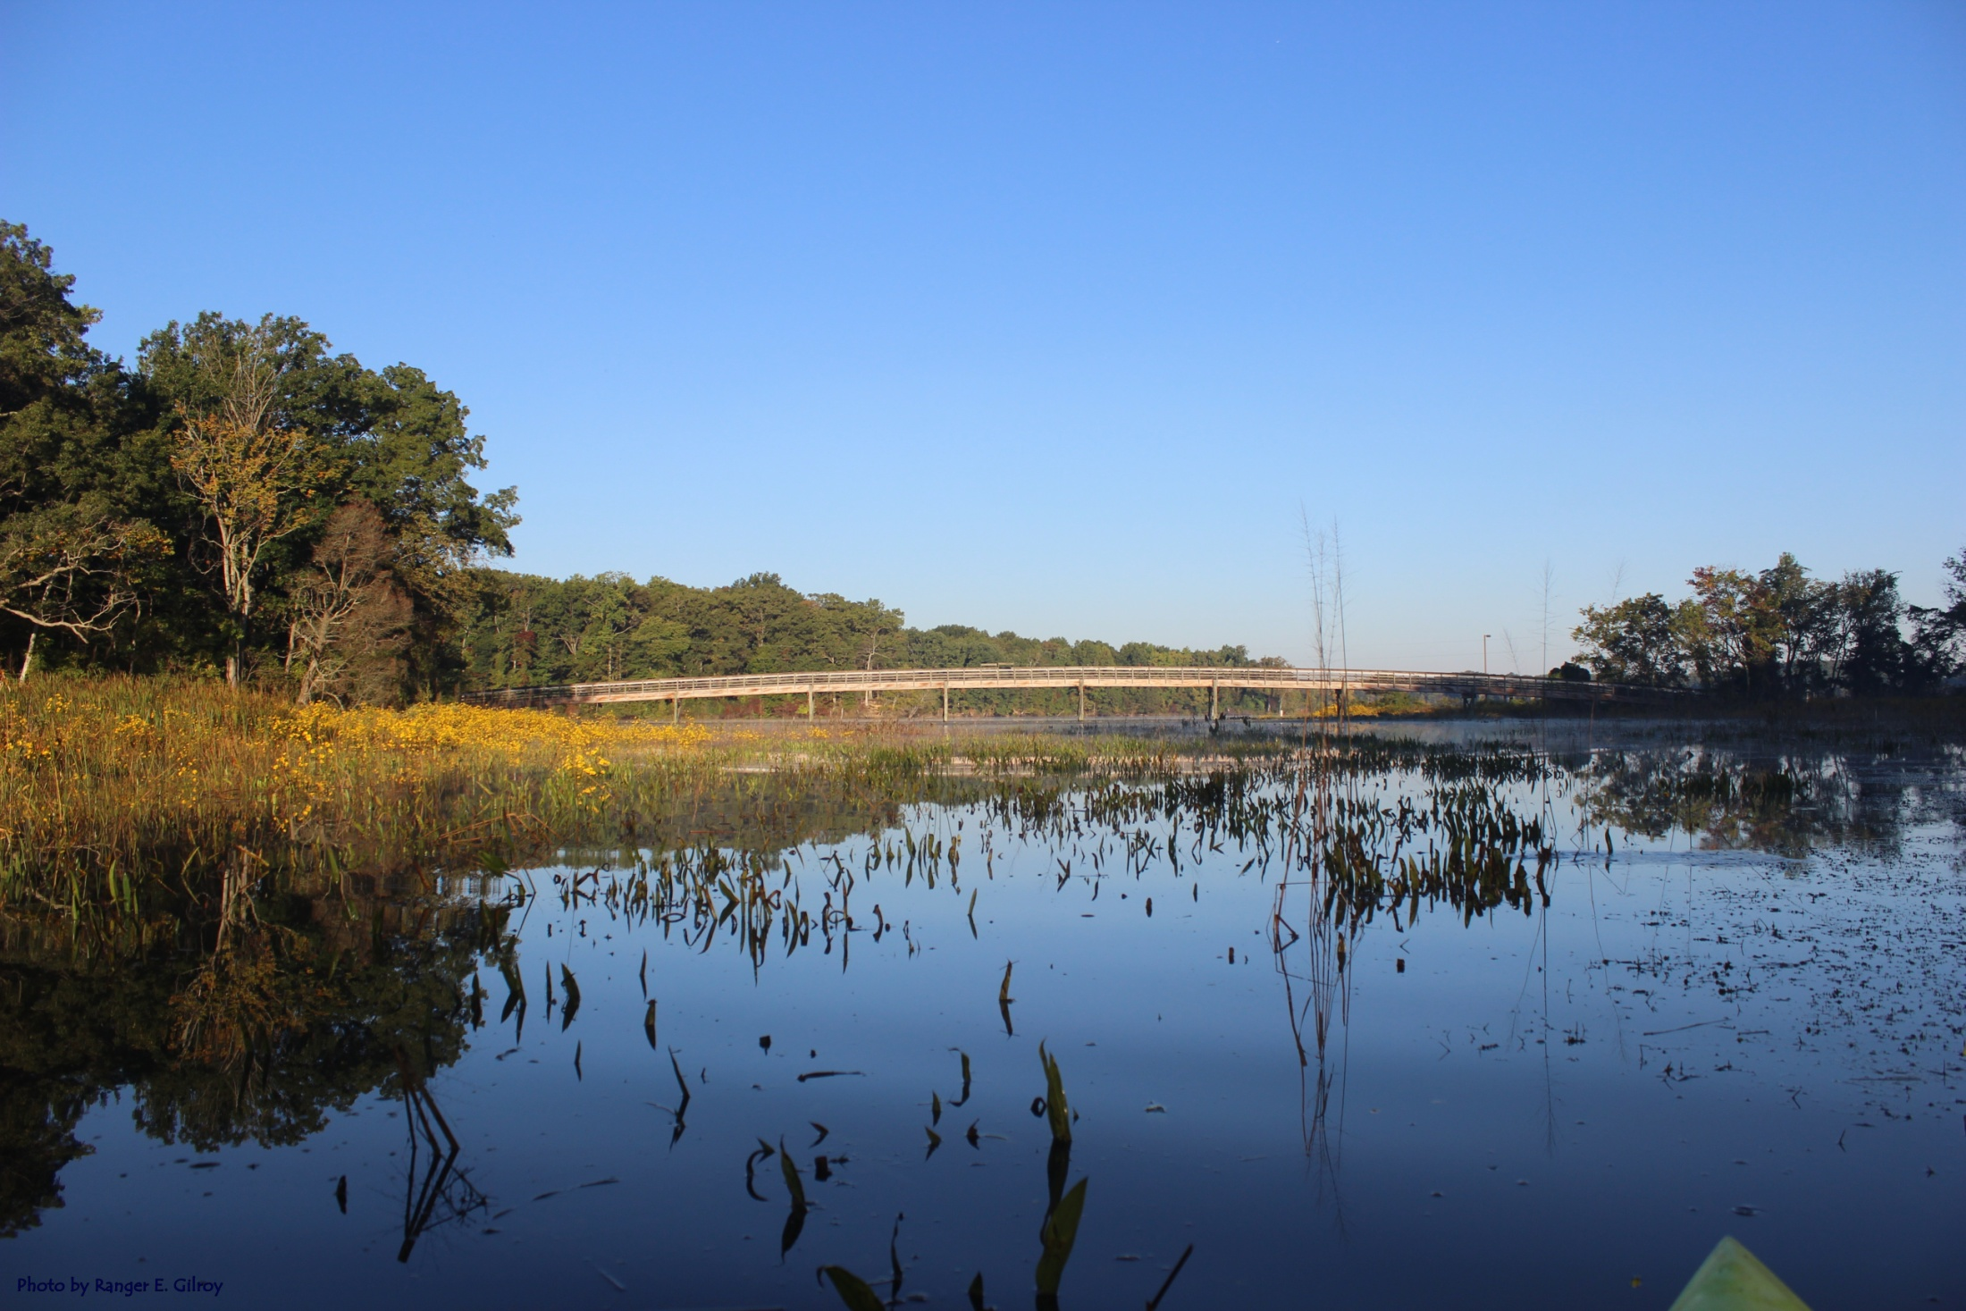
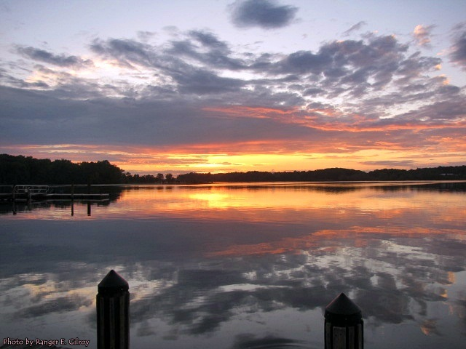
Water Quality Response at Local Scales:
Mattawoman Creek
Photo from Elena Gilroy
Notes:
strongly impacted by nutrients from 1970 – mid-1990s
large and persistent algal blooms, sea grasses rare
WWTP load reductions stimulated restoration

Slide 59
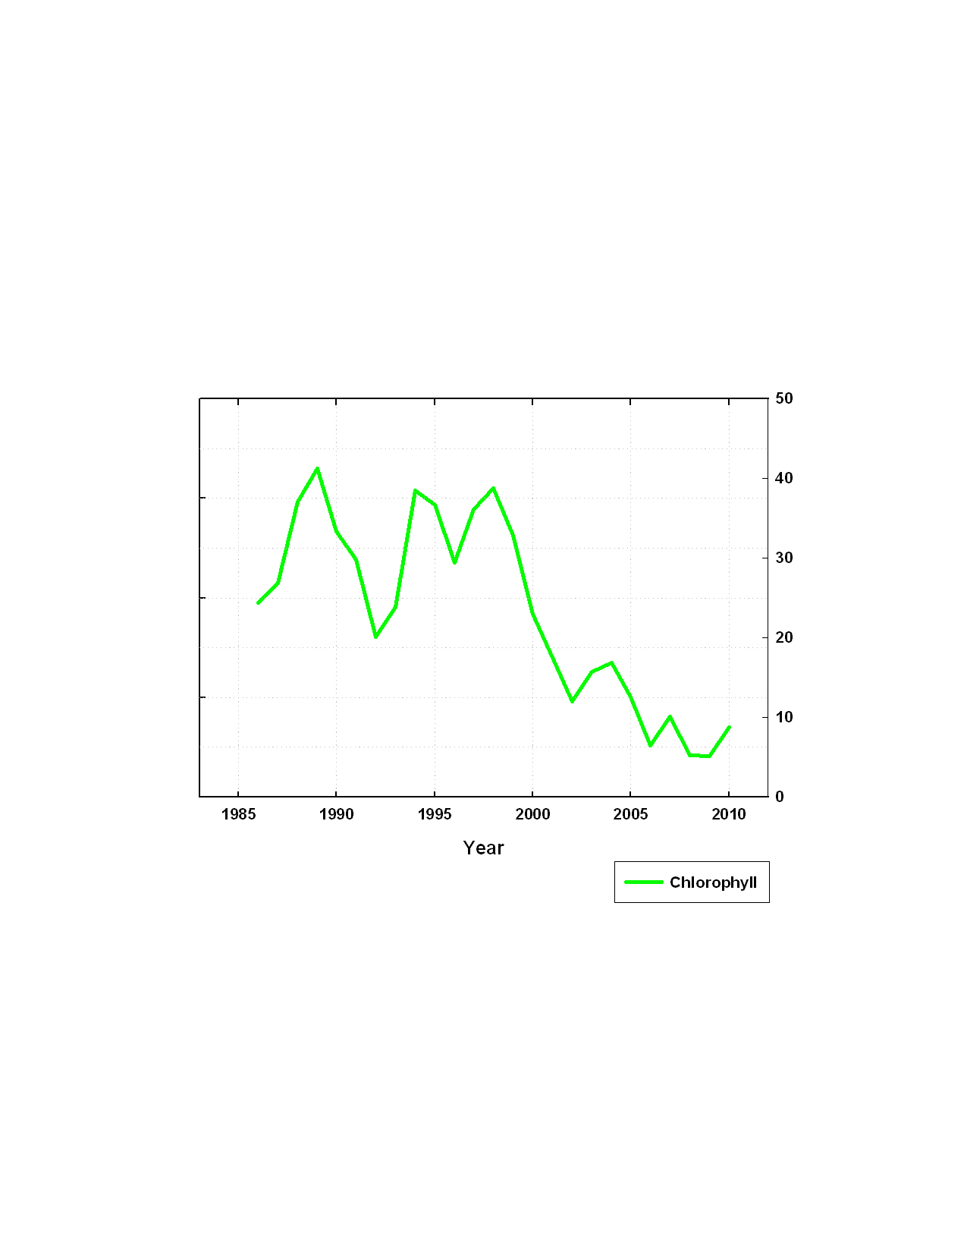
Algal Biomass Decreased
…with Substantial Lag Time
Drought Year
More
Algae
40
No clear response for about 4 years followed by sharp decline in algae
After 2005 low levels of algae became normal
30
20
10
0
Major WWTP load reduction completed

Slide 60

Water Clarity Increased
…Also with a Lag Time
Drought Year
More
Algae
No clear increase for about 8 years followed by sharp increase in clarity
Water clarity and algae highly correlated in shallow Chesapeake Bay systems
Clearer Water
Major WWTP load reduction
WWTP load reduction completed

Slide 61
SAV Increased
…Shorter Lag with Threshold Response
Drought Year
More
Algae
Very low levels of SAV were present prior to nutrient load reductions
Major expansion of SAV in 2002, a severe drought year
SAV relatively stable after 2002; lag in SAV relatively short
More SAV
Clearer Water
1971
0 ha SAV
Major WWTP load reduction completed
Notes:
Similar responses have been seen in other systems (Tampa Bay, Danish Coastal Zone) where nutrient reductions were SUBSTANTIAL and SUSTAINED
Point out that this has been repeated un many parts of the Bay

