Slide 1
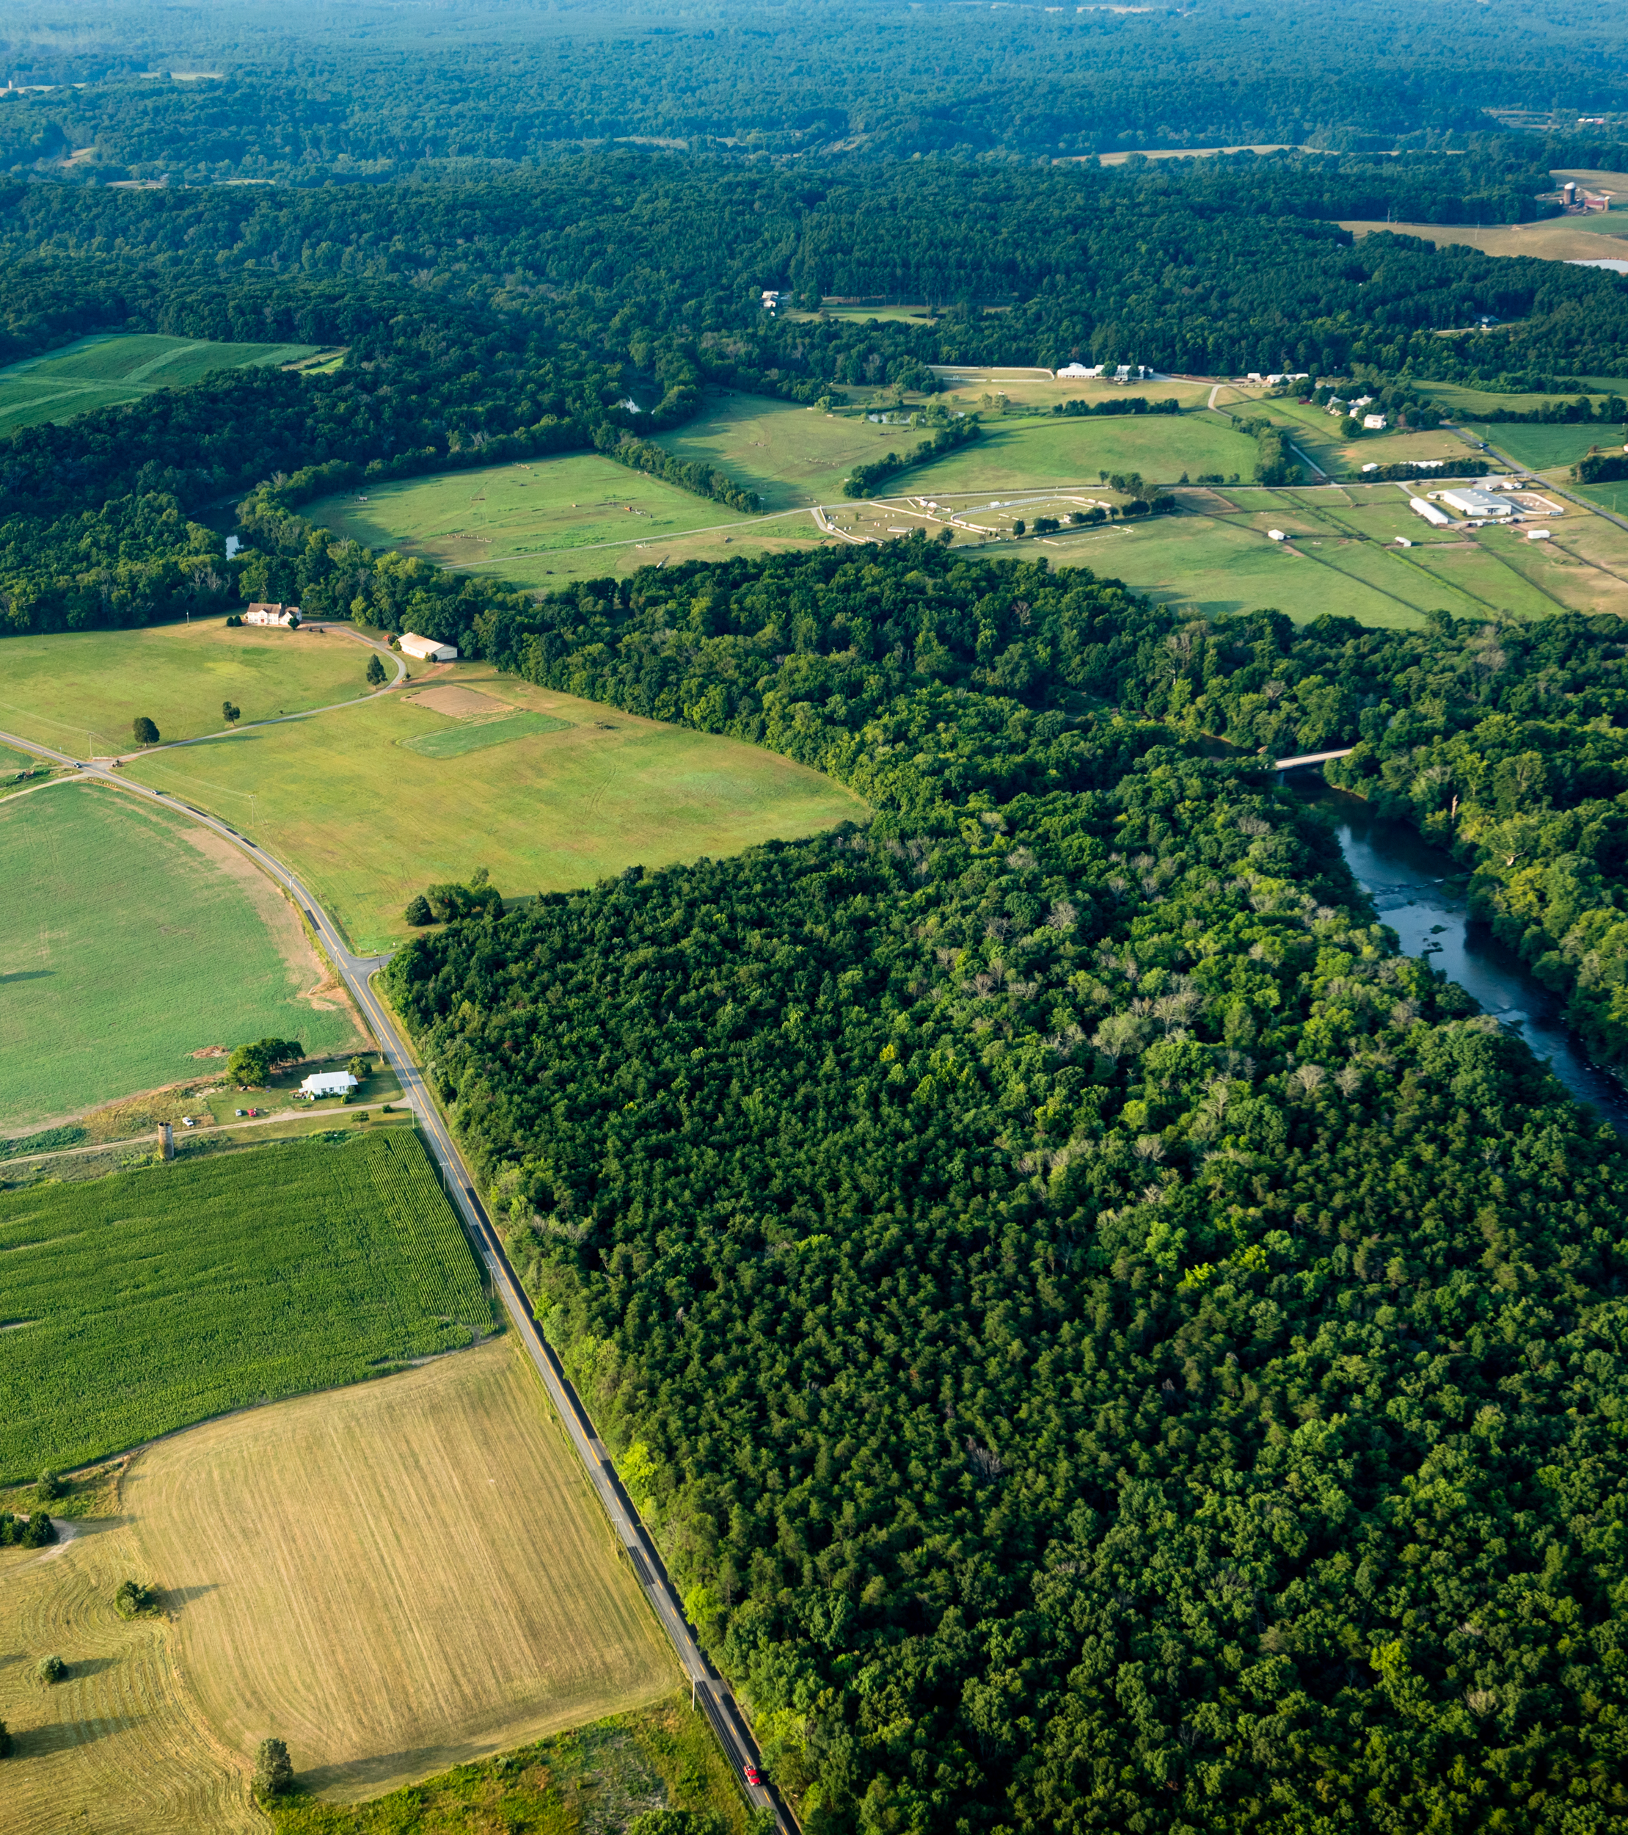
CAST Optimization: Intermediate Status
Kalyanmoy Deb, Pouyan Nejadhashemi, Gregorio Toscano, and Hoda Razavi
Meeting with STAC Members
June 13, 2023
Michigan State University

Slide 2
Agenda
1
Introduction to Michigan State University (MSU) Team
4
Current Status of the Project
2
STAC Workshop Report, 2016: Goals and Applications
5
Short Demo (video)
3
Objectives and Main Tasks of the Project
6
Future Plan

Slide 3

Kalyanmoy Deb
Title:
  University Distinguished Professor
  Koenig Endowed Chair Professor
    Dept of Electrical and Computer Engineering
    Dept of Computer Science and Engineering
    Dept of Mechanical Engineering
Expertise and Achievements:
  Optimization, Multi-objective optimization, Machine Learning, Modeling
  36 years of experience in optimization and its applications
  Author of popular evolutionary optimization methods: NSGA-II, NSGA-III
  Author of two text-books on optimization, 610 research papers
  185,000 Google Scholar citations, h-index: 133
  Director, Computational Opt. and Innovation (COIN) Lab at MSU

Slide 4

Pouyan Nejadhashemi
Title:
  University Foundation Professor
    Department of Biosystems and Agricultural Engineering
    Department of Plant, Soil and Microbial Sciences
  Elected board member
    International Environmental Modelling & Software Society
Expertise and Achievements:
  Soft computing applications in water resources management
  Computational Ecohydrology
  Evaluation and development of watershed and water quality models
  $41M in grant funding
  130 peer-reviewed publications
  180 scientific presentations
  Director, Center for Intelligent Water Resources Engineering (CIWRE)

Slide 5
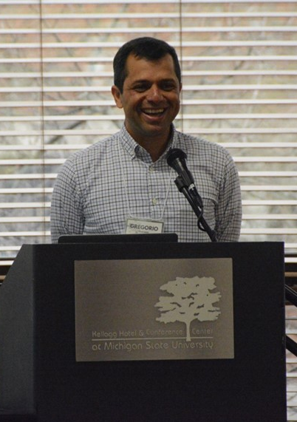
Gregorio Toscano
Title:
  CBPO CAST optimization researcher
  Associate Professor - Center for Research and Advanced Studies, Mexico
  PhD in Evol. Multi-Criterion Optimization, 2005
Expertise and Achievements:
  Multi-objective optimization, Computational Intelligence, and Machine Learning
  Multi-objective Micro-GA, Multi-objective PSO
  Full Stack
  Programming Languages
  7,692 Google Scholar citations

Slide 6

Hoda Razavi
Title:
  PhD Student, Biosystems and Agricultural Engineering, Michigan State University
  MS Water and Hydraulic Structures, Civil Engineering, Khajeh Nasir Toosi University of Technology
  BS Civil Engineering University of Tehran
Expertise:
  Watershed/water quality modeling
  Environmental flow
  Multi-objective optimization
  Uncertainty quantification
  Water resources management
  Data-driven models
  Climate change impacts

Slide 7
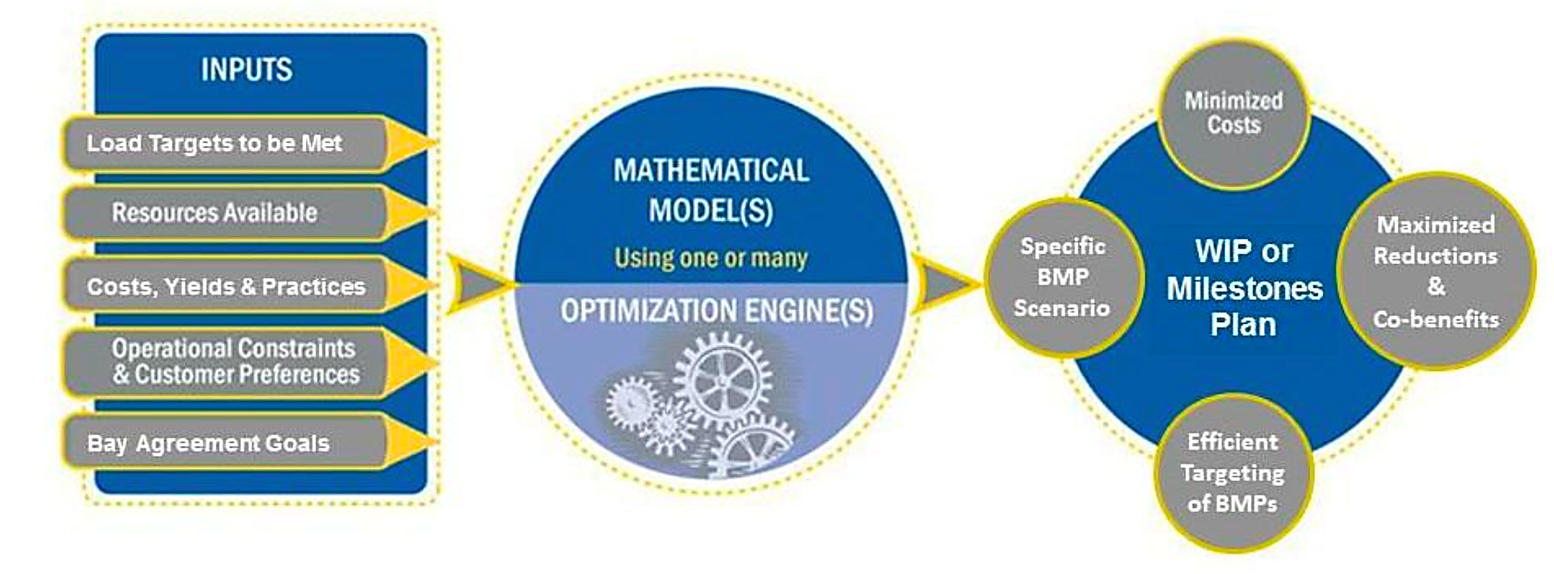
“Cracking the WIP” - Designing an Optimization Engine to Guide Efficient Bay Implementation STAC Workshop Report, 2016
Goals:
Cost minimization was a key goal for the partners
Maximizing co-benefits, particularly those supporting Chesapeake Bay Watershed Agreement goals
Maximizing load reduction reliability
Equitable distribution of effort among jurisdictions
Equitable distribution of effort among source sectors
Limits on retirement of agricultural land
Ability to use the tool at various scales

Slide 8
Applications: STAC Workshop Report, 2016
Under development | Future Application
Address optimization of multiple co-benefits Minimize costs of BMP implementation Optimal use of BMPs on land use by county Make Bay TMDL load targets achievable Make Phase III WIP scenario that achieves nitrogen, phosphorus, and sediment targets for the lowest cost with the ability to tweak to see the different scenario costs | Rethink the allocation of responsibilities by sector, by geography, by funding Recognize the value/influence of ecosystem services in local decision making Assist with the development of grant applications Help local governments document co-benefits of WIP implementation Identify cost savings within a source sector | Provide a basic resource for planners to understand advantages and disadvantages of implementation options Assist progress towards other management strategy objectives Help in development of state implementation plans (Bay Milestones and WIPs) Help in development of local implementation plans (local and Bay TMDLs) Develop sector implementation plans cost effectively

Slide 9
Objective of the MSU-Optimization Project
Investigate, develop, program, verify, and implement an optimization system built around the CBP’s CAST Model to:
Improve the water quality
At the lowest cost

Slide 10
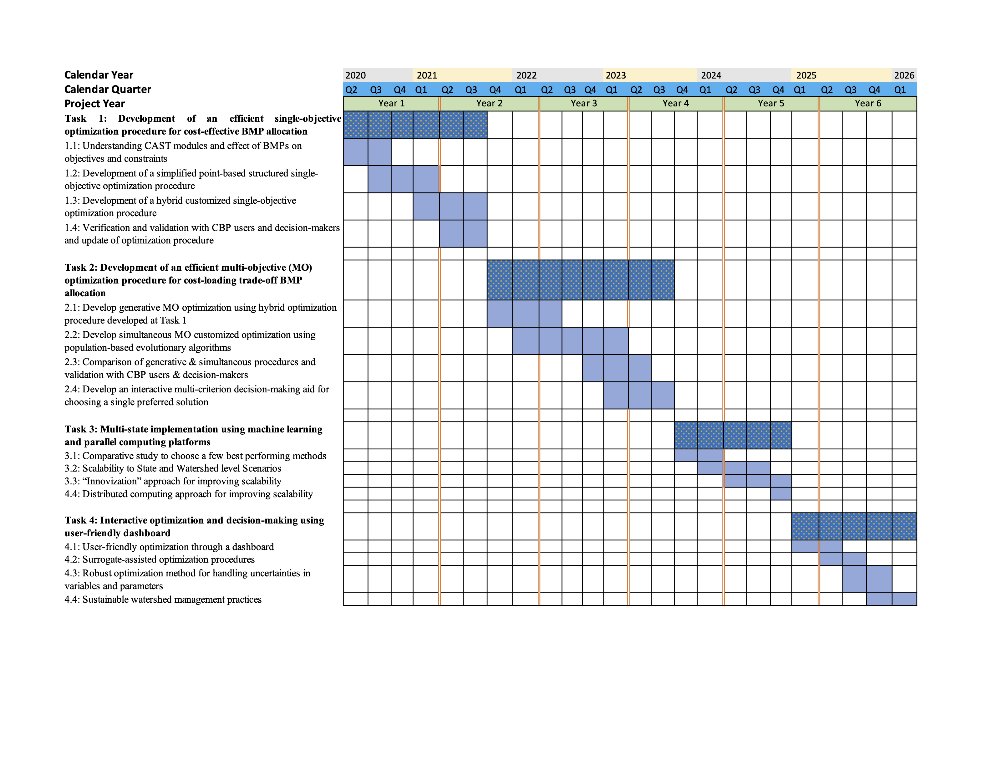
Timeline of the Project
Show our plan here
We are here
Notes:
Pouyan asked to change the tasks names.
GT: Tasks names updated.

Slide 11
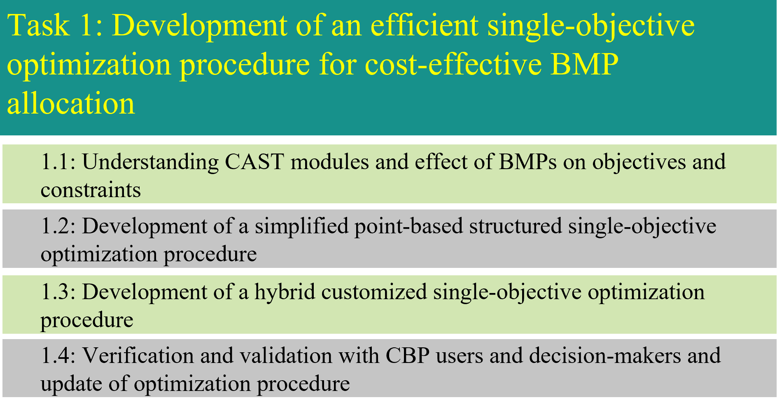
Timeline of the Project
Show our plan here
We are here
Notes:
Pouyan asked to change the tasks names.
GT: Tasks names updated.

Slide 12
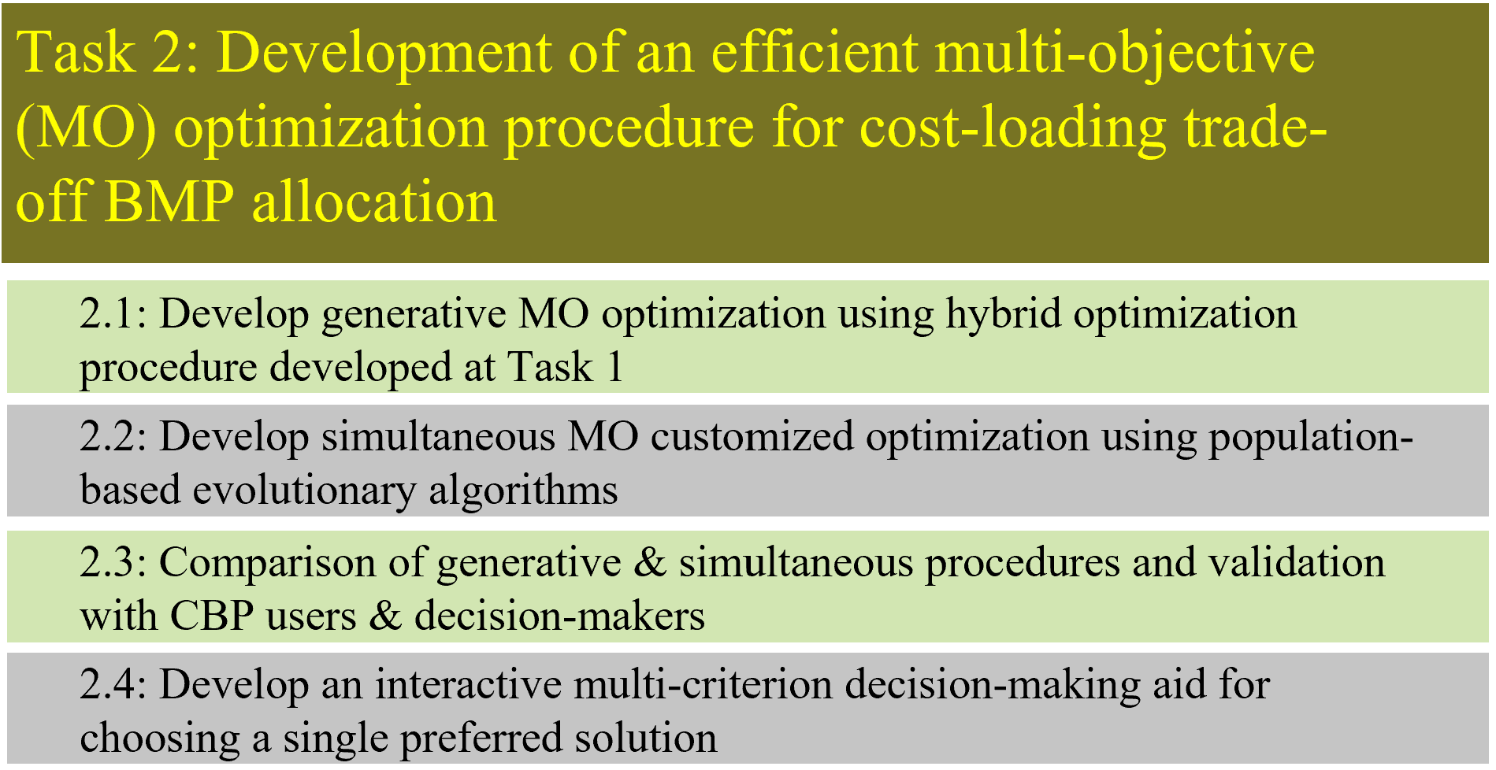
Timeline of the Project
Show our plan here
We are here
Notes:
Pouyan asked to change the tasks names.
GT: Tasks names updated.

Slide 13
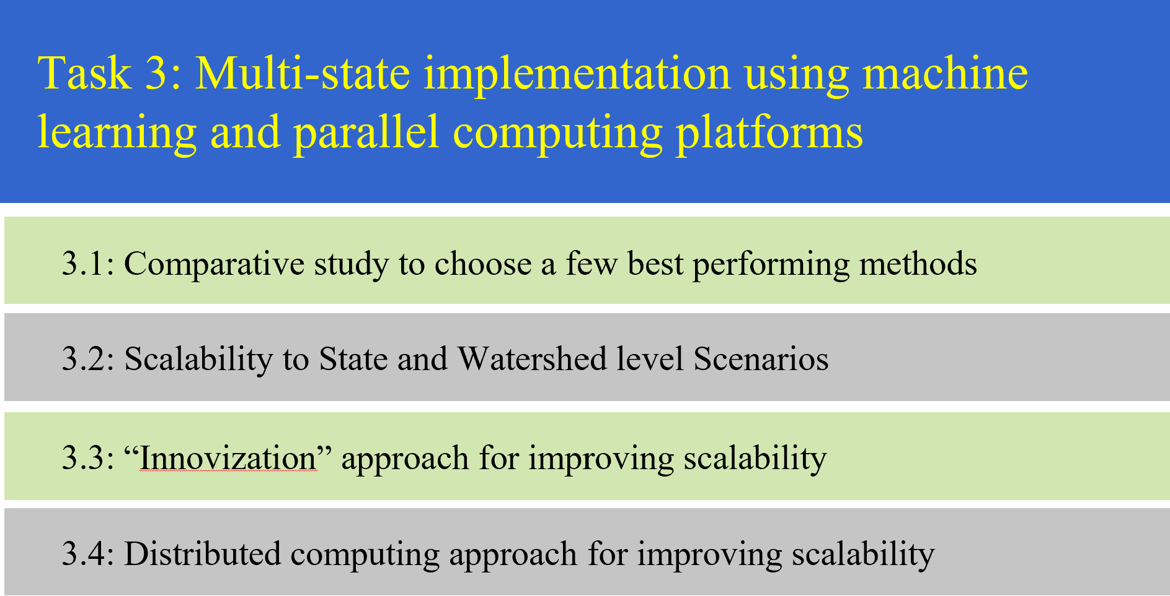
Timeline of the Project
Show our plan here
We are here
Notes:
Pouyan asked to change the tasks names.
GT: Tasks names updated.

Slide 14
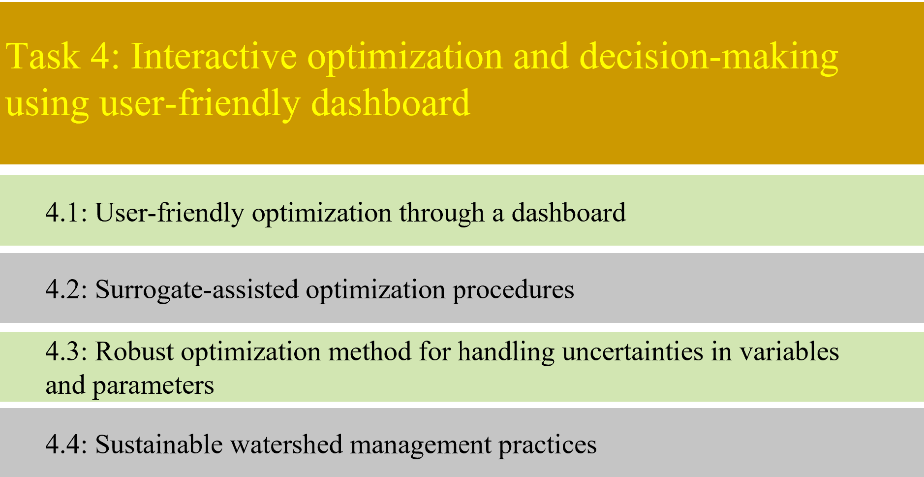
Timeline of the Project
Show our plan here
We are here
Notes:
Pouyan asked to change the tasks names.
GT: Tasks names updated.

Slide 15
Related Optimization Research at MSU
Point and population-based optimization and their combined use
A case study on a billion-variable resource allocation problem
Multi-objective optimization (MO) and decision-making
  Evolutionary multi-objective optimization (EMO) algorithms to find multiple Pareto solutions
  "Innovization": Knowledge extraction from learning from Pareto solutions
  Multi-criterion decision-making (MCDM) to choose a preferred Pareto solution

Slide 16
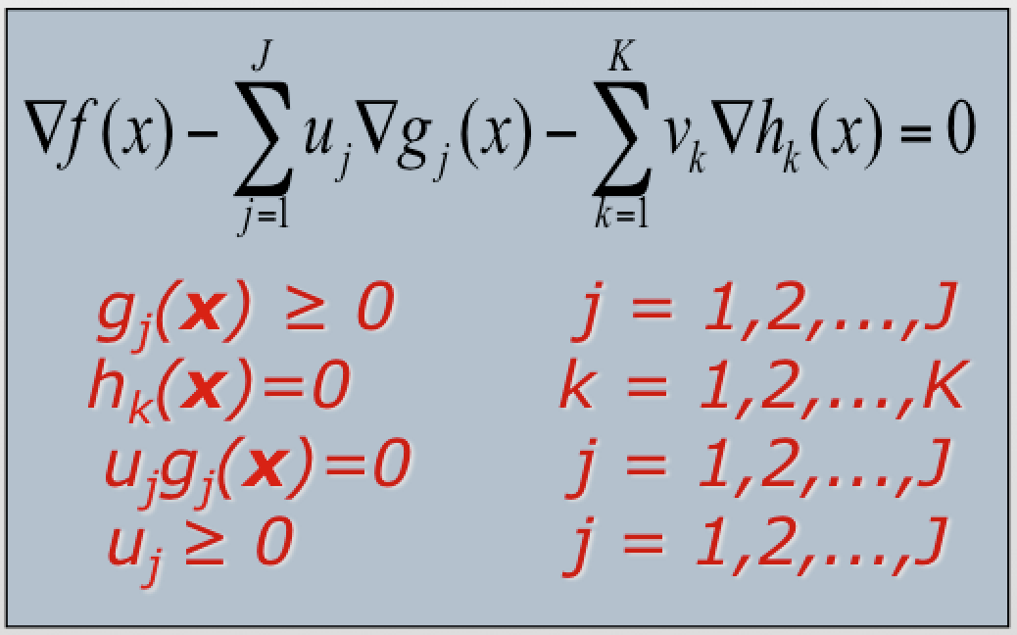

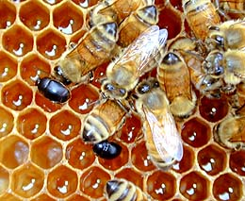
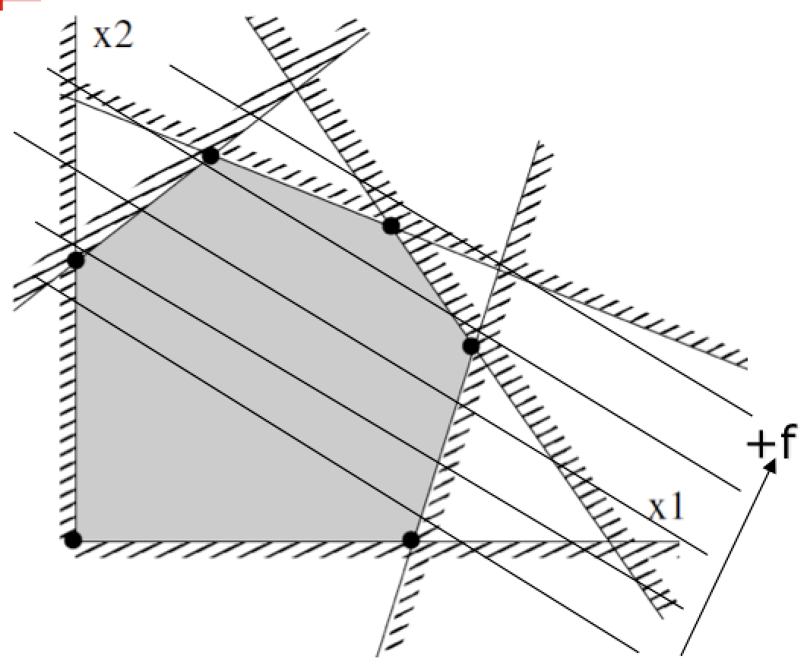
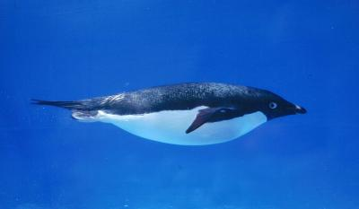
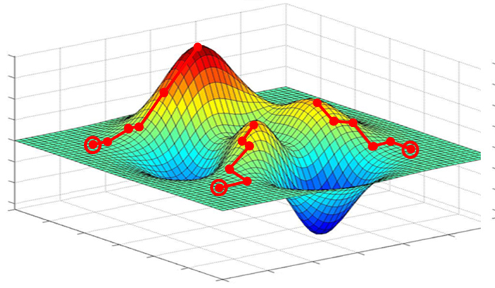
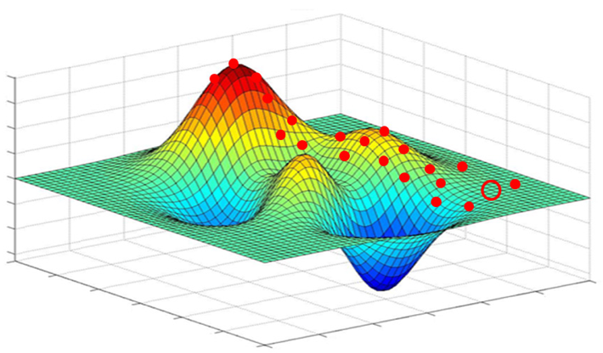
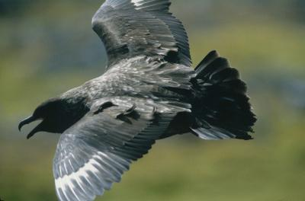
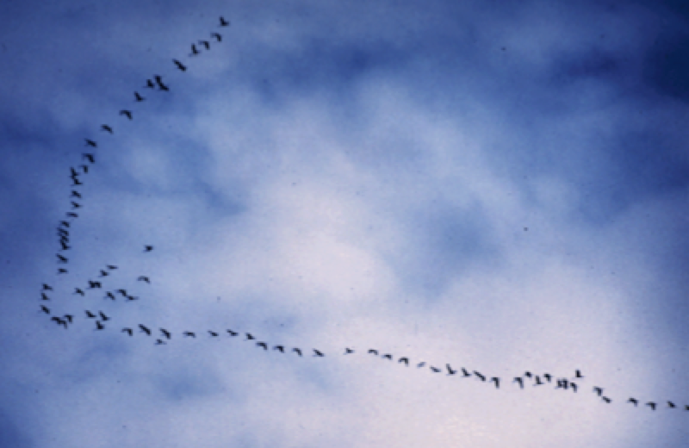
Point and Population Based
Optimization Methods: Adv and Disadv
Point-Based
Population-Based
Best for
simplistic problems, difficult to modify for different problem classes
Ideal for local search
Nonlinear Programming
Best for
complex problems, flexible to suit a problem class
Ideal for global search
Linear
Programming
Math. optimization
Evolutionary optimization
Single-obj Opt.:
Search for a point which minimizes an
objective function satisfying constraints
Other Metaheuristics

Slide 17
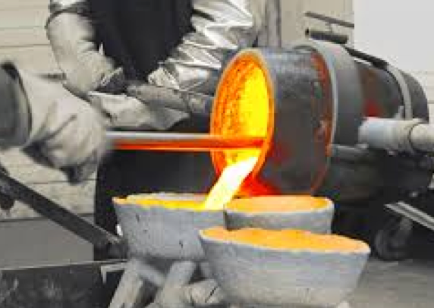
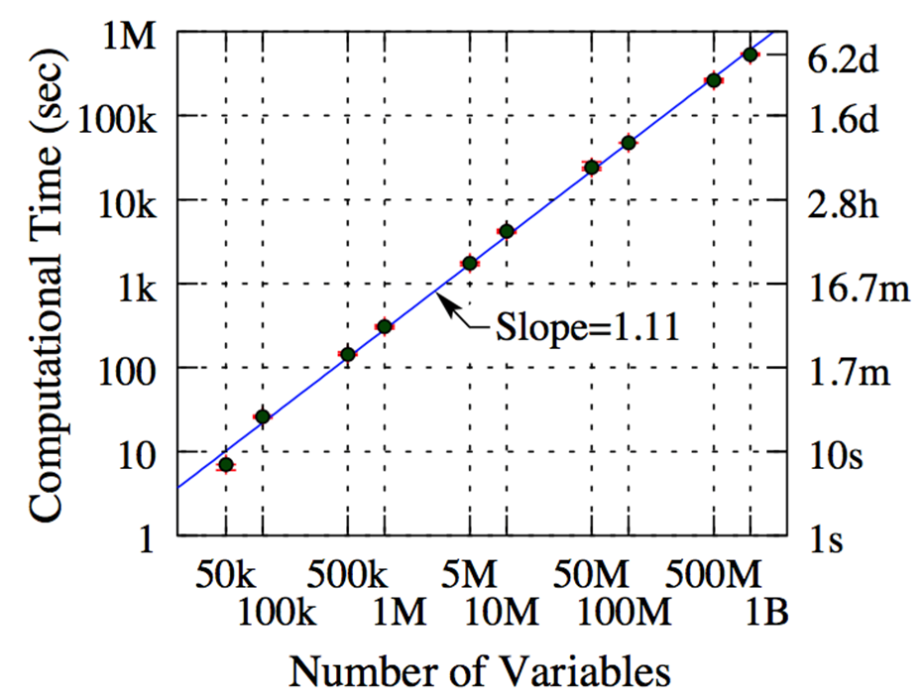
Population-based Optimization:
A Case Study on Resource Allocation Problem
Casting scheduling problem requiring 50,000 variables
CPLEX software could not solve 2,000-variable version
Customized Evol. Algorithm (population based) solves Billion-variable version
  Polynomial time performance
Deb, K. and Myburgh, C. (2017). A Population-Based Fast Algorithm for a Billion-Dimensional Resource
Allocation Problem with Integer Variables. European Journal of Operational Research, 261(2), 460–474.

Slide 18
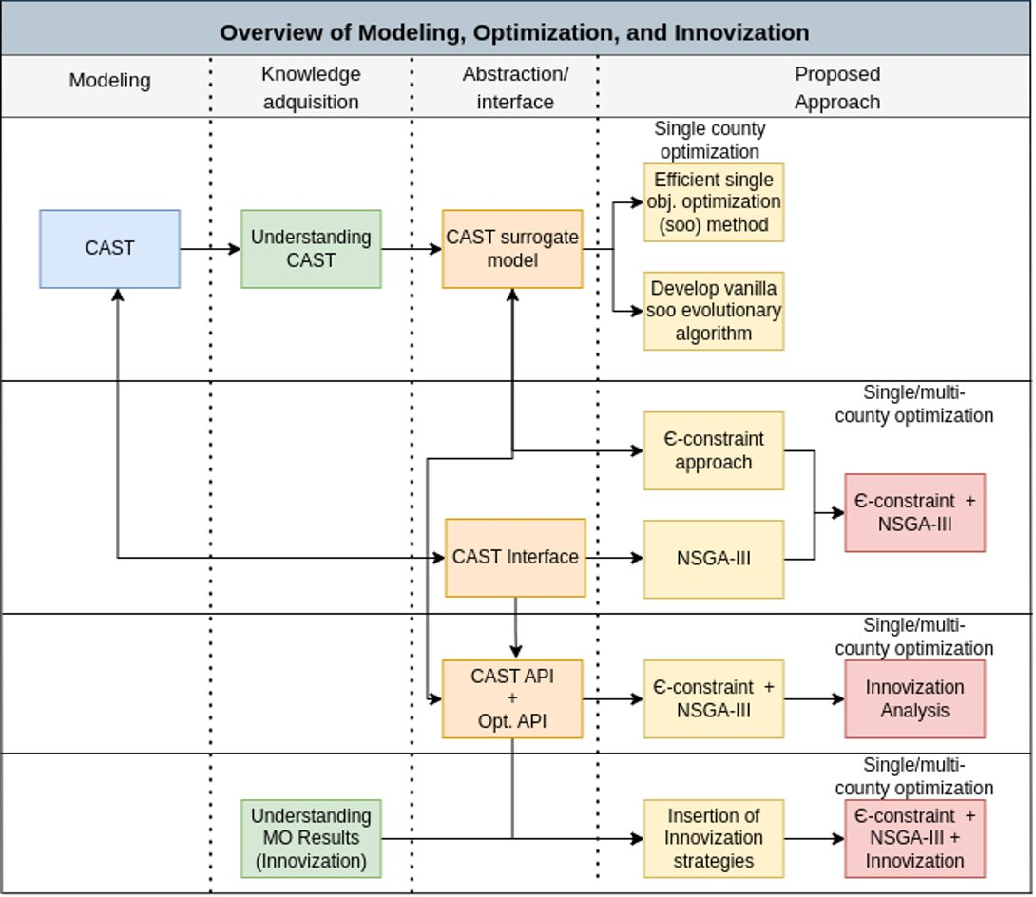

Slide 19
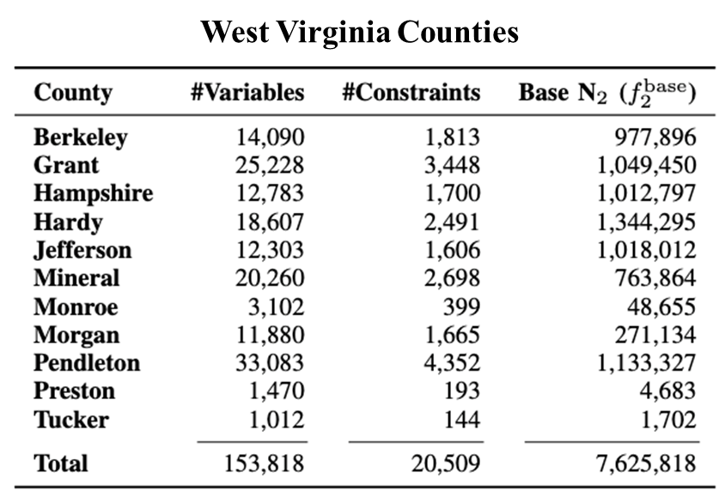
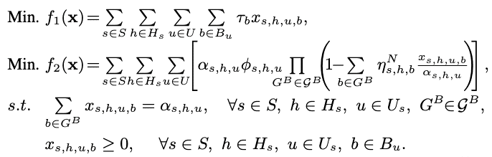

Chesapeake Bay Watershed Optimization Problem
Allocate a specific BMP to
  Land River Segment (LRS)
  Agency
  Load source
Minimize {Cost, Loadings}
Large number of variables will require large computational time
s: LRS
h: Agency
u: Load source
b: BMP
Surrogate model:
(N2)

Slide 20
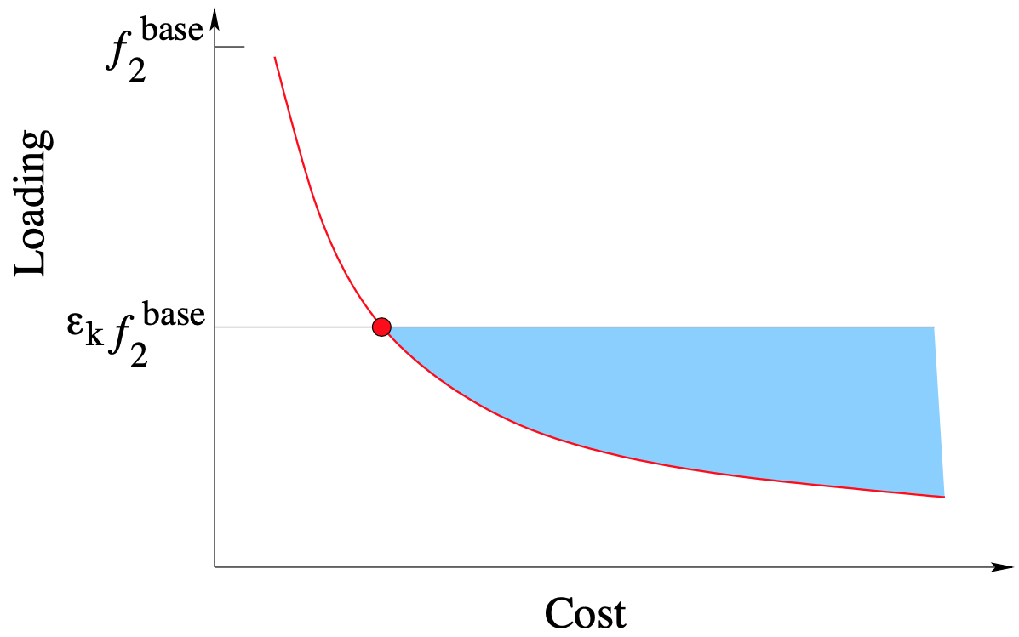
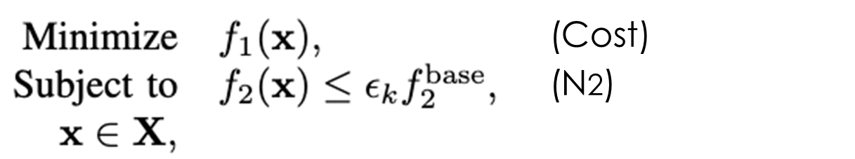
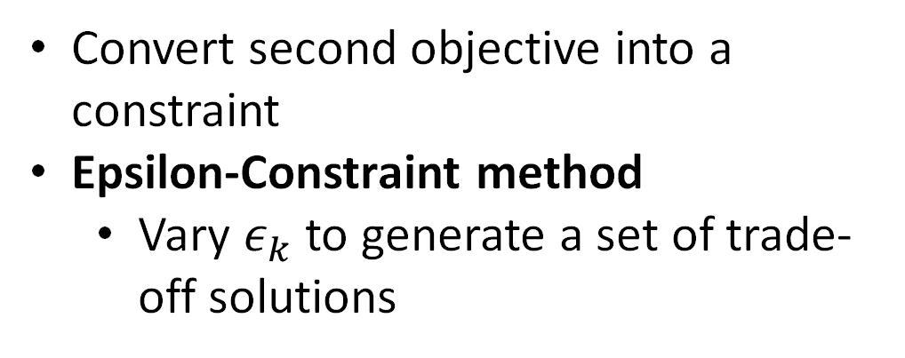
Converting Multiple Objectives Into One
Convert second objective into a constraint
Epsilon-Constraint method
  Vary $ε_{k}$ to generate a set of trade-off solutions

Slide 22
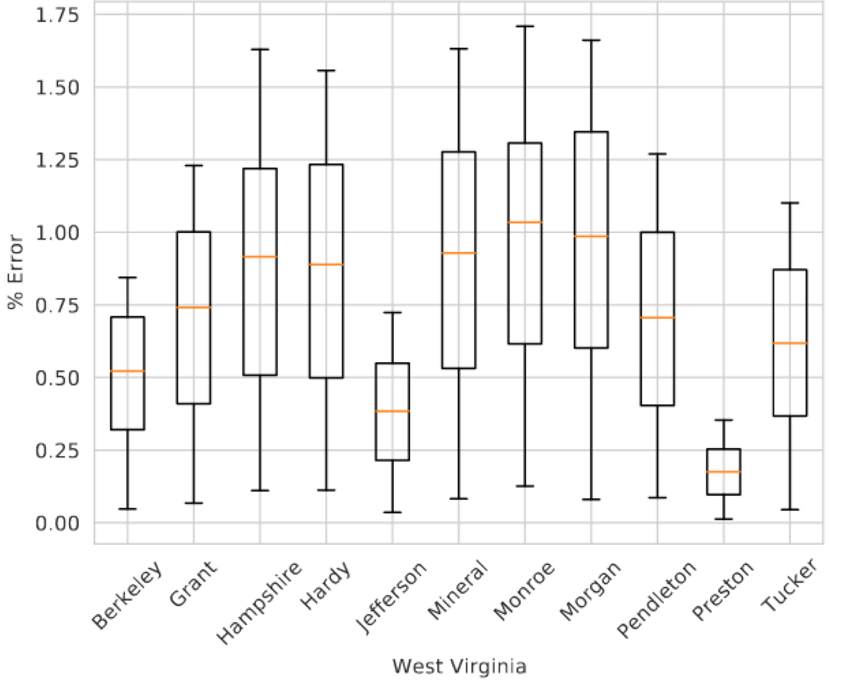
Surrogate Model Error
Surrogate Model Percent Error Compared To CAST
10,000 BMP scenarios are evaluated using surrogate model and CAST on West Virginia counties
Observed small error in Nitrogen loading value
Supports the use of surrogate model based optimization, if needed

Slide 23
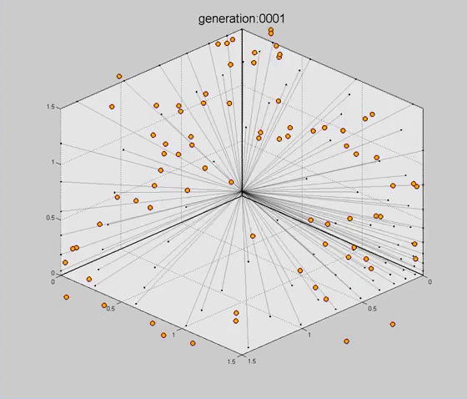
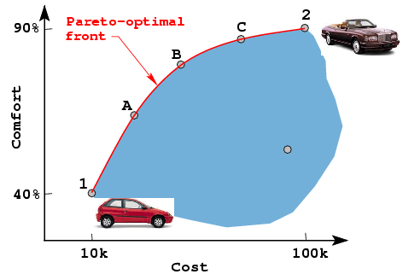
Multi-Objective Optimization
Results in a set of Pareto-optimal solutions
Step 1: Find multiple trade-off solutions
Step 2: Choose a preferred solution
Evol. Multi-objective optimization (EMO)
NSGA-III can handle 2-15 objectives with constraints

Slide 24
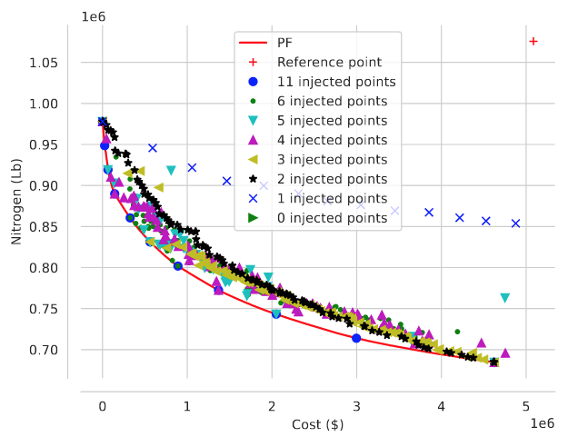
Customized NSGA-III for CBW Problem
Berkeley County
NSGA-III initialized with Eps-Constraint solutions
Repair operator to fix constraint violation
Optimize surrogate model
Major finding:
Toscano, G., Hernandez-Suarez, J. S., Blank, J., Nejadhashemi, P., Deb, K. and Linker, L. (2022). Large-scale Multi-objective Optimization for Water Quality in Chesapeake Bay Watershed. Proceedings of 2022 Congress on Evolutionary Computation (CEC-2022), IEEE Press. (pp. 1–8). BEST PAPER AWARD
At least 3 injected solutions make NSGA-III efficient

Slide 26
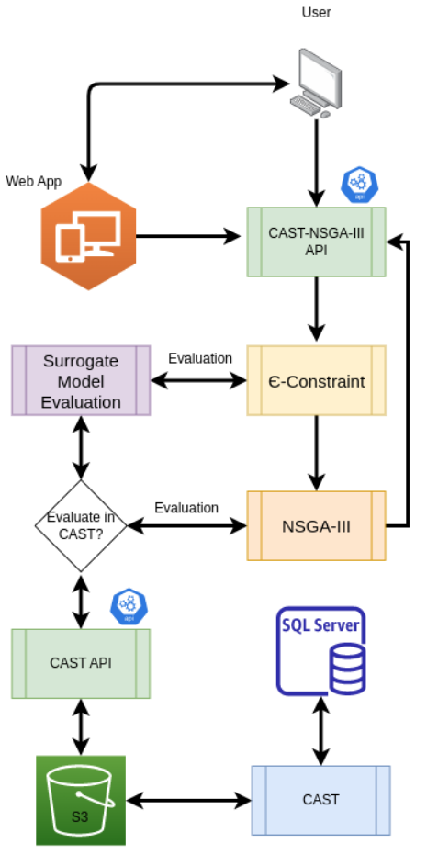

API-based Linking of CAST with NSGA-III
Automatic Programming Interface (API)
Allows multiple users with different programming environments to interact
Makes application modular

Slide 27
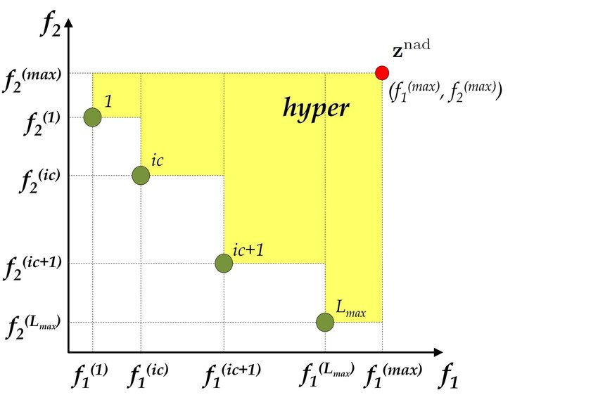
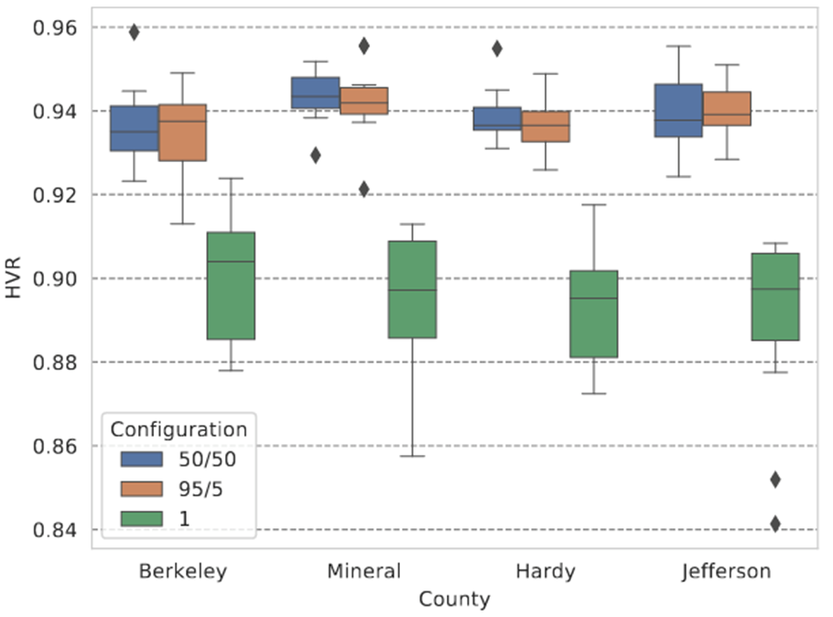
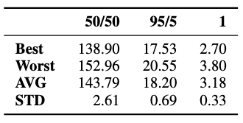

NSGA-III Linked with CAST
Hypervolume (HV)
NSGA-III calls CAST to evaluate using Restful APIs
Mixed Heterogeneity:
  50/50: 50% surrogate, 50% CAST
  95/5: 95% surrogate, 5% CAST
  1: All surrogates, evaluate final solutions by CAST
Time (min)
Major finding:
95/5 is almost as good but requires less time

Slide 28
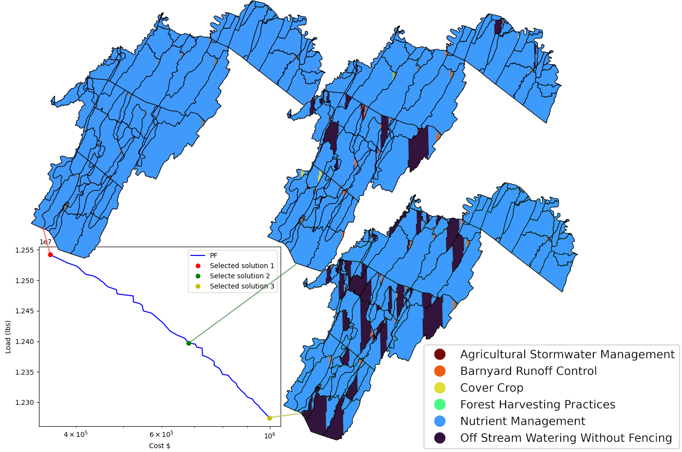
Alternate Solutions Using
Multi-objective Optimization
Evaluate alternate solutions before picking a single preferred solution
Analyze solutions for extracting knowledge for future use

Slide 29
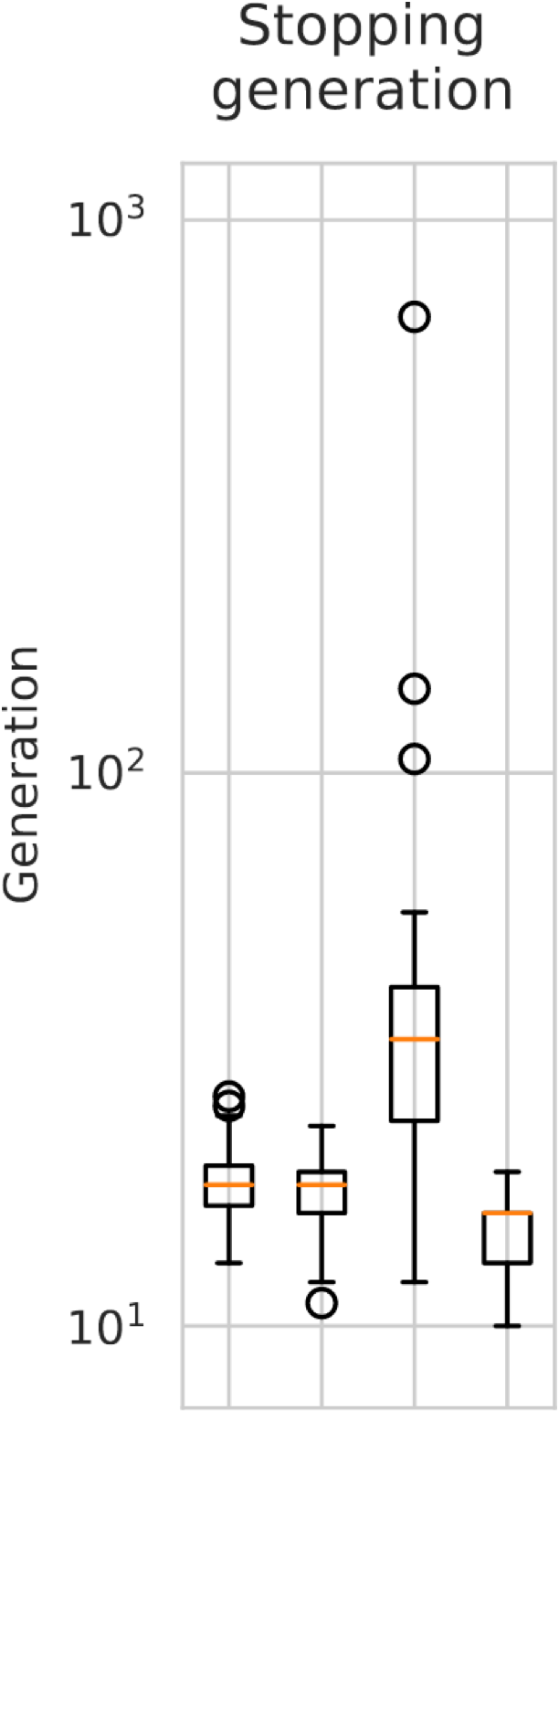
Multi-County Optimization
Observation:
  Some combinations of counties make the problem easier to solve compared to individual counties
    Ex: Group gets optimized faster than Hampshire county
Major finding:
This provides promise for extending the proposed optimization method to multi-state and to watershed level
Grant
Group
Berkeley
Hampshire
Counties and Group

Slide 30

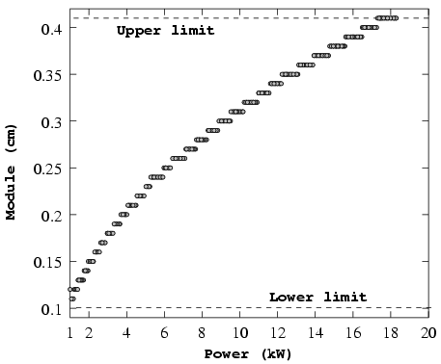
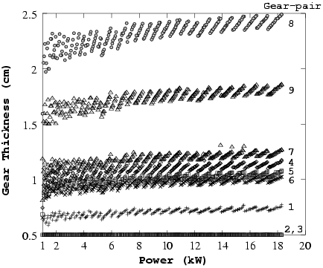
“Innovization”
A Gear-box design with 28 variables
Innovation through Optimization
Not much change in 27 variables
Finding patterns in Pareto-optimal solutions for knowledge discovery using AI/ML methods
Optimality conditions must manifest as common patterns
Extract patterns and re-optimize
Large change in one variable
Deb, K. and Srinivasan, A. (2006). Innovization: Innovating design principles through optimization. Proceedings of the Genetic and Evolutionary Computation Conference (GECCO2006), New York: The Association of Computing Machinery (ACM), (pp. 1629–1636)

Slide 32
Knowledge Discovery Using Optimization
What are the benefits of optimization?
  Identify the best solutions for the problem in hand.
  Generating knowledge to solve future problems.

Slide 33
Innovization Analysis
What is innovization?
Learning from optimization results and introducing new ideas, products, and services different from the existing ones.
1
What innovization can do to CBPO?
Provide information for better decision-making for BMP selections (farmers)
Identify the high priority areas for BMP implementation (regulators)
Help with resources allocation (policymakers)
2

Slide 34
Methodology
BMP Selection ranking methodology based on Land use:
Overall goal: learn from optimization results to
1
Examine different ranking methodologies to identify the top BMPs,
2
Identify the similarities and differences between top-ranked BMPs,
3
Provide recommendations to reduce the optimization time

Slide 35
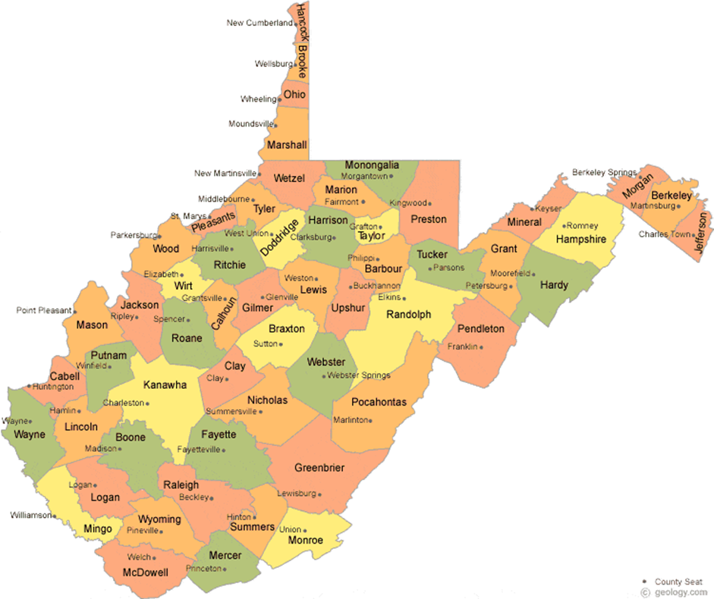
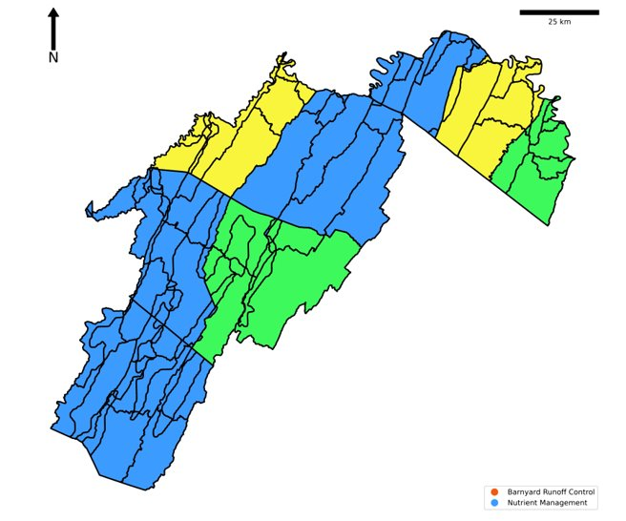
Methodology
BMP Selection ranking methodology based on Land use:
In West Virginia, we identified the top two counties with the highest areas of urban and agricultural land uses.
(Berkeley and Mineral): Urban dominated
(Jefferson and Hardy): Agricultural dominated
Notes:
Our study area is West Virginia. Based on the total land use area in West Virginia, we identified the top two countries with the highest areas of urban and agricultural land uses for innovization.
Study area: WV

Slide 36
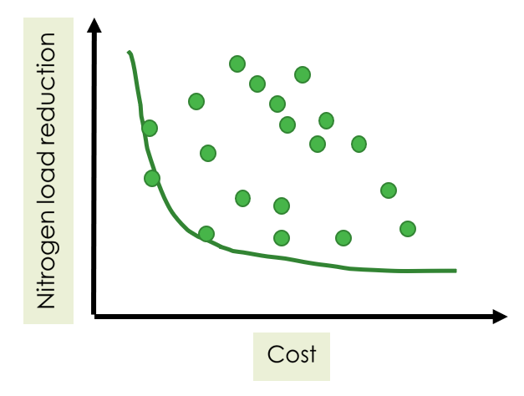

Methodology
1
Running CAST-optimization algorithm resulted in 220 solutions for each county
2
2420 solutions for 11 counties in about thousands land river segments.
3
Identified the best solutions from optimization.

Slide 37
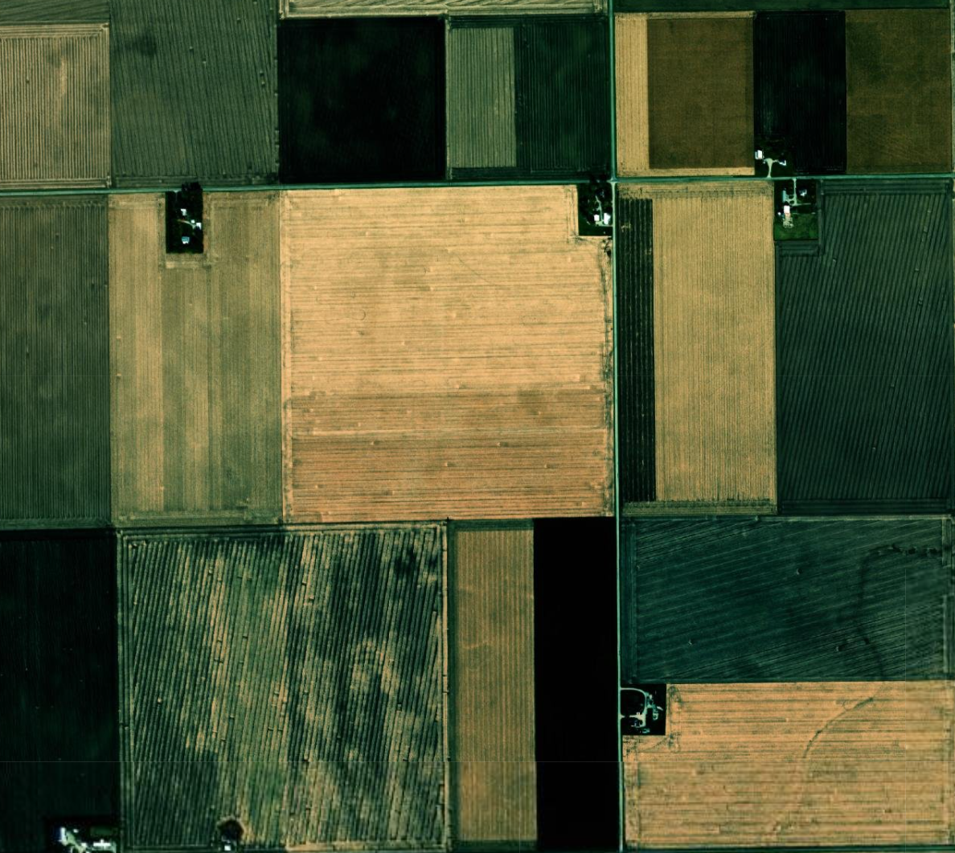



Methodology
1
Examine different ranking methodologies to identify the top BMPs,
Ranking methodology 1) rank the top BMPs based on the implementation acreages;
Ranking methodology 2) rank the top BMPs based on the percentage of maximum allowable acreages;
Ranking methodology 3) rank the top BMPs based on the amount of nitrogen reduction per dollar spent.
1
2
3
Notes:
Item 1) We propose three ranking strategies from the Pareto front:
Strategy 1) rank the top BMPs based on the implementation acreages;
Strategy 2) rank the top BMPs based on the percentage of maximum allowable acreages for specific BMPs;(every BMP does not apply to a certain place, this metric tells us what proportion of this allowable isused by our solutions.
Strategy 3) rank the top BMPs based on the amount of nitrogen reduction per dollar spent.

Slide 38
Methodology
1
Examine different ranking methodologies to identify the top BMPs,
Ranking methodology 1) rank the top BMPs based on the implementation acreages;
Ranking methodology 2) rank the top BMPs based on the percentage of maximum allowable acreages;
Ranking methodology 3) rank the top BMPs based on the amount of nitrogen reduction per dollar spent.
Ranking methodology1):
BMP1
BMP2
BMP3
BMP1
BMP2
BMP 3
Notes:
Item 1) We propose three ranking strategies from the Pareto front:
Strategy 1) rank the top BMPs based on the implementation acreages;
Strategy 2) rank the top BMPs based on the percentage of maximum allowable acreages for specific BMPs;(every BMP does not apply to a certain place, this metric tells us what proportion of this allowable isused by our solutions.
Strategy 3) rank the top BMPs based on the amount of nitrogen reduction per dollar spent.

Slide 39
Methodology
1
Examine different ranking methodologies to identify the top BMPs,
Ranking methodology 1) rank the top BMPs based on the implementation acreages;
Ranking methodology 2) rank the top BMPs based on the percentage of maximum allowable acreages;
Ranking methodology 3) rank the top BMPs based on the amount of nitrogen reduction per dollar spent.
Ranking methodology 2):
BMP3
BMP2
BMP1
BMP1
BMP2
BMP 3
Notes:
Item 1) We propose three ranking strategies from the Pareto front:
Strategy 1) rank the top BMPs based on the implementation acreages;
Strategy 2) rank the top BMPs based on the percentage of maximum allowable acreages for specific BMPs;(every BMP does not apply to a certain place, this metric tells us what proportion of this allowable isused by our solutions.
Strategy 3) rank the top BMPs based on the amount of nitrogen reduction per dollar spent.

Slide 40
Methodology
Ranking methodology 1) rank the top BMPs based on the implementation acreages;
Ranking methodology 2) rank the top BMPs based on the percentage of maximum allowable acreages;
Ranking methodology 3) rank the top BMPs based on the amount of nitrogen reduction per dollar spent.
1
Examine different ranking methodologies to identify the top BMPs,
Ranking methodology3):
BMP2 ($12/lb N)
BMP3 ($15/lb N)
BMP1($24/lb N)
BMP1
BMP2
BMP 3
Notes:
Item 1) We propose three ranking strategies from the Pareto front:
Strategy 1) rank the top BMPs based on the implementation acreages;
Strategy 2) rank the top BMPs based on the percentage of maximum allowable acreages for specific BMPs;(every BMP does not apply to a certain place, this metric tells us what proportion of this allowable isused by our solutions.
Strategy 3) rank the top BMPs based on the amount of nitrogen reduction per dollar spent.

Slide 41
Methodology
1
Examine different ranking methodologies to identify the top BMPs,
Ranking methodology 1) rank the top BMPs based on the implementation acreages;
Ranking methodology 2) rank the top BMPs based on the percentage of maximum allowable acreages;
Ranking methodology 3) rank the top BMPs based on the amount of nitrogen reduction per dollar spent.
Ranking methodology1):
BMP1
BMP2
BMP3
Ranking methodology2):
BMP3
BMP2
BMP1
BMP1
Ranking methodology3):
BMP2 ($12/lb N)
BMP3 ($15/lb N)
BMP1($24/lb N)
BMP2
BMP 3
Notes:
Item 1) We propose three ranking strategies from the Pareto front:
Strategy 1) rank the top BMPs based on the implementation acreages;
Strategy 2) rank the top BMPs based on the percentage of maximum allowable acreages for specific BMPs;(every BMP does not apply to a certain place, this metric tells us what proportion of this allowable isused by our solutions.
Strategy 3) rank the top BMPs based on the amount of nitrogen reduction per dollar spent.

Slide 42
Results:
2
Identify the similarities and differences between top-ranked BMPs,
Table: Top choice BMPs based on the all three-ranking methodology
All three-ranking methodologies:

Slide 43
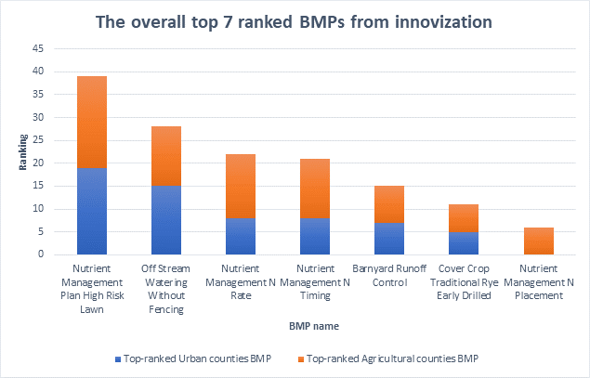
Results:
3
Provide recommendations to reduce the optimization time
Obtaining the total ranking of each BMP by adding the associated ranking to induvial BMPs.
Notes:
Item 3) Recommend an innovative approach to reduce the optimization time through a new BMP ranking strategy. Each ranking mythology has advantages and disadvantages.we come up with an approach to to use a weighted average to come up with a common approach that get benefits of all three rankings.results are presented here.

Slide 44
Results:
2
Identify the similarities and differences between top-ranked BMPs,
Similarities:
Top BMP choice: Nutrient management lawn or farm
The pasturelands: Off-stream watering facilities
Differences:
More diversity in BMP types was in agricultural settings compared to urban ones.

Slide 45
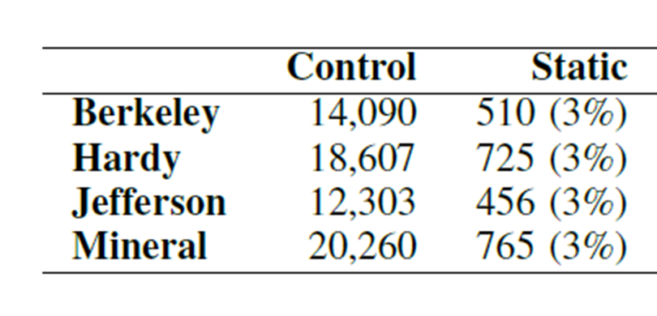
“Innovization” Study on CBW Problem
Variable Reduction
Pareto solutions spilt for rural and urban counties
7 out of 200 BMPs are frequently used in Pareto solutions
1
3
Frequency of BMPs extracted
Re-optimize using only 7 BMPs
2
4

Slide 46
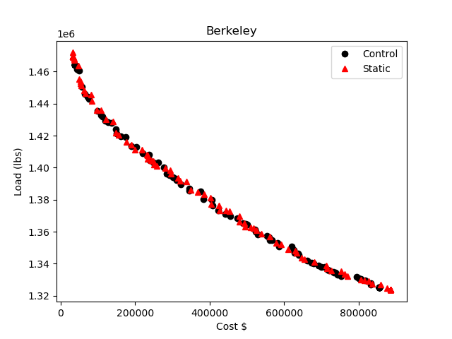
Reoptimization Using Innovization
Results on Berkeley County
Notes:
Comment: Gregorio please replace this figure with the all combined counties
GT: I have the plot.
Comment2: Gregorio: Please add a new figure for Berkely here. I modified the one from your papr that which include other methods (e.g., preferred)
GT: I understood that you want a figure comparing the result of only one strategy vs the Control one. Here I have the accumulated PF, using Strategy 2 (which was the selected one for Hoda’s paper).
GT: I also added the next slide (which is hidden) with the attainment surface.

Slide 47
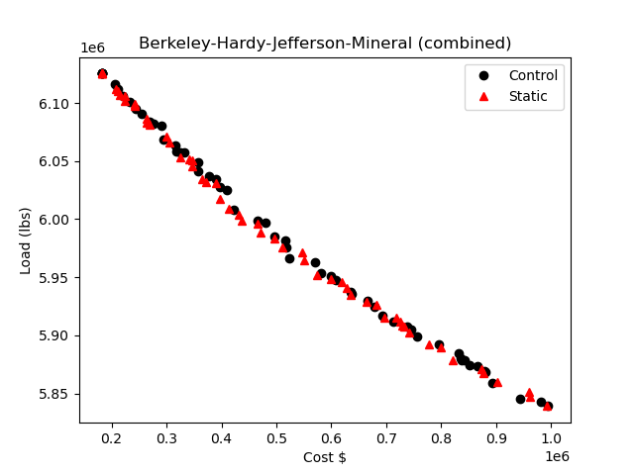
Reoptimization Using Innovization
Results on Berkeley, Hardy, Jefferson, and Mineral Counties (Combined)
Notes:
Comment: Gregorio please replace this figure with the all combined counties
GT: I have the plot.
Comment2: Gregorio: Please add a new figure for Berkely here. I modified the one from your papr that which include other methods (e.g., preferred)
GT: I understood that you want a figure comparing the result of only one strategy vs the Control one. Here I have the accumulated PF, using Strategy 2 (which was the selected one for Hoda’s paper).
GT: I also added the next slide (which is hidden) with the attainment surface.

Slide 48

Results:
3
Provide recommendations to reduce the optimization time
Recommend the selection of the top seven BMPs from the overall column for optimization.
Can be used in developing the initial population in other counties within the state of West Virginia.
Hypothesis: this approach could significantly reduce the optimization processing time while producing more cost-effective BMP implementation plans.
Notes:
we recommend the selection of the top seven BMPs from the overall column for optimization.
This group of BMPs can be used in developing the initial population for the optimization process in other counties within the state of West Virginia.
Hypothesis: this approach could significantly reduce the optimization processing time while producing more cost-effective BMP implementation plans.

Slide 49
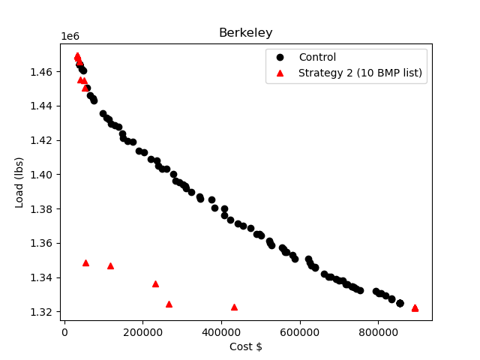
Reoptimization Using Innovization
Results on Berkeley County
Notes:
Comment: Gregorio please replace this figure with the all combined counties
GT: I have the plot.
Comment2: Gregorio: Please add a new figure for Berkely here. I modified the one from your papr that which include other methods (e.g., preferred)
GT: I understood that you want a figure comparing the result of only one strategy vs the Control one. Here I have the accumulated PF, using Strategy 2 (which was the selected one for Hoda’s paper).
GT: I also added the next slide (which is hidden) with the attainment surface.

Slide 50
Prototype Interactive Web Tool
Input-output through the web portal (Done)
1
Collects scenario for optimization (Done)
2
NSGA-III is invoked and calls CAST for evaluation (Done)
3
Calls Decision-making Dashboard for analysis of Pareto solutions (Remaining)
4
Re-optimize using "Innovized" principles until satisfied (Partially Done)
5

Slide 51
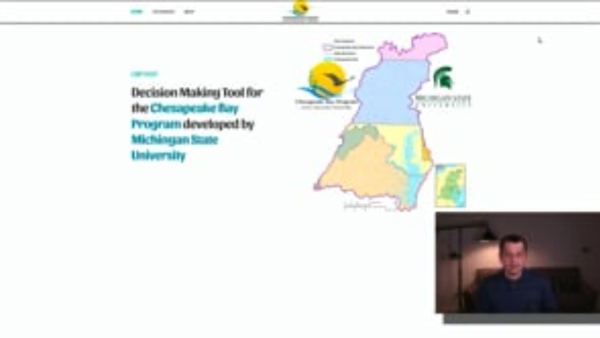

Slide 52
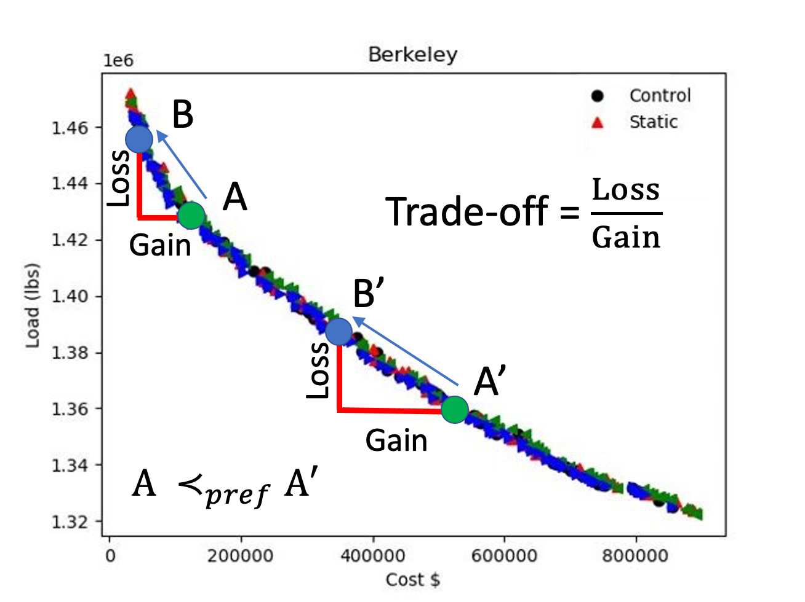
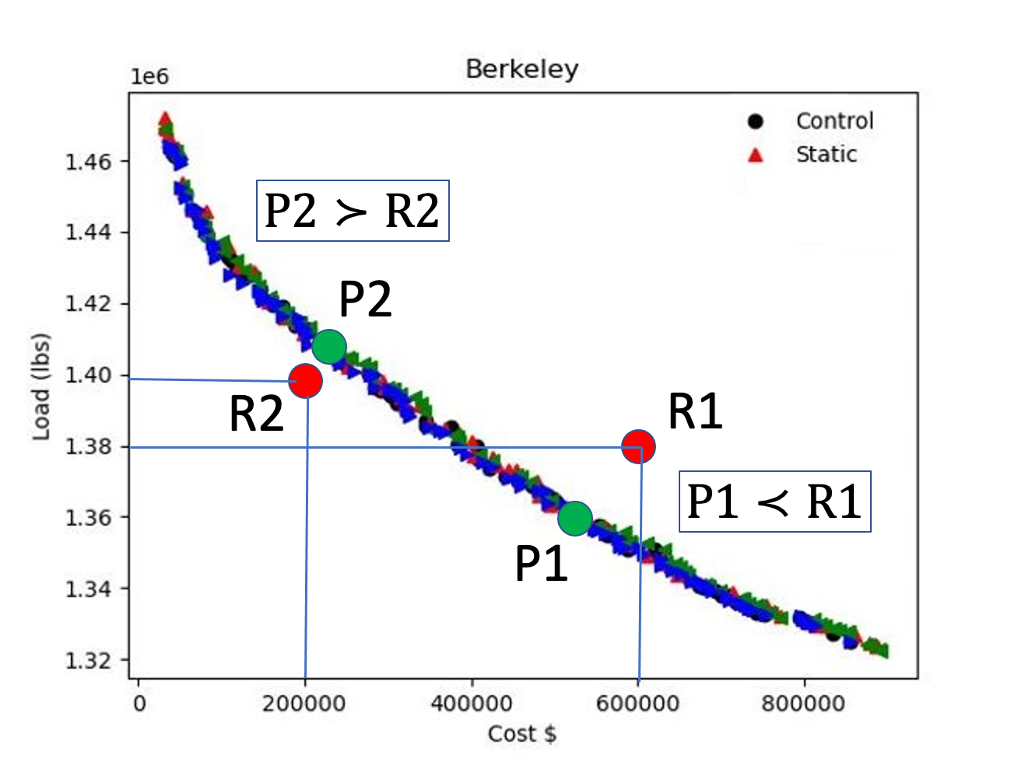
Decision-Making Methods
Decision-making:
A systematic approach to pick a preferred solution
  A-posteriori Trade-off analysis
  A-priori Aspiration based approach
  Interactive EMO-MCDM
    DM provides preference information during optimization
Deb, K., Sundar, J., Reddy, Uday, B., and Chaudhuri, S. (2006). Reference point based multi-objective optimization using evolutionary algorithms. International Journal of Computational Intelligence Research (IJCIR), 2(6), 273–286.

Slide 53
Remaining Tasks
Completion of all BMP types: Land conversion, Animal, Manure transport, etc.
More than two-objective optimization
Multi-criterion Decision-making (MCDM) to choose a single solution
Harnessing hardware parallelism
Converted Oxygen optimization to combine multiple loadings
Scale-up study to multi-state and watershed level optimization
Dashboard for interactive applications
  A partial framework is completed
Demonstration through workshops and tutorials

Slide 54




Computational Optimization and Innovation
Thank you

