Slide 1
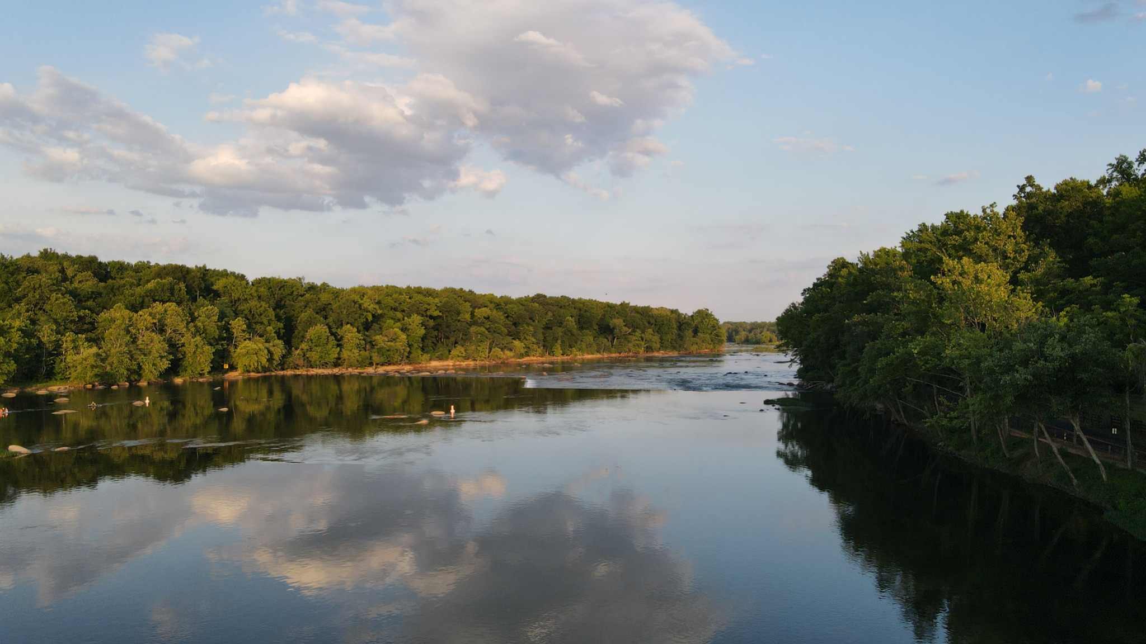

Comprehensive Evaluation of Chesapeake Bay Response to Water Quality Efforts: Gaps, Uncertainties, and Policy Implications
Maryland Governor’s Chesapeake Bay Cabinet
Denice Wardrop
June 1, 2023

Slide 2
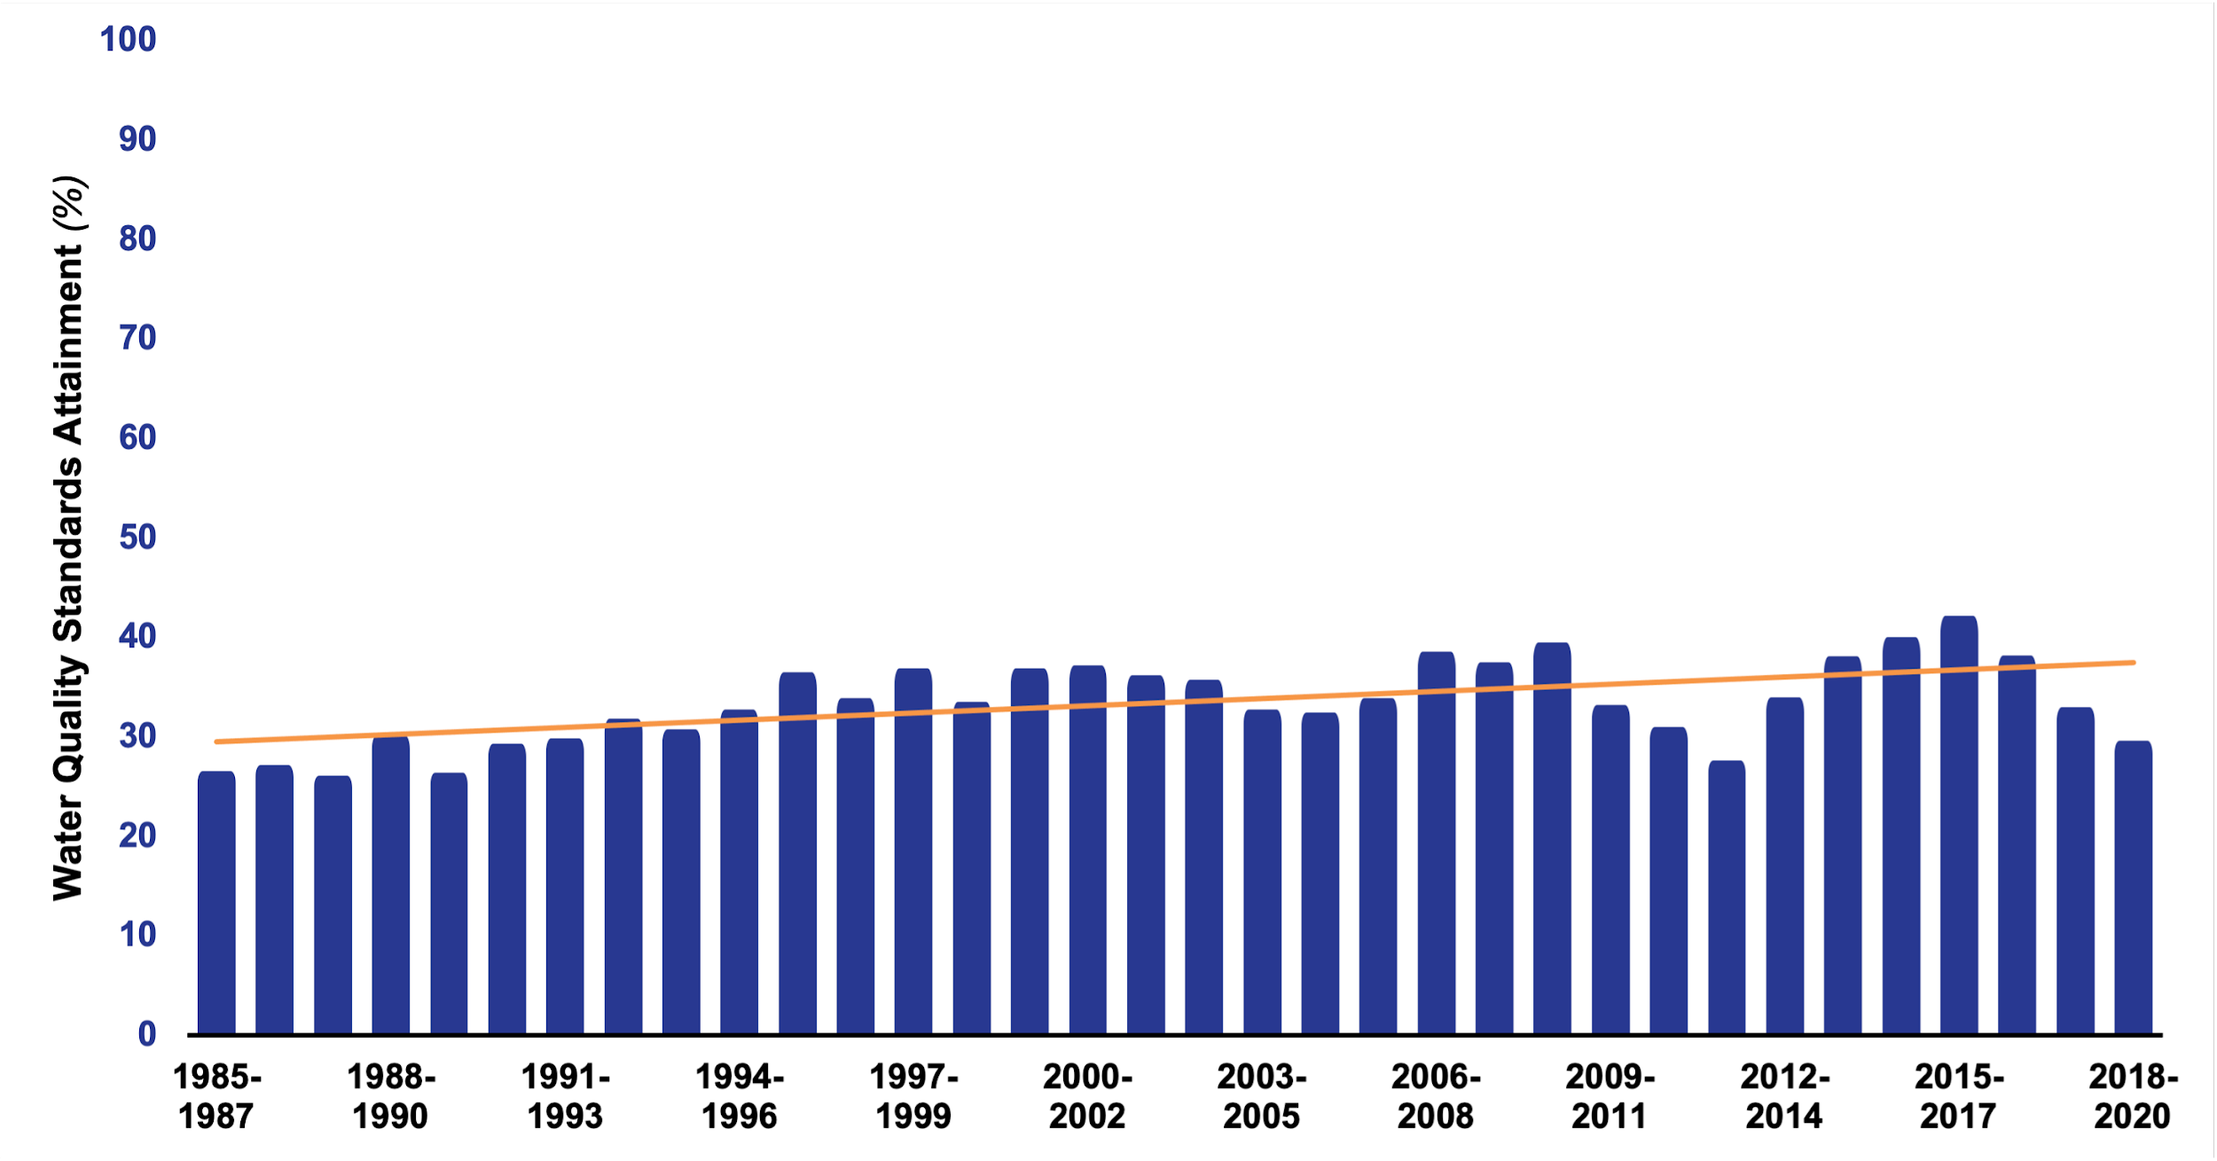
Achieving Bay Water Quality Standards
Why?
Notes:
Introduce graph
We see progress! Direction of change is correct. Upward trend in WQ attainment. Significant achievement. More people, more ag, more development, more animals, changing climate. WQ didn’t get worse.
CESR really focused on the magnitude of response, specifically why isn’t it larger? Afterall, of the 3 main pollutants, CB Program says we have achieved sediment goals, we are close on phosphorus, and we’ve made significant reductions in N, including reducing N loads by 100+ million pounds since 1985.

Slide 3
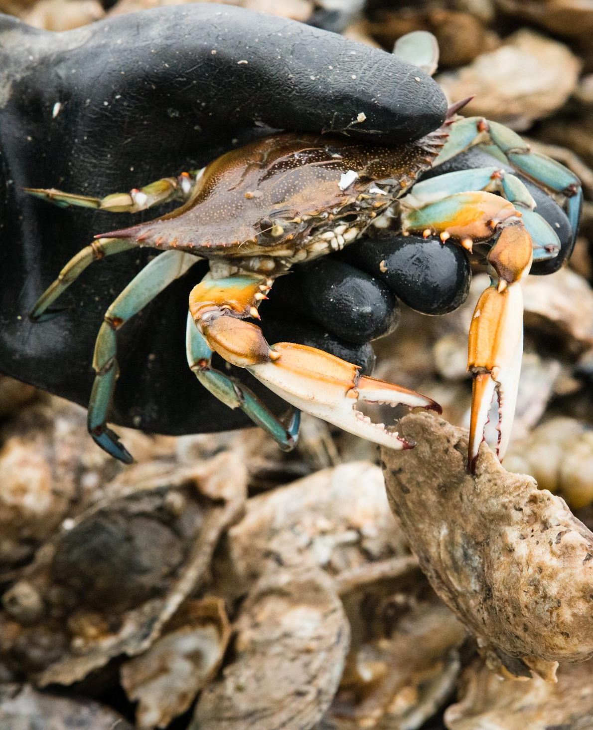
Gaps in implementation and system response present major challenges to achieving water quality goals & improving living resource response.
Opportunities to improve program effectiveness exist but require programmatic change (not simply doing more of the same).
CESR Conclusions
Photo by Will Parson/Chesapeake Bay Program
Notes:
Uncertainties are not the challenge per se, the gaps are.

Slide 4
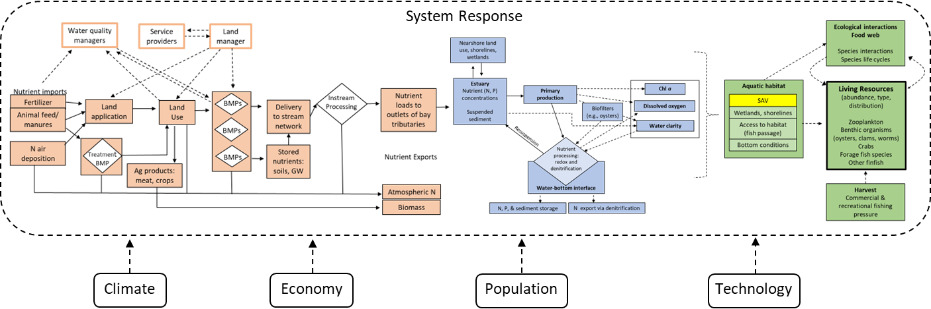
System Response to Meeting Bay Water Quality Standards
Implementation Policies
Policy and Programs
WQ Criteria & Assessment
SAV
wetlands, shorelines
Access to habitat
(fish passage)
Bottom conditions
External Factors
Notes:
Two levers: Implementation policies and WQS

Slide 5
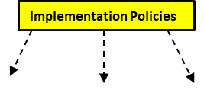
Findings:
Pollutant Response to Management Efforts

Slide 6
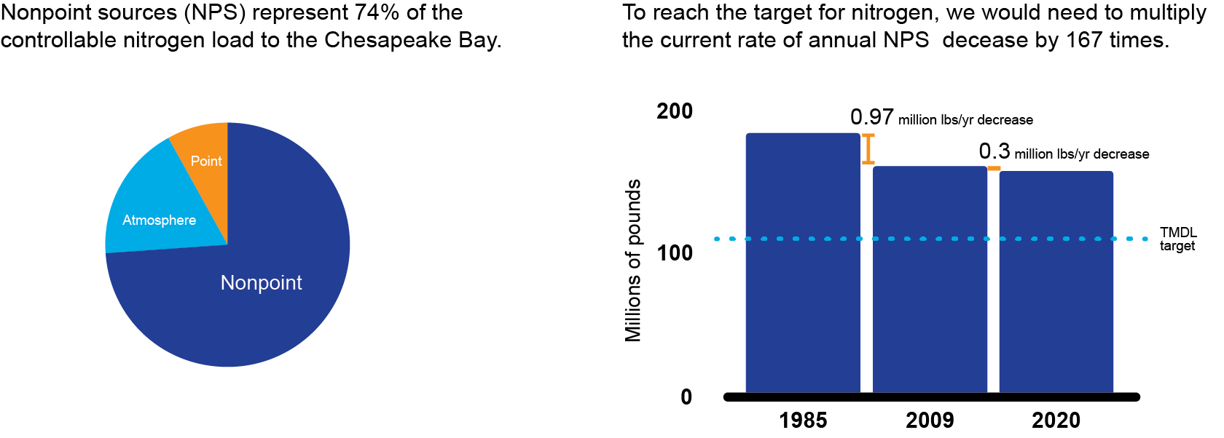
Are nonpoint source programs generating enough adoption/change (“implementation gap”)?

Slide 7
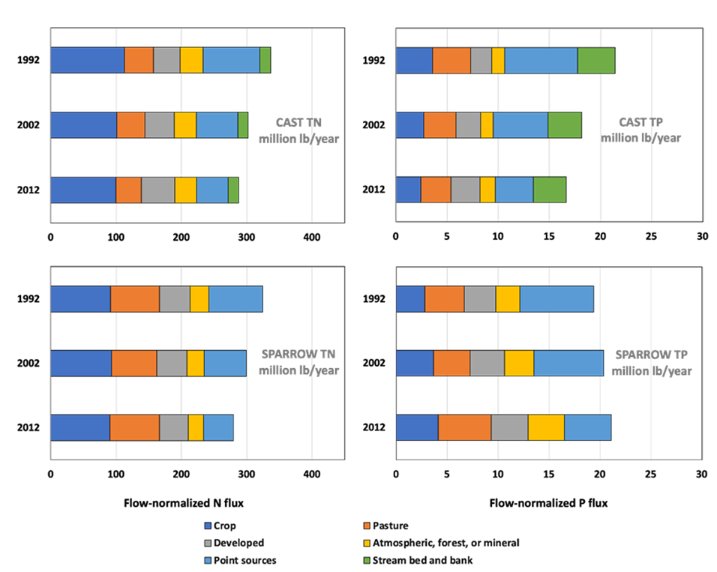
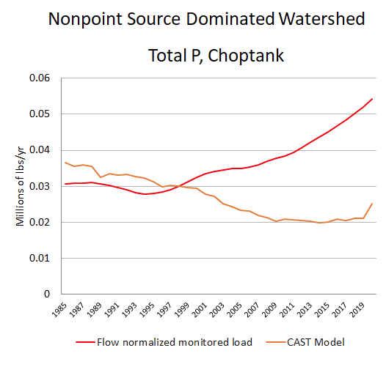
Are nonpoint source programs generating the expected response (“response gap”)?
Nitrogen Phosphorus
CAST Model Predictions
Response Gap
Statistical model of observed trends
Ator, et al., 2020
Notes:
I think this slide is fairly risky, viewers start wondering what Sparrow is and why you’ve got it next to CAST, it then becomes about the models and not the story. If you can keep the story as: modelled and monitored are going in the same and right direction for N but P is opposite, where there is a significant difference between modelled and monitored and monitored is going in the wrong direction. What were doing on the landscape may not be effective. Point is that slap BMP on ground but not getting what’s expected.

Slide 8
Why Response/Implementation Gaps?
Lag times/Legacy sources
Behavior/Implementation (who, what, where)
BMP Effectiveness
Nutrient Mass Imbalances
Data/Monitoring Limitations (model inputs [nutrient inputs, etc], monitoring cannot detect signal)

Slide 9

FINDING: Existing nonpoint source water quality programs are insufficient to achieve the nonpoint source reductions required by the TMDL

Slide 10
Findings:
Bay Water Quality Response to Nutrient Reductions

Slide 11

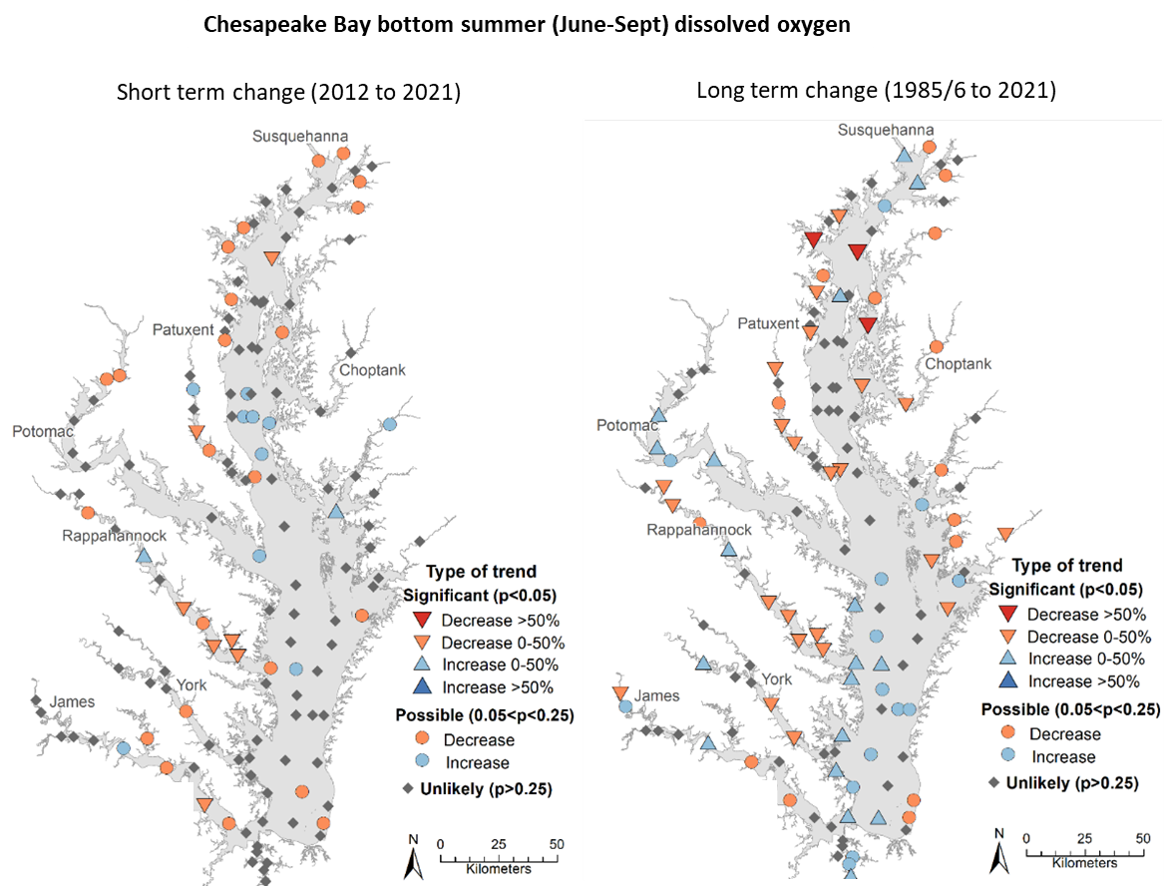

Water Quality Response at Bay Scale; DO
(Source: CBP)
Notes:
“Food” for algae is going down, long term trends

Slide 12
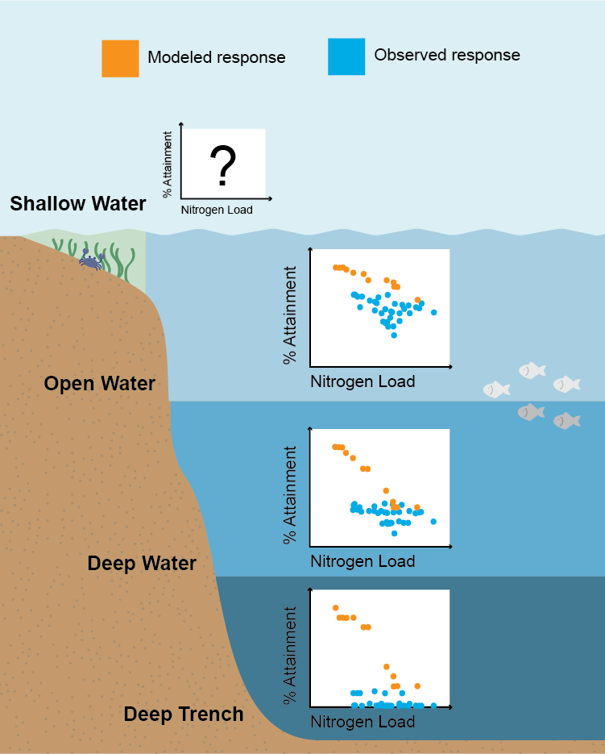
Response Gaps for DO across Habitats
Potential response gap across all habitats
Response gap largest at low loads
Response gap largest for Deep Channel
No expected response for shallow waters

Slide 13
FINDING: Load reductions have not produced expected level of WQ response. Full achievement of WQS is is distant and unlikely, particularly for deep water DO

Slide 14
Implications
Costs of Achieving TMDL and Water Quality Criteria
Implementation Cost
(w response gaps)
Implementation Cost (expectations)
The Bay of the future is not the Bay of the past
Costs to meet WQS ($)
Full Attainment
20% 40% 60% 80% 100%
% Achievement of Water Quality Standard
Notes:
Gaps are shifting the cost of attainment curve
Costs expected to increase rapidly
May never intersect full attainment.

Slide 15
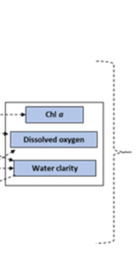
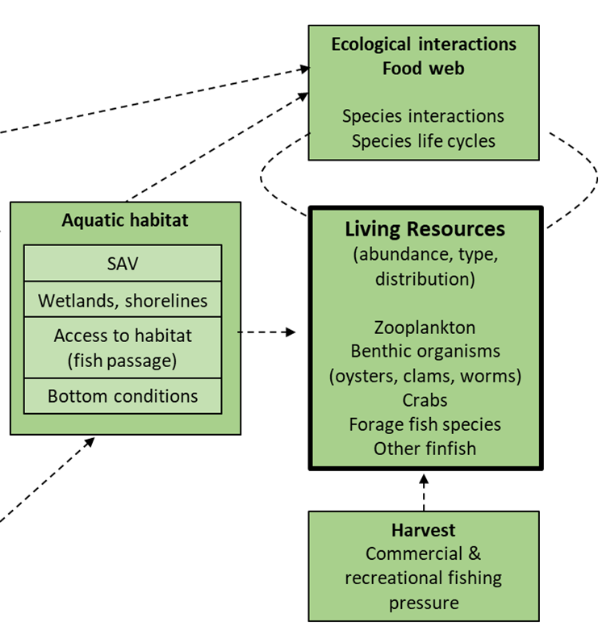
Findings: Living Resource Response to Water Quality Improvement

Slide 16
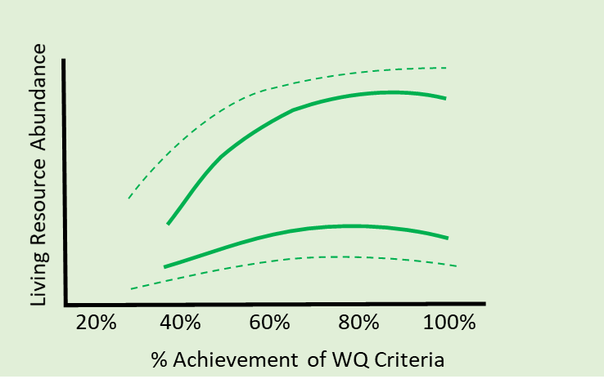
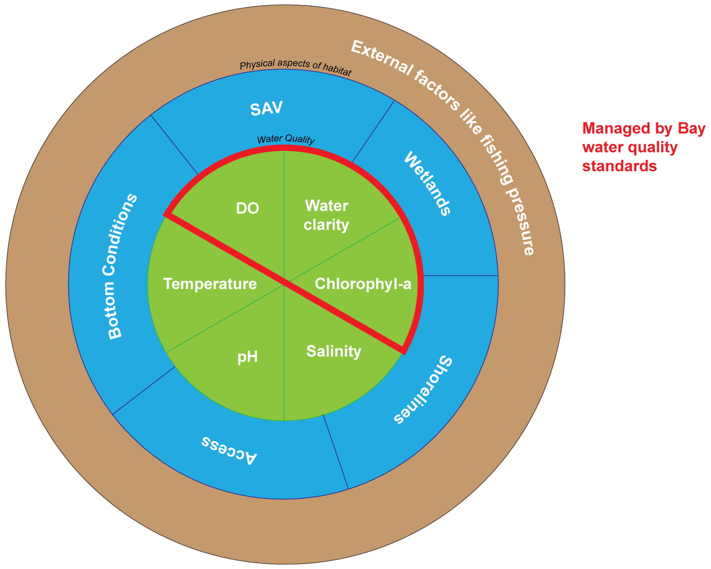
Boosting Living Resource Response

Slide 17
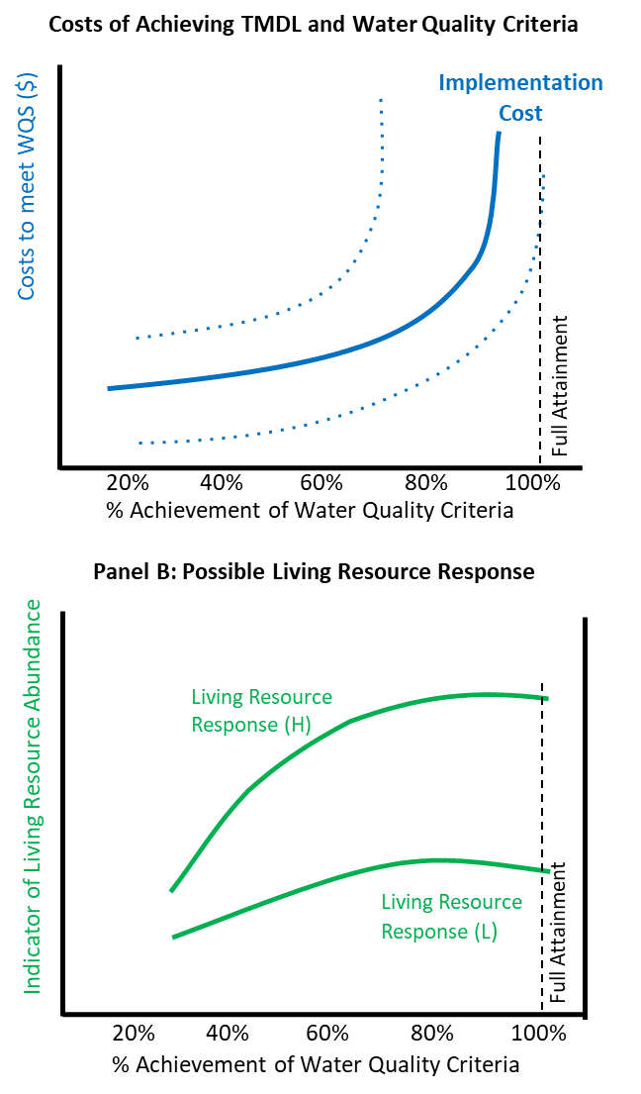
Implications
Full attainment may not be necessary to improve and support living resources goals
Notes:
Gaps are shifting the cost of attainment curve
Costs expected to increase rapidly
May never intersect full attainment.

Slide 18
CESR Implications and Opportunities
Improving WQ outcomes
  Incentives
  Attention to mass imbalances
  Innovation/Sandboxing
Improving living resource outcomes
  Prioritizing attainment in different habitats (shallow waters)
  Status of other factors to boost response
Improving decision-making under uncertainty
Photo by Will Parson/Chesapeake Bay Program

Slide 19
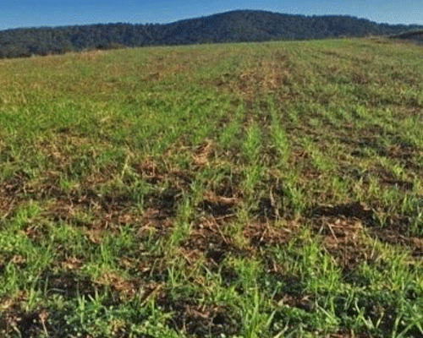
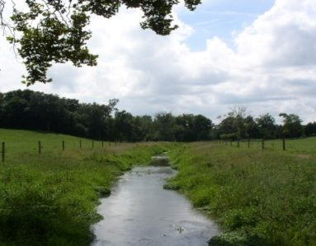
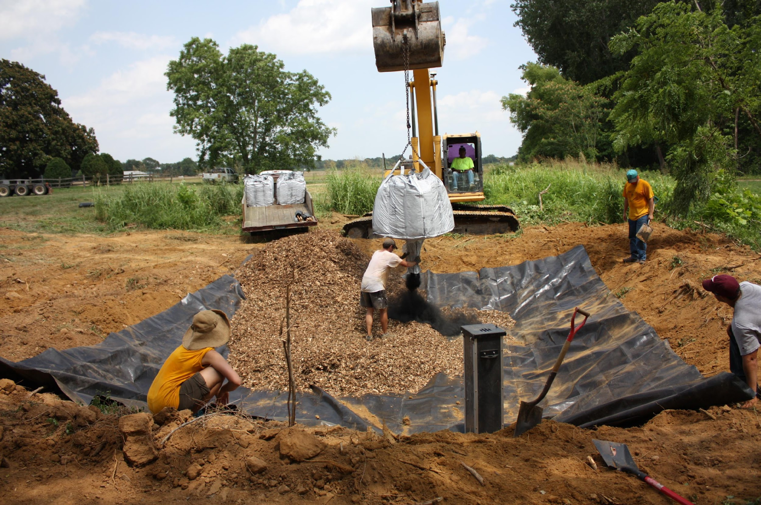
Implementation Gap
Limits to Adoption (practice-based cost share)
Cover crops
Livestock Exclusion Fencing
Denitrifying Bioreactor
Low upfront installation costs
Private benefits
High up front installation costs
No private benefits
Notes:
The predominate way we motivate land managers to reduce pollutants is through practice-based cost share… We offer people a payment to cover part of the costs to install a practice. Ex.. cover crops, stream fencing, ditch bioreactors

Slide 20
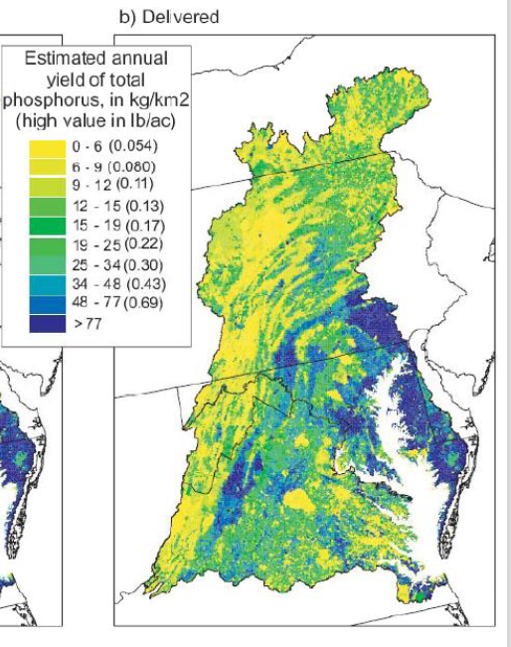
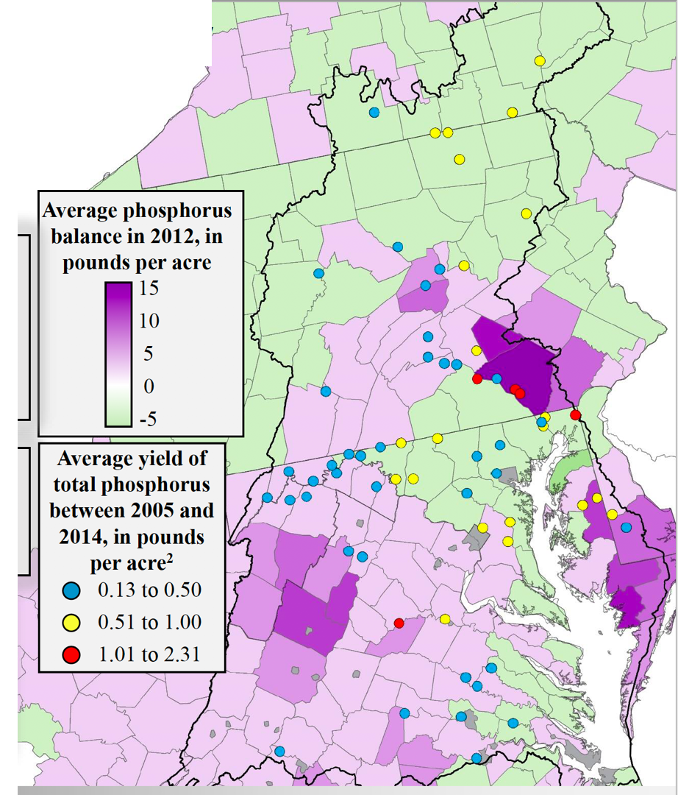
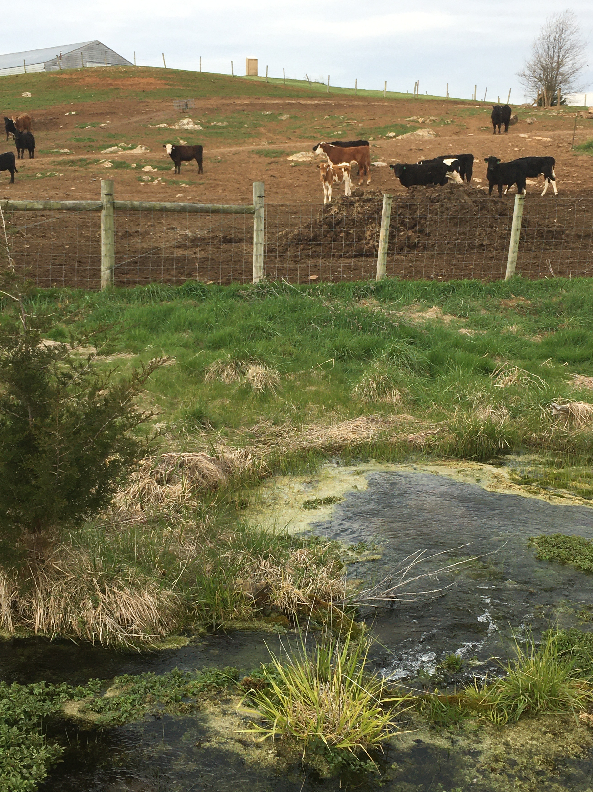
Nutrient Mass Balance
Moyer et al. 2107, Webber, 2017
Source: USGS Sparrow Model Output

Slide 21
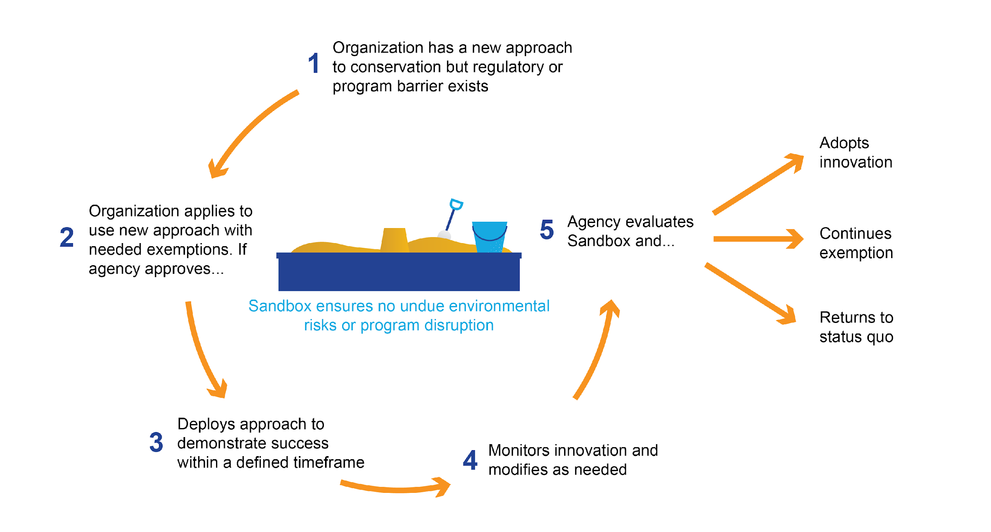
Improving Nonpoint Source Program Effectiveness:
New Opportunities for Technological & Institutional Innovation
The Sandboxing Process (Figure adapted from Higgins and Male, 2019)

Slide 22
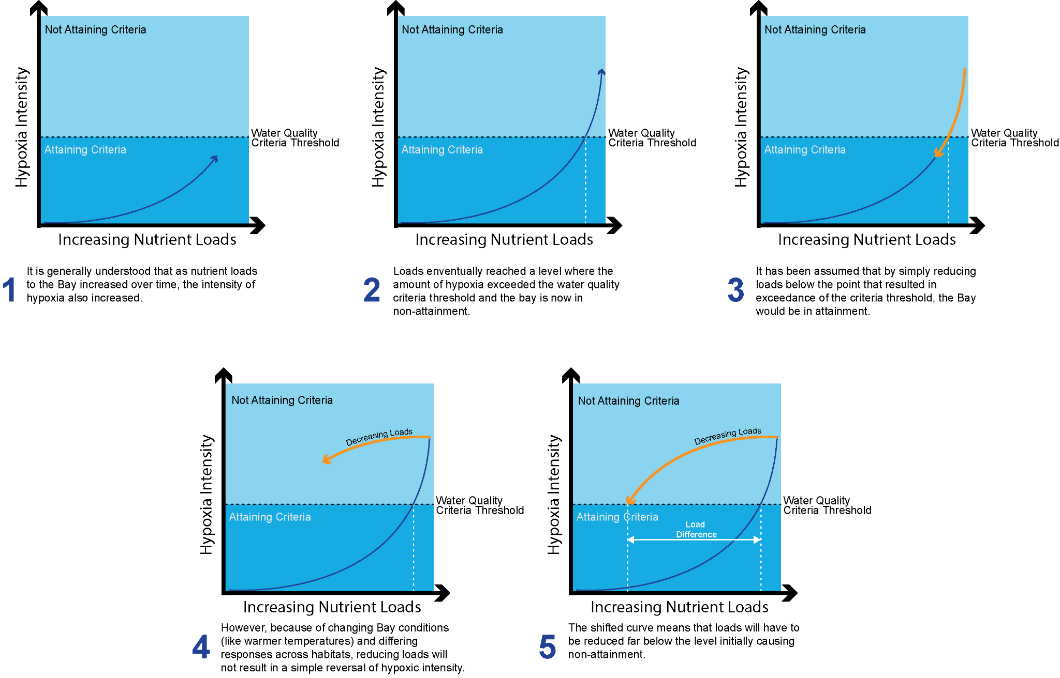
Notes:
Here is my thinking on a variant of your graphic… including a return to neverland idea.

