Slide 1
Discussion of Utilizing Remaining FY23 Workshop Funds on Activities Related to
Findings in the Comprehensive Evaluation of System Response (CESR)
Denice Wardrop and Meg Cole

Slide 2

Important Points for STAC
Sunsetting of CESR Steering Committee/Initiation of CESR Outreach and Engagement Committee
Use of STAC workshop funds for CESR outreach
Consistency of concepts and languages

Slide 3
But first……

Slide 4
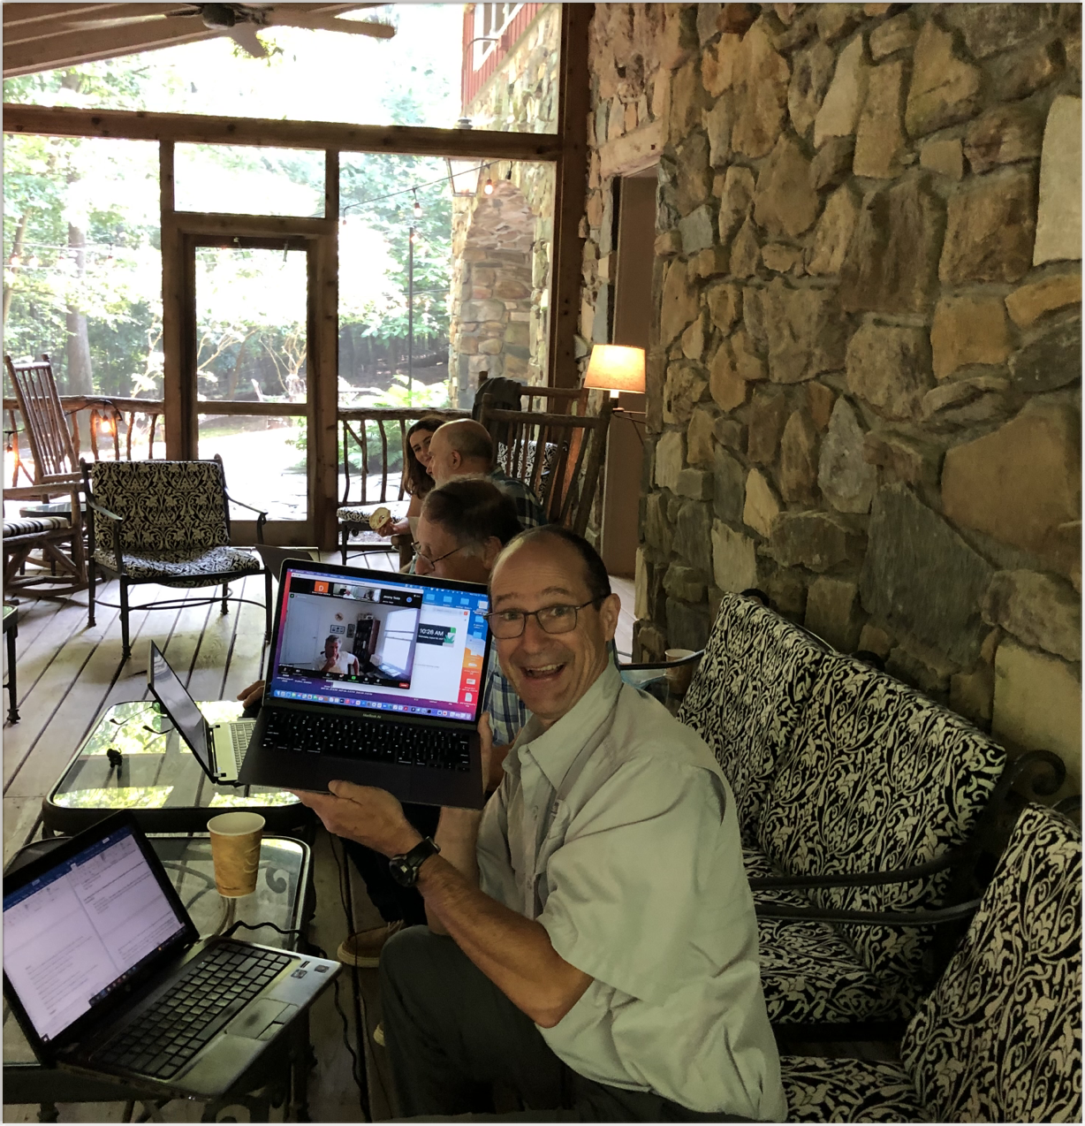
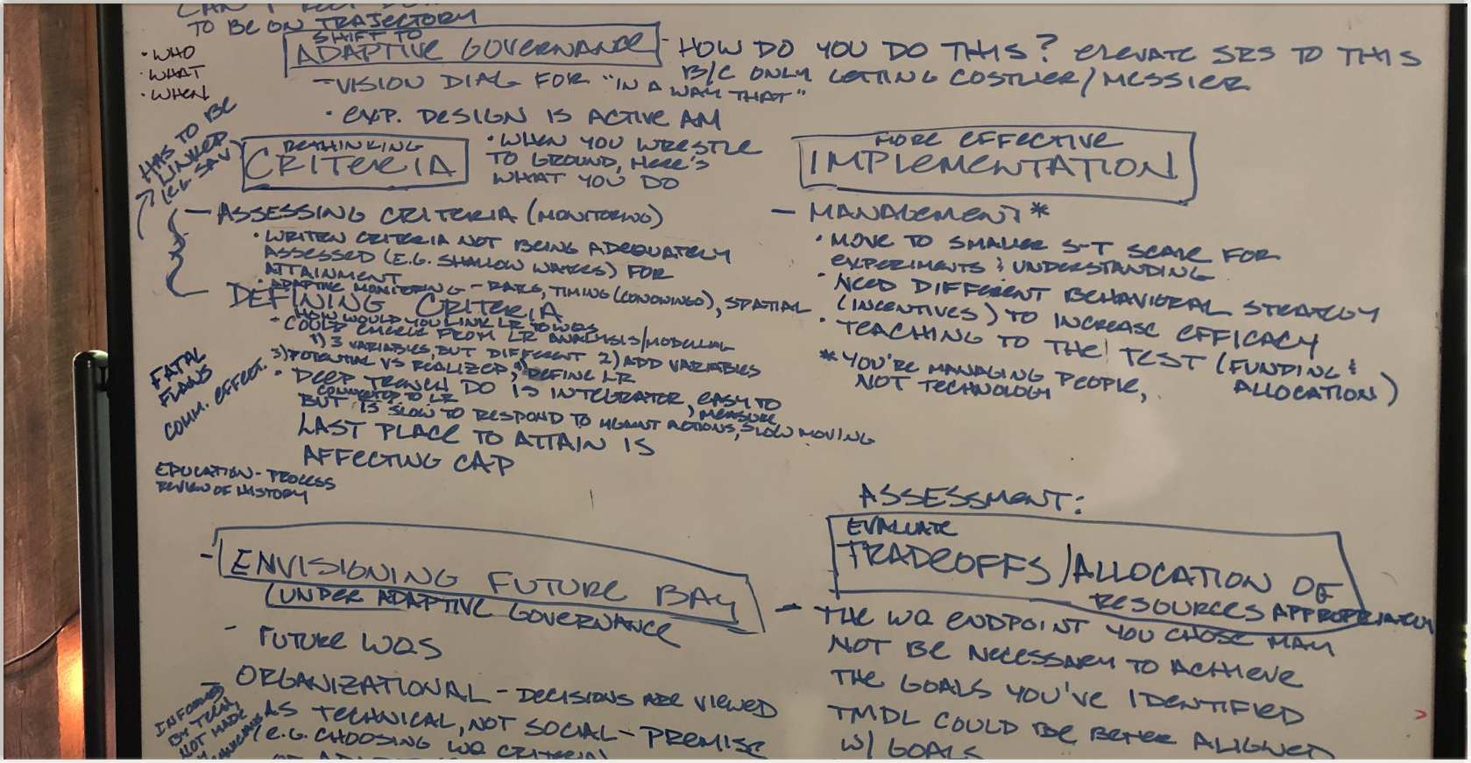
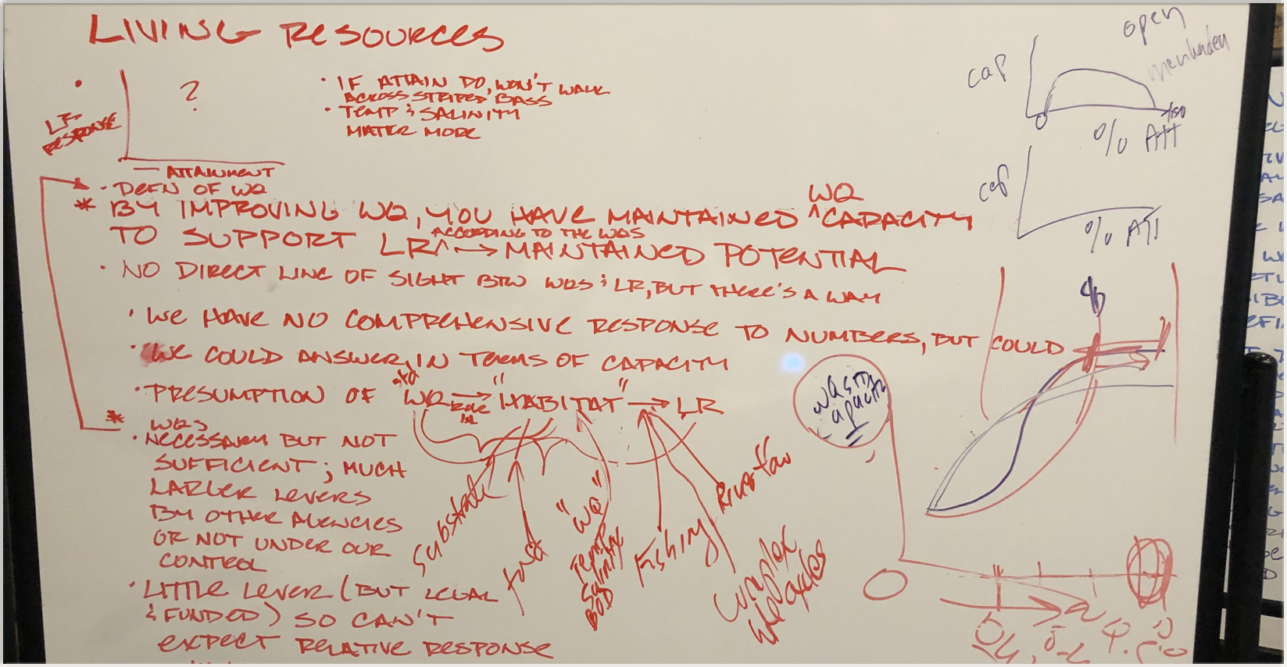

Slide 5
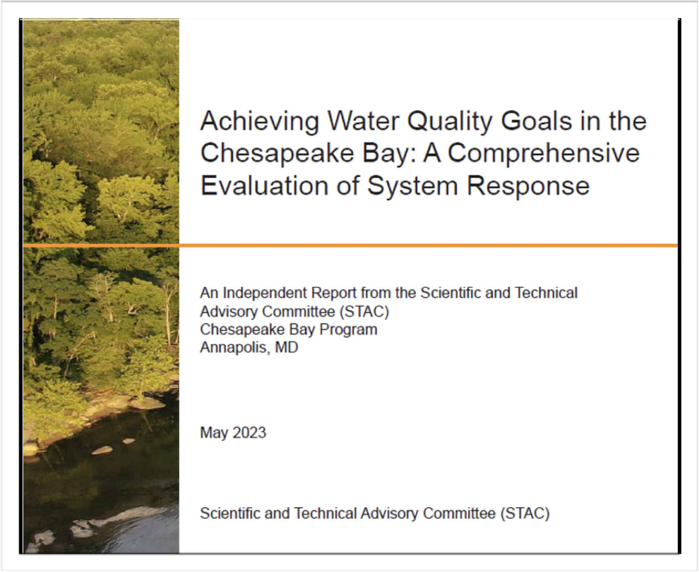
CESR
Joint STAC effort (2019-2023)
Inclusive of STAC Membership (designed by Brian Benham)
Major Resource Documents as a foundation
Synthesis
Multiple levels of review

Slide 6
Heavy Lifters
Steering Committee
STAC Chairs
Brian Benham, Virginia Tech
Anthony Buda, USDA, ARS
Bill Dennison, UMCES
Zachary Easton, Virginia Tech
Ellen Gilinsky, Ellen Gilinsky LLC
Andy Miller, UMBC
Mark Monaco, NOAA
Kenny Rose, UMCES
Leonard Shabman, Resources for the Future
Kurt Stephenson (Co-editor)
Jeremy Testa, UMCES
Denice Wardrop (Co-editor)
Brian Benham, Virginia Tech
Andy Miller, UMBC
Kathy Boomer, FFAR
Communication
Dave Jasinski, GreenFin
Paula Jasinski, GreenFin
Lauren Huey, GreenFin
Rachel Felver, CBP

Slide 7
Refocusing water quality management efforts on improving living resource response
Tiered approach to structuring the TMDL and achieving WQS
Revisions to existing WQC
Improving effectiveness of nonpoint source management
Addressing mass imbalances
Spatial considerations
Incentives
Institutional innovation through sandboxing
Enhancing adaptive management to improve the CBP’s ability to learn and respond to uncertainties and response gaps
Expand participation in adaptive management
Use decision science for enhanced adaptive management
Expand analytical tools to support decision-making under uncertainty.
Target monitoring and research to support adaptive management

Slide 8
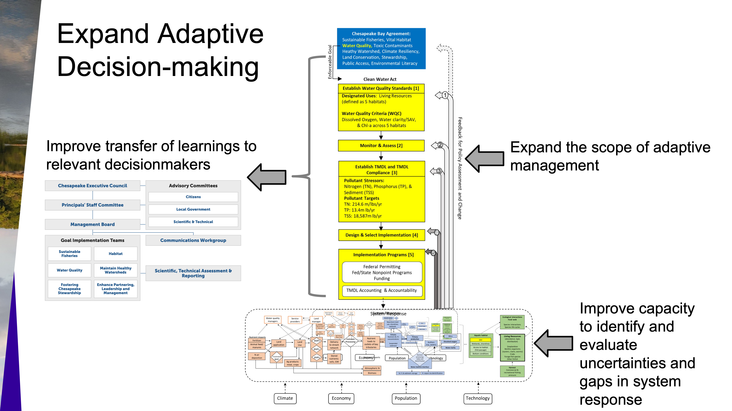

Slide 9
Kathy’s presentation to MB
An entrance ramp onto expanding adaptive decision-making

Slide 10
Socializing Messages in Preparation for Conversation
WQGIT
Sustainable Fisheries GIT
STAR
Management Board (2)
GIT Chairs and Leadership
Adam Ortiz, Region III Administrator
Maryland Governor’s Bay Cabinet
Chesapeake Bay Commission
Virginia Bay Cabinet (scheduled)
Chesapeake Bay Foundation
Clean Water Coalition
Local Government Advisory Committee
SRS Biennial Meeting
Long Island Sound STAC (scheduled)
Academic (UMBC , CCMP Plenary)
Resource Documents (Estuary, LR)

Slide 11
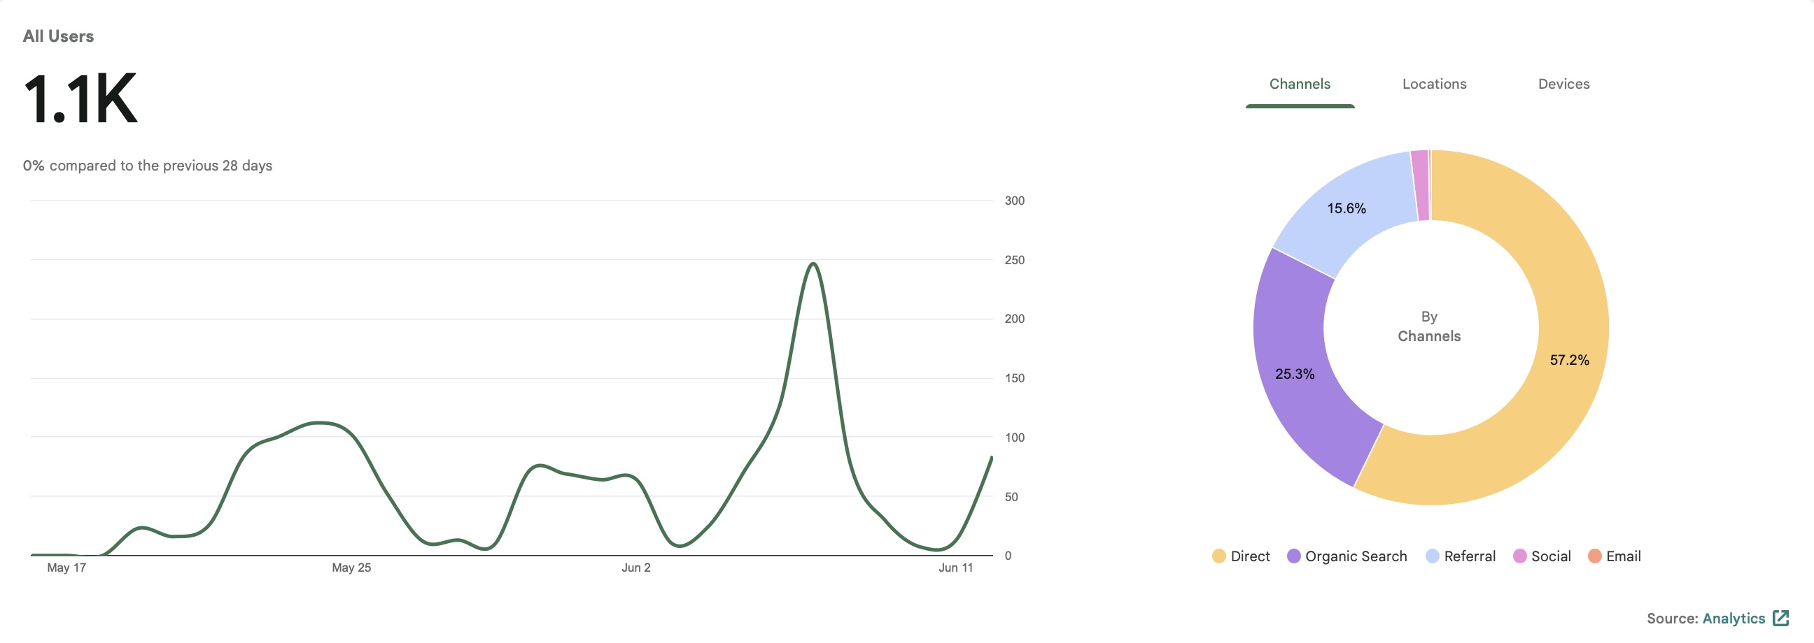

Slide 12
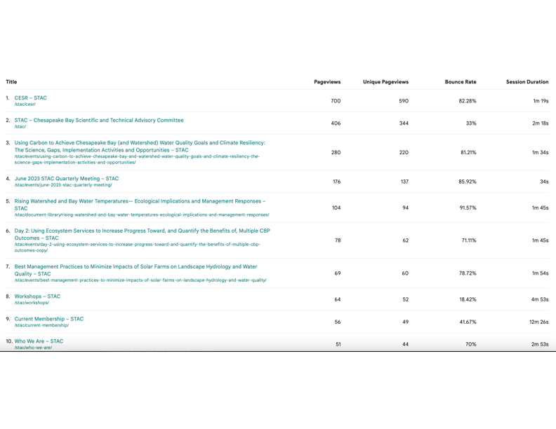

Slide 13
CESR Outreach and Engagement Committee
Vision: A CESR outreach plan will advance dissemination and understanding of the CESR findings and motivate implementation of the options identified in the report.
Process: Formed from members of the CESR Steering Committee* plus STAC Chair and Vice Chair, and will have a team leader (Stephenson). Access to support from the CRC and would coordinate with the CRC.
* can include STAC and non-STAC members

Slide 14
Two primary activities; Activity 1
Support CBP partner efforts to investigate CESR findings and policy implications. Would identify STAC and other scientific expertise to encourage and support continuing interest in topics that have generated interest. Would be alert to funding opportunities that would support these activities, and to help connect partners across the watershed who are working on similar issues. The CESR Outreach Team Lead would track and report back to the Team the progress of these efforts.

Slide 15
Two primary activities; Activity 2
Facilitate the dissemination of under-served, but key CESR findings and policy implications. Would identify key issues not receiving attention, would evaluate why this is the case, and then would further develop and highlight the topic within the CBP partnership (through workshops, technical papers, etc). As a start, we propose a focus on adaptive decision-making to address uncertainty in system response.

Slide 16
Next steps
Presentation repository
Focus and process for a Step 2 of adaptive decision making
Late June meeting for above

Slide 17
Resources
Covered under “old” award
  GreenFin work on Chesapeake Bay Commission presentation, Executive Summary, Final CESR report
  Professional technical editor (Pat Nichols )
Funds in Year 1 and 2 of current award:
  Workshop funds: Year 1 $25-30,000 unused, Year 2 $30,000
  Professional consultants: Year 1 $5000, Year 2 $5000
  Web and technical services Year 1 $2000, Year 2 $718
  Supplemental from Year 1 savings (unknown)

Slide 18
Important Points for STAC
Sunsetting of CESR Steering Committee/Initiation of CESR Outreach and Engagement Committee
Use of STAC workshop funds for CESR outreach
Consistency of concepts and language

Slide 19
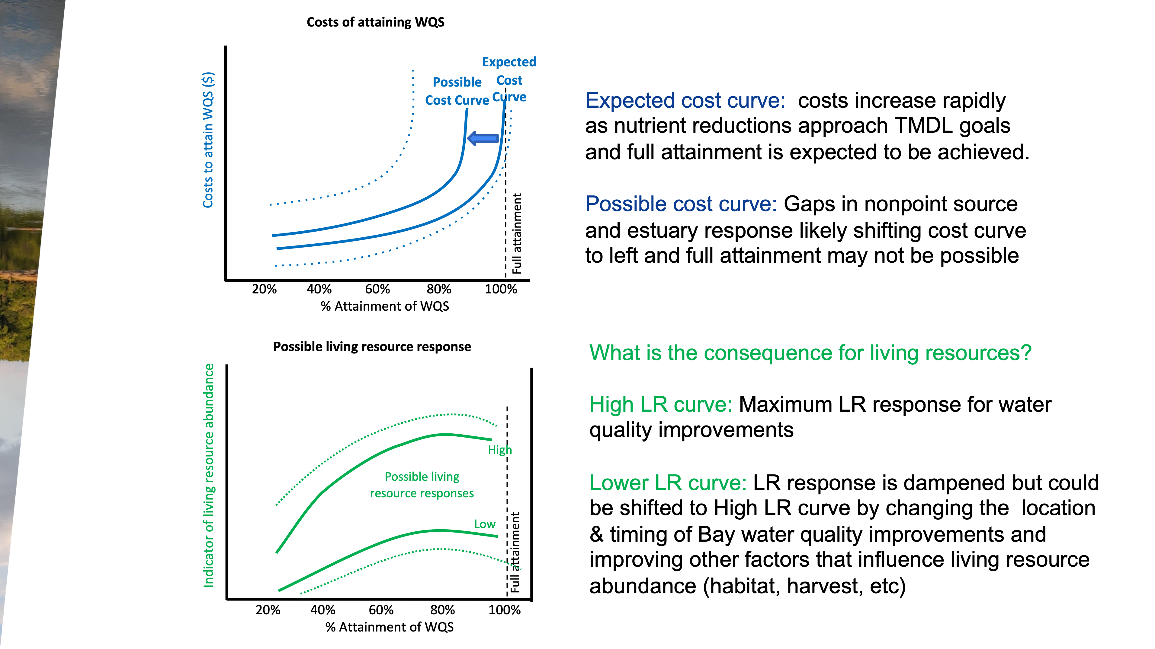

Slide 20
CESR Policy Implications
There are opportunities to further reduce nutrients from nonpoint sources, but changes to programs and policies need to be considered.
Additional nutrient reductions will improve water quality, but water quality criteria may be unattainable in some regions of the Bay under existing technologies.
The legal requirements of the Clean Water Act (the water quality goal) divert attention away from considering multiple means of improving living resources (support of aquatic life as the designated use) as articulated in the Chesapeake Bay Watershed Agreement.
Opportunities exist to adjust approaches to prioritize management actions that improve living resource response.
Expanding the scope of adaptive management could address critical uncertainties and response gaps.

