Slide 1
CAST-21
CBPO Staff

Slide 2
Always improve and Never Change
Management model rule #1
Knowledge
2017
Knowledge
Contained in model
2010
2003
CBP history – long periods of model stability

Slide 3
Always improve and Never Change
Knowledge
2017
Knowledge
Contained in model
2010
2003
Management
Tension
CBP history – long periods of model stability

Slide 4
Always improve and Never Change
Knowledge
2025
2023
2021
2019
Knowledge
Contained in model
2017
2010
Phase 6 plan – update models every 2 years

Slide 5
Always improve and Never Change
Knowledge
2025
2023
2021
2019
Knowledge
Contained in model
2017
2010
CAST- 2019 Loads would have increased substantially
due to an error in fertilizer data, they increased only a little
CAST- 2021 – error was found => loads increased substantially
- other changes => loads increased more
Phase 6 plan – update models every 2 years

Slide 6
Always improve and Never Change
Knowledge
2025
2023
2021
2019
Knowledge
Contained in model
2017
2010
CAST- 2019 Loads would have increased substantially
due to an error in fertilizer data, they increased only a little
CAST- 2021 – error was found => loads increased substantially
- other changes => loads increased more
Partnership discussion about whether to move forward with new model
Phase 6 plan – update models every 2 years

Slide 7
STAC EB Opinion
“The STAC Executive Board, on behalf of STAC, supports the updates to CAST, as embodied in CAST-21, including the correction of the fertilizer data from 2013-2014. The incorporation of the best available information, using standard operating procedures agreed upon by the partnership, is a central tenet of how the work of the CBP proceeds. STAC recognizes that there are consequences of the 2-year delay in the realization of the error in the fertilizer data to partner members. The partnership may wish to consider changes to management expectations in light of this delay, but STAC supports the transparency of the best available science.”

Slide 8
Principals’ Staff Committee – August 29, 2022
Decision 3
Partners expressed an interest in ensuring steps are taken to avoid data analysis errors in the future and to have a process in place to evaluate the reasonability of modeling results once the CBP protocols are applied.
Decision: The partnership will update the process for incorporating data into CAST to include additional safeguards to prevent data analysis errors and to assess reasonability of modeling results after CBP protocols are applied.
Action: The Management Board will determine the appropriate existing GIT and/or workgroup, to develop proposed solutions including additional safeguards to prevent data analysis errors and to assess reasonability of modeling results after CBP protocols are applied.
https://d18lev1ok5leia.cloudfront.net/chesapeakebay/documents/Draft-PSC-Actions-and-Decisions-8.29.22.V2_KES-lam.pdf

Slide 9
Principals’ Staff Committee – August 29, 2022
Decision 2
Address Fertilizer Issues
States lack confidence in the fertilizer sales data in accurately describing current fertilizer use. The PSC discussed both short- and long-term ways to resolve the concerns.
Decision: The partnership will convene a committee to develop short-term, interim resolutions to fertilizer data concerns before moving forward with CAST 2021 as well as long-term resolutions for Phase 7 model. The committee will report out on progress towards this action at the next PSC meeting.
https://d18lev1ok5leia.cloudfront.net/chesapeakebay/documents/Draft-PSC-Actions-and-Decisions-8.29.22.V2_KES-lam.pdf

Slide 10
Principals’ Staff Committee – August 29, 2022
Decision 1
Address Unaccounted Additional Loads Post-2025
Multiple factors have been identified which create greater than expected loads in the updated CAST. During this meeting the PSC discussed the best way to address these new challenges as we approach 2025.
Decision: Over the next year, as a partnership we will figure out how the unaccounted additional loads are addressed post-2025 and on what timeframe as we work to ‘recalibrate’ the goal line.
https://d18lev1ok5leia.cloudfront.net/chesapeakebay/documents/Draft-PSC-Actions-and-Decisions-8.29.22.V2_KES-lam.pdf

Slide 11
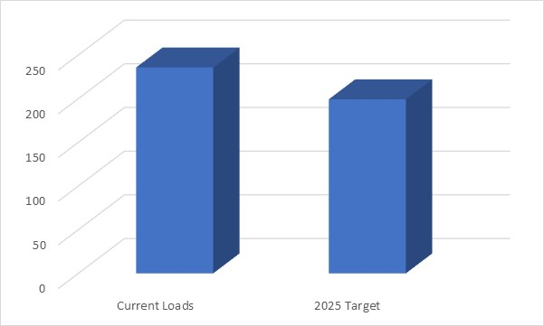

Original Phase 3 level of effort
Maryland Proposal
Let’s do this!
Nitrogen Load =>
Reach WIP + Address initial shortfall
199.3

Slide 12
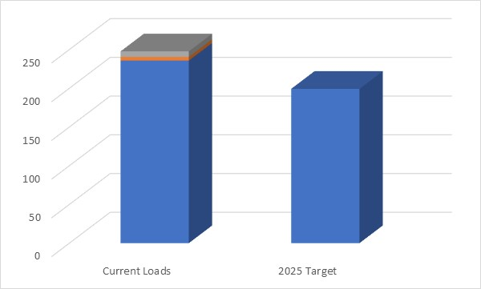
New versions of CAST raised loads
Maryland Proposal
Uh oh, getting harder
CAST 2021
CAST 2019
Nitrogen Load =>
Reach WIP + Address initial shortfall
199.3
Notes:
New versions of CAST raised loads, when makes it harder to achieve target
Guy speaking: “Let’s do this!”

Slide 13
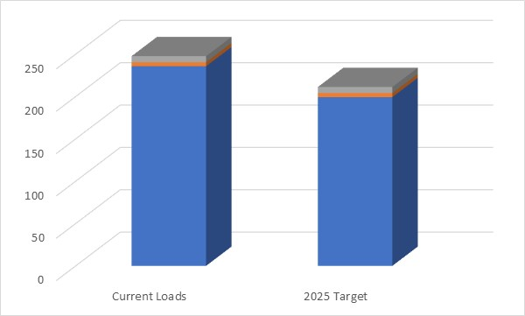
Get back to the original phase 3 level of effort
Maryland Proposal
Let’s do this!
Raise the interim planning target by the difference between the WIP on the current version of CAST and the WIP on the planning target version of CAST
CAST 2021
207.9
CAST 2021
5.8
CAST 2019
2.8
CAST 2019
Nitrogen Load =>
Reach WIP + Address initial shortfall
199.3

Slide 14
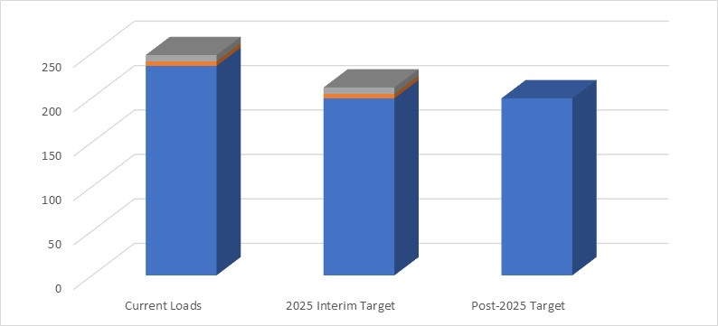
Maryland Proposal
Get back to the original phase 3 level of effort
We can claim some success in 2025 – We achieved what we said we would do in our WIPs.
We will address the unexpected loads after 2025
Let’s do this!
Let’s do this!
…and climate
after 2025!
207.9
Nitrogen Load =>
Reach WIP + Address initial shortfall
199.3
We can move forward with CAST2021 – following partnership decisions

Slide 15
Benefits of Maryland’s Approach
Maryland Proposal
Makes Good on PSC Decision to move unexpected loads to post-2025
Keeps Original Level of Effort in WIPs through 2025. We achieved what we said we’d do in our WIPs.
  Using CAST2019 with error would be a greater level of effort.
Follows partnership decisions
  Allows CAST2021 to move forward, which represents the partnership decisions.
  Using CAST2019 with known error is not defensible.
Saves Staff Time – May simplify discussion on short-term resolutions to ag fertilizer data.
Keeps Fertilizer Experts Focused on long-term, scientifically defensible model improvements for Phase 7 of model.

Slide 16
Proposal the fine print
Maryland Proposal
Retain original planning targets, but extend the date
Move forward with CAST-2021 and CAST-2023
Define unaccounted loads as loads identified after the planning targets were set in July 2018
Create interim 2025 planning targets by adding the difference between the WIP on the current version of CAST and CAST-2017.
  The interim planning targets would change when CAST versions change.
Conowingo is still evaluated separately
Continue to enhance Partnership QA procedures

Slide 17
Next Steps
Management Board 12/15
PSC 12/19 – Not on the agenda
Following PSC meeting

Slide 18
…the numbers

