Slide 1

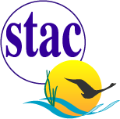
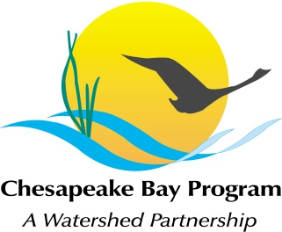
Rising Watershed and Bay Water Temperatures—
Ecological Implications and Management Responses
Ask for STAC Workshop Report Approval
Rich Batiuk
STAC Workshop Steering Committee Member
Co-Founder, CoastWise Partner
Retired, U.S. EPA Chesapeake Bay Program Office Associate Director for Science, Analysis and Implementation

Slide 3
A Unique STAC Workshop – Two Years in the Making
Idea for workshop originated with Rebecca Hanmer with workshop proposal initial drafted by Rich Batiuk
Convened a Steering Committee, Project Team and Synthesis Drafting Teams
Addressed the workshop outcomes in three sequential phases including synthesis of the available science and data through 10 papers
Hosted series of three one-day work sessions/workshops:
  Climate Resiliency Workgroup Synthesis Session-June 21, 2021
  First workshop-January 12, 2022
  Second workshop-March 15, 2022

Slide 4
A Unique STAC Workshop – Watershed/Tidal Focus
Findings from prior work session/workshop set the stage for the next workshop
Both one-day workshops structured with parallel sessions focused on the watershed and the tidal waters lead by Katie Brownson and Julie Reichert-Nguyen, respectively
The January workshop focused on identification of the ecological impacts and management implications
The March workshop focused on development and refinement of management recommendations

Slide 5
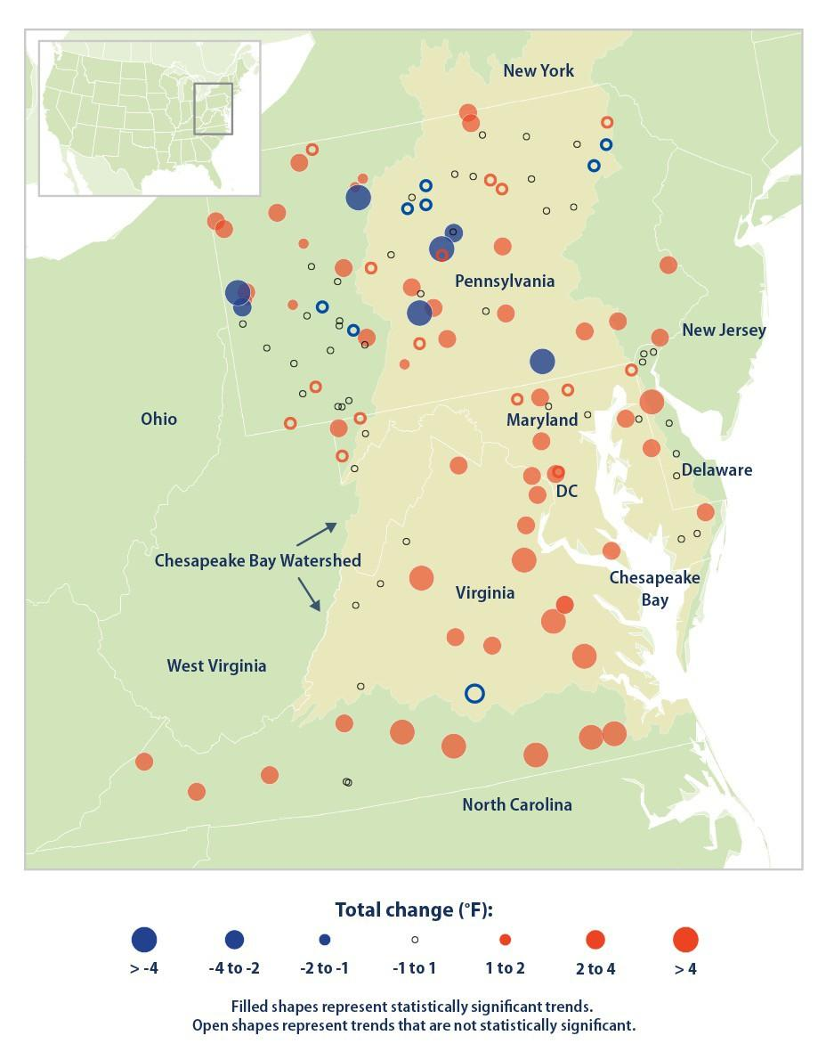
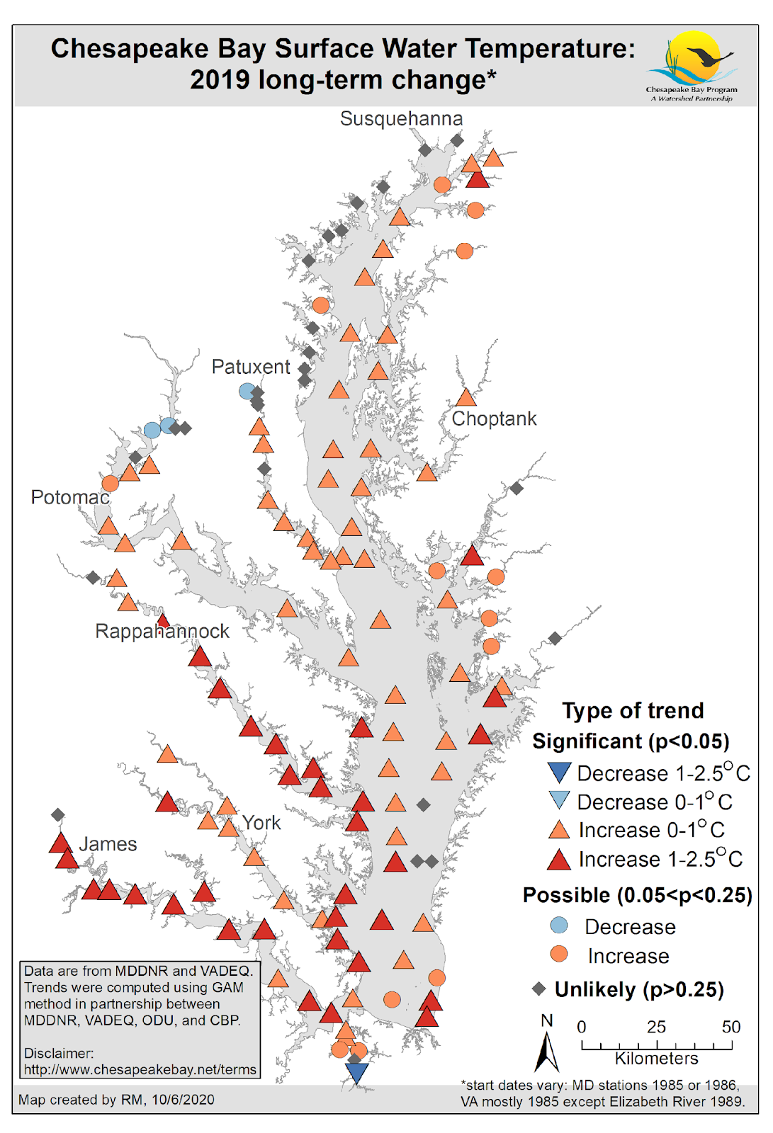
Water Temperatures are Rising

Slide 6
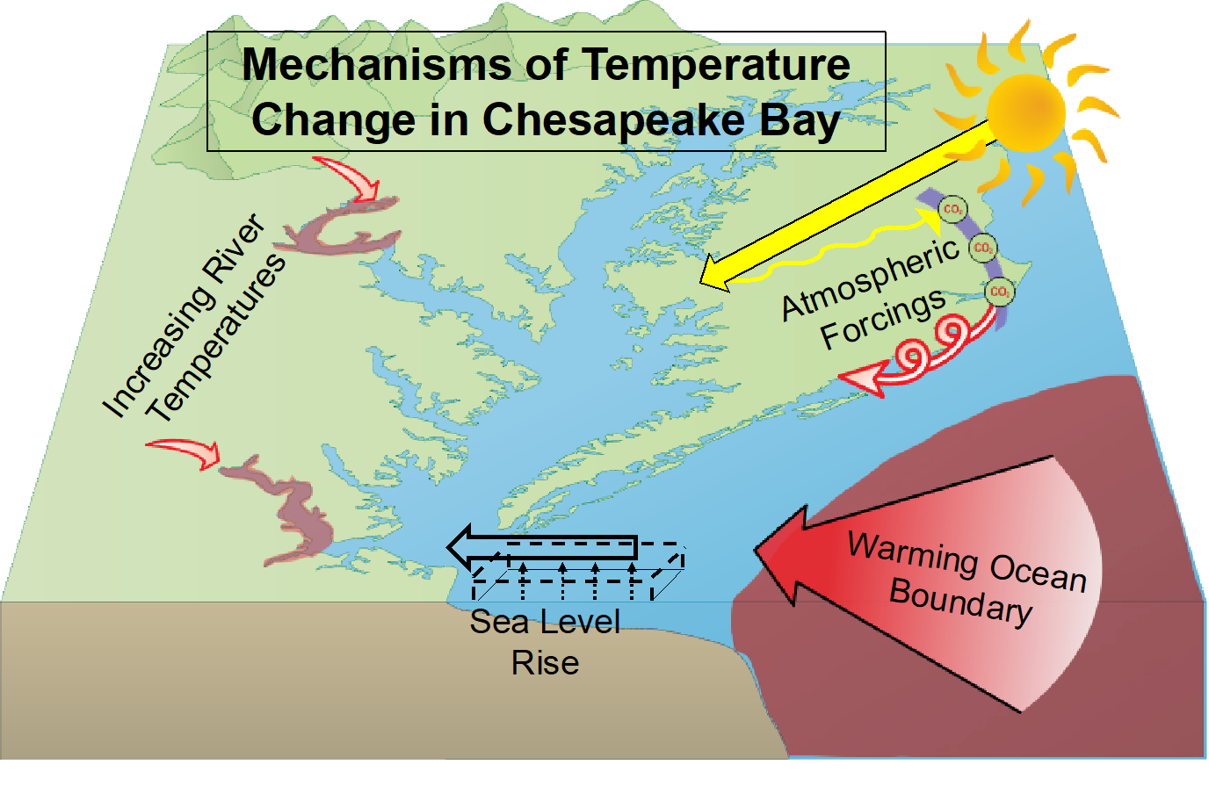
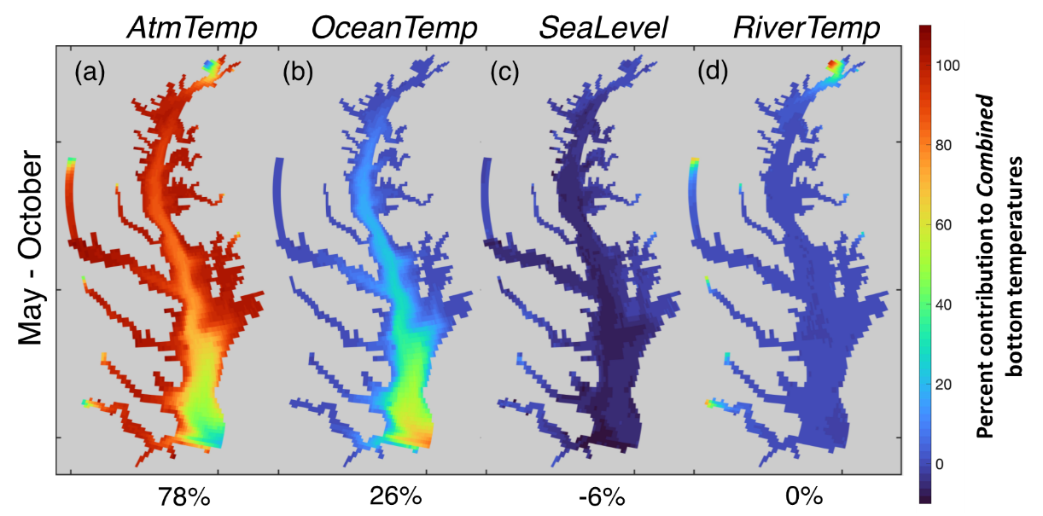
Air and Ocean Temperatures are Key Drivers for Tidal Waters
Air temperatures
Ocean temperatures
Sea level rise
River temperatures

Slide 7
Increasing stream and river temperatures have been driven by rising air temperatures, but other drivers have a strong influence
Heat transfer from channel substrate
  Substrate composition (bedrock vs. gravel)
  Hyporheic exchange
  Residence time in hyporheic zone
Groundwater inputs
  Hyporheic exchange
  Groundwater temperature
  Degree of infiltration
  Groundwater residence time
  Legacy sediment
  Underlying geology
Runoff temperature
  Sources of water (farm ponds, municipal, mining and industrial discharge, snowmelt, etc.)
  Upstream and riparian land use
  Degree of infiltration
Channel temperature buffering capacity
  Surface area: volume ratio
  Channel form
  Large woody debris
  Instream vegetation
  Water clarity
  Stream size
Streamflow
  Baseflow
  Withdrawals (from surface or groundwater)
  Local hydrology (presence of dams, floodplain connectivity, etc.)
  Hydraulic resistance
  Upstream and riparian land use
  Groundwater inputs
  Degree of infiltration
  Rainfall
Non-tidal water temperature
Air temperature
  Direct solar radiation
  Canopy cover
  Ambient air temperature
Notes:
In nontidal waters, the story is more complex. Rising air temperatures are a factor influencing rising water temperatures, but in many areas, water temperatures increased more than air temperatures, demonstrating that air temperature is not always the primary driver of water temperature in non-tidal waters.
There are also multiple other drivers that can either exacerbate rising water temperatures, such as runoff temperature and heat transfer from channel substrate. There are also factors that can either directly cool water temperatures or buffer against warming water temperatures, including streamflow and groundwater inputs
-This conceptual diagram is an oversimplification - These drivers will vary in importance over space and time – some may be more relevant than others in different seasons and in different parts of the watershed.

Slide 8
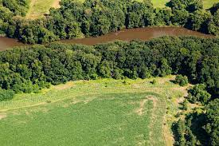
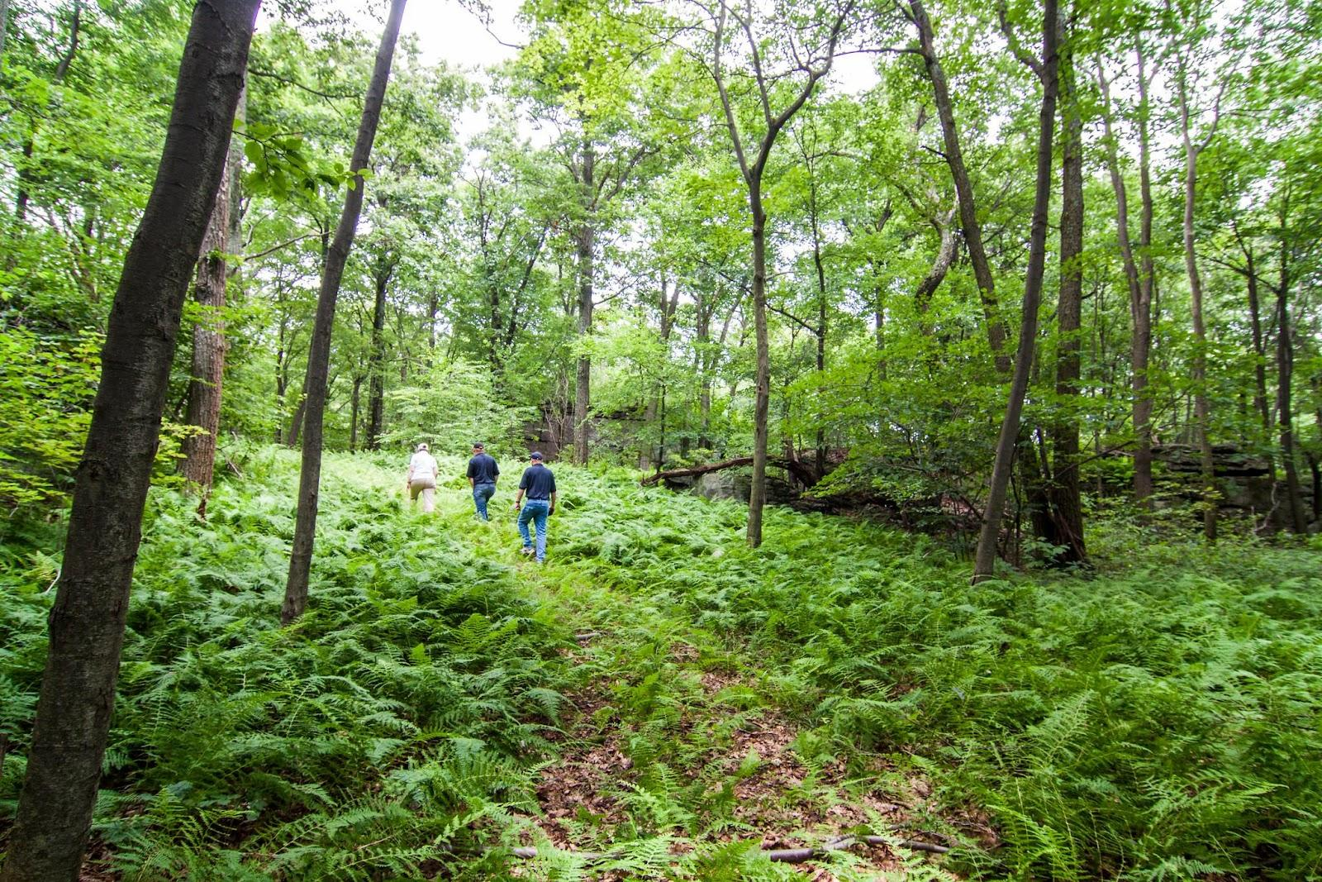
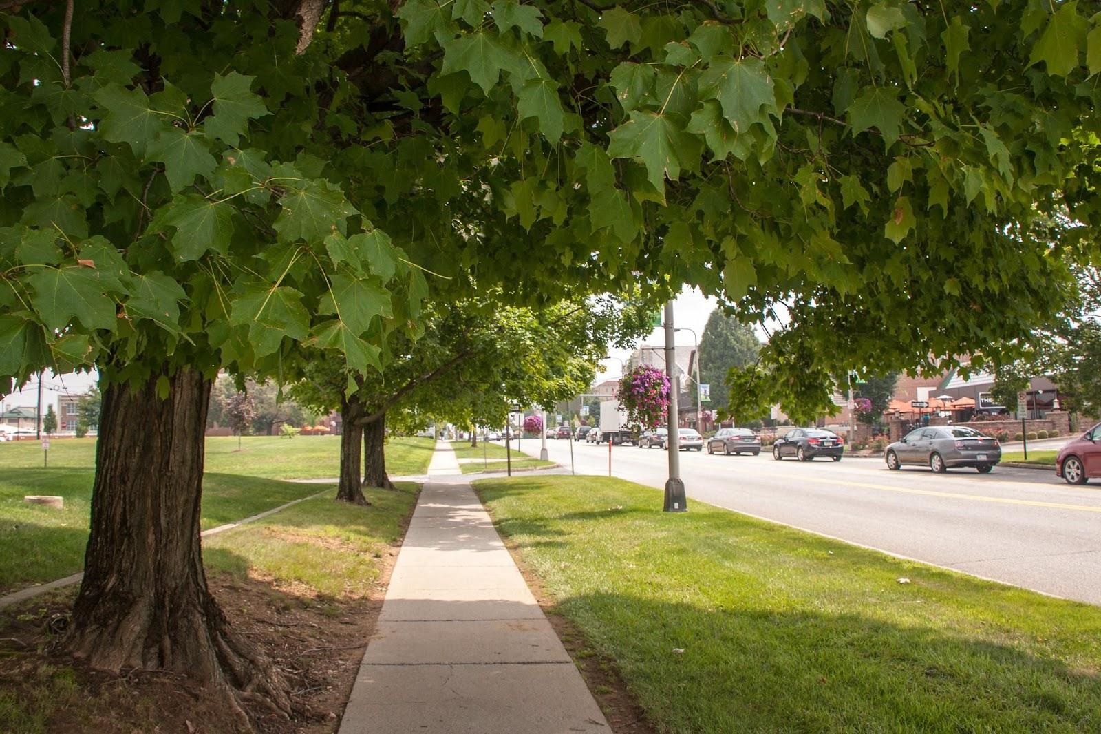
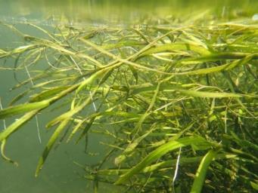
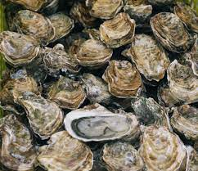
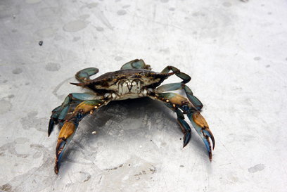
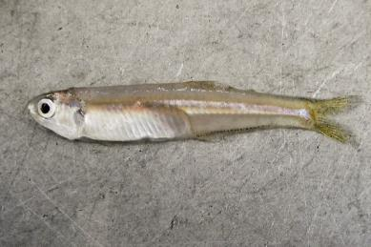
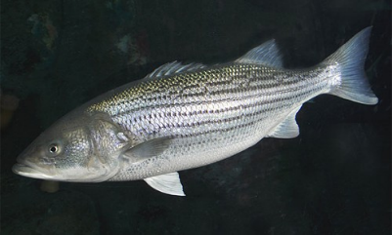
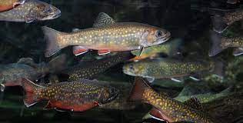
BMPs
Conservation
Land use practices
Mitigation
Lowering of Water Temps
Watershed
Tidal & Watershed
Adaptation
Minimize Impacts & Adjust
Submerged Aquatic Vegetation (SAV)
Oysters
Blue Crabs
Forage
Striped Bass
Brook Trout
(Menhaden, Bay anchovy, benthic invertebrates)
Notes:
Given these important differences between the drivers of rising water temperatures between tidal and nontidal waters, we divided the workshop effort into two sub-groups. The watershed, or non-tidal subgroup looked at opportunities to both mitigate and adapt to rising water temperatures. Mitigation efforts focus on what we can do on the land to directly cool water temperatures or minimize the extent to which heated runoff is entering waterways.
- Adaptation approaches tend to be focused on restoration or management activities that can help minimize impacts on particular species or habitats. The tidal group primarily focused on adaptation approaches, given that tidal water temperatures are more driven by global forces

Slide 9
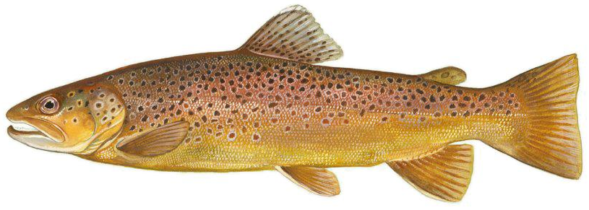
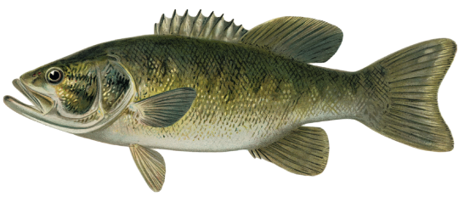
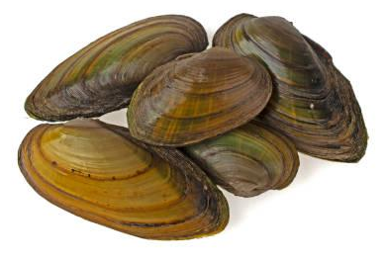
Watershed Ecological Impacts - Species
Strongest negative impacts on coldwater species (e.g., trout, sculpin) and their habitats (esp. where streams aren’t driven by groundwater )
Watershed-wide, warmwater aquatic species are most common. Although more tolerant to temperature increases, they are sensitive to extreme temperatures including rapid changes and to indirect effects (e.g., invasives, pathogens) from higher temps.
More study needed of temperature effects on lower foodweb
    Algae, biofilms, zooplankton
    Macroinvertebrates
    Freshwater mussels & host species
Notes:
In nontidal waters, we expect the strongest negative impact for coldwater species such as brook trout and checkered sculpin that are more sensitive to warm water
Warm water species such as perch and bass may be less vulnerable, but they may nonetheless sensitive to extreme temperatures and indirect effects related to multiple stressors that may occur in urban streams and rivers. These species are also found in the places where most people live in the watershed, so are still really important to consider
- Lower parts of the foodweb including biofilms, algae, zooplankton, and macroinvertebrates may also be vulnerable, as are freshwater mussels and their host species, but more study is needed on how temperature affects these species.

Slide 10
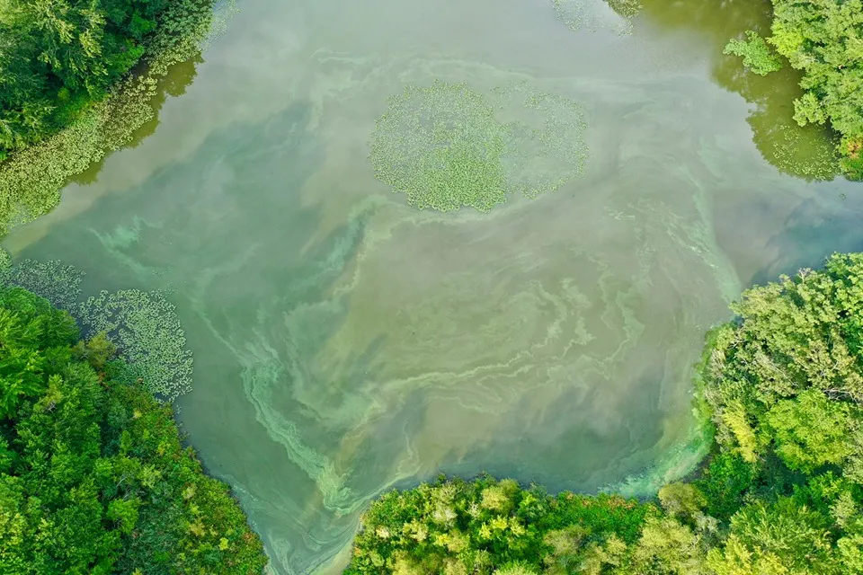
Ecological Impacts - Other Stressors
Co-occurring Stressors
  Low dissolved oxygen
  Invasive species
  Algal blooms
  Bacterial/viral outbreaks
  Distribution & toxicity of other
pollutants (e.g., heavy metals,
pesticides, ammonia, etc.)
  Expansion of invasives
Notes:
Also need to account for how temperature interacts with other stressors
Temperature is also known to modify the toxicity of other contaminants in waterways and these co-occurring stressors can negatively impact stream health. For example, during Workshop 1, participants referenced how prolonged heat waves can co-occur with pathogen outbreaks to cause massive fish die-offs. So even where species may not be particularly sensitive to temperature itself, they can still be negatively impacted by the combination of temperature and other stressors.
Warm temperatures can also be associated with algal blooms, which can be detrimental to human health.
We may also expect to see changes in species assemblages to include more non-native invasive species, which may have broader implications for our stream and river ecosystems

Slide 11
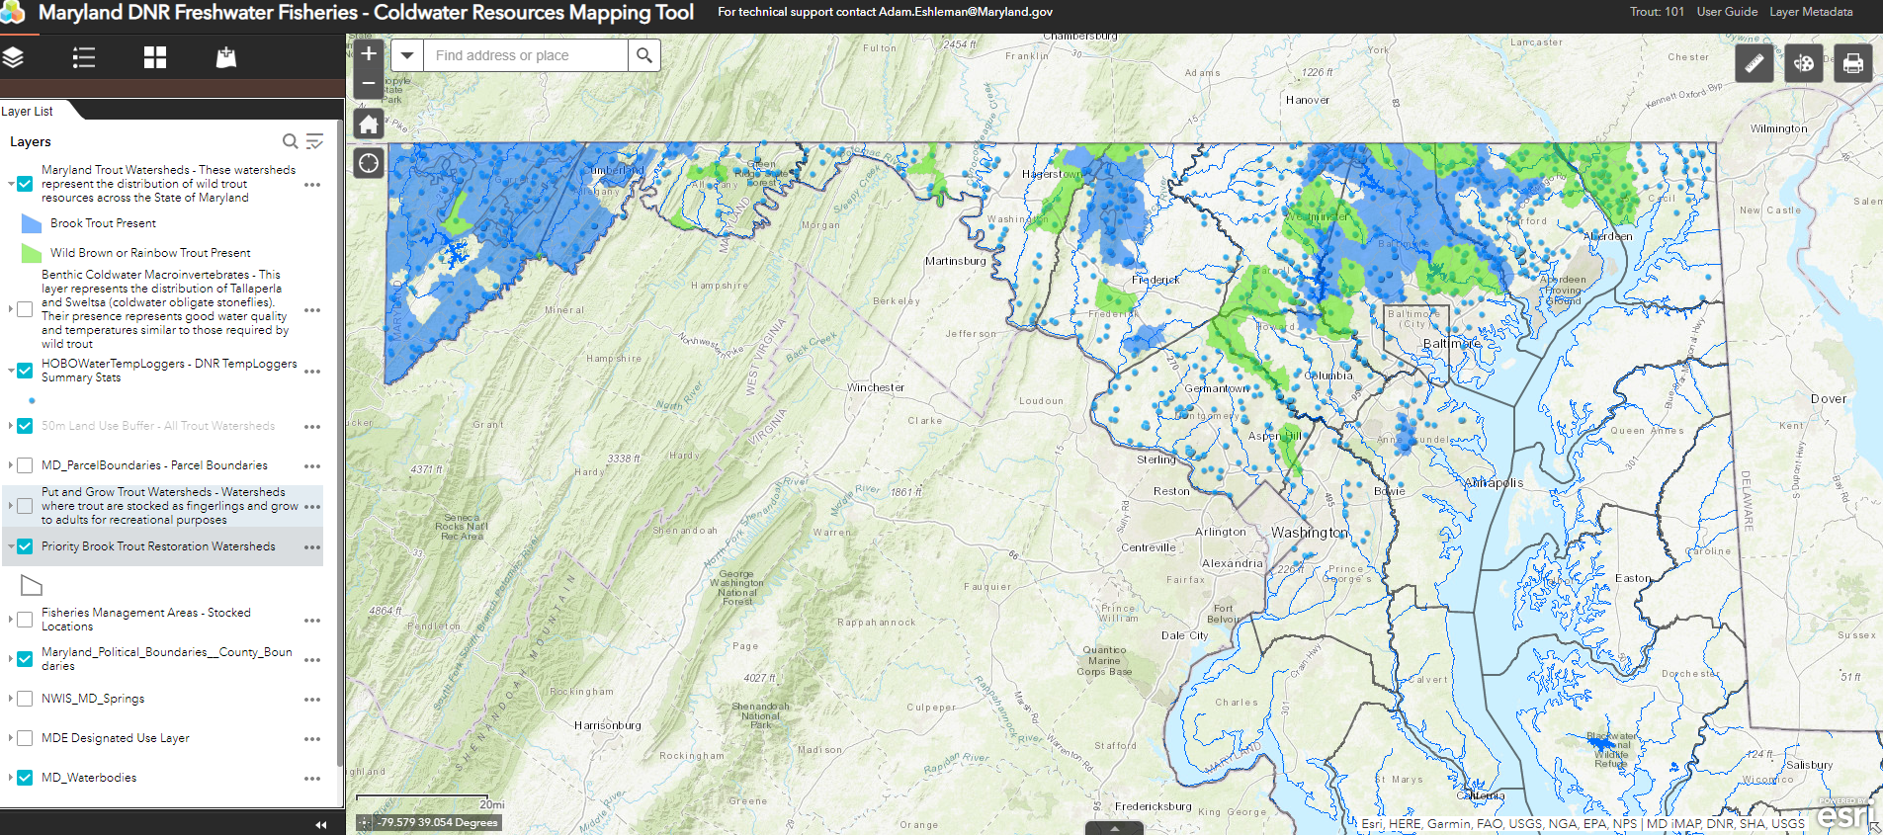
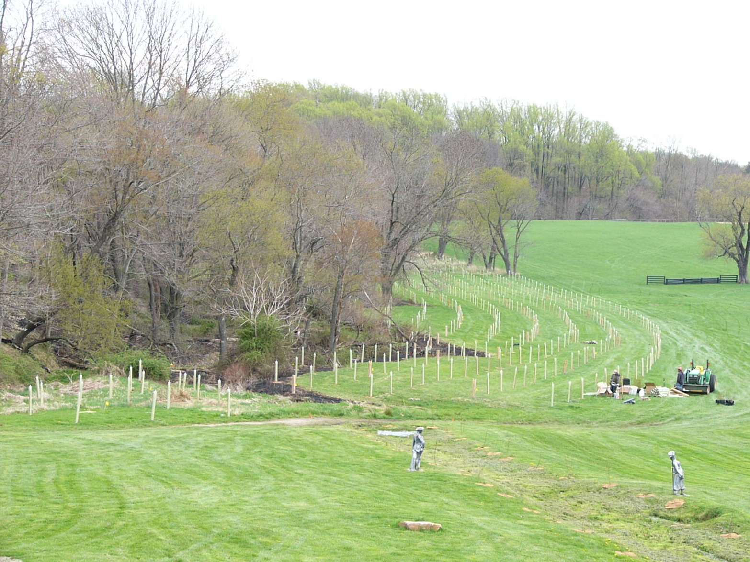
Coldwater Fisheries and Habitat Recommendation
Accelerate conservation to protect the coldwater streams now supporting healthy aquatic life…and continue resiliency analyses and mapping to focus coldwater habitat restoration efforts.
Rural Waters and Habitats Recommendation
Work to strategically restore forests and aquatic habitats while promoting good agricultural stewardship practices that can reduce the amount of heated runoff being generated by farms
Notes:
Even though the CBP partnership is committed to brook trout stream protection and restoration, suitable brook trout habitat is still diminishing, at least in part due to development impacts and especially the loss of riparian forest. Stream warming increases the urgency to identify the best currently forested habitat for land conservation and places where other restoration actions could most benefit vulnerable coldwater habitat.
Restoration activities should include planting new riparian forest buffers where needed, but also promoting good agricultural stewardship and reforesting abandoned minelands in watersheds with high quality brook trout habitat. This will require developing stronger engagement with private landowners and working strategically through partnerships to ensure these valuable habitats are conserved and restored
There are excellent mapping tools for habitat identification that should be utilized to focus these efforts, such as the Maryland DNR Coldwater Resources Mapping Tool you see here

Slide 12
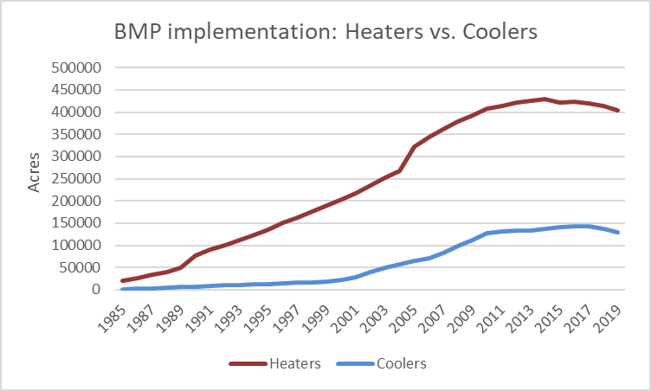
Best Management Practices Recommendation
Work to minimize the extent to which water quality BMPs are further heating waterways and strategically use cooling BMPs to counteract the warming effects of climate change and land use where possible
State Temperature Water Quality Standards Recommendation
The states and EPA should review and modernize the components of current WQS systems that would strengthen their capability to address climate-related rising water temperatures and drive area-targeted protection and restoration strategies
Notes:
Moving to our overarching, cross-landscape recommendations:
Certain water quality BMPs are known to warm surface water temperature, including wet ponds, detention ponds, farm ponds and CAFO lagoons. While these practices may be very effective and necessary to achieve nutrient and sediment load reductions, they may be having unintended consequences for water temperatures and stream ecosystems.
The graph on the right shows that over time, the use of heating BMPs has greatly exceeded cooling BMPs in the Chesapeake Bay watershed, suggesting a need to focus on incorporating temperature considerations into BMP selection and design. This focus is especially important near coldwater habitat areas where species are particularly vulnerable to any further increases in stream warming. However, promoting cooling BMPs over heating BMPs could be beneficial watershed-wide to offset as much as possible the heating effects of impervious land uses.
For practices with the potential to exacerbate stream warming, design recommendations and criteria should be developed to minimize warming impacts

Slide 13
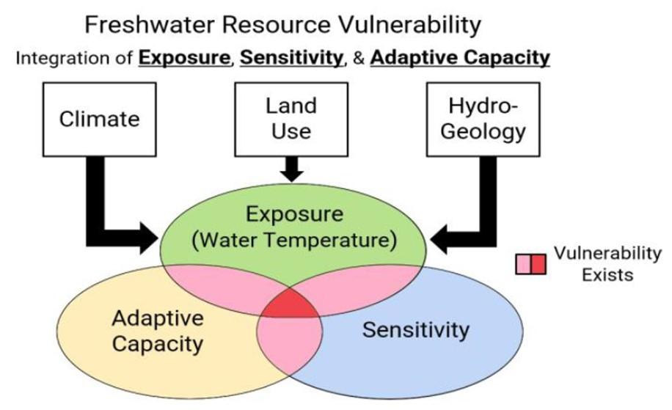
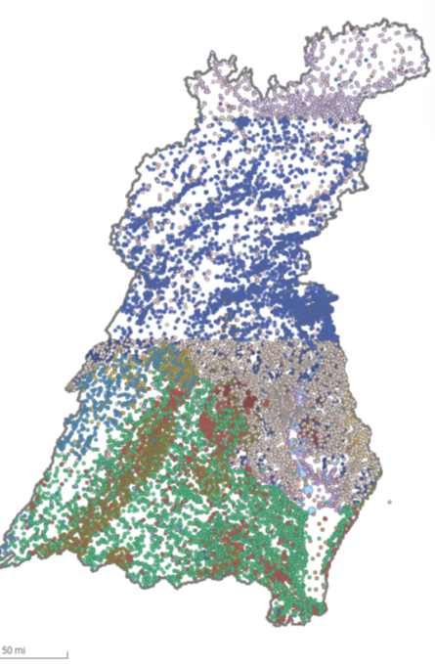
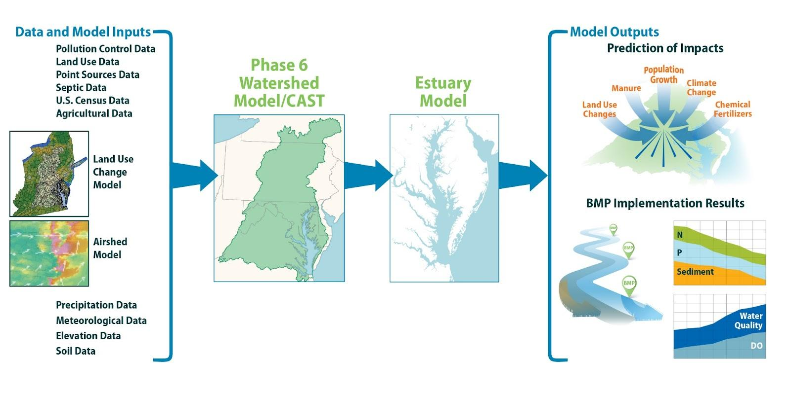
Overarching Recommendation for Research
Enhance and facilitate partnership efforts to collect data and develop tools needed to fill critical knowledge gaps, improve understanding of the impacts of rising temperatures on aquatic ecosystems, and inform management decisions
Overarching Recommendation for Monitoring and Analysis
Increase monitoring of water temperature in smaller streams, and further analyze existing data from larger streams and rivers, to improve understanding of the effectiveness of restoration and conservation of stream communities and fisheries in the face of land-use and climate change
Overarching Recommendation for Watershed Modeling
Develop new modeling tools and expand the use of CAST and the Chesapeake Healthy Watershed Assessment to better inform the management of watershed fisheries and ecosystems
Notes:
Moving now to our overarching scientific recommendations: The first recommendation is for research and states that …
Some of these critical knowledge gaps included limited understanding of the ecological impacts of rising water temperatures, how temperature interacts with other stressors, and how best to mitigate detrimental impacts in different landscape contexts.
Coldwater fisheries are at high risk for habitat degradation and loss given their specific temperature thresholds. Although groundwater inputs can mitigate temperature increases and provide thermal refugia, additional research is needed to assist partners in identifying streams with groundwater inputs and providing the data necessary to improve existing groundwater models and develop new groundwater models
A lot of effort has gone into brook trout (for good reason), but information on coldwater species other than brook trout is quite limited
AND While not as vulnerable as coldwater fisheries to rising temperatures, warmwater fish species are more widespread throughout the watershed and there is little information on both the direct and indirect effects higher temperatures are having on these species.

Slide 14
Ecological Implications
Fisheries:
  Positive impacts are likely for blue crab and some forage species
  Negative impacts are predicted for oysters
  Striped bass may experience both negative and positive
Positive
Direct
Increased growth rates & earlier maturation
Reduced winter mortality (blue crabs & oysters)
Indirect
Longer spawning seasons and/or growing seasons
More algae/food (oysters
Negative
Direct
Reduced survival due to detrimental temperature ranges (more so during early life stages
Indirect
Increased hypoxic conditions
Ocean acidification
Increases in pathogens/disease occurrence
Alternation in food resources (abundance & quality
New non-native predators
Submerged Aquatic Vegetation:
  Viable populations of eelgrass likely to be extirpated
  Impacts to other SAV not as well studied
  CO₂ fertilization effect may provided some counterbalance to impacts of warming
Notes:
A review of regional species climate vulnerability scores and bay-specific research, showed a range of positive and negative responses of living resources to water temperature
Positive impacts are likely for blue crab and some forage species, as warmer temperatures support higher productivity and increased habitat range as species move northward
Negative impacts are predicted for oysters due to their already depressed populations as a result of disease, overfishing and habitat loss
While oysters can thrive in higher temperature regimes and may experience an increase in habitat range, they are highly vulnerable to other climatic impacts such as ocean acidification and changes in salinity driven by precipitation.
Striped bass may experience both negative and positive impacts at different stages of life (larval to adult) and habitat use (rivers and estuaries to marine)
The range of responses and potential for localized impacts (for example changes in habitat quality and reproductive success within specific tributaries) leads to higher uncertainty in evaluating Striped bass vulnerability
SAV
Eelgrass – poor heat tolerance
Acute warming from summertime heat waves has triggered shoot mortality and population declines.
Widgeon grass – tolerant to increases in temps
The CO₂ fertilization effect
may counterbalance some of the impacts from warming,
unknowns associated with invasive species, pathogens, cyanobacteria, etc. could counteract balance

Slide 15
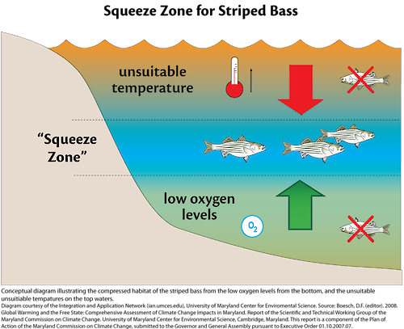
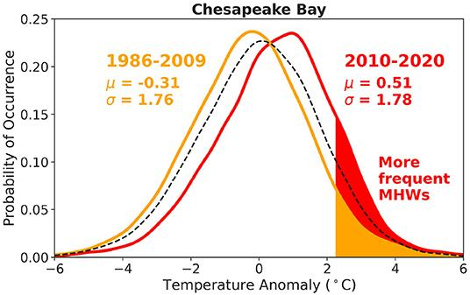
Implications of Ecosystem-Level Effects on Living Resources
Lower oxygen solubility in water
Shifts in species ranges and habitats
Some Bay species’ populations are shifting north while other species from the south are becoming more prevalent in the Bay
Changes in the intensity, duration, & frequency of marine heat wave events & effects on survival
Higher water temperature
Higher remineralization rate = more nutrients for algae growth
More stratified water column
All combined = even lower dissolved oxygen
Source: Mazzini and Pianca 2022
Notes:
On this slide are examples of science-supported concepts that led to the recommendations that we are presenting
Range Shifts:
First off are the occurrence of shifts in species ranges and habitats
Some Bay species’ populations are shifting north while other species from the south are becoming more prevalent in the Bay
Range shifts can result in changes to habitats and species affecting abundance and distributions, food web dynamics, and fishing behavior
Concerns of a new temperature regime allowing for new pathogens
Additionally, there is evidence that climate drivers including temperature are allowing range expansion for cobia, brown shrimp, and red drum. The impacts of southern species moving into the Bay are not fully understood. However, the increased abundance of brown shrimp has led to a new fishery in the Bay and some scientists have pointed to red drum increasing predation pressure on species such as blue crab.
Other impacts from these multiple stressors
Reduced water clarity & salinity from increased precipitation negatively impacting both SAV & oysters
The reduction of SAV habitat from sea level rise and hardening of shorelines
SAV community changes & effect on habitat-use by fish and crabs
It important to emphasize that species like blue crabs might not be directly impacted by this new temperature regime, but their habitat is negatively impacted
Additionally research shows that some of these stressors have impacted striped bass habitat, leading to a habitat squeeze where striped bass can only thrive in certain regions of the water column, as the higher portions of the water column are too warm, and the lower portions have low dissolved oxygen levels
Lastly evidence shows extreme events such as marine heat waves negatively impact both habitat and species survival
Heat waves are associated with harmful algal blooms, increase in bacteria such as vibrio, mortality of SAV and other organisms, shifts in species composition, increased risk during recreational activities and impacts to fishing and aquaculture.

Slide 16
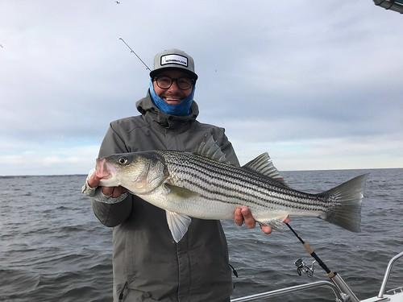
Ecosystem-Based Management & Temperature Regime Recommendation 1
Establish Chesapeake Bay wide Striped bass fishing guidance based on temperature and dissolved oxygen thresholds to reduce catch and release mortality
Consider developing habitat condition thresholds and fishing guidance for other recreationally targeted species at risk during periods of poor habitat conditions
Associated Science Needs
  Determine temperature and oxygen thresholds for striped bass and other key species.
  Conduct investigations to better understand behavior of anglers on the water
  Develop habitat suitability models and indicators for key fishery resources
Notes:
Rationale:
Higher water temperatures put more stress on multiple fish species. Low oxygen conditions are worsened by high water temperatures.
Combined high water temperature and low oxygen reduce the area of suitable habitat for Striped bass and other species.
This stress can be minimized by notifying anglers of days when habitat conditions are poor and discourage fishing that could result in catch and release mortality.
Implementation Actions:
Host focused meetings with the joint Sustainable Fisheries and Habitat GIT, Fish Habitat Action Team (FHAT) to review existing science on temperature and oxygen thresholds, application of the science to develop bay wide thresholds and guidance.
The desired outcome of these meetings is to establish temperature and oxygen thresholds for striped bass and other key species based on best available science
Convene discussions at the Sustainable Fisheries GIT (SFGIT) meetings with managers and invited anglers to:
To discuss the utilization of temperature and oxygen thresholds findings from the FHAT to help develop and communicate guidance to anglers on the environmental thresholds and ways to modify fishing practices to reduce mortality when fish are most vulnerable
To consider fishing restrictions in areas where conditions exceed thresholds to reduce fishing mortality, and
To develop options for how the thresholds could be built into fishery management plans at state and regional (Atlantic States Marine Fisheries Commission) levels.

Slide 17
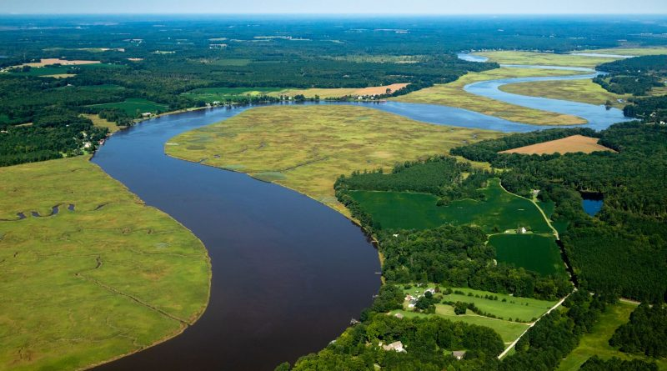
Ecosystem-Based Management & Temperature Regime Recommendation 2
Develop and implement a strategy to improve communications between living resource managers, scientists and stakeholders on the new temperature regime, the impacts and management response/adaptation strategies
Associated Science Needs
  Understand where the gaps are in our current communication strategies
  Social science research to help understand decision making (e.g., understanding behavior of anglers on the water when throwing back or keeping catches, understanding property owners’ choice in shoreline protection)
  Development of communication strategies to specific audiences (e.g., policy-makers, managers, residents, local partners)
Notes:
Rationale:
Higher water temperatures put more stress on multiple fish species. Low oxygen conditions are worsened by high water temperatures.
Combined high water temperature and low oxygen reduce the area of suitable habitat for Striped bass and other species.
This stress can be minimized by notifying anglers of days when habitat conditions are poor and discourage fishing that could result in catch and release mortality.
Implementation Actions:
Host focused meetings with the joint Sustainable Fisheries and Habitat GIT, Fish Habitat Action Team (FHAT) to review existing science on temperature and oxygen thresholds, application of the science to develop bay wide thresholds and guidance.
The desired outcome of these meetings is to establish temperature and oxygen thresholds for striped bass and other key species based on best available science
Convene discussions at the Sustainable Fisheries GIT (SFGIT) meetings with managers and invited anglers to:
To discuss the utilization of temperature and oxygen thresholds findings from the FHAT to help develop and communicate guidance to anglers on the environmental thresholds and ways to modify fishing practices to reduce mortality when fish are most vulnerable
To consider fishing restrictions in areas where conditions exceed thresholds to reduce fishing mortality, and
To develop options for how the thresholds could be built into fishery management plans at state and regional (Atlantic States Marine Fisheries Commission) levels.

Slide 18
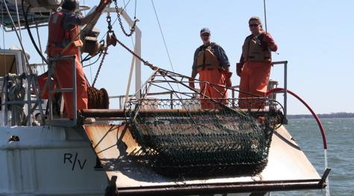
Ecosystem-Based Management & Temperature Regime Recommendation 3
Hold a workshop with multiple fishery stakeholders to explore strategic, long- term ways to advance ecosystem approaches to fishery management in the Bay that incorporate climate change
Associated Science Needs
  Improve environmental monitoring of surface and bottom temperature, dissolved oxygen and fish habitat condition
  Explore a State of ecosystem report level synthesis for the Chesapeake Bay to track how climate change is progressing and for use by managers to adapt actions addressing the changes appropriately
  Better understanding of physiological response of certain species
  Explore assessments for emerging fisheries to facilitate management as climate change creates conditions for these fisheries to be economically viable
  Consider establishing monitoring stations where there are significant fisheries habitat and spawning grounds (long-term monitoring currently is more set up to characterize large bay segments)
  Evaluate need for zooplankton monitoring at spawning and nursery areas
  Improve information on drivers of natural mortality and recruitment success for key fishery species and build into ecosystem models- inclusion of how climate change will affect fisheries
Notes:
Rationale:
Higher water temperatures put more stress on multiple fish species. Low oxygen conditions are worsened by high water temperatures.
Combined high water temperature and low oxygen reduce the area of suitable habitat for Striped bass and other species.
This stress can be minimized by notifying anglers of days when habitat conditions are poor and discourage fishing that could result in catch and release mortality.
Implementation Actions:
Host focused meetings with the joint Sustainable Fisheries and Habitat GIT, Fish Habitat Action Team (FHAT) to review existing science on temperature and oxygen thresholds, application of the science to develop bay wide thresholds and guidance.
The desired outcome of these meetings is to establish temperature and oxygen thresholds for striped bass and other key species based on best available science
Convene discussions at the Sustainable Fisheries GIT (SFGIT) meetings with managers and invited anglers to:
To discuss the utilization of temperature and oxygen thresholds findings from the FHAT to help develop and communicate guidance to anglers on the environmental thresholds and ways to modify fishing practices to reduce mortality when fish are most vulnerable
To consider fishing restrictions in areas where conditions exceed thresholds to reduce fishing mortality, and
To develop options for how the thresholds could be built into fishery management plans at state and regional (Atlantic States Marine Fisheries Commission) levels.

Slide 19
Multiple Stressors Recommendation
An interdisciplinary team of scientists, resource managers, meteorologists, and communicators should collaborate to design and create a publicly available heat wave alert system.
Associated Science Needs
Review current definitions of heat waves and conduct research to determine an appropriate definition for Chesapeake Bay (or tributaries as appropriate)
Explore real time monitoring of marine heat waves and need for forecast products
Link heat waves to living resources by analyzing heat waves and fishery survey data such as ChesMMAP
Incorporate dissolved oxygen and link to habitat preferences of key species such as striped bass, blue crabs, oyster, and SAV
Development of the warning system
Outreach to public, and to partners in development
Notes:
Rationale:
Higher water temperatures put more stress on multiple fish species. Low oxygen conditions are worsened by high water temperatures.
Combined high water temperature and low oxygen reduce the area of suitable habitat for Striped bass and other species.
This stress can be minimized by notifying anglers of days when habitat conditions are poor and discourage fishing that could result in catch and release mortality.
Implementation Actions:
Host focused meetings with the joint Sustainable Fisheries and Habitat GIT, Fish Habitat Action Team (FHAT) to review existing science on temperature and oxygen thresholds, application of the science to develop bay wide thresholds and guidance.
The desired outcome of these meetings is to establish temperature and oxygen thresholds for striped bass and other key species based on best available science
Convene discussions at the Sustainable Fisheries GIT (SFGIT) meetings with managers and invited anglers to:
To discuss the utilization of temperature and oxygen thresholds findings from the FHAT to help develop and communicate guidance to anglers on the environmental thresholds and ways to modify fishing practices to reduce mortality when fish are most vulnerable
To consider fishing restrictions in areas where conditions exceed thresholds to reduce fishing mortality, and
To develop options for how the thresholds could be built into fishery management plans at state and regional (Atlantic States Marine Fisheries Commission) levels.

Slide 20
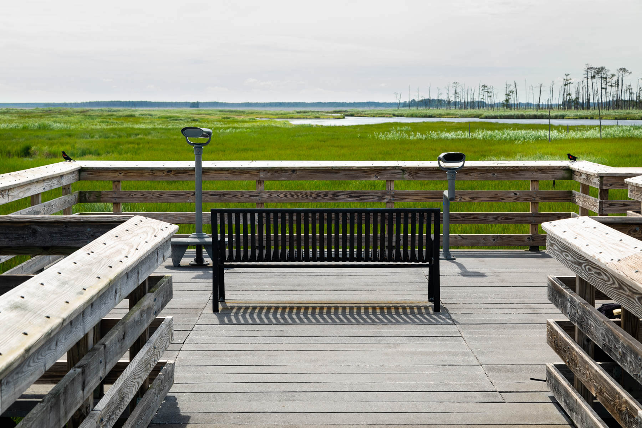
Nearshore Habitat Recommendation
Develop common criteria and metrics to help target, site, design and implement tidal natural infrastructure projects in the nearshore where ecological and climate resilience benefits are highest
Associated Science Needs
  Detailed analysis of costs of natural infrastructure versus hardened infrastructure
  Threshold analysis of ecological impacts and benefits
  Research into behavioral drivers behind shoreline hardening decisions
  Development of criteria for targeting where multiple benefits and ecosystem services can be optimized.
  Use of models to increase understanding of habitat change from sea level rise
Notes:
Rationale:
Higher water temperatures put more stress on multiple fish species. Low oxygen conditions are worsened by high water temperatures.
Combined high water temperature and low oxygen reduce the area of suitable habitat for Striped bass and other species.
This stress can be minimized by notifying anglers of days when habitat conditions are poor and discourage fishing that could result in catch and release mortality.
Implementation Actions:
Host focused meetings with the joint Sustainable Fisheries and Habitat GIT, Fish Habitat Action Team (FHAT) to review existing science on temperature and oxygen thresholds, application of the science to develop bay wide thresholds and guidance.
The desired outcome of these meetings is to establish temperature and oxygen thresholds for striped bass and other key species based on best available science
Convene discussions at the Sustainable Fisheries GIT (SFGIT) meetings with managers and invited anglers to:
To discuss the utilization of temperature and oxygen thresholds findings from the FHAT to help develop and communicate guidance to anglers on the environmental thresholds and ways to modify fishing practices to reduce mortality when fish are most vulnerable
To consider fishing restrictions in areas where conditions exceed thresholds to reduce fishing mortality, and
To develop options for how the thresholds could be built into fishery management plans at state and regional (Atlantic States Marine Fisheries Commission) levels.

Slide 21
Responses to Comments Received
18 participants in the workshop commented when the draft report was sent out for review
The bulk of the comments were received from members of the workshop project team who had previously contributed to the synthesis papers and/or preparations for the two workshop days
Almost all of the comments were on the Watershed section of the report, and concentrated on the findings and the “rationale” paragraphs accompanying the recommendations
A few comments were made on the recommendations and implementing actions
Where editorial clarifications were suggested, changes were accepted
No changes were made in the recommendations, and no implementing actions were added or deleted
We separate documentation of responses to both key comments and all comments

Slide 22
Final Notes
We ran into challenges with recognizing USGS and EPA research colleagues as contributing authors of the workshop report given its contains management recommendations
Please be aware several synthesis papers are undergoing USGS reviews and some further edits may be incorporated
UMCES colleagues are working on an 8-page summary paper to communicate the workshop findings and recommendations to a broader audience

Slide 23
Final Asks
Rebecca and I were able to champion the workshop, from proposal through delivery of the final draft workshop report
However, we can’t champion the follow through on the management actions
I ask STAC to challenge the Management Committee to integrate the management recommendations (and associated science needs) from the STAC workshop into plans for implementation of the Chesapeake Executive Council’s Directive No. 21-1 Collective Action for Climate Change
I ask for STAC’s approval to finalize and publish the STAC workshop report

