Slide 1
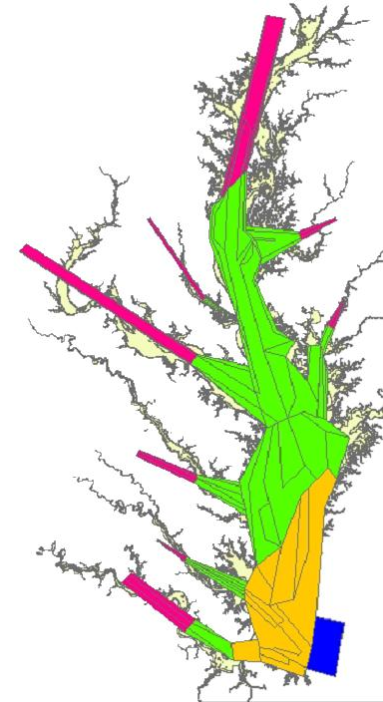


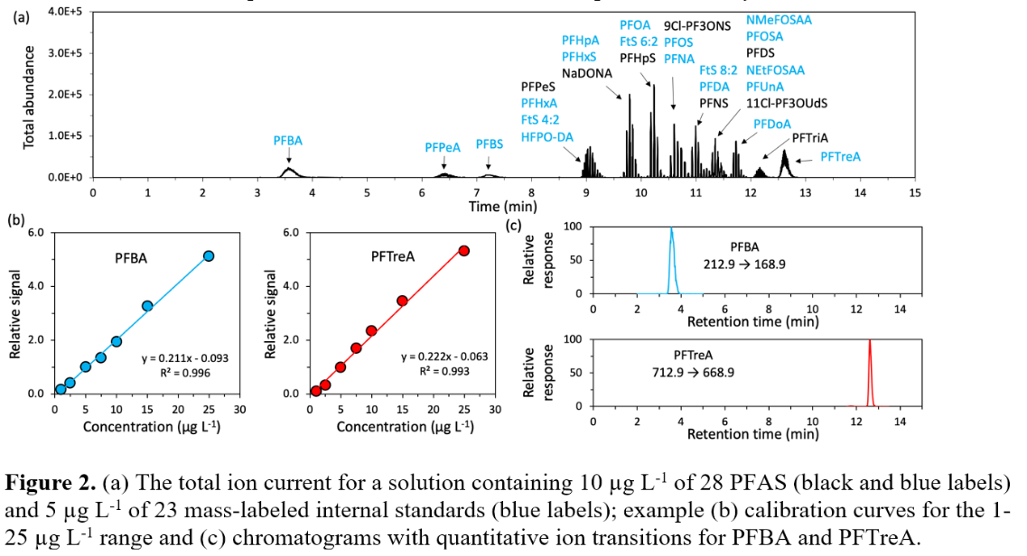
An Integrative Modeling Approach to Support Consumption Advisories
Tom Ihde
Morgan State University – PEARL
Dr. Lee Blaney
University of MD Baltimore County
https://ian.umces.edu/media-library/

Slide 2
PFAS Contamination in the Chesapeake Bay Food Web
(PFAS == per- and polyfluoroalkyl organic compounds)
  Issues:
    PFAS have been accumulating in the Bay environment since the 1940’s
      Persist over long time periods – degrade slowly
      Bioaccumulate in muscle tissues
      Human effects dire:
        Increased infant mortality
        Birth defects, including skeletal alteration
        Neurodevelopmental effects
        Reduced immune function
        Cancer
    Testing is difficult, expensive
    Monitoring needs to be spatial (contaminated animals move)
    Consumption advisories likely will require multiple target species
  Pilot Study:
  Focuses on the development of a cost-effective approach to estimate PFAS concentrations spatially for multiple focal species simultaneously

Slide 3
NIH/Morgan State University Pilot Study:
Estimating Toxic PFAS Concentrations in Seafood Spatially in the Chesapeake Bay
  Aim 1
  Predict relative concentrations of PFAS contamination spatially for Chesapeake Bay species.
  Aim 2
  Test the predictive ability of the model as proof of concept of its use to estimate and map relative concentrations of contaminants.
The Chesapeake Atlantis Model (CAM)

Slide 4
The Chesapeake Atlantis Model
A Holistic Ecosystem Modeling Approach
Incorporating:
Biological environment
Primary production
Trophic interactions
Recruitment relationships
Age structure
Size structure
Life History
Refuge Habitat
Fisheries
Multiple sectors
Gears
Seasons
Spatially explicit
Physical environment
Geology
Chemistry
Circulation & currents
Temperature
Salinity
Water clarity
Climate variability
Nutrient Inputs
Currency is Nitrogen
Oxygen
Silica
3 forms of detritus
Bacteria-mediated recycling

Slide 5
The Chesapeake Atlantis Model
A Holistic Ecosystem Modeling Approach
Incorporating:
Biological environment
Primary production
Trophic interactions
Recruitment relationships
Age structure
Size structure
Life History
Refuge Habitat
Fisheries
Multiple sectors
Gears
Seasons
Spatially explicit
Ecotoxicolgy
Biomagnification
Physical environment
Geology
Chemistry
Circulation & currents
Temperature
Salinity
Water clarity
Climate variability
Nutrient Inputs
Currency is Nitrogen
Oxygen
Silica
3 forms of detritus
Bacteria-mediated recycling

Slide 6
Ecological Groups: Federal fisheries, Forage, Protected, Habitat
Finfish
- Alosines (Amer.Shad, Hickory Shad, Alewife & Herring)
- Atlantic Croaker
- Bay anchovy
- Black drum
- Bluefish
- Butterfish, harvestfish (“Jellivores”)
- Catfish
- Gizzard shad
- Littoral forage fish: silversides, mummichog
- Menhaden
- Striped bass
- Summer flounder
- Other flatfish (hogchoker, tonguefish, window pane, winter flounder)
- Panfish:
Euryhaline: Spot, silver perch; FW to 10ppt: yellow perch, bluegill
- Reef assoc. fish: spadefish, tautog, black seabass, toadfish
- Spotted hake, lizard fish, northern searobin
- Weakfish
- White perch
Elasmobranchs
- Cownose ray
- Dogfish, smooth
- Dogfish, spiny
- Sandbar shark
Birds
- Bald Eagle
- Piscivorous birds (osprey, great blue heron, brown pelican, cormorant)
- Benthic predators (diving ducks)
- Herbivorous seabirds (mallard, redhead, Canada goose, & swans)
Mammals
- Bottlenose dolphin
Reptiles
- Diamond-back Terrapin
- Seaturtles
Invertebrates
- Benthic feeders: (B-IBI “CO”+”IN”) …,
- Benthic predators: (B-IBI “P”) …,
- Benthic suspension feeders: (B-IBI “SU”)
- Blue crab YOY
- Blue crab adult
- Brief squid
- Macoma clams: (B-IBI)
- Meiofauna: copepods, nematodes, …,
- Oysters
Primary Producers
- Benthic microalgae (“microphytobenthos” benthic diatoms, benthic cyanobacteria,
& flagellates)
- “Grasses:”
SAV – type varies with salinity
- Marsh grass
- Phytoplankton – Large: diatoms & silicoflagellates (2-200um)
- Phytoplankton – Small: nannoplankton, ultraplankton,
aka “picoplankton” or “picoalgae” (0.2-2um),
cyanobacteria included (2um)
- Dinoflagellates (mixotrophs) (5-2,000um)
ZooPlankton
- Ctenophores
- Sea nettles
- Microzooplankton (.02-.2mm): rotifers, ciliates, copepod nauplii
- Mesozooplankton (.2-20mm): copepods, etc.
Detritus
- Carrion
- Carrion (sediment)
- Labile
- Labile (sediment)
- Refractory
- Refractory (sediment)
Bacteria (.2-2 um [.002 mm] - feed microzooplankton food chain)
- Benthic Bacteria (sediment)
- Pelagic Bacteria: (free-living)
Images courtesy of ian.umces.edu/imagelibrary/

Slide 7
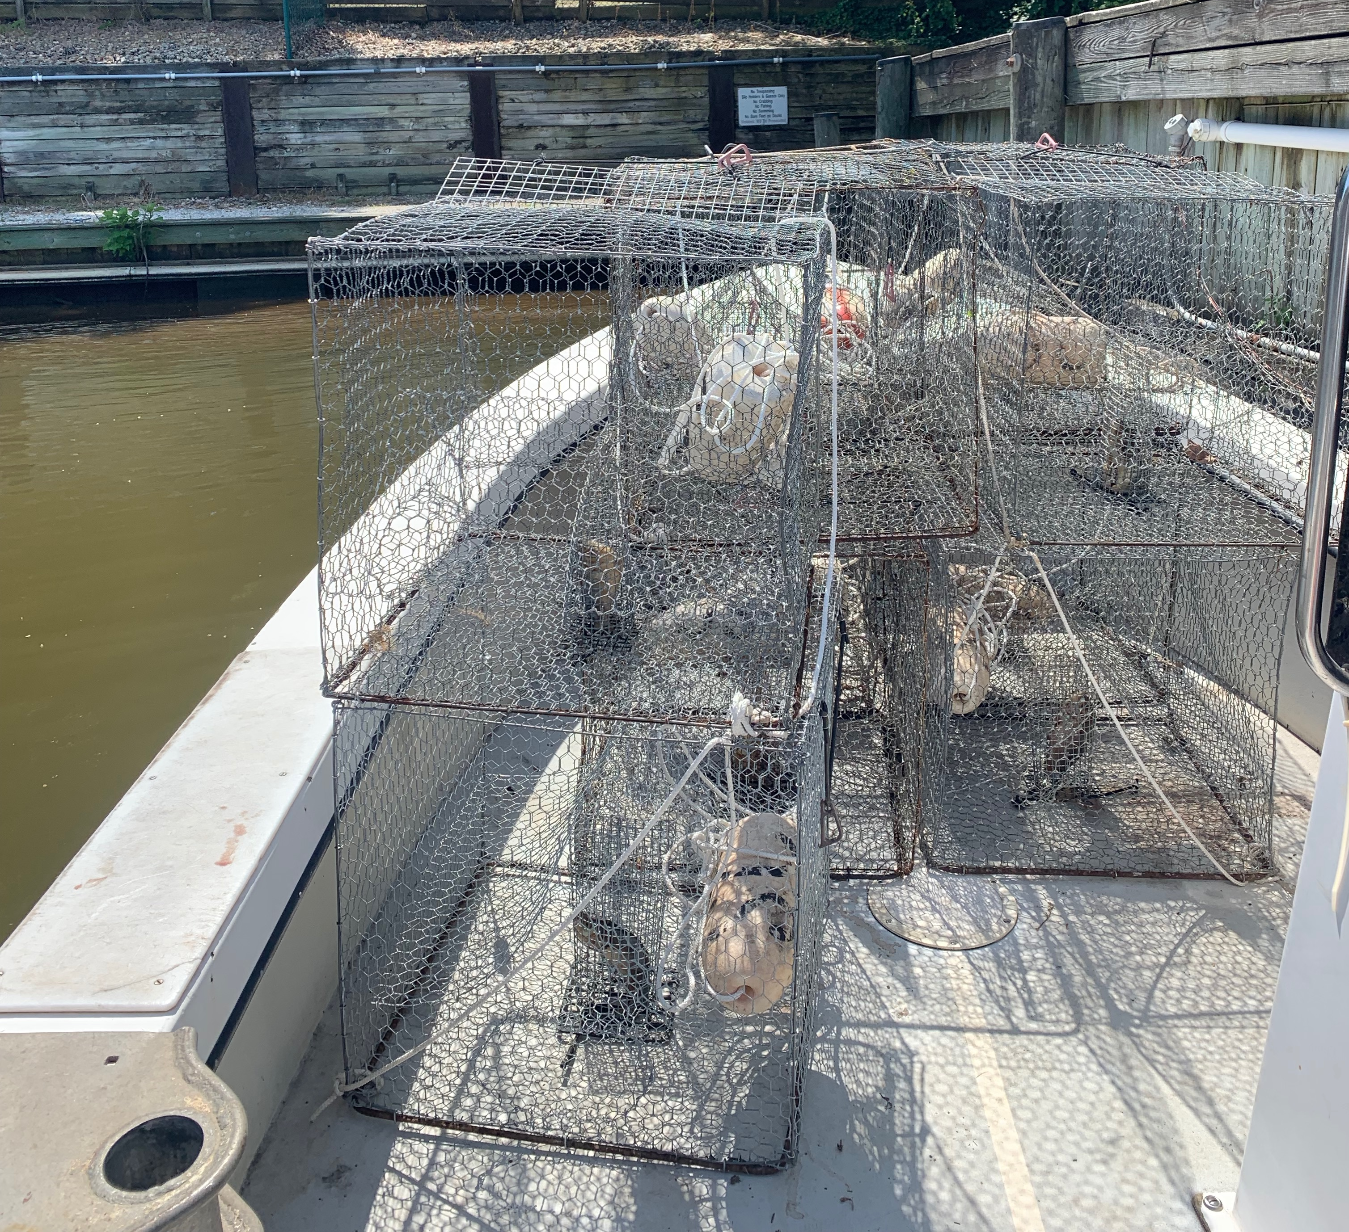
Over the next Year:
Parameterize CAM to estimate biomagnified concentrations of PFAS
Run the model
Choose two tributaries for field testing
Collect Blue Crabs in the test tributaries
Quantify actual PFAS levels (29) in tissues
Tune the model for Blue Crab

Slide 8
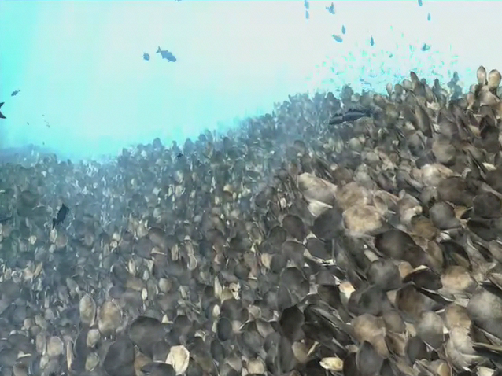


Thank You!
Questions: Thomas.ihde@morgan.edu
Funding:
RCMI Pilot Studies:
Award Number 5U54MD013376
RISE Scholars Program:
NIGMS RISE 5 R25 GM058904

Slide 9
EXTRA SLIDES

Slide 10
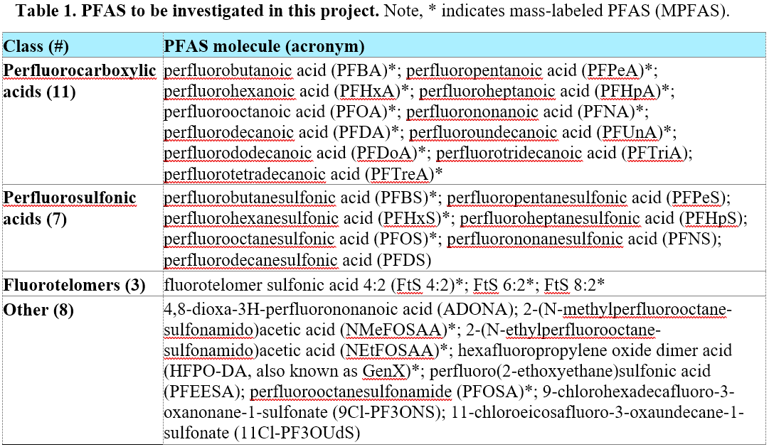

Slide 11
The Chesapeake Atlantis Model
Design

Slide 12
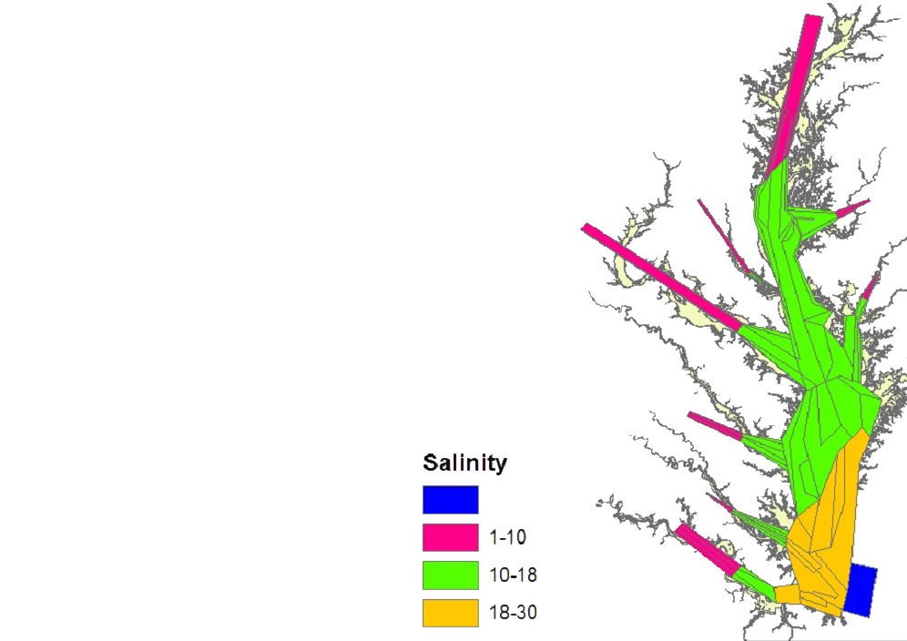
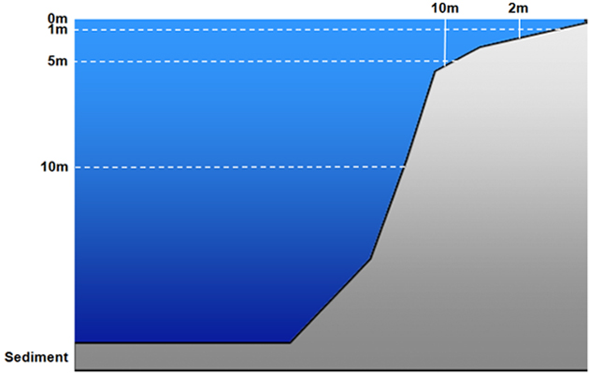
CAM Design: 3-Dimensional Box Model:

Slide 13
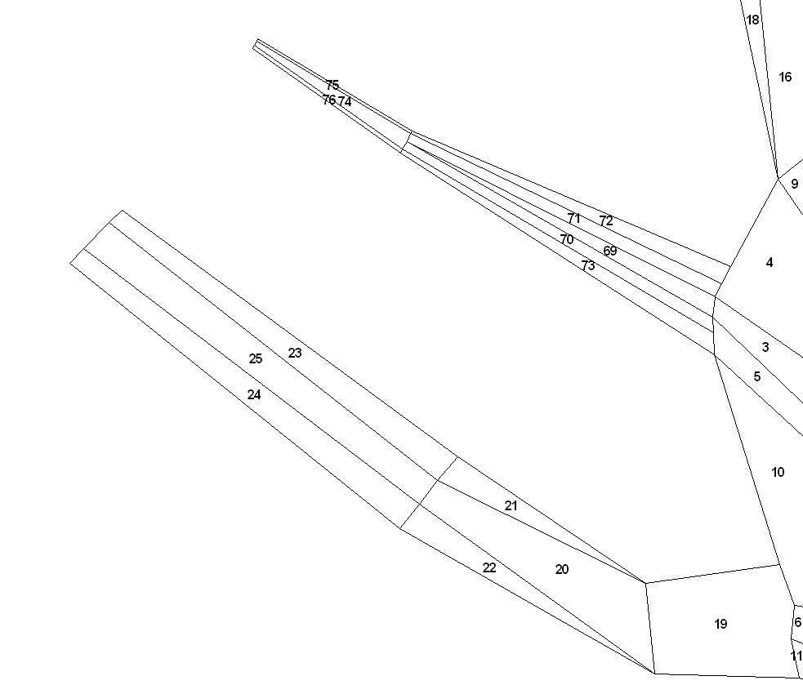
NOAA Chesapeake Bay Office – Ecosystem Modeling Team
CAM: River Box Structure
Notes:
Tribs all have deeper channel with very shallow, narrow boxes that allow for conditions favorable for marsh grasses or SAV to predominate
This structure can accommodate changes in development or water treatment plants, etc.

