Slide 1
Short and long-term station-specific Secchi Depth trends
STAC Advancing Monitoring Approaches Workshop
April 22, 2022
Rebecca Murphy
UMCES at Chesapeake Bay Program
Results generated in collaboration with: Renee Karrh (MDDNR), Mike Lane (ODU),
Cindy Johnson (VADEQ), Elgin Perry (consultant), Jon Harcum (Tetra Tech) and ITAT team

Slide 2
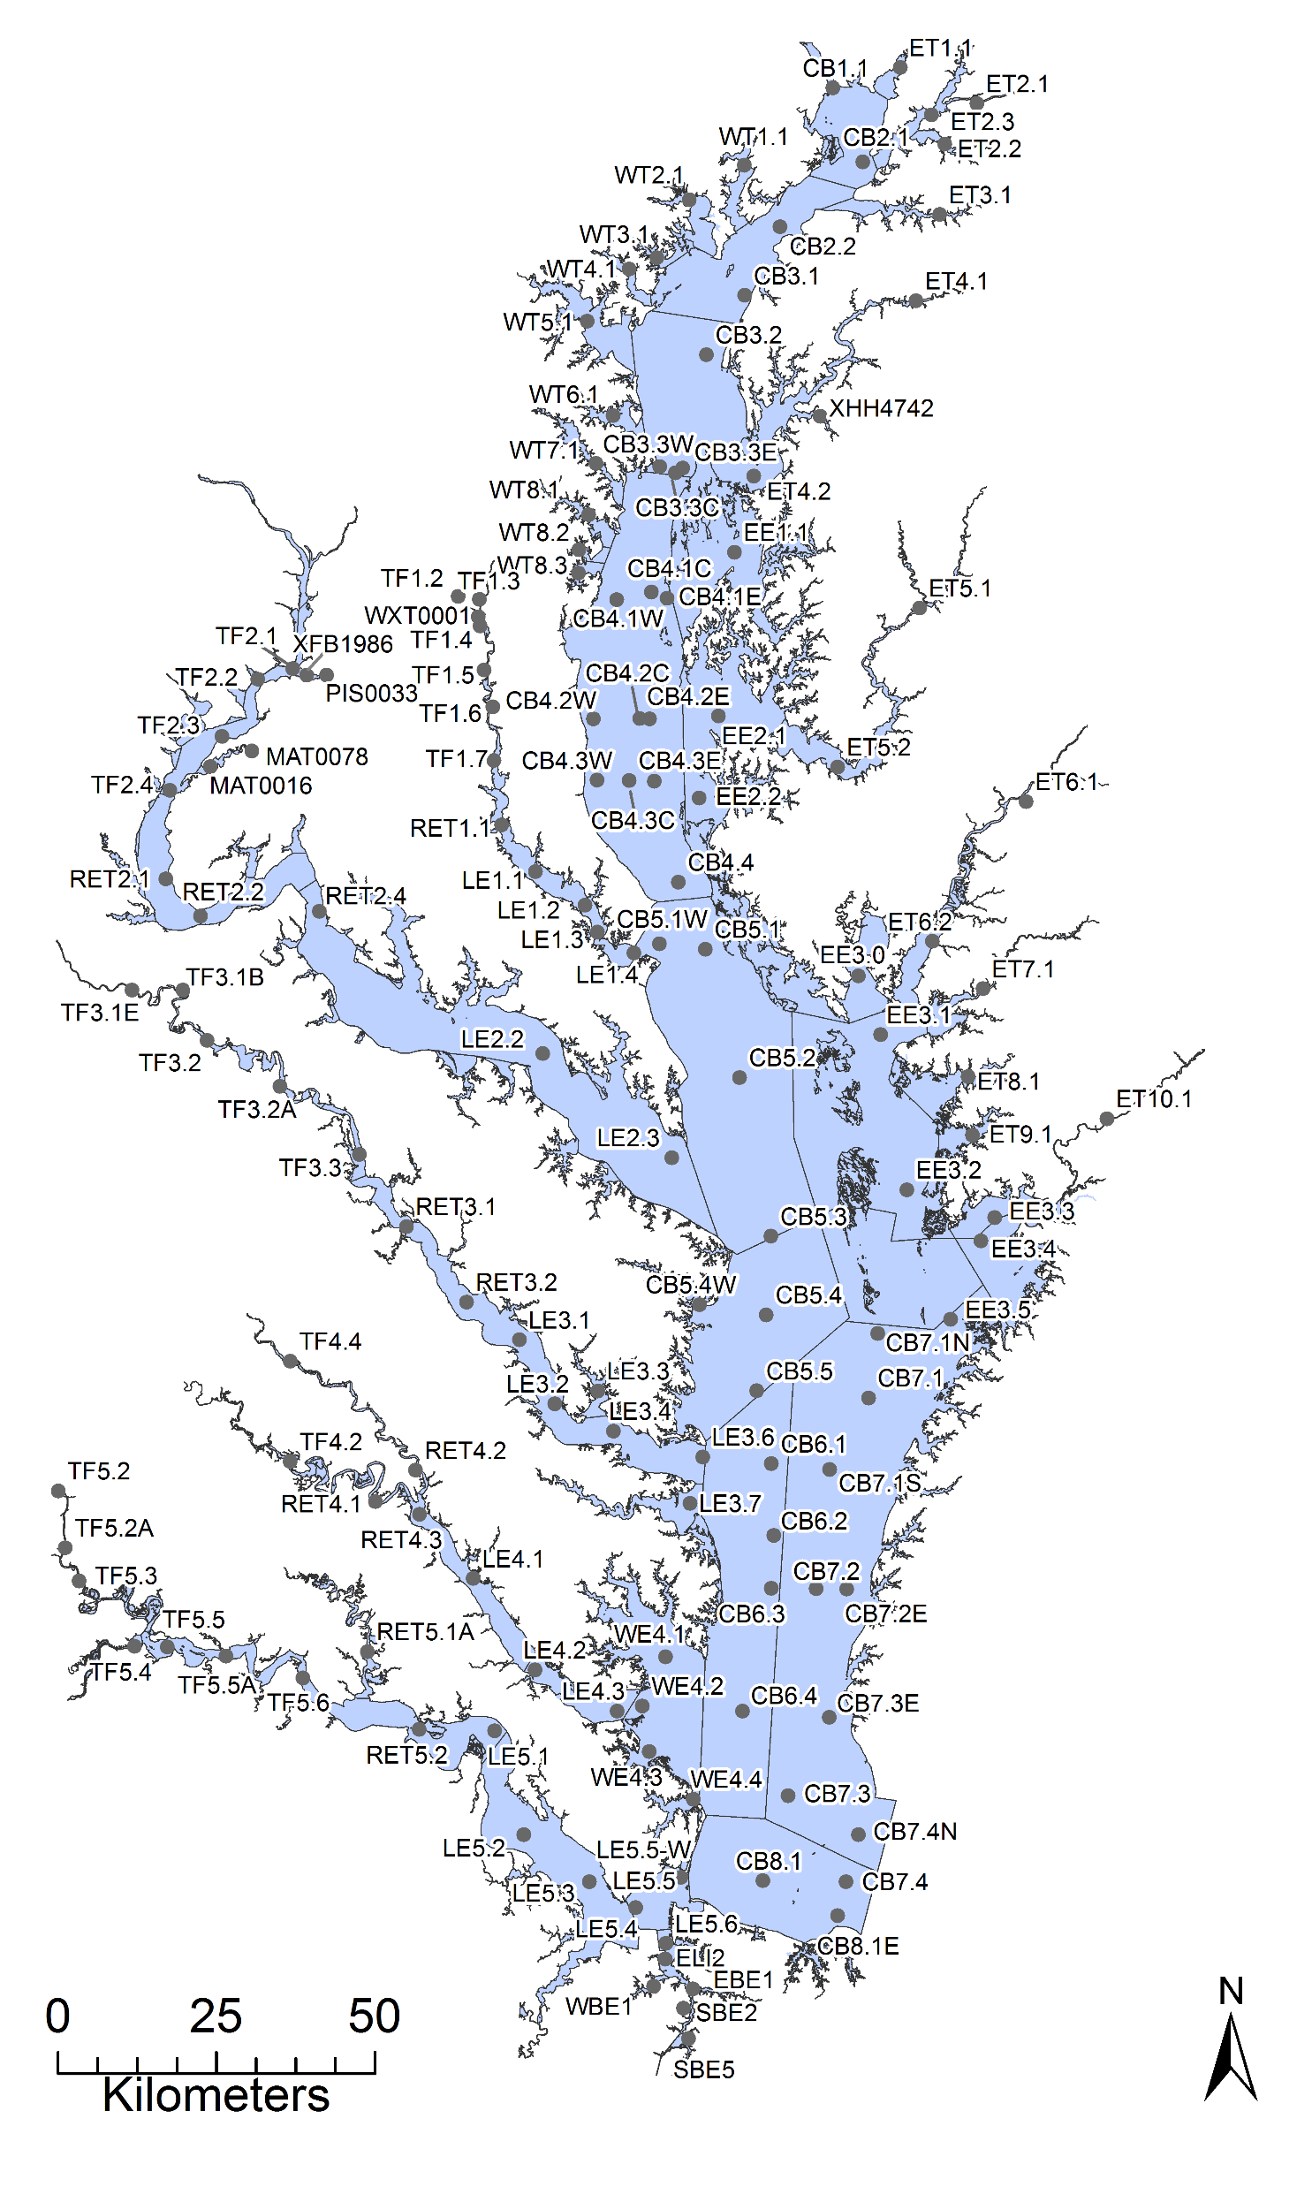
Annual Tidal Trend Analysis
Focus on long-term fixed stations
  150+ stations (mostly mid-channel)
  Data collection 1-2x/month since 1985
  Multiple samples collected with depth: Surface & bottom + more depending on station & parameter
Annual cycle in collaboration with MD, VA (and soon DC) analysts and ITAT team to analyze data and compute trends for:
  Annual Secchi depth
  Spring & summer, surface & bottom: Chlorophyll a
  Annual surface & bottom TN, TP, DIN, PO4, TSS, water temp, salinity
  Summer surface & bottom DO

Slide 3
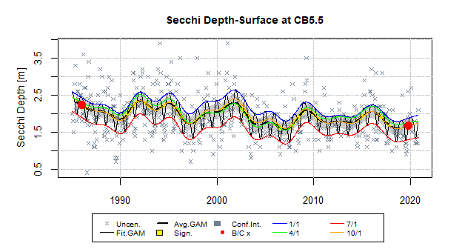
Annual Observed Secchi Depth
Statistical Generalized Additive Model (GAM) fit to all Secchi measurements at each station
  Captures non-linear patterns in the data
  Can be used with data that is not spaced regularly
  Generates observed and flow-adjusted patterns over time
Results extracted from the full models to summarize change across different times
Murphy et al. 2019. Environ. Modelling Software 118: 1-13.
https://doi.org/10.1016/j.envsoft.2019.03.027.

Slide 4
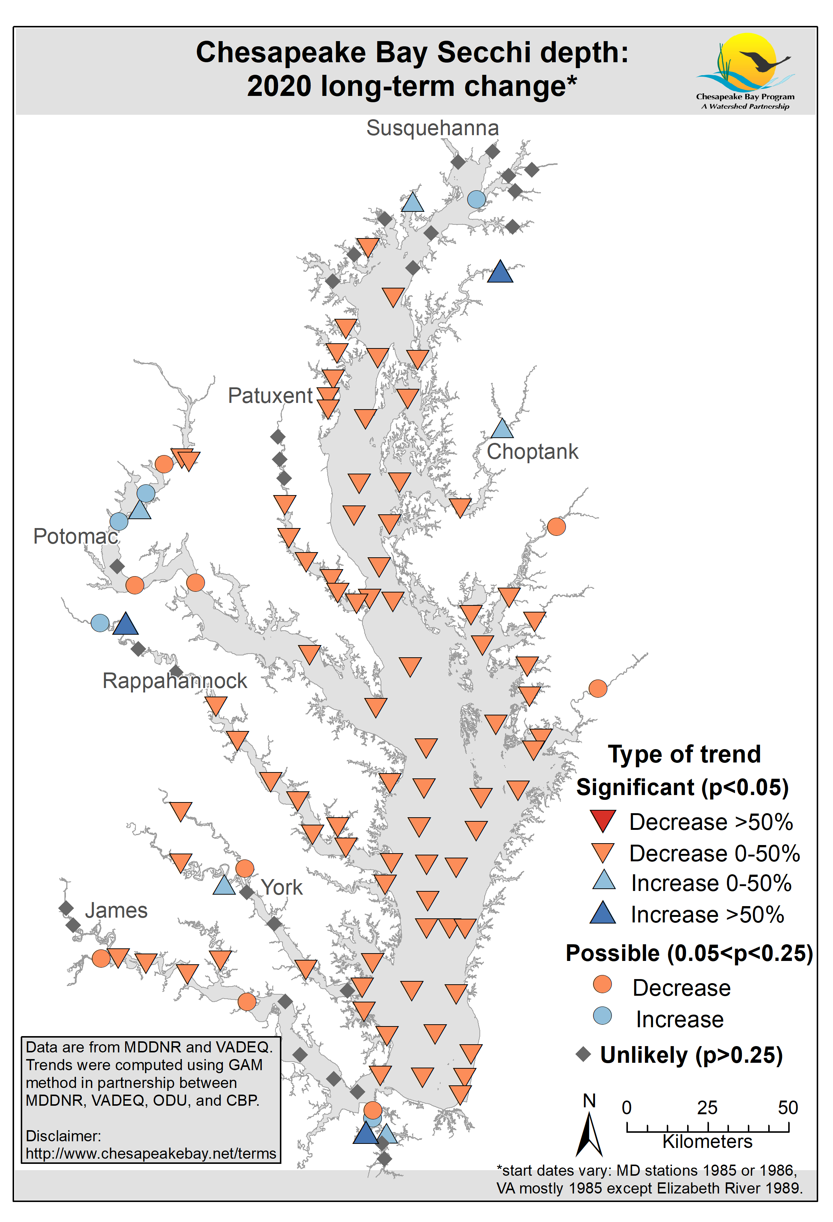
Annual Observed Secchi Depth
1980s-2020

Slide 5
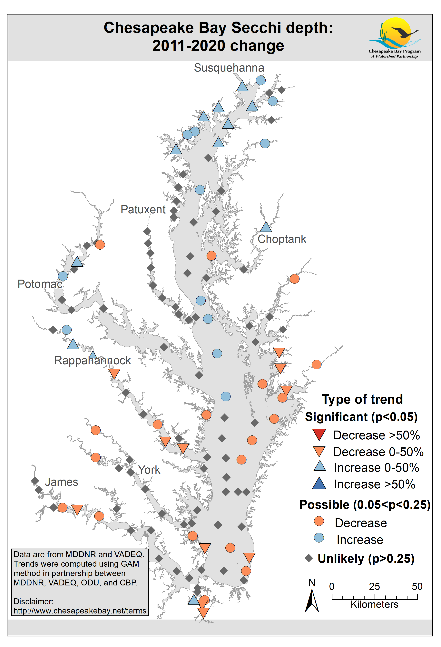
Annual Observed Secchi Depth
2011-2020
1980s-2020
Patterns vary, but this example shows a long-term degradation, and short-term plateau

Slide 6
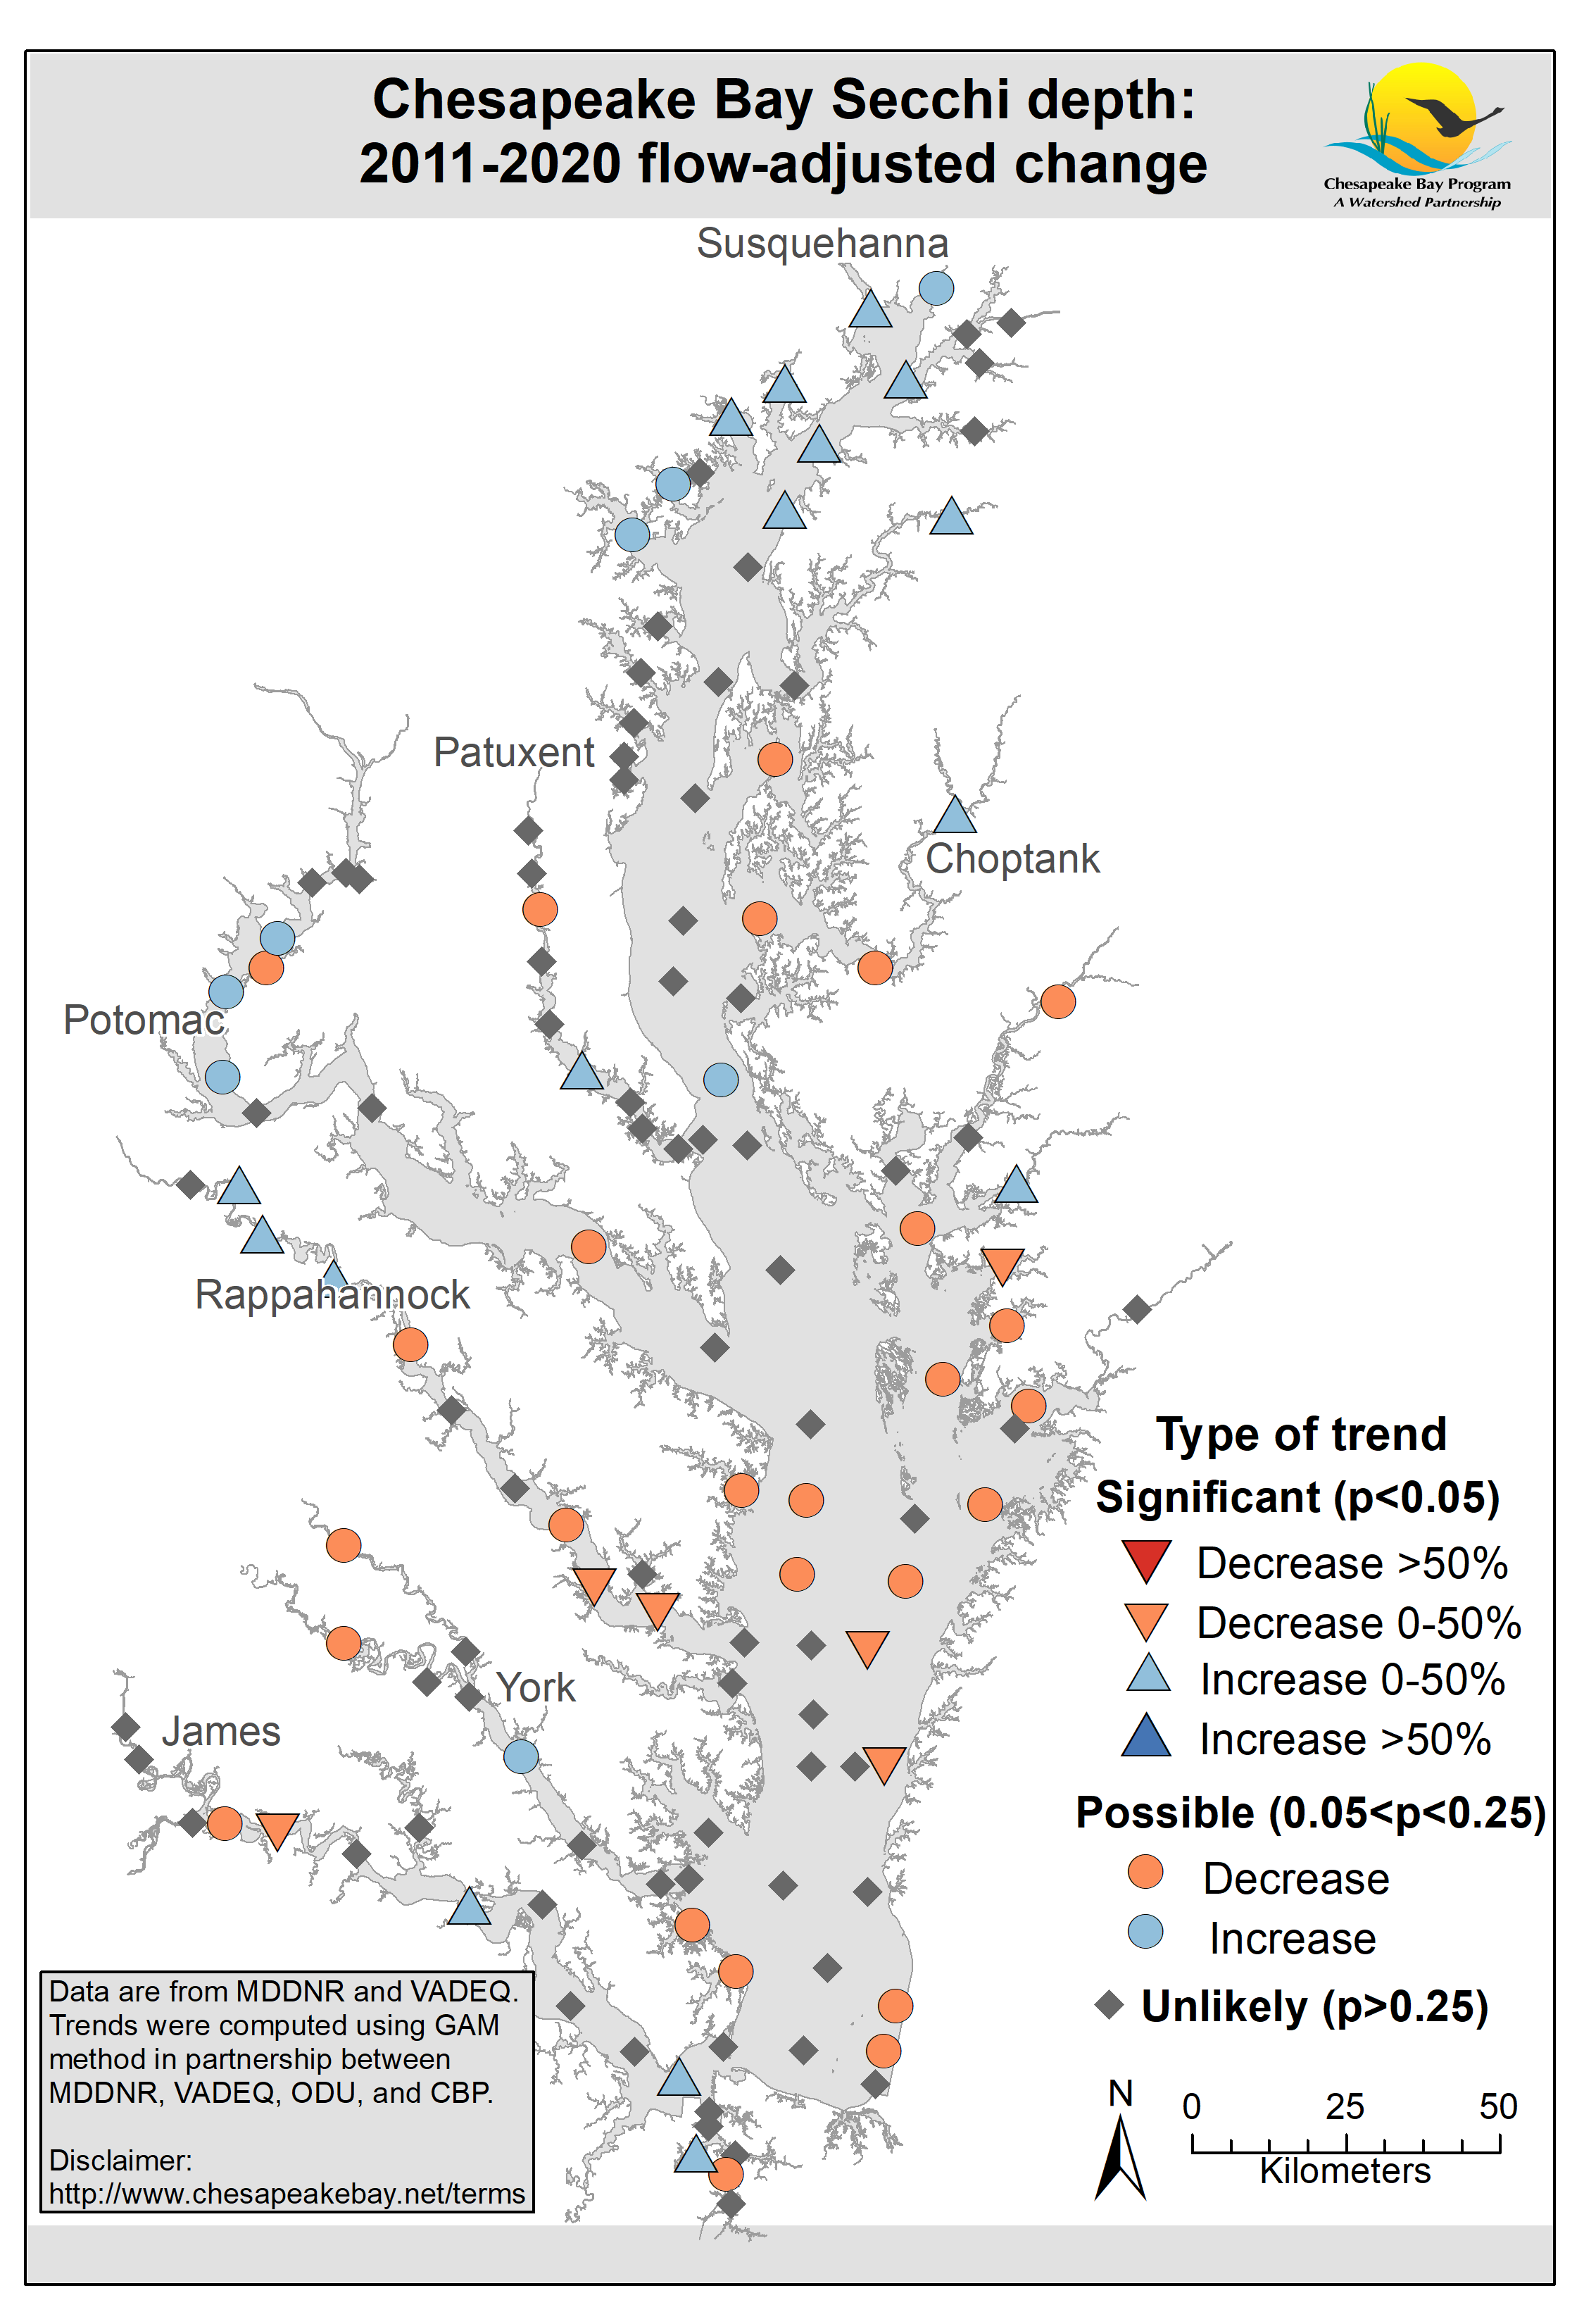
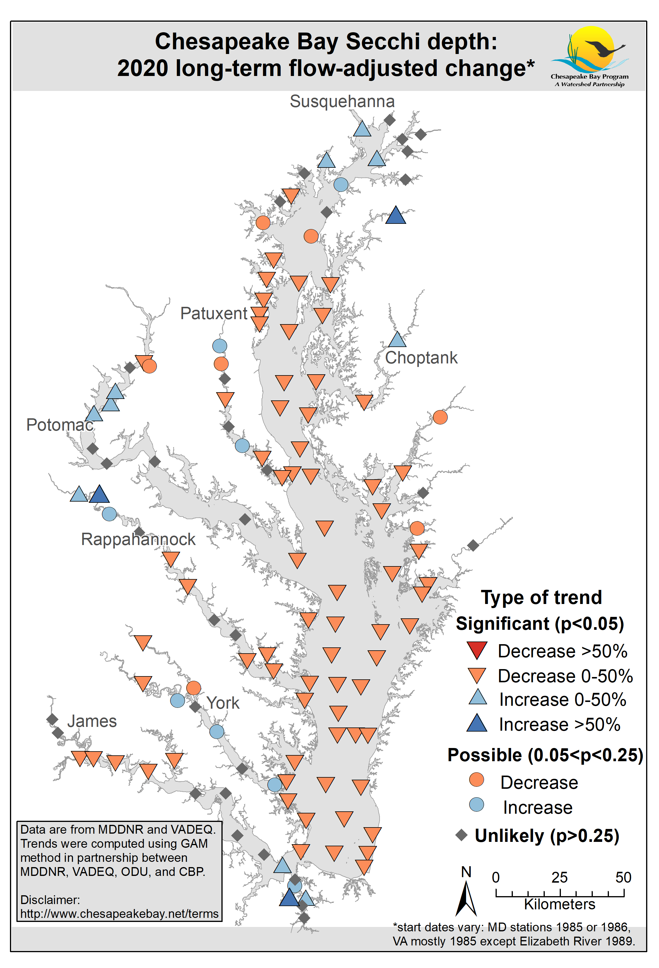
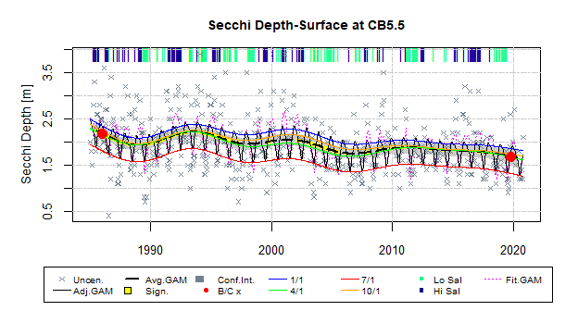
Annual Flow-adjusted Secchi Depth
2011-2020
Flow-adjusted show results “if flow had been average”
Not too much difference from observed for secchi (this year at least)
1980s-2020
Long-term

Slide 7
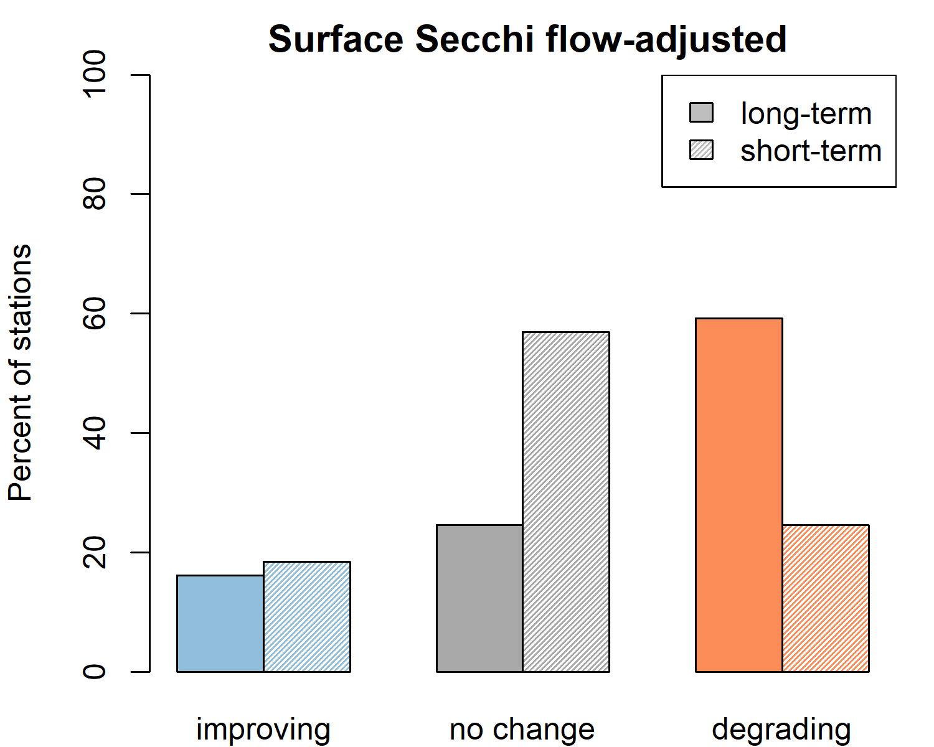
Annual Flow-adjusted Secchi Depth
2011-2020
1980s-2020
Long-term
We also aggregate all stations into a bar graph

Slide 8
Summary: 2020 Secchi Depth Trends
Annual maps summarize our very detailed GAM analysis of the monitoring data to give bay-wide picture
We also found these bar graphs help with a big-picture summary as well
  → e.g., can see how the majority of the stations have long-term degrading Secchi, but over the short-term, that swapped to be mostly “no change” for the majority of the stations

Slide 9
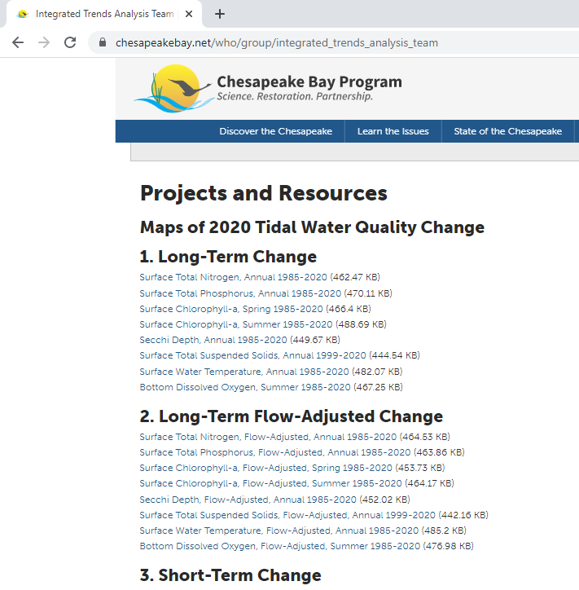
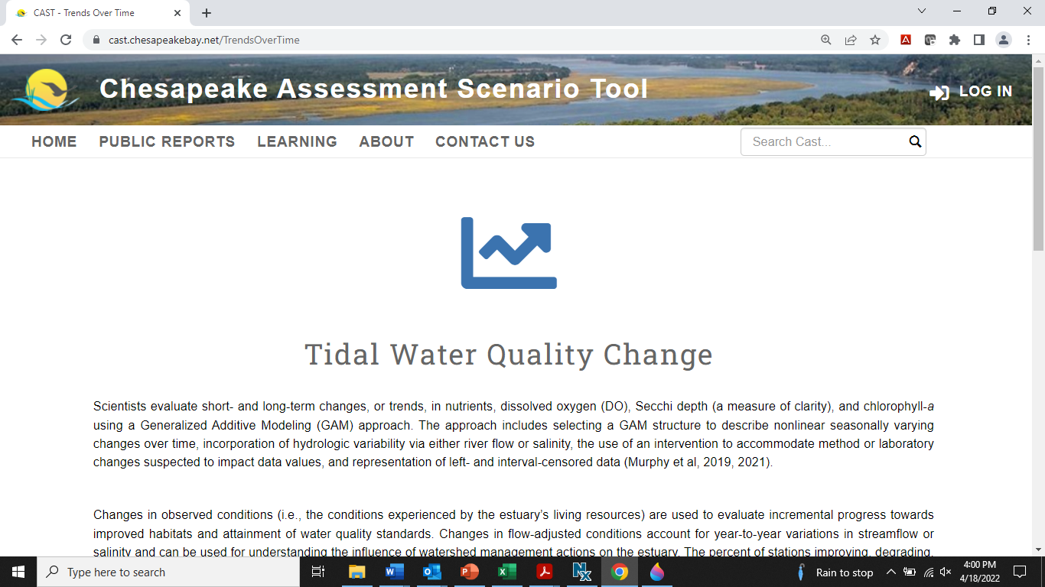
Accessing Tidal Trends
ITAT webpage
  2020 maps are available for all parameters.
  https://www.chesapeakebay.net/who/group/integrated_trends_analysis_team
Baytrendsmap via CAST
  Summary file, table, and interactive website to explore the trends.
  https://cast.chesapeakebay.net/TrendsOverTime
Rebecca Murphy rmurphy@chesapeakebay.net
ITAT leads:
Breck Sullivan bsullivan@chesapeakebay.net
Vanessa Van Note vannote.vanessa@epa.gov

