Slide 1
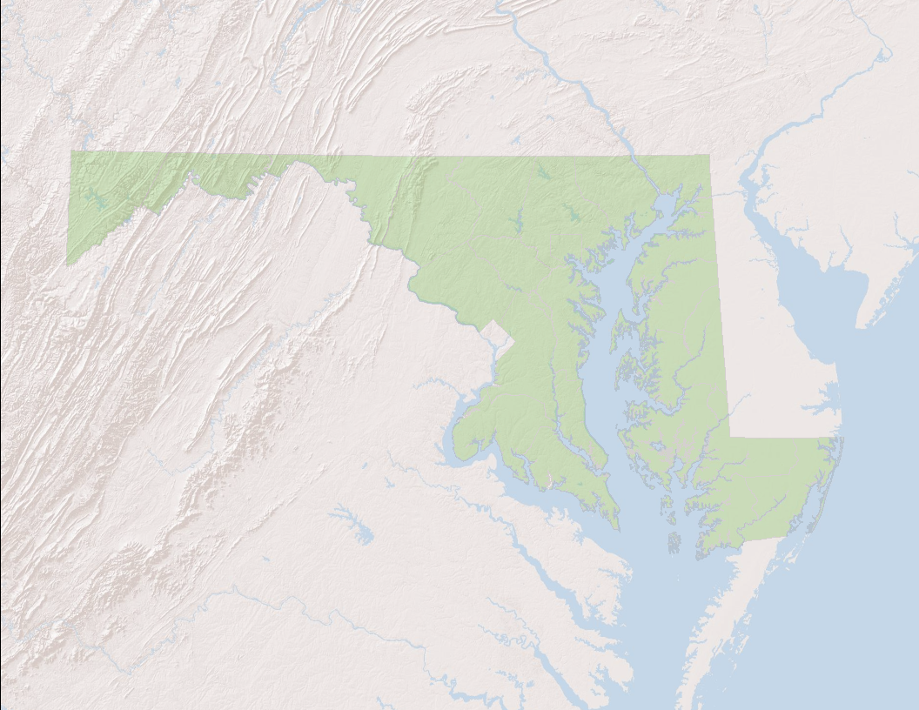
Maryland’s Chlorophyll a Criteria, Monitoring & Assessment Summary
Slides for STAC Workshop: Advancing Monitoring Approaches to Enhance Tidal Chesapeake Bay Habitat Assessment on Morning Water Clarity and CHLA
Friday, April 22, 2022
1:15 pm

Slide 2
Maryland’s Chlorophyll a Criteria
Narrative Criteria for Class II – Estuarine and Marine Waters COMAR 26.08.02.03-3C.(10):
  “Chlorophyll a. Concentrations of chlorophyll a in free-floating microscopic aquatic plants (algae) may not exceed levels that result in ecologically undesirable consequences that would render tidal waters unsuitable for designated uses.”
Numeric Criteria for Public Water Supply Reservoirs assigned the “-P” designation (COMAR 26.08.02.03-3H.):
“(1) The arithmetic mean of a representative number of samples of chlorophyll a concentrations, measured during the growing season (May 1 to September 30) as a 30-day moving average may not exceed 10 micrograms per liter; and
(2) The 90th-percentile of measurements taken during the growing season may not exceed 30 micrograms per liter.”

Slide 3
Maryland’s Tidal Chlorophyll a Monitoring
Sonde Measurements
  MDNR monitors CHLA at its Continuous Monitoring sites (temporally intensive)
  MDNR monitors CHLA in its DATAFLOW monitoring program (spatially intensive)
Lab-Analyzed Measurements
  MDNR samples at multiple depths at Main Bay and tidal trib sites
  Samples taken at DATAFLOW calibration sites
  Samples collected during ConMon site visits

Slide 4
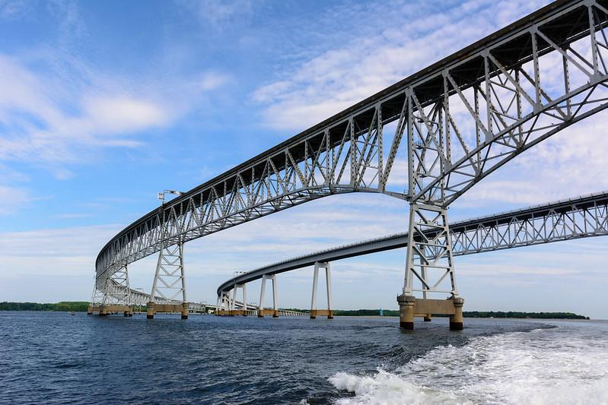
Maryland’s Freshwater Chlorophyll a Monitoring
MDNR collects lab-analyzed samples at a subset of non-tidal tributary sites (Core/Trends)
MDNR and MDE both collect lab-analyzed CHLA at impoundments at a set of representative monitoring stations
(MDE, 2016)

Slide 5
Maryland’s Chlorophyll a Assessments
Estuarine – What data is available has not been recently assessed.
Freshwater – CHLA monitoring data in (-P) reservoirs was most recently assessed for MD’s 2020-2022 Integrated Report and led to several impairment listings

Slide 6
Thoughts for CHLA and Other Assessment Needs
For Estuarine waters – Hold regular CAP workgroup meetings to address assessments of existing nutrient-related criteria (i.e. high frequency DO)
For Freshwater Lakes, evaluate EPA’s 304a criteria (2021) for nutrient pollution in Lakes and Reservoirs

Slide 7
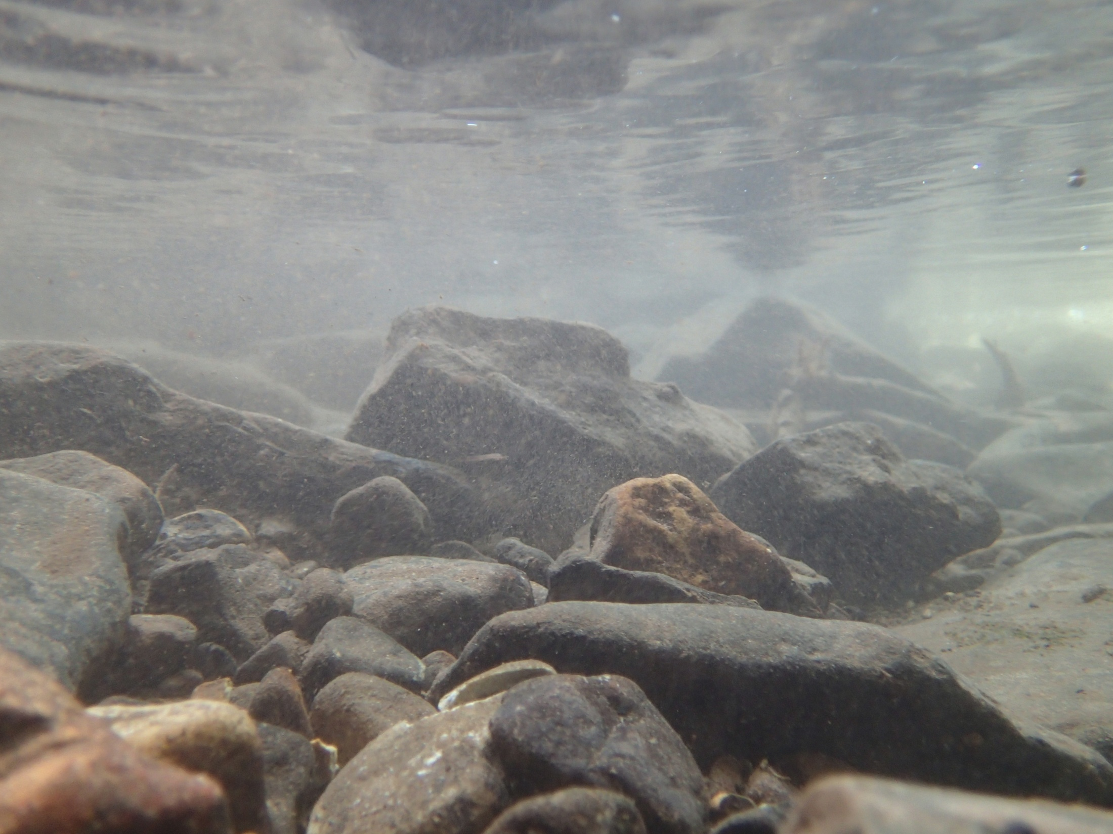


1800 Washington Boulevard | Baltimore, MD 21230-1718
410-537-3000 | TTY Users: 1-800-735-2258 www.mde.maryland.gov
Contact Information
Matthew Stover & Becky Monahan
Water and Science Administration
410-537-3611 matthew.stover@maryland.gov
becky.monahan@maryland.gov

