Slide 1
Improving Modeling and Mitigation Strategies for
Poultry Ammonia across the Chesapeake Bay Watershed
What practices work, don’t work, or perhaps could work with more development or guidance?
What are obstacles, concerns, and also opportunities related to adoption of proposed mitigation strategies?

Slide 2
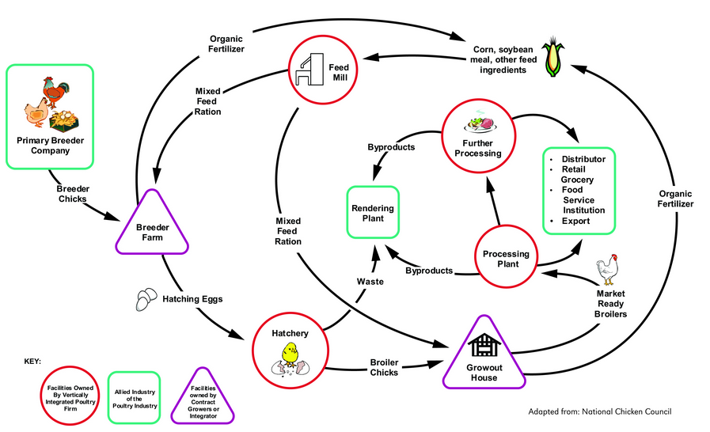
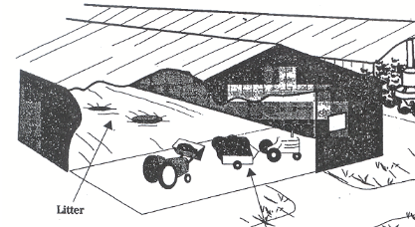
10 - 45% of NH₃ emissions
Litter Storage
5 - 45% of NH₃ emissions*
10 - 35% of NH₃ emissions
Becker and Graves 2004. Ammonia emissions and animal agriculture. CSRESS Mid-Atlantic Regional Water Quality Project
https://ag.umass.edu/crops-dairy-livestock-equine/fact-sheets/conserving-ammonia-in-manure

Slide 3
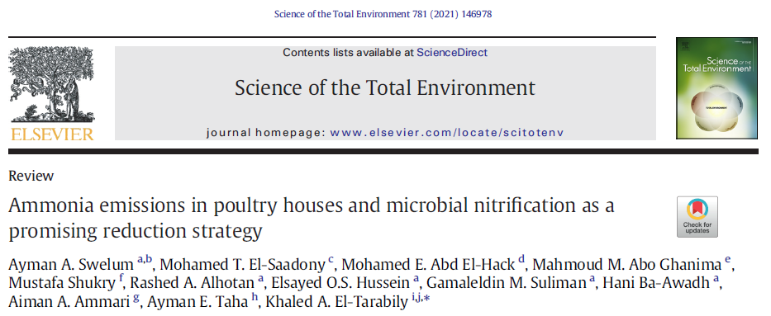
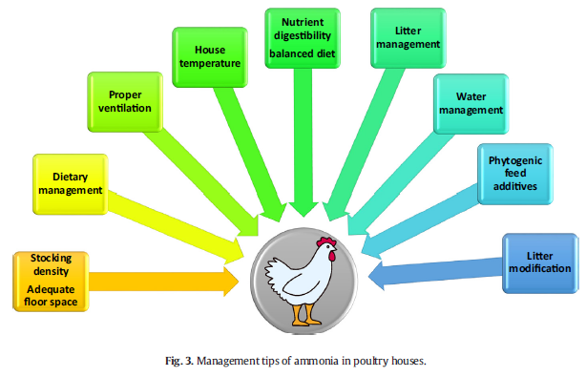
PLT
Al+Clear
Citric acid

Slide 4
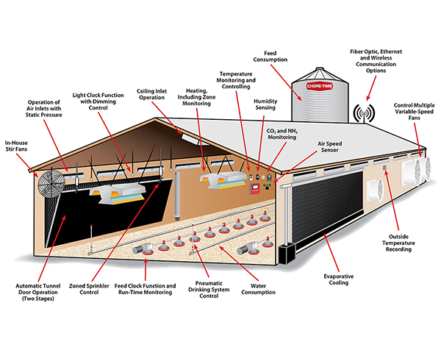

Slide 5
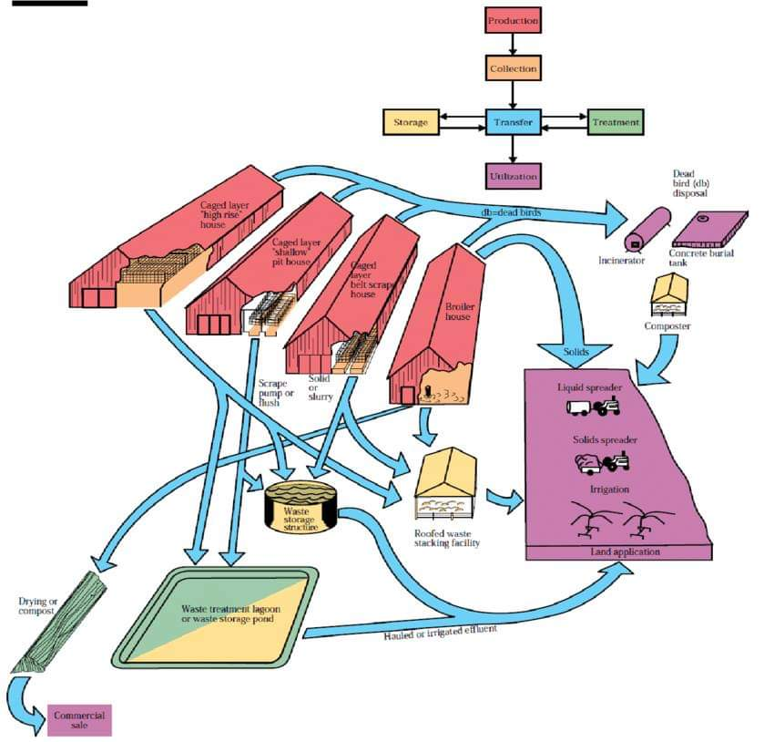
https://www.pashudhanpraharee.com/latest-approach-to-poultry-waste-management/
Composting
Shed storage
Amendments
By Dr.Surinder Khanna
International Poultry Consultant,

Slide 6
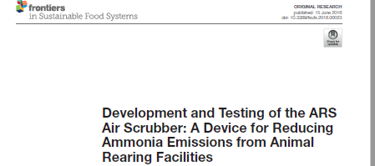
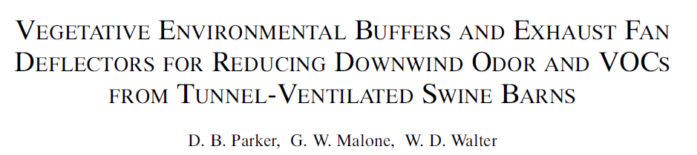
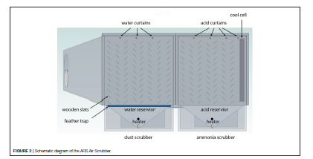
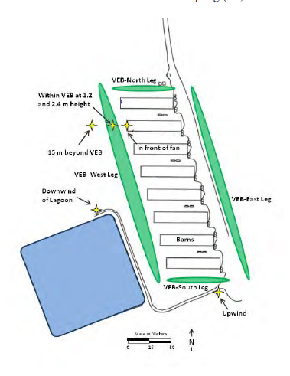
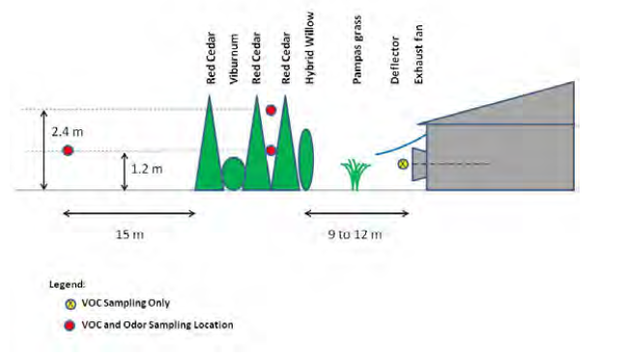
Fan Operations:
Flow rate
Slat angle
Scrubber design/operation
Vegetative Buffers:
Species
Buffer Width/Density
Distance, height
Distribution, spatial patterning
Vegetated Buffers
Biofilters

Slide 7
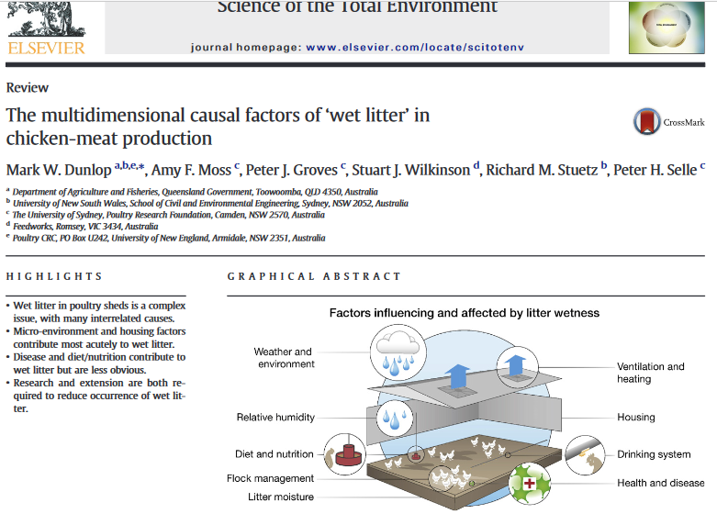
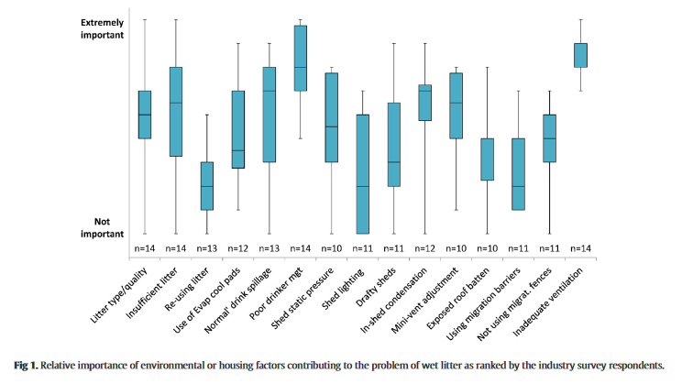

Slide 8
Improving Modeling and Mitigation Strategies for
Poultry Ammonia across the Chesapeake Bay Watershed
What practices work, don’t work, or perhaps could work with more development or guidance?
What are obstacles, concerns, and also opportunities related to adoption of proposed mitigation strategies?
  Variability in house management operations within and among poultry operations.
How could the CBP partnership help address the obstacles? New Policies? Resources? Other support?

