Slide 1
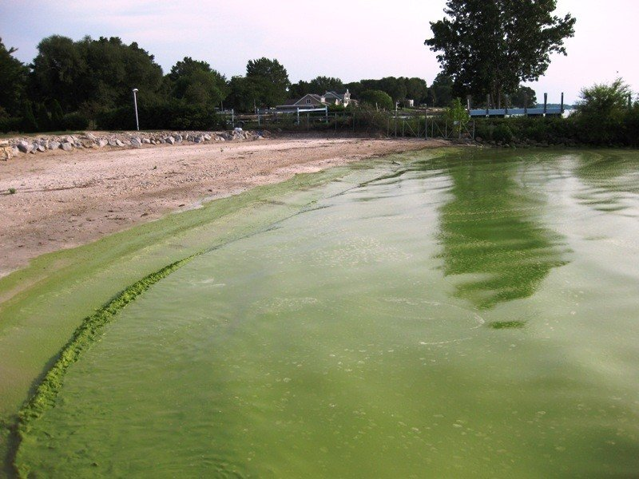
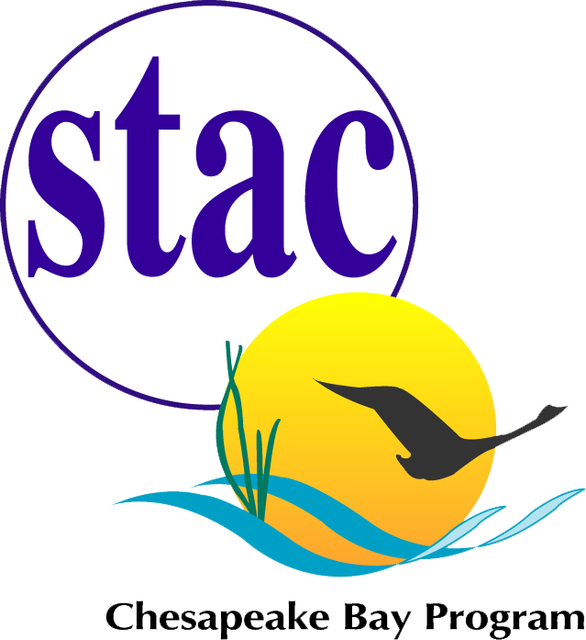
Save the Date!
April 22, 2022
Virtual STAC Workshop
Advancing Monitoring Approaches to Enhance Tidal Chesapeake Bay Habitat Assessment including Water Quality Standards for Chesapeake Bay Water Clarity and Chlorophyll a
The Scientific and Technical Advisory Committee (STAC) invites you to participate in a one-day virtual workshop to explore the state of the science and develop recommendations on adaptive monitoring and assessment for the next generation Chesapeake Bay Program tidal monitoring program. This workshop will explore new monitoring and analysis approaches and alternative data sources in order to fill gaps limiting habitat assessments for water clarity and Chlorophyll a.
Please register for the workshop using this link. Registration is required.
The STAC Workshop Webpage will continue to update with materials and workshop news.
If you have any questions, please contact STAC Staff, Meg Cole (colem@chesapeake.org)
Workshop Steering Committee: Peter Tango (USGS), Tish Robertson (Virginia Department of Environmental Quality), Brooke Landry (Maryland Department of Natural Resources), William Richardson, U.S. Environmental Protection Agency), Mark Trice (Maryland Department of Natural Resources).
Blue-green algae bloom on the shore of Catawba Island, Ohio, in Lake Erie, summer 2009. Photo: NOAA.

