Slide 1

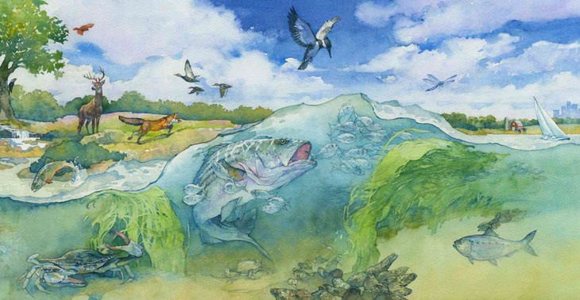
Overview of Strategy Review System and Strategic Science & Research Framework
Breck Sullivan, STAR Coordinator (USGS)
STAC Quarterly Meeting
3/8/2022

Slide 2
What is the Strategy Review System?

Slide 3
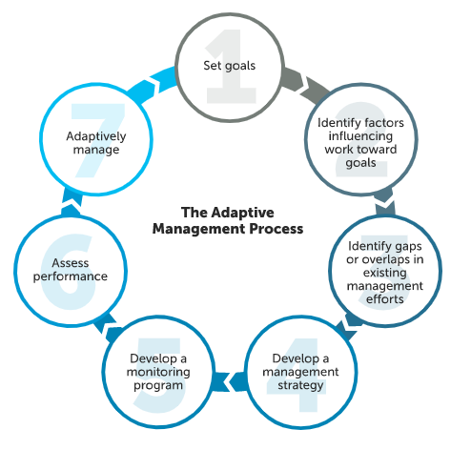
SRS was created to help the CBP apply the adaptive management “decision-making framework” towards achieving the outcomes of the Chesapeake Bay Watershed Agreement.

Slide 4
Adaptive Management Framework:
Allows the CBP to take action,
monitor results,
assess progress,
and adjust efforts as needed

Slide 5
When Cohorts assess progress and adjust efforts they consider what policy, financial, and science gaps are needed to be fulfilled to achieve progress towards their outcome.
Review Existing Logic & Action Plan: Link factos impacting outcome to actions
Write Narrative Analysis: Summary of Findings
Presentation to Management Board: Summary of progress and challenges

Slide 6
When Cohorts assess progress and adjust efforts they consider what policy, financial, and science gaps are needed to be fulfilled to achieve progress towards their outcome.
Review Existing Logic & Action Plan: Link factos impacting outcome to actions
Write Narrative Analysis: Summary of Findings
Presentation to Management Board: Summary of progress and challenges

Slide 7
Management Board requested, “develop an approach to identify, track, and help prioritize, both short- and long-term science needs.”

Slide 8
What is the Strategic Science and Research Framework?
SSRF provides a strategic approach to:
Gather, track, and maintain science needs for different outcomes identified for outcomes
  This includes science needs identified through the SRS process or STAC workshop recommendations
  Tracking is through Science Needs Database
Focus existing resources to address the science needs
  This includes sharing and collaborating with the academic community
Effectively provide science to advance CBP’s efforts and decision-making

Slide 9
What is the Strategic Science and Research Framework?
SSRF provides a strategic approach to:
Gather, track, and maintain science needs for different outcomes identified for outcomes
  This includes science needs identified through the SRS process or STAC workshop recommendations
  Tracking is through Science Needs Database
Focus existing resources to address the science needs
  This includes sharing and collaborating with the academic community
Effectively provide science to advance CBP’s efforts and decision-making

Slide 10
What is the Strategic Science and Research Framework?
SSRF provides a strategic approach to:
Gather, track, and maintain science needs for different outcomes identified for outcomes
  This includes science needs identified through the SRS process or STAC workshop recommendations
  Tracking is through Science Needs Database
Focus existing resources to address the science needs
  This includes sharing and collaborating with the academic community
Effectively provide science to advance CBP’s efforts and decision-making

Slide 11
SSRF and SRF are two different processes, but the processes are complementary.
SSRF
SRS
Each Outcome can update throughout the year
Identify Scientific Knowledge Gaps
2-year cycle for each Outcome
Track and Update Science Needs in CBP Science Needs Database
Track and Update Outcome Progress through Narrative Analysis, Logic & Action Plan, & Management Strategy
Identify Areas Outcomes Need Support on Scientific Challenges
Conduct resource assessment for science needs
Identify Scientific Factors Influencing Short – term and Long-term Actions
Review process for progress of all aspects of an Outcome – science, policy, financial, communication, engagement
Engage with stakeholders to align resources
Recommend approaches for CBP partners to address science needs
Assess Progress on Scientific efforts
Engages with CBP MB to request action or assistance
Outcomes prioritize their science needs

Slide 12
Chesapeake Bay Program Strategic Science & Research Framework:
Healthy Watershed Cohort
Breck Sullivan, STAR Coordinator
Alison Santoro (MD DNR), Stephen Faulkner (USGS), Bruce Vogt (NOAA), Justin Shapiro (CRC), Renee Thompson (USGS), Olivia Wisner (CRC), Jake Leizear (Chesapeake Conservancy)
STAC Quarterly Meeting
3/8/2022

Slide 13
Healthy Watersheds Cohort Schedule
STAR science needs discussion
Management Board Progress Review
Public and signatory feedback
Management Board follow-up
Final workplan materials due
STAC science needs discussion
August
September
November
December ‘21
March ‘22

Slide 14
Healthy Watersheds Cohort
Feedback requested from STAC:
Do you or any of your colleagues have interest in contributing to addressing one of these needs?
Do you or any of your colleagues know of existing efforts to support one of these needs?
Do you want more information to come back to STAC from any groups on specific needs/projects?
Are these needs appropriate? Do you see something missing?

Slide 15
Stream Health Outcome
Benthic data collection from under-represented catchment types
Freshwater macroinvertebrate data from under-represented catchment types in the Chesapeake watershed are critically needed to fill in monitoring gaps and improve model predictions. Presently “Engaged” resources are very general. Data are pulled from multiple jurisdictions who are monitoring for their own purposes.
Better understanding of the effects of climate change on stream processes
Global climate change has increased the occurrence of extreme weather events and has the potential to change patterns of seasonality (annual rainfall, temperature). These changes have the potential to alter fundamental stream processes.
Separate the impact of climate change vs. management actions on stream health.
  The negative impacts of climate change may reduce the effects of restoration practices and confound monitoring results.

Slide 16
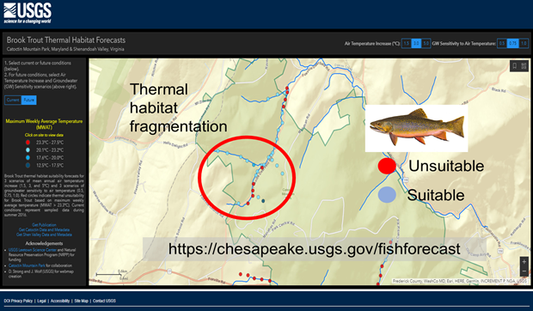
Brook Trout Outcome
Priority Science Needs
Groundwater can mitigate stream temperatures providing more suitable habitat and prevent loss of brook trout due rising temperatures from changes in climate and land use.
Need more data on stream reaches with significant groundwater inputs.
Can’t measure everywhere; need models at the stream-reach scale to identify thermally resilient areas to inform management and restoration efforts.
1. Expand spatial-temporal groundwater model to rest of Chesapeake Bay Watershed to predict groundwater influence in headwater streams.

Slide 17
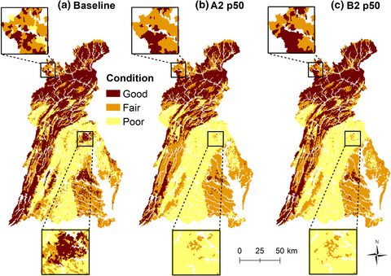
Brook Trout Outcome
Priority Science Needs
Some climate models suggest the Chesapeake Bay watershed will experience some of the most significant warming in the contiguous United States in addition to increased population growth resulting in changes to land-use patterns in coming decades.
Small streams are particularly susceptible to land-use and climate change; impacts will significantly affect brook trout populations.
Recent studies indicate combined scenarios reveal an interactive response in stream condition that was different than the additive effects of land-use and climate.
2. Determine how interactions between climate change and land use will affect brook trout.
Maloney KO, Krause KP, Buchanan C, et al. Disentangling the potential effects of land-use and climate change on stream conditions. Glob Change Biol. 2020;26:2251–2269.

Slide 18
State of Science Needs for the Fish Habitat Action Team
Bruce Vogt and Justin Shapiro

Slide 19
Research Science Needs
Synthesis and indicators to support Ecosystem Based Fisheries Management at bay and regional fishery management level
  Ex. Evaluating how changing conditions (T, S, DO) affect fish distribution and abundances by analyzing long term water column observation data with fishery survey data
  Ex. State of the Ecosystem Report
Research to quantify success of nearshore/shoreline restoration sites
  Ex. fish abundance/diversity found across various restoration project types
Better understand climate change impacts on water quality and fish habitat
  Ex. Changes to salinity, flow rates, and other habitat conditions and development of habitat suitability models and forecasts
  Ex. Leverage new telemetry arrays to track fish movements and relate to habitat conditions

Slide 20
Healthy Watersheds Outcome Science Needs
Renee Thompson, Coordinator,
Maintain Healthy Watersheds GIT
Geographer, USGS, CPB

Slide 21
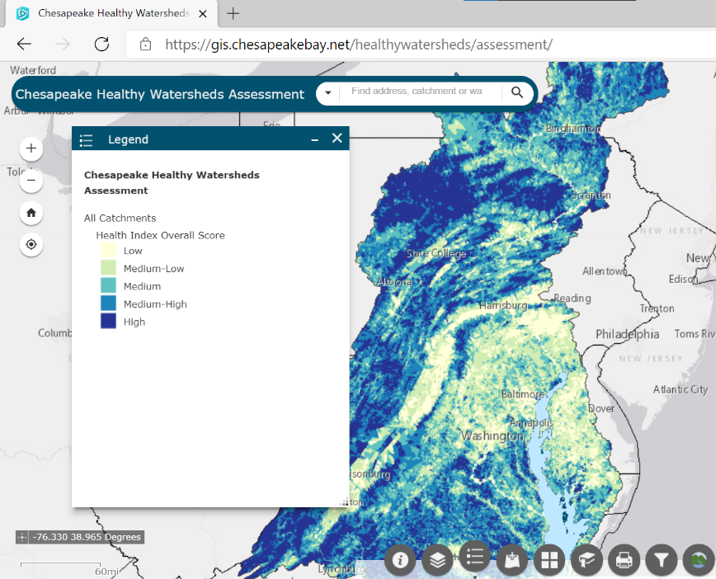
Science to inform outcome:
Outcome: 100 percent of state-identified healthy waters and watersheds remain healthy.
  Indicator development :
    impervious surface, development pressure and proportion of healthy watersheds protected (interim 2023)
    Healthy Watersheds Assessment 2.0 tool in 2022-2023.
          Integrate marsh migration, resiliency, rising stream temperature, and thresholds and stressors related to the spectrum of watershed health and vulnerability.
Notes:
Goal: Sustain state-identified healthy waters and watersheds recognized for their high quality and/or high ecological value

Slide 22
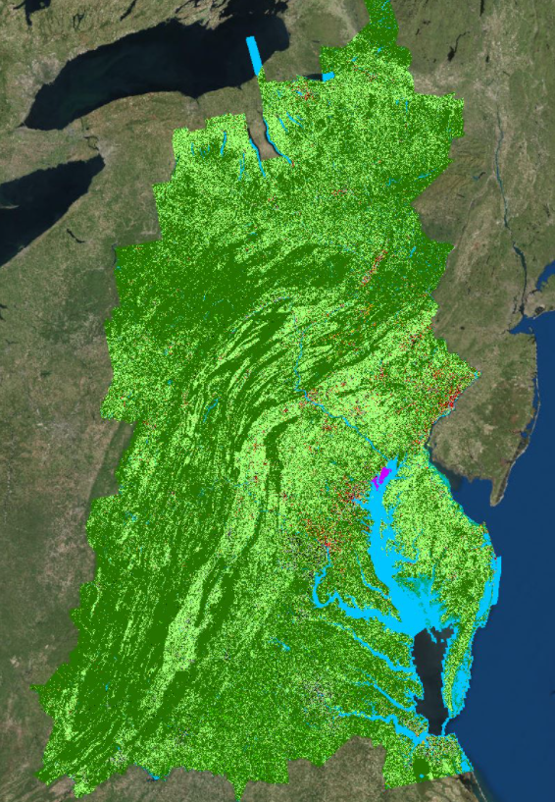
Land Use Metrics / Hi Resolution Data
very-high resolution land cover/use change monitoring currently is funded only until 2024, needs to be extended through at least the year 2030 and beyond.
Online tools (localized and scalable):
Assess changes in impervious cover, turf grass, forests, wetlands (loss only), tree canopy, and agriculture, for any user-specified geography (e.g., user-drawn polygons, Census Tracts, Municipalities, etc.)
Notes:
Long term monitoring and evaluation of land conversion
Output a standardized set of graphs and interpretive text tailored to graph content.

Slide 23
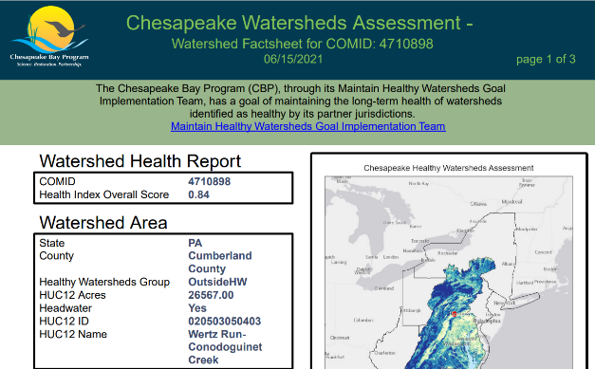
User Experience and Research / Synthesis and Communication
Understanding end user needs (of different stakeholder audiences)
Improvements to data and communication to meet local needs
Communication, Translation, (pathways), and Engagement.
Translate, format, package and flow information through to trusted sources.
How to effectively engage locals directly
Notes:
RTI under a subcontract of the CIC / EPA geospatial contract recently completed a user needs research study related to our “cross GIT” mapping needs. This is a primarily internal, GIT leadership, outcome focused audience. We have been able to glean a lot of information from this study related to the need for better organization of online tools, tutorials etc. We can cater to this audience, but what about other audiences.
Increasingly and under the leadership of Amy Handen now with EPA and our , Rachel Felver and CBP Communications team Social science, behavior change, user needs and research is an essential and often over looked when developing data communication and tools.
Lara Fowler presentation on pulling different data source together. Learning from the work they have done related to local gov challenges.
How can the COVID response support CBP outcomes…? I really appreciate the synergies across systems term vs. data gaps or needs. It an opportunity!

Slide 24
Protected Lands Outcome Science Need
(NEW) Synthesis of Studies on Human Health and Outdoor Green Space
Urgent need to provide green spaces that support improved public health, especially in traditionally underserved communities in both rural and urban settings
Does a synthesis like this already exist that you know of?
Are you familiar with any studies that should be included in a synthesis like this?

Slide 25
Chesapeake Bay Program Strategic Science & Research Framework:
Aquatic Life Cohort
Breck Sullivan, STAR Coordinator
Brooke Landry (MD DNR), Mandy Bromilow (ERT), Bruce Vogt (NOAA), Justin Shapiro (CRC)
STAC Quarterly Meeting
3/8/2022

Slide 26
Submerged Aquatic Vegetation:
Science and Research needs summary
Restoration science:
Research into the design and benefits of co-locating SAV and bivalve restoration (oysters, clams, freshwater mussles).
Continued research into restoration protocols for various high value species.
Updated Habitat Requirements
Current habitat requirements (N, P, TSS, Chl a, Kd/Secchi depth) are based on the requirements of existing, stable beds rather than seedlings or newly established/restored beds. The dynamic changes in SAV and water quality over the last decade provide the data necessary to update the habitat requirements for SAV to recover, which may inform needed updates to the TMDL.
Carbon Sequestration Capacity of CB SAV
A detailed study of carbon sequestration capacity (and potential offset by methane production in the TF/OH) of all of the Bay’s SAV communities is necessary to join the voluntary carbon market.

Slide 27
State of Science Needs for Oyster Outcome
Notes:
Intro (verbal)-- largest oyster restoration project in the world; put a very intensive monitoring program in place; spent seven years doing an intensive 'oyster reef ecosystem services project' to begin understanding what all that restoration is buying us.

Slide 28
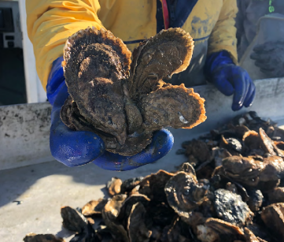
Current Ongoing Needs
Quantifying ecosystem services and economic impact
  The large-scale restoration can continue to serve as living lab to understand ecosystem services
  7- year ‘Oyster Reef Ecosystem Services’ project complete
Oyster restoration BMP
  In situ methods and quantification of denitrification rates by restored reefs over a range of Bay conditions

Slide 29
Emerging Science Needs
Climate Change impacts and adaptation
  Understanding impacts of climate and weather change on oyster restoration and productivity (ex: OA, salinity and temp changes, etc)
  Evaluating oysters as green infrastructure to provide shoreline resilience
Refining restoration approaches
  Modeling and mapping larval source/sink dynamics
  Analyzing reef performance to inform future restoration
  Evaluating if tributary-based, large scale restoration is the appropriate scale to develop self sustaining reefs that are resilient to seasonal and interannual stressors
  Spatial analysis informing ways to best link restoration, wild harvest, and aquaculture at a tributary scale

Slide 30
State of Science Needs for Blue Crab Abundance Outcome
Mandy Bromilow

Slide 31
Blue Crab Science Needs
Improving Model Performance
Currently the primary focus for CBSAC
Immediately useful for management
Understanding Blue Crab Ecology
Of great interest, but not as high priority for CBSAC
Not immediately useful for management; EBFM is not applied to the blue crab fishery
Notes:
Female-specific mgmt framework - science needs tied to this
Two aspects to blue crab science needs:
Improving SA model
Understanding blue crab ecology - impacts of ecology and environment on abundance/recruitment

Slide 32
Blue Crab Science Needs
Improving Model Performance
Investigate potential applications of existing fishery-independent data sets (e.g., environmental effects on catchability, seasonal and sex-specific distributions)
Understanding Blue Crab Ecology
Evaluate the effects of environmental factors on blue crab abundance and recruitment
Notes:
Improving model performance
CBSAC has looked at effects of habitat on catchability
Further interest in using FI data to understand distributions
Can inform parameters to improve SA model
CBSAC continuing with this work and will likely be addressed in upcoming workshop
Understanding blue crab ecology
Longer-term science need given lack of EBFM
UMCES initial study ranking factors that affect abundance/recruitment
Interest in further research focused on ecological/environmental impacts on the blue crab population
Effects of currents, storm events, habitat loss, etc on recruitment
Impacts of predators (blue catfish)

Slide 33
State of Science Needs for the Forage Outcome

Slide 34
Research Science Needs
Climate related changes in fish distribution
  Ongoing example:. Ongoing GIT-funded work exploring the relationship between forage indices and key climate indices
Indicators to support Ecosystem Based Fisheries Management at bay and regional fishery management level
  Ongoing examples: Development of habitat suitability models for top forage species (bay anchovy and juvenile spot, establishing relationships between habitat suitability and forage abundance
  Ongoing: Development of Bay specific abundance estimates for striped bass which can be used to assess the impacts of multiple stressors on bay populations
Better understand relationships between phyto/zoo plankton base and key Chesapeake Bay fish species
  Ex. Examining plankton abundance in striped bass spawning areas and evaluating relationships
Notes:
Shoreline changes over time would be valuable for communications and potentially restoration/conservation guidance

Slide 35
Resources
CBP Science Needs Database:
https://star.chesapeakebay.net/
Healthy Watersheds Cohort STAR Science Needs Presentations
Presentations provide additional science needs then presented today and includes additional details
https://www.chesapeakebay.net/what/event/scientific_technical_assessment_and_reporting_star_team_meeting_septem2
Aquatic Life Cohort STAR Science Needs Presentations
https://www.chesapeakebay.net/what/event/joint_c_s_star_december_2021_meeting

Slide 36
Chesapeake Bay Program Strategic Science & Research Framework:
Healthy Watersheds and Aquatic Life Cohorts
Breck Sullivan, STAR Coordinator
bsullivan@chesapeakebay.net

