Slide 1
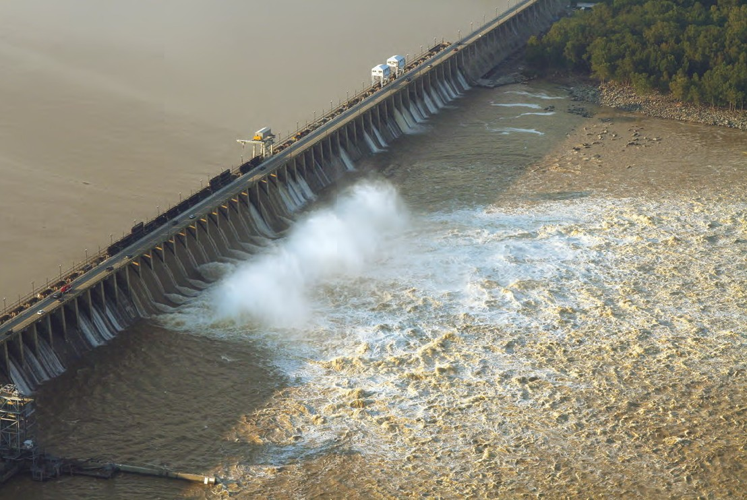
Introduction to Conowingo presentations and panel discussion
Andy Miller
STAC Quarterly Meeting
September 13, 2021

Slide 2
Summary of previous investigations and STAC involvement
  Lower Susquehanna River Watershed Assessment (2014 Draft, 2016 Final Report)
  STAC Review of LSRWA (2014)
  USGS long-term analyses of sediment and nutrient flux
  STAC Workshop on Conowingo Reservoir Infill (2016)
  UMCES Reports on Biogeochemistry, Geology and Physics of Conowingo Reservoir and Upper Chesapeake Bay (2017)
  2019 USGS analysis of orthophosphorus flux trends
  2020 STAC comment and recommendation to FERC on Exelon Agreement

Slide 3
Today’s session:
  Summary of previous findings on long-term trends affecting Conowingo Reservoir mass balance
  Brief review of additional previous findings from LSRWA, STAC review, and STAC workshop
  Presentations by invited speakers:
    Cindy Palinkas, UMCES
    Joel Blomquist, USGS
    Matt Rowe, Maryland Department of Environment
    Deni Chambers and colleagues, Northgate Environmental
  Panel discussion with invited speakers, moderated by Kathy Boomer

Slide 4
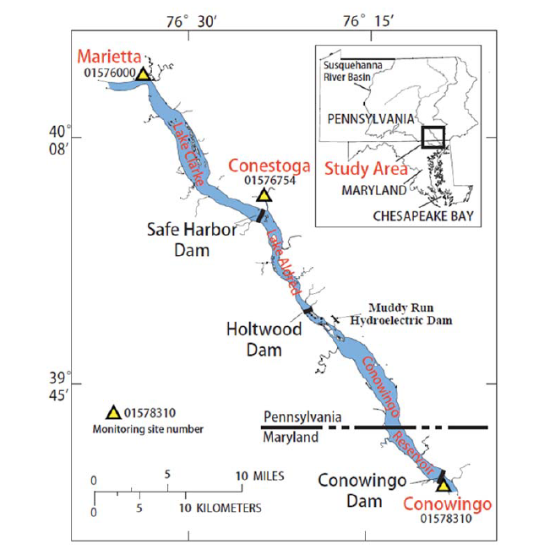
The System of Reservoirs has been filling over time.
Three Reservoirs in the Lower Susquehanna
Safe Harbor Dam
Lake Clark
1950-2015
Holtwood Dam
Lake Aldred
Vertical Exaggeration 264x
1920-2015
Conowingo Dam
Built 1931
Equilibrium - 1950
Built 1910
Equilibrium - 1920
Conowingo Reservoir
Built 1928
Equilibrium – around 2010
(First evidence - late 1970s)
1960
1990
2015
Source: Langland and Blomquist, USGS, personal communication
Notes:
For almost a century, the lower Susquehanna Reservoirs trapped significant amounts of sediment and phosphorus from reaching the Bay.
The reservoir system has been losing their storage capacity over time and since about the mid-1990s, phosphorus and sediment began increasing into the Bay. Please explain why
The major consequence is it may more difficult to meet water-quality goals in the Bay
The modeling tools are not accounting for the recent infill. The model represents a 1990 time periods
history of infill of the three reservoirs and highlight how the recent changes in Conowingo Reservoir could affect water quality at the outflow.
The lower diagram shows sedimentation levels in the three reservoirs and highlights the time period of each measured level. Lake Clark and Aldred are shown to be at equilibrium since 1960. Conowingo shows a growing amount of sediment infill over the period1960-2015, with the vast majority of total sediment infill occurring prior to 1960 for the three-reservoir system.

Slide 5
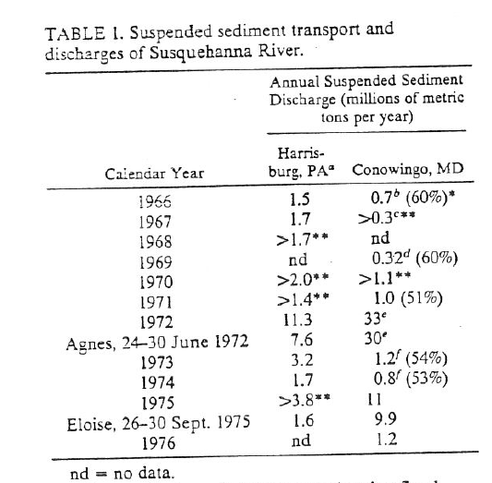
Table from Gross et al., 1978
It has been known for more than 40 years that Conowingo was trapping large volumes of Susquehanna River sediment and associated contaminants, and could export a decade’s worth of sediment in a single large flood

Slide 6
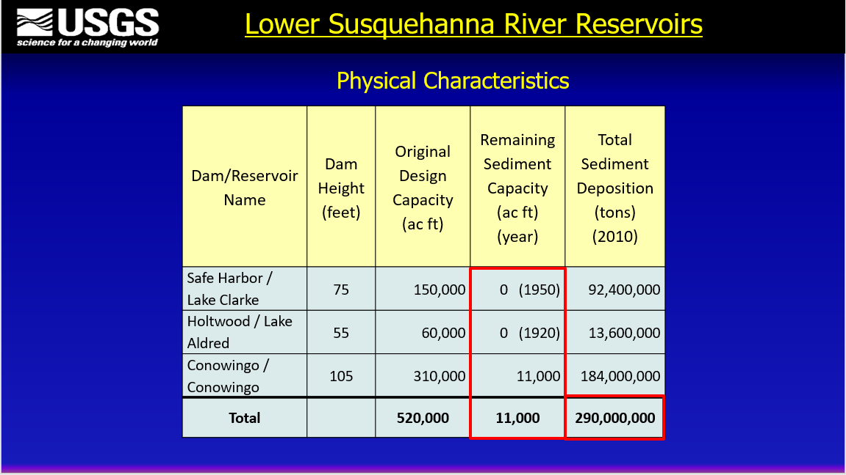
Langland, 2016

Slide 7
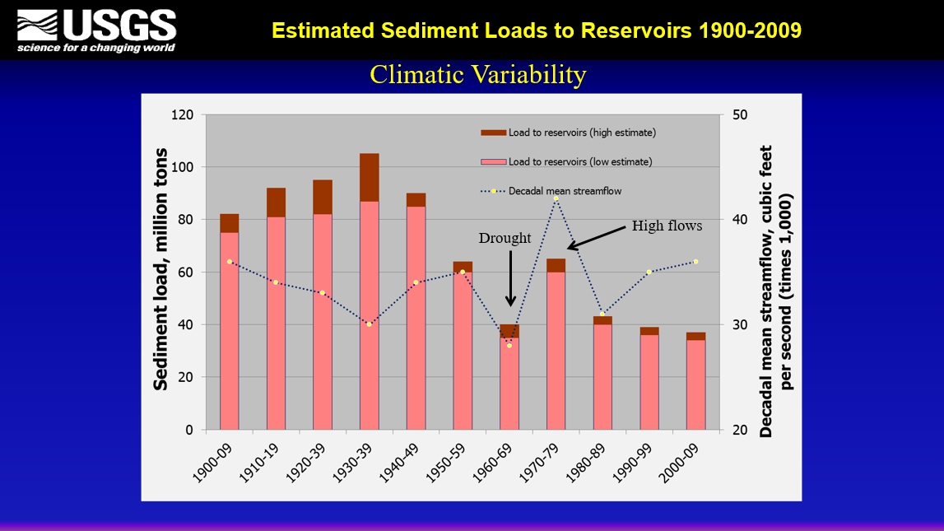
~60% reduction
Langland, 2016

Slide 8
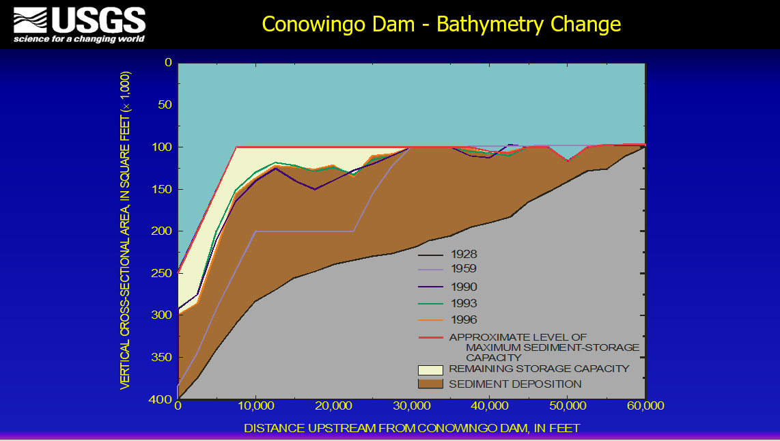
Langland, 2016

Slide 9
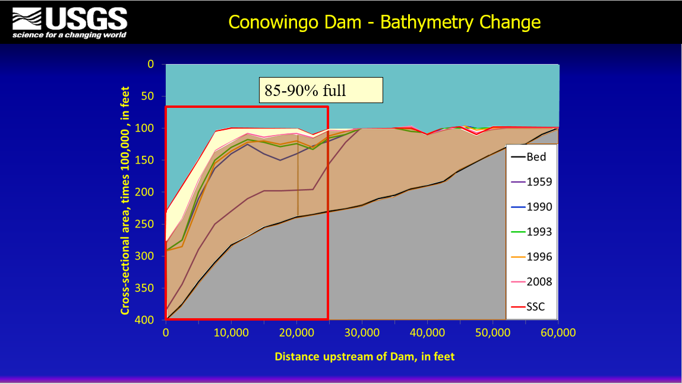
Langland, 2016

Slide 10
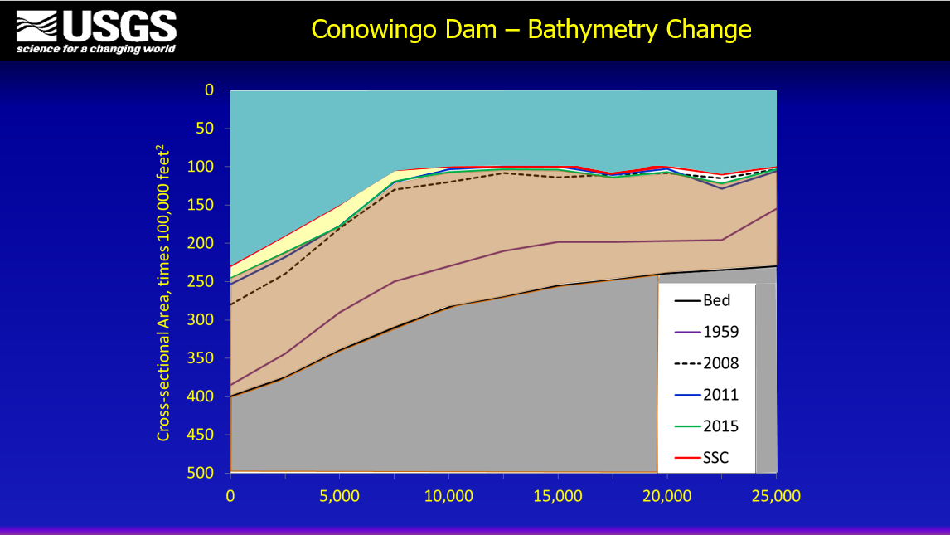
Langland, 2016

Slide 11
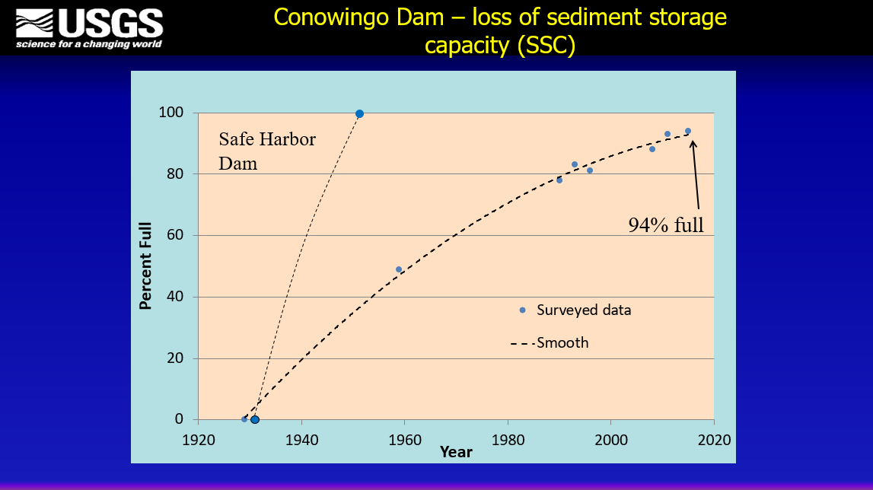
Langland, 2016

Slide 12
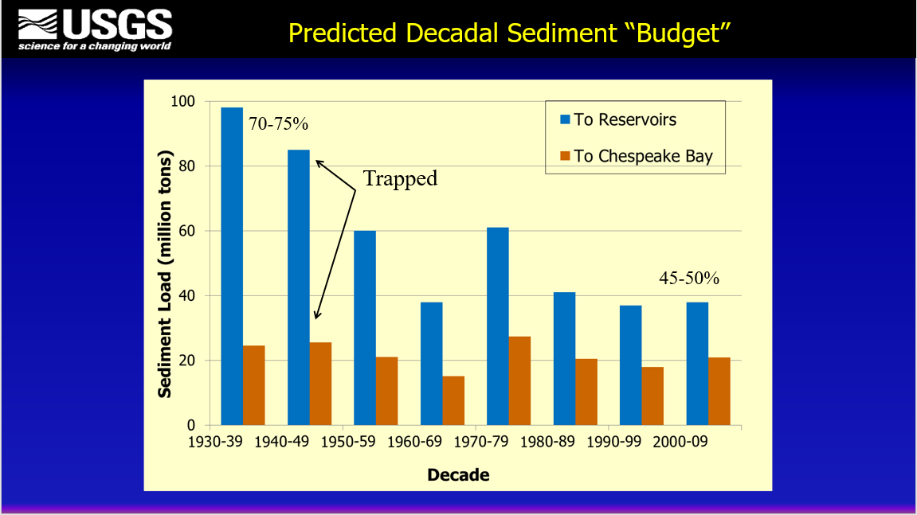
Langland, 2016

Slide 13
Sediment Loads Into, Trapped Within and Exiting the Reservoir System: 1990s-2010s
Early 1990’s, about 60% of Sed trapped
~7
~4
~3
Loads Out of Reservoir System - Conowingo Long term degrading trend
Loads Into Reservoir System
Long term improving trend
Early 2000’s, about 40% of Sed trapped
~8
~3
~5
Early 2010’s, approaching no net Sed trapping
From the 2016 Conowingo Infill Webinar
~6
~0
~6
Source: Data from USGS (2016), http://cbrim.er.usgs.gov/loads_query.html
loads are approximate and in units of billion lbs/year using estimates for 1992, 2002, and 2012
Notes:
The sediment trapping efficiency is decreasing and has gone from 70-75% to 40-45%.
The reservoir system has stored 2% of N, 31% P and 27% of Sed between 1987 -2014.

Slide 14
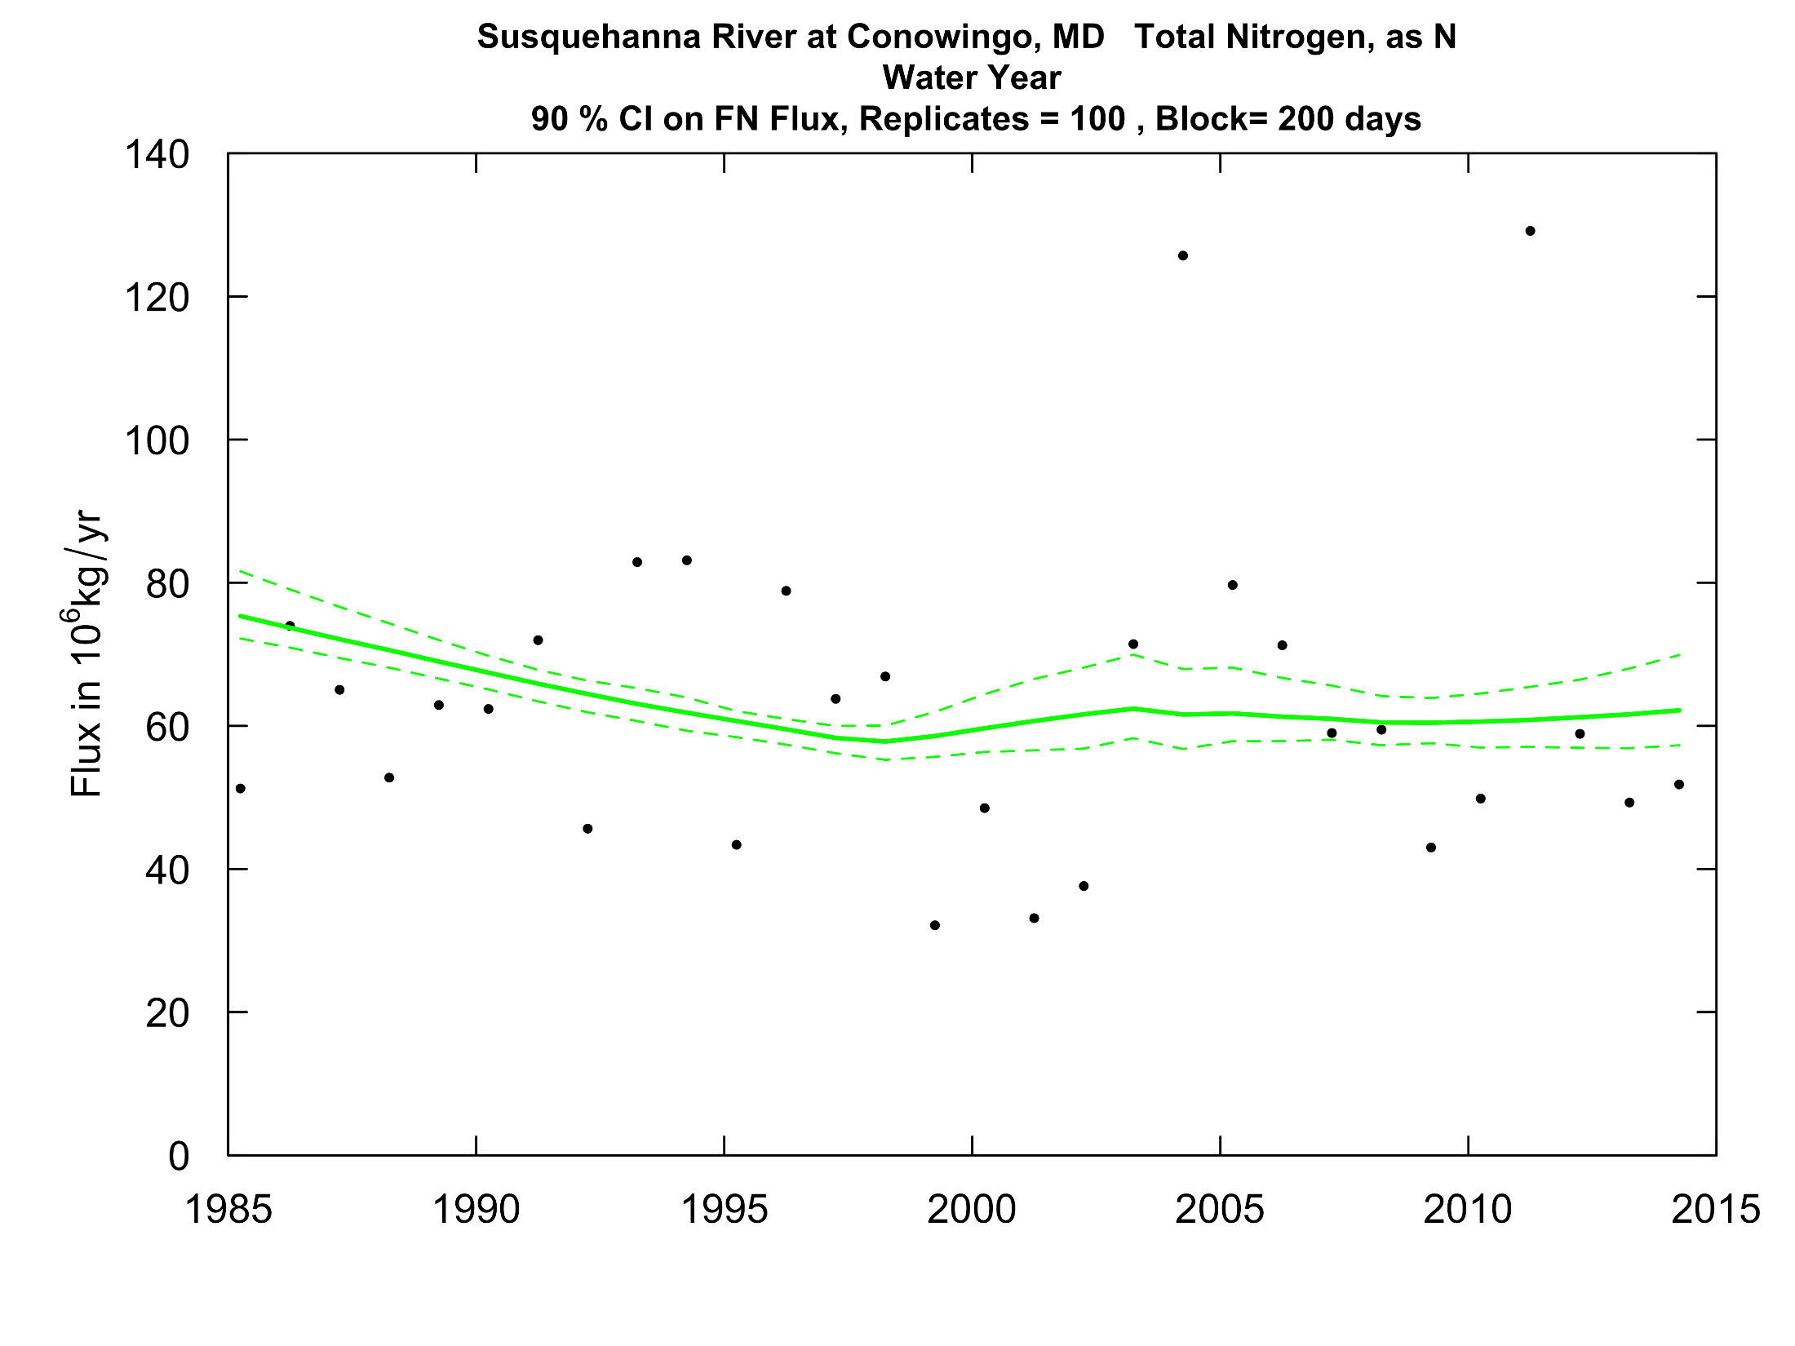

Total Nitrogen Flow-Normalized Flux
1995-2014 +0.13%/yr 2005-2014 + 0.08%/yr
Hirsch, 2016

Slide 15
Nitrogen Loads Into, Trapped Within and Exiting the Reservoir System: 1990s-2010s
Early 1990’s, about 20% of N trapped
~170
~30
~140
Loads Into Reservoir System
Long term improving trend
Early 2000’s, about 10% of N trapped
Loads Out of Reservoir System - Conowingo long term improving trend
~160
~20
~140
Early 2010’s, Approaching no net trapping
From the 2016 Conowingo Infill Webinar
~130
~0
~130
Source: Data from USGS (2016), http://cbrim.er.usgs.gov/loads_query.html
loads are approximate and in units of million lbs/year using estimates for 1992, 2002, and 2012
Notes:
The inputs have decreased by 40 million lbs and the outputs have decreased by 10 million lbs
Most of the nitrogen is dissolved and does not settle out.

Slide 16
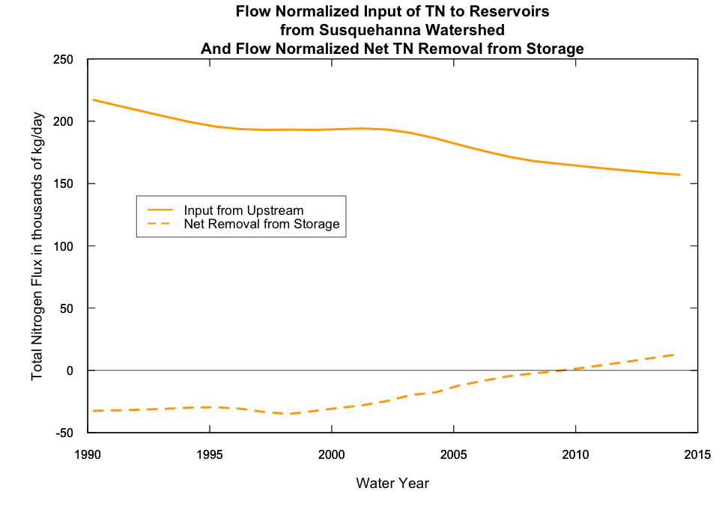
in 1990 additions to storage were about 15% of annual input
by 2014 losses from storage were about 8% of annual input
Hirsch, 2016

Slide 17
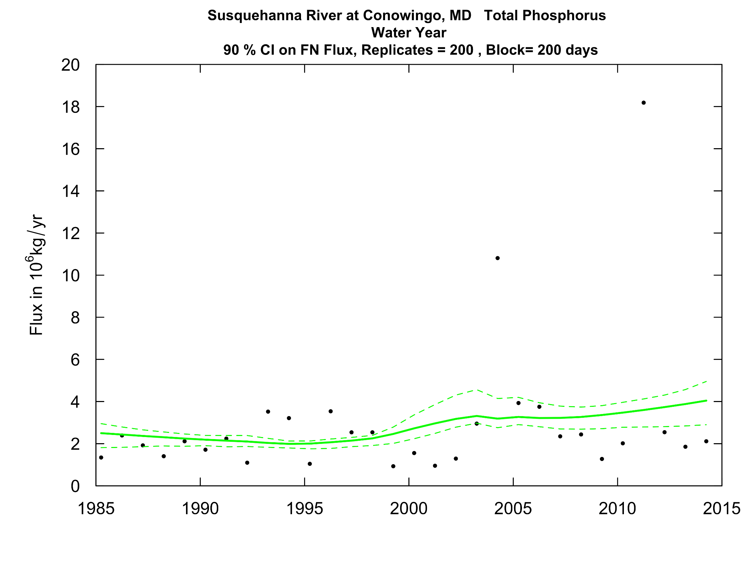
Total Phosphorus Flow-Normalized Flux
1995-2014 +5.4%/yr 2005-2014 + 2.6%/yr
Hirsch, 2016

Slide 18
Phosphorus Loads Into, Trapped Within and Exiting the Reservoir System: 1990s-2010s
Early 1990’s, about 50% of P trapped
~10
~5
~5
Loads Into Reservoir System
Long term improving trend
Loads Out of Reservoir System - Conowingo Long term degrading trend
Early 2000’s, about 40% of P trapped
~11
~5
~6
Early 2010’s, Approaching no net trapping
From the 2016 Conowingo Infill Webinar
~8
~0
~8
Source: Data from USGS (2016), http://cbrim.er.usgs.gov/loads_query.html
loads are approximate and in units of million lbs/year using estimates for 1992, 2002, and 2012
Notes:
The sediment trapping efficiency is decreasing and has gone from 70-75% to 40-45%.
The reservoir system has stored 2% of N, 31% P and 27% of Sed between 1987 -2014.
Conostoga is just like marietta.
If PA meets it’s load targets in
PA has more influence and should be doing more.

Slide 19
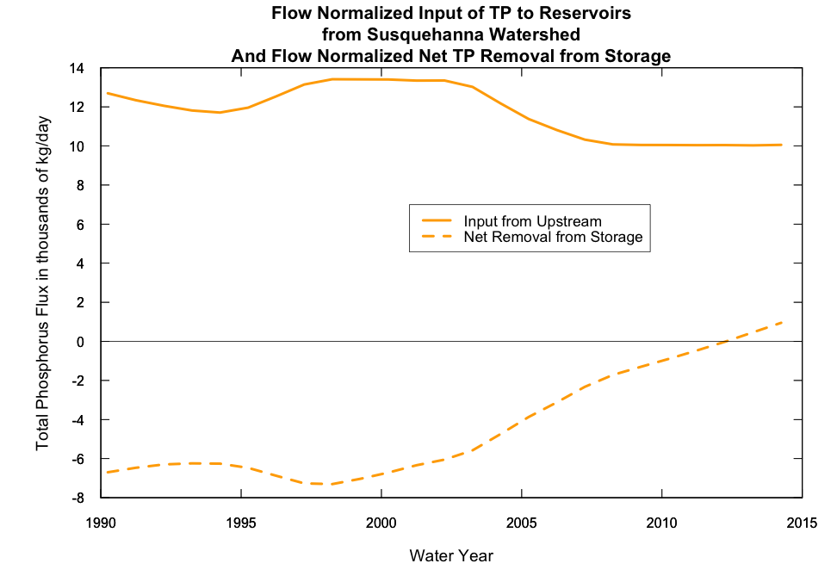
in 1990 additions to storage were about 53% of annual input
by 2014 losses from storage were about 9% of annual input
Hirsch, 2016

Slide 20
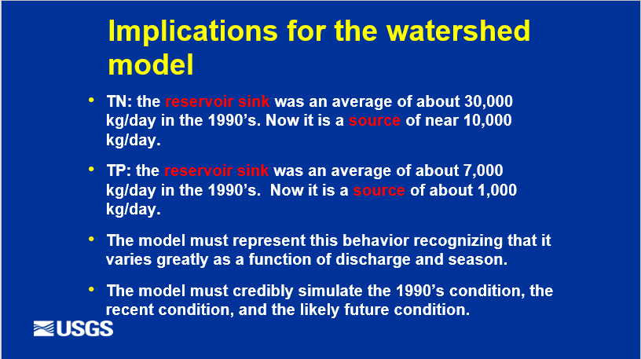
Langland, 2016

Slide 21
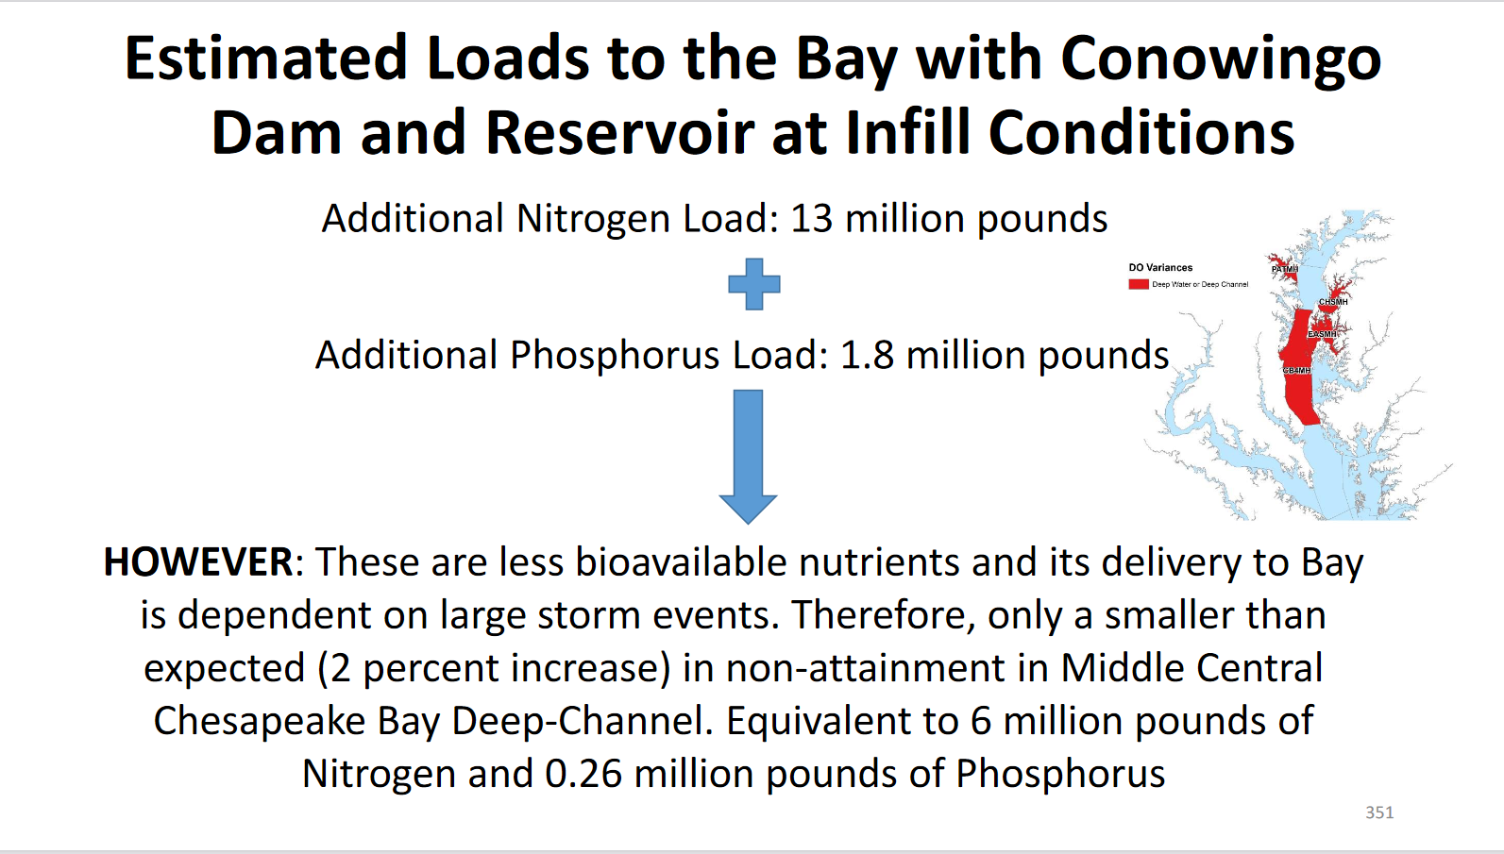

Slide 22
Lower Susquehanna River
Watershed Assessment
Key Findings
Anna Compton
USACE
  Graphic courtesy of SRBC
Scientific and Technical Advisory Committee Workshop
January 13, 2016
Notes:
Focus is on Key Findings and recommendations from multi-year study of the lower Susquehanna River watershed and its environmental effects on the health of the upper Chesapeake Bay.
This assessment was conducted by a team of federal and state agencies and non-governmental organizations.
Focus is big picture findings, modelers that were part of study team you will hear from later and they will go into more detail about modeling work.

Slide 23
Finding 3 Continued:
Notes:
Finding #3, cont’d- Sources upstream of Conowingo Dam deliver more sediment and nutrients and, therefore, have more impact on the upper Chesapeake Bay ecosystem, than do the scoured sediment and associated nutrients from the reservoir behind Conowingo Dam.
On average during a 4-5 year event, approximately 70-80% of the sediment that empties into Chesapeake Bay from the Susquehanna River is from watershed sources while 20-30% scour of reservoir material (from behind Conowingo).
During lower flow periods, the reservoirs act as a sediment trap aiding in the health of the Bay until the next high flow event.
Watershed contributions of sediment and nutrients during large storm events will have significant effects on the Bay’s living resources with or without a “full” Conowingo reservoir .
-The majority of sediment and nutrients, and their impacts on the upper Chesapeake Bay ecosystem during storm events, originate from the upstream Susquehanna River watershed rather than from being scoured from the reservoirs behind the dams. Conowingo Reservoir and the two upstream reservoirs’ bed sediment scour comprised an average of approximately 30 percent with a range of 20 to 35 percent of the total sediment loads entering Chesapeake Bay during an event up to 800,000 cfs (recurrence interval of less than 40 years); the remaining load was estimated to be from the Susquehanna River watershed. The range of scour to watershed loads is due to variations in sediment-loading conditions from the bed and the watershed. The study data indicate that as flow increases the bed scour load becomes an increasingly higher proportion of the total sediment load. On average, flows above 800,000 cfs produced scour load that comprised about 30 to 50 percent of the total load entering the Bay; however, an event of this magnitude is extremely rare with a recurrence interval of 40 years or more. There will be a point where the sediment transported into the reservoirs will have a limited ability to scour based on the transport capacity and the ability of the reservoir bed to erode. So at some point, the bed will either not erode, or the erosion rate will be very low.
-Under 2011 bathymetry conditions, the bed sediment scour load from Conowingo Reservoir during Tropical Storm Lee comprised about 20 percent of the Tropical Storm Lee total sediment load (about 3.0 million tons of the 14.5 million tons); this load included scour from the two upstream reservoirs and loads from the rest of the Susquehanna River watershed. Similar results were calculated for the “full” Conowingo Reservoir bathymetry. These results imply that the Susquehanna River watershed located above the Conowingo Dam (including the two upstream reservoirs) provided 80 percent of the load during Tropical Storm Lee, with the remaining 20 percent from scoured bed sediment trapped in Conowingo Reservoir behind the dam.
*Storm characteristics are highly variable and variations in track, timing, and duration can alter the amount of sediment entering the system from both the watershed and from the reservoirs behind the dams. Consequently, this percentage of scour and watershed contributions can vary as well, so this concept is not universal to all storms, but it does give a good sense of magnitude. For the entire time period of 2008-2011 under 2011 bathymetry, scour from the Conowingo Reservoir (estimated 3.0 million tons) comprised 13 percent of the total sediment load to the Chesapeake Bay (estimated 22.3 million tons ), with 87 percent of the load originating from the upstream Susquehanna River watershed, including any scour from the two upstream reservoirs.

Slide 24
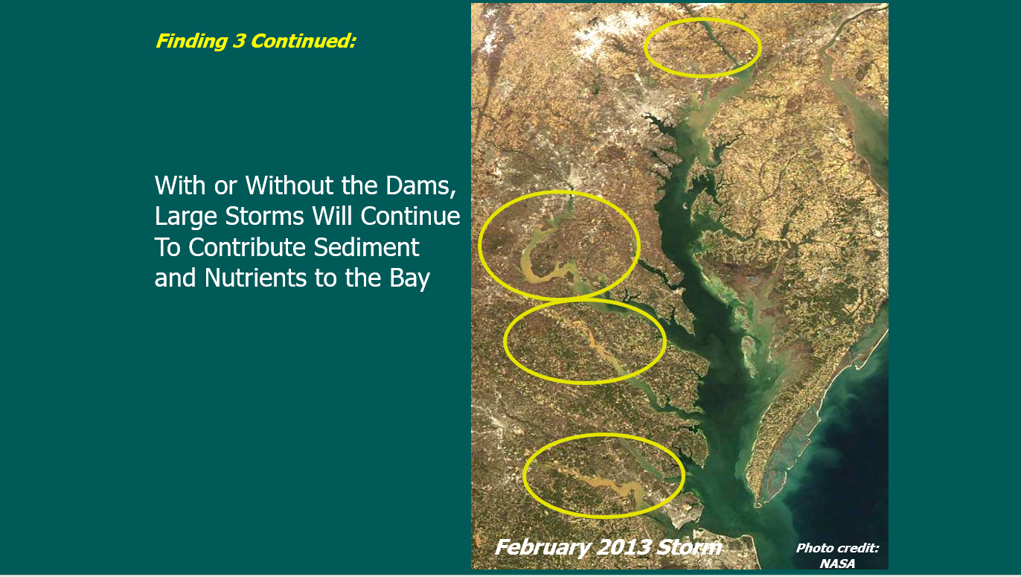

Slide 25
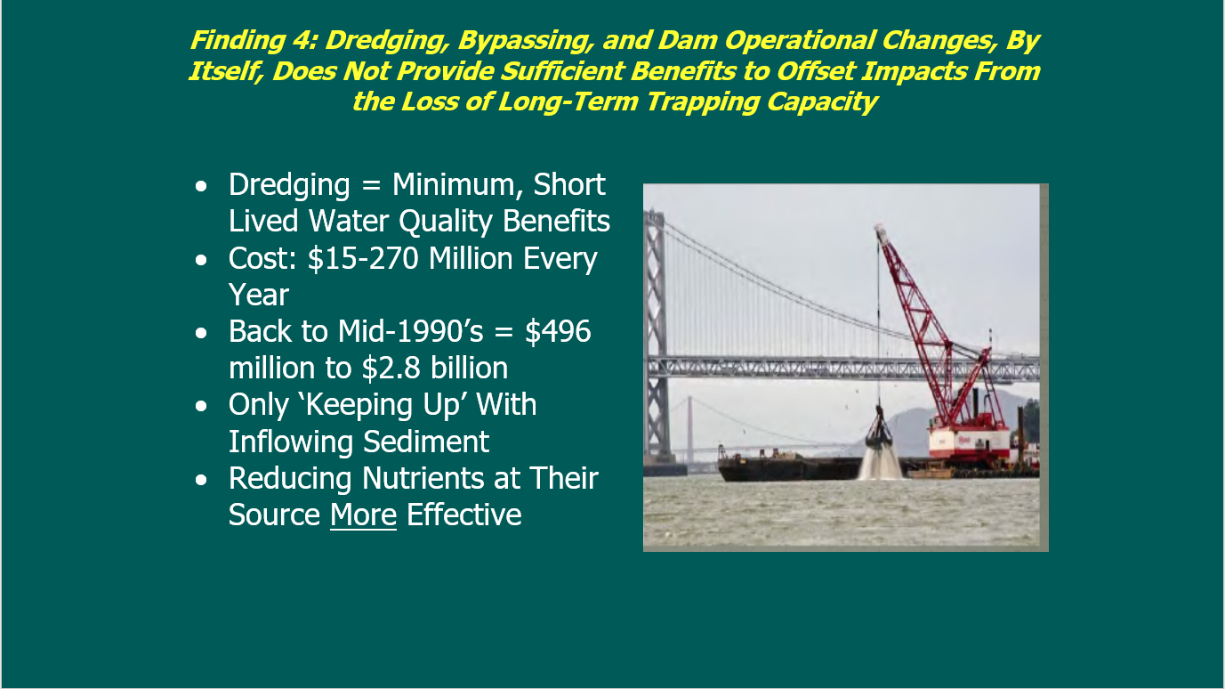

Slide 26
2014 STAC Review of LSRWA report:
The Conowingo Reservoir is essentially at full capacity and is no longer a long-term sink helping to prevent sediment-associated nutrients (primarily particulate phosphorus) from entering the Chesapeake Bay.
Increases in particulate phosphorus loads entering the Bay as a result of the full reservoir are likely causing significant impacts to the health of the Chesapeake Bay ecosystem.
Sources of nutrients upstream of the Conowingo reservoir have far more impact on the Chesapeake Bay ecosystem than do the increases in nutrients caused by scour plus reduced deposition in the reservoir.
Managing sediment via large-scale dredging, bypassing and/or operational changes are clearly not cost-effective ways to offset Chesapeake Bay water quality impacts from the loss of long-term trapping of sediment-associated nutrients.

Slide 27
2014 STAC Review of LSRWA report:
As soon as possible, follow-up studies should more fully quantify the impact on Chesapeake Bay water quality from increases in sediment-associated nutrients brought about by reservoir infilling.
There is no compelling reason to reduce sediment loads per se from the Susquehanna watershed to compensate for increased sediment passing out of the Conowingo reservoir. Nutrients are the main problem, not sediments.
Additional particulate phosphorus load reductions from the Susquehanna watershed (beyond present WIPs) should be considered to compensate for changes to the Conowingo.

Slide 28
From the STAC Workshop on Conowingo Infill
Suspended solids loads produced by a Conowingo scour event are relatively non-detrimental to Bay water clarity and SAV survival.
The organic matter and nutrients associated with the solids are, however, detrimental.
This material settles to the estuary bottom and is mineralized in bed sediments. Nutrients are recycled to the water column and stimulate algal production.
As a result of a winter scour event, computed bottom-water DO in the subsequent summer declines up to 0.2 g m⁻³ although the decline is 0.1 g m⁻³ or less when averaged over the summer season.

Slide 29
The 2016 STAC workshop included these conclusions:
  Infilling of the Conowingo Reservoir primarily influences particulate nutrient delivery, with negligible influence on fresh water discharge or dissolved nutrient delivery to the Chesapeake Bay system. Most nitrogen is transported in dissolved form.
  Under low to moderately high flow conditions, it is likely most of the sediment loading from the Susquehanna is trapped (and buried) by processes at or before the Estuarine Turbidity Maximum (ETM).
  There is significant bypassing of the ETM under very high flow conditions, but when and how much remains to be determined

Slide 30
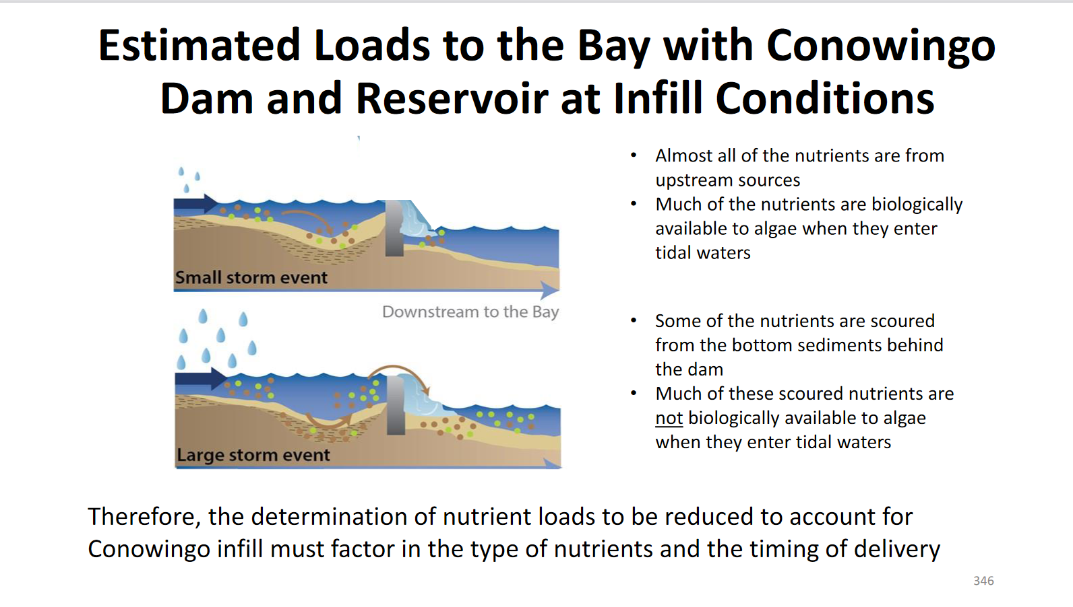
Updates to the modeling framework incorporating findings have led to determination of additional load reductions needed.
Dec. 2017 WQGIT Midpoint assessment

Slide 31
A new problem – reported in 2019
USGS scientists observed increases in dissolved phosphorus loads from Conowingo that appear to be associated with biogeochemical processes within the reservoir sediment and water column, and could have implications for water quality that have not been considered previously by the watershed partnership. The reservoir ecosystem is largely unexamined and poorly understood. This information was not available when the TMDL was written.
STAC therefore posted a statement to the Federal Energy Regulatory Commission in reference to the Exelon Agreement on Jan. 17, 2020 which summarizes the reasons for concern and then says:
  STAC recommends that MDE consider using some of the funds from the Exelon agreement to undertake new programs of monitoring within Conowingo Reservoir and its environs that will allow better understanding of trends affecting the flux of dissolved nutrients, and particularly dissolved phosphorus, to the upper Bay.

Slide 32
Conowingo Dredging and Innovative and Beneficial Reuse Project
Questions from STAC for the panel discussion:
Does Conowingo currently function largely as a run-of-river system, or does it have the potential to function as a kind of super-BMP with strategic dredging?
What monitoring/modeling would be needed to confirm, modify, or reject previously published conclusions about the potential role of dredging?
What locations were chosen for the pilot studies and why?
Will the pilot studies include assessment of near-term and long-term nutrient and sediment reductions, including potential nutrient and sediment releases during dredging?
What plans have been made for monitoring and for evaluation of monitoring results associated with the pilot projects?
How will this evaluation be scaled up to inform decisions about whether dredging is to be implemented as a part of the overall effort for mitigation of the additional loads anticipated from Conowingo?

