Slide 1
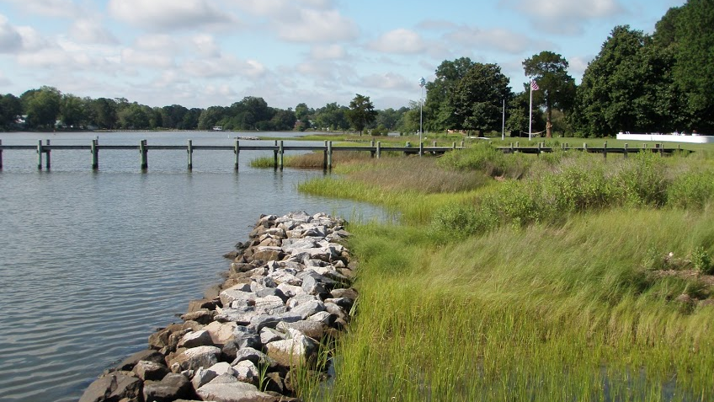



Shoreline Property Owner Decision Making: Motivations and Drivers
Amanda G. Guthrie*
Sarah Stafford, Donna Marie Bilkovic, Carl Hershner
*agguthrie@vims.edu

Slide 2
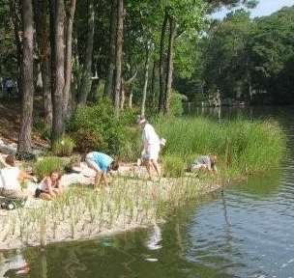
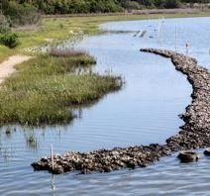
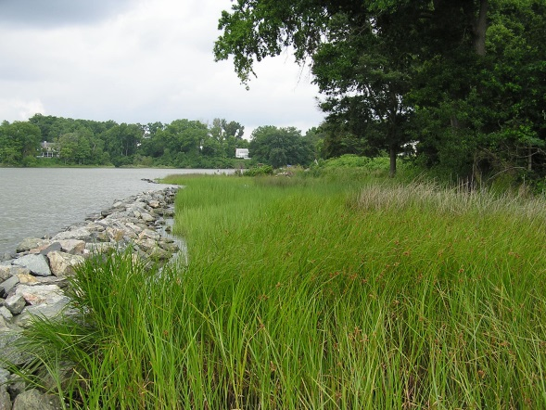
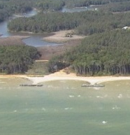
Living shoreline spectrum
Planted marsh
Oyster sill
Rock sill
Breakwater
Notes:
Part one – fish condition – looks at how the natural system supports ecosystem services – as in fish communities – for the social system.

Slide 3
VA Living shorelines implementation
Courtesy of Donna Bilkovic
Image courtesy of D. Bilkovic
Notes:
Part one – fish condition – looks at how the natural system supports ecosystem services – as in fish communities – for the social system.

Slide 4
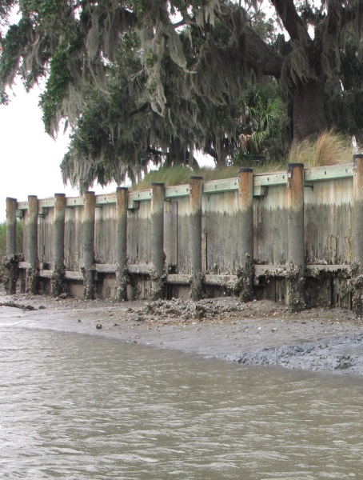
The Decision Process: Armoring
Bulkheads are seen as “effective and durable”;
Natural shorelines are more aesthetic
More likely to amor
  More valuable properties
  Lower elevation & higher erosion rates
Neighboring shorelines often predict
modification type
(Scyphers et al 2015, Beasley and Dundas 2019, Peterson et al. 2019)
Notes:
Part one – fish condition – looks at how the natural system supports ecosystem services – as in fish communities – for the social system.

Slide 5
Objective
Evaluate property owners’ motivations when deciding if and how to alter their shoreline for erosion control
Notes:
Part one – fish condition – looks at how the natural system supports ecosystem services – as in fish communities – for the social system.

Slide 6
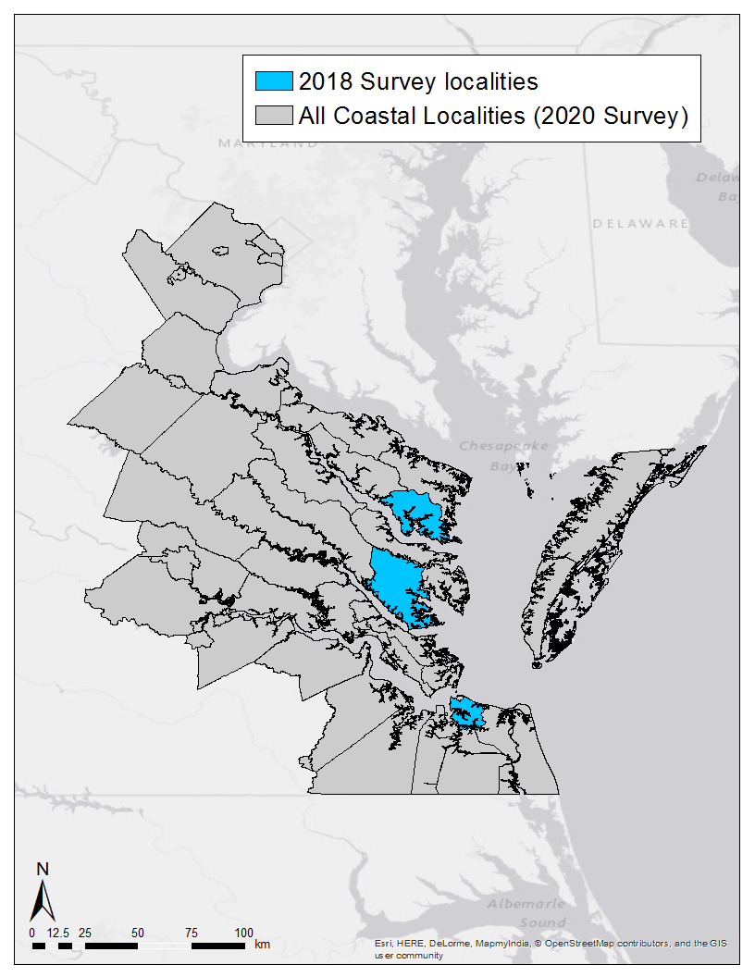

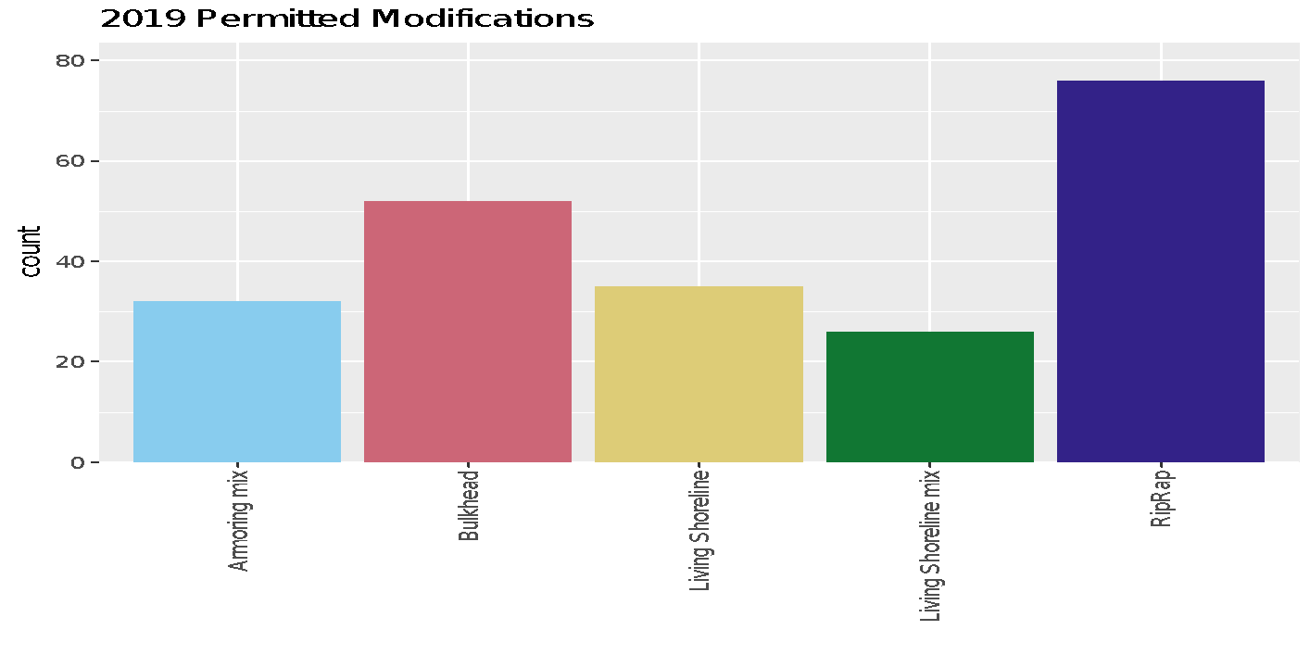
2020 survey
Mail survey: permit applications
  40+% response / 500 surveys
Armoring mix
Living Shoreline
Living Shoreline
mix
RipRap
Bulkheads
Notes:
We have sent out a survey to three localities. The survey was stratified based on the permit database listing what shoreline modification they had – if any. Then each modification category was stratified by connectivity and fetch. Connectivity was selected as this may be a proxy or indicate what habitats are around and could influence decisions, and fetch may be indicative of the wave action in the area and can influence a property owners decision.
The three localities have different levels of living shoreline implementation and are in rural and urban locations.
The survey objective assesses property owner attributes and assess who they contacted to make their decision.

Slide 7
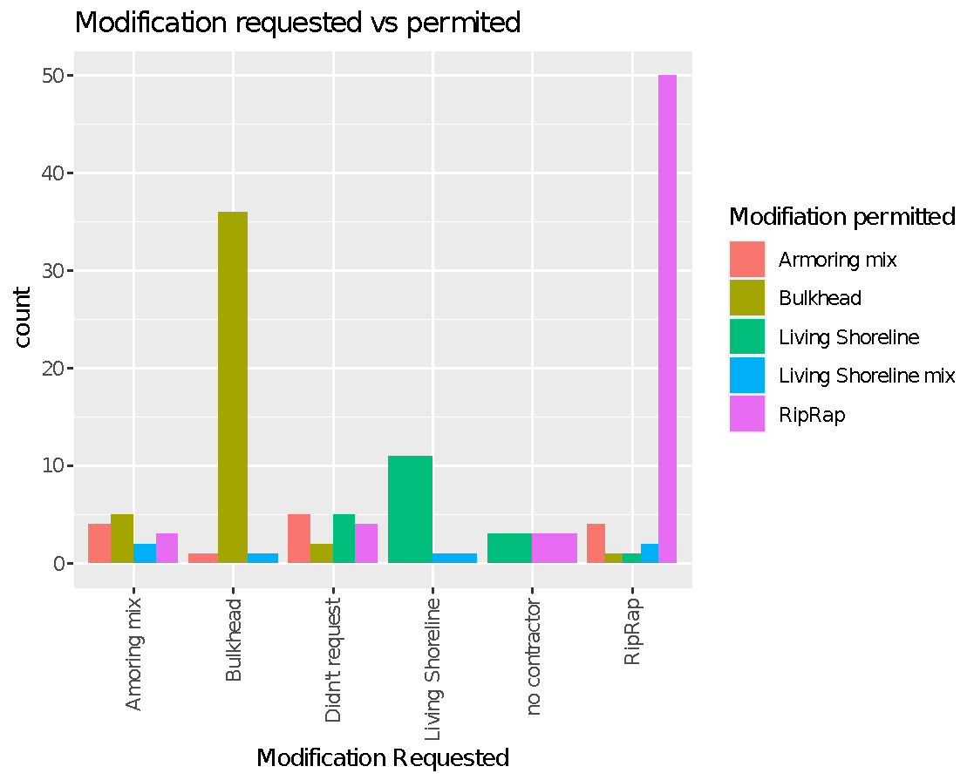
Mostly, people received the modification that they requested from contractors

Slide 8
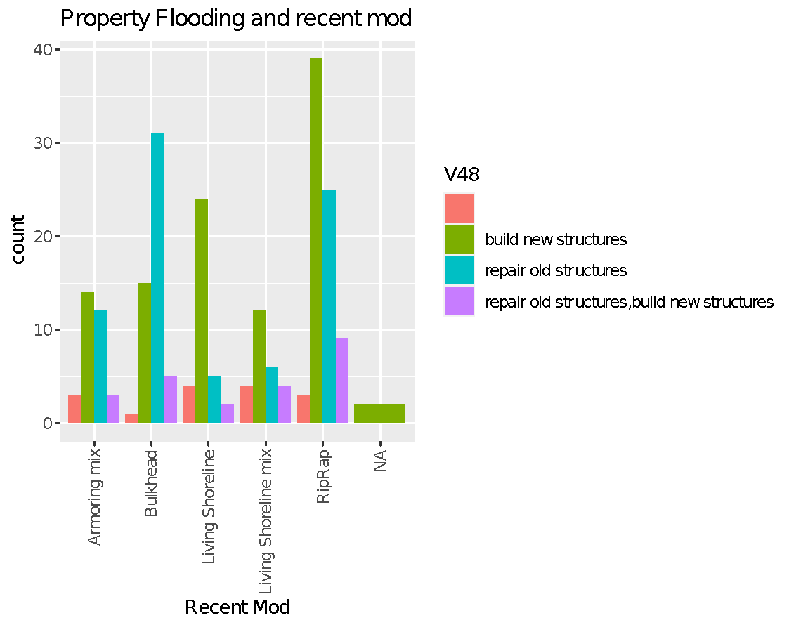
New or repair status
Installation goal
No response
Previous riprap is somewhat often being repaired – potential opportunity to add plants/greenery

Slide 9
Most Frequent Motivations
 | Effectiveness | Withstand storms | Restore the shoreline | Cost | Effect on property value
Armoring mix | 1st | 2nd | 3rd
Armoring |  | 2nd |  | 3rd | 1st
Rip Rap | 1st | 2nd |  |  | 3rd
Living Shoreline mix | 3rd | 1st | 2nd
Living Shoreline | 2nd | 3rd | 1st

Slide 10
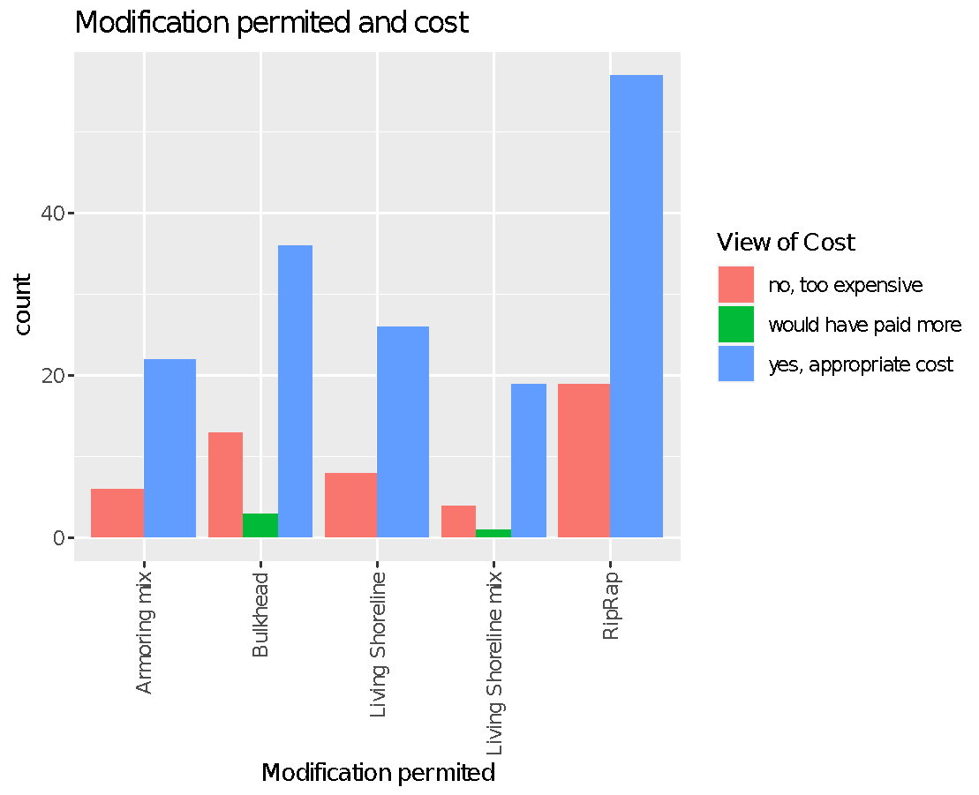
Roughly 1/3 of people for each modification thought it was too expensive

Slide 11
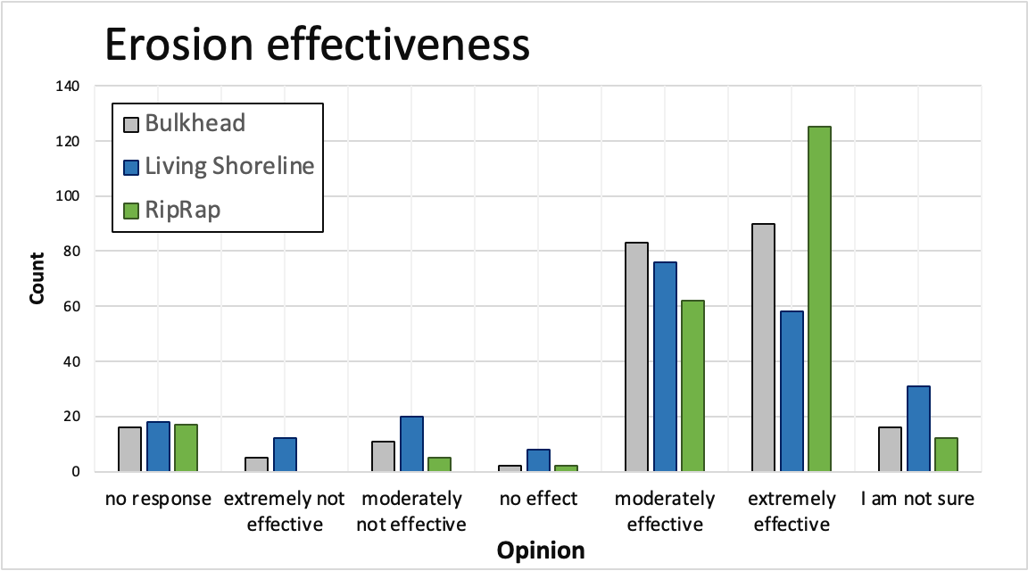

Slide 12
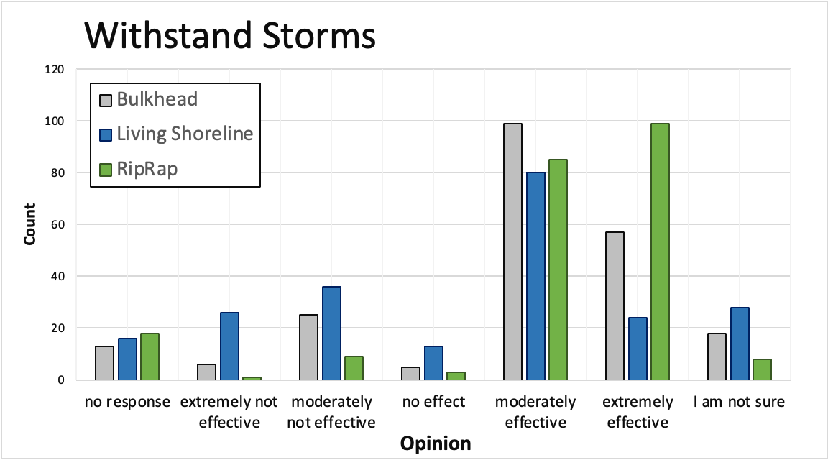

Slide 13
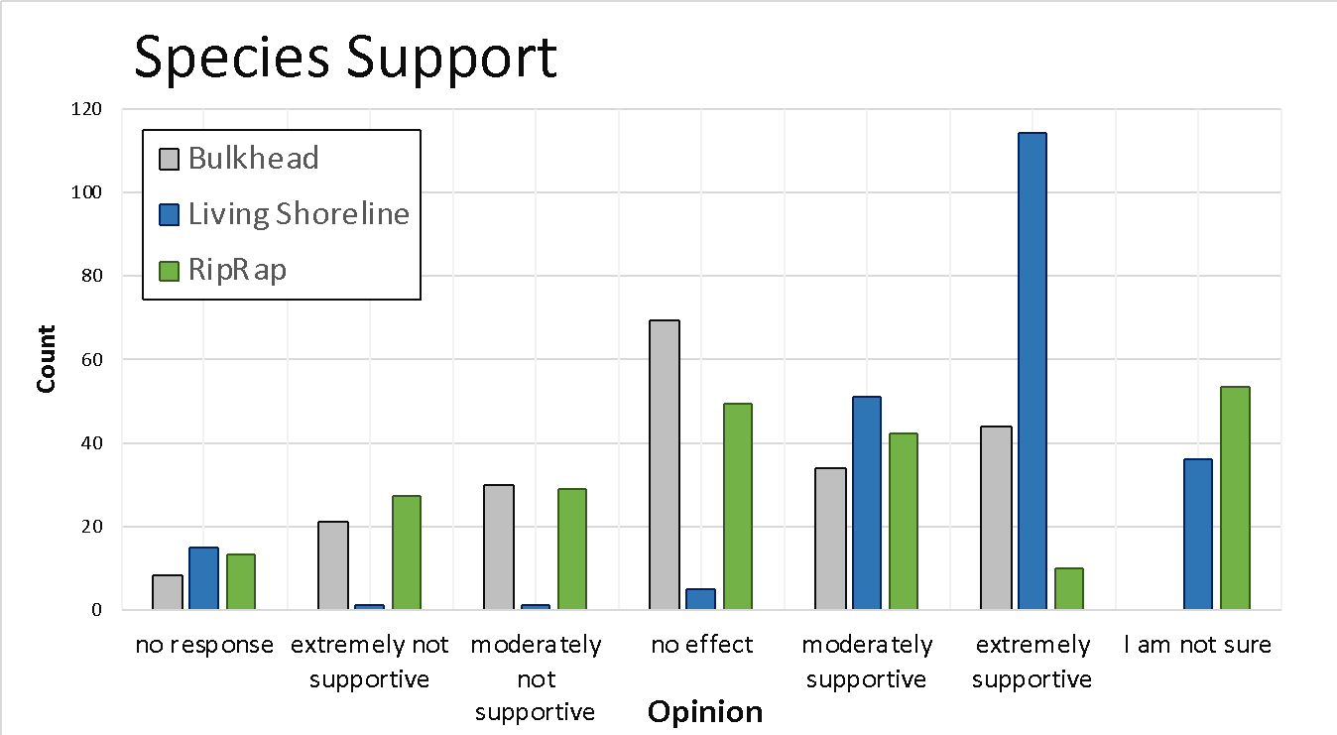

Slide 14
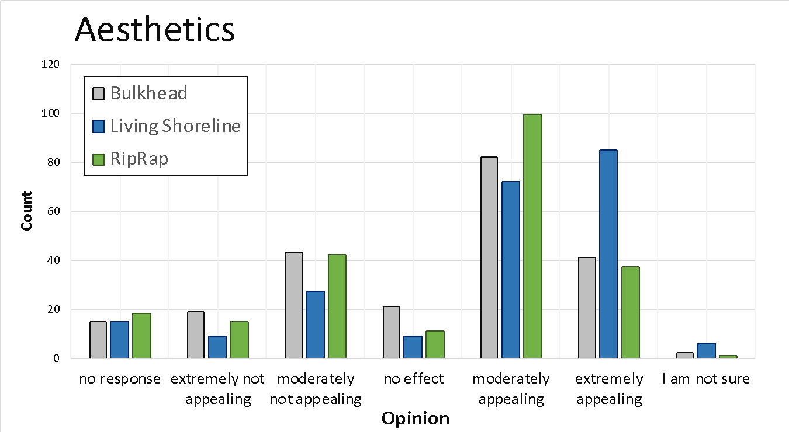

Slide 15
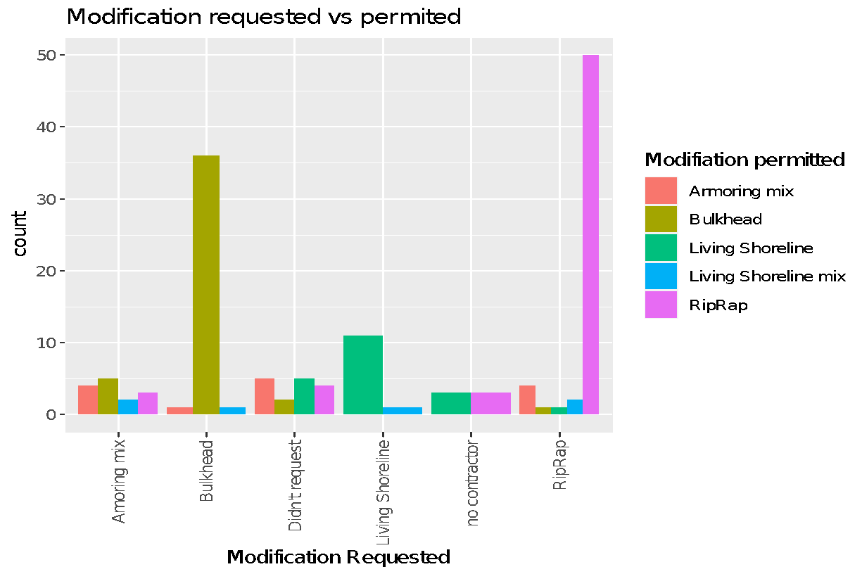
Perception and Decision making
RipRap is being repaired and
newly installed
  Contractors are key messengers
  Property owners know what
  modification what they want
  (potentially only little “wiggle room” to sway their opinion)
Most properties applying for permits bought their home in the last 10 years

Slide 16
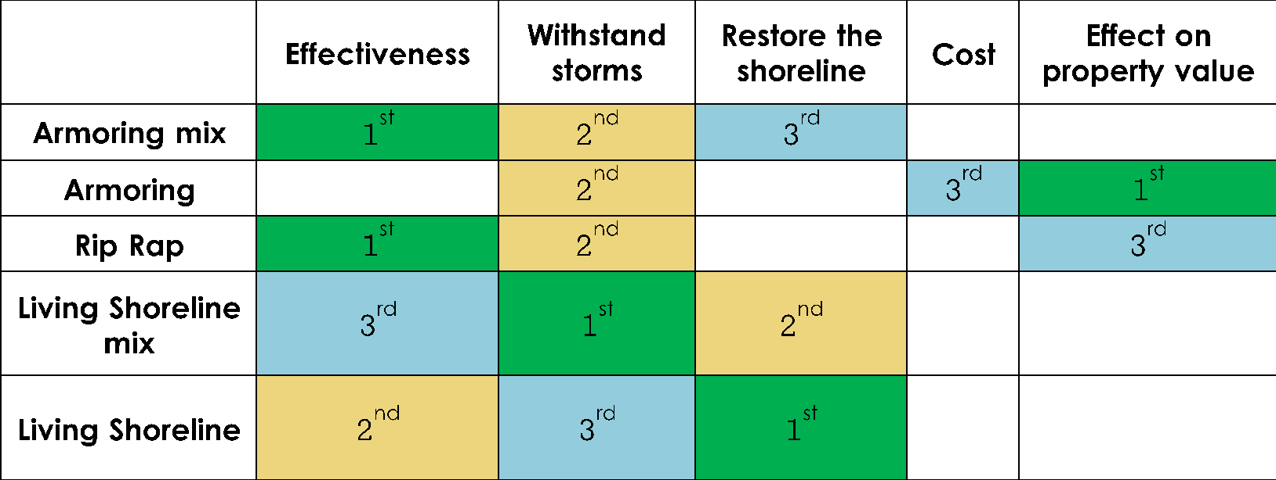
Perception and Decision making
Property owners focus on erosion effectiveness, and ability to withstand storm damage
  Riprap is often perceived to be better
Living shorelines are valued aesthetically and are seen as good for species
  but are not viewed as
  effective against erosion
  and storms

Slide 17
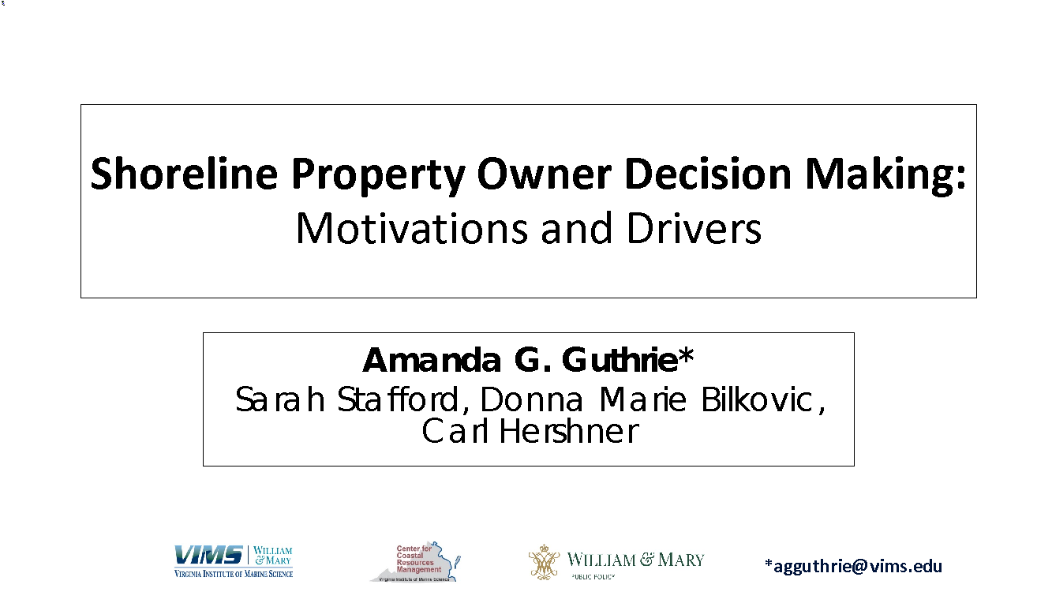
Questions or comments?
agguthrie@vims.edu
Econometrics and
2018 survey
Stafford, S., and A. G. Guthrie. 2020. What Drives Property Owners to Modify Their Shorelines? A Case Study of Gloucester County, Virginia. Wetlands. https://doi.org/10.1007/s13157-020-01358-6
Thanks to National Science Foundation, Coastal SEES, Award #1600131, and William & Mary Green Fee Fund

