Slide 1
Green Riprap Case Study – Gibson Island Anne Arundel County, Maryland
Sepehr baharlou, pe
September 15, 2021

Slide 2
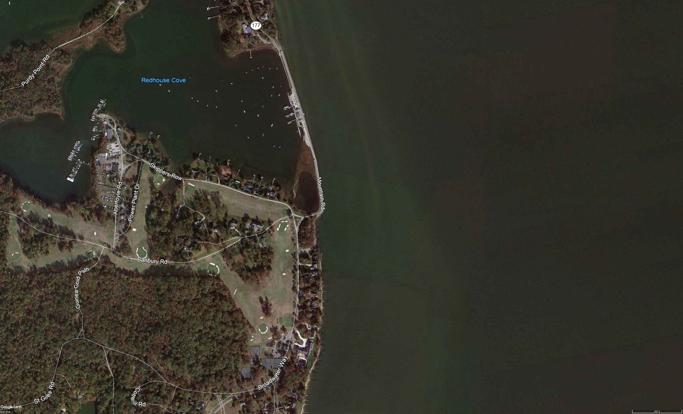
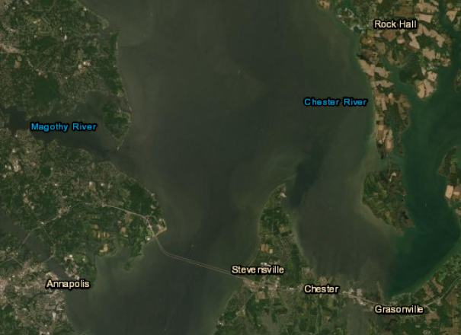
Chesapeake Bay
Project Site
Chesapeake Bay Bridge

Slide 3
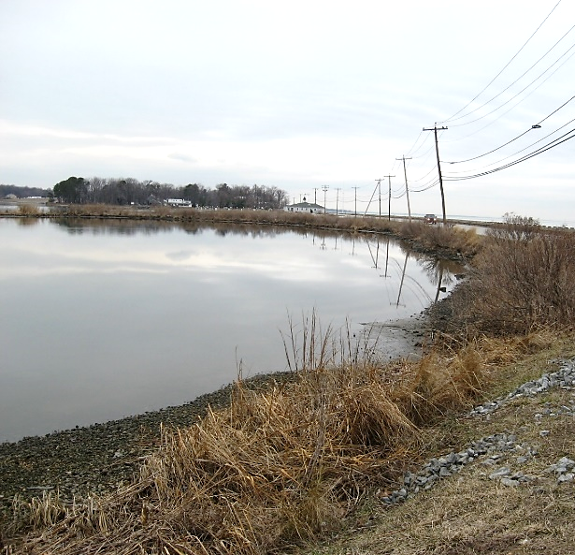
Gibson Island
500 LF of shoreline along a protected cove
Eroding from overtopping of the causeway and from the wave action inside the cove
Living shoreline option was not favored due to impacts to adjacent SAV habitat
Community did not want a “hard” solution and was looking for a more aesthetically pleasing option

Slide 4
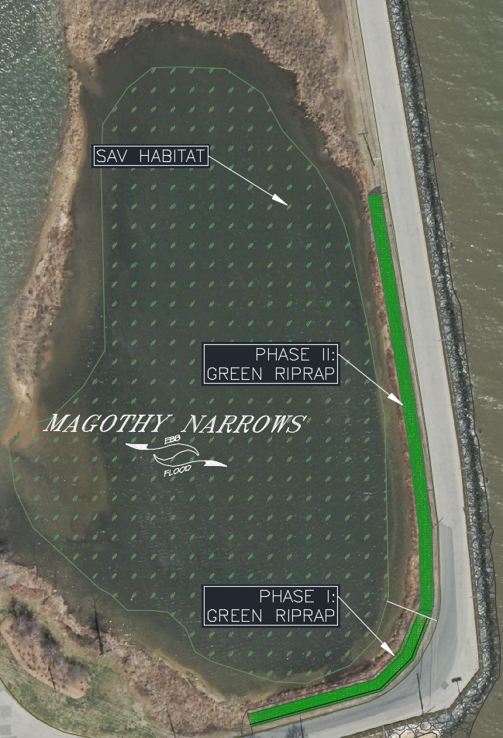
Gibson Island
Modified Stone Revetment (Green Riprap) was proposed
Protected the slope and roadway
Avoided impacts to SAV habitat
Provide for higher habitat value than traditional riprap alone
Aesthetically pleasing look desired by the community
Constructed in two phases in 2005 and 2011

Slide 5
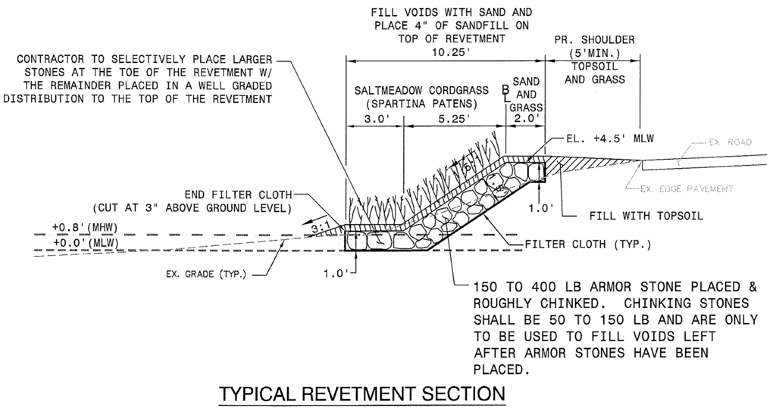
Gibson Island
Constructed with Class I riprap
Voids filled and covered with 4-inches of sand and pea gravel
Planted with high marsh - spartina patens

Slide 6
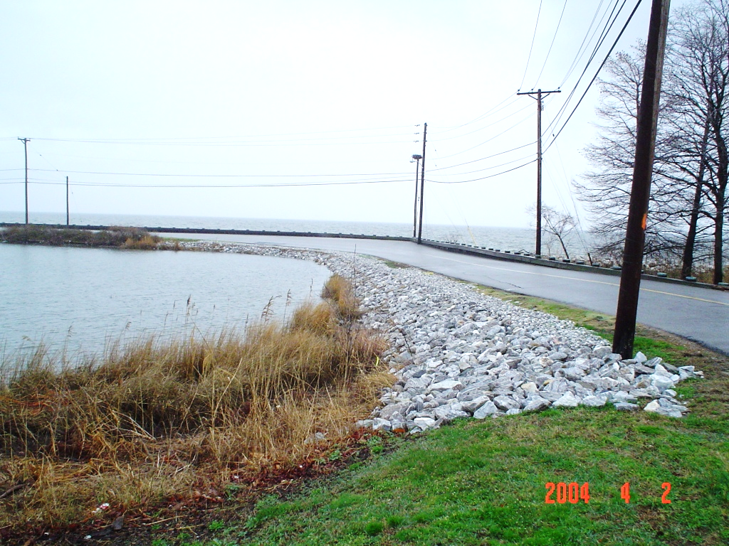
Gibson Island
Placed riprap prior to filling with sand and pea gravel

Slide 7
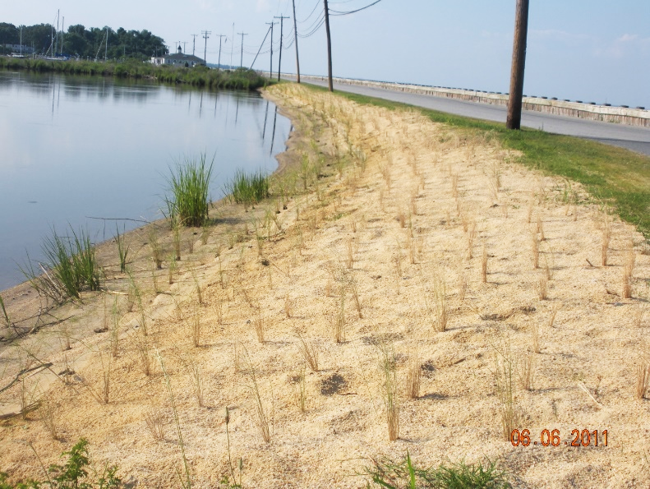
Gibson Island
Completed Green Riprap - immediately after construction, June 2011

Slide 8
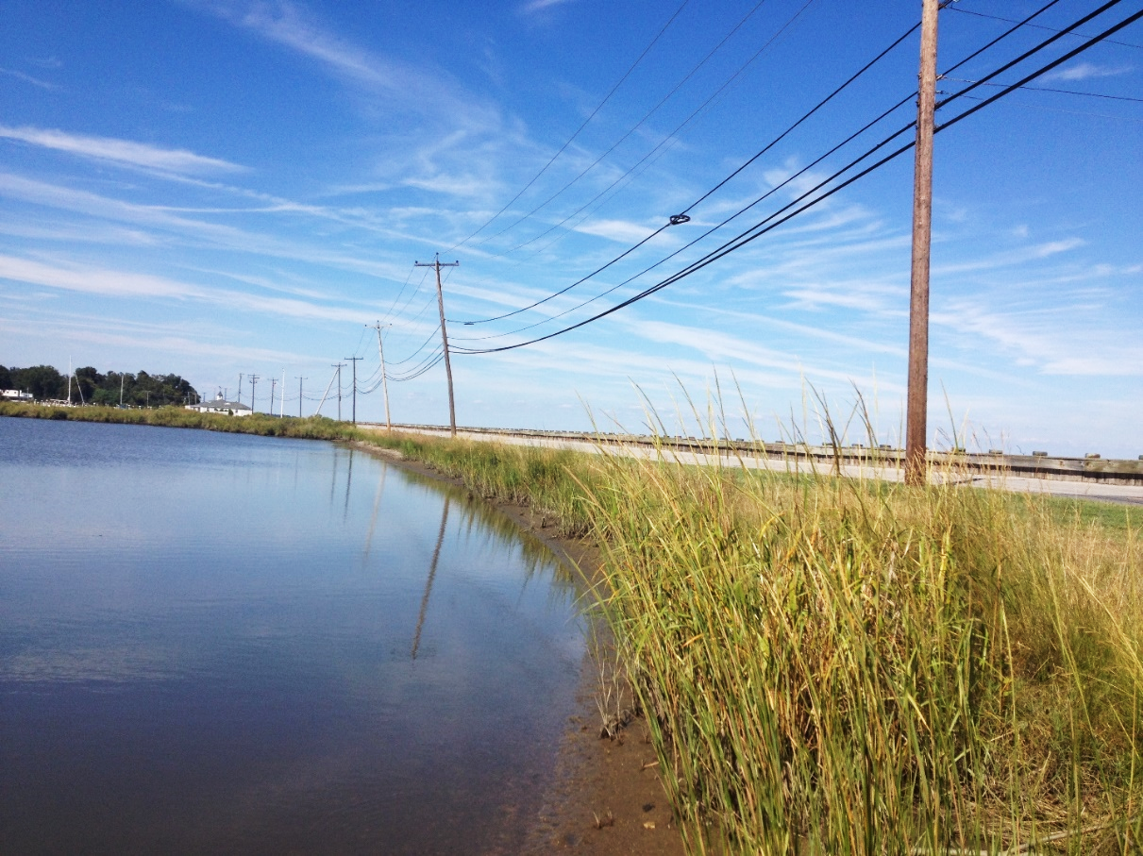
Gibson Island
Completed Green Riprap - 15 months after construction, September 2012

Slide 9
Discussion

