Slide 1
ITAT Workshop on Integrating Findings to Explain Water Quality Change
December 12-13, 2017
Annapolis, MD
STAC publication 18-005

Slide 2
Workshop Purpose
Interdisciplinary Dialogue
To convene research synthesis groups in one venue, to share their findings and identify complementary and contradictory insights across disciplinary and geographical boundaries;
To foster a dialogue between these scientists and a group of managers representing each jurisdiction of the Chesapeake Bay Program (CBP) Water Quality Goal Implementation Team (WQGIT).

Slide 3
Workshop Purpose
Cross-discipline dialogue: Introduction
Decision Support and Challenges Faced:
Timing: The CBP’s “accountability schedule” drives decision-making for the jurisdictions. As a result, information must be available in an accessible format, with insights for application, within that timeframe.
Technical: Decision-making is complicated by the watershed’s highly variable landscape and the local scale at which several of these decisions must be made. Extrapolating scientific insights to scales and locations outside of their original scope adds uncertainty with regard to source attribution and BMP effectiveness.
Social and Political: The degree to which science-based information can guide decision-making is mediated by an array of factors over which managers may have little to no control. Decisions are constrained by the availability of limited public resources, with multiple public needs competing for attention and prioritization. The desire to place BMPs in those locations where they will be most effective is complicated by the need to consider fair and equitable distribution of resources across communities. Finally, private property rights and lack of a regulatory mandate for most non-point sources limit the options open to managers when it comes to optimal BMP placement.

Slide 4
Workshop Purpose
Cross-discipline dialogue: Research Synthesis Sessions
4 sequential sessions
For each session:
  2-3 synthesis presentations
  80 minutes of breakout discussion
  Outcomes:
    Science messages for further communication
    Potential implications for management
    Research recommendations

Slide 5
Workshop Purpose
Cross-discipline dialogue: Research Sessions
Insights from USGS Monitoring and Analysis of the Chesapeake Bay Watershed
Insights from monitoring and analysis of watershed sediment transport, estuarine water clarity, and SAV abundance
The history of major tributary loads and conceptual models of estuarine response
Integrating research and science communication from watershed to estuary to inform management strategies

Slide 6
Session I: Insights from USGS Research and Monitoring
Non-Tidal Network 1

Slide 7
Session I: Insights from USGS Research and Monitoring
Non-Tidal Network 2
N flux to the bay declined between 1992 and 2012, but not at a pace that would be sufficient to attain goals by 2025.
The decline in flux is due primarily to point-source reductions, and to a lesser extent by declines in atmospheric deposition and in inputs from urban non-point sources.
Agricultural fluxes provide the majority of loads to the bay, and changed little between 1992 and 2012.
P fluxes to streams declined between 1992 and 2012, due primarily to point-source reductions.
P fluxes to Chesapeake Bay increased, due to reduced retention in the Conowingo reservoir.
The increasing importance of dissolved phosphorus from agricultural areas may reflect soil saturation.

Slide 8
Session I: Insights from USGS Research and Monitoring
Some Discussion Highlights
Science messages for further communication:
Existing spatial information on geology, loading hotspots, land use, and other relevant factors can be applied locally to inform BMP implementation decisions.
Local management efforts have resulted in changes to local water quality in some areas.
Implications for management:
Consider targeting newly urban and urbanizing areas for urban BMPs rather than well-established urban areas
Suggestions for future research:
Identify and map primary flow paths for each pollutant in various places, in order to inform how BMPs can be targeted to better interrupt those flow paths.

Slide 9
Session II: Insights on sediment transport, water clarity, and SAV abundance
Sediment
Active sediment storage can delay detection of effects of BMPs on sediment loads
Least certain elements of current conceptual models include:
  time spent in different storage zones and how this varies across watersheds;
  interactions of sediment transport and storage with phosphorus;
  how individual BMPs affect downstream sediment processes.
Scientific expertise and technical tools for addressing questions relevant to management are available and continue to expand.

Slide 10
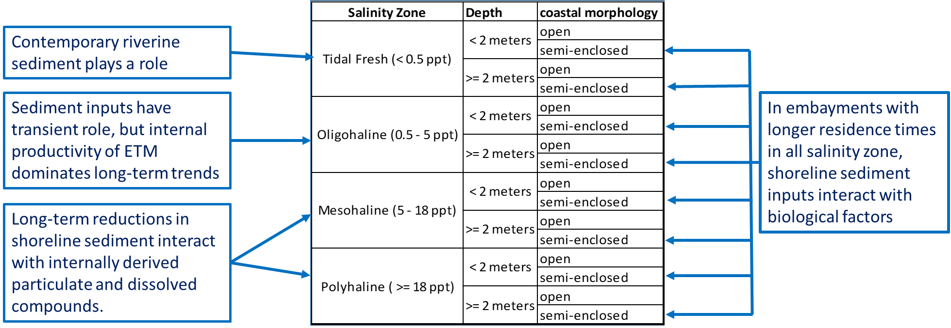
Session II: Insights on sediment transport, water clarity, and SAV abundance
Water Clarity

Slide 11
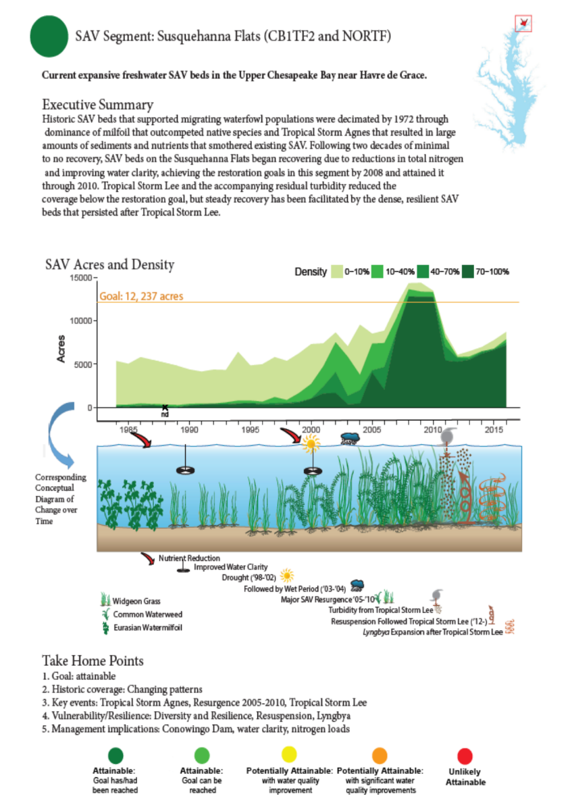
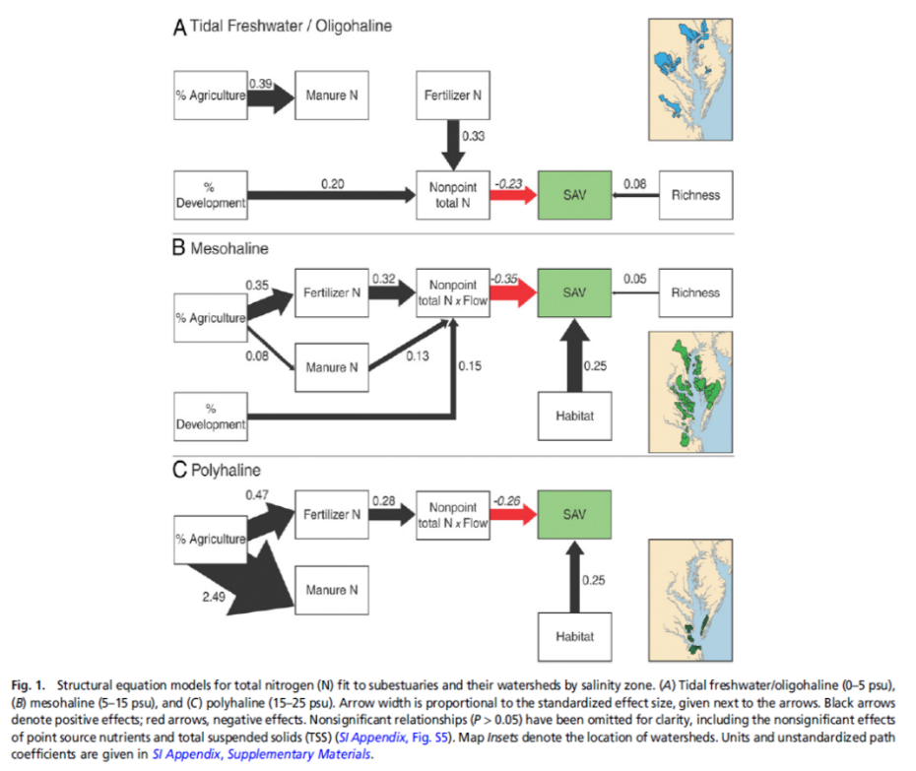
Session II: Insights on sediment transport, water clarity, and SAV abundance
SAV Synthesis

Slide 12
Session II: Insights on sediment transport, water clarity, and SAV abundance
Some discussion highlights
Science messages for further communication:
In places where nutrient loads and concentrations have been reduced, SAV has shown recovery within about 3-4 years.
Controlling sediment erosion is important for local stream health, and local sediment management benefits local fish populations and farm productivity.
Implications for management:
Target fine sediment transport and suspension rather than coarse sediment.
Suggestions for future research:
Conduct more research on sediment effects on insects, algae, and nutrient concentrations in small stream areas.
Collect and analyze data to better characterize causes of change in suspended particle size and composition in tidal waters

Slide 13
Session III: Major tributary loads and conceptual models of estuarine response
RIM Synthesis

Slide 14
Session III: Major tributary loads and conceptual models of estuarine response
Estuarine Biogeochemistry synthesis

Slide 15
Session III: Major tributary loads and conceptual models of estuarine response
Some discussion highlights
Science messages for further communication:
Flow-normalized loads and concentrations are useful for detecting effects of management actions and other changes in the watershed, and for comparing to TMDL models.
Observed loads and concentrations are important for understanding what the estuary is experiencing and how it is responding.
Implications for management:
Information on geographic distribution of nutrient sources can be used to target areas that provide most of the loads to the bay for BMP implementation.
The value of local tradeoffs in N, P, and sediment reductions varies depending on local conditions and BMP choices.
Suggestions for future research:
Improve our understanding of how lag times vary across the watershed, at the RIM stations, and across the estuary.
Update conceptual models to consider the effects of location on estuarine response

Slide 16
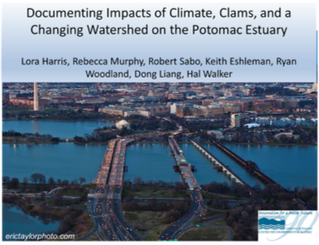
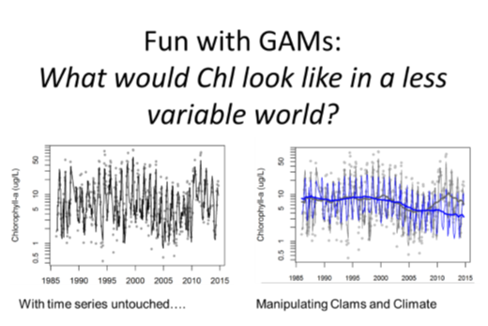
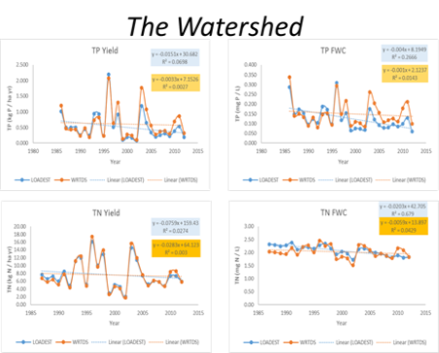
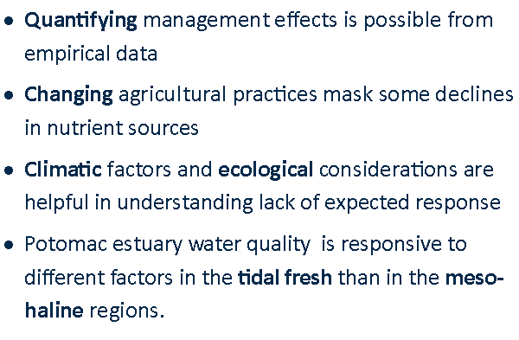
Session IV: Integrating research from watershed to estuary to inform management
Potomac Synthesis

Slide 17
Session IV: Integrating research from watershed to estuary to inform management
Tributary summary reports and storylines

Slide 18
Session IV: Integrating research from watershed to estuary to inform management
Some discussion highlights
Science messages for further communication:
Continue to communicate that nutrient reductions have an effect. Do not exclude the roles of uncertainty and complexity in how streams, rivers, and the estuary respond.
Show how the problems on land relate to the problems in the water using the fact sheet approach to communicate key messages accessible to both politicians and practitioners.
Implications for management:
Consider mechanisms to allow county-scale planning to reach across county boundaries, to better match scale of research findings.
Suggestions for future research:
Connect nutrients and water-quality trends to living resources in both directions, i.e. effects of living resources on water quality and effects of water quality on living resources.

Slide 19
Jurisdiction Panel
What was useful
Examples showing that point source reductions have worked; the fact that local improvements to an action have been observed gives us more confidence to write our WIP.
To see that there actually is a lot of scientific information that you can apply locally.
Information that there is a scientifically established lag effect.
That there are ways that science can inform prioritizing resources. This makes resource decisions easier, and is a good direction for future synthesis projects.
Direct communication between managers and scientists, without ulterior motives or agendas.
The opportunity to give feedback directly to scientists on what we need, such as more information at local scales.

Slide 20
Jurisdiction Panel
What was missing (1)
The full atmospheric deposition story. Communicate the importance of change in atmospheric deposition at the local level, even if its importance is relatively small over larger areas.
Sufficient actionable information diffuse (i.e. nonpoint source) loads to water quality.
Sufficient actionable information tying water quality to fishable and swimmable goals.
The incorporation of economic cost into science that informs BMP effectiveness. This will help us prioritize resources with regard to BMP decisions.
A holistic discussion of uncertainty, confidence levels, and variability in a management context. Distinguish between variability (which in some cases is well understood) and uncertainty (which is less well understood). Managers can handle uncertainty. They want to hear what the best currently available science is, what the gaps are, and that the research community is working towards filling those gaps.
Analysis of whether the Bay TMDL is more or less restrictive than local TMDLs. This will drive restoration action.

Slide 21
Jurisdiction Panel
What was missing (2)
A clear statement about what on the land is causing the problem, and whether there is solid science and technology to manage it.
A scientific analysis of what works and what doesn’t, what doesn’t work if you mess it up, and whether practices implemented in the past are still working. Examples include prioritizing the number of septic replacements over installation of more efficient septic systems, and street sweeping that mobilizes fine sediment.
An analysis of whether it would be more cost-effective to fully fund agricultural non-point source BMPs than to spend money on nutrient trading.
More local basin storylines for all synthesis topics, that can be taken to both the Secretary level and the local conservation group level.

Slide 22
Workshop Findings and Recommendations
Recommendation categories
Recommendations to the Chesapeake Bay Program to support jurisdiction implementation
Recommendations to the Chesapeake Bay Program for science communication
Recommendations to the Chesapeake Bay Program to promote research for BMP implementation decision support
Recommendations to Chesapeake Bay Watershed jurisdictions
Recommendations to the Chesapeake Bay Watershed research community

Slide 23
Workshop Findings and Recommendations
Lessons Learned
Original workshop goals to have a very targeted discussion of remaining research gaps and receive feedback on prioritization from managers were not quite met.
Watershed and estuarine researchers should collaborate and communicate more to integrate analysis of ecosystem trends and their explanations.
Unanticipated benefit:
  Direct communication between this group of researchers and managers
  Relationship building through sincere exchange of information

Slide 24
Workshop Findings and Recommendations
Where do we go from here?
This workshop generated a LOT of recommendations
Those of direct relevance to WIP planning were immediately acted upon by the CBP
Regarding remaining recommendations for science communication and research prioritization...
Regarding the original workshop goals….

