Slide 1
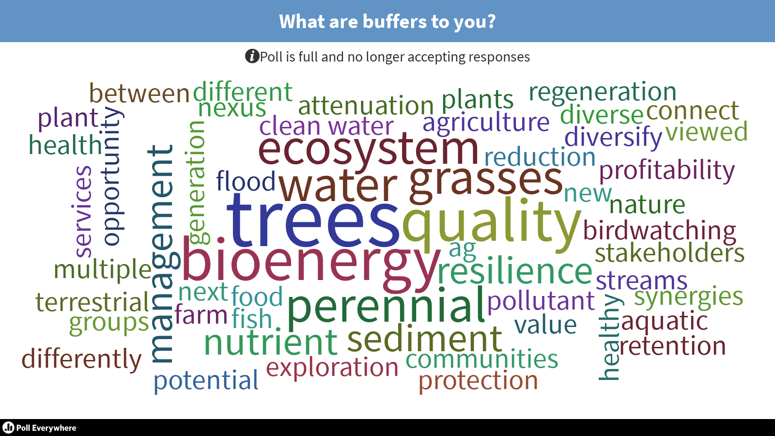
Dec. 7, 2018 STAC Update
Multi-Functional Buffer Workshop
Nov. 13-14, 2018, Harrisburg, PA
Notes:
Establishment of multifunctional riparian buffers: How do we accelerate the path to 95,000+ acres with the greatest economic, social, and environmental impact?

Slide 2
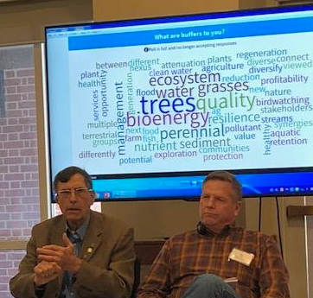
Overarching workshop goal: how do we accelerate implementation of buffers as a critical BMP?
Potential for “multi-functional” buffers to speed adoption?
  Water quality benefits
  Harvestable/diversified products
  Flood resiliency
  Aesthetics
  Habitat
  More
~50 participants from wide range of perspectives (including producers)
  Pre-workshop webinar
  Workshop itself

Slide 3
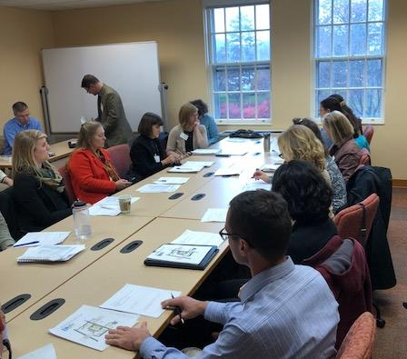
The workshop depended on a lot of intense work in breakout groups to allow participants time to talk
Session 1: solutions to barriers
  What are key barriers to getting buffers on the ground and why?
  What solutions do you see?
Session 2: key steps to implement the solutions
  What are key barriers to getting buffers on the ground and why?
  What solutions do you see?
Case study session:
  Examples where multifunctional buffers are working.
  What can we learn?

Slide 4
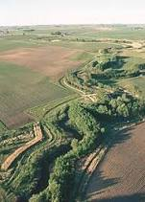
Preliminary findings: multi-functional buffers key part of the solution; working together = critical
Timing of discussion critical given WIP III, 2025 deadline
Multi-functional approach allows for local & Bay goals
Economics key– need viable farms
  diversifying crops/outputs
  protecting against loss (flood)
# of practical considerations
  Needs of landowner (farm, urban)
  Buffer as part of larger system (uplands also critical)
  One size does not fit all: niche crops, biomass production, conventional ag
  Local markets, options for outputs
  Maintenance, operation

Slide 5
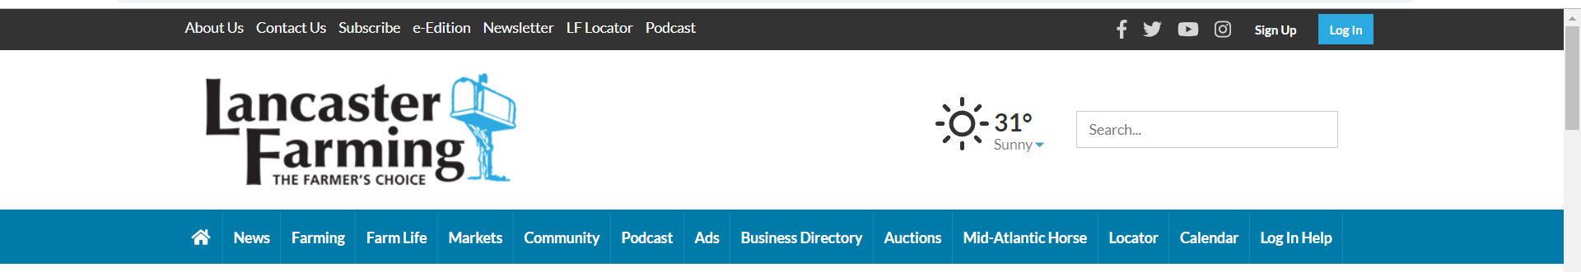
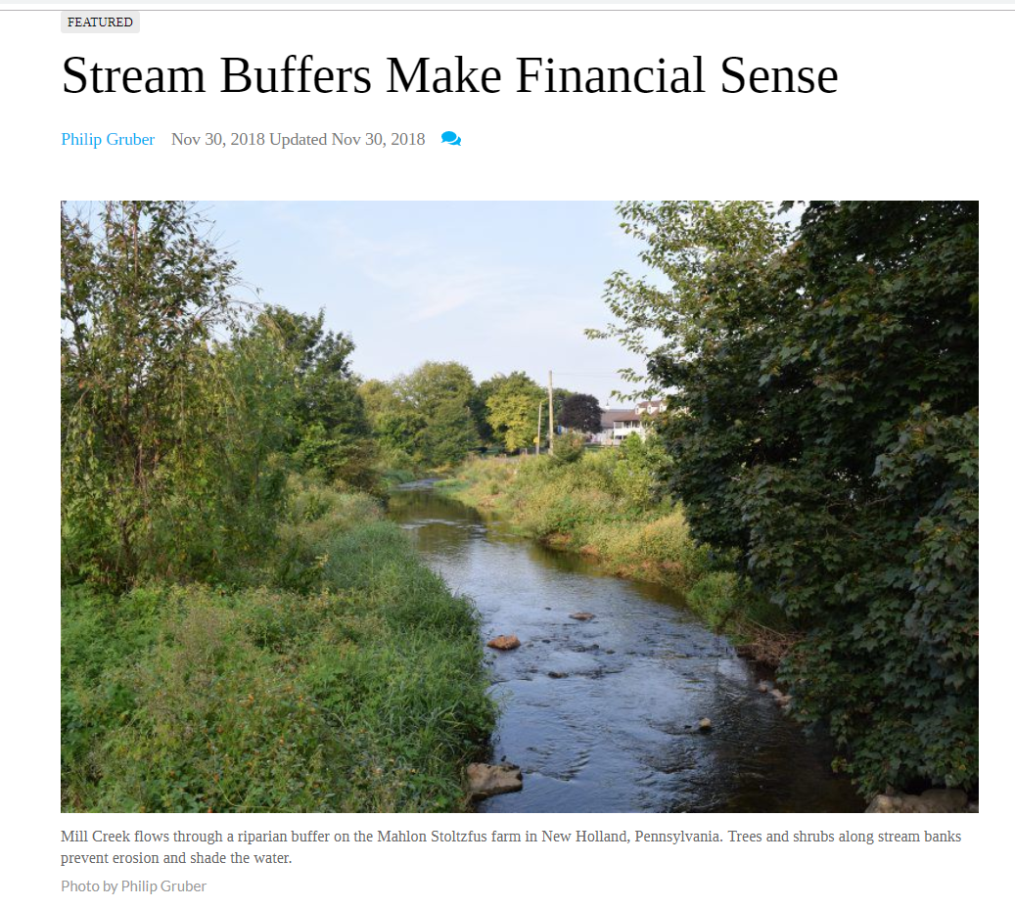
p
Article about workshop published last week
https://www.lancasterfarming.com/farm_life/conservation/stream-buffers-make-financial-sense/article_1c024bbe-db50-5971-9926-541fcb9b075d.html

Slide 6
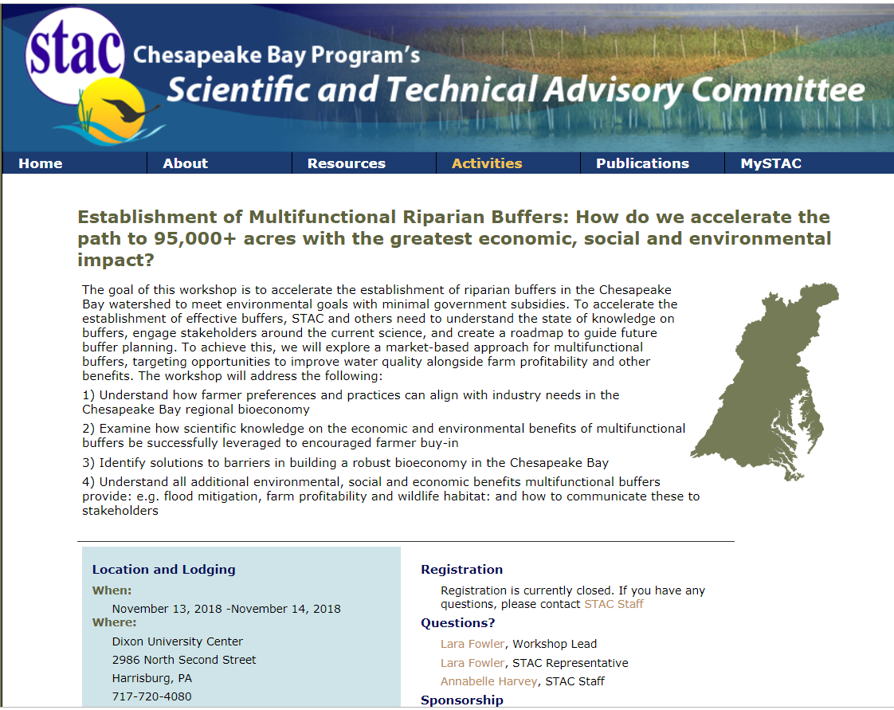

Next: STAC report to synthesize workshop results; presentations already online
Follow up info already distributed to participants
Workshop leads: Penn State grad students Veronika Vazhnik and Stephanie Herbstritt
Big thanks to STAC staff (Rachel Dixon & Annabelle Harvey)
Questions?
  Lara Fowler: lbf10@psu.edu
291_DCNR Case Study_Coulter.pdf
291_FDC Case Study_Circle.pdf
291_Grazed Forest Buffers_Unruh.pdf
291_Horn Farm_Earl.pdf

