Slide 1
Approach to Prioritize Chesapeake Bay Program Science Needs
Presentation to STAC by Kristin Saunders and Emily Trentacoste
December 7, 2018

Slide 2
Request from Management Board
Consolidate and analyze sciences needs to recommend prioritization for those requiring resources.
The request came up during the August 2018 with the MB wanting to better understand all the science needs, so they can help prioritize resources.
The action from the August MB meeting was: “The SRS small group will compile into a list the SRS data and science needs requests. This list will be shared with STAR and STAC leadership and the CBP associate directors for input. The Management Board will review the 2017-18 SRS requests to prioritize science and data needs. The Management Board will present their prioritization during the 2019 SRS Biennial meeting”

Slide 3
Proposed Approach
Have the Goal Teams, STAR, and STAC work together to:
Revise science needs (include what was already gathered through STAR and include SRS science items)
Conduct a resource assessment of how needs are being currently addressed by different science providers
Prioritize science needs that require additional resources
Provide recommendations to the MB at 2019 SRS Biennial Meeting and discuss how resources could be used

Slide 4
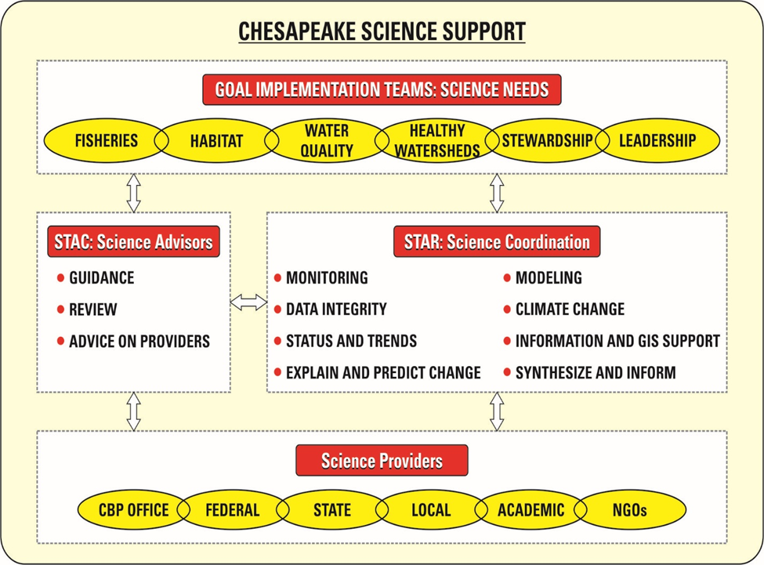
Brief Reminder on Roles

Slide 5
What we’d like from STAC:
Feedback on process
Input on criteria for prioritization
Identify smaller group of STAC members to be involved in initial prioritization
Connect prior STAC workshop and research recommendations that relate to the science requests
Input on resource assessment

Slide 6
Detailed Approach/Timeline
Nov 29
STAR meeting
Present process & gather feedback from STAR
Dec 7
STAC meeting
Present process & gather feedback from STAC
Dec 20
STAR meeting
Review final needs list; finalize prioritization process/criteria
Conduct resource assessment
Jan 24
STAR meeting
Provide initial resource assessment results & get feedback
Jan 29
GIT chairs meeting
Conduct initial prioritization with GIT chairs, smaller STAR & STAC cohorts
Gather feedback and adjust
Mar 13-14
SRS Biennial
Present prioritization for feedback

Slide 7
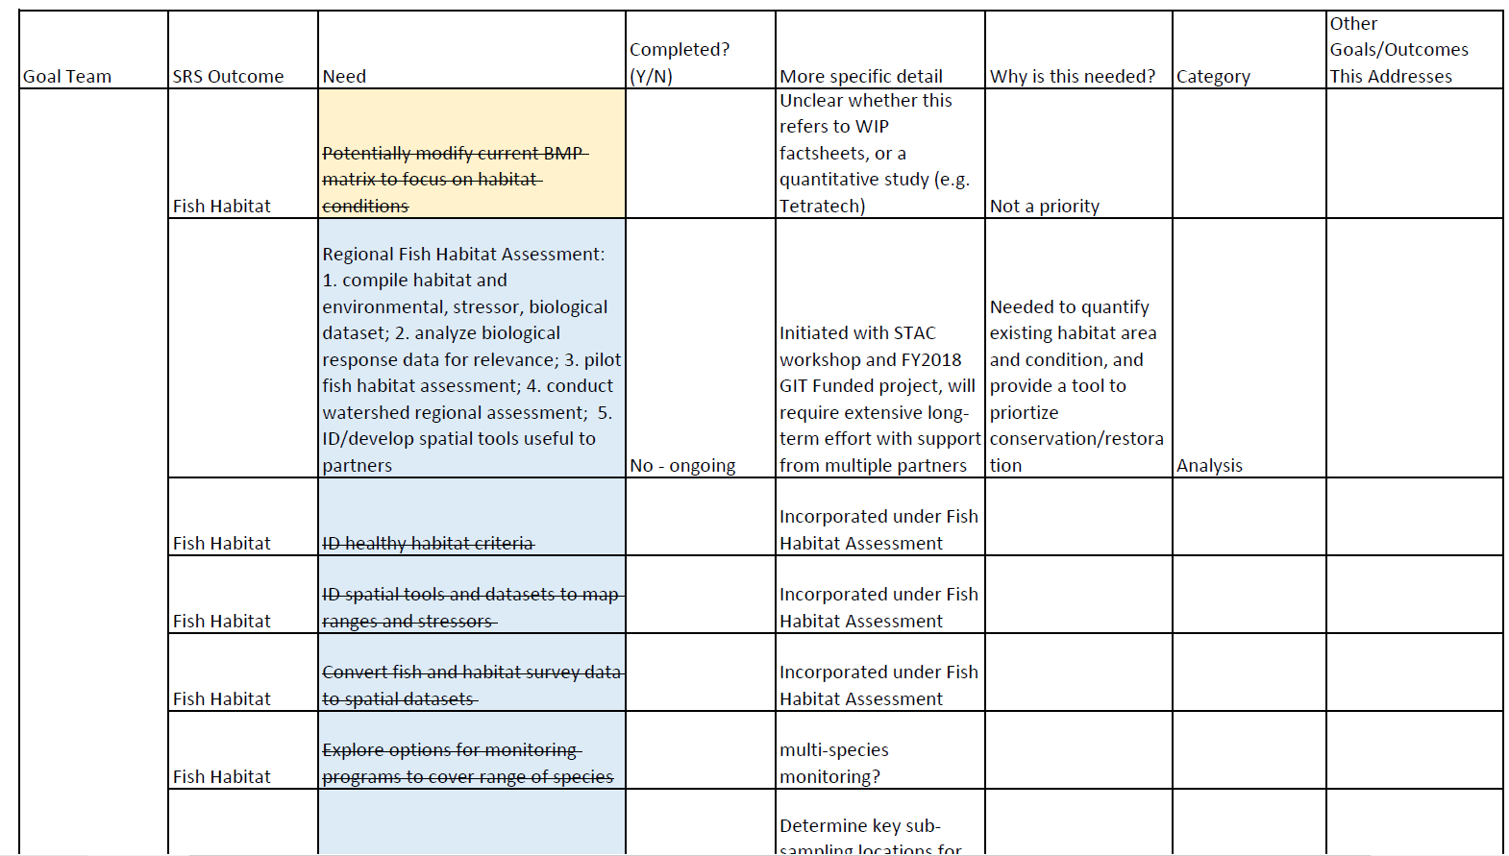
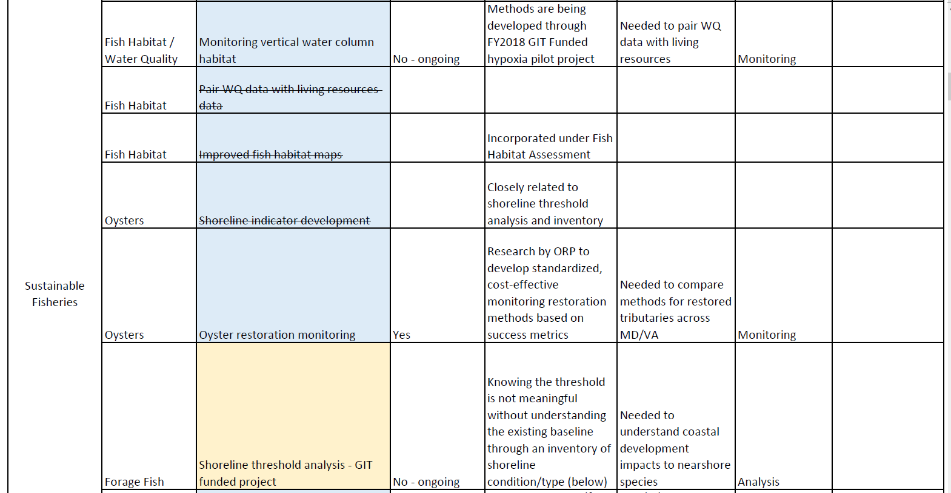
Science Needs List

Slide 8
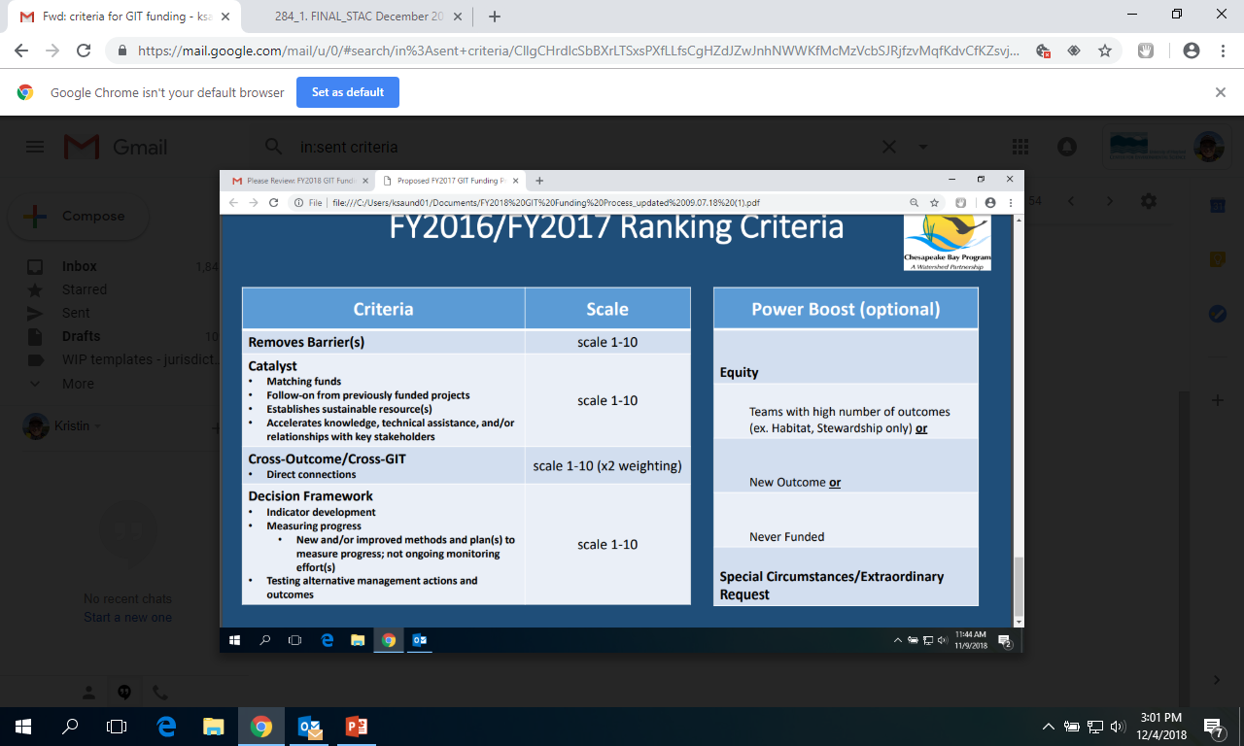
Prioritization Criteria
Current GIT Funding Project Criteria

