Slide 1
STAC Fish Habitat Workshop Report
Factors Influencing the Headwaters, Nontidal, Tidal, and Mainstem Fish Habitat Function in the Chesapeake Bay Watershed: Application to Restoration and Management Decisions
April 25-26, 2018
Maymont Estate Richmond, Virginia.
Notes:
Point out that fish utilization of habitat spans a wide range in the estuarine environment. This makes it tricky to fit the pieces of the puzzle together to connect habitat condition to natural mortality. Reducing natural mortality, or increasing fish population resiliency requires working across this broad range and considering the various factors that influence it.
Land use practices
Shoreline condition of rivers and bays, etc.
Water temperature and salinity
Connecting fisheries and habitat management

Slide 2
Workshop Steering Committee
Gina Hunt – Coordinator (MDNR/ FHAT)
Mark Monaco (NOAA / STAC)
Margaret McGinty (MDNR / FHAT)
Tom O’Connell (USGS)
Donna Bilkovic (VIMS/STAC/FHAT)
Bruce Vogt (NOAA/SFGIT/ FHAT)
Peter Tango (USGS/STAR)
Rich Starr (Ecosystem Planning & Restoration/SHWG)
Neely Law (SHWG)
Tom Ide (STAC/ FHAT)
Mary Gattis (Alliance for the Chesapeake Bay /LGAC)

Slide 3

Outline
  Workshop Process and Framework
  Utility of a Chesapeake Bay Watershed Regional Fish Habitat Assessment
National Fish Habitat Assessment
      What can you do with an assessment?
  Results
  Recommendations
  Next Steps

Slide 4
Fish Habitat Workshop Assessment Framework
Objective: To identify the necessary information and analytical approaches to assess the condition and vulnerability of fish habitat in the Chesapeake Bay Watershed.
Guiding Principles:
  Scale must support planning and management decisions
  Based on best available science, data, and analytical approaches.
  Designed to integrate or compliment with other tools
Notes:
Point out that fish utilization of habitat spans a wide range in the estuarine environment. This makes it tricky to fit the pieces of the puzzle together to connect habitat condition to natural mortality. Reducing natural mortality, or increasing fish population resiliency requires working across this broad range and considering the various factors that influence it.
Land use practices
Shoreline condition of rivers and bays, etc.
Water temperature and salinity
Connecting fisheries and habitat management

Slide 5

Regional Fish Habitat Assessment User Needs
A guiding principal for the assessment framework is that it should support planning and management decisions.
Therefore, a user-needs questionnaire was developed to determine what land use and restoration planners, and habitat and fish managers need in a fish habitat assessment.

Slide 6
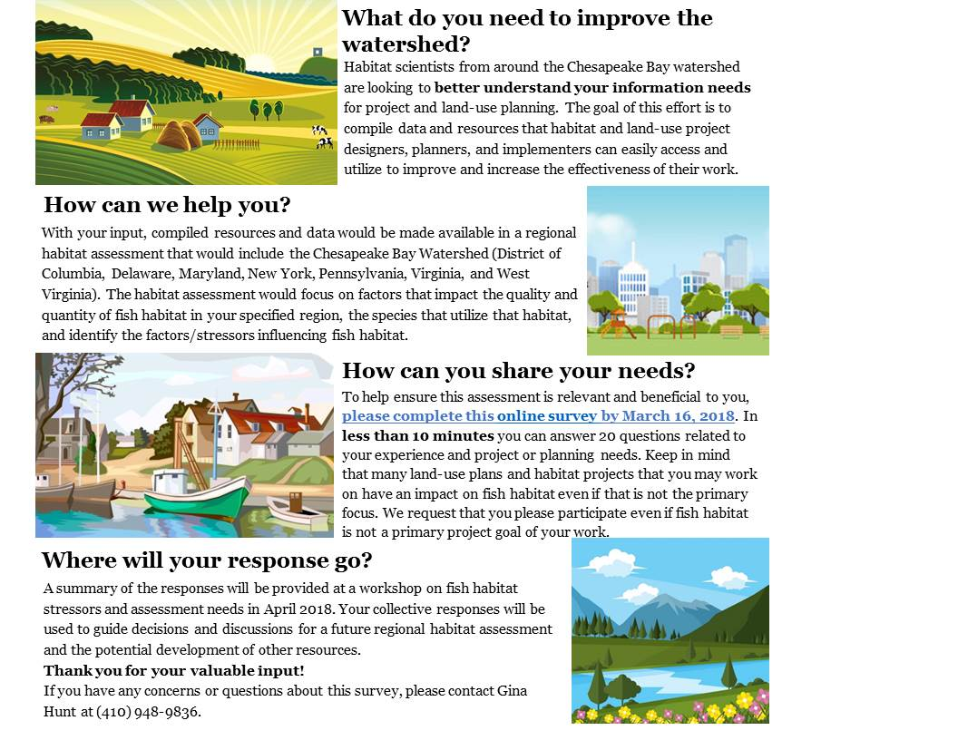
Questionnaire Methods
  Survey Monkey –
  all online.
  40% open rate
Nineteen Questions
  148 individuals responded to the questionnaire.
  41% work in local government. More than any other sector.

Slide 7
Questionnaire Results
Responses from all jurisdictions in the watershed

Slide 8
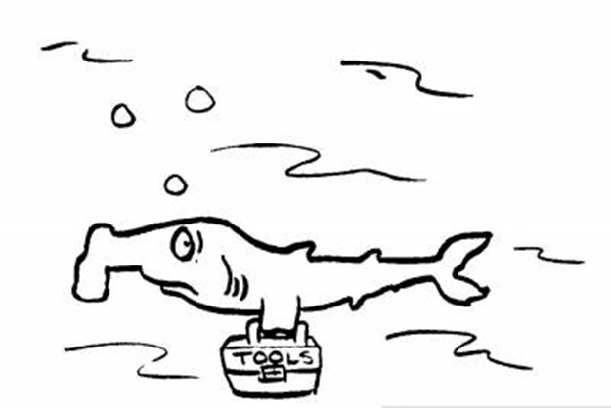
Questionnaire Results
Good News! 70% indicated that they would use a regional habitat assessment to prioritize potential sites for restoration/conservation.
But there are many existing spatial tools! Additional responses indicated it would need to complement their current process or tools.

Slide 9
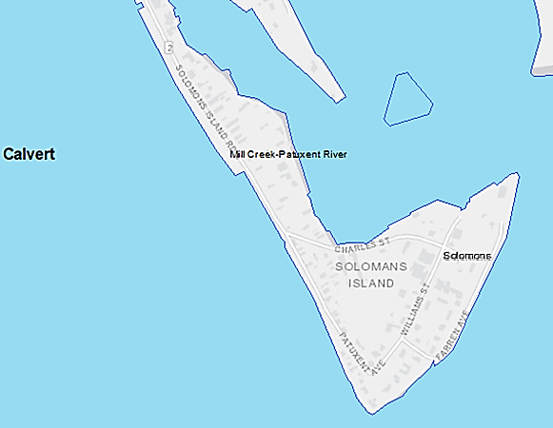
Questionnaire Results
What map scale is most appropriate so you could use a regional Habitat Assessment to improve your work?
Majority requested the smallest scale offered:
less than 1:24,000.
Others suggested the HUC 12 scale or smaller and the ability to switch from a Google Earth to Topo map scale.
Ability to move back and forth based on resolution of available data- Hierarchical assessment

Slide 10
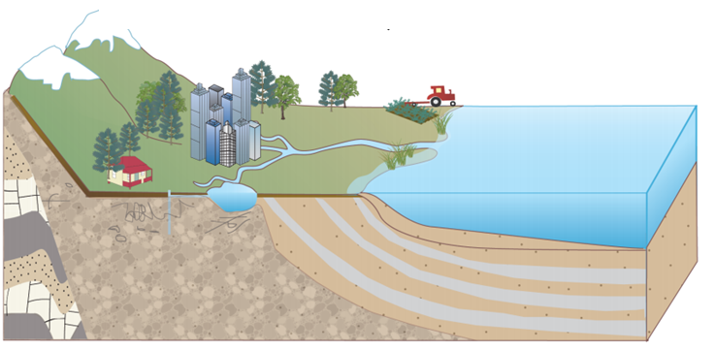
Questionnaire Conclusions
The assessment will not be the primary process for choosing a restoration or conservation area; but they will use it.
In order to be meaningful, it will need to work well with their existing tools and processes, provide resolution at a
local scale and provide information that has been
otherwise unavailable or scattered in its availability.

Slide 11
Fish Habitat Workshop Assessment Framework
Objective: To identify the necessary information and analytical approaches to assess the condition and vulnerability of fish habitat in the Chesapeake Bay Watershed.
Guiding Principles:
  Scale must support planning and management decisions
  Based on best available science, data, and analytical approaches.
  Designed to integrate or compliment with other tools
Notes:
Point out that fish utilization of habitat spans a wide range in the estuarine environment. This makes it tricky to fit the pieces of the puzzle together to connect habitat condition to natural mortality. Reducing natural mortality, or increasing fish population resiliency requires working across this broad range and considering the various factors that influence it.
Land use practices
Shoreline condition of rivers and bays, etc.
Water temperature and salinity
Connecting fisheries and habitat management

Slide 12
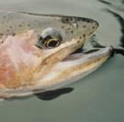
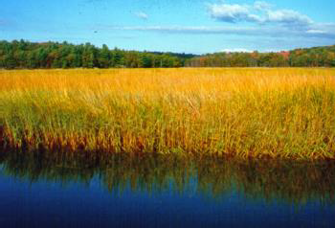
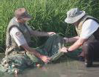
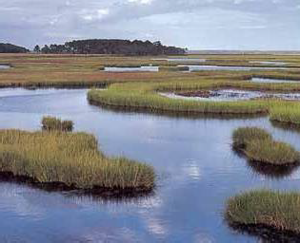
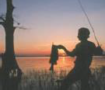
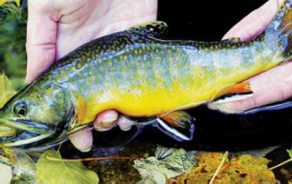


National Fish Habitat Partnership
Produce “Status of Fish Habitats in the United States” report every 5 years
Three Products for 2015
    Inland Stream Assessment
    National Estuary Assessment
    Regional Estuary Assessment-Gulf of Mexico
http://assessment.fishhabitat.org/

Slide 13
What Do the Assessments Tell Us?
Status – Which areas are most affected by anthropogenic stress?
Areas with the worst relative condition could be considered high priority for restoration
Can identify where high quality areas are that may be targets for conservation.
Finer-scale assessments could help guide management actions, and specific habitat management objectives to help recover or improve productivity of fish populations.

Slide 14
What Do the Assessments Tell Us?
Gives a national picture of fish habitat condition; landscape-scale results are seamless across the US. But won't be very good at local scale using 1:100K data.
And missing some significant regional data because it is not nationally available.
What do we have that it is missing???

Slide 15
Thank Goodness for USGS and NOAA Partners!!!
A team of USGS and NOAA scientists determined the availability of these data for the Chesapeake Bay watershed and compiled the relevant metadata.
Objective- Identify data specific to the Chesapeake Bay watershed that were either not used in the 2015 National Fish Habitat Partnership (NFHP) Assessment or that were newly available at a finer spatial scale.

Slide 16
A summary of variables identified from the compilation effort compared to the National Fish Habitat Partnership Assessments separated by Factor Grouping
Factors | # Variables | # Variables NFHP Inland | # Variables NFHP Estuary
Watershed | 18 | 0 | 0
Pollution | 38 | 3 | 1
Dams | 12 | 2 | 1
Mines | 53 | 4 | 1
Water Use | 7 | 5 | 1
Human | 5 | 1 | 1
Urban | 34 | 6 | 7
Ag | 26 | 2 | 2
Natural | 86 | 3 | 13
Nutrient | 29 | 3 | 0
Water Quality | 19 | 0 | 1
Climate | 20 | 2 | 0
Habitat | 38 | 0 | 0
Biological (Response and Predictor) | 46 | 11 | 0
Miscellaneous | 10 | 0 | 0
Total = 15 | 441 | 31 | 28

Slide 17
Fish Habitat Workshop Assessment Framework
Objective: To identify the necessary information and analytical approaches to assess the condition and vulnerability of fish habitat in the Chesapeake Bay Watershed.
Guiding Principles:
  Scale must support planning and management decisions
  Based on best available science, data, and analytical approaches.
  Designed to integrate or compliment with other tools
DAY 1
Identify scale needed to drive action at relevant management levels
Determine criteria for selection and ranking of variables
Identify the variables (stressors and conditions) most influencing habitat condition and vulnerability.
DAY 2
Prioritize the variables (stressors and conditions) most influencing habitat condition and vulnerability.
Identify information gaps
Recommendations
Notes:
Point out that fish utilization of habitat spans a wide range in the estuarine environment. This makes it tricky to fit the pieces of the puzzle together to connect habitat condition to natural mortality. Reducing natural mortality, or increasing fish population resiliency requires working across this broad range and considering the various factors that influence it.
Land use practices
Shoreline condition of rivers and bays, etc.
Water temperature and salinity
Connecting fisheries and habitat management

Slide 18
Workshop Results
Determine Scale and Criteria to Rank Variables
Scale: 1:24,000
Three Criteria selected:
  Severity
  Mitigation Potential
  Certainty
Ranked- assigned a numerical score (2, 4, or 6) to each criteria

Slide 19
Workshop Results
Identify the Variables Most Influencing Habitat
From the list of 441 variables:
87 variables were identified from the combined habitat groups as likely to have a significant impact on fish habitat in the Chesapeake Bay watershed (determined as a severity and certainty score of 6).
54 unique variables identified as having a significant impact on fish habitat.
Habitat Type | Total Number of Selected Variables | Number of Unique Variables Identified with High Severity and Certainty
Headwaters | 23* | 7*
Large Nontidal Rivers | 108 | 15
Tidal Freshwater | 83 | 31
Tidal Saltwater | 66 | 34

Slide 20
Workshop Results
Variables that were Identified as Significant by Multiple Habitat Types
Factor | Stressor/Variable | Habitat
4 Habitats
Agriculture, Nutrients | Nutrients | Large Nontidal Rivers , Tidal Salt, Headwaters, Tidal Fresh
Urban, Human | Impervious Surface | Large Nontidal Rivers, Tidal Salt, Tidal Fresh, Headwaters
3 Habitats
Climate, Habitat, Pollution, Water Quality | Water Temperature | Tidal Salt, Tidal Fresh, Headwaters
Agriculture, Urban, Pollution | Sedimentation | Large Nontidal Rivers , Tidal Salt, Headwaters
Urban, Human | Stormwater discharge/runoff | Large Nontidal Rivers , Tidal Salt, Headwaters
Agriculture, Human | Land use | Tidal Salt, Tidal Fresh, Headwaters
Agriculture, Habitat | Erosion | Large Nontidal Rivers , Tidal Fresh, Headwaters
Human | population density/change | Large Nontidal Rivers , Tidal Fresh, Headwaters
2 Habitats
Habitat | SAV Loss | Tidal Salt, Tidal Fresh
Biological | Invasive species | Tidal Salt, Tidal Fresh,
Urban, Human | Habitat loss | Tidal Salt, Tidal Fresh,
Urban, Natural | Wetlands loss | Tidal Salt, Tidal Fresh,

Slide 21
Identify Information Gaps
Each Habitat type answered the following questions:
What variables are we missing or underrepresented with data per habitat type (gaps)?
What additional stressors should we recommend need study/monitoring?
What are the implications on the assessment tool of not having without having the information?
Research recommendations?

Slide 22
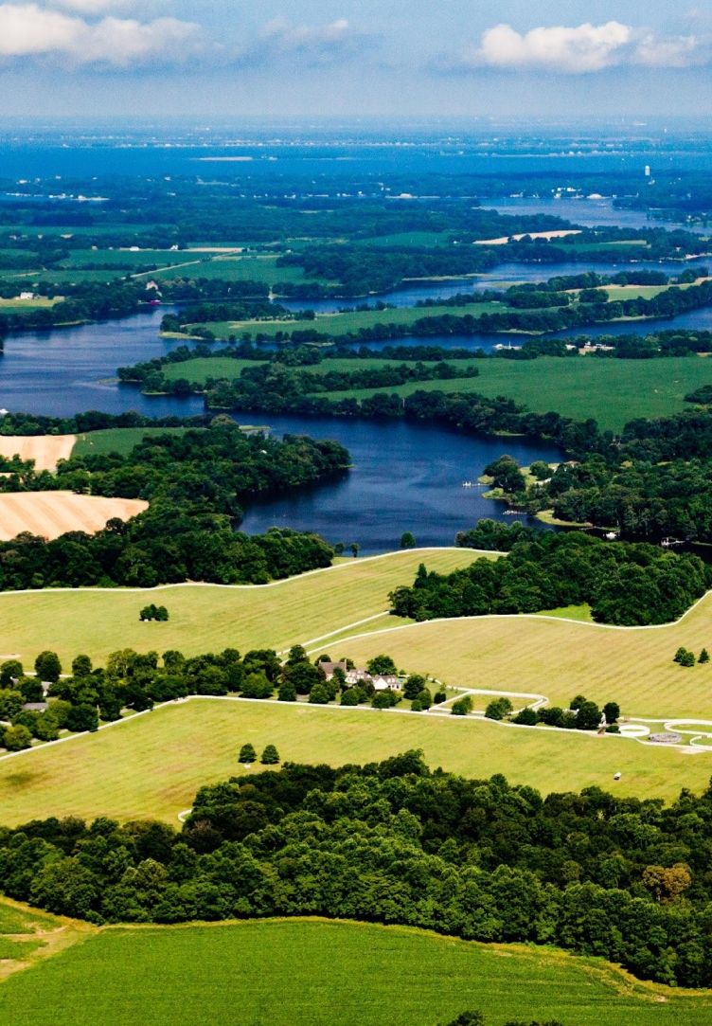
Recommendations
Develop Pilot Assessment- Continue gathering data sets on key stressors along with biological data and evaluating the scale of applicability.
Select pilot areas and test various biological response metrics to determine which measures are most sensitive to stressors and to validate approach and utility.
Incorporate Adaptability- an assessment should be built in a way that can incorporate additional stressors as science evolves.

Slide 23
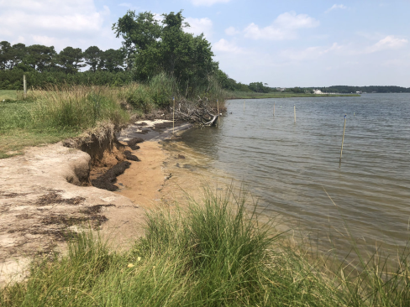
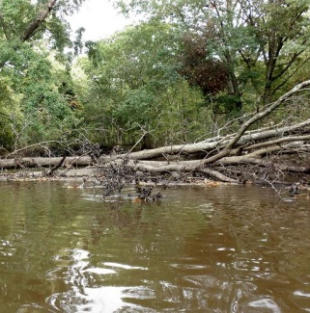
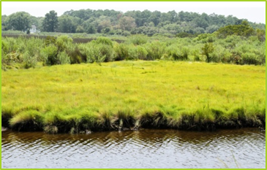
Recommendations
Develop the Assessment at the finest scale possible- A fine spatial scale (1:24,000 or finer) is recommended for planning, management, restoration, or mitigation of fish habitats.
Participants recognized a hierarchical approach may be necessary because not all data are available Bay-wide at this resolution.

Slide 24
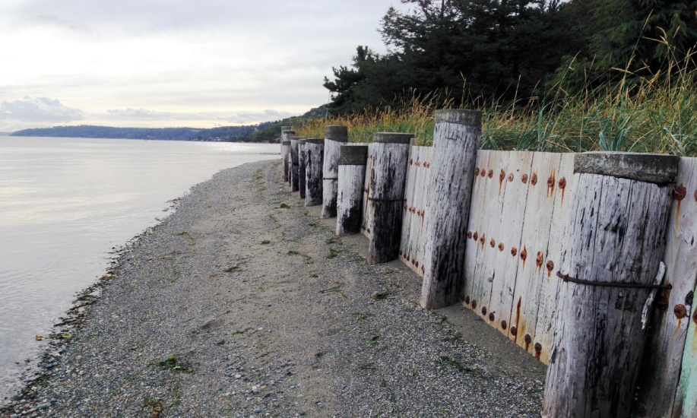
Recommendations
Prioritize Research Needs- Identified numerous research needs.
All groups suggested researching stressors that were ranked as low certainty and expected high severity.
Conduct data mining exercise to fill data gaps- Datasets were identified, but data were lacking for some habitat types.
Additional data needs are listed under each habitat type.
Where data gaps persist, research should be prioritized.

Slide 25
Recommendations
Establish a Community of Practice- a group of people among those utilizing and developing fish habitat assessment tools to facilitate the transfer of knowledge on lessons learned.
Identify a person as an Assessment Coordinator- Identify a person to lead the workshop recommendations and build upon the enhanced collaborations from this workshop.
A coordinator would be instrumental in making the connections with this Chesapeake Bay habitat assessment effort and the larger Northeast habitat assessment.

Slide 26
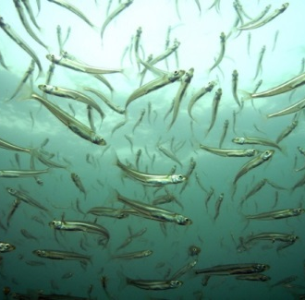
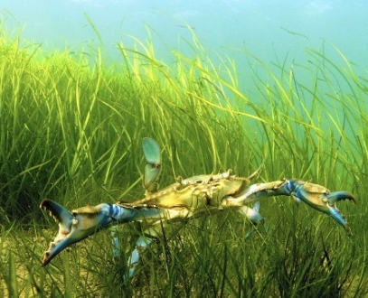
Next Steps
We incorporated the recommendations and the new stressor information into Version 2 of the Fish Habitat Management Strategy. Approved by the board yesterday!

Slide 27
Next Steps
A post-workshop project proposal was selected for Chesapeake Bay Program GIT funding. Funds will be used to secure a contractor for one year to continue building on the STAC workshop data inventory with biological data and analysis of the data for use in the pilot assessments, and potential regional assessment.
Collaboration with NOAA and USGS partners will continue with this project.

Slide 28
Regional Fish Habitat Assessment Project
Technical Project Advisory Committee-
Steve Faulkner (USGS)
Bruce Vogt (NOAA, Fish GIT Coordinator)
Suzanne Skelley (NOAA, Director Oxford Cooperative Lab)
A.K. Leight (NOAA)
Gina Hunt (MD. DNR, Fish Habitat Team Coordinator)
Additional folks added for information sharing at certain meetings. (ie. Scott Phillips (USGS), ACFHP, MAFMC).
Coordinating with other fish habitat assessments: National Assessment, Southeast Regional Assessment (NC to FL), Northeast Assessment. Not the same stressor data focus.
Fish Habitat Action Team will serve in non-technical oversight role; coordination with user-needs.

Slide 29
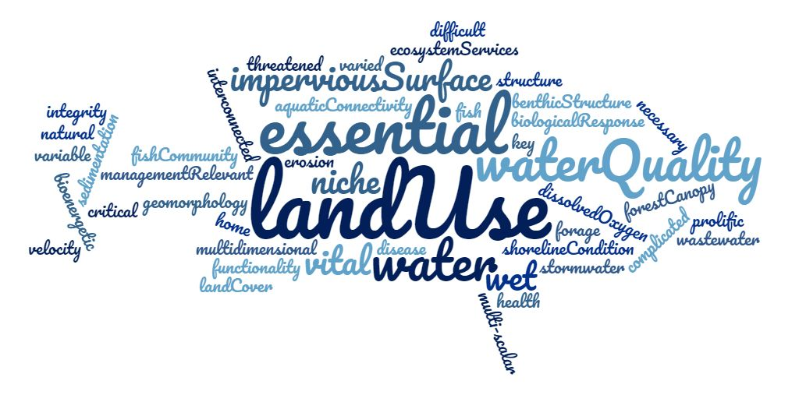
Questions

Slide 30
Project Timeline
Project timeline illustrates a systematic approach to a regional fish habitat assessment and contribution of GIT funding.
Look for communication (outreach to assessment users) and coordination opportunities.
We are Here!

Slide 31
Project Timeline

