Slide 1
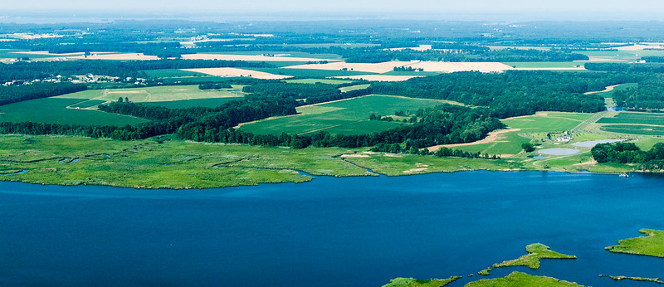
COVID-19 Impacts on Nutrient Dynamics in the Chesapeake Bay Region
(Photo by Chesapeake Bay Program)

Slide 2
STAC COVID-19 mini-workshop series
This effort is to better understand and identify impacts, changing dynamics, and learning opportunities that may have come from COVID-19 to inform current and future efforts to reach management targets.
Short term risks/impacts, changes, and learning opportunities for CBP
Longer term risks/impacts, changes, and opportunities for CBP
Comparison with other regions
Identify critical needs, action steps
May 24 | Impacts of COVID-19 on Local Government
June 7 | Impacts of COVID-19 on Fisheries and Aquaculture
June 14 | Impacts of COVID-19 on Nutrient Dynamics

Slide 3
Maria Tzortziou
City College of New York
Mark Trice
MD DNR
Chris Brosch
DE Dept of Ag
STAC Member
Ed Dunne
DOEE
Lara Fowler
PSU, STAC member
Facilitator

Slide 4
Main questions
What are our underlying assumptions about how the impacts of covid-19 might be affecting nutrient flows? What do we think might be happening that might not turn out to be true?
What changes in nutrient inputs and dynamics are we seeing? To what extent have these changes provided opportunities for action? Opportunities to learn?
How do changes in data (both ability to collect plus actual changes in system dynamics) affect longer term management?
What management actions can we take from this? What do we do now? Is there anything we can learn from this that would cause us to do something differently?

Slide 5
Thank you
Email colem@chesapeake.org or go to chesapeake.org/stac/ to be added to the STAC Interested Parties List.
Materials and session recordings from this session and the two previous can be found on the STAC website
https://www.chesapeake.org/stac/events/impacts-of-covid-19-on-management-efforts/

