Slide 1
  CESR Report Objectives
  Identify gaps and uncertainties in system response —physical, chemical, biological, and socioeconomic— that impact efforts designed to attain WQS.
  Identify recent scientific developments that can shed light on the gaps and uncertainties in system response to advance efforts to attain WQS, and
  Recommend research strategies that improve understanding of system response to support informed decision making to attain WQS.
  Recommend strategies for integrating scientific and technical analysis with active adaptive management in order to aid decision-making under uncertainty (to achieve WQS).
Notes:
2025 deadline

Slide 2
Outline
  Section 1: Introduction
  Section 2: Gaps and Uncertainties in System Response to Meet Water Quality Standards
  Section 3: Watershed Response
  Section 4: Estuary Response
  Section 5: Living Resource Response
  Section 6: Implications

Slide 3
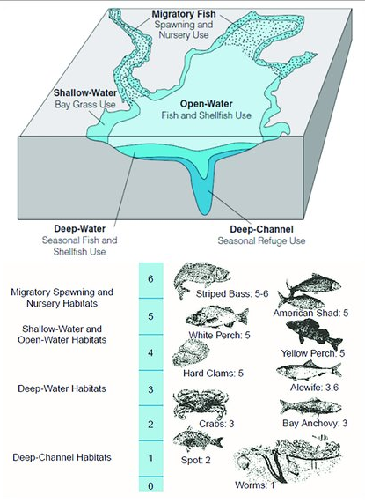
Public Policy
Chesapeake Bay Agreement: Restoration Goals
Sustainable Fisheries
Vital Habitat
Water Quality
Toxic Contaminants
Heathy Watershed
Climate Resiliency
Land Conservation
Stewardship
Public Access
Environmental Literacy
Water Quality Standards
TMDL: Stressor Reduction Goals
Targets: Nitrogen, phosphorus, sediment loads to achieve water quality criteria
TN: 214.6 m/lbs/yr
TP: 13.4m lb/yr
TSS: 18,587m lb/yr
Implementation Policy
Policies designed to reduce stressors to achieve WQS.
Point source
Urban nonpoint source
Ag nonpoint source
Budgets
Designated Uses
Water Quality Criteria
Dissolved Oxygen, Water clarity/SAV,
& Chl-a
across 5 habitats
Enforceable Goal
Biological, Physical, and Social System Response
Living Resource Response to WQ
WQ Response to N,P and Sediment
N,P, and Sediment Response to Mgt
Nutrient/Sediment Reductions Achieved
100% Achievement of WQC
Expected Response
N, P, & S reduction goals
Expected Response
% Achievement of WQ Criteria (ex DO)
Achievement of open water criteria
Living Resource Abundance
Achievement migratory fish habitat criteria
Uncertainty
Expected Current Condition
% Achievement of WQ Criteria (ex DO)
Nutrient/Sediment Reductions
Management Effort
(ex BMPs, land treated, etc)

Slide 4
Section 3: Evaluation of Watershed System Response to Management of Nutrient and Sediment Stressors (TMDL)
Section Framing Questions
Is the physical and social system responding to management efforts to meet TMDL N, P, and S goals in ways consistent with expectations?
What are the major uncertainties in efforts to reduce N, P, and S stressors delivered to the Chesapeake Bay?
What management actions/policy options could improve nutrient/sediment response or reduce response uncertainties?

Slide 5
Section 4: Evaluation of Estuary System Response to Achieve Water Quality Criteria
Section 4 Framing Questions:
Is estuary water quality responding in ways consistent with expected response to stressor reductions (N,P, & S) achieved to date?
What are the major uncertainties in efforts to achieve and assess Bay water quality criteria (DO, water clarity/SAV, chl-a)?
Have other stressors impacting achievement of WQC been identified and adequately accounted for?
What management actions/policy options could improve estuary water quality (criteria) response?

Slide 6
Section 5: Evaluation of Living Resource Response to WQ
Section 5 Framing Questions:
How have historical changes (~30 years) in water quality and habitat (due to both natural variation and management actions) affected living resource populations and food webs?
What is the expected (projected) response of living resources if the TMDL does to meet the current numeric water quality criteria (water quality conditions DO, Clarity/SAV, Chl -a across different habitats), recognizing that living resource conditions are affected by changes in multiple factors?
What are the uncertainties of the model/empirical analyses and how can they help guide future monitoring and modeling efforts?
How can the analyses inform what types and magnitude of changes in water quality and habitat are needed to evoke an agreed-upon set of the desired living resources responses?

Slide 7
Section 6. Implications
Holding spot
Summative
What are the prospects of getting there from here (uncertainties and response gaps to achieving WQS)
How can water quality response to management/investments/policy actions be improved?
Integrative/cross cutting
What are the lessons and options for the design and assessment of future water quality standards (criteria and designated uses)?
What are the implications of existing WQS standards and TMDL nutrient reduction goals for the achievement and improvement of other Bay restoration goals?

