Slide 1
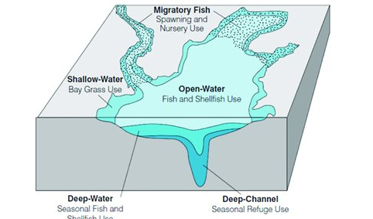
Attainability and Costs of WQS
Section 6: Implications
Incremental Costs
$
Costs to meet WQS
A possible actual condition
Expected current condition
Attainment of some criteria
Full Attainment
Nonattainment
100%
% Achievement of WQS
Notes:
Points you can make about the graph:
This slide integrates all previous slides…. Management actions to reduce stressors to achievement of WQ goals.
Horizontal axis is % attainment of WQS… across 3 different criteria (DO, water clarity, Chl-a) and the 5 different areas/habitats in the Bay (open water, deep water, deep channel, nursery, shallow water). Note, we partially reach attainment for some critiera or in some places before others.. For example, achieve DO in open waters (partial attainment of DO) but not in deeper waters.
Blue line is the additional costs necessary to meet improvements in attainment. This represents, conceptually where we think we are. Red dot is our expected current condition…
Blue line is nonlinear based on economic empirical research (ex Shortle; Wainger, etc) and the frequently acknowledged phrase that “we have picked the low hanging fruit”
Uncertainty: But we could be at the yellow dot (which is animated)… which means we aren’t getting the response we think we are getting and we are going to have to spend more resources (costs) to achieve any given outcome. The dotted lines represent the uncertainty we have in how the system is responding to management actions/policies. Could have the top dotted line… that no amount of $ and investment can achieve the goal (given mass balances, population, stressors like CC). Conceptually things could be better than we expect, bottom dotted blue line (e.g some tipping point is reached that spawns a positive feedback loop).

Slide 2
Attainability and Costs of WQS
Section 6: Implications
Incremental Costs
Where are we relative to our expected response in achieving existing WQS?
What management/policy investments can we make to improve system response (shift blue curve to the right)?
What questions and issues need to be confronted in evaluating/deciding the next generation of water quality standards (including implications for living resources and restoration goals)?
$
Costs to meet WQS
Attainment of some criteria
Full Attainment
Nonattainment
% Achievement of WQS
Notes:
Graph help illustrate what might be in the implication section of the report.
Possible framing questions (animated to come it one at time) for the Implications section (what are the implications of the policy choices that have been made and have to made in the future
where do our existing polices put us on this graph now and into the future.. A) the limits of the physical response in the system (may be impossible to achieve existing standards; B) Tradeoffs… costs are going up and thus the cost of making errors in our investments and the consequences on the public budgets for other restoration goals.
what can be done (policy/investment changes) to shift curve to attain the WQ goals we got. Are their changes in policy or investments that can be made in existing programs that can “shift the blue curve” to the right… more environomentally responsive investments, less expensive ways to improve WQ.
What are issues for in beyond existing WQ standards? Many possible implications and questions: Questions about assessing outcomes in key habitats? Design of standards that focus on LR? Consequences for other bay restoration goals.

