Slide 1
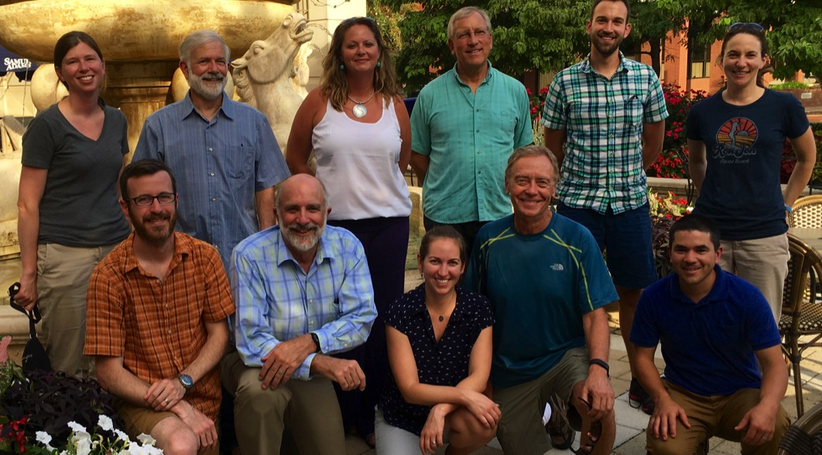
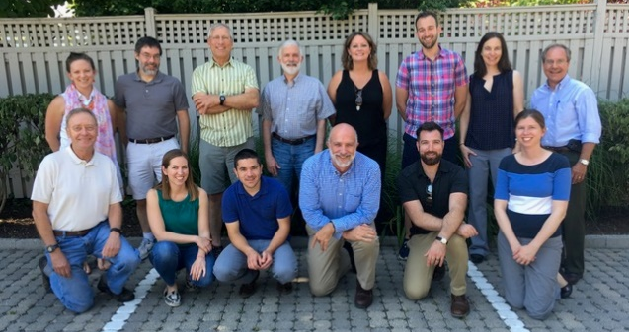
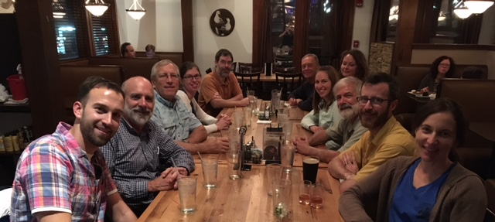
Explaining Trends in Tidal Waters
Synthesis Process and Lessons Learned
Experienced leadership
  One or 2 leaders who’ve been through process before
  At least one “champion” – preferably two
  Early-career participants
Limited size (≤ 12)
Topic is ripe for synthesis
  Clear research AND management goals
  Multiple products; co-authorship
Multiple immersive workshops:
  4 multi-day workshops
  Minimal powerpoints; focus on breakouts and schedule flexibility
  Conducive location (‘walkability’, good IT, whiteboards, break outs, food, drinks, photo ops)
Regular communication in between workshops (leader emails, conference calls, offline collaboration)

Slide 2
Needs for successful synthesis:
  Time – resources to hire a dedicated individual with the technical competence (e.g., a postdoc).
  Engagement of relevant expertise – resources to engage relevant members of the science community (e.g., travel support).
  Payoff – to both the CBP Partnership and SS participants.
    Focused effort of and engaged SS cohort to address a specific need.
    Findings that inform management decisions.
    Publishable work and synergies that may result in additional collaborations.

Slide 3
STAC Synthesis - Background
Summer 2017
  Rich Batiuk (et al) proposed STAC consider taking on ‘science synthesis’ (SS) topics as a way to provide a more in-depth information to decision makers. Example used was submerged aquatic vegetation (SAV) effort.
  Deep-dive; beyond a 2-3 day workshop. Support among STAC members
  Identified importance of linking SS effort with partnership needs
Fall 2018
  First STAC led SS effort focusing on climate change - based on STAC’s long record of encouraging the CBP to address climate, the need to build on recent and forthcoming STAC climate chance (CC) efforts (including this workshop), and the recent decisions taken by the PSC.
  Subcommittee of STAC members formed to develop overall ‘mechanism’
  $125,000 added to STAC’s budget to fund 1-2 SS efforts

Slide 4
(DRAFT) General STAC science synthesis model
  Includes a research scientist and Advisory Committee. The scientist will be employed by the Chesapeake Research Consortium (CRC) and located as appropriate for the work.
  Advisory Committees (AC) composed of 4 to 6 members…
    one AC member being a current STAC member or STAC-approved designee.
    each AC should include in individual that is specifically interested and/or engaged in the SS topics and is involved in making decisions related to Bay recovery management.
    AC led by one or more researchers currently active in the area of the proposed SS project.

Slide 5
(DRAFT) General STAC science synthesis model
  Potential SS topics may be responsive (a request from the Chesapeake Bay Program, e.g., GITs, Workgroups, STAR) or proactive (an issue that STAC believes requires attention).
  Some topics may be a mix of both responsive and proactive. Topics may also be identified using the outputs from future (or past) STAC-sponsored workshops.
  SS products are expected to capture the “state of the science.”
  Findings should provide the CBP Partnership with a good foundation on which to build future research and make informed policy/management decisions.

Slide 6
Some potential SS topics heard today
Nutrient speciation methodology and WQ impacts
Multi-model comparison and skill assessment for estuarine models
BMP performance and resiliency under future climate conditions
Holistic assessment of regional resilience
  Resilience to extremes? Flooding?
  Coupling local concerns with broader Bay resiliency across the watershed
Assess ability to meet current Bay Agreement goals and water quality standards under future climate conditions

