Slide 1
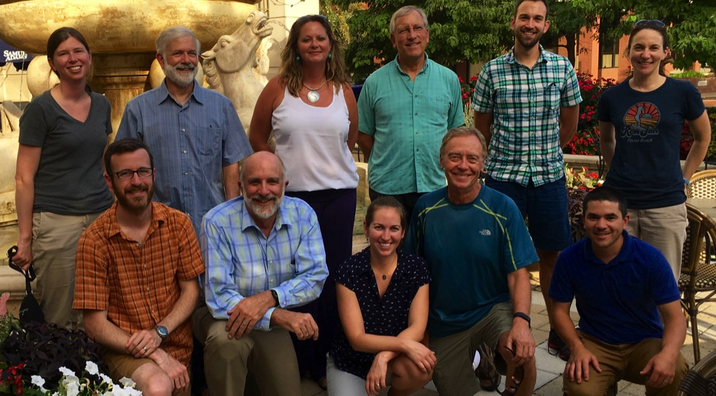
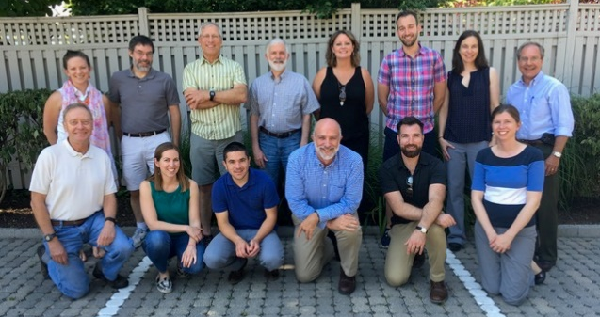
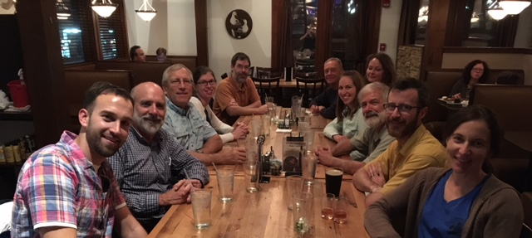
Explaining Trends in Tidal Waters
Synthesis Process and Lessons Learned
Experienced leadership
  One or 2 leaders who’ve been through process before
  At least one “champion” – preferably two
  Early-career participants
Limited size (≤ 12)
Topic is ripe for synthesis
  Clear research AND management goals
  Multiple products; co-authorship
Multiple immersive workshops:
  4 multi-day workshops
  Minimal powerpoints; focus on breakouts and schedule flexibility
  Conducive location (‘walkability’, good IT, whiteboards, break outs, food, drinks, photo ops)
Regular communication in between workshops (leader emails, conference calls, offline collaboration)

Slide 2
Synthesis for Explaining Trends in Water Quality
Goals: Original proposal
  significant research question
  critical point
  collation and synthesis of existing data
  collaborative analysis
  interdisciplinary research team

Slide 3
STAC Synthesis - Background
2017
  Rich Batiuk (et al) proposed STAC consider taking on “science synthesis” (SS) topics as a way to provide a more in-depth information to decision makers. Example used was submerged aquatic vegetation (SAV) effort.
  Deep-dive; beyond a 2-3 day workshop. Support among STAC members
  Identified importance of linking SS effort with needs of partnership
2018
  First STAC led SS effort focusing on climate change - based on STAC’s long record of encouraging the CBP to address climate, the need to build on recent and forthcoming STAC CC efforts (including this workshop), and the recent decisions taken by the PSC.
  Subcommittee of STAC members formed to develop overall mechanism
  $125,000 added to STAC’s budget to fund “1-2 syntheses”

Slide 4
Remaining Needs for Synthesis:
  Time – resources to hire a dedicated individual with the technical competence (e.g., a postdoc).
  Engagement of relevant expertise – resources to engage relevant members of the science community (e.g., travel support).
  Payoff – to both the CBP Partnership and SS participants.
    Focused effort of and engaged SS cohort to address a specific need.
    Publishable work and synergies that may result in additional collaborations.

Slide 5
(DRAFT) General STAC Science Synthesis Model
  Includes a research scientist and Advisory Committee. The scientist will be employed by the Chesapeake Research Consortium (CRC) and located as appropriate for the work.
  Advisory Committees (AC) will be composed of 3 to 5 members with one AC member being a current STAC member. An AC will be led by one or more researchers currently active in the area of the proposed SS project.

Slide 6
Topics Heard Today
Biogeochemical dynamics of speciation
Conduct multi-model comparison and skill assessment for estuarine models
BMP efficiencies and resiliency
Holistic assessment of regional resilience
  Resilience to extremes? Flooding?
  Coupling local concerns with broader Bay resiliency across the watershed
Assess ability to meet current Bay Agreement goals and water quality standards under future climate conditions

