Slide 1
Watershed Group
Change the N and P speciation
Change the nutrient response to flow and sediment change
Incorporate the effects of climate change into the BMP effectiveness estimates
Introduce uncertainty into the decision-making process

Slide 2
Change the N and P Speciation
Current
  N speciation determined by observed relationship between load per acre and nitrate percent
  Probably a land use and water balance signal
2019 - How would speciation respond to climate signal?
  Perhaps looking at observed surface and baseflow speciation and apply modeled change in surface and baseflow?
  Likely assume no change
Long term –
  Complex observed Concentration-discharge relationships
  Land use and geology-dependent (through sparrow?). Can we tease out climate from land use and BMP implementation
  Review of smaller scale studies?
  Mine existing data sets: DNR storm sampling network, national BMP database; MS4 databases; Jordan/Weller, Occoquan
  CEAP data as you move south indicates climate temperature change

Slide 3
Change the N and P Speciation
Current
  N speciation determined by observed relationship between load per acre and nitrate percent
  Probably a land use and water balance signal
2019 - How would speciation respond to climate signal?
  Perhaps looking at observed surface and baseflow speciation and apply modeled change in surface and baseflow?
  Likely assume no change
Long term –
  Complex observed Concentration-discharge relationships
  Land use and geology-dependent (through sparrow?). Can we tease out climate from land use and BMP implementation
  Review of smaller scale studies?
  Mine existing data sets: DNR storm sampling network, national BMP database; MS4 databases; Jordan/Weller, Occoquan
  CEAP data as you move south indicates climate temperature change
Synthesis

Slide 4
Nutrient Responses to Flow and Sediment Changes
Current –
  TN is 1:1 with flow
  TP is based on surface runoff and sediment washoff except in developed where there is no effect
2019 and long term
  Spatially vary the N relationship.
    Perhaps existing sensitivities to groundwater recharge and available water capacity
  Developed area Sensitivity to P
    Review of small-scale modeling efforts
  SSOs would have an effect

Slide 5
Incorporate the effects of climate change into the BMP effectiveness estimates
See prior STAC workshop!
  BMP panels are supposed to deal with it now, but none do
  Need IDF curves some are already developed
  Need response to IDF curves
CBP recommend that states update their stormwater regulations (CA, WI, MA, Canada)
Consider failure in extreme conditions
Co-benefits change as well as efficiencies
Request CBTrust RFP for BMP response to climate change.

Slide 6
Incorporate the effects of climate change into the BMP effectiveness estimates
See prior STAC workshop!
  BMP panels are supposed to deal with it now, but none do
  Need IDF curves some are already developed
  Need response to IDF curves
CBP recommend that states update their stormwater regulations (CA, WI, MA, Canada)
Consider failure in extreme conditions
Co-benefits change as well as efficiencies
Request CBTrust RFP for BMP response to climate change.
Synthesis

Slide 7
Introduce uncertainty into the decision-making process
Climate change presents an opportunity for a ‘trial run’ of decision making under uncertainty
  Smaller stakes than full target-setting
  Some uncertainty components determined
2019 - Present to managers as probabilities
  5% chance that climate has no or beneficial effect on oxygen
  50% chance that it is equivalent to a 9 million lb reduction or more
    or
  Climate change increases risk of failure by a certain amount
  Reducing loads by 9 million lbs reduces that risk of failure by X%
Longer-term
  fully integrate uncertainty into models and decisions
  Convert to probabilities of environmental consequences and benefits in dollars
  Consider robust decision making

Slide 8
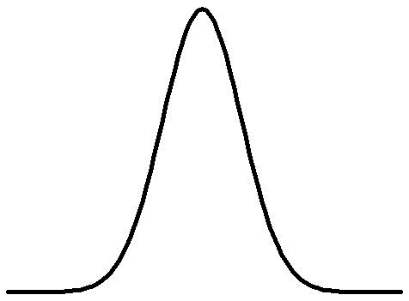
Probability =>
0
9 Mlbs
Additional Reduction =>

Slide 9
Watershed Group
Change the N and P speciation
Change the nutrient response to flow and sediment change
Incorporate the effects of climate change into the BMP effectiveness estimates
Introduce uncertainty into the decision-making process

Slide 11
Knowledge Generation
Research on climate effects in general
Finer scale models
  Knowledge generation to be generalized
    Would allow for climate analysis that could be used in BMP panels
Finer scale data on inputs and water quality

Slide 12
Add-ons
Need to articulate to PSC that we need research money
Linkage between climate change and future land use
Linkage between climate change and Conowingo

Slide 13
Recommendations for 2019
Speciation
  Current – N speciation determined by
Response to flow and sediment changes
  TN:Flow
  TP:Flow
  Spatial variability in the response
Uncertainty
BMP efficiencies

Slide 14
Long-term
Uncertainty
Co-Benefits, Costs, Social Science
Finer-scale modeling
BMP efficiencies

Slide 15
synthesis
Bgc signals in species

