Slide 1
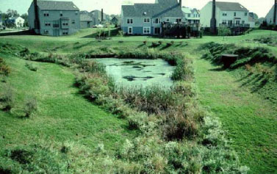
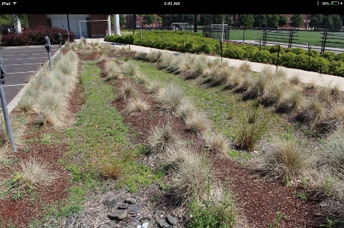
Resilient BMPs for a Changing Climate
BMPs work by a variety of physical and biological mechanisms
These mechanisms determine how BMPs are sensitive to climate drivers (e.g., rainfall volume and intensity, temperature, soil moisture
Evaluate climate response:
  Simulation models
  Space for time substitution
  Field experiments (rare to date)
Sensitivity - Is the practice and its performance sensitive to the range of potential change?
Adaptability – Can the practice be modified to be resilient to potential changes as they emerge?
Timeliness – How short is the time line to adapt to changes?
Research sponsored by EPA ORD over the last four years

Slide 2
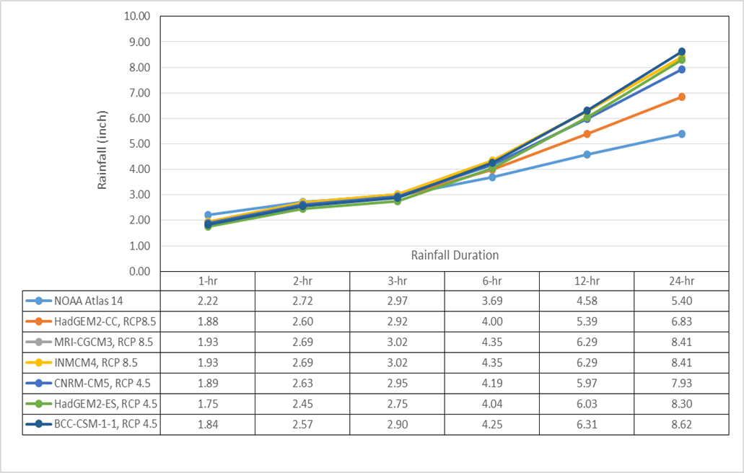
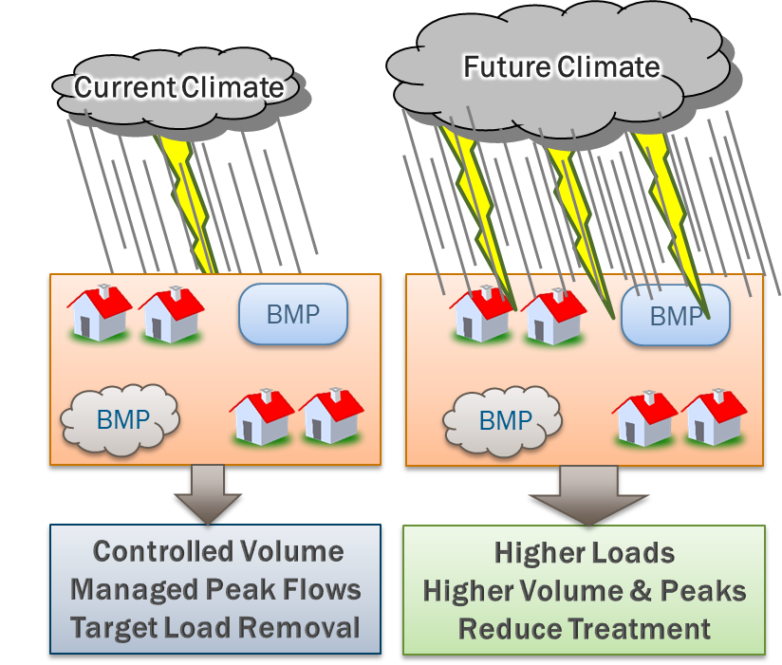
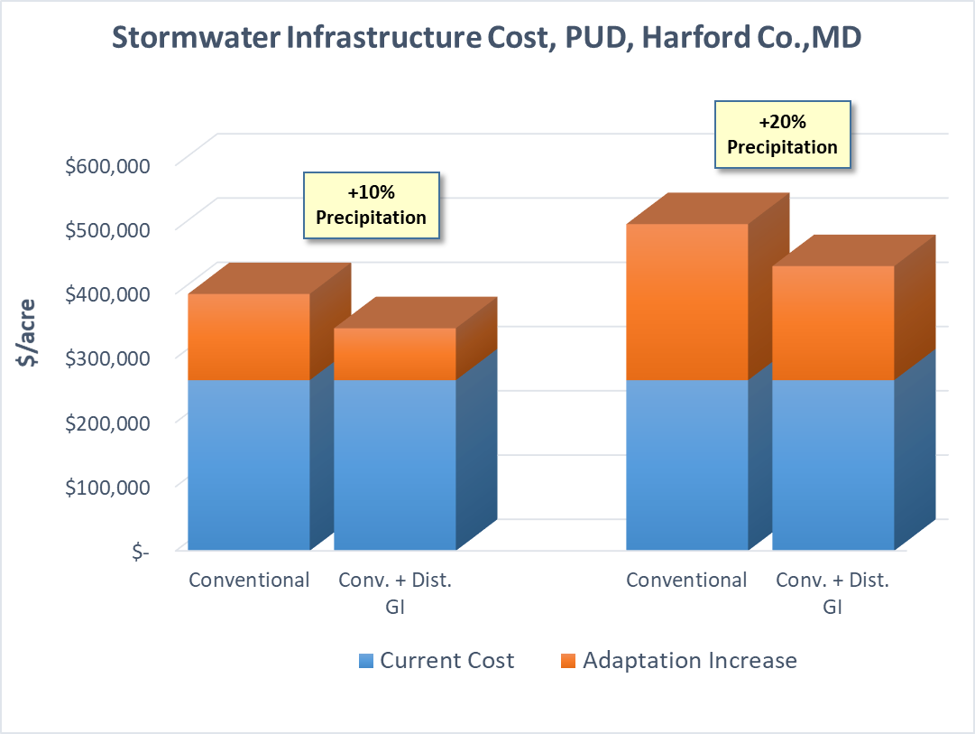
Urban BMPs
Dauphin Co. PA 2085, 25-yr event
Notes:
Emphasis on sizing; Dependence on both physical and biological components
HSPF, SUSTAIN, RHESSys tools

Slide 3
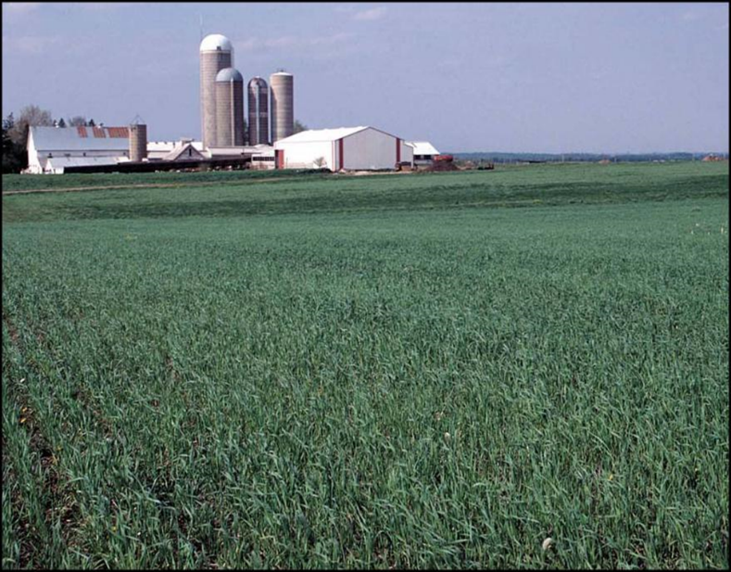
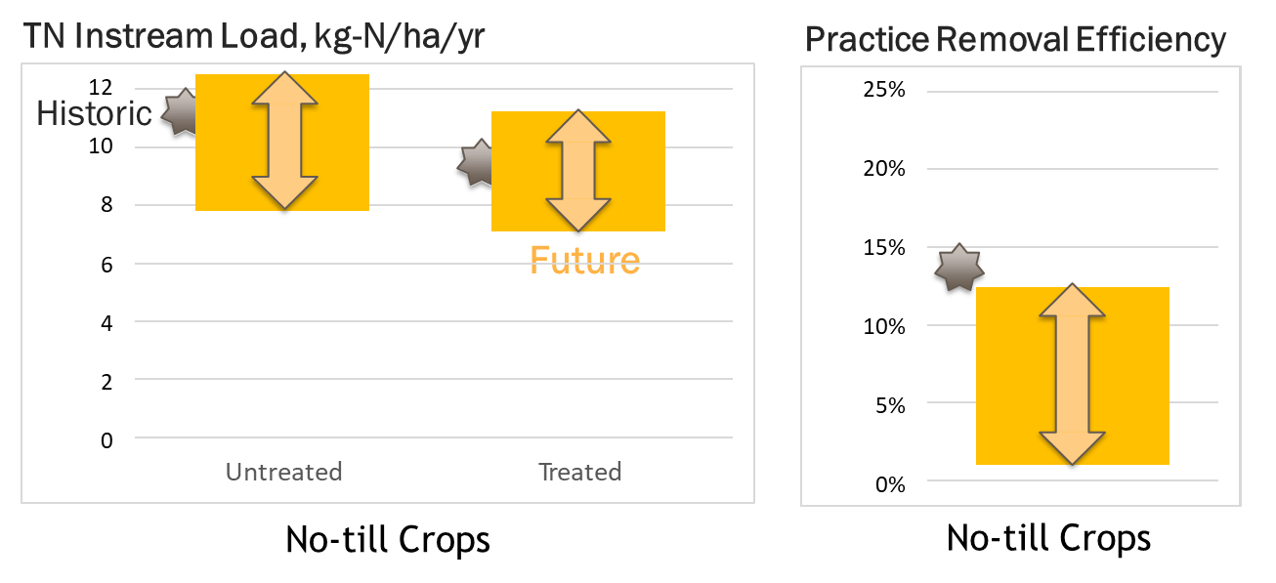
Rural BMPs
Example: No-till on GA coastal plain: SWAT suggests little change in future TN load, but practice effectiveness decreases due to changes in water balance
Climate resilience summary for riparian buffers
Notes:
Emphasis on biological processes for ag and forestry
SWAT and APEX modeling

