Slide 1
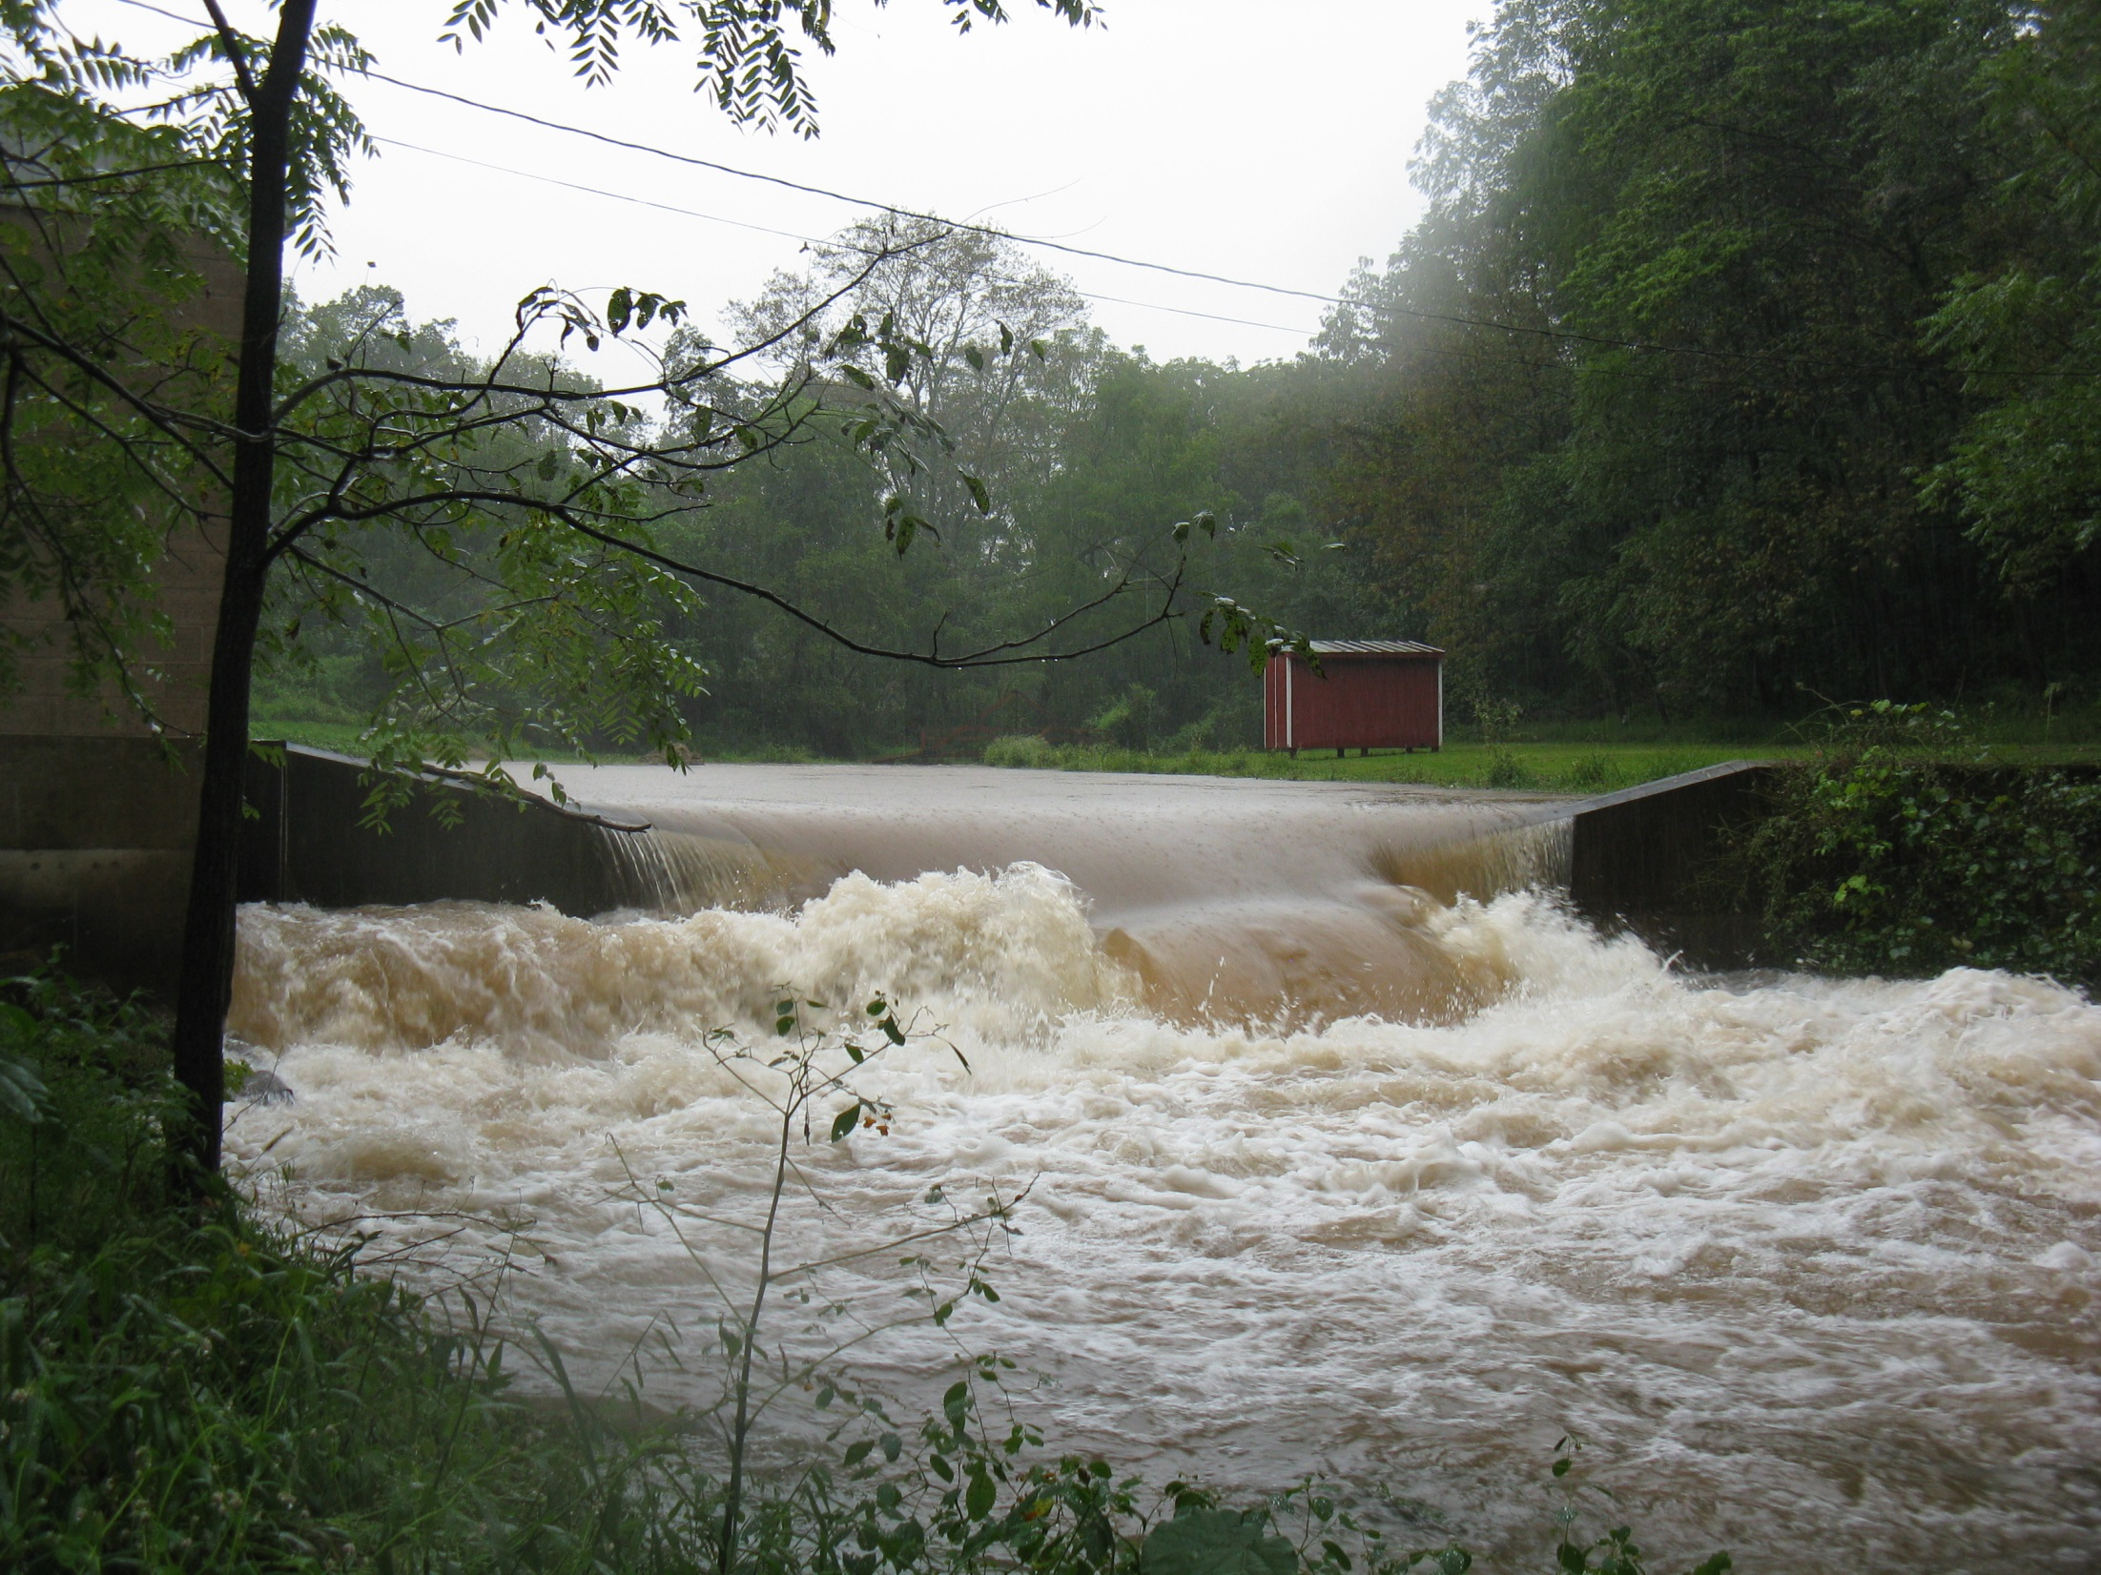


Consider the role of extreme rainfall events in nutrient loss from agricultural watersheds
Anthony Buda
USDA Agricultural Research Service
University Park, PA
STAC Workshop: Climate Change Modeling 2.0
September 24-25, 2018
Crowne Plaza Hotel
Annapolis, MD

Slide 2
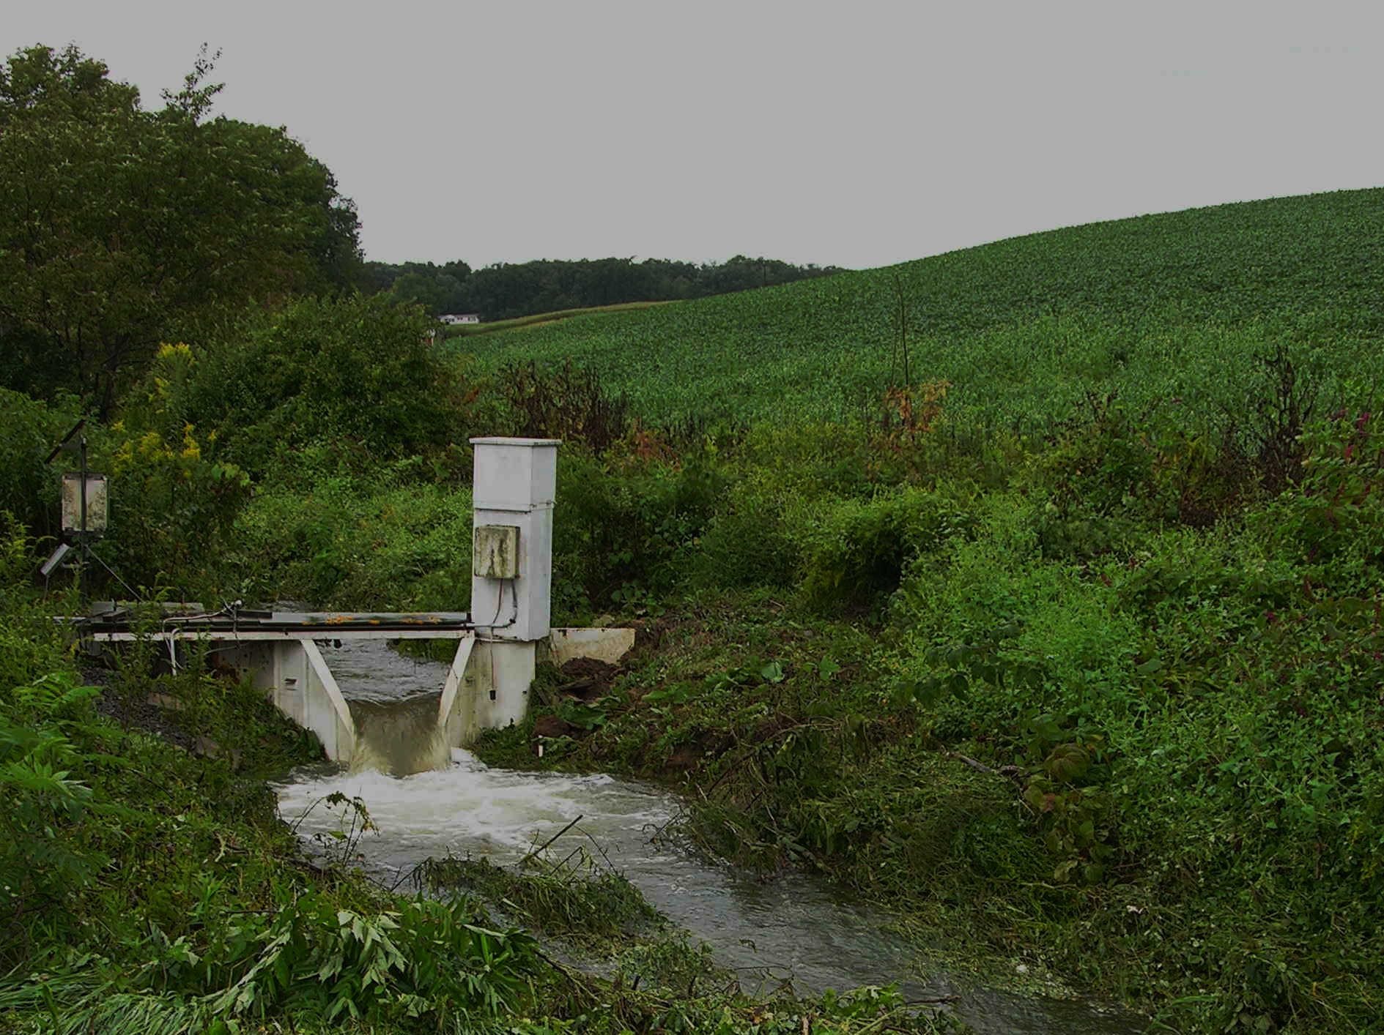
Case in point: Tropical Storm Lee in 2011
Lee contributed significantly to 2011 and decadal P loss
30.0
29.5
Tropical Storm Lee accounted for 21% of the P loss over the past decade.
2007-2016
P loss (kg)
15.0
9.8
Tropical Storm Lee accounted for 63% of the P loss in 2011.
2011
6.1
Lee
0.0

Slide 3
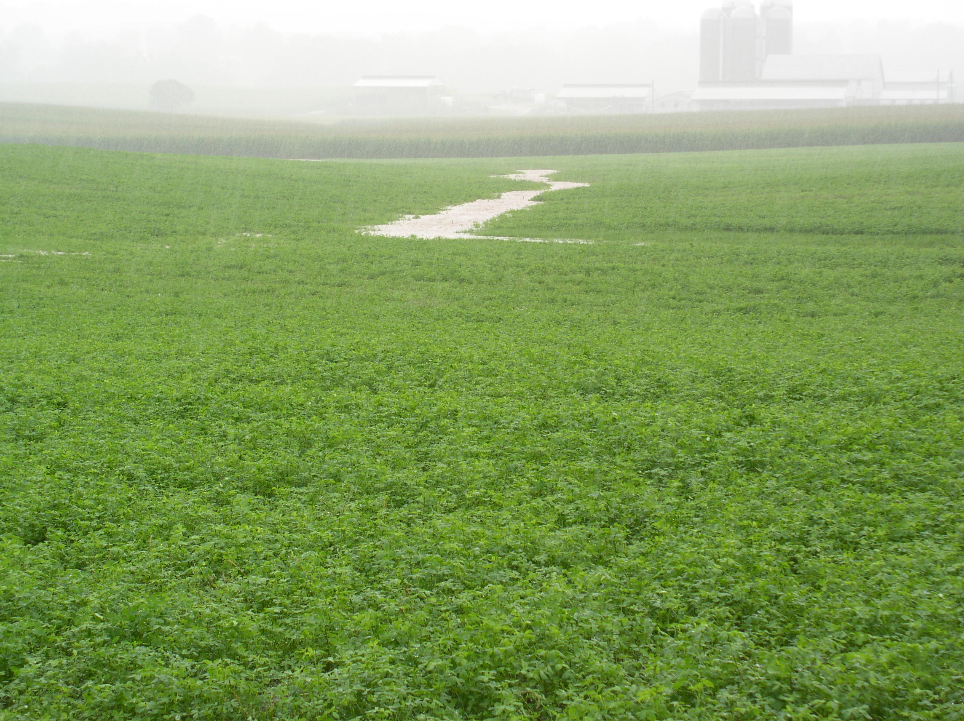

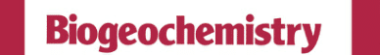


Extreme rainfall greatly affects N and P loss
BMPs need to be assessed in the context of weather extremes
Extreme precipitation and phosphorus loads from
two agricultural watersheds

