Slide 1
COVID Survey results
Survey was distributed to the Partnership and STAC Interested Parties

Slide 2
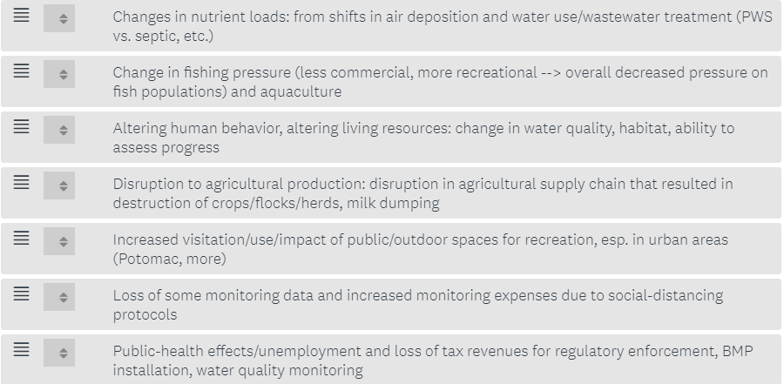
Rank highest priority out of stac’s top 7

Slide 3
Rank highest priority out of stac’s top 7: REsults
Top Choices:
(32% respondents voted as top priority): Public-health effects/unemployment and loss of tax revenues for regulatory enforcement, BMP installation, water quality monitoring
(20%) Altering human behavior, altering living resources: change in water quality, habitat, ability to assess progress
(20%): Increased visitation/use/impact of public/outdoor spaces for recreation, especially in urban areas
(13%) Changes in nutrient loads: from shifts in air deposition and water use/wastewater treatment

Slide 4
Rank highest priority out of stac’s top 7: REsults
Lowest Priority
(0% as top, 34% as last ranked): Change in fishing pressure; less commercial, more recreational→ overall decreased pressure on fish populations; aquaculture impacts
Categories with an even spread across priority results:
Disruption to agricultural production: disruption in agricultural supply chain that resulted in destruction of crops/flocks/herds, milk dumping
Loss of some monitoring data and increased monitoring expenses due to social-distancing (It is interesting this wasn’t a top priority– loss of monitoring data was mentioned multiple times in Question 2)

Slide 5
Are any important impacts on the Bay missing from this list?
Environmental Education: loss of opportunities for students to participate in field based environmental education; education programming losses because of limitations on in-person instruction; Disruptions in education and youth engagement that will lead to a greater shortage of science, technology, engineering and math ready graduates; impact to MWEEs; Sustainable schools/outdoor classrooms could actually get a bump because of increased awareness of indoor air quality/health considerations
Behavior/Attitude Change: increased use of disposable products; Public attitudes towards Bay and environment are key to most of these issues; long term effect of lifestyle changes (both positive and negative); land use change is important, as drivers of urban land use change have profound impacts on the bay land use model. e.g., people stop concentrating in urban areas and large lot development increases, core business districts are abandoned or turned into housing, what impacts do changes in land use due to covid long term have on loading from sectors?
Funding/Local Gov: Hearings can't occur, planning sessions can't be effectively held, etc. Inspections, brainstorming sessions, educational activities: all have been set back 6 to 12 months; Intensity of COVID impacts to budgets at the local government level; Agricultural profit loss, state and local funding all negatively affecting BMP implementation rates; loss of funding for monitoring/regulatory organizations; reduction in delivery of technical and in some financial resources to plan, design and implement BMPs; big loss in WV was opportunities to directly educate people and landowners of the importance of BMP implementation and water quality

Slide 6
Are any important impacts on the Bay missing from this list?
Nonprofits: volunteer watershed associations and non-profits may have trouble with retaining and recruiting members because there are no face-to-face opportunities.
Other:
  Abandoned Mine Drainage Impacts in the Headwater Tributaries
  Impacts on salinization of the Bay - has staying at home increased or decreased residential salt use in the winter? Any impacts from increased sanitization/disinfection usage? Are gray or green infrastructure projects being deferred and will this have any impact on Bay outcomes?
  Human health in general subtopic: connections between COVID, environment, and DEIJ (communities of color hit hardest by pandemic, communities of color having highest co-morbidities, communities of color having lower access to healthy green/open space (which contributes - maybe one small piece - to having highest co-morbidities and therefore highest COVID mortalities)

Slide 7
What risks, changes in the Bay, and learning opportunities do you see in the short and long-term due to COVID-19?
  Outdoor Access: people are more aware of and appreciative of outdoor resources; purchased kayaks and fishing gear which they may now make use of more often; More recreational use equals more dumping, environmental abuse, etc; survey of watershed residents that explores their evolving relationship with the Bay as they were either forced to stay home and entertain themselves outdoors or had more time to do so because they worked from home; Leverage this new found interest in recreational space and subsistence fishing/hunting/foraging. Seems like an opportunity for outreach and community engagement that clearly connects citizen value of these experiences to the need for investing in these amenities; increased non-point source inputs to the bay from people being outdoors; a study that analyzes water quality and living resource data for the months that watershed residents stayed home and off their boats
  BMP Implementation/WIPs: Lack of BMP implementation due to government funding shortfalls; Revenue shortfall to states and local government resulting in their ability to achieve WIP III goals; increased impacts to accelerating on the ground BMP implementation; re-prioritizing of staffing and financial resources; new business and field practices to minimize exposure; Reduced agriculture and urban BMP implementation. Potential increase in nutrients to local waterways as a result; be decreased group or one-on-one interaction with farmers which could lead to a decrease in outreach / education opportunities and possibly BMP implementation rates. This could also possibly affect BMP Verification Programs as far as "on-farm" visits
  Going virtual: it would be interesting to think about how much decreased human activity (even just commuting) has had on the health of the Bay and whether a period of brief inactivity could be a strategy for decreasing human caused effects on the Bay; Virtual interactions have been largely effective, and we have seen a huge dip in carbon emissions (affecting both atmospheric deposition and climate change). What does this mean for CBP meetings?

Slide 8
What risks, changes in the Bay, and learning opportunities do you see in the short and long-term due to COVID-19?
  DEIJ: COVID-19 cases in vulnerable communities. Environmental factors increasing symptoms or virus impact; A concentration on public health, access to open space and DEIJ issues is very well timed with current events and provides and opportunity to show some attention to minority communities;
  Education/Nonprofit: More limited and difficult outreach, education, and volunteer opportunities with limited participation numbers for gatherings and volunteer work. Basically loss of momentum; Equity is highlighted: some have access some don’t; Considerable struggles for the nonprofit community, which affects all programs -- but perhaps disproportionately those that full under the Citizen Stewardship portfolio
  Behavior Change: This is a natural experiment in human behavior change. What were the changed behaviors and what was their impact? How is this likely to change behavior in the future in ways that affect the ecosystem? For example, how did remote work affect driving? Does this have an effect on the spatial organization of the built environment in the future and what are the follow-on effects on the Bay?; The enormity of the reach of the pandemic and the spread of its repercussions may have given the population a greater feel and understanding of the relative dangers of Global Warming and climate change, and the need to work together, and recognize the need for US leadership
  Other:
    how air quality change due to COVID has changed nutrient loading from air deposition. Use that as an "experiment" to model air quality policy Learning opp - because of the above, a better ability to connect the air quality (Clean Air Act) and water quality (Clean Water Act) worlds
    CV-19 has elevated awareness of failed urban infrastructure (sanitary and storm sewer systems). It would be great to see more attention and funding directed toward these hidden infrastructure as both pollution source and public health crisis

