Slide 1
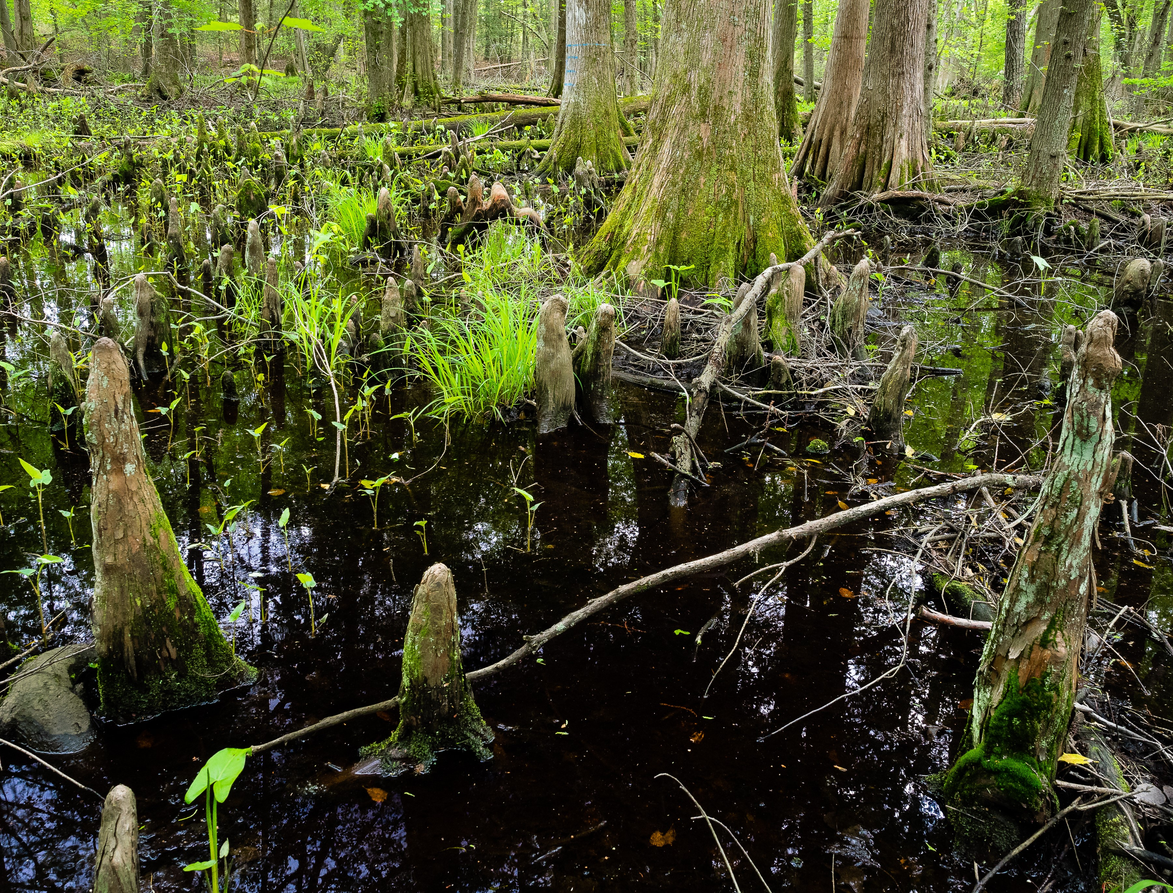
Importance of Landowner Outreach and Engagement to Accelerating Conservation Practice Adoption Case Studies from Chesapeake Bay Amy Jacobs, Mike Dryden, Katie Turner The Nature Conservancy STAC Stakeholder Workshop January 26, 2021

Slide 2
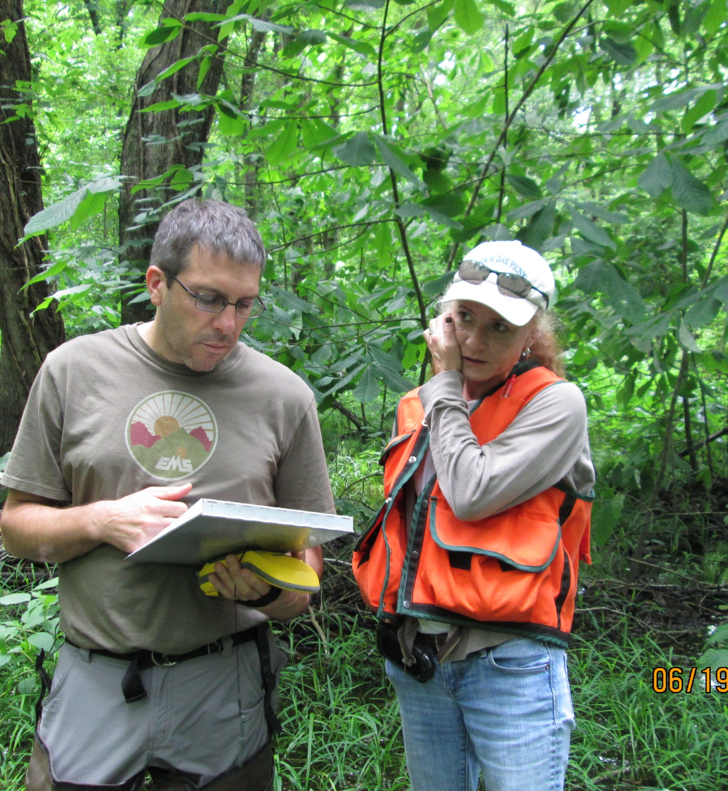
Overview
Engaging agricultural landowners and operators is critical to meeting our conservation goals
Outreach is a large portion of conservation practitioners' efforts
Outreach and engagement is complex and difficult to evaluate
Working together we can find ways to accelerate our efforts

Slide 3
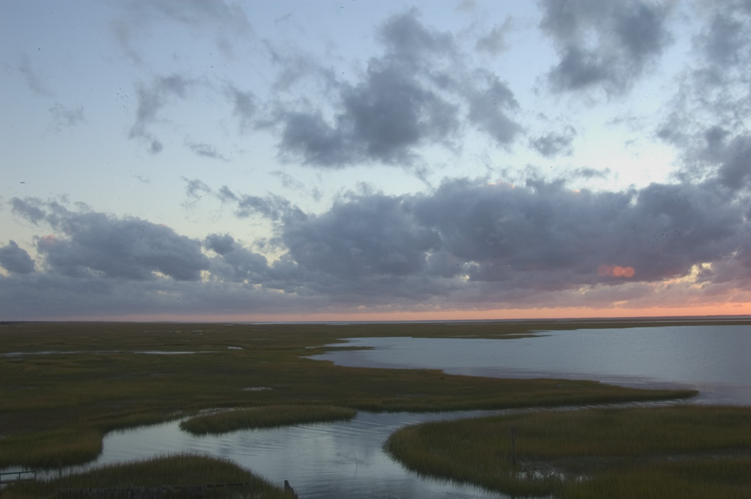
© Hal Brindley.com
Notes:
Robinson Neck

Slide 4
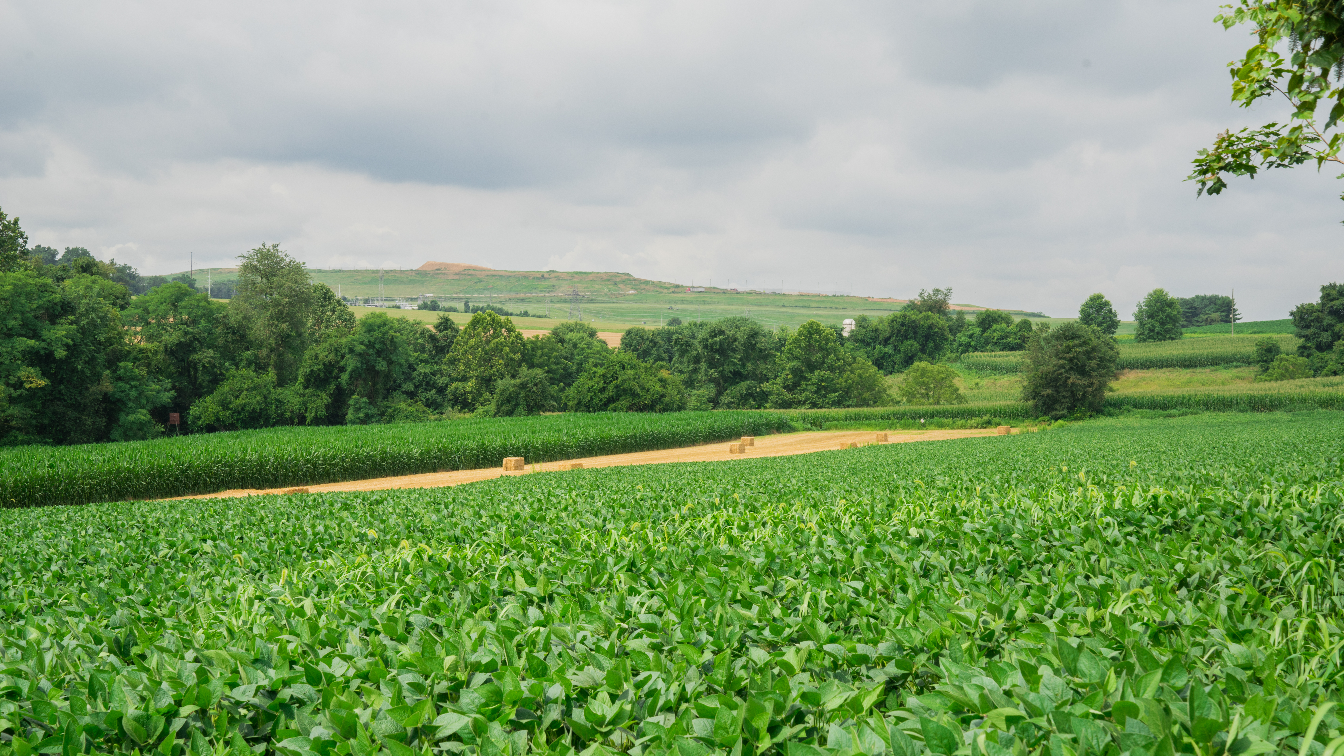
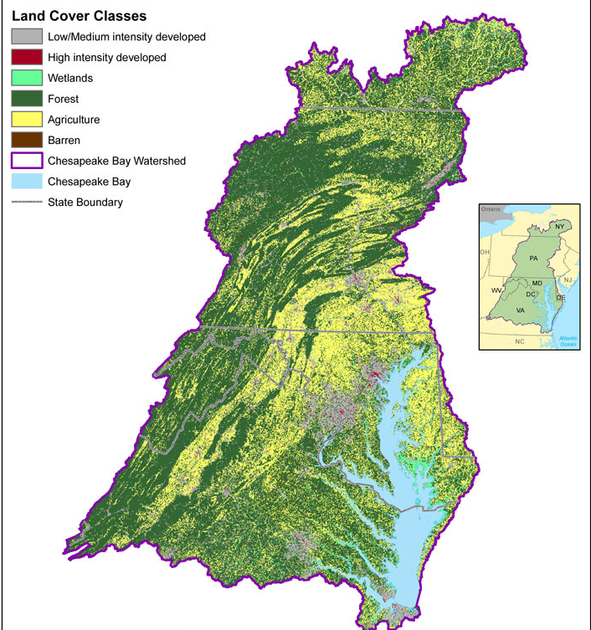

Slide 5
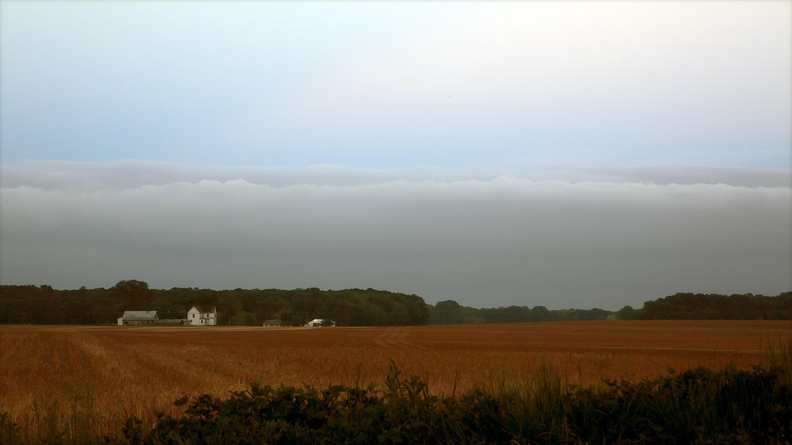
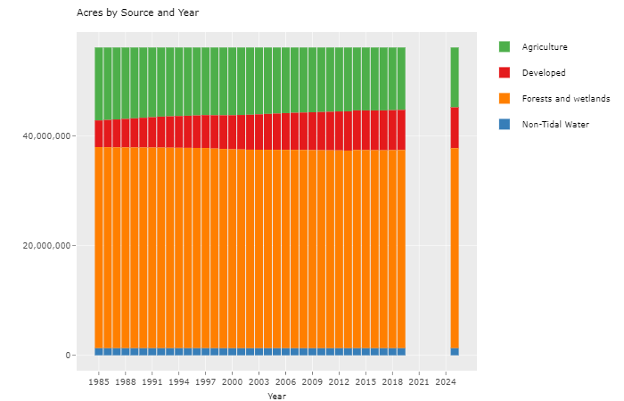
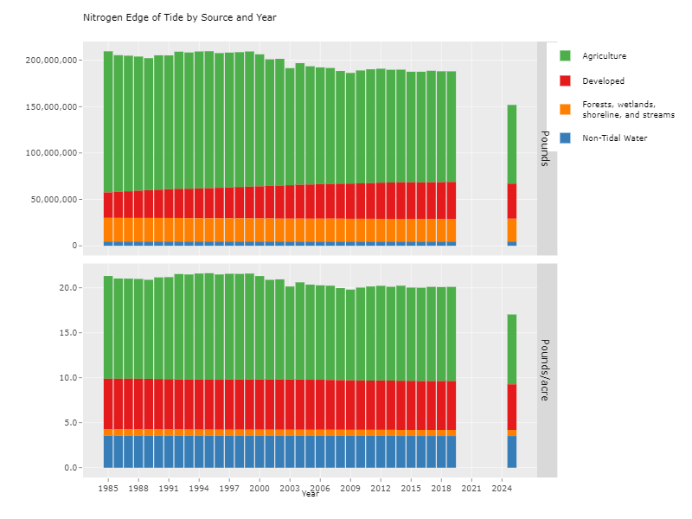
Agriculture in Chesapeake Bay Watershed
Notes:
Ag will make or break meeting clean water goals
56M acres total in watershed, 11.4M in Ag or 20% of land
Contributing almost ¾ of the load

Slide 6
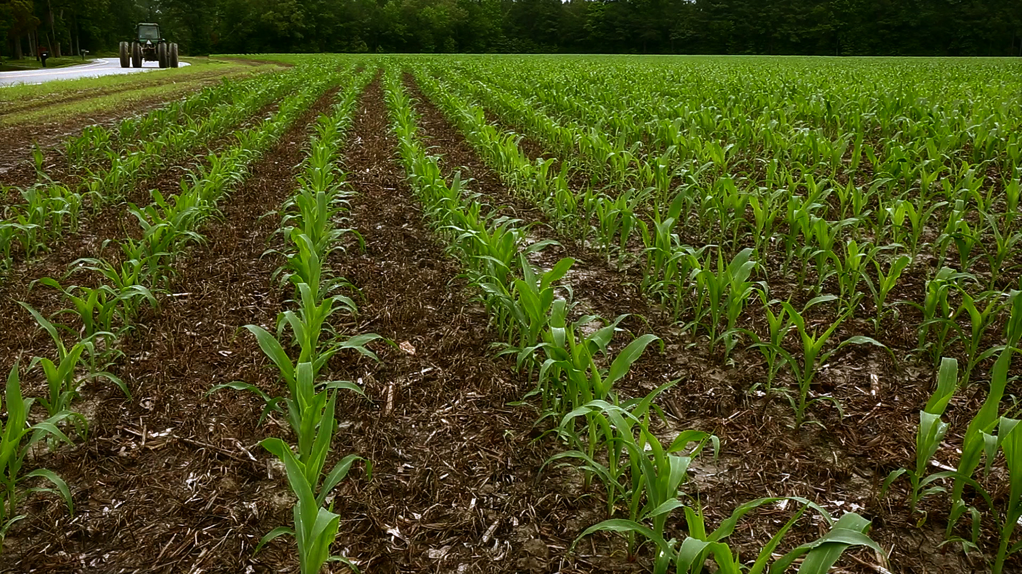
@Steve Droter

Slide 7
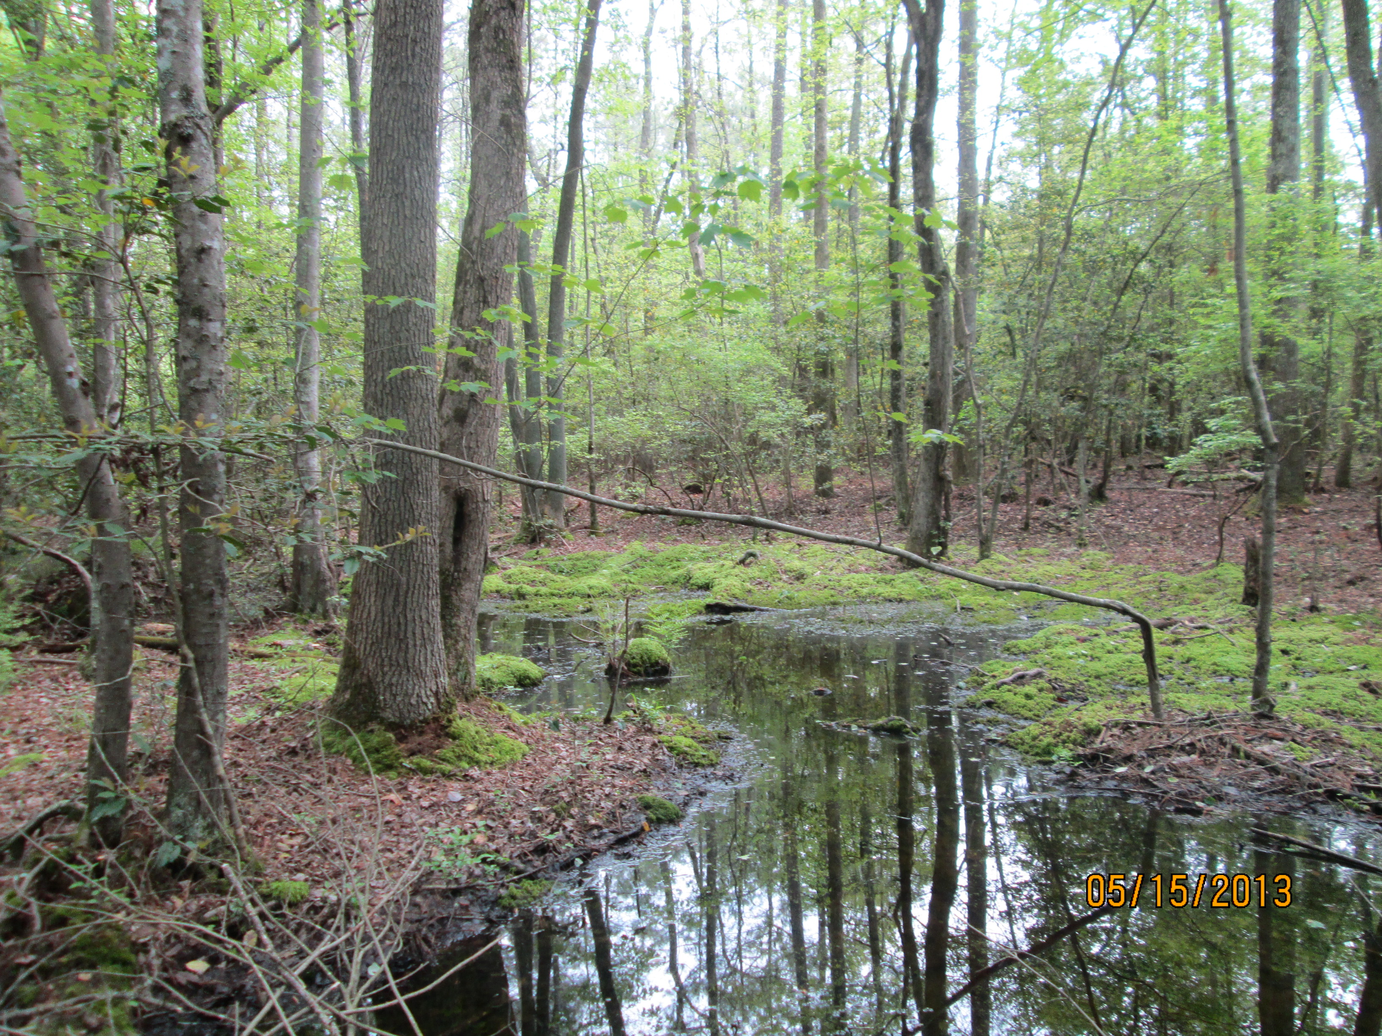
Notes:
Nanticoke headwater

Slide 8
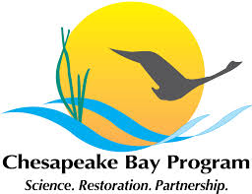
Chesapeake Bay Wetland Restoration Goal
85,000 ac. Goal Restoration
(150,000 Rehabilitation)
Notes:
Project background – need to accelerate restoration toward CB wetland goals – less than 20% of goal

Slide 9
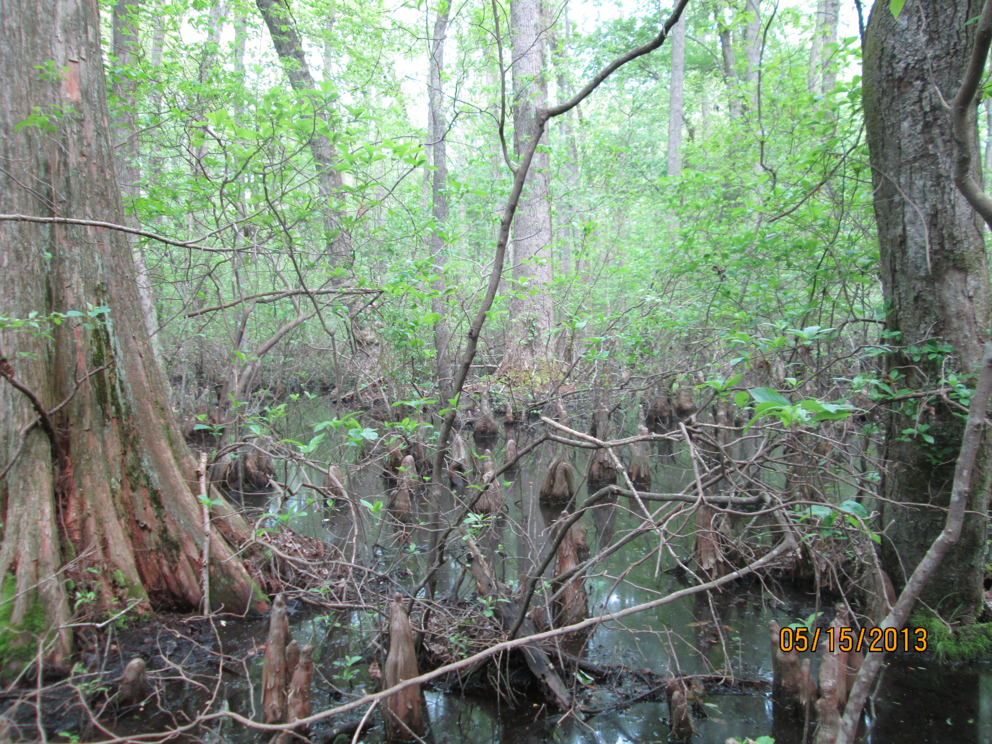
1M Acres of Restorable Wetlands
11M Acres of Cropland and Pasture
720k Acres of Wetlands for Rehabilitation/ Enhancement
Notes:
Nassawango

Slide 10
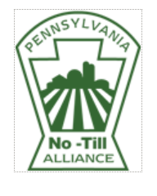
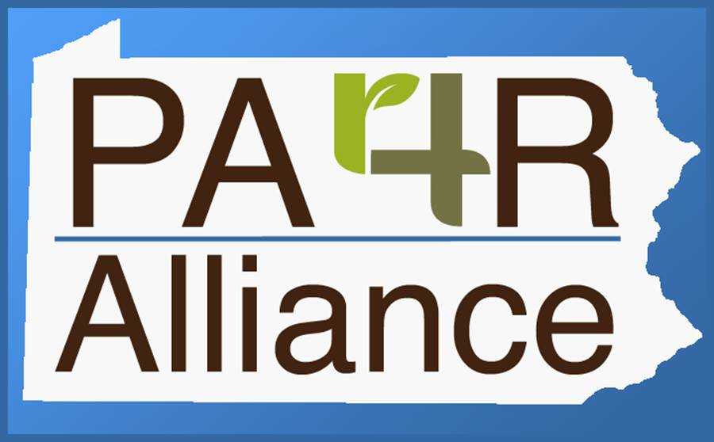
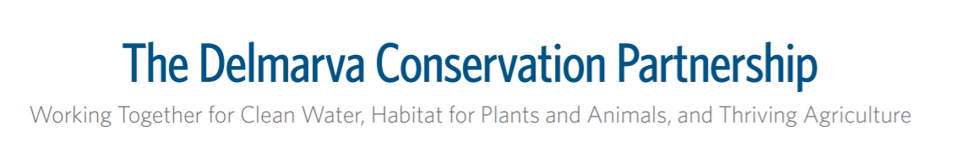
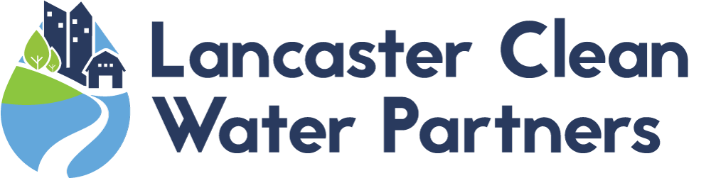
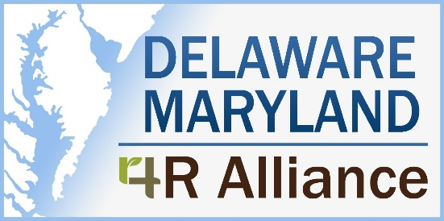
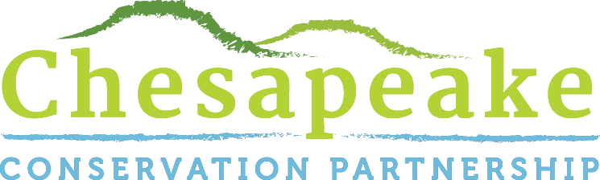


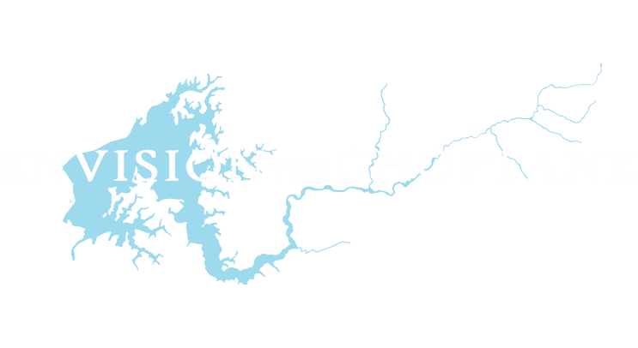
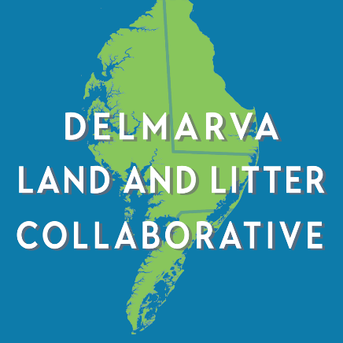
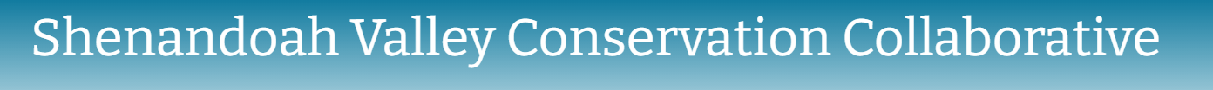
Notes:
Envision and black duck

Slide 11
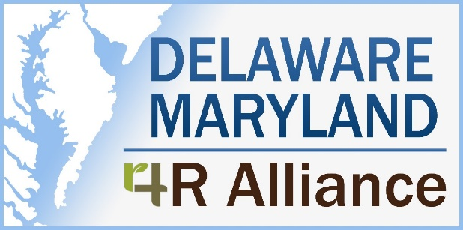
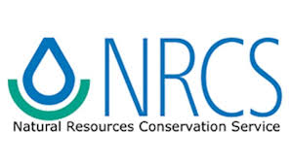




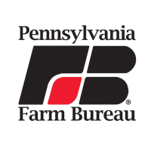
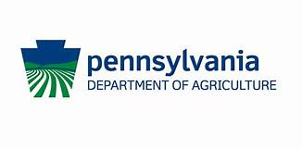


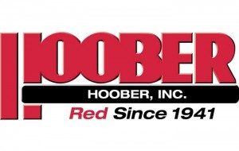
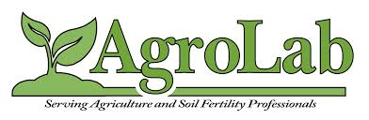
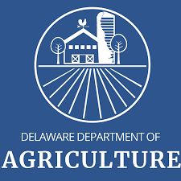
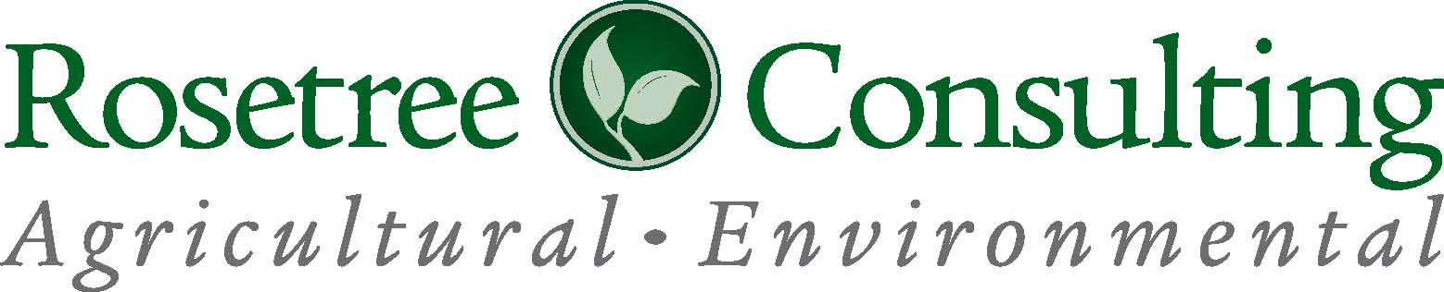
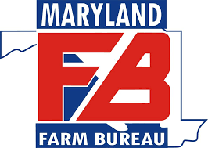

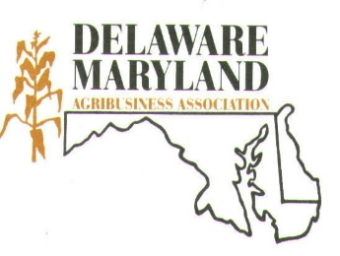

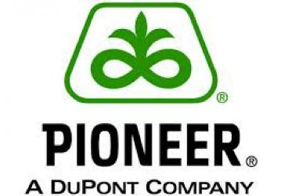
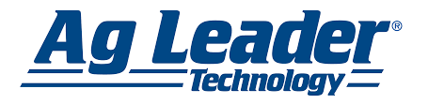

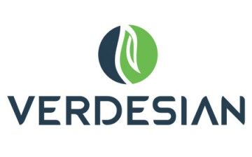
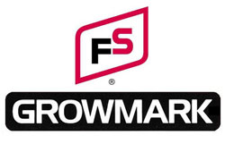


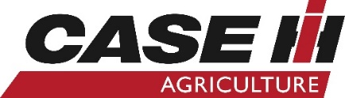
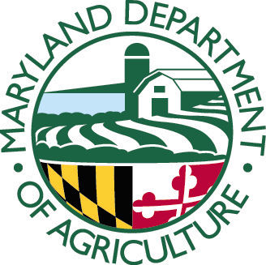
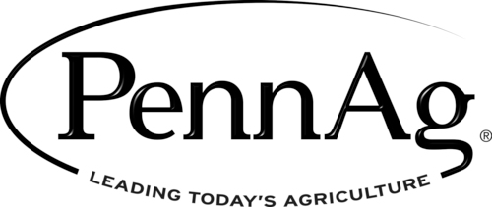


Slide 12
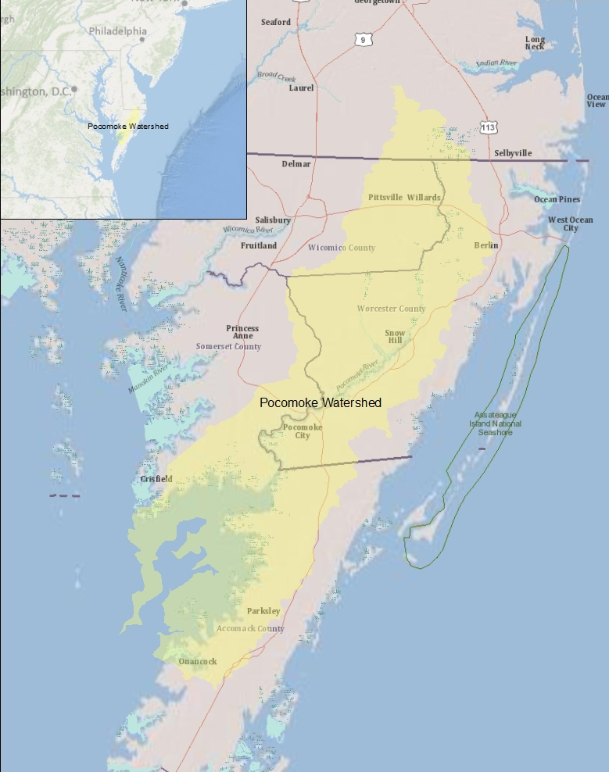

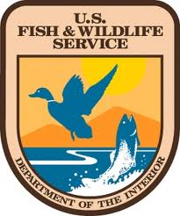
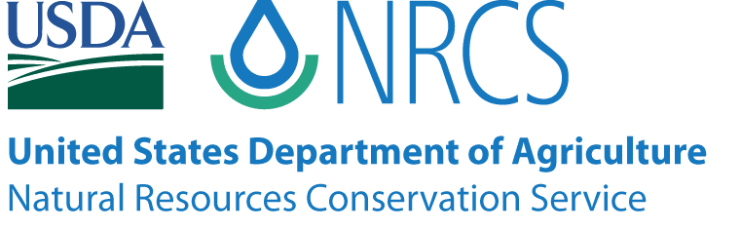
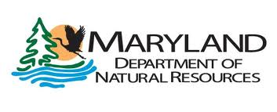
Pocomoke Watershed

Slide 13
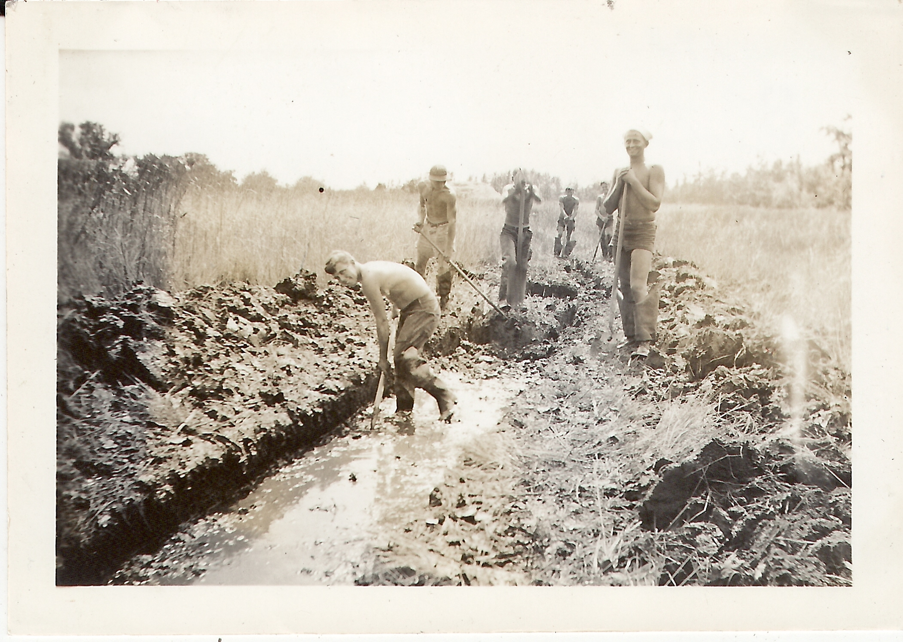
Notes:
Early 1900’s – Channel modification using dynamite
1940’s – Civilian Conservation Corps (CCC) channel straightening and dredging
1950’s to 1970’s – Public drainage ditches constructed on tributaries

Slide 14
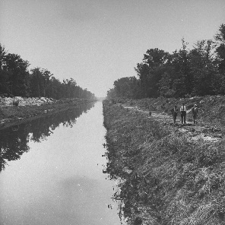
Getty Images
Notes:
Channelization shortened the river by almost 3 miles
1,100 miles of ditches

Slide 15
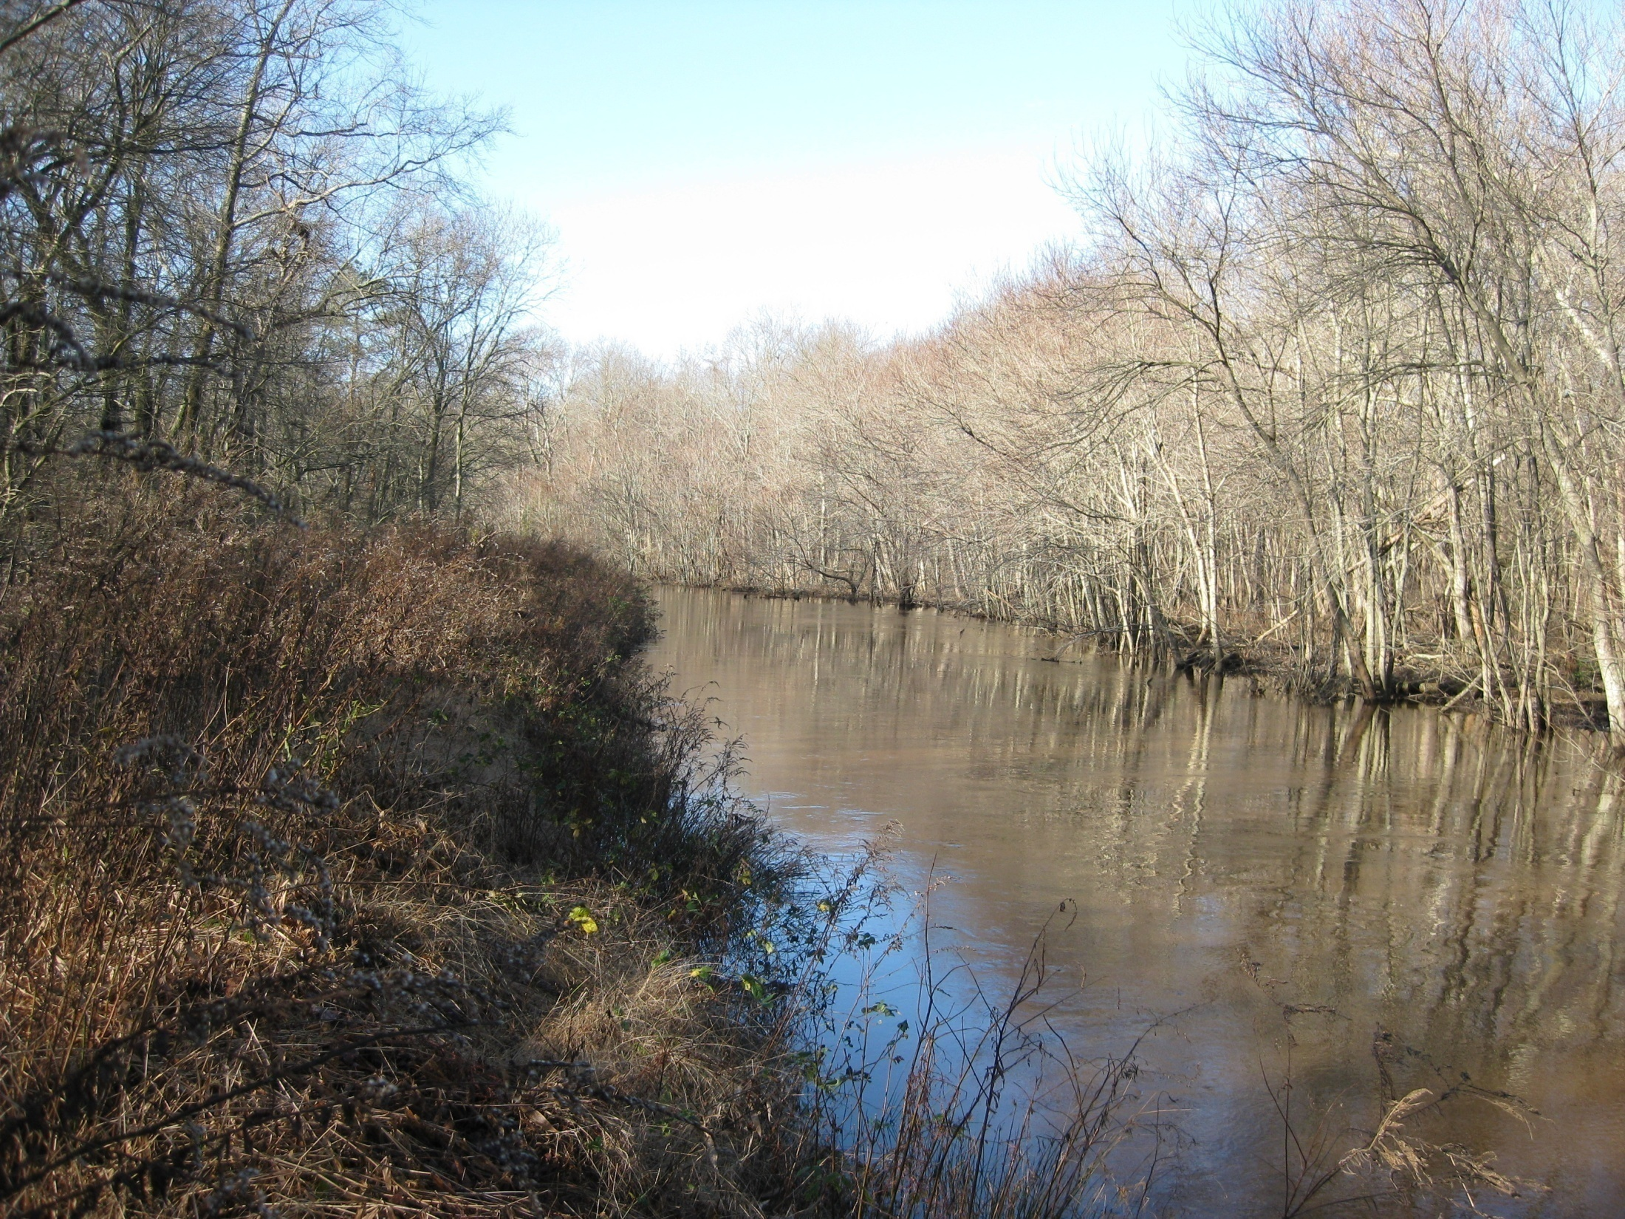

Slide 16
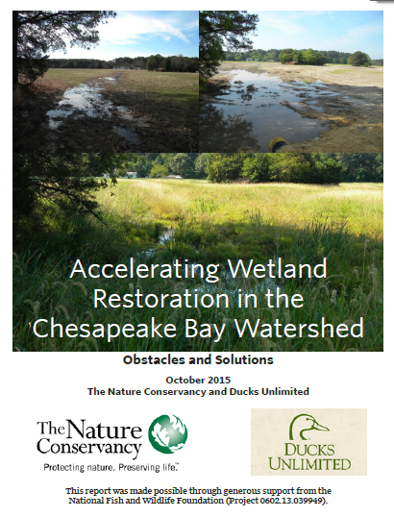


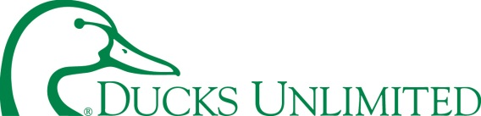
Wetland Stakeholder Survey
Interviewed >70 stakeholders involved in wetland restoration in VA, PA, MD, DE
Report on 5 Categories of Obstacles to Accelerating Wetland Restoration
Recommend solutions to overcome each obstacle

Slide 17
Wetland Stakeholder Survey
Outreach Solutions
Obstacles
Focus funding to priority areas
Designate a local leader for outreach and coordination
Host annual cross-training for wetland practitioners
Develop better marketing strategies
Invest in market research to evaluate the need to change incentive values
Limited funding
Outreach is limited/ not coordinated
Programmatic or Institutional
Permitting
Limited Approaches to Restoring Wetlands

Slide 18
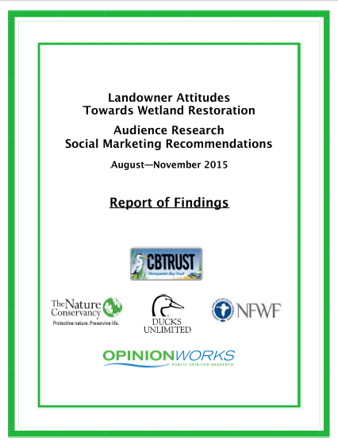


Agricultural Landowner Survey
August 2015
409 Agricultural Landowners MD and PA
Parcels >40ac.
Wetland Workgroup

Slide 19
Agricultural Landowner Survey
About 40% of landowners were not aware of programs to assist with restoring and/or protecting wet areas or natural habitat.
Multiple reasons that landowners would be interested in restoring wetlands from financial payments, water quality, habitat, etc.
Wetland Workgroup

Slide 20
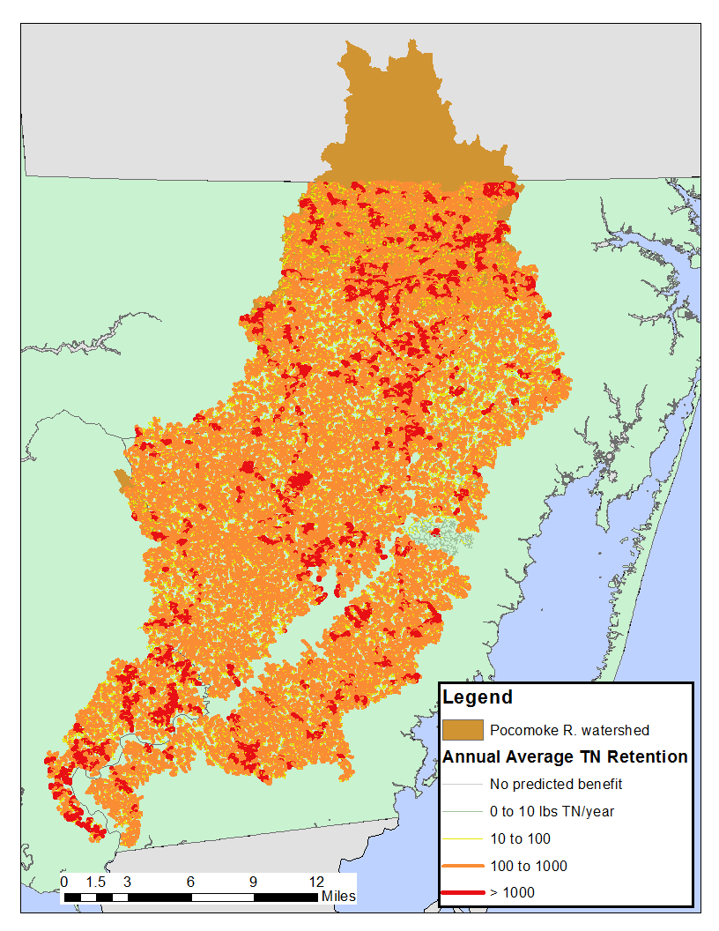
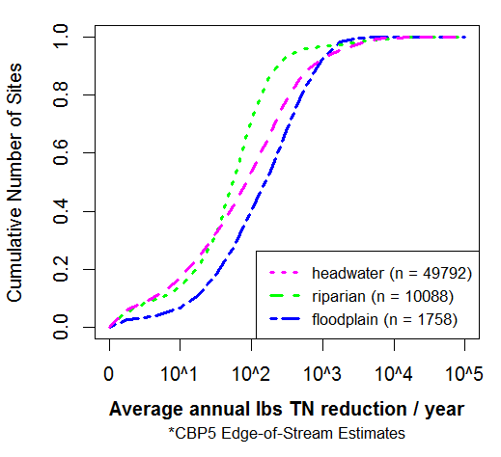
Targeting for Greatest Returns on Investments
50 lbs./year
150 lbs./year
Percentile | TN Retention per Acre per Year
50 | 65
90 | 250
Boomer, K. unpublished

Slide 21

Pocomoke Project Area
3,400 acres (more than 5 square miles) of floodplain disconnected from river
9.3 miles of dredged and straightened channel
Notes:
2011 LiDAR digital elevation model, Used to identify floodplain boundary, spoil levees and existing breaks in levee

Slide 22


Notes:
So depending on the location, we may only need 1 or 2 landowners to participate in order to restore a floodplain restoration area.
Some parcels are more critical than others because they occur in multiple restoration areas, or because they are the parcels that contain the spoil levee.
The main point is that we do not need everyone to participate to have a successful projects. We can restore the floodplain in discrete units.
But we would appreciate if everyone was supportive and wanted to participate, of course.

Slide 23


Awareness

Slide 24

Dedicated outreach capacity
Commitment
Responsive to meet with landowners
Capacity to follow-up
Time to listen to and address concerns
Mike Dryden, The Nature Conservancy
Notes:
Concerns? How to address?

Slide 25

Adoption
Portfolio of Program Options
10-year Agreement
Consent for Adjacent Restoration
Engineering/ Design Support
Survey/ Access Support

Slide 26
Landowner Interest in Restoration
 | Parcels | Acres | % of Area | % of Parcels
Interested | 49 | 2,994 | 88% | 75%
No Contact | 5 | 27 | <1% | 8%
Declined | 11 | 379 | 11% | 17%
Total | 65 | 3,400

Slide 27





© DelawareWildLands, Inc.
3,756 Acres
Wetlands Restored or in Process in Pocomoke Watershed since 2014

Slide 28
Targeted outreach results in greater enrollment in priority areas
Dedicated capacity to perform outreach and follow-through with interested landowners increases enrollment in restoration programs.
Providing restoration program options that meet landowners’ goals increases enrollment in restoration.
Research needed to consolidate efforts and evaluate various types of incentives
Amy Jacobs, ajacobs@tnc.org
Mike Dryden, mdryden@tnc.org
© Hal Brindley.com
Notes:
Include findings from Blackduck project, WREP, etc.

Slide 29
How to Scale Efforts to meet Conservation Goals?
Hire additional capacity
Expand network of TSPs “selling” programs
Increase broadscale outreach to drive landowners to NRCS offices
Increase incentives to increase interest in programs

Slide 30

Notes:
Pocomoke Watershed

Slide 31

Landowner Interest by Program
 | Parcels | Acres | % of Area
Interested | 49 | 2,994
NRCS/ WRE | 19 | 1,122 | 37%
TNC | 11 | 397 | 13%
Public | 8 | 917 | 31%
Restoration Only | 4 | 202 | 7%
Not eligible | 7 | 356 | 12%

Slide 32

Pocomoke Watershed 1,100 miles of ditches Shortened river by 3 miles
Notes:
LiDAR 1-meter resolution digital elevation model.
The high resolution lidar data was used to identify floodplain boundaries, drainage features, spoil levees and existing breaks in the levees, and topographical boundaries (e.g. roads, levees) between floodplain areas.

