Slide 1
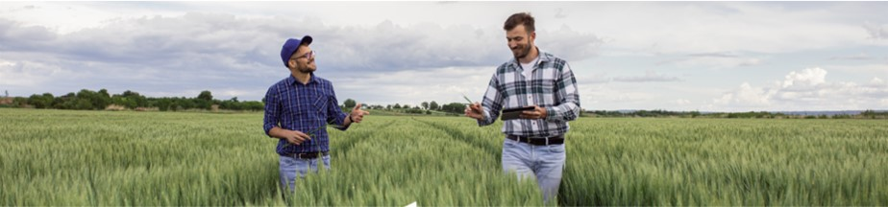




Advancing Outreach Effectiveness to Improve Conservation Practice Adoption
Thank you sponsors!

Slide 2
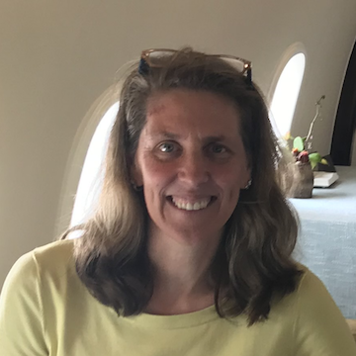
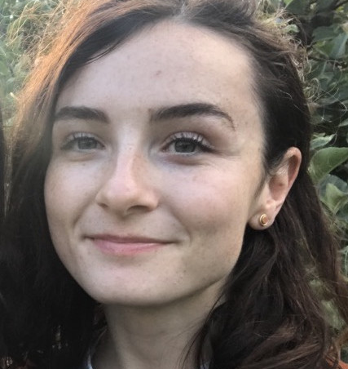
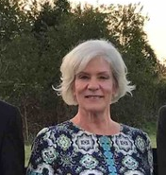
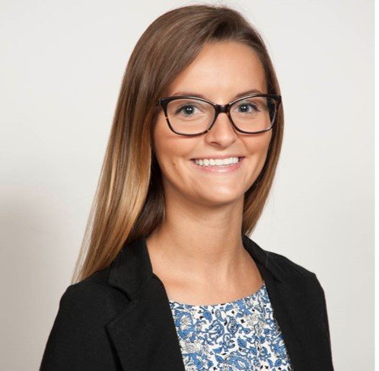
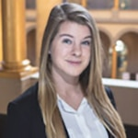
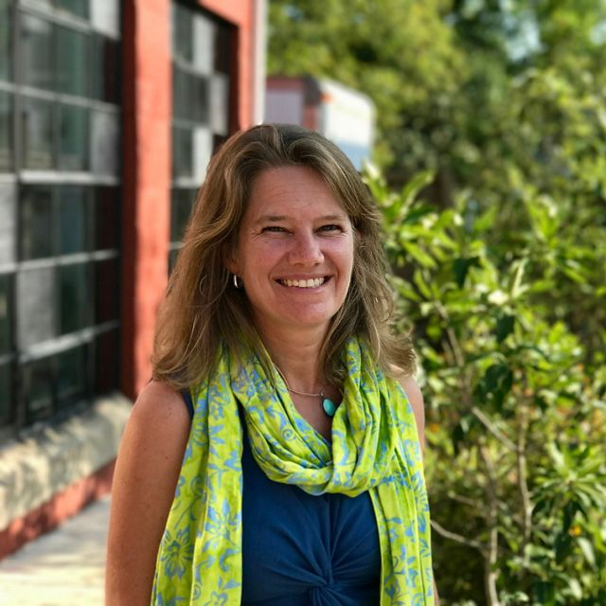
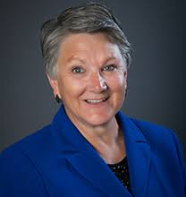
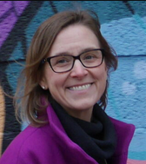
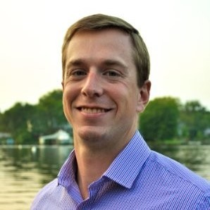
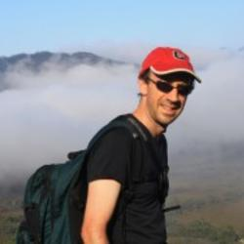
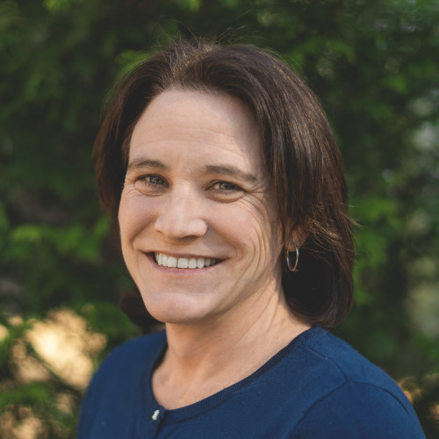
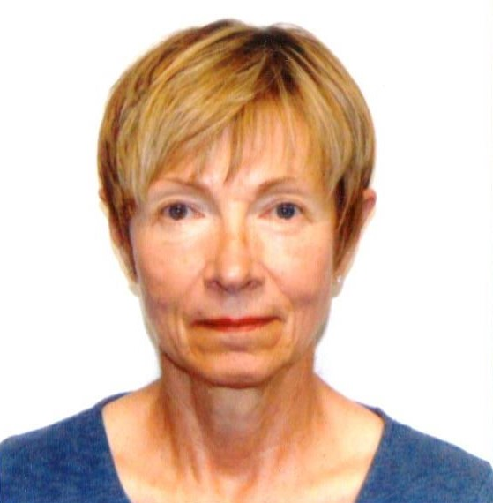
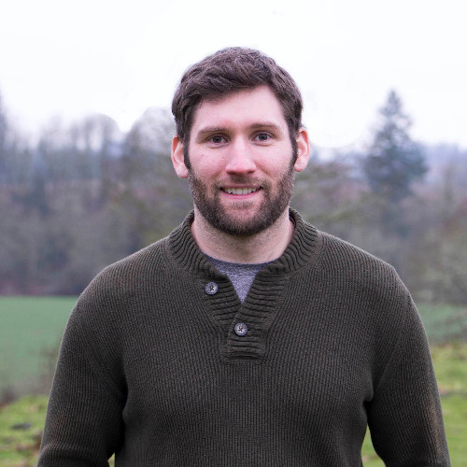
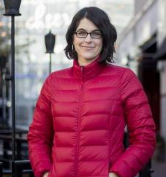
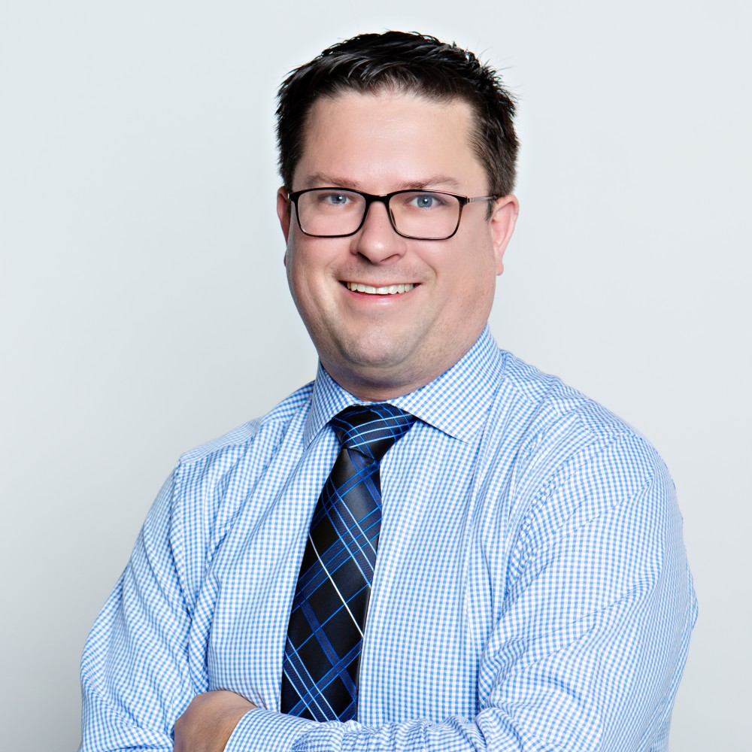
Advancing Outreach Effectiveness to Improve Conservation Practice Adoption
Workshop Steering Committee Members:
Kathy Boomer
FFAR
Meg Cole
CBP STAC
Christine Conn
MD DNR
Annabelle Harvey
CBP STAC
Cordelia Hiers
FFAR
Amy Jacobs
TNC
Rochelle Krusemark USFRA
Sarah Preisser
Mindset Talent
Jake Reilly
NFWF
Michael Runge
USGS
Allison Thomson
Field to Market
Jan Urban-Lurain
Spectra Data and Research
Collin Weigel
JHU/TNC
Robyn Wilson
OSU
Paul Wolfe
Walton Family Foundation
Thank you!

Slide 3
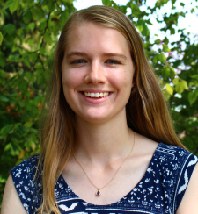
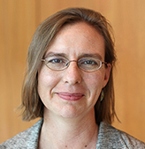
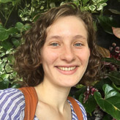
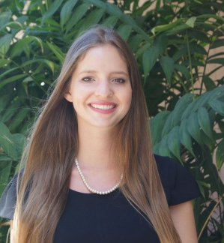
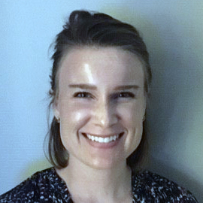
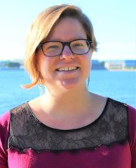
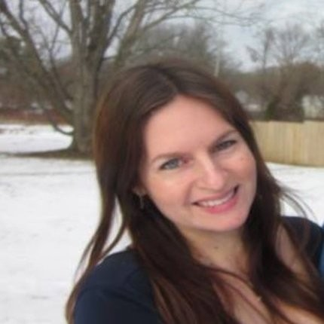
Advancing Outreach Effectiveness to Improve Conservation Practice Adoption
Workshop Facilitators and Note Takers:
Maggie Beetstra
OSU
Christine Conn
MD DNR
Lara Fowler
Penn State
Julianna Greenberg
EPA
Maile Hartsook
FFAR
Lauren Hershey
FFAR
Cordelia Hiers
FFAR
Amy Jacobs
TNC
Michael Runge
USGS
Taryn Skinner
WWF
Allison Thomson
Field to Market
Katie Walker
Chesapeake Conservancy
Collin Weigel
JHU/TNC
Paul Wolfe
Walton Family Foundation
Thank you!

Slide 4
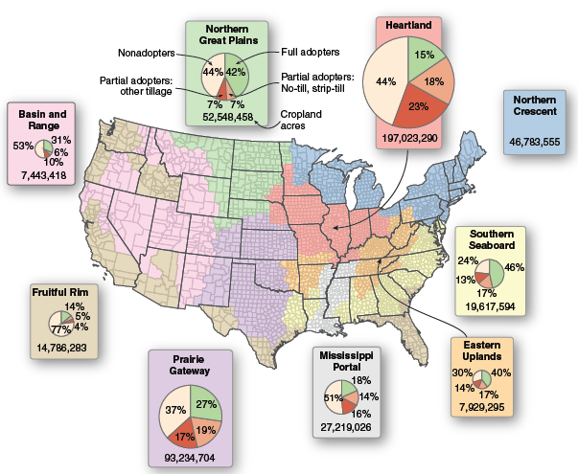
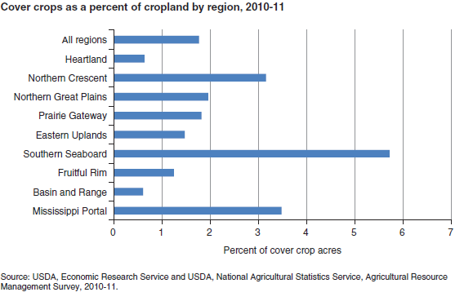
Advancing Conservation Practice Adoption:
Why this Workshop - Low Infield Practice Adoption Rates
Lots of opportunity to advance soil and watershed restoration goals,

Slide 5
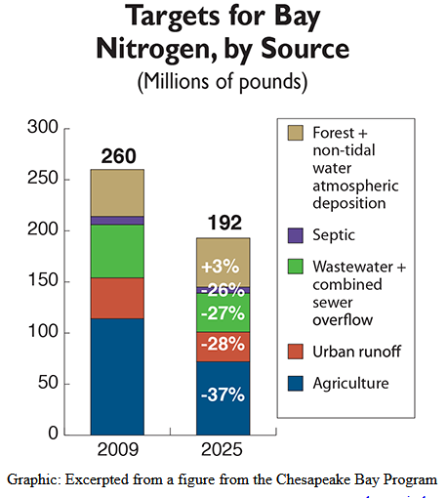
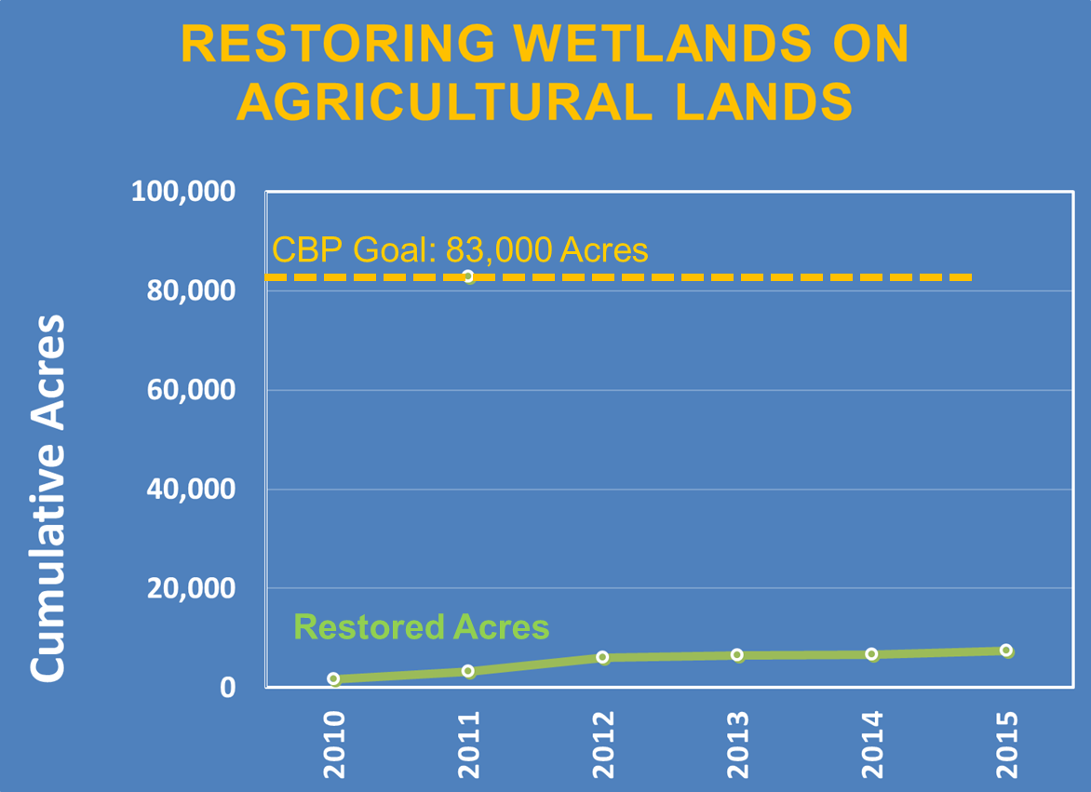
Advancing Conservation Practice Adoption: Why this Workshop – Slow Progress toward Restoration Goals
… and a critical need to advance soil and watershed restoration goals,

Slide 6
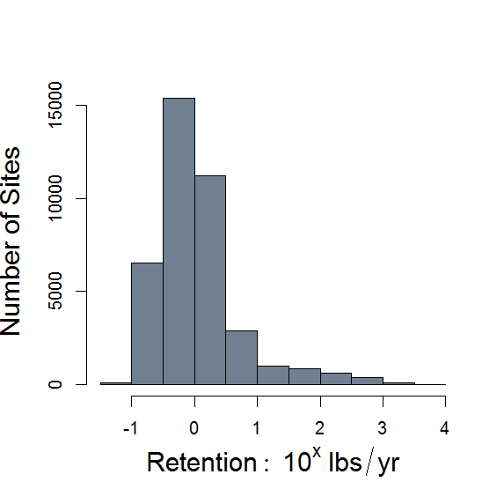
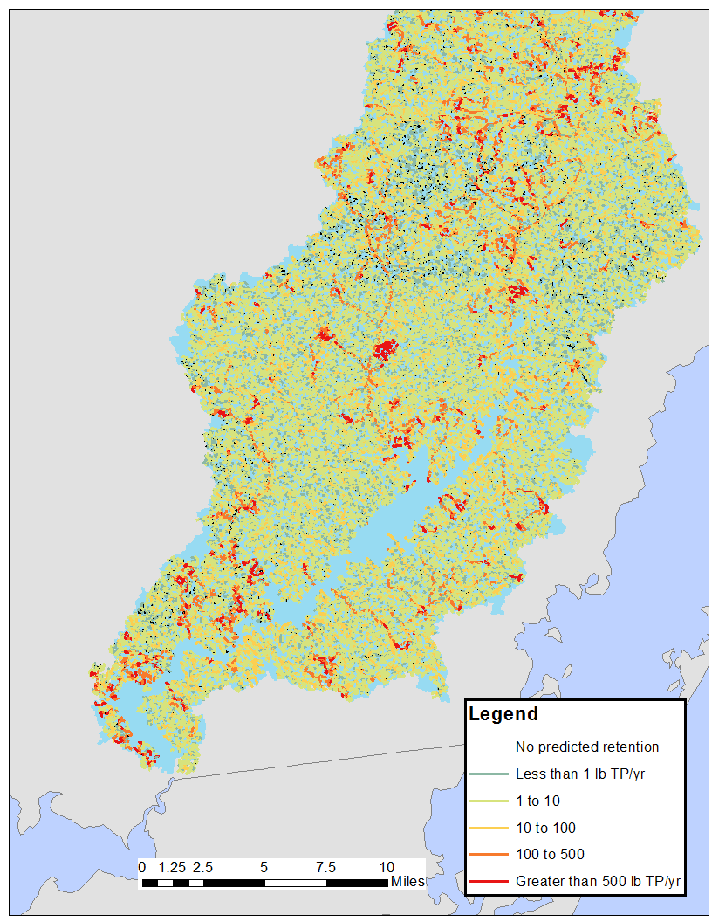
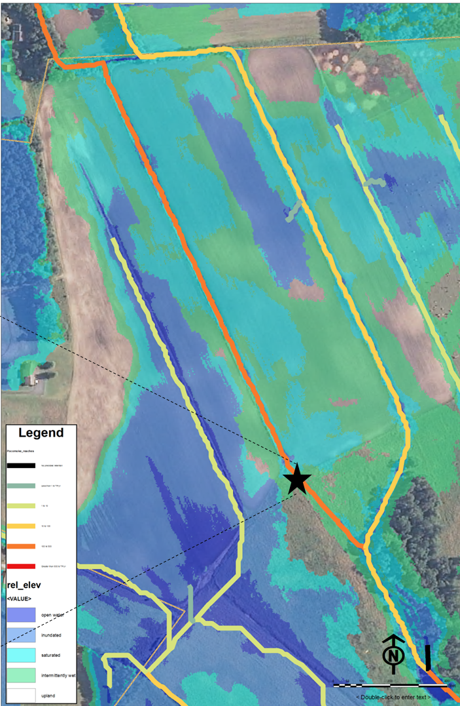
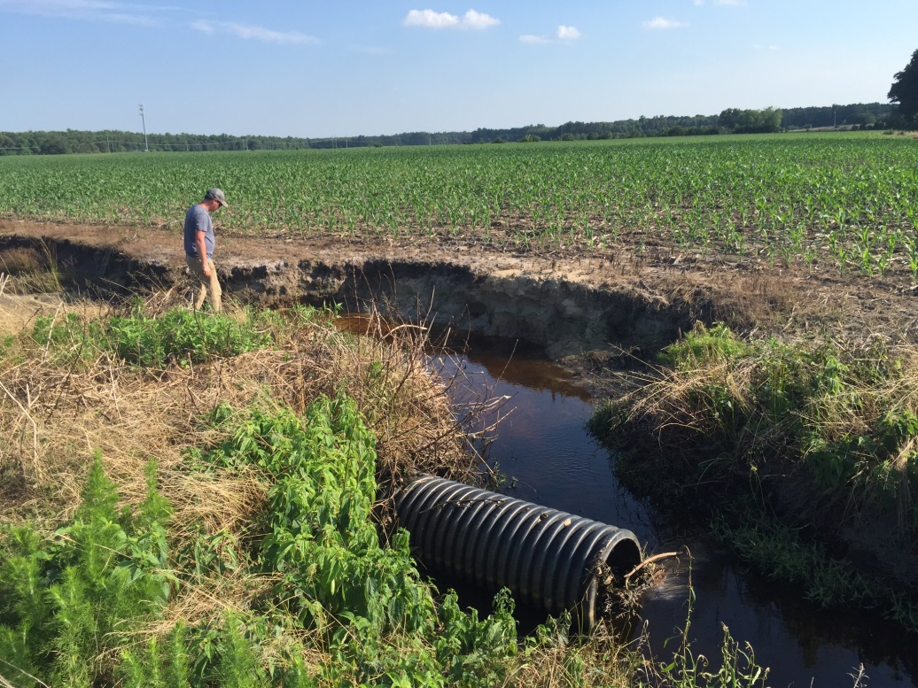
Advancing Conservation Practice Adoption: Why this Workshop – Targeted Implementation is Essential
Predicted Wetland TP Retention Benefit
Percentile | TP Retention lbs per site per year
50 | < 1
95 | 32 (1,966 sites)
n = 39,177!
640 Square Mile Project…
1/100 of Chesapeake Bay Watershed
How do we advance conservation practice adoption in high priority locations?

Slide 7
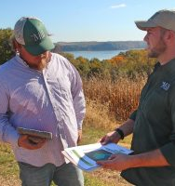

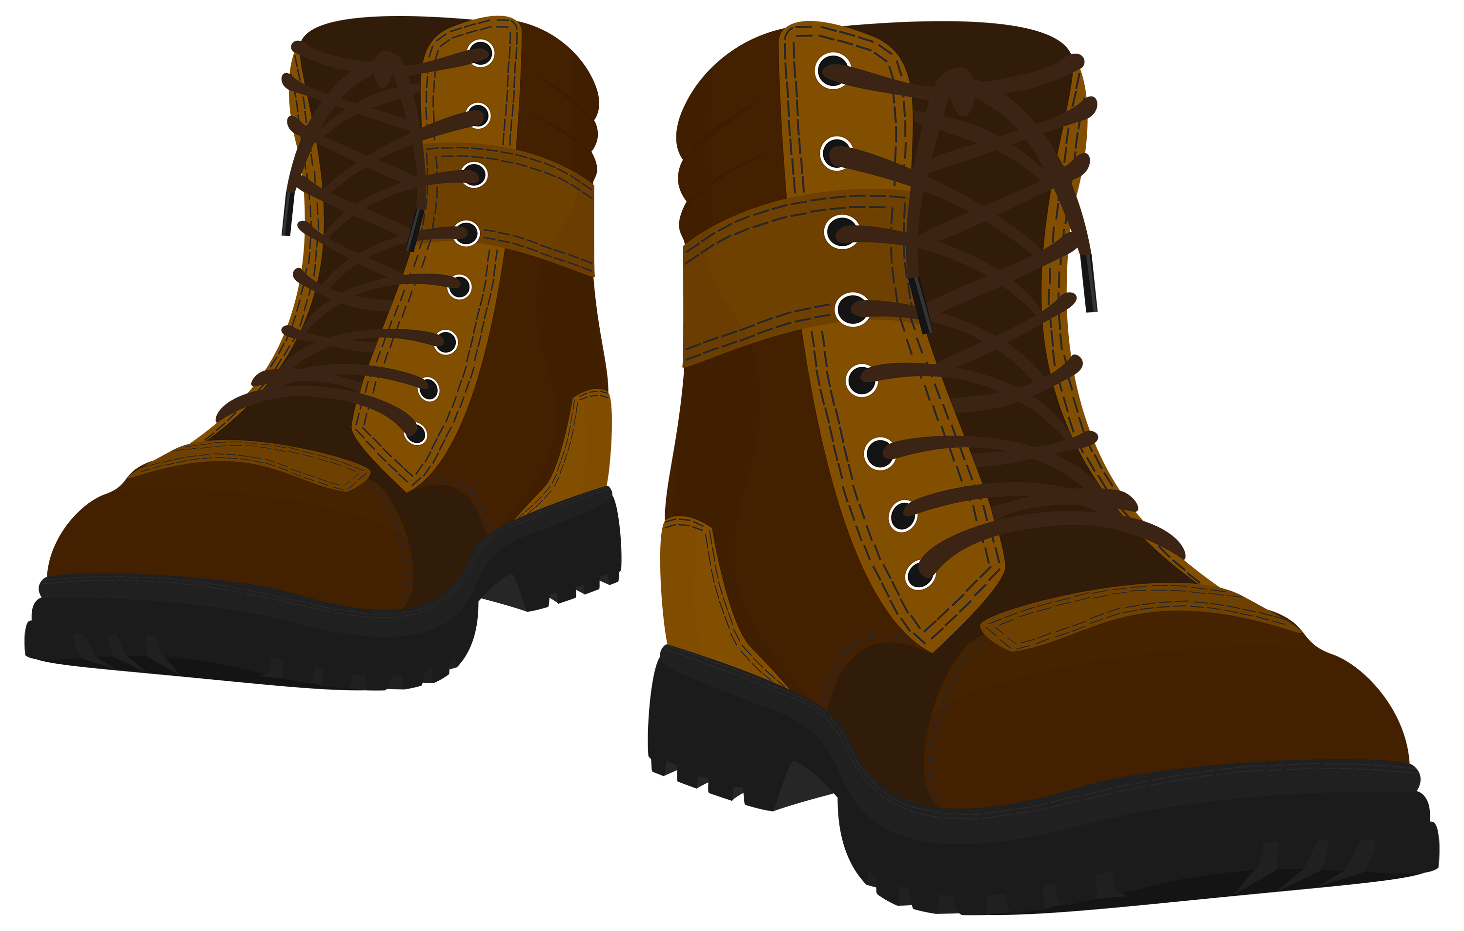
Advancing Outreach Effectiveness to Improve Conservation Practice Adoption
Workshop Objectives:
Share insights, knowledge & experience to advance conservation practice adoption.
Explore alignment between outreach strategies and farmer concerns related to conservation practice adoption.
Identify knowledge gaps and collaborative opportunities to advance soil and watershed health.
Photo Credit: Gates Rhodes for
The Nature Conservancy

Slide 8
Advancing Outreach Effectiveness to Improve Conservation Practice Adoption: Workshop Strategy
Workshop Objectives:
Share insights, knowledge & experience
Explore alignment between outreach strategies and farmer concerns related to conservation practice adoption.
Identify knowledge gaps and collaborative opportunities to advance soil and watershed health.
SESSION I: Welcome & Introductions
SESSION II: Understanding Concerns and Priorities
SESSION III: Assessing Potential to Influence Operator Decisions
SESSION IV: Outreach Exchange
SESSION V: Cross-walking Perspectives and Tying It Together
SESSION VI: Key Take-Aways
1/26
1/27
1/28

Slide 9
Advancing Outreach Effectiveness to Improve Conservation Practice Adoption
January 26 – 28, 2021
Targeted Workshop Outcomes:
Spark new friendships, ideas and perspectives; spark collaborations.
Inform outreach practitioners or technical service providers how best to address farmers concerns related to conservation practice adoption
  Guide decisions related to allocation of effort and selection of strategies
Converge upon key knowledge gaps that can initialize public-private partnerships to advance conservation practice adoption.

Slide 10
Advancing Outreach Effectiveness to Improve Conservation Practice Adoption: Agenda for January 26th
SESSION I: Welcome & Introductions
9:30 Welcome and Workshop Kick-Off
9:40 Introduction to FFAR and NFWF – Sally Rockey, Jake Reilly
10:00 The Story of the Pocomoke River Restoration and this Workshop Genesis – Amy Jacobs, TNC
10:20 Breakout Discussion: Participant Introductions & Survey Orientation
10:40 Break - 5 minutes
10:45 Introduction to the Workshop Discussion Framework
Understanding Adoption of Agricultural Conservation Practices (Linda Prokopy, Purdue University)
Overview of Workshop Set-Up (Kathy Boomer, FFAR)
Workshop Logistics & Tech Overview
11:15 Break - 15 minutes

