Slide 1

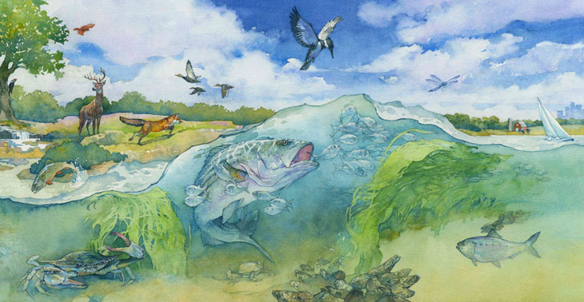
Chesapeake Bay Program Strategic Science & Research Framework Update
Emily Trentacoste, STAR Co-Coordinator
STAC Quarterly Meeting
9/16/2020

Slide 2
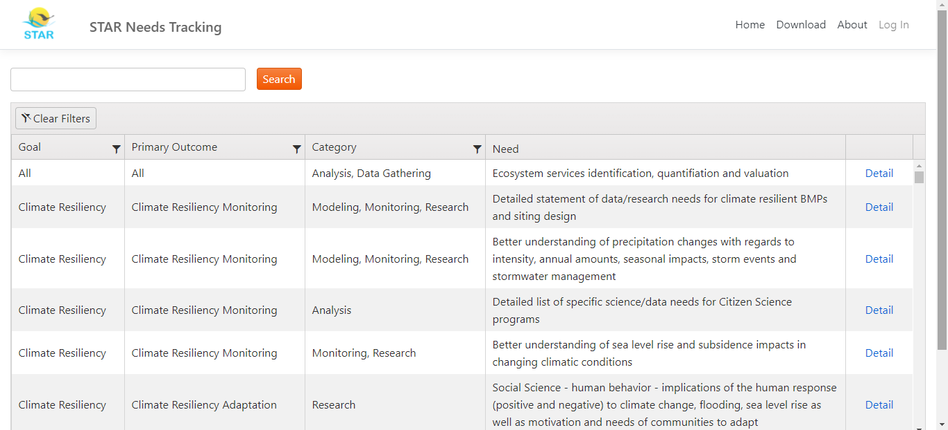
Developing online science needs database

Slide 3
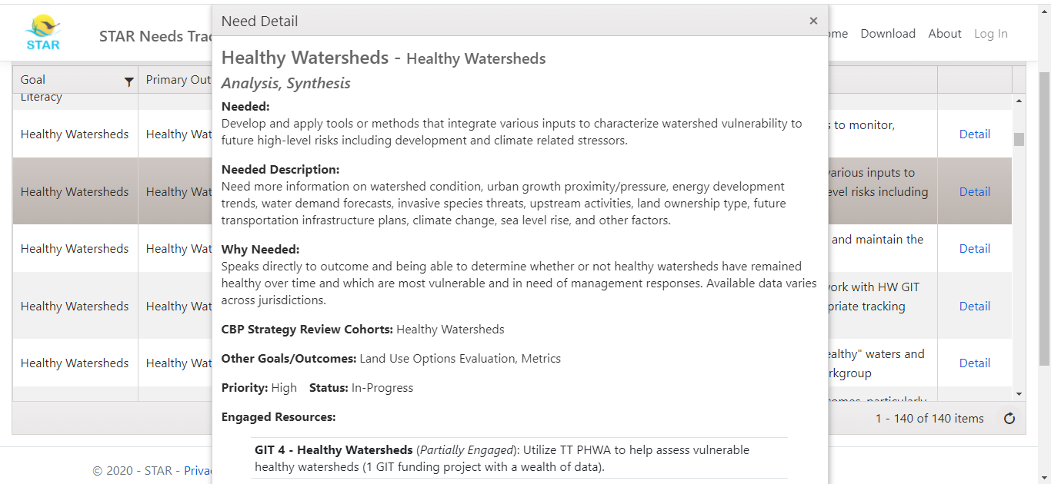
Developing online science needs database

Slide 4
Next-Generation Stewards Cohort
Chesapeake Watershed Agreement Goal: Environmental Literacy
Outcomes in this cohort:
    Environmental Literacy Planning
    Student
    Sustainable Schools

Slide 5
Next-Gen Stewards cohort SRS schedule
STAR science needs discussion
Management Board review
Management Board follow-up
Final workplan materials due
STAC science needs discussion
May
June
July
August
September

Slide 6
Up next: Clean Water Cohort
Outcomes in the Clean Water cohort:
  2025 Watershed Implementation Plans
  Water Quality Standards Attainment & Monitoring
  Toxic Contaminants Research
  Toxic Contaminants Policy & Prevention
  Forest Buffers

Slide 7
Clean Water cohort SRS schedule
STAC members encouraged to participate
STAR science needs discussion: Sept 24
STAC science needs discussion
Management Board review
Management Board follow-up
Final workplan materials due
August
September
October
November
December

Slide 8
Clean Water Cohort
2025 Watershed Implementation Plans: By 2025, have all practices and controls installed to achieve the Bay’s dissolved oxygen, water clarity/submerged aquatic vegetation and chlorophyll a standards as articulated in the Chesapeake Bay TMDL document.
Water Quality Standards Attainment & Monitoring: Continually improve the capacity to monitor and assess the effects of management actions being undertaken to implement the Bay TMDL and improve water quality. Use the monitoring results to report annually to the public on progress made in attaining established Bay water-quality standards and trends in reducing nutrients and sediment in the watershed.

Slide 9
Clean Water Cohort
Toxic Contaminants Research: Continually increase our understanding of the impacts and mitigation options for toxic contaminants. Develop a research agenda and further characterize the occurrence, concentrations, sources and effects of mercury, polychlorinated biphenyls (PCBs) and other contaminants of emerging and widespread concern. In addition, identify which best management practices might provide multiple benefits of reducing nutrient and sediment pollution as well as toxic contaminants in waterways.
Toxic Contaminants Policy & Prevention: Continually improve practices and controls that reduce and prevent the effects of toxic contaminants below levels that harm aquatic systems and humans. Build on existing programs to reduce the amount and effects of polychlorinated biphenyls (PCBs) in the Bay and watershed. Use research findings to evaluate the implementation of additional policies, programs and practices for other contaminants that need to be further reduced or eliminated.

Slide 10
Clean Water Cohort
Forest Buffers: Continually increase the capacity of forest buffers to provide water quality and habitat benefits throughout the Chesapeake Bay watershed. Restore 900 miles of riparian forest buffers per year and conserve existing buffers until at least 70 percent of riparian areas in the watershed are forested.

