Slide 1
Chesapeake Bay Program Communications Team
Discover the Chesapeake
State of the Chesapeake
Learn the Issues
In the News
Style Guide
Media Toolkits
Products
Multimedia
Social Media
Notes:
Discover

Slide 2
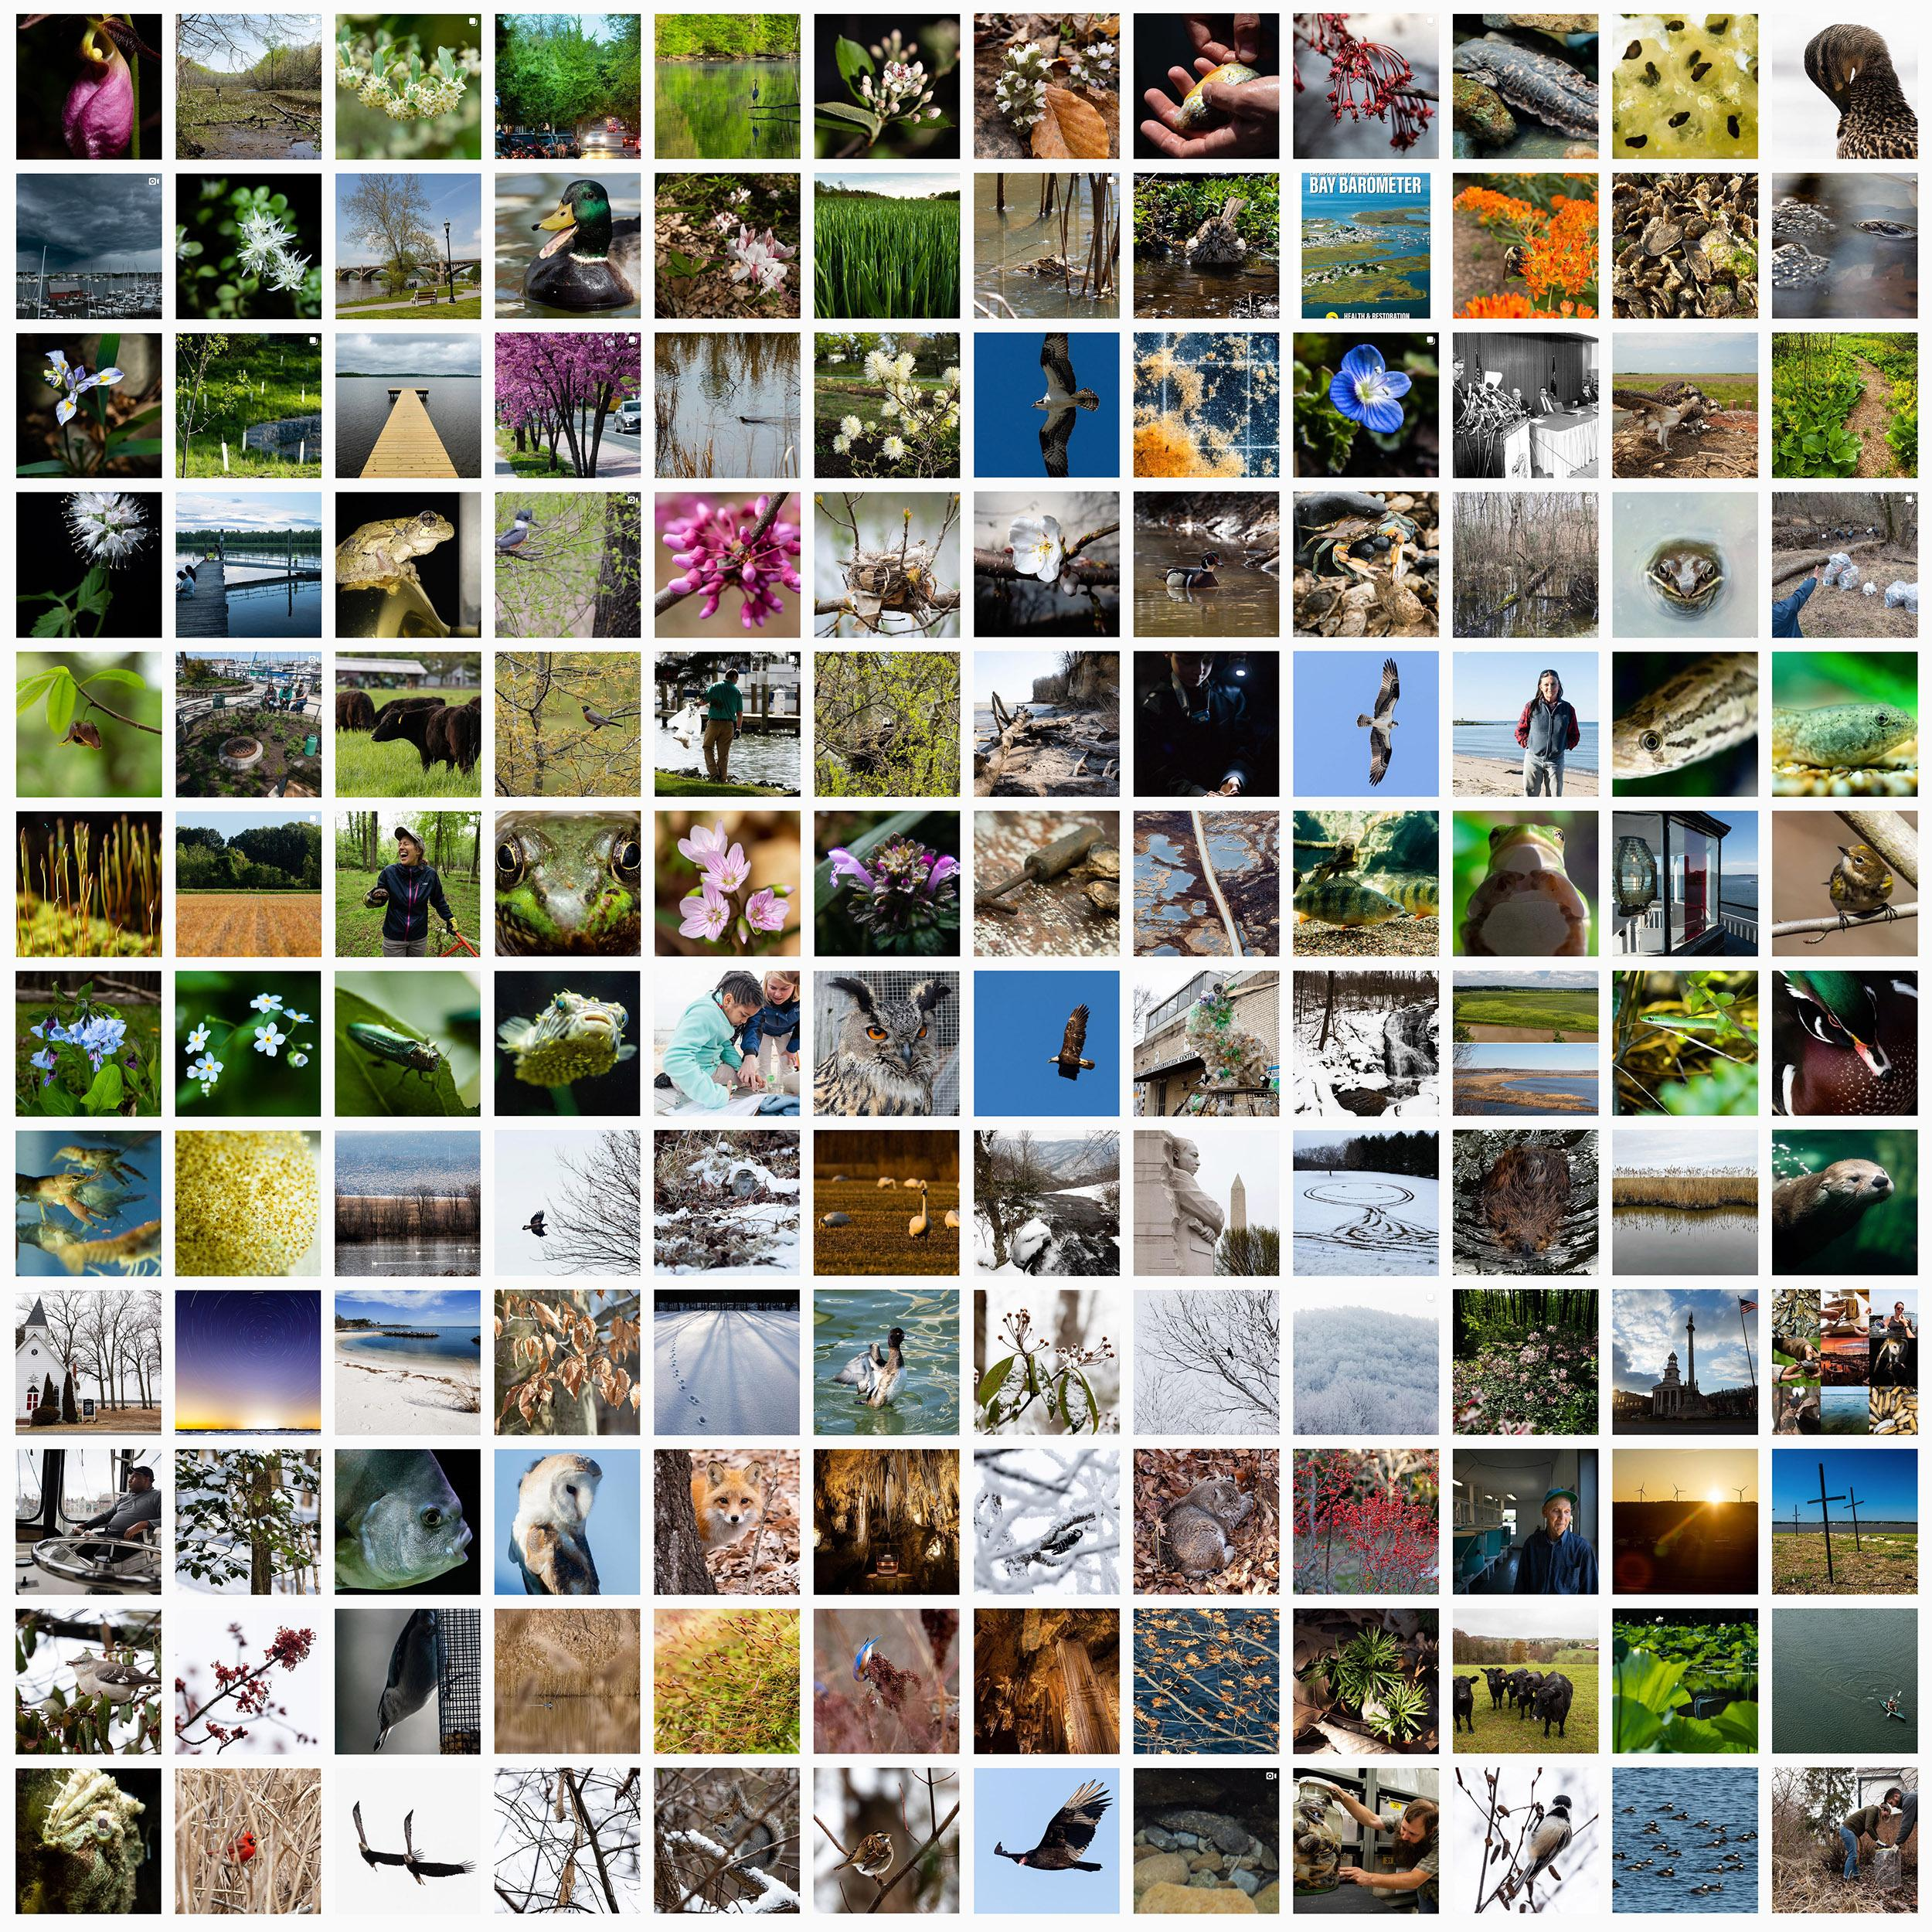
@chesbayprogram
Notes:
Daily posts that at a basic level show the geographic diversity of the watershed.
My job at a fundamental level is to introduce the Chesapeake watershed to itself, and to help people fall in love with the region so that they’ll want to take care of it.
You should follow us on social media.

Slide 3
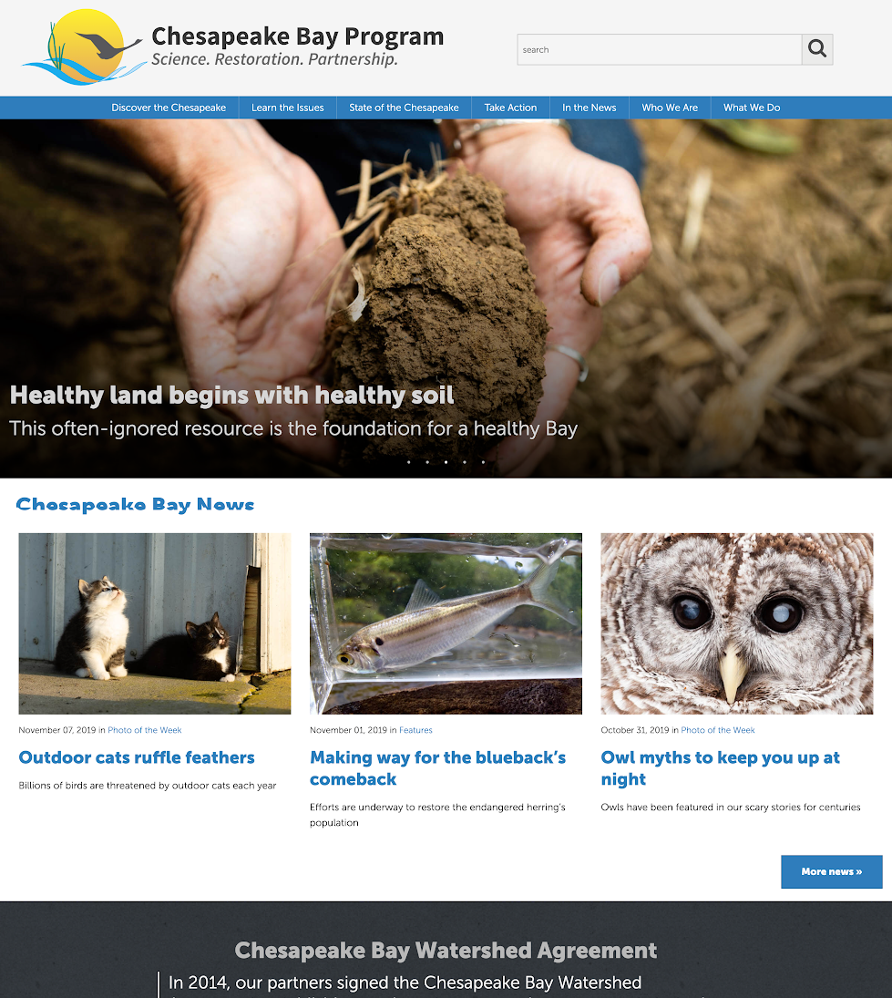
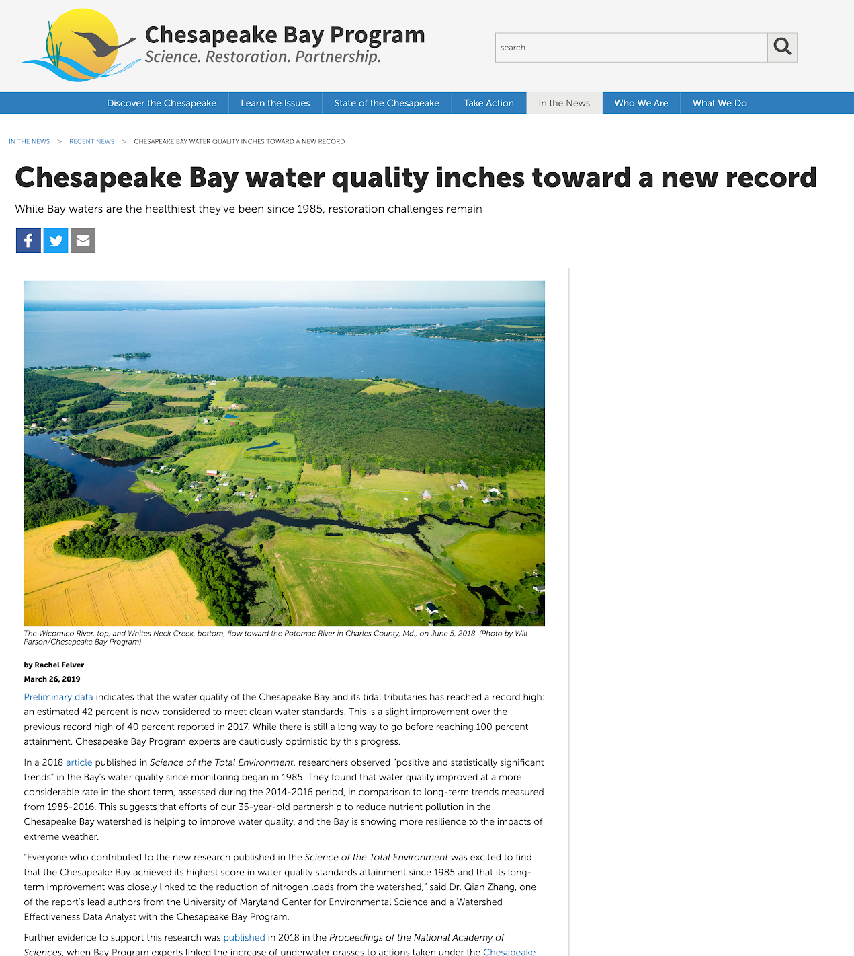
www.chesapeakebay.net
Notes:
I contribute stories and photos on www.chesapeakebay.net and sibling websites like ChesapeakeProgress and BayBackpack.

Slide 4
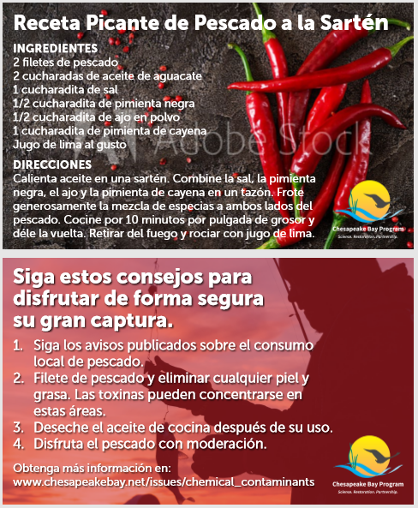
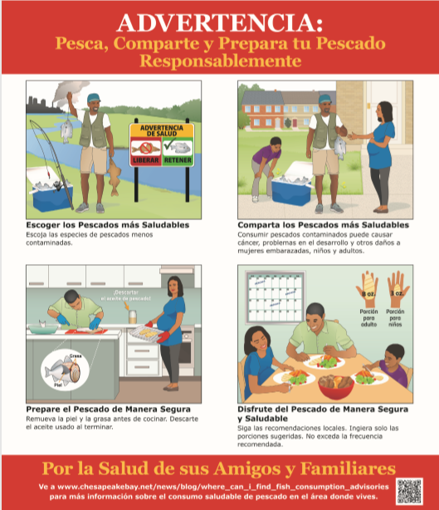
Outreach materials
Notes:
I also build our networks with communities and organizations, and I create programming and outreach that brings our science and outcomes to life. When I tell a story, I am often looking at the big picture and how things connect.

Slide 5
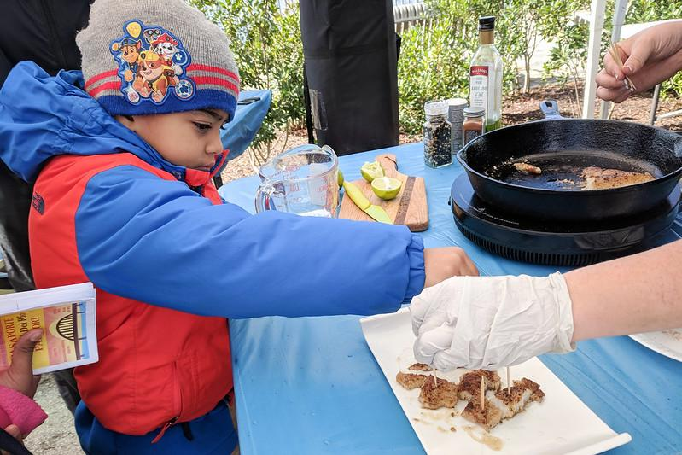
Outreach
Notes:
I also build our networks with communities and organizations, and I create programming and outreach that brings our science and outcomes to life. When I tell a story, I am often looking at the big picture and how things connect.

Slide 6
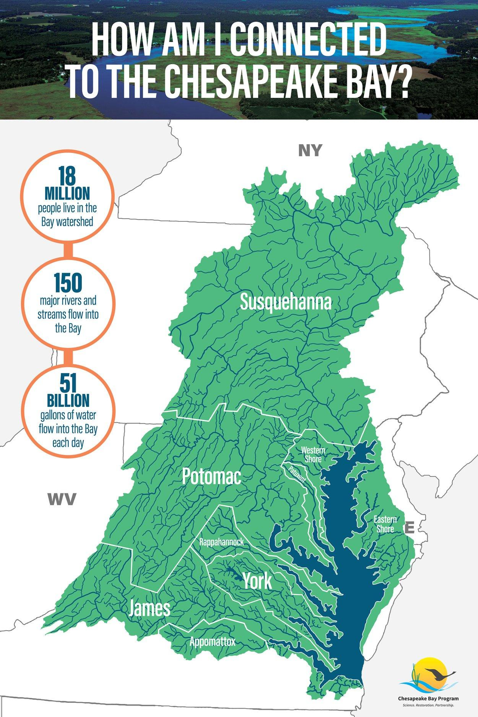

Slide 7
Microplastics in the Chesapeake Bay and its Watershed: State of the Knowledge, Data Gaps, and Relationship to Management Goals
Establishing Multifunctional Riparian Buffers: How do we accelerate riparian buffer plantings across the Chesapeake Bay with the greatest economic, social and environmental impacts?
Understanding and Explaining 30 Years of Water Clarity Trends in the Chesapeake Bay’s Tidal Waters
Integrating Science and Developing Approaches to Inform Management for Contaminants of Concern in Agricultural and Urban Settings
STAC Reports

Slide 8
Small plastics are a big problem
What’s in a tree? Oxygen, food, clean water and money
|
Planting buffers for the future
A look back at 30 years of water clarity
A cocktail of contaminants in Chesapeake waters
STAC Articles

Slide 9


Slide 10
Define acronyms
Don’t repeat
Go global
Case study detail
Draw connections
Communicate
Outreach needs
Media contacts
STAC and Comms
Writing reports:

