Slide 1
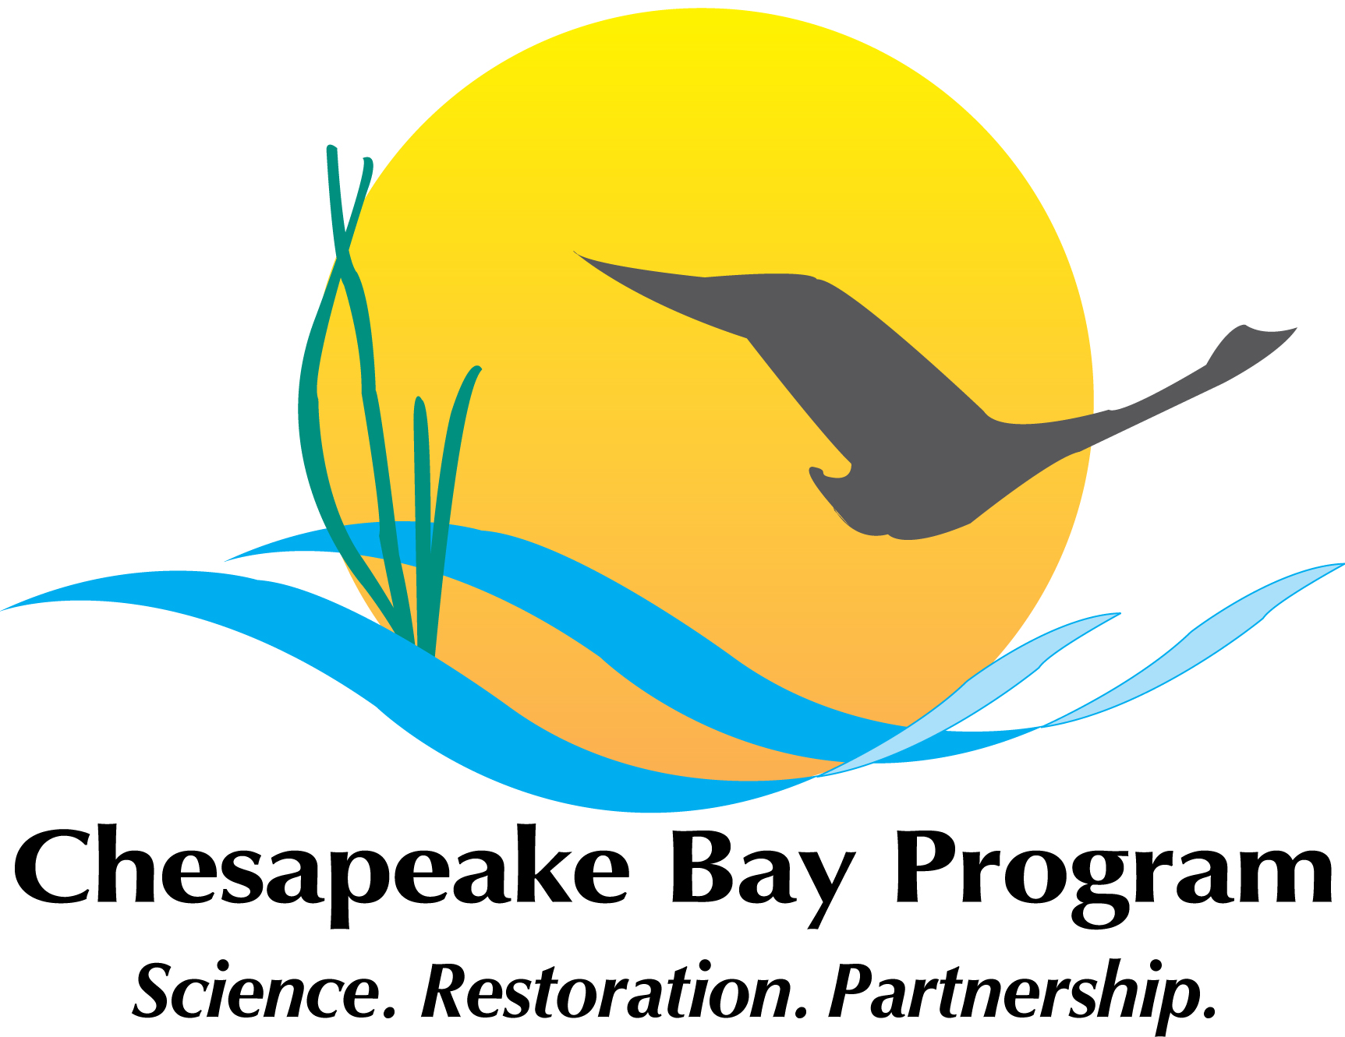

Status Update From the
CBP Plastic Pollution Action Team
MATT ROBINSON
Chair, Plastic Pollution Action Team (PPAT)
Watershed Protection Division
DC Department of Energy and Environment
Notes:
This will be a brief overview of DC’s participation in a multi-jurisdictional effort to address trash in the Anacostia River.
Trash is not one of the pollutants that total maximum daily loads, or TMDLs, have been traditionally developed for.
However, given the regulatory framework that a TMDL provides for addressing various sources for trash, I hope to illustrate to everyone here today how it has been used to effectively address trash in local waterways in DC.

Slide 2
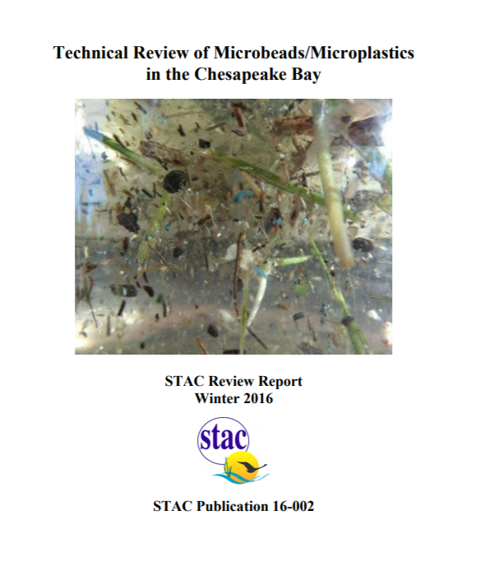
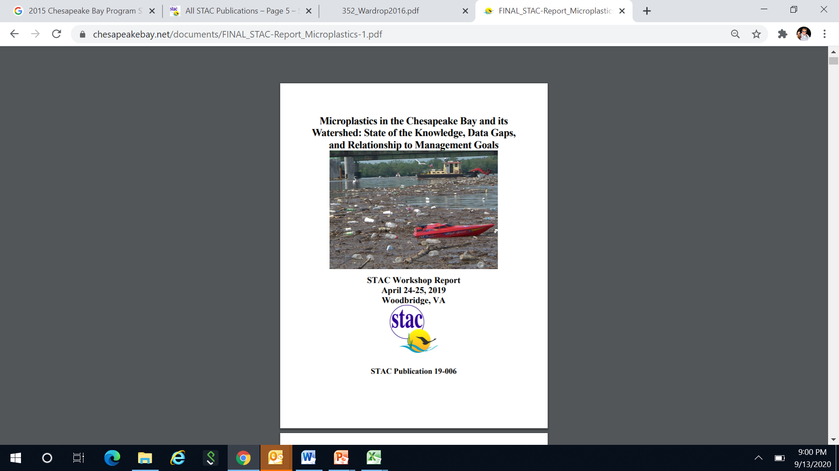

STAC & Microplastics
Two previous reports from STAC on microplastic pollution in Chesapeake Bay:
1) Technical Review of Microbeads/Microplastics
in the Chesapeake Bay
(2016)
2) Microplastics in the
Chesapeake Bay and its
Watershed: State of the
Knowledge, Data Gaps, and
Relationship to Management
Goals (2019)
@DOEE_DC
Notes:
For many of you this picture might be of particular interest. Trash negatively impacts aquatic vegetative habitat in DC.
The trash in this picture comes from a stormwater outfall which enters this restored wetland along the Anacostia River in DC, just across the river from RFK stadium.
This site has also been retrofitted with a trash trap.

Slide 3
Bringing the Issue to Light
How can we bring more attention to this issue regionally?
The CBP’s SAV Workgroup applied for STAC funding to hold a workshop in 2019 about microplastics in the Bay and watershed
@DOEE_DC
Notes:
Now, how do we implement a trash TMDL?
Well, in DC, two major policy pieces are pushing compliance:
The 2012 iteration of our MS4 permit required the District to have the tools on the ground, by 2017, to capture or remove 103,188 lbs of trash per year from the Anacostia River watershed. That is the equivalent of the MS4 point source load.
Per the NPDES permit for the combined sewer system, DC Water is required to implement a multi-year long term control plan for reducing the frequency of overflows from the combined sewer system. These are commonly known as combined sewer overflows. They are in the process of implementing a multi-year, multi-billion dollar to construct nderground tunnels to capture this overflow and hold it for eventual piping to blue plains for treatment.

Slide 4
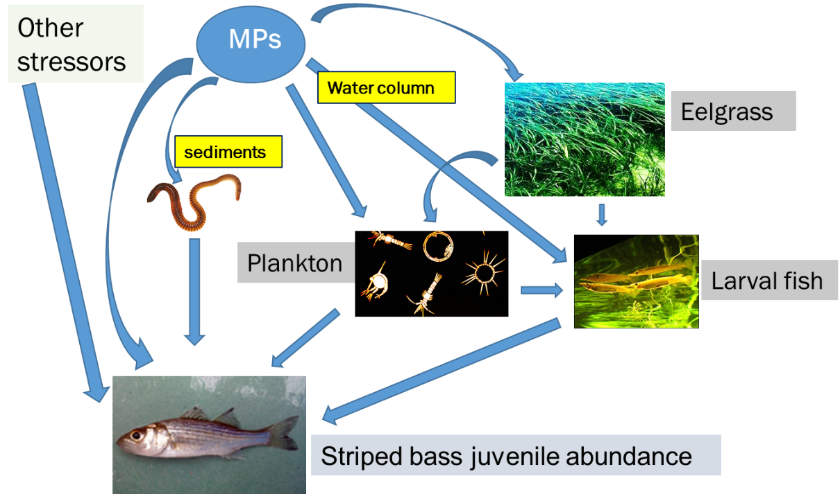
Workshop Format: Ecological Risk Assessment
Courtesy of Bob Murphy, 2019
@DOEE_DC

Slide 5
Key Recommendations
The CBP should create a cross-GIT Plastic Pollution Action Team to address the growing threat of plastic pollution to the bay and watershed.
The Scientific, Technical Assessment and Reporting Team should incorporate development of ERAs of microplastics into the CBP strategic science and research framework, and the Plastic Pollution Action Team should oversee the development of the ERAs focused on assessment of microplastic pollution on multiple living resource endpoints.
STAC should undertake a technical review of terminology used in microplastic research, specifically size classification and concentration units, and recommend uniform terminology for the CBP partners to utilize in monitoring and studies focused on plastic pollution in the bay and watershed.
The CBP should develop a source reduction strategy to assess and address plastic pollution emanating from point sources, non-point sources, and human behavior.
The CBP should direct the Plastic Pollution Action Team and STAR Team to collaborate on utilizing the existing bay and watershed monitoring networks to monitor for microplastic pollution.
@DOEE_DC
Notes:
DC now has 9 trash traps installed.
Pictured here is the installation of a proprietary design, a bandalong trash trap. This was installed in Watts Branch, the District’s largest tributary to the Anacostia River.
The Bandalong is an Australian design. The District was the first jurisdiction in the western hemisphere to install this design. We now have four of these and they typically capture between 8 and 10,000 lbs of trash per year.
This trap was installed and maintained by the Anacostia Riverkeeper, through a grant from DOEE.

Slide 6
Progress to Date
The Management Board authorized the creation of a Plastic Polluton Action Team to address recommendations in the 2019 STAC report.
The focus → get the science straight.
An ecological risk assessment will help us do that. It will help contextualize the problem of plastic pollution in the Chesapeake Bay and its watershed. For example, how much is too much?
The focus of the PPAT will be development of an ERA for the Potomac River focused on one ecosystem endpoint. The Potomac River is an appropriate scale waterbody to focus on given the available resources.
DC has agreed to champion this issue and chair the PPAT.
@DOEE_DC
Notes:
DC now has 9 trash traps installed.
Pictured here is the installation of a proprietary design, a bandalong trash trap. This was installed in Watts Branch, the District’s largest tributary to the Anacostia River.
The Bandalong is an Australian design. The District was the first jurisdiction in the western hemisphere to install this design. We now have four of these and they typically capture between 8 and 10,000 lbs of trash per year.
This trap was installed and maintained by the Anacostia Riverkeeper, through a grant from DOEE.

Slide 7
PPAT Progress to Date
EPA Region III awarded a contract to Tetra Tech to:
  Develop a preliminary ecological risk assessment for the Potomac River.
  Develop a Standardization of Terminology document that will recommend a standardized size classification scheme and units of concentration.
  Develop a Science Strategy to address information gaps identified in the ecological risk assessment.
  PPAT has been formed and is chaired by Matt Robinson (DOEE) and vice-chaired by Kelly Somers (EPA Region III Water Division)
  Membership consists of representatives from the states; federal agencies; universities and research institutions; and the advisory committees.
  PPAT is advising Tetra Tech on the development of all three products.
@DOEE_DC
Notes:
DC now has 9 trash traps installed.
Pictured here is the installation of a proprietary design, a bandalong trash trap. This was installed in Watts Branch, the District’s largest tributary to the Anacostia River.
The Bandalong is an Australian design. The District was the first jurisdiction in the western hemisphere to install this design. We now have four of these and they typically capture between 8 and 10,000 lbs of trash per year.
This trap was installed and maintained by the Anacostia Riverkeeper, through a grant from DOEE.

Slide 8
PPAT Progress to Date
The PPAT has met twice since June 2020.
  Key Decisions:
  Ecological risk assessment will focus on “General Microplastics.” Why?
    We don’t want to focus too heavily on one particle type (e.g. fibers, fragments) or polymer type (e.g. PE, PET, PVC)
    While most particles found may be fibers, monitoring has shown that majority of particles transported by some sources (e.g. stormwater) are fragments. What does that mean for management?
    Organisms are likely exposed to a “cocktail” of different particle types and polymers in the environment.
  PPAT approved Striped Bass (Morone saxatilis), ages 0-3, to serve as the ecological endpoint for the risk assessment. Why?:
    Apex predator. Food chain analysis for this species will encompass a multitude of trophic levels and other species.
    Abundance of data on Striped Bass (e.g. juvenile abundance index)
    Ubiquitous in the Potomac River. All jurisdictions in tidal waters are responsible for managing this species.
    One of the “Iconic Bay Species.”
@DOEE_DC
Notes:
DC now has 9 trash traps installed.
Pictured here is the installation of a proprietary design, a bandalong trash trap. This was installed in Watts Branch, the District’s largest tributary to the Anacostia River.
The Bandalong is an Australian design. The District was the first jurisdiction in the western hemisphere to install this design. We now have four of these and they typically capture between 8 and 10,000 lbs of trash per year.
This trap was installed and maintained by the Anacostia Riverkeeper, through a grant from DOEE.

Slide 9
PPAT Progress to Date
  Key Decisions (continued):
    PPAT approved Phase I of the ecological risk assessment.
      This phase consists of developing food web models illustrating pathways that lead to uptake and passage of microplastics through the food chain.
      Models were developed for the mesohaline, oligohaline, and tidal fresh portions of the Potomac River.
@DOEE_DC
Notes:
DC now has 9 trash traps installed.
Pictured here is the installation of a proprietary design, a bandalong trash trap. This was installed in Watts Branch, the District’s largest tributary to the Anacostia River.
The Bandalong is an Australian design. The District was the first jurisdiction in the western hemisphere to install this design. We now have four of these and they typically capture between 8 and 10,000 lbs of trash per year.
This trap was installed and maintained by the Anacostia Riverkeeper, through a grant from DOEE.

Slide 10
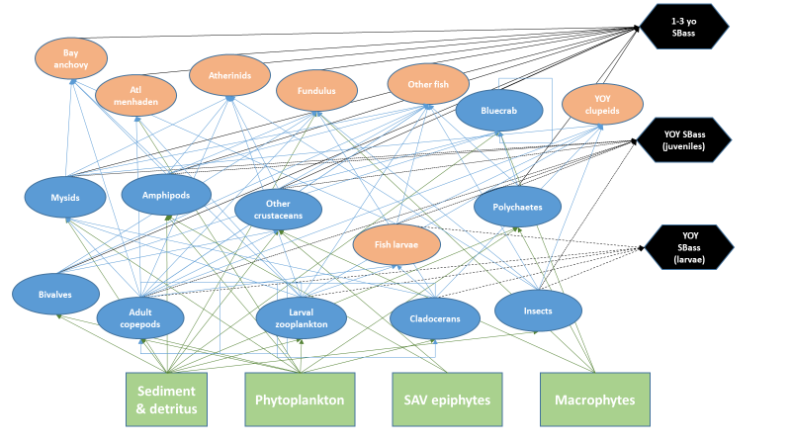
Example Food Web Model
@DOEE_DC
Notes:
DC now has 9 trash traps installed.
Pictured here is the installation of a proprietary design, a bandalong trash trap. This was installed in Watts Branch, the District’s largest tributary to the Anacostia River.
The Bandalong is an Australian design. The District was the first jurisdiction in the western hemisphere to install this design. We now have four of these and they typically capture between 8 and 10,000 lbs of trash per year.
This trap was installed and maintained by the Anacostia Riverkeeper, through a grant from DOEE.

Slide 11
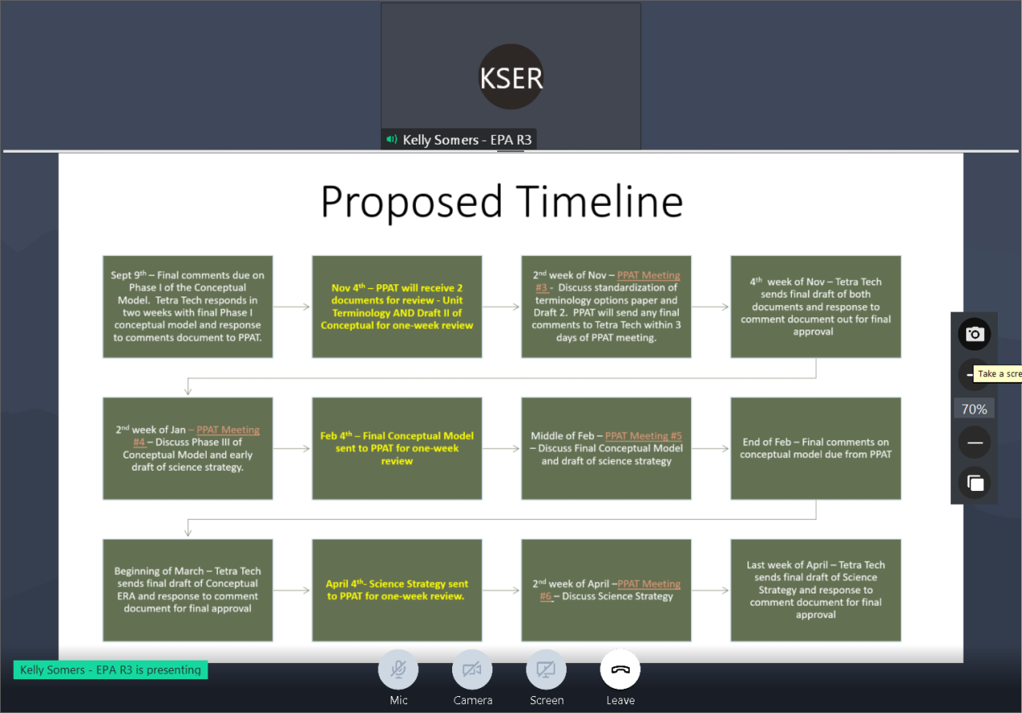
Remaining Project Schedule:
@DOEE_DC
Notes:
DC now has 9 trash traps installed.
Pictured here is the installation of a proprietary design, a bandalong trash trap. This was installed in Watts Branch, the District’s largest tributary to the Anacostia River.
The Bandalong is an Australian design. The District was the first jurisdiction in the western hemisphere to install this design. We now have four of these and they typically capture between 8 and 10,000 lbs of trash per year.
This trap was installed and maintained by the Anacostia Riverkeeper, through a grant from DOEE.

Slide 12
Future STAC Involvement
Per their contract, Tetra Tech is required to consult with STAC on the following:
Phases II and III of the ecological risk assessment
Standardization of Terminology document
Science Strategy
  The Management Board has requested STAC provide a review of these documents.
  In the coming months, we will work the STAC Executive Secretary to organize a technical review or merit review of all of these documents.
@DOEE_DC
Notes:
DC now has 9 trash traps installed.
Pictured here is the installation of a proprietary design, a bandalong trash trap. This was installed in Watts Branch, the District’s largest tributary to the Anacostia River.
The Bandalong is an Australian design. The District was the first jurisdiction in the western hemisphere to install this design. We now have four of these and they typically capture between 8 and 10,000 lbs of trash per year.
This trap was installed and maintained by the Anacostia Riverkeeper, through a grant from DOEE.

Slide 13
Special Thanks
All members of the PPAT
Vice Chair Kelly Somers (EPA Region III Water Division)
  Project Team:
    Bob Murphy (Tetra Tech)
    Jennifer Flippin (Tetra Tech)
    Ryan Woodland (UMCES-CBL)
    Kristin Saunders (UMCES)
    Emily Trentacoste (EPA CBPO)
    Bill Jenkins (EPA Region III)
    Cuiyin Wu (CRC)
@DOEE_DC
Notes:
DC now has 9 trash traps installed.
Pictured here is the installation of a proprietary design, a bandalong trash trap. This was installed in Watts Branch, the District’s largest tributary to the Anacostia River.
The Bandalong is an Australian design. The District was the first jurisdiction in the western hemisphere to install this design. We now have four of these and they typically capture between 8 and 10,000 lbs of trash per year.
This trap was installed and maintained by the Anacostia Riverkeeper, through a grant from DOEE.

Slide 14
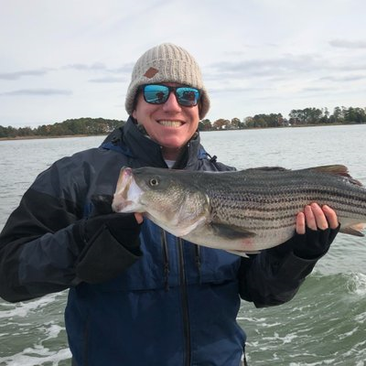
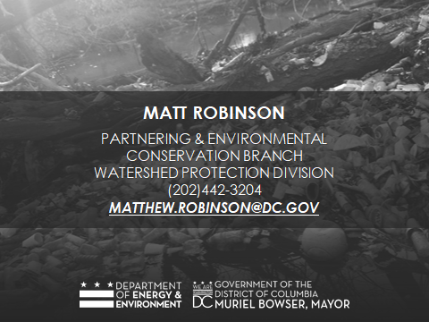
@DOEE_DC

