Slide 1
Lessons from the Baltic Sea
Lara Fowler, Penn State
STAC Quarterly Meeting, 15 September 2020

Slide 2



Opportunity from Fulbright Sweden Aug. 2019- May 2020
Where are people finding “success” in managing water (water quality, flood/drought)
Scale?
Scope?
How?
What are the commonalities/differences in solutions?

Slide 3
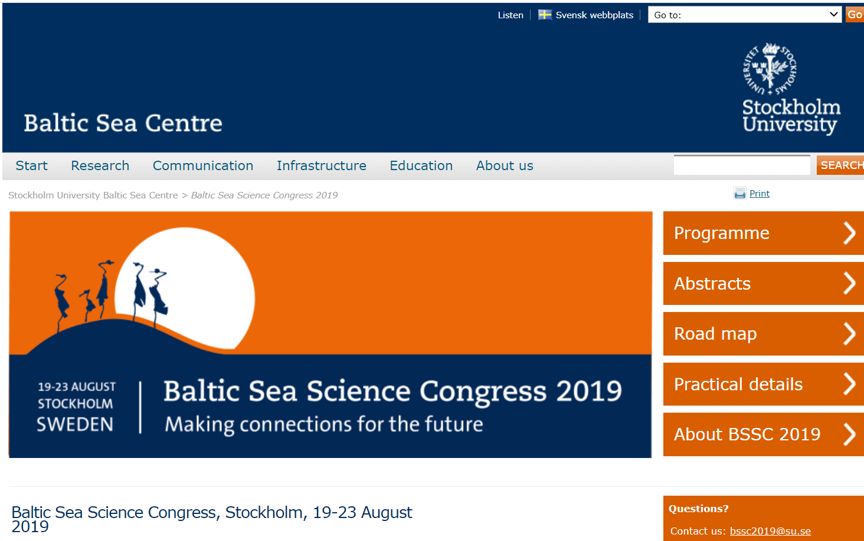
Key takeaways from the Baltic Sea Science Congress (Aug 2019)
Lot of great people/research
Nutrient reductions made, but more needed (ag, urban stormwater)
No easy answers
Need to better engage social scientists, stakeholders, decision makers
Science/policy gap sizable
Many existing challenges (esp. impact of people on system)
New challenges emerging (CECs, climate change)
Regular call for more cooperation
BONUS funding critical
Could have been talking about the Chesapeake!
Notes:
Notes from after the meeting (shared on twitter: https://twitter.com/fowler_lara/status/1164906300318371843)
1) There are a lot of great researchers focused on the #Baltic
2) While nutrient reductions have been made, more are needed, esp. from ag & urban stormwater
3) Like in the #Chesapeake, there are no easy answers.
4) There is a need to better engage social science researchers, stakeholders, and decision makers
5) The science--> policy gap is sizable, but people are actively working to address it.
6) Many existing challenges remain: importantly, the impact of people on the system through ag, fishing, tourism, etc.
7) New challenges are coming: contaminants of emerging (emerged) concern, climate change.
8) There is a regular and common call for better cooperation across all scales: local, regional, national, international.
9) It sounds like @BONUSBaltic has helped with funding critical research; loss of funding or lack of renewal of funding would have a big impact
10) I could have substituted the word "Baltic" for the word "Chesapeake Bay" over the last few days. We are having the same conversations (almost verbatim). The point has been made by others that we should be coordinating more not only within regions, but between regions.

Slide 4
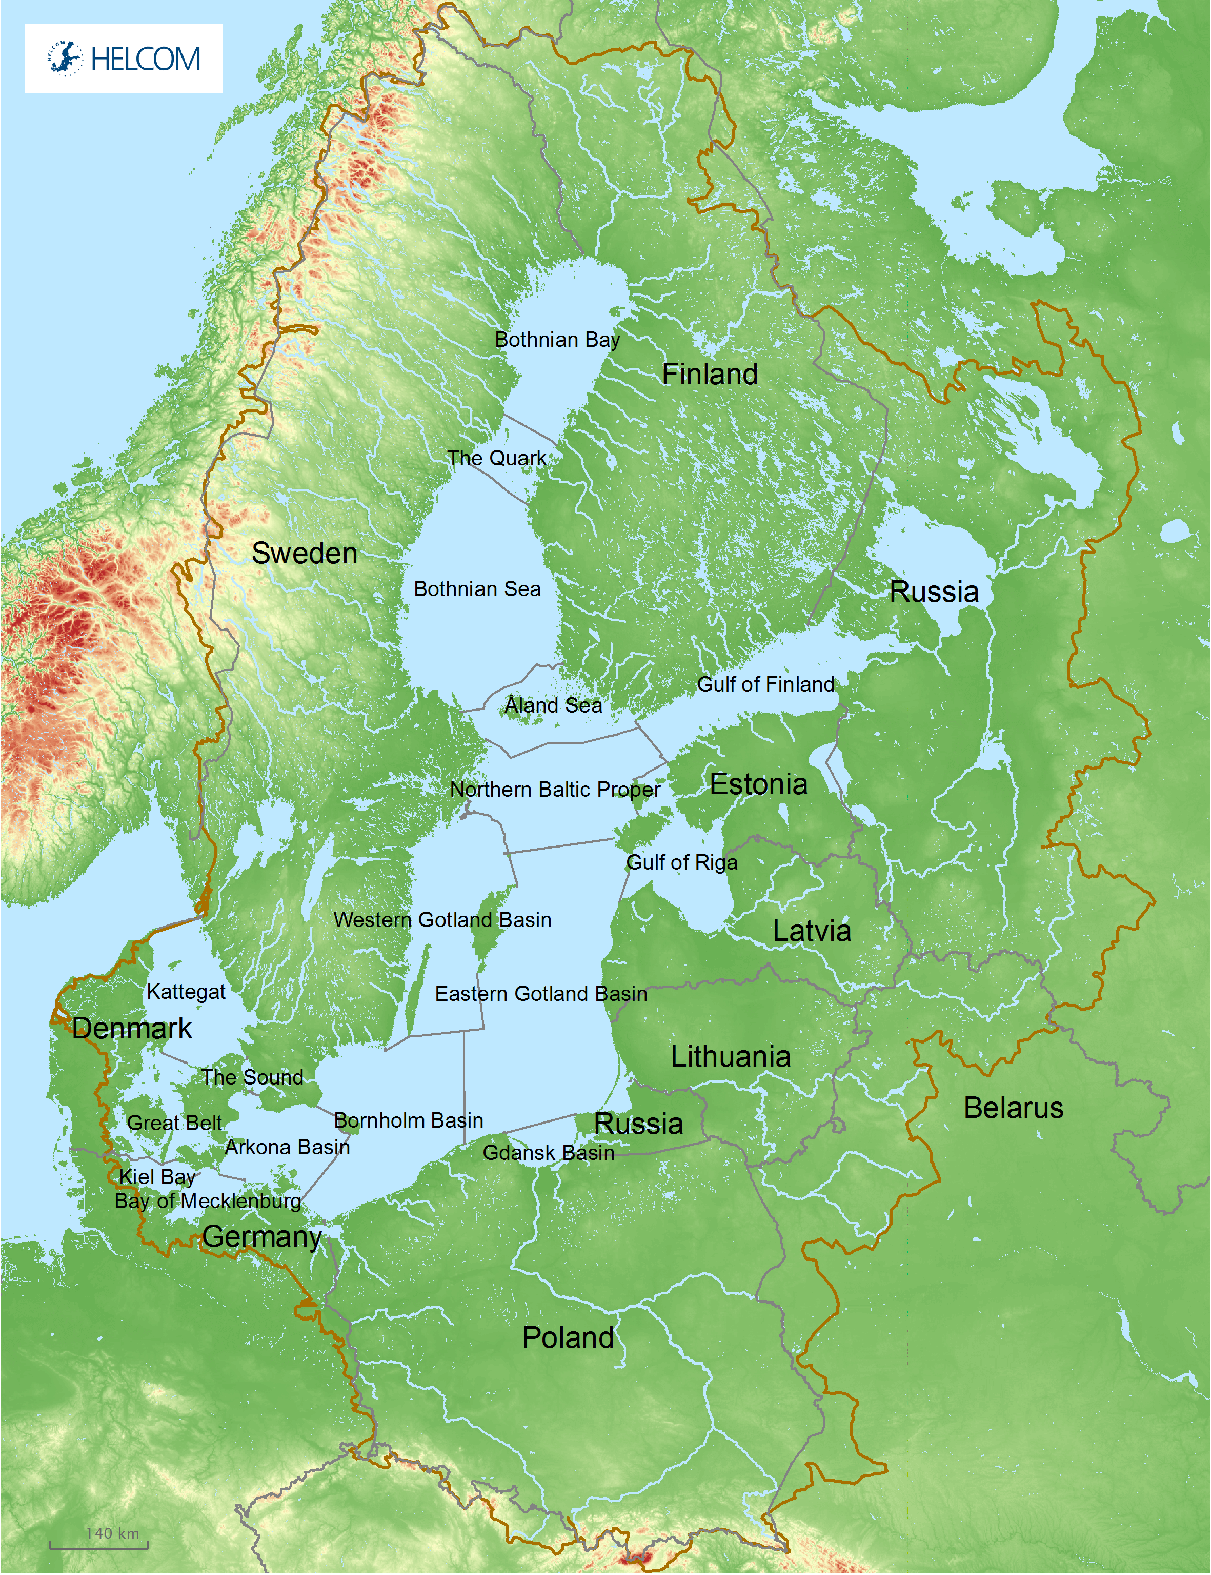
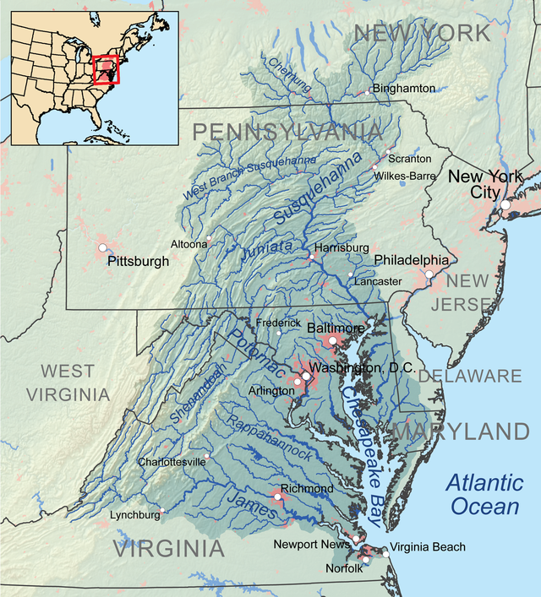
Comparing the Baltic & the Chesapeake
Land: 2 million km², 9 countries
Population: 85 million people
Water: 415,000 km², 250 rivers. Land/ water ratio of 4:1. Mean depth: 58 meters
Land: 166,000 km², 6 states + Wash. DC
Population: 17 million people
Water: 11,400 km², 150 rivers, Land/water ratio of 15:1. Mean depth: 6.5 meters
Sources: Iho et al 2015; Reusch et al., Sci. Adv. 2018, HELCOM; Chesapeake Bay Program
Notes:
Iho et al: https://www.sciencedirect.com/science/article/abs/pii/S0025326X15000909
Bay Program: https://www.chesapeakebay.net/discover/facts
HELCOM: http://stateofthebalticsea.helcom.fi/in-brief/our-baltic-sea/

Slide 5
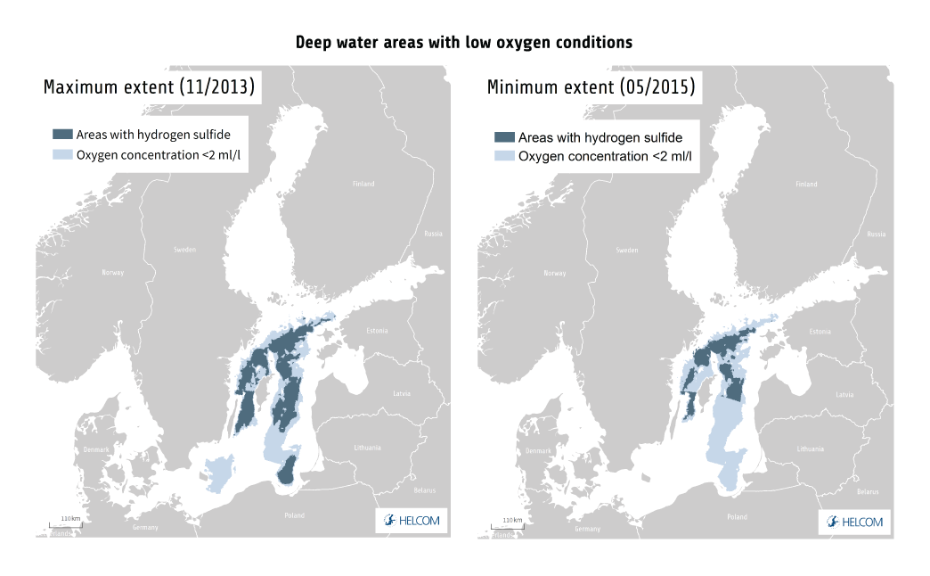
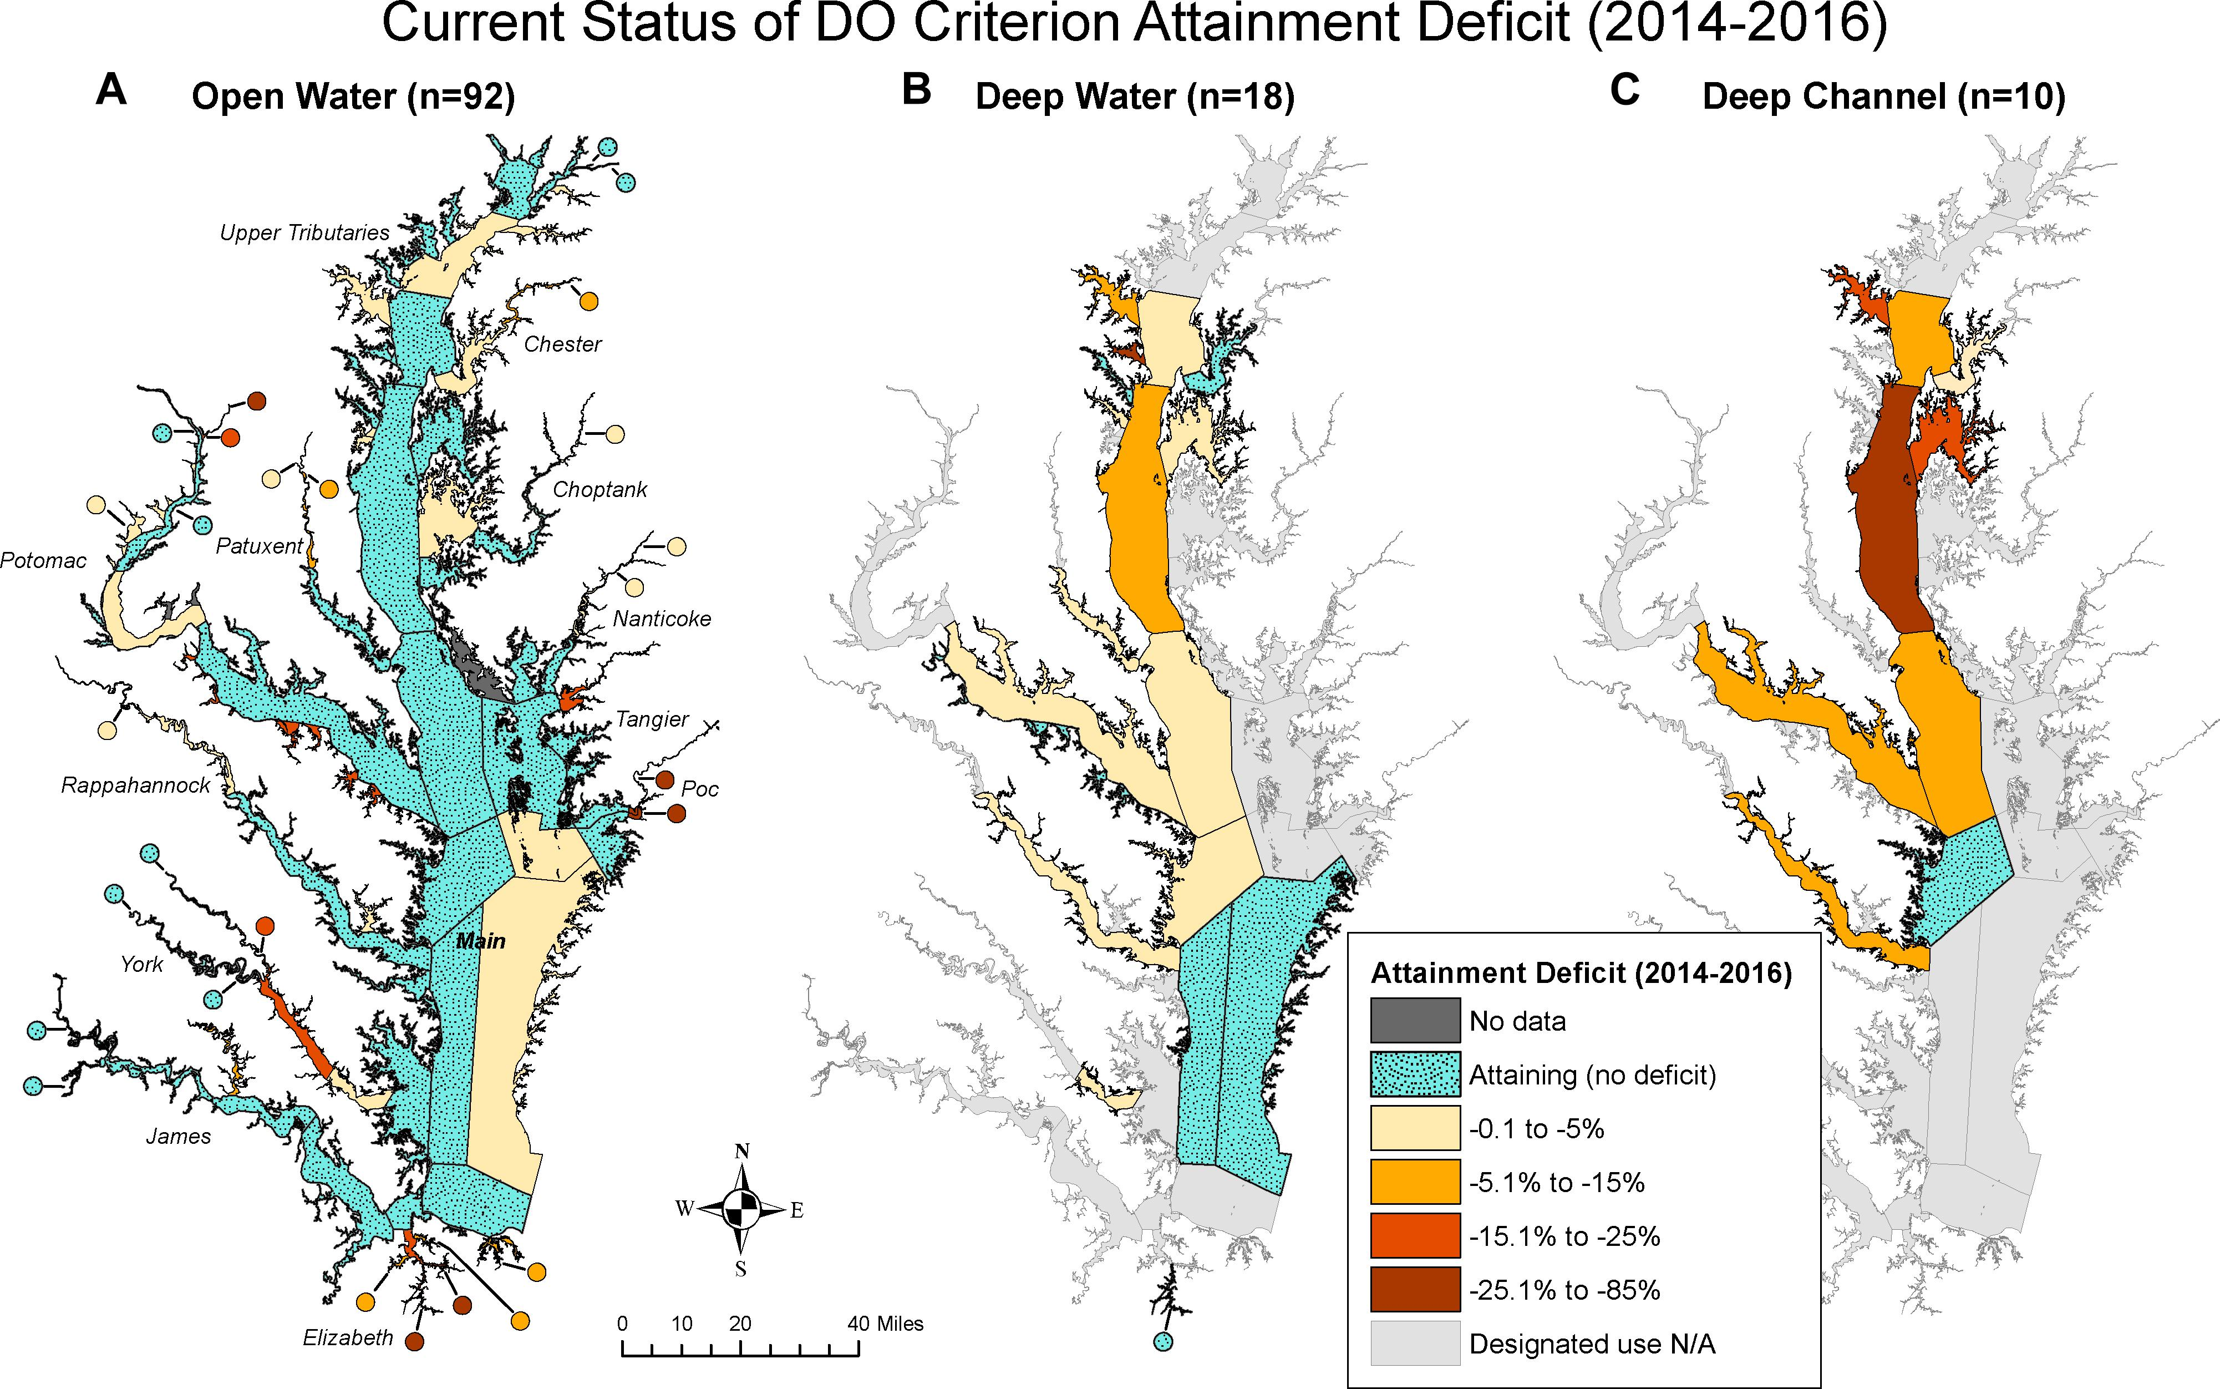
Challenges & multiple stressors common to the Baltic and the Chesapeake
Large deoxygenated areas, particularly in the deep-water areas
Although decreasing nutrient discharge (esp. from wastewater treatment), lag in improvements due to legacy sediments, nutrients
Continued nutrient pollution, particularly from agriculture and stormwater runoff
Climate change impacts: warming, acidification, weather extremes, more
Toxics & emerging contaminants
Impacts to biodiversity: fishing, predation, invasive (non-indigenous) species
Human well-being
Sources: Zhang et al 2018; Reusch et al. 2018; HELCOM; Chesapeake Bay Program
Notes:
Sources:
HELCOM State of the Baltic: http://stateofthebalticsea.helcom.fi/in-brief/summary-of-findings/#pressures-on-the-baltic-sea
Zhang et al 2018, Chesapeake Bay Dissolved Oxygen Criterion Attainment Deficit: Three Decades of Temporal and Spatial Patterns: https://www.frontiersin.org/files/Articles/416819/fmars-05-00422-HTML/image_m/fmars-05-00422-g005.jpg
Reusch et al., Sci. Adv. 2018;
Reusch et al: « To fully meet the targets outlined under the BSAP, current N and P loads need to be reduced a further 13 and 41%, respectively (75), whereas, for many coastal water bodies, the requirements for complete compliance with target loads are even higher. Unfortunately, nutrients are maintained in the ecosystem on decadal or even centennial scales because of large pools stored in the sediments. P release from sediments, in particular, will continue for several decades after the load reduction (18), which is likely to be a problem also for other world regions, particularly in coastal brackish areas. Second, it appears that increased N fixation by cyanobacteria stimulated by P release specifically in hypoxic areas counteracts the decreasing nutrient inputs (77). In addition, climate warming will make the ecosystem more vulnerable to nutrient loads (15) and could even result in increased N loads from agricultural areas due to increased run-off from land under altered precipitation patterns.”
Re: ag: “even ambitious nutrient reduction goals may now be offset by increased freshwater run-off, enhanced nutrient remineralization, and water stratification due to ocean warming” (Rausch et al. 2018).

Slide 6
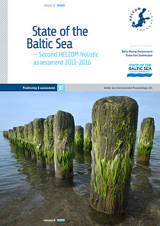
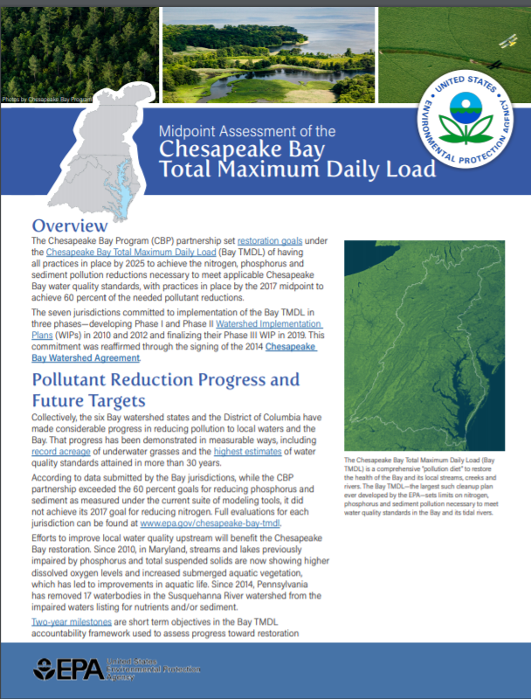
The Baltic & the Chesapeake are both making progress but aren’t there yet
“[A]lthough signs of improvement in the state of the Baltic Sea are seen in some cases, the Baltic Sea Action Plan goals and ecological objectives have not yet been reached”
- HELCOM State of the Baltic Sea
The assessment found that the jurisdictions have made considerable progress in reducing pollution that is reflected in measurable ways, including record acreage of underwater grasses and the highest estimates of water quality standards attained in more than 30 years. While the 60 percent goals for reducing phosphorus and sediment as measured under the current suite of modeling tools were exceeded, the goal for reducing nitrogen was not met.
-EPA 2017 Mid Point Assessment
Notes:
Sources:
HELCOM State of the Baltic Sea: http://stateofthebalticsea.helcom.fi/in-brief/summary-of-findings/
EPA 2017 Mid Point Assessment: https://www.epa.gov/chesapeake-bay-tmdl/epa-final-evaluation-2016-2017-milestone-and-midpoint-progress-and-2018-2019

Slide 7
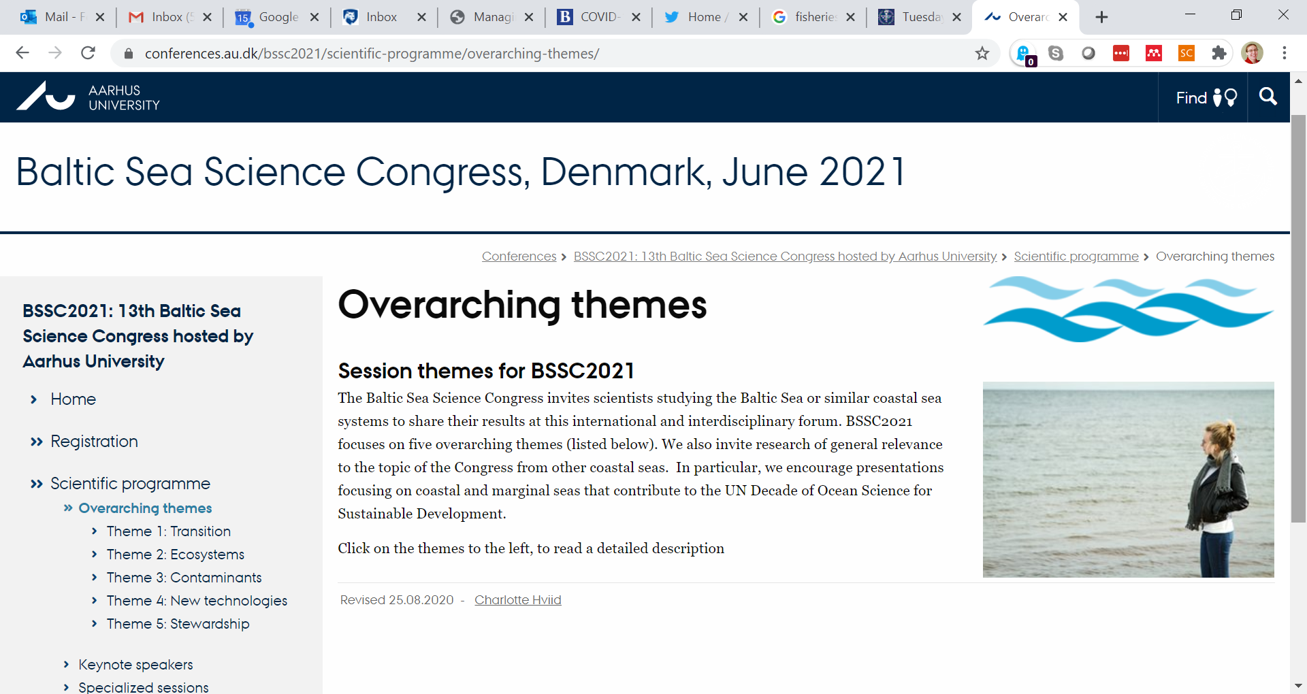
Opportunity for engagement

Slide 8
Opportunities to engage for the Baltic Sea Science Congress (June 14-18, 2021, https://conferences.au.dk/bssc2021/)
Specific Chesapeake Bay related opportunities
Ann Swanson, keynote speaker
Special session on Chesapeake/Baltic comparisons
[Each call for abstracts will include “what can we learn from elsewhere”]

Slide 9
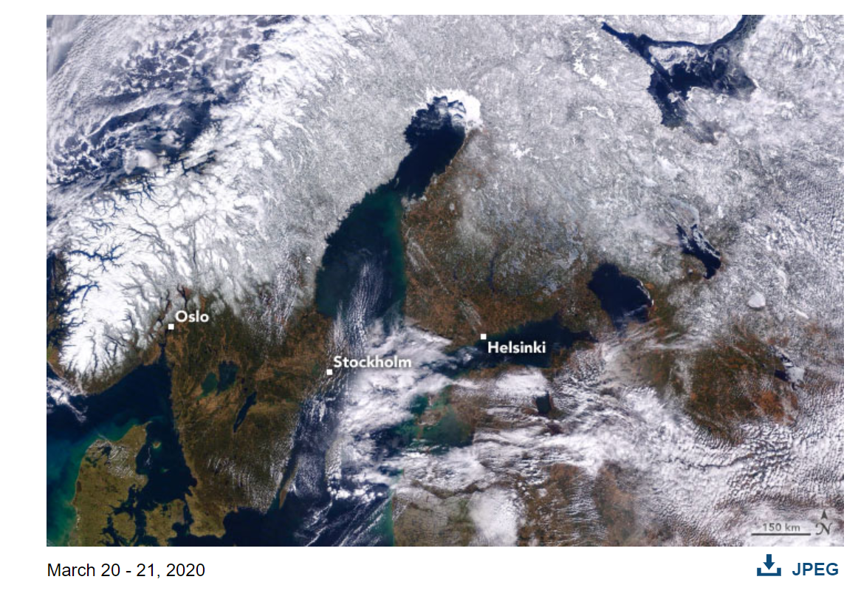
Opportunities for research?
Loss of snow cover/potential cover crops
Shift in crops (corn in Denmark?)
Nonpoint runoff (ag/urban)
Socio-behavioral
Climate
CECs
More

Slide 10
Questions/discussion?
Lara Fowler, Penn State
lbf10@psu.edu

