Slide 1
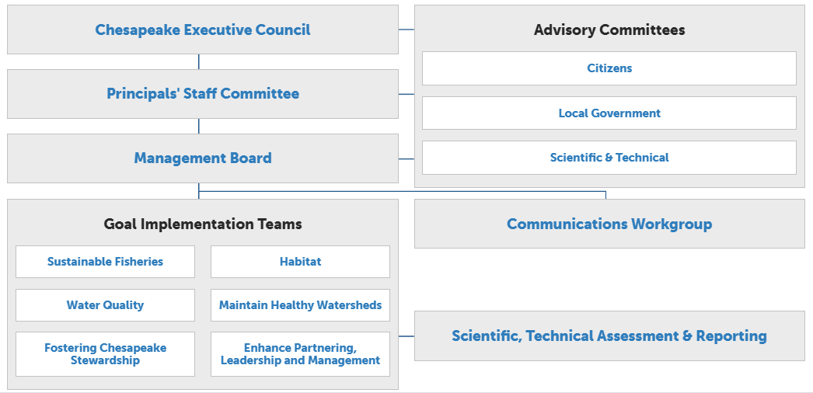

Slide 2
Since its creation in December 1984, STAC has worked to enhance scientific communication and outreach throughout the Chesapeake Bay watershed and beyond.

Slide 3
Turning a report to an article
What is the new science?
Does the public possess the background knowledge to understand the significance?
What is the significance of the new science for the watershed?
How does that relate to peoples’ lives?
Why would the public care?

Slide 4
Title and Audience
Microplastics in the Chesapeake Bay and its Watershed: State of the Knowledge, Data Gaps, and Relationship to Management Goals
Understanding and Explaining 30 Years of Water Clarity Trends in the Chesapeake Bay’s Tidal Waters
How do we accelerate riparian buffer plantings across the Chesapeake Bay with the greatest economic, social and environmental impacts?

Slide 5
Simplify and relate
Microplastics in the Chesapeake Bay and its Watershed: State of the Knowledge, Data Gaps, and Relationship to Management Goals
Small plastics are a big problem
Understanding and Explaining 30 Years of Water Clarity Trends in the Chesapeake Bay’s Tidal Waters
A look back at 30 years of water clarity
How do we accelerate riparian buffer plantings across the Chesapeake Bay with the greatest economic, social and environmental impacts?
What’s in a tree? Oxygen, food, clean water and money

Slide 6
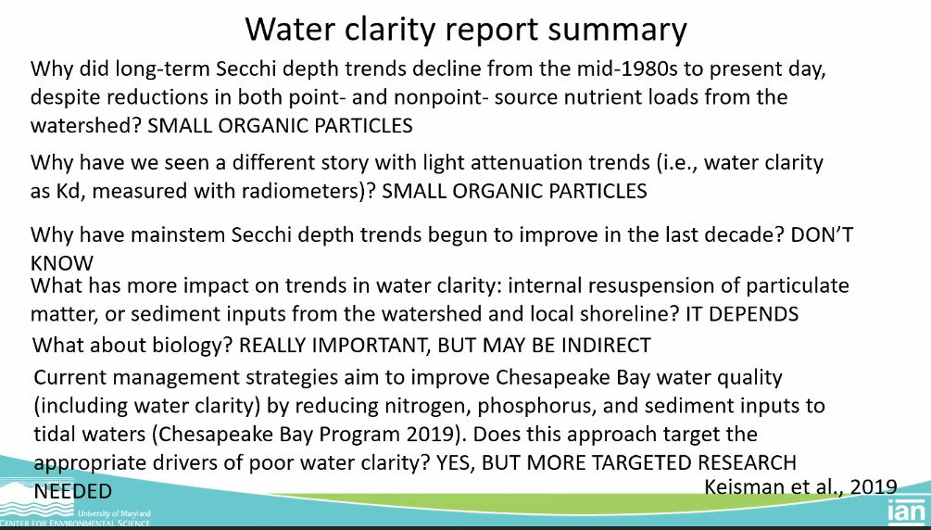
Summarizing: report

Slide 7
Summarizing: article subheadings
What is water clarity?
  2 common definitions, defined, therefore: cloudy but more light
Sunlight and sediment
  Fine particulates… “like mixing powder into a drink”
The impact of algal blooms on clarity
  Temporary effect, chronic stress if occurs too often
Underwater grasses and bivalves rely on clear water, and vice versa
  The ecosystem is connected. Corbicula fluminea in Potomac
How to improve water clarity
  Best management practices, but watch out for extreme weather

Slide 8
Provide examples
What threat do microplastics pose?
  Wildlife ingestion numbers across the world
  Microplastics in all samples at nontidal stations in the watershed
Disease and other contaminants
  Susanne Brander and sea bass
  3 species of vibrio
Oysters
  Christine Knauss and oyster stress.
Wastewater
  516 major wastewater treatment plants in the watershed
What can we do?
  VIMS biopolymers

Slide 9
Clearly explain easy mistakes
“Microplastics in the water column float along in much the same way as algae, the oyster’s preferred food source. Knauss exposed oysters to water containing concentrations of microplastics that match the current pollution levels found in the wild. Over six days, the oysters that ate plastic significantly increased their algal clearance rates. Algal clearance rates relate to how much water the oysters are filtering, so at first glance this would sound like good news.
What it really means is stress. The oysters eating microplastics must clear more algae in order to get the same amount of nutrition as their clean-water brethren. Think of it like hyperventilating—you aren’t better at breathing by doing it faster; your system is stressed, and something is wrong.”

Slide 10
Make the science real with visuals
“At this size, nanoplastics are small enough to cross the cellular membrane. Do they affect respiration? Gene expression? It is hard to say. Research into nanoplastics and their effects have only just begun. But take a deep breath—you probably just breathed in plastic.”

Slide 11
Make the science real with visuals
“Like a piece of tape is a magnet for dust in a room, microplastics pick up chemicals—and diseases.”

Slide 12
What do I seek in a STAC report?
Direct science
Clear examples
Names and details
Accessible authors

Slide 13
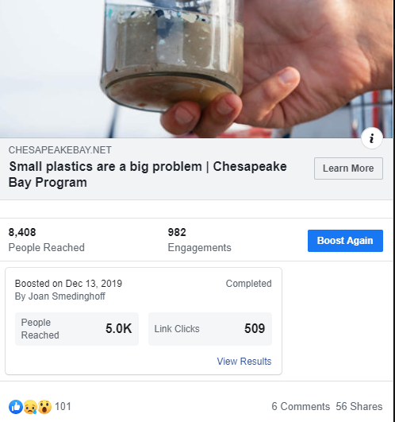
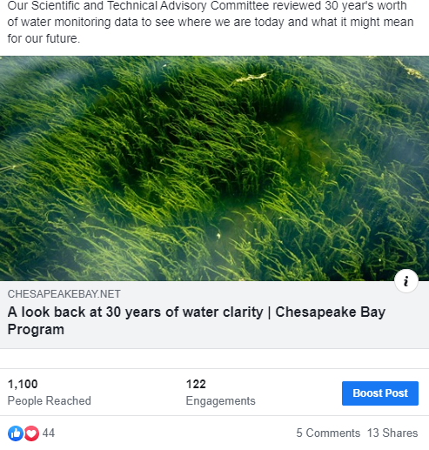
Social media

