Slide 1
The Chesapeake Bay Program Watershed Model Processes and Results
Gary Shenk – CBPO
Based on the work of:
Lewis Linker, Gopal Bhatt, Isabella Bertani, Jeff Sweeney, Jessica Rigelman, Olivia Devereux, Matt Johnston, Andrew Sommerlot, Richard Tian, Danny Kaufman, Ruth Cassilly and many, many more
Presentation to STAC
12/18/2019
This information is being provided to meet the need for timely best science. The information is provided on the condition that neither the U.S. Geological Survey nor the U.S. Government shall be held liable for any damages resulting from the authorized or unauthorized use of the information.

Slide 2
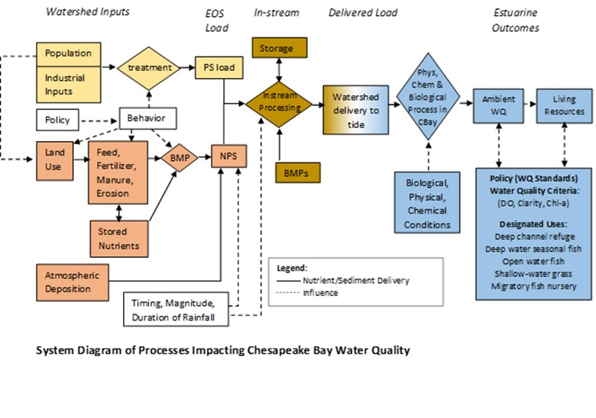

Slide 3
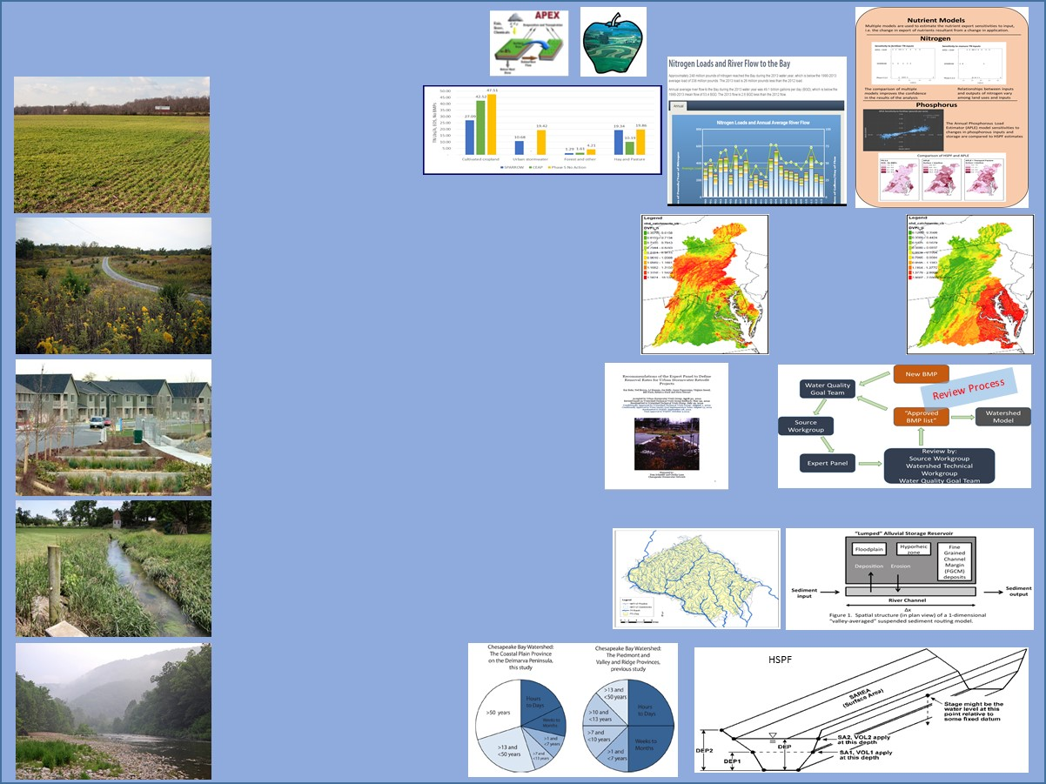
Time-Averaged Model
Keep It Simple
Include Everything
Average Load + Inputs * Sensitivity
Land Use Acres
BMPs
Land to Water
Stream Delivery
River Delivery
*
*
*
Direct Loads
*
*
Load per land use per area

Slide 4
Time-Averaged Model
CAST
Time averaged scenario output
Estimates the long-term average load given a set of anthropogenic inputs
Connected to a dynamic model for calibration and to estimate some sensitivities
Average Load + Inputs * Sensitivity
Land Use Acres
BMPs
Land to Water
Stream Delivery
River Delivery
*
*
*
Direct Loads
*
*
Load per land use per area

Slide 5
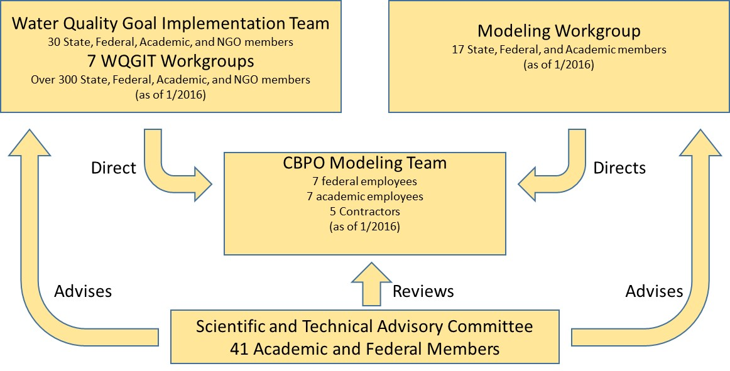
Include Everyone

Slide 7
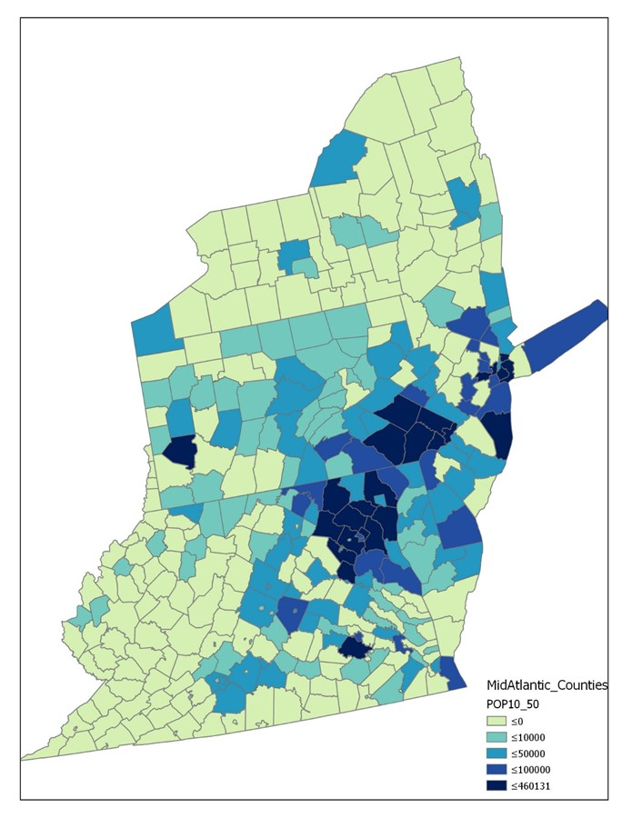
LOCAL POPULATION PROJECTIONS
CBLCM v4
2010 - 2050
Modeling the Effects of Population Growth on Land Use Change and Pollutant Loads
Modeling Assumption:
Urban development results from growth in population and employment.

Slide 8
Chesapeake Bay Land Change Model v4
County-level Population Projections
County-level
Employment Projections
Total Housing
Demand
Historic
Infill
Patterns
Potential
Infill
Development
Historic
Development
Patterns
Land Conservation Demand
Housing Land Demand
Employment Land Demand
Unprotected
Unprotected and Developable
Unprotected and Developable
Conservation Probability
Residential Probability
Commercial Probability
Road Gravity
Road Gravity
Road Gravity
Housing Density
Job Density
Land Conservation
Residential Development
Commercial Development
Iterative & Stochastic
Present
Land Cover
Future Land Cover
Summary Units
(P6 modeling segments)
Future Development Statistics
Notes:
Accessibility = peak travel times for single-occupancy vehicles between transportation modeling zones.

Slide 9
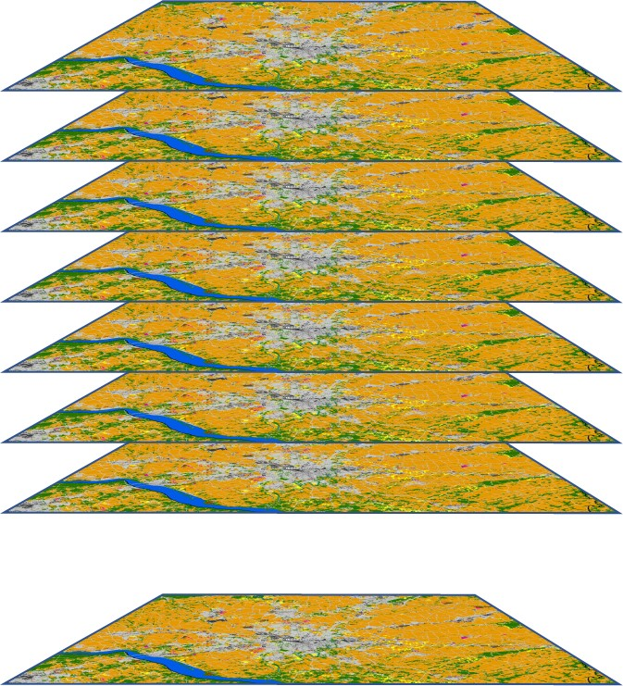
Multiple Stochastic Iterations
Every county is simulated 101 times for each scenario and target year, i.e., 2025.
Average of simulations by summary unit = future development
Relative Standard Deviation = estimate of uncertainty

Slide 10
Point Sources
Most WWTP use default values for load based on flow and technology
about 10% use monitored values
Makes up about 85% of the load
Industrial sources are monitored
States estimate industrial sources to increase based on population trend, linear trend, or no trend

Slide 11
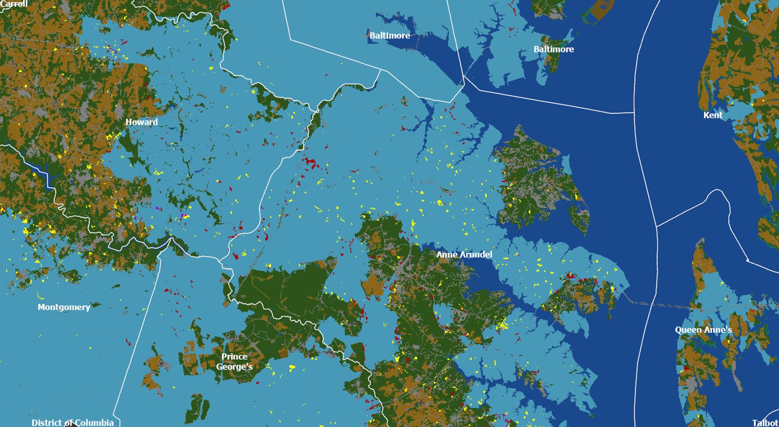
Forecasted 2025 Growth on Sewer vs Septic in Maryland
Sewer Service Area
Residential Growth (sim.)
Commercial Growth (sim.)

Slide 12
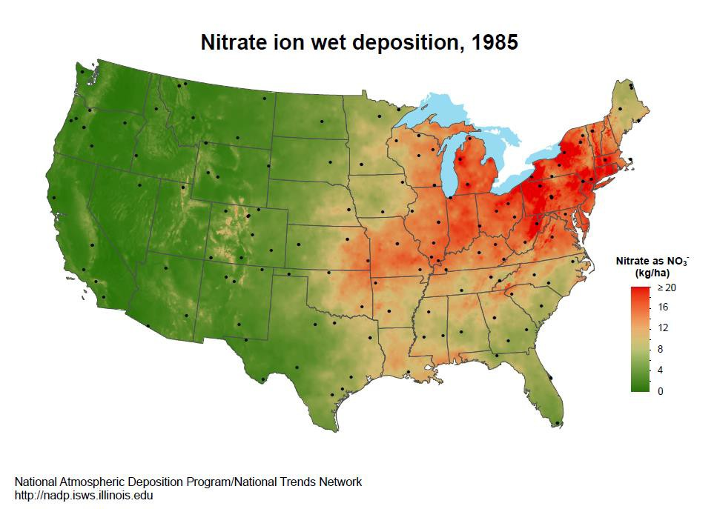
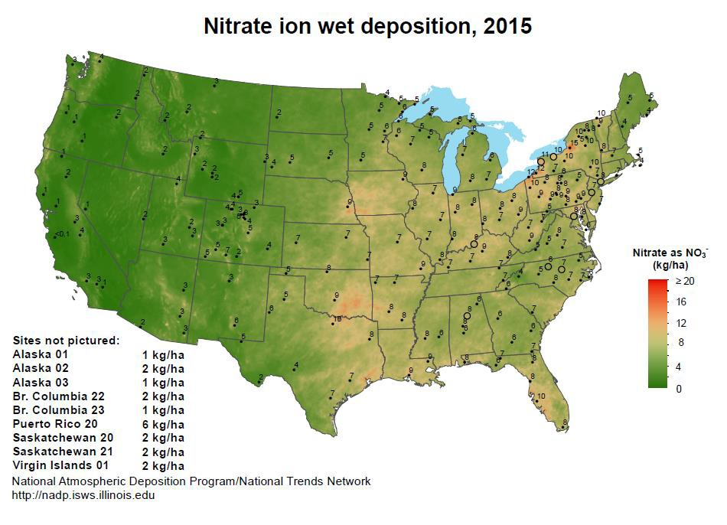
Atmospheric Deposition Model
Regression model for history of wet deposition
Hourly estimate based on
Weather
Physical landscape
Upwind sources

Slide 13
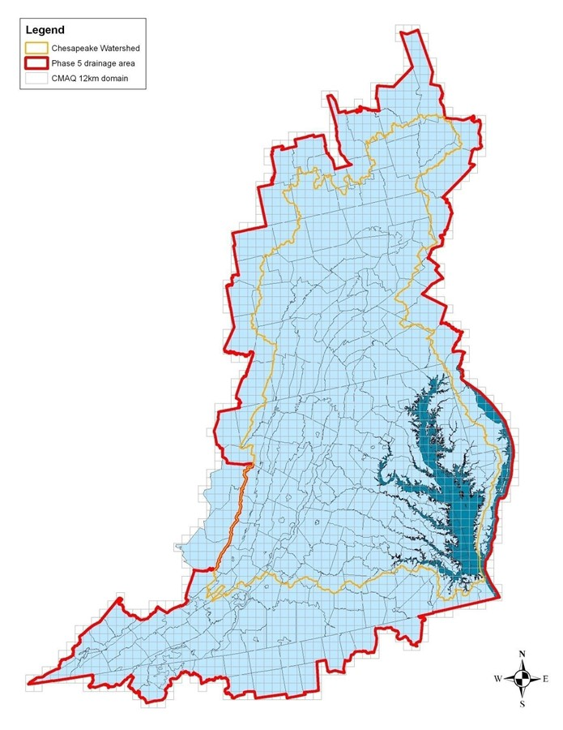
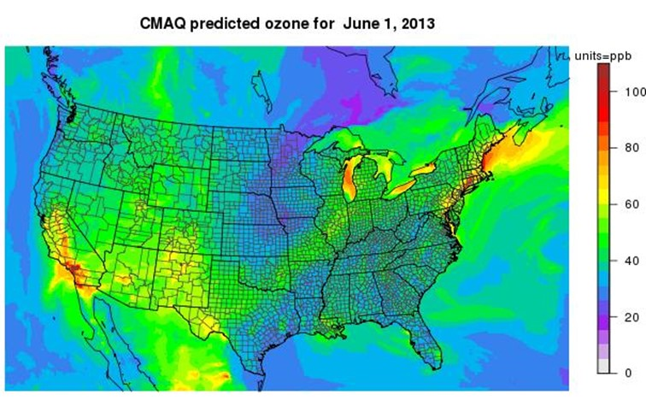
Atmospheric Deposition Model
CMAQ National-scale EPA model
Used for many national air regulations
CBP uses dry deposition and changes in future wet and dry deposition due to policy

Slide 14
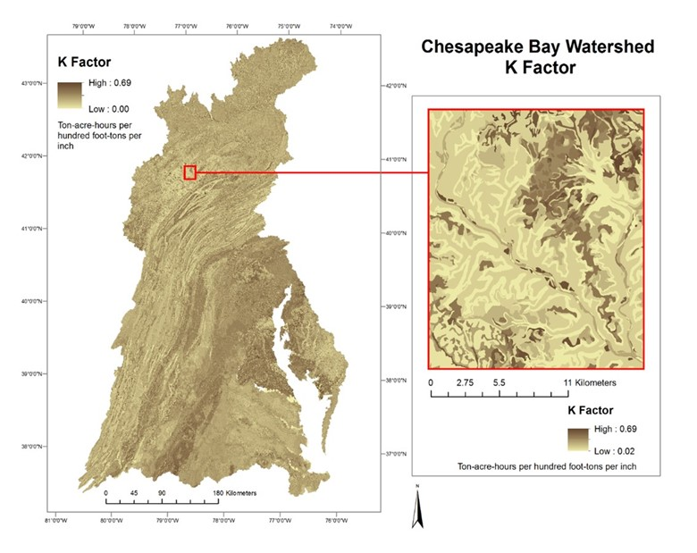
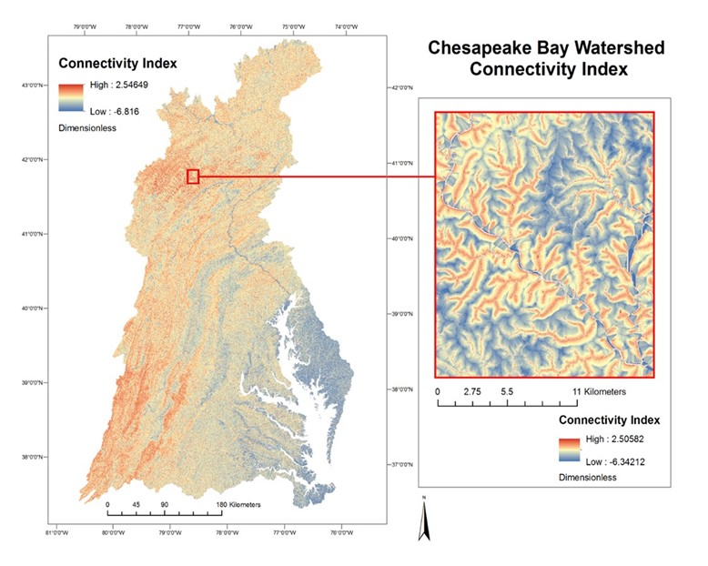
Fine-scale spatial analysis to improve sediment prediction

Slide 15
Sources
WQGIT determines inputs
Ag Workgroup
Ag Modeling Subcommittee
Poultry Litter Subcommittee
Riparian Pasture Deposition Subcommittee
…
Urban workgroup
Wastewater Treatment Workgroup

Slide 16
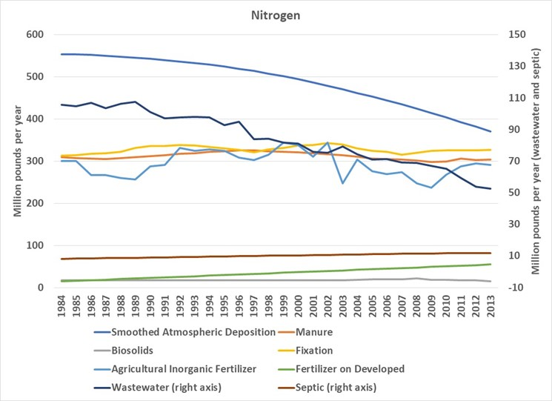

Slide 17
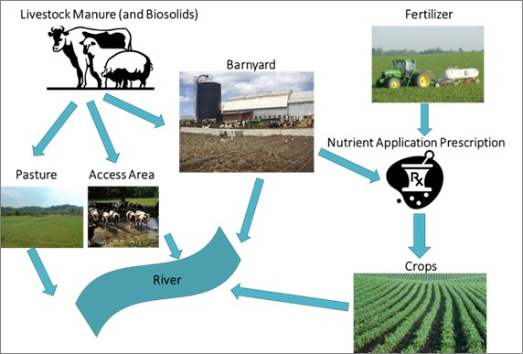

Slide 18
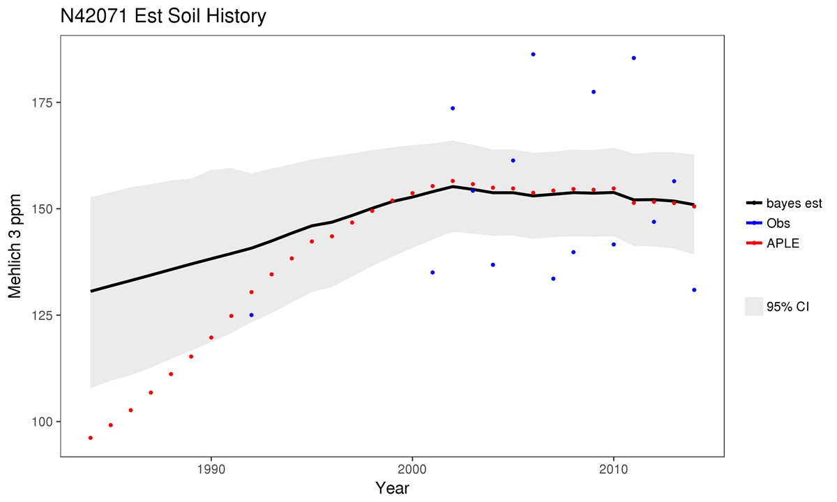
Soil P data – Lancaster
Soil Test Data
Mass-Balance Process Model
Bayesian Estimate

Slide 19
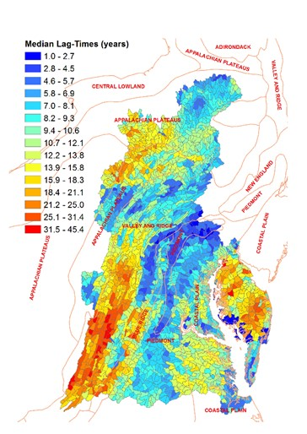
Nitrogen in Groundwater
Used MODFLOW models of Potomac and Eastern Shore from Ward Sanford
Coastal Plain – PC regression model
Others – related to recharge and depth to groundwater

Slide 20
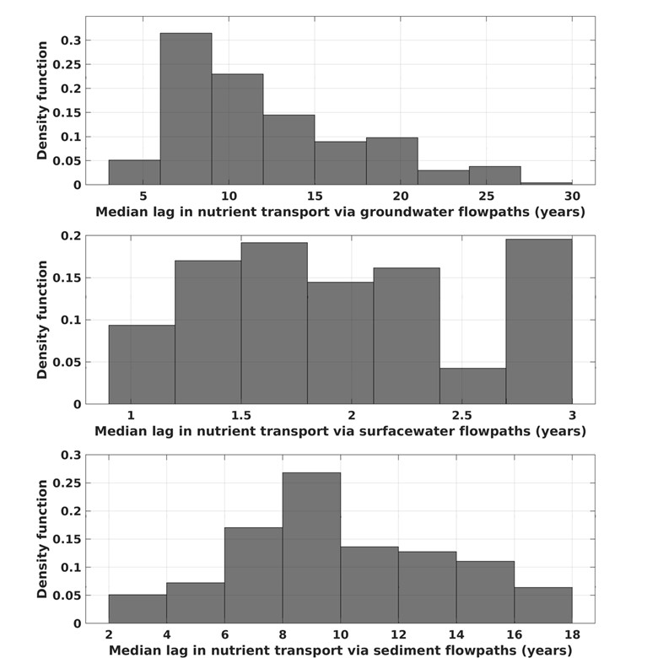
Flowpath Lags
Used in dynamic model for calibration
Not used in scenarios

Slide 21
Management Practices – BMP Panel Results
CBP partnership asks for a panel (WQGIT)
Panel forms for 1-2 years
At least six subject matter experts
Academics
Implementers
Government scientists
…
After approval by the partnership, it is included in the watershed model

Slide 22
BMPs
189 BMPs with specified percent reduction
104 are cover crops
Cover Crop Traditional Rye Early Drilled
Cover Crop Traditional Forage Radish Early Aerial
Appalachian Plateau Siliciclastic TN 11% TP 6% TSS 9%
Coastal Plain Dissected Uplands TN 14% TP 6% TSS 9%

Slide 23
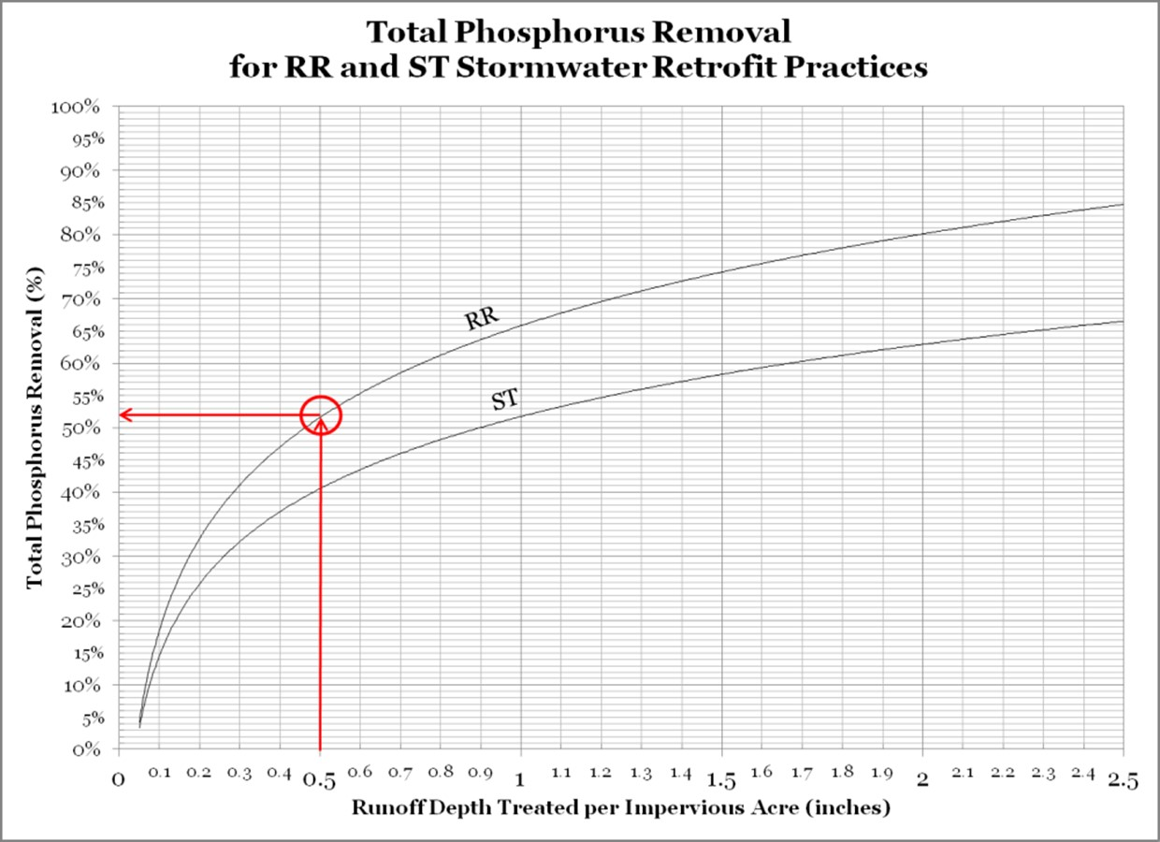

Slide 24
Feed Additives
Stream Fencing
Lagoon Covers
Manure Storage
Manure transport
Nutrient
management

Slide 25
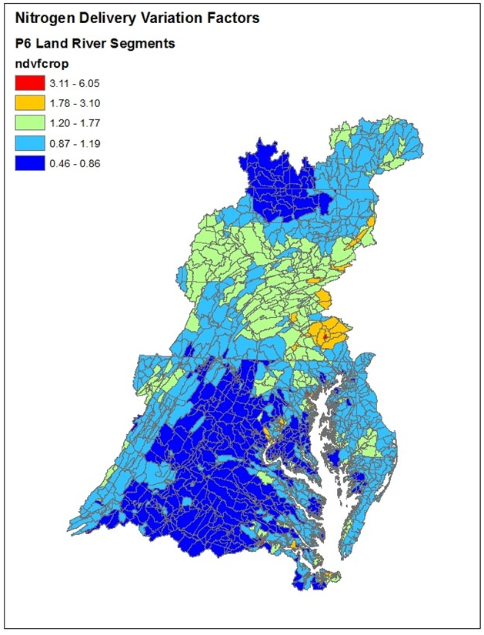

USGS
Sparrow Model
Nitrogen
Land to Water factors
Groundwater recharge
Piedmont Carbonate
Enhanced Vegetative Index
Available water capacity

Slide 26
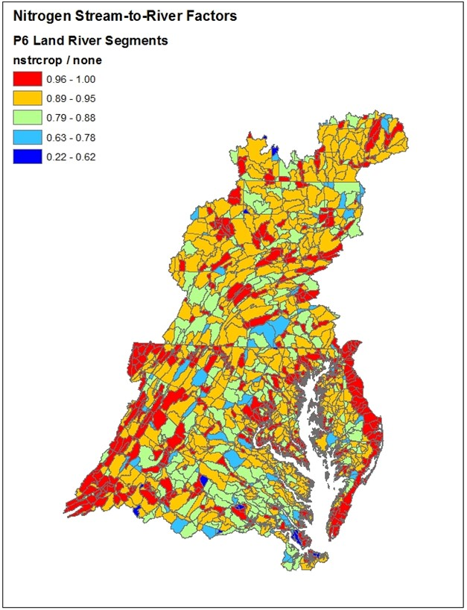
Stream to River factors
Temperature
Travel time
Reservoirs
Nitrogen

Slide 27

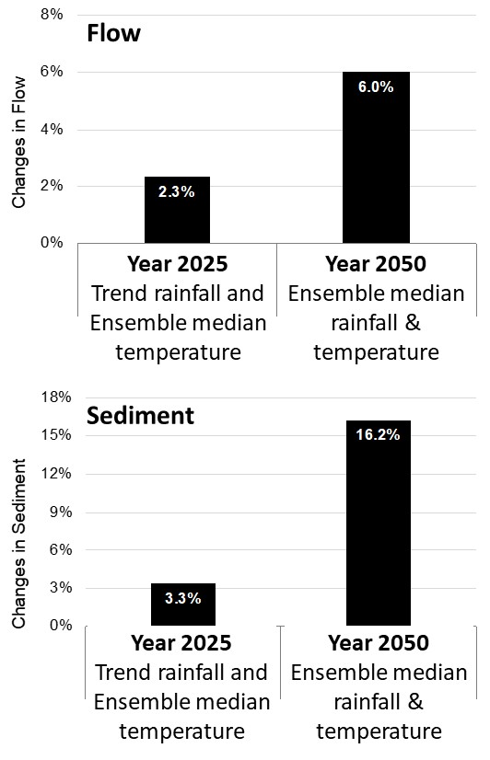
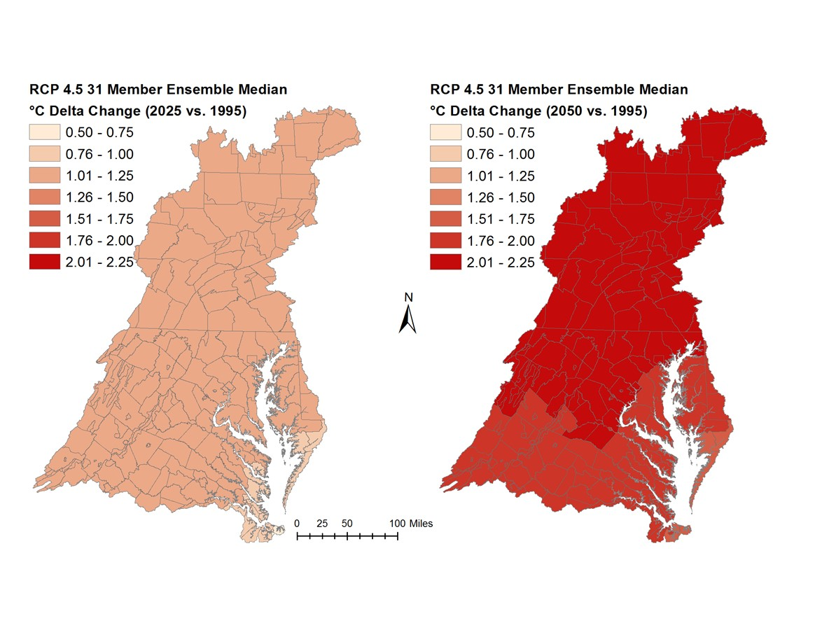
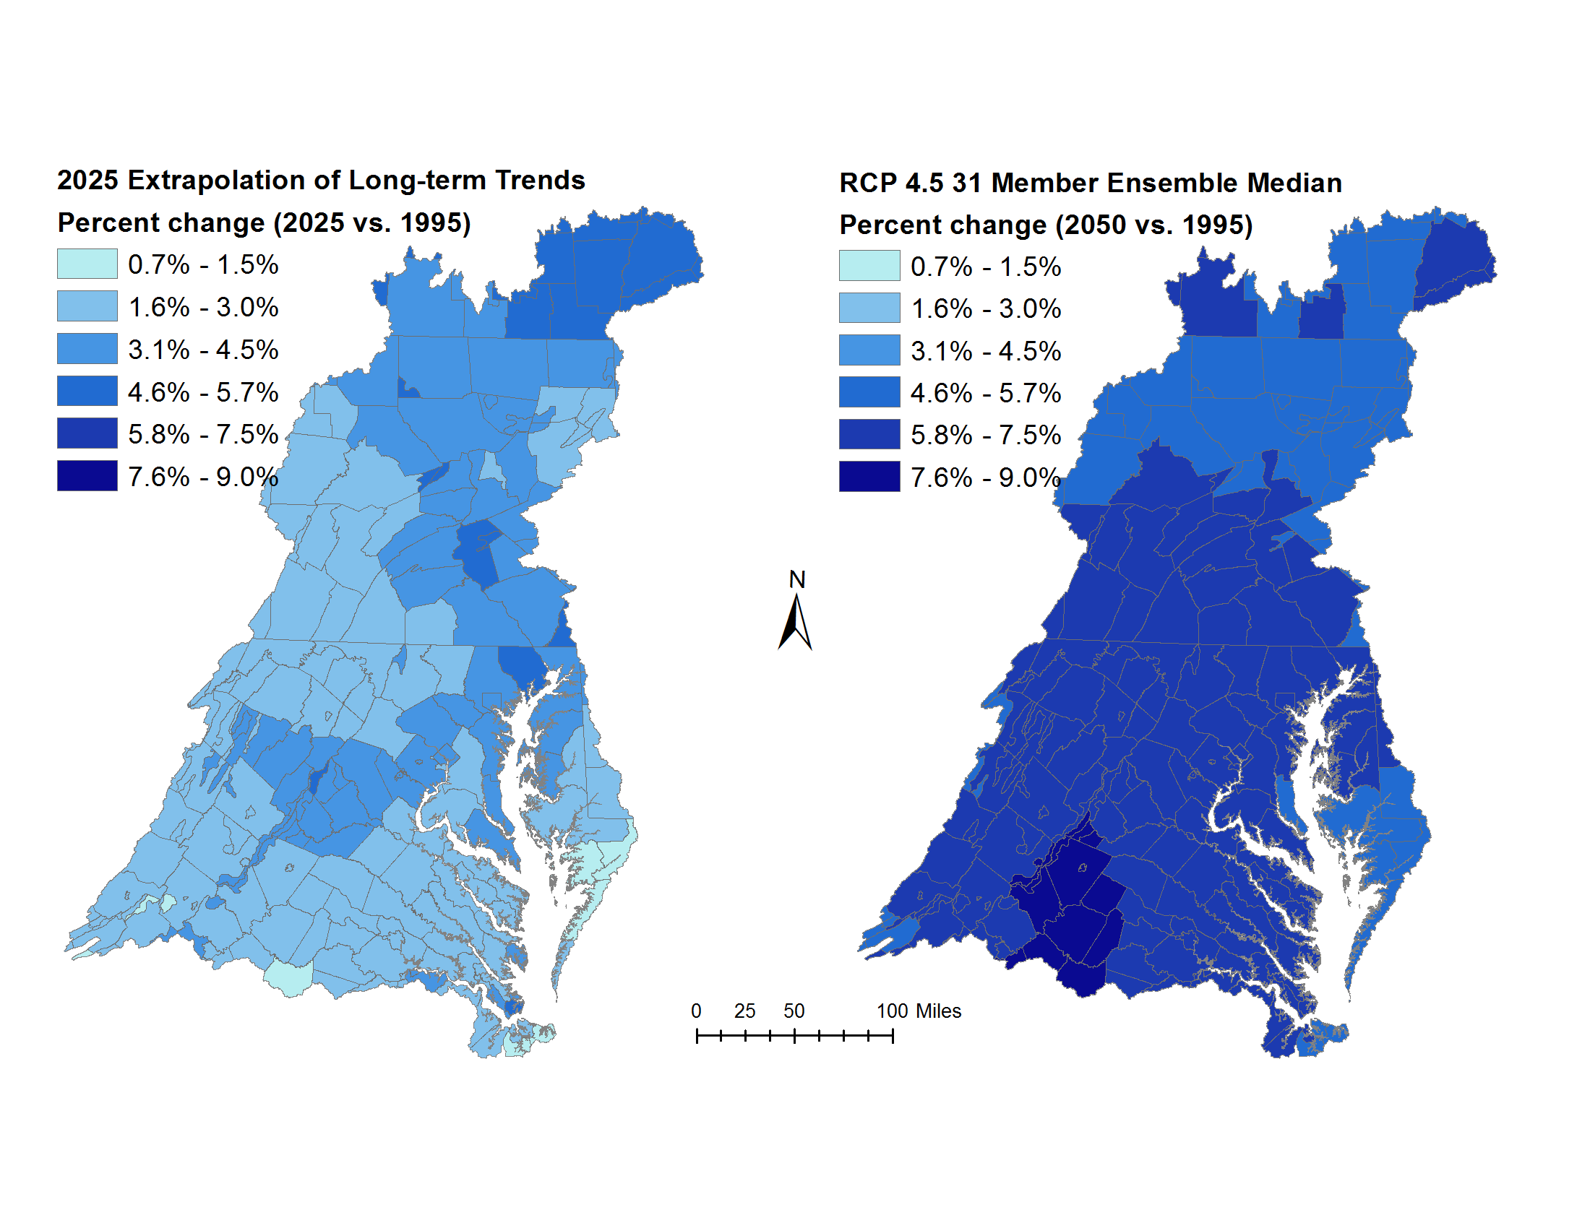
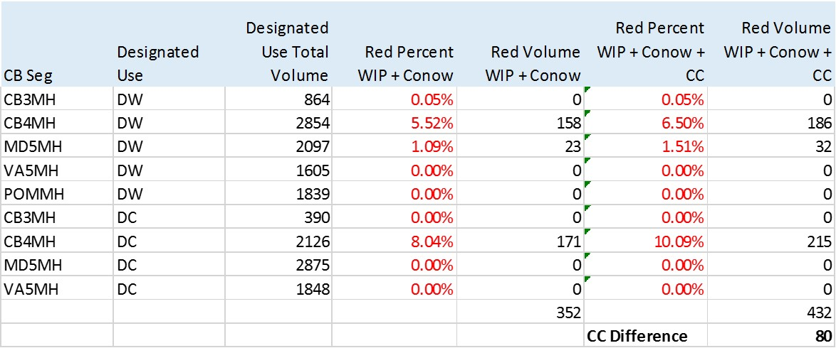
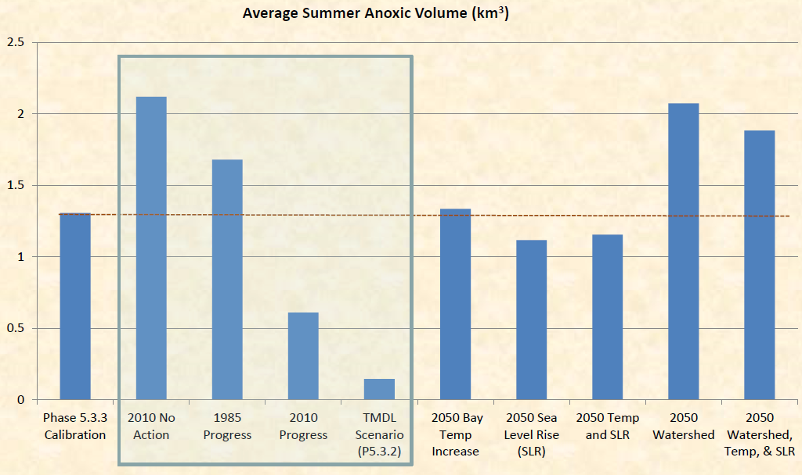
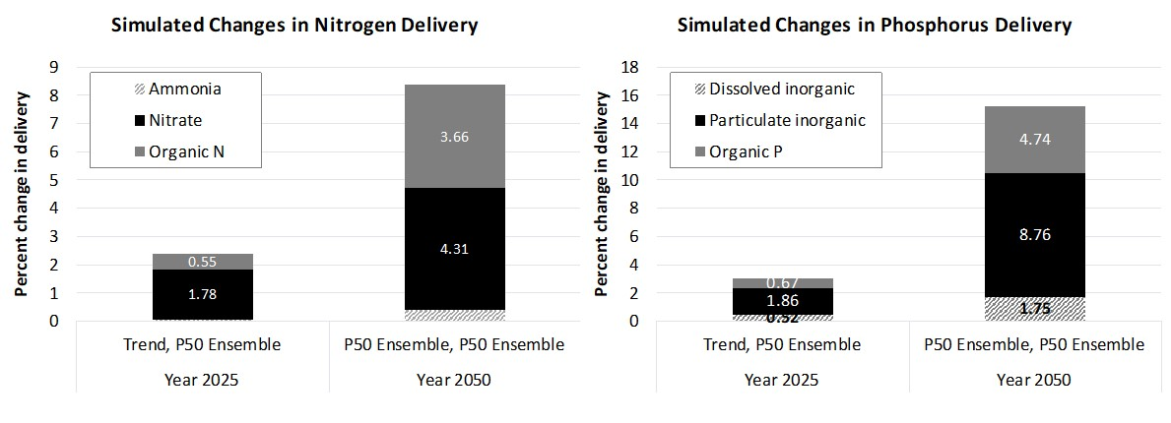
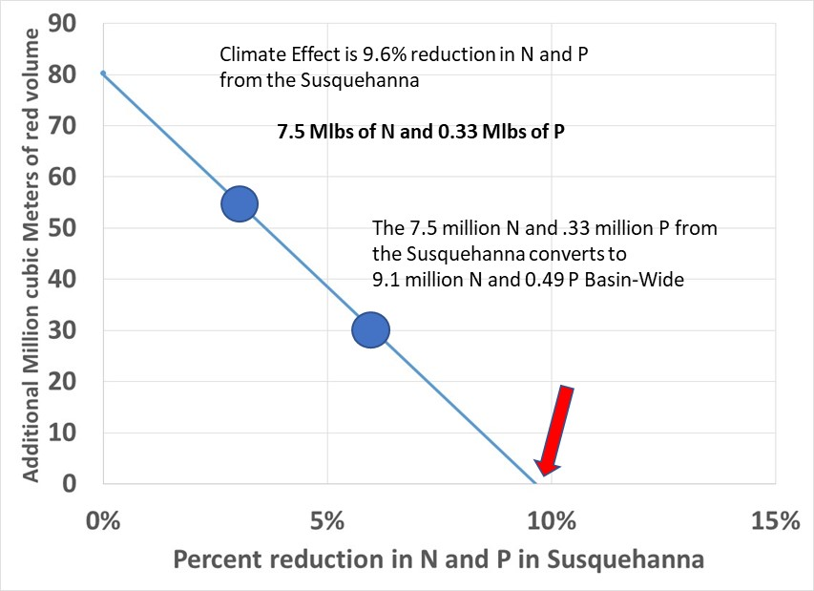
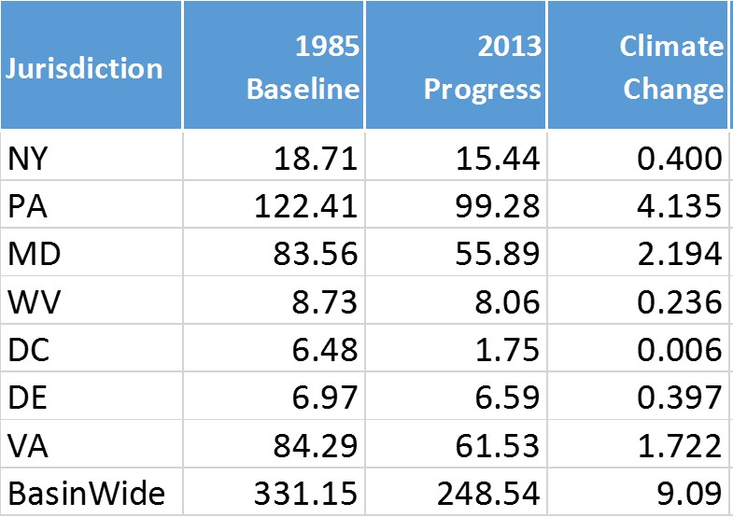
Carbon Dioxide effect
RCP
GCM
Selection
Down-scaling
Support/Revise
Flow--N relationship
GCMs
Investigate
Speciation changes
Process-based response of flow and sediment
On land
Soil P history
effect
Climate scenarios
Observed Precipitation Trends
Extrapolation
Watershed
Specified land nutrient response
Climate
Effect on land use
P sensitivity in developed
Estuary
Nutrient Inputs
Effect on Ag
BMP effectiveness change
Reasonable response to temperature?
BMPs
CMAQ
Climate change effect
Wetlands losses and gains
Growth and respiration curve for phytoplankton
Reasonable response to sea level rise?
Land to water factor effect
Estuarine Model
WQSTM
Land to Water
Wind effects
Loads from flooding
Management
Stream to River factors effect
Estuarine Inputs
Streams
Sea level Rise
Groundwater Travel Time effect
UNEC
Ocean Temp
Reservoir Rules effects
Rivers
Included
Diversion
Effect
Not included
But important
Not included
minor
CSO
Effect
WWTP and septic
Effect
Effect on water quality standards
Management Effort Adjustment
STAC CC2.0
Framework recommendations
Model
Project/Decision
Data Set
Endpoint

Slide 28
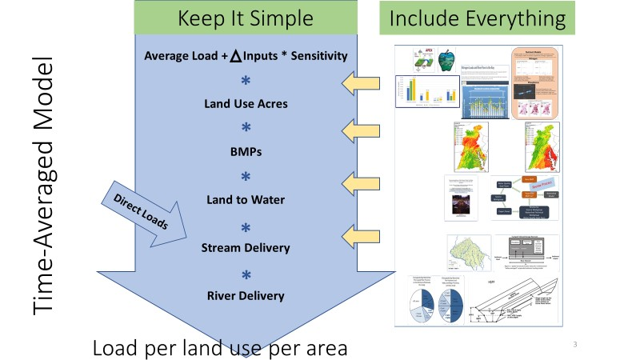

Slide 29
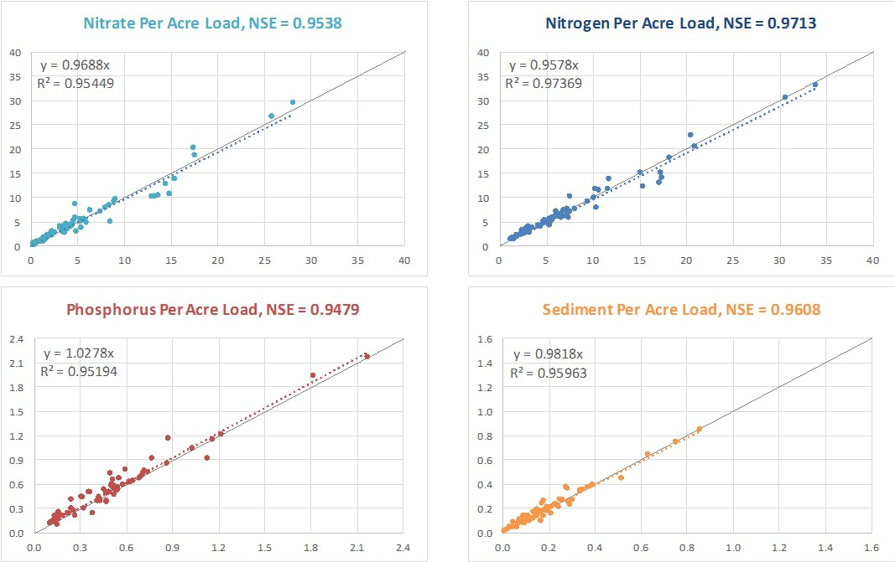
How well does the model predict spatial differences in load?
Simulated Per Acre Load
WRTDS Per Acre Load

Slide 30
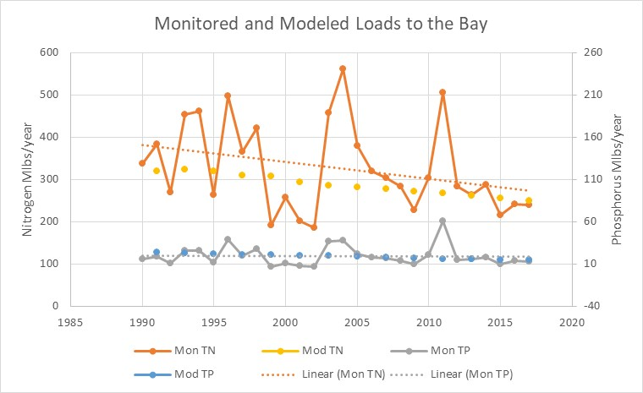
How well does the model predict Temporal differences in load?
CBP loads indicator and CAST scenarios

Slide 31
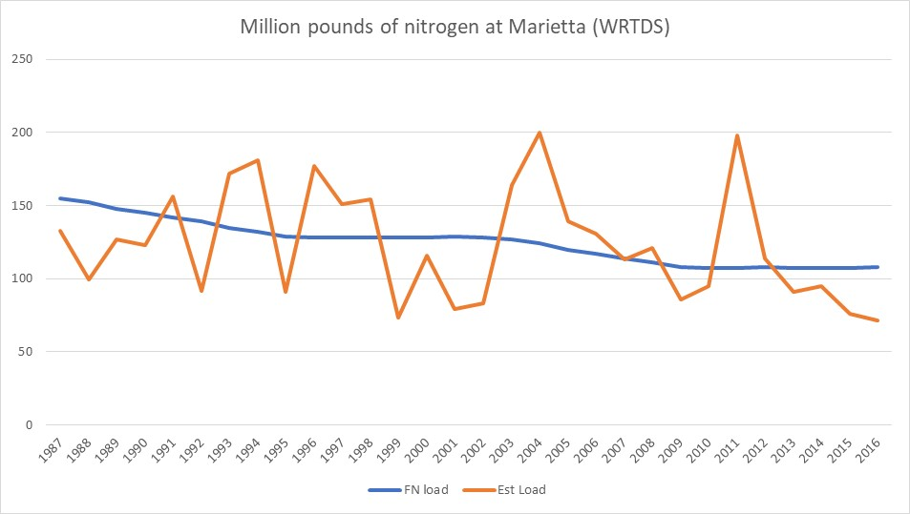

Slide 32
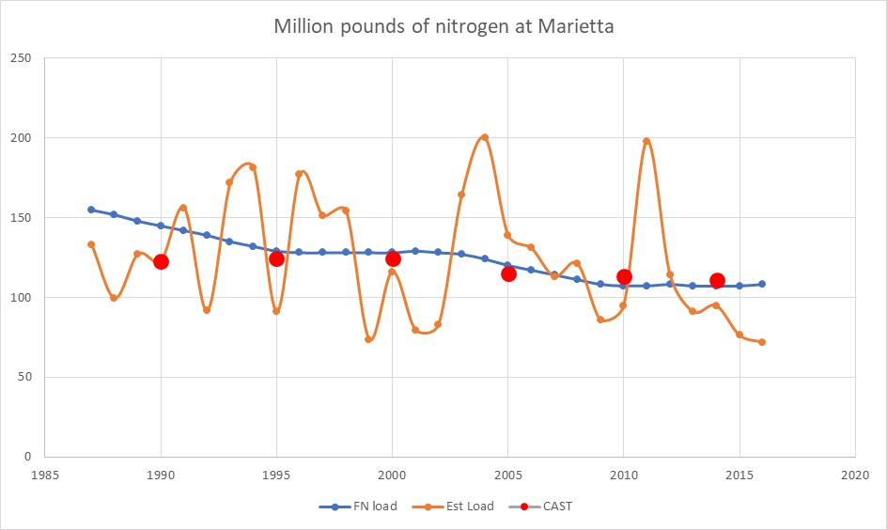

Slide 33
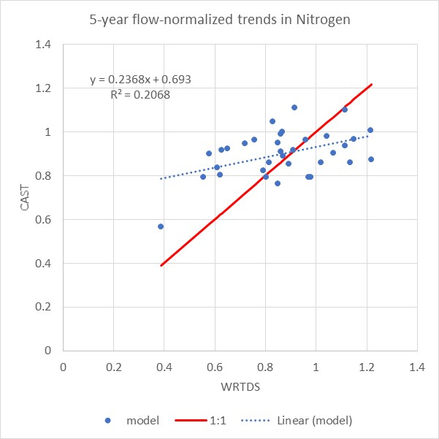
34 stations with long-term data
1985-2014
WRTDS trends
CAST scenarios with constant atmospheric deposition
WRTDS more variable
Average reduction similar
74% directionally correct
Nitrogen

Slide 34
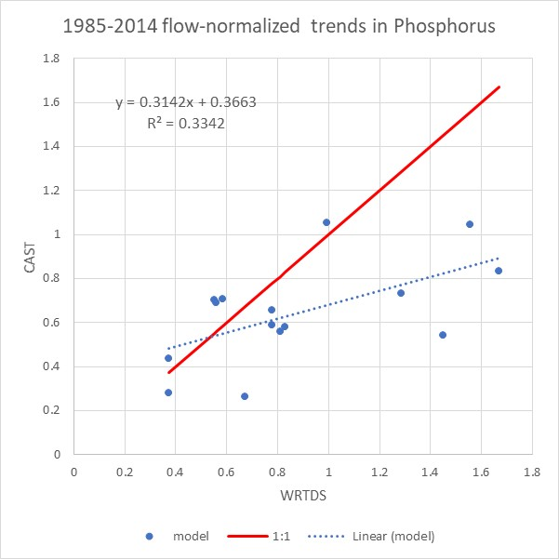
15 stations with long-term data
1985-2014
WRTDS trends
CAST scenarios
WRTDS more variable
Average reduction similar when there are reductions
73% directionally correct
Phosphorus

Slide 35
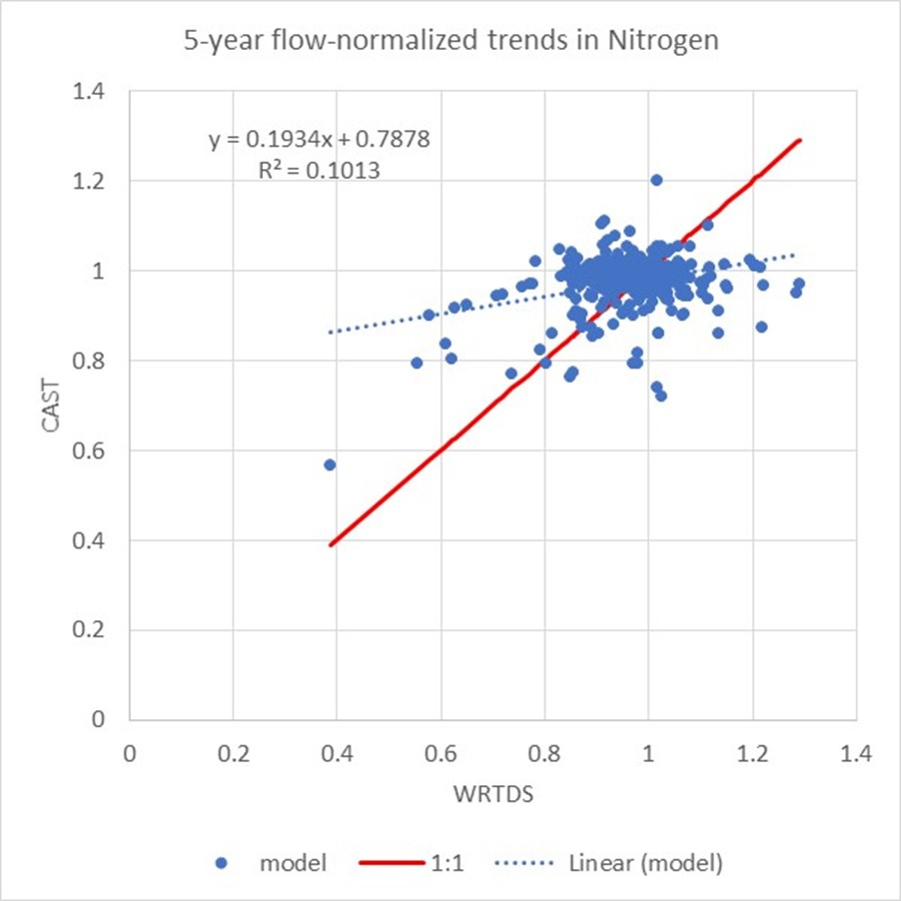
319 5-year trends
1985-2014
WRTDS trends
CAST scenarios with constant atmospheric deposition
WRTDS more variable
58% directionally correct
Likely too short of a time frame
Nitrogen

Slide 36
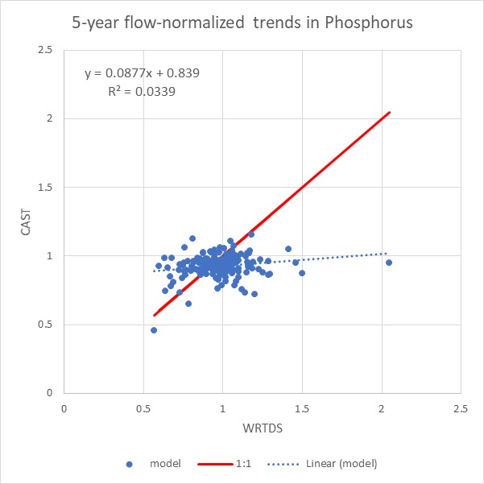
180 5-year trends
1985-2014
WRTDS trends
CAST scenarios
WRTDS more variable
Average reduction similar
59% directionally correct
Phosphorus

Slide 37
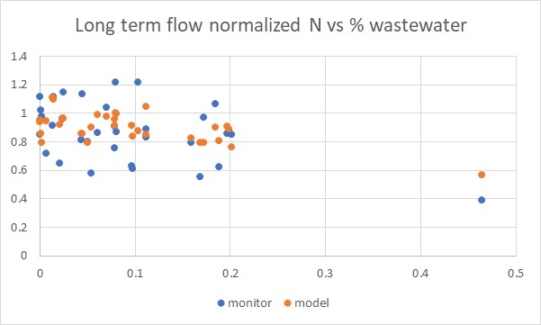
Nitrogen

Slide 38
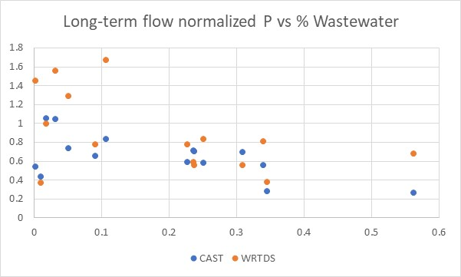
Phosphorus

Slide 39
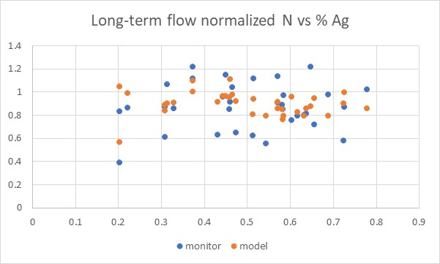
Nitrogen

Slide 40
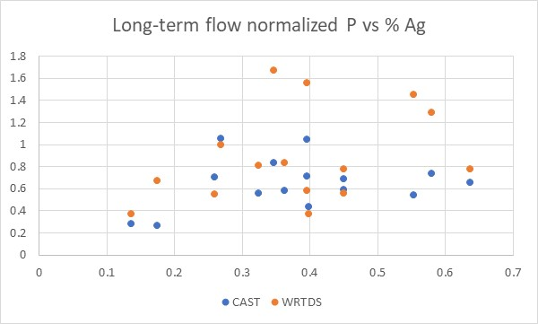
Phosphorus

Slide 41
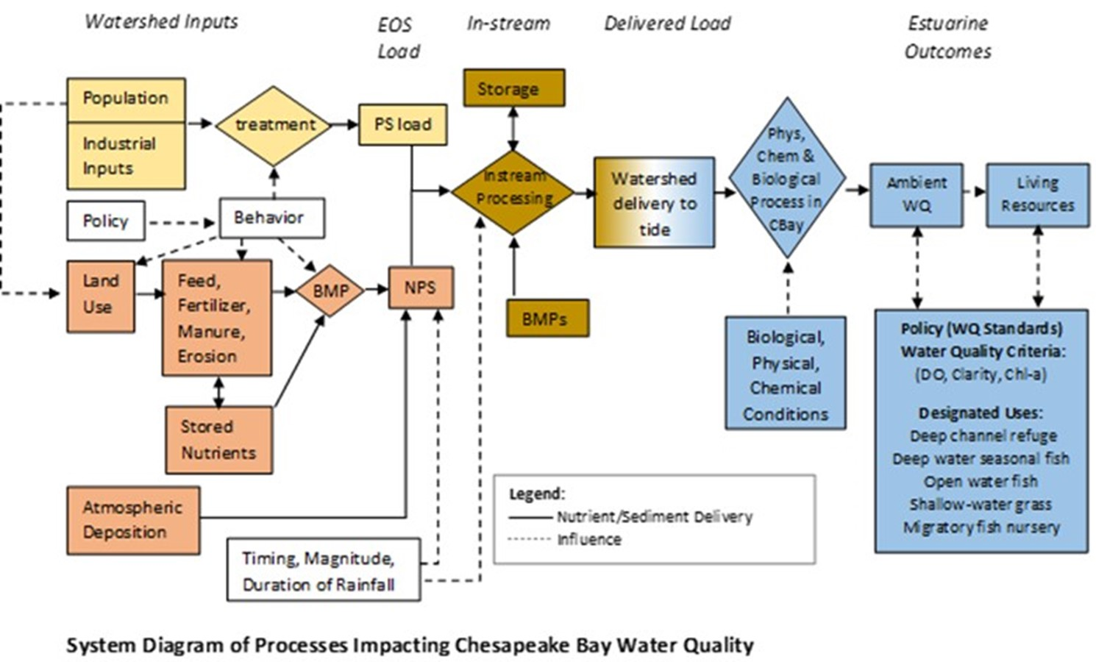
Further investigation
Include atmospheric deposition
What is the effect of lag times
Investigate uncertainty of both WRTDS and CAST
Attempt to isolate factors =>

