Slide 1
Connecting Soil Health and Watershed Health
Mark Tomer
USDA-Agricultural Research Service
Ames, Iowa

Slide 2
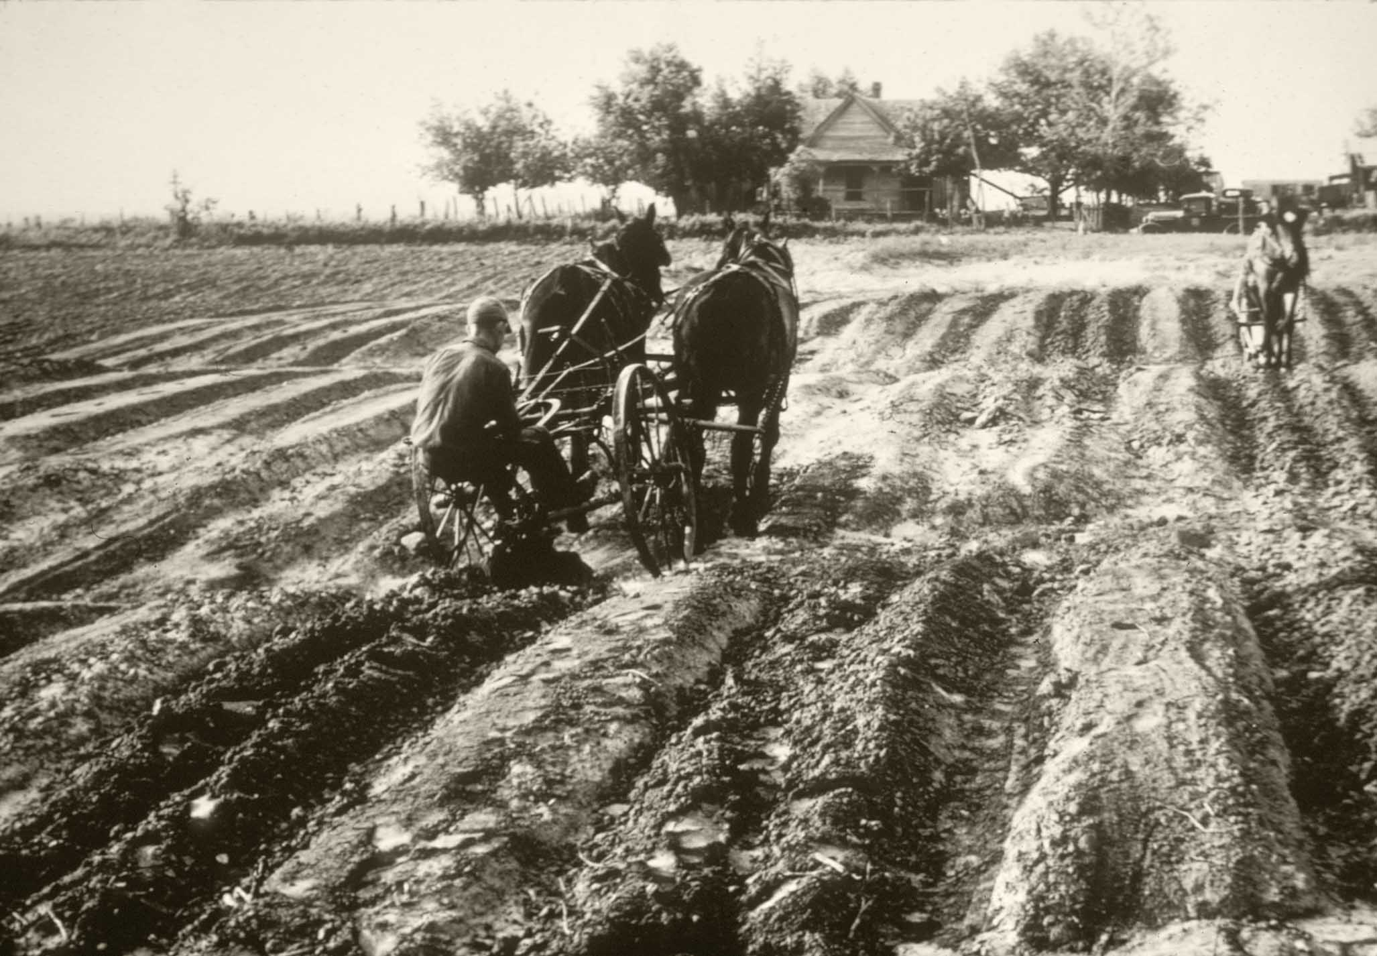
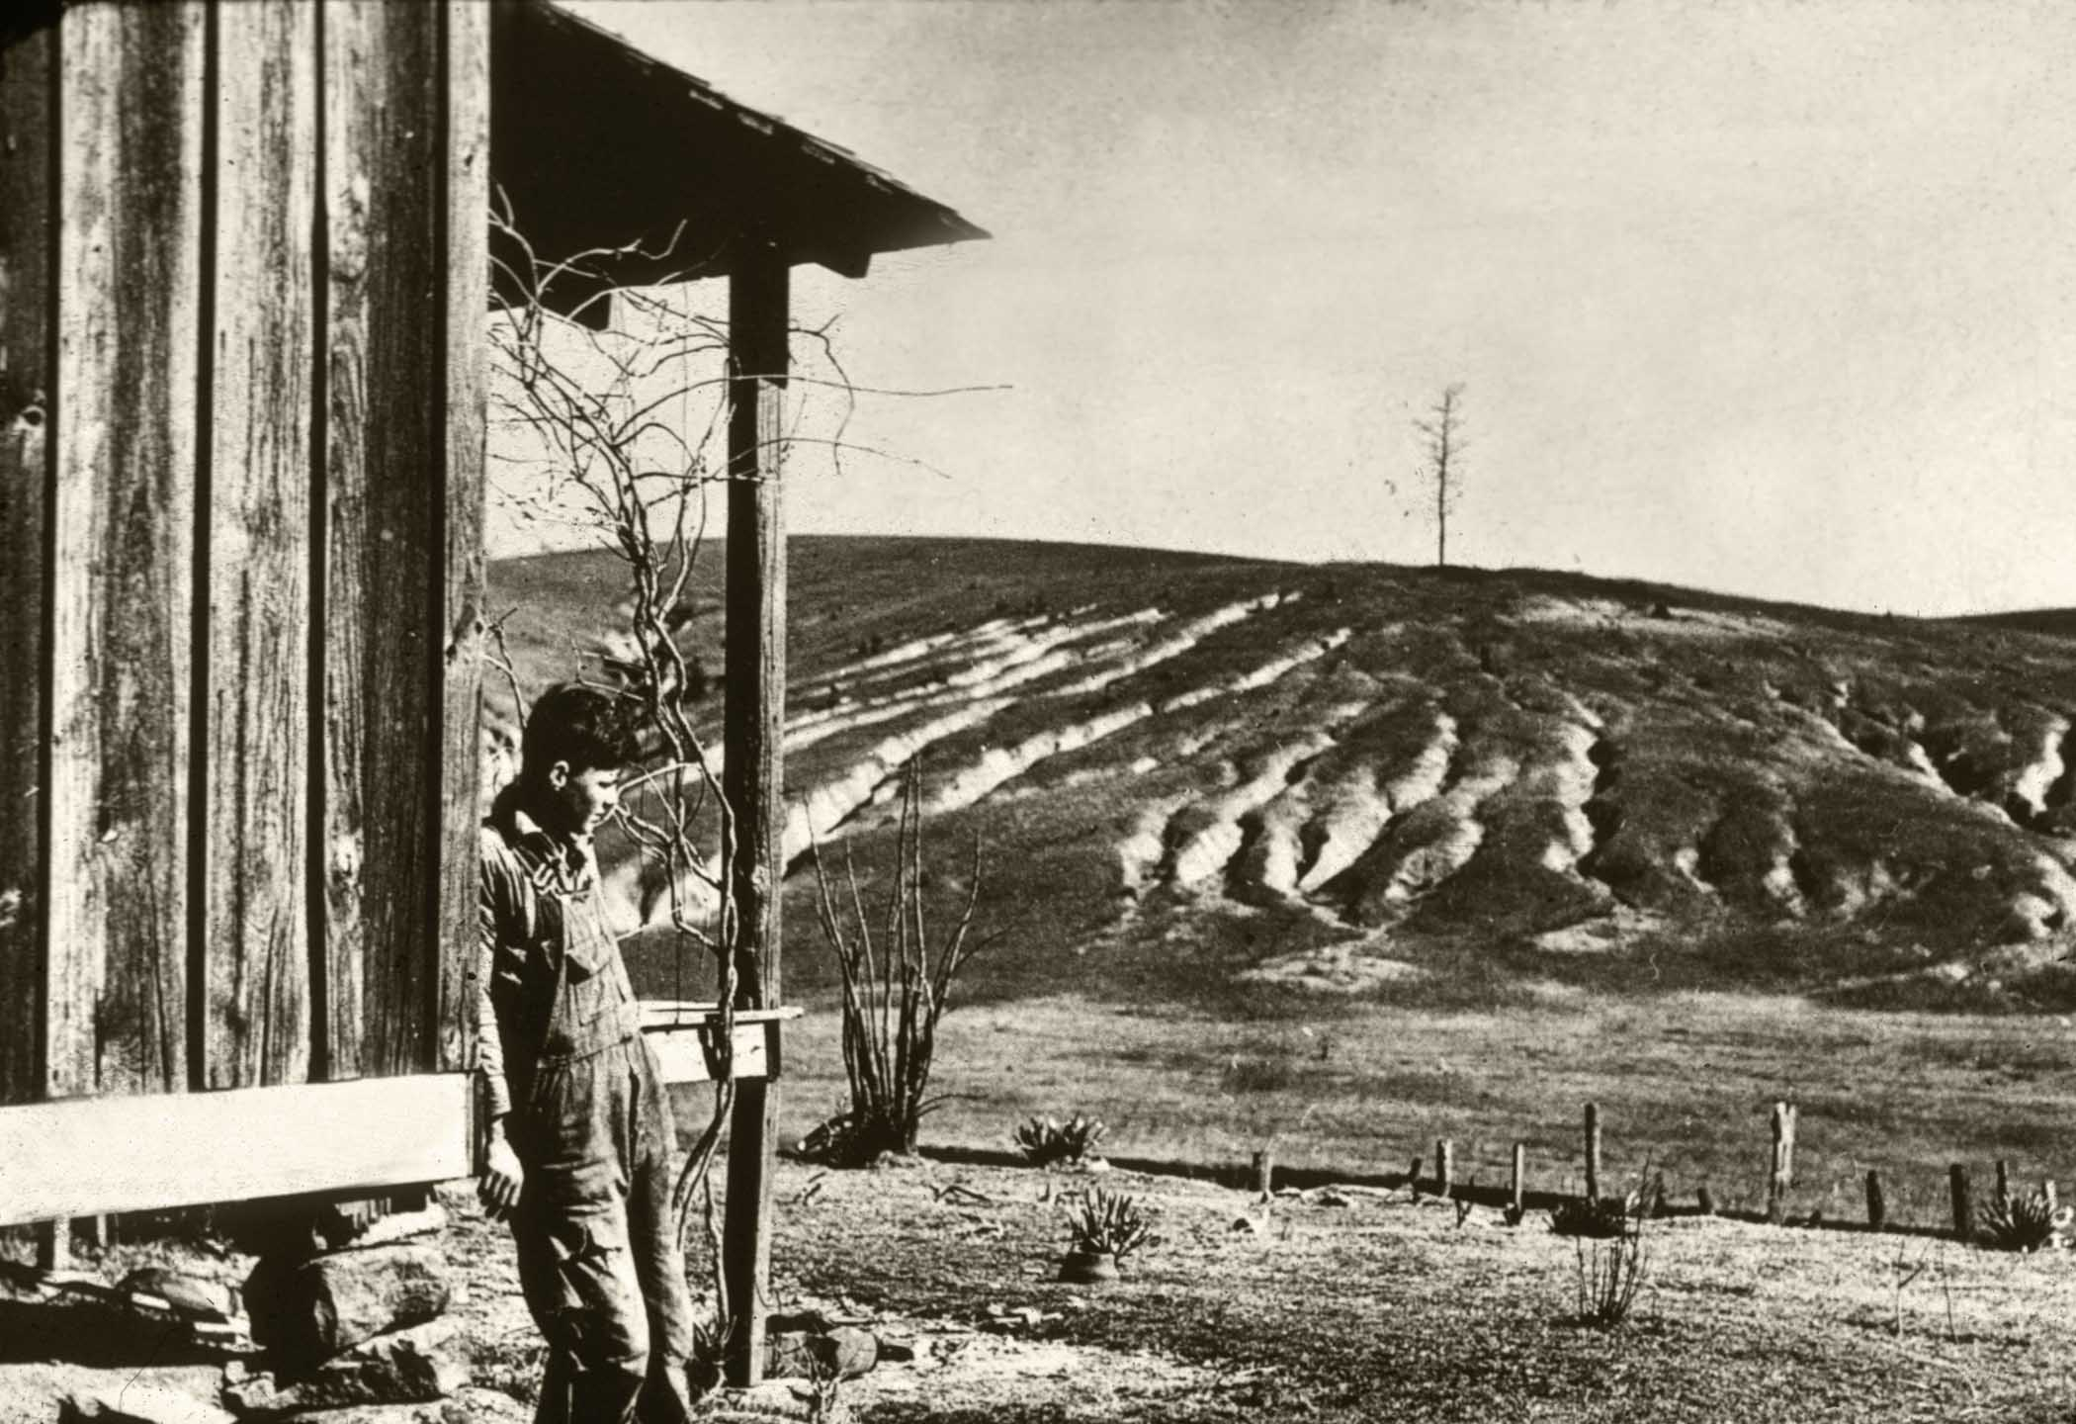

Slide 3
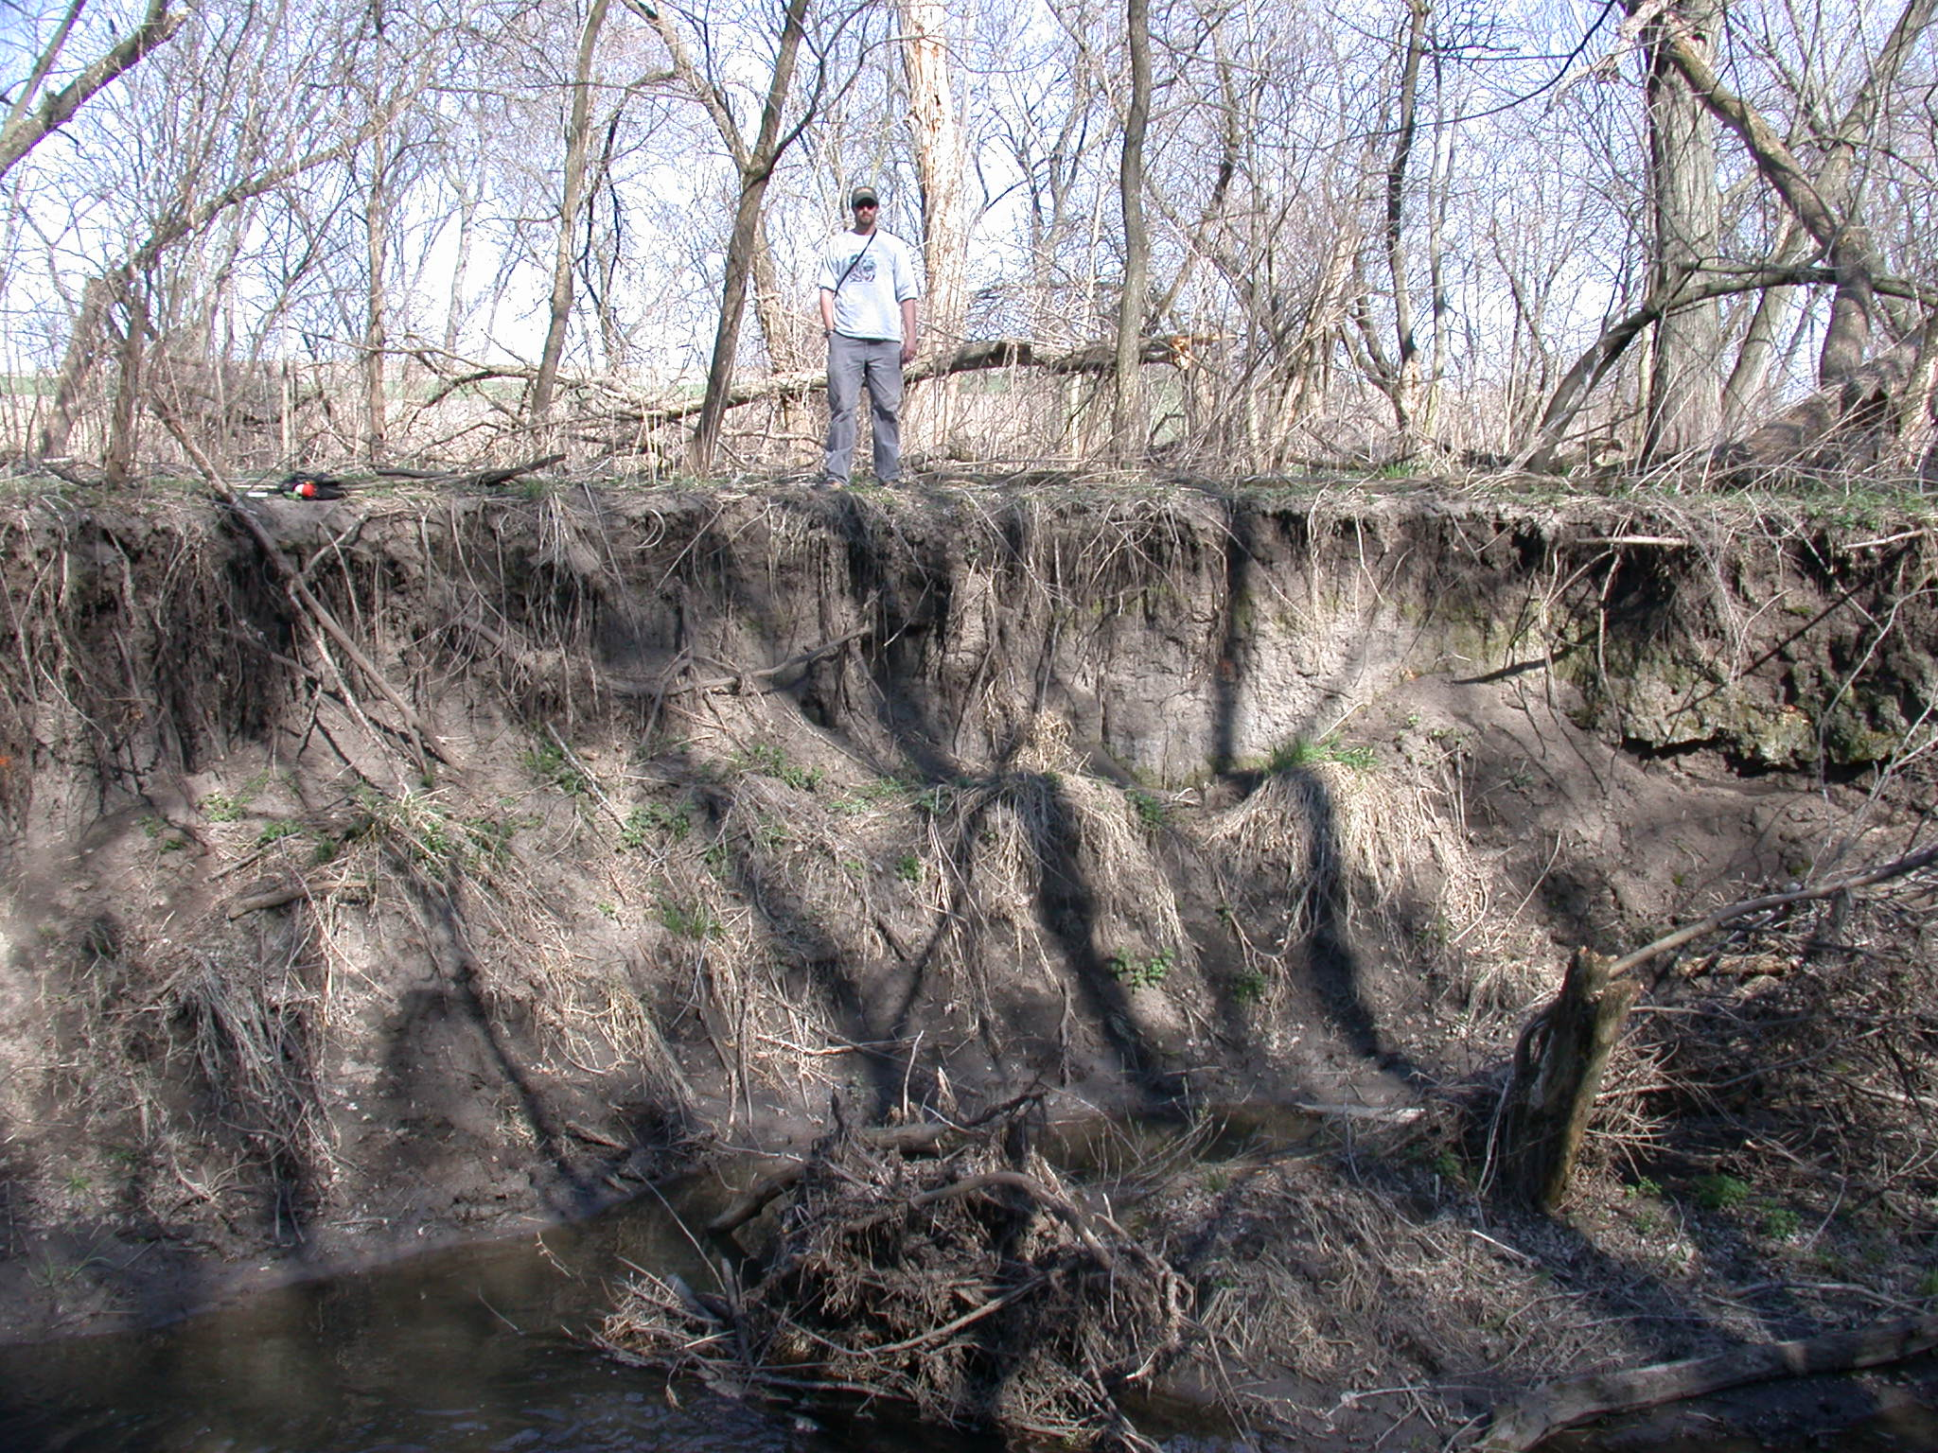
Post-settlement
alluvium
Pre-settlement soil surface

Slide 4
Disclaimer:

Slide 5
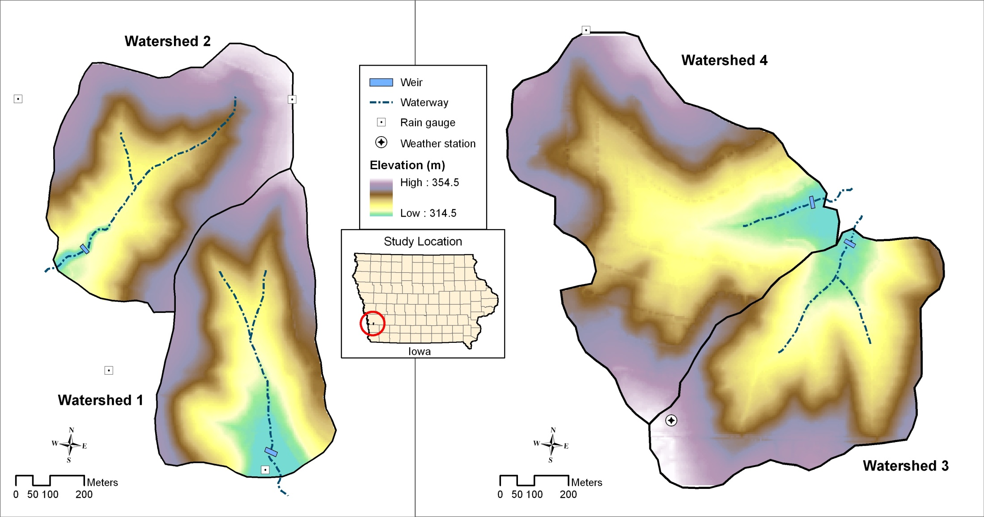
Deep Loess Research Station: Watersheds & Experimental design
Conventional Tillage:
1971-1995
Ridge Tillage:
1971-1995
(plus terraces)

Slide 6
The conservation watershed showed lower bulk density (by 0.08 Mg m⁻³), and higher organic carbon content (by 0.42% mass).
Implications for field water contents?

Slide 7
Effect of conservation practices on stream hydrology: flow duration curves
baseflow
runoff
Ridge-till
Conventional-till
Conventional-till
Ridge-till

Slide 8
After each of four droughts, baseflow recovered more rapidly in watersheds under conservation tillage than those under conventional tillage

Slide 9
Impact of management change:
Conventionally tilled watersheds both converted to no-tillage in 1996,
With a Corn-soybean rotation in W1, and a
Six-year (CSCAAA) rotation in W2

Slide 10
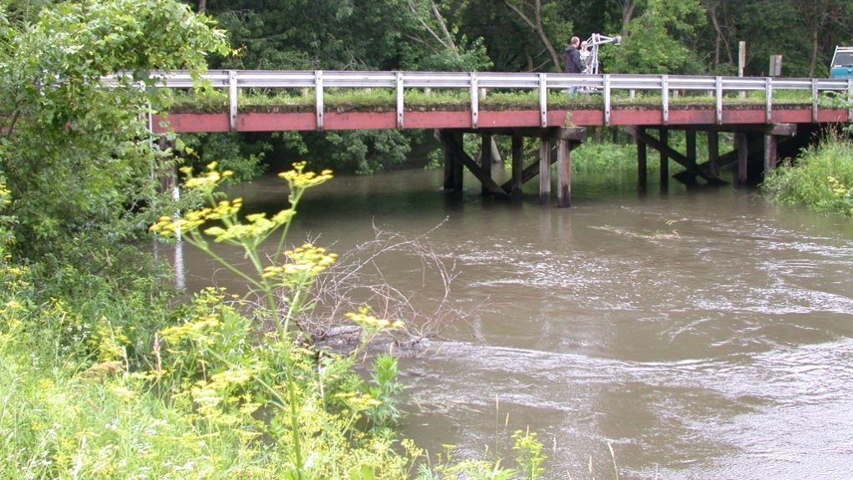
Changes in NO₃-N and total P concentrations during a runoff event

Slide 11
Nutrient Transport: General Truths Contrasting N versus P
Nitrogen:
Biologically complex
Dominant form is a gas
Easily leached from well-drained soils
Subsurface transport
Seasonally dynamic
Released from saturated soils as a gas
Phosphorus:
Chemically complex
Not any gaseous form
Strongly adsorbed in well-drained soils
Surface transport
Episodically dynamic
Released from saturated soils in dissolved form

Slide 12
No-tillage
Conservation crop rotation

Slide 13
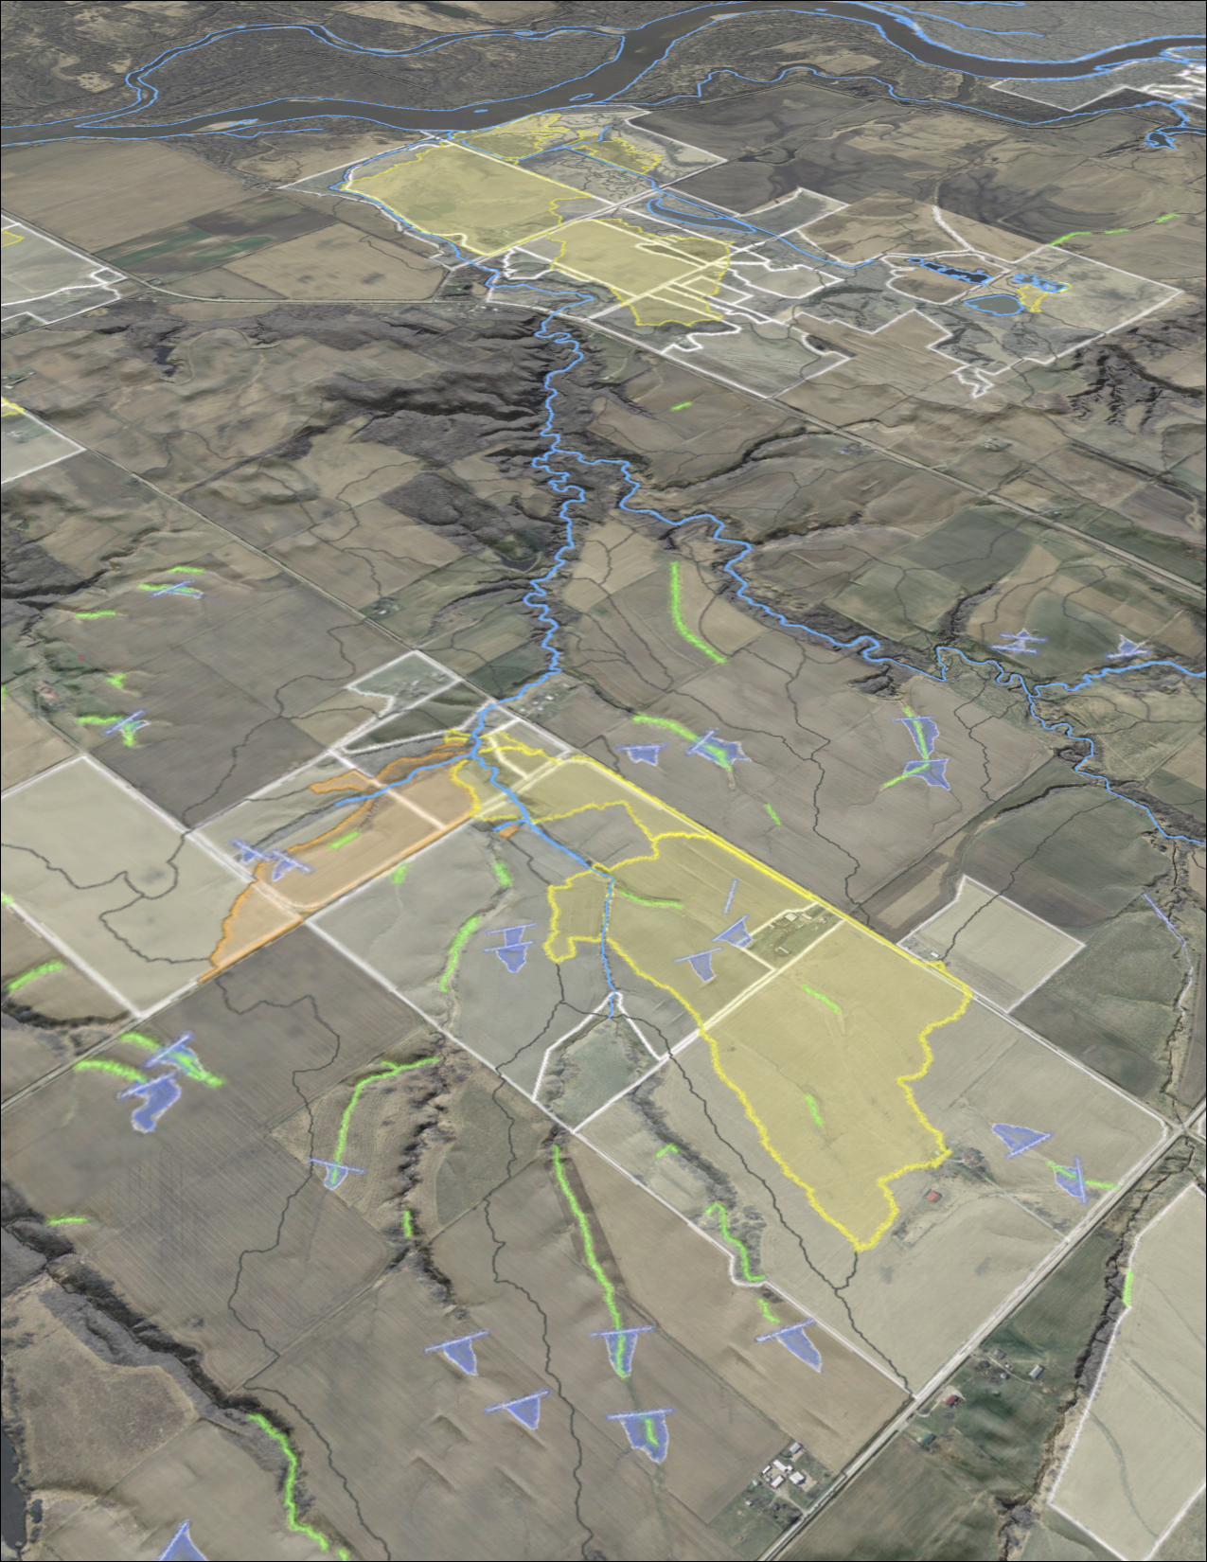
Agricultural Conservation Planning Framework:
A data-driven toolset for watershed conservation and landscape research

Slide 14
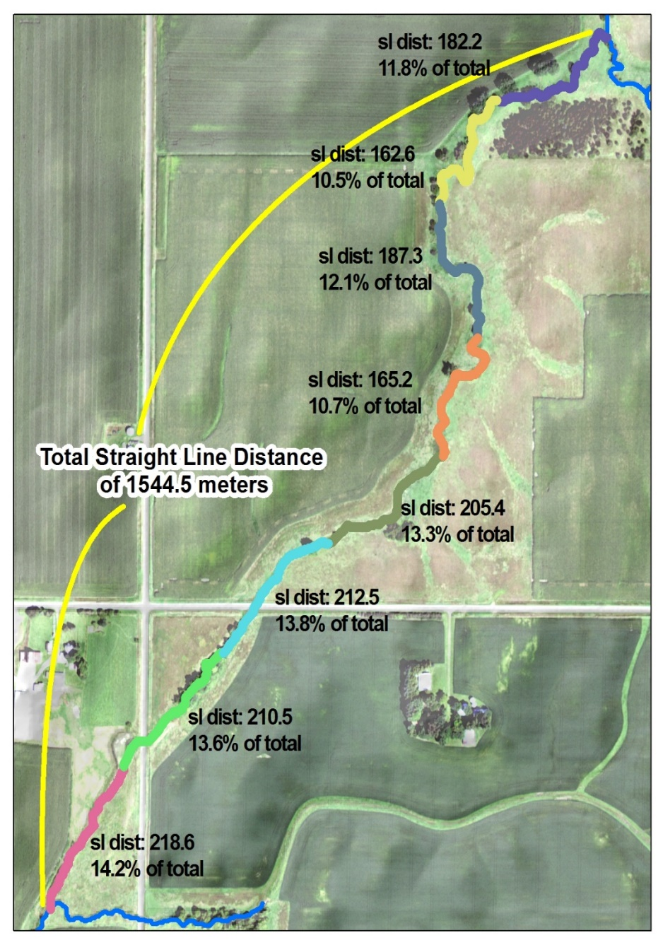
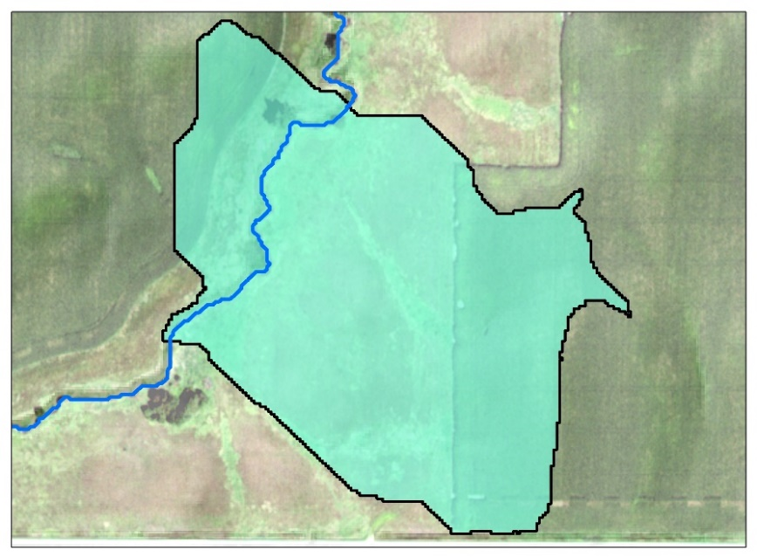
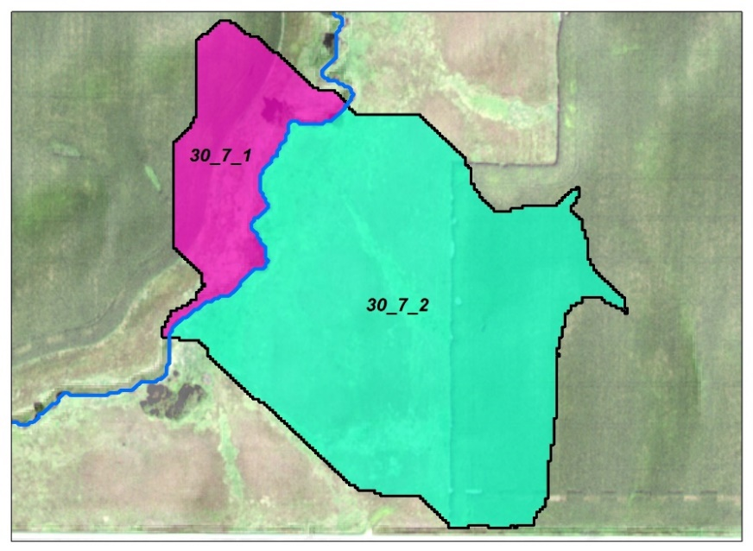
ACPF Version 3 - Riparian catchments: Discretizing watersheds by riparian segment lengths
Define Watersheds to each stream segment
Split watersheds by stream

Slide 15
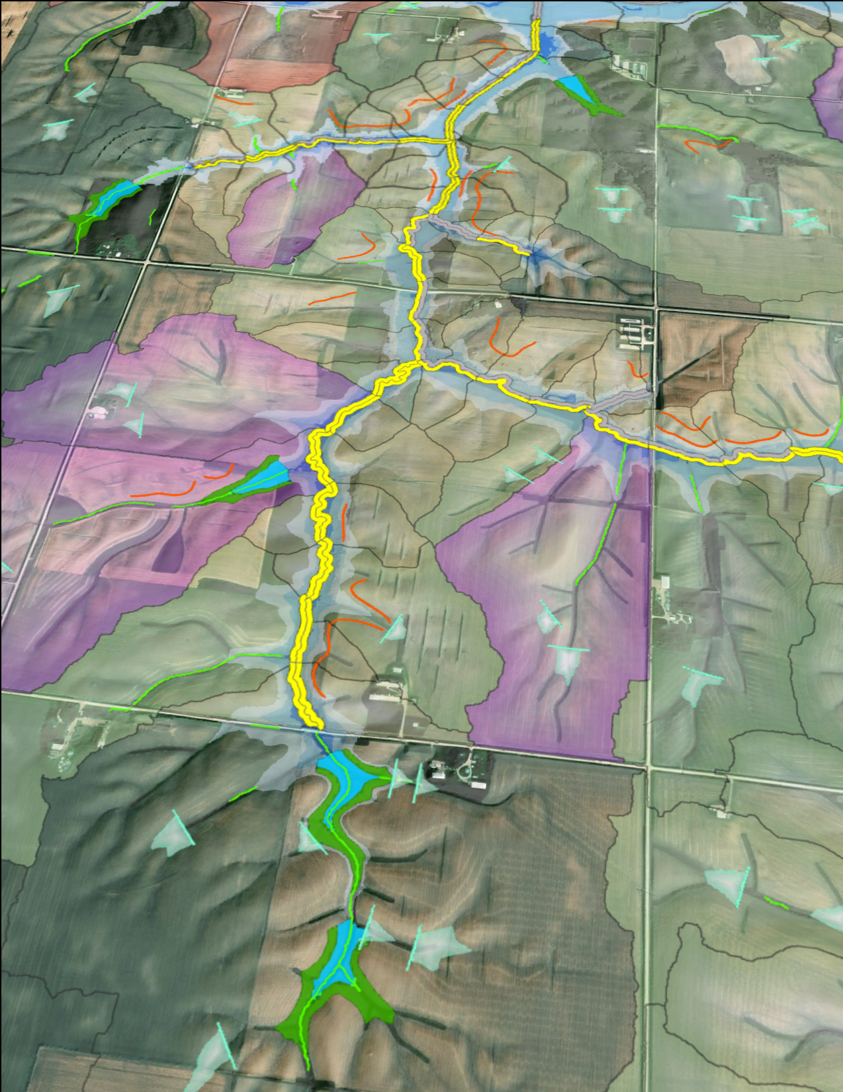
Research results on landscape capacities-
Quantifying water storage capacities of different landscapes based on specific practices (flood water detention)
Quantifying densities at which different EOF practices can be placed (siting potentials)
Quantifying saturated buffer placements relative to distribution of tile drainage
Prioritizing locations where riparian buffers can treat disproportionate delivery of nutrients from cropland

Slide 17
Summary
Soil improvement has significant potential to reduce impacts of flood and drought.
Diversified crop rotations provide important options for soil improvement and addressing environmental trade-offs often associated with conservation management.
Analysis tools are available that enable researchers to develop a greater landscape-based cognizance of opportunities and challenges for soil and water conservation unique to any given watershed.

Slide 18
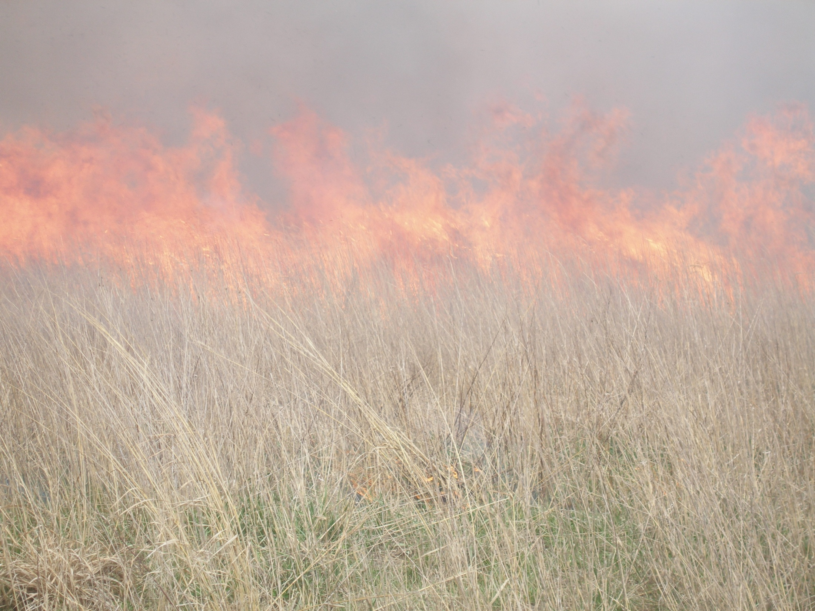
QUESTIONS?

