Slide 1
Drainage requirements to maintain soil health
Jeff Strock
Southwest Research and Outreach Center
Lamberton, MN
Linking Soil and Watershed Health to
In-field and Edge-of-Field Water Management
January 23-24, 2020
Source: Northwest MN Arts Council

Slide 2
Comment on phosphorus in tile drainage
Elevated P loss from drainage system; some plausible explanations:
Soil texture?
Plant available soil P?
History of manure applications?
Artifact of new tile drainage?
Preferential flow?
Reductive dissolution of P?
Mineralization of SOM?
Dissolution of P minerals?
Sorption/desorption of P from sediment in tiles?
Microbial reduction?

Slide 3
Key Points
Proper water management (aka tile drainage) in the root zone is necessary to maintain adequate soil water conditions for:
healthy plant growth and optimum yield.
healthy soil biological communities and biological function.
It is not a matter of either or but rather both and

Slide 4
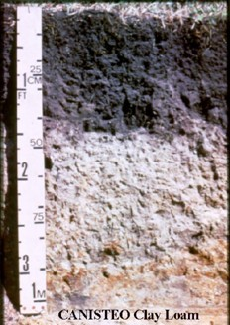
Soil function
carbon sequestration
~
climate security
plant production
~
food security and biodiversity
OM // nutrient cycling
~
resource use efficiency
habitat for biological activity
~
biodiversity
filter and buffer for water
~
water security, flood protection

Slide 5
Stability of soil function
Resistance is defined as the capacity to resist change due to an in imposed disturbance
Resilience is defined as the capacity to return to a pre-disturbed/stressed condition.
Source: Mark Tomer, 1/23/20

Slide 6
physical properties
~
AWC and soil water retention
gas exchange
~
O² and CO₂
carbon mgmt.
~
structure, aggreg.
microbial activity
~
WFPS
60% & 80%
plant disease
~
water logging
soil temp.
~
SWC, thermal conductivity
root growth
~
water logging
fire
pH, liming
environmental disturbance
management disturbance
flood-drought
acid rain
texture
tillage
freeze-thaw
cycles
hot-cold
cycles
nutrients
cropping
system
wet-dry
cycles
compaction
resistance
resilience
Importance of drainage
beyond agronomics and economics
tolerance
adaptation
regulation
cycles
ecosystem
function,
services
Scale
rate
process
productivity

Slide 7
Example Disturbances and Responses
Disturbance
Response
Extreme precipitation:
wetting-drying cycles // flooding // drought
Extreme temperature:
hot-cold // freeze-thaw cycles
Nutrient availability (macro and micro nutrients)
deficit – excess
Inorganic amendments // organic amendments
Compaction
Fire
Respiration
Enzyme activity
Microbial growth rates
Microbial biomass carbon
Fungal growth rates
Soil structure/aggregate stability
Decomposition rates
Water availability
Nitrification // Denitrification rates
B.S. Griffiths and L. Philippot, FEMS Microbiology Reviews, (2013), 37:112-129

Slide 8
Soil Water Content and Microbial Activity
Conceptual relationship between percent water filled pore space (WFPS) and relative biogeochemical process rates. (Adapted from Linn and Doran, 1984, and Lohse et al., 2009).
Relationships between the decomposition constant with temperatures and moisture classes of 79 soils across Italy. (From Alessandro Petraglia et al., 2019)

Slide 9
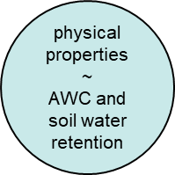
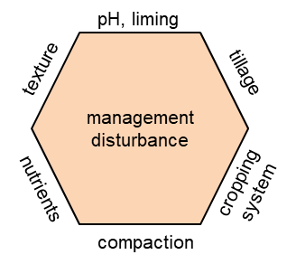
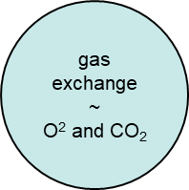
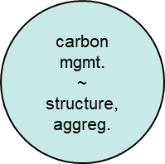
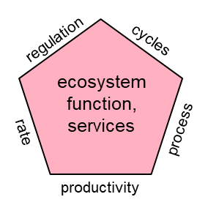
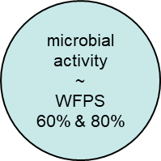
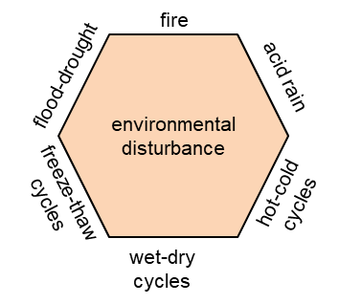
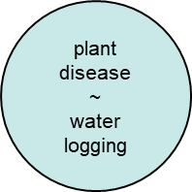
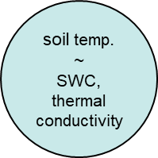
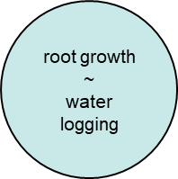

Slide 10
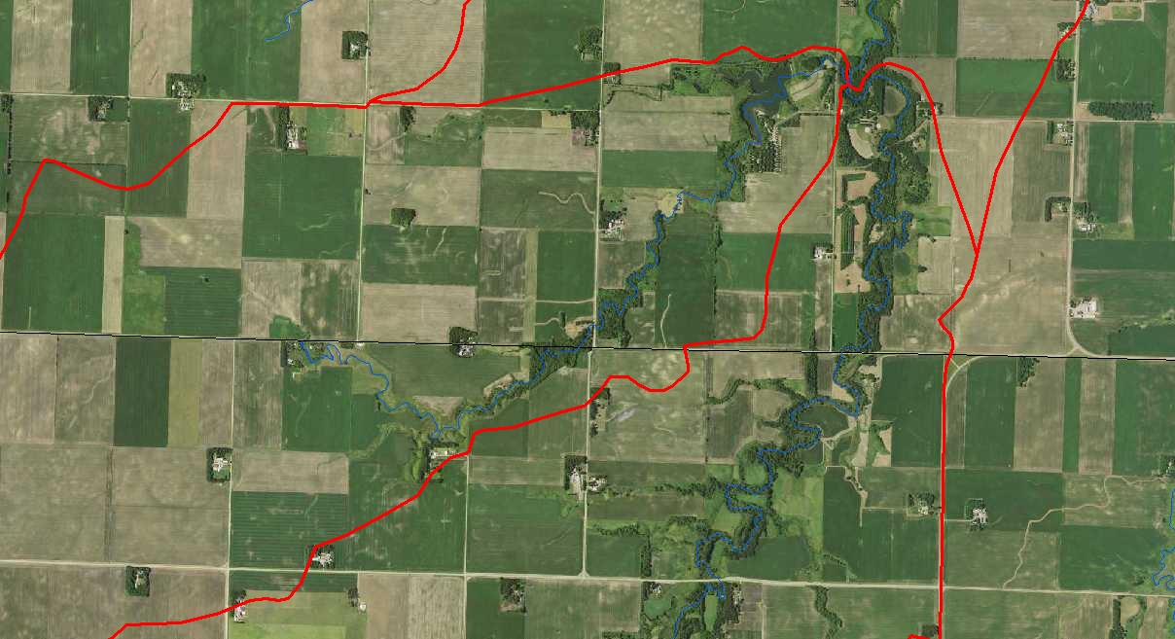
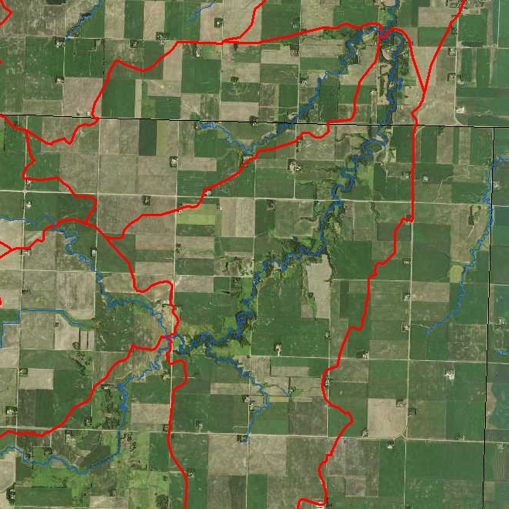
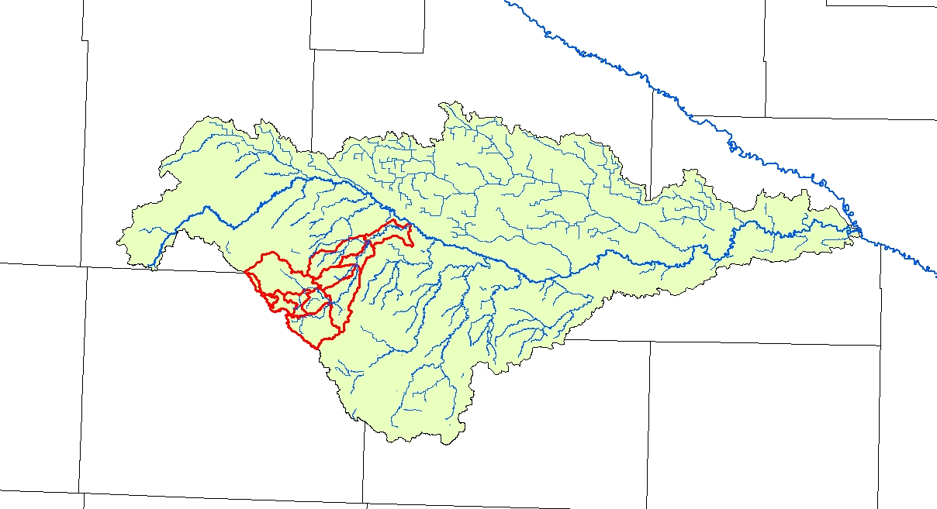
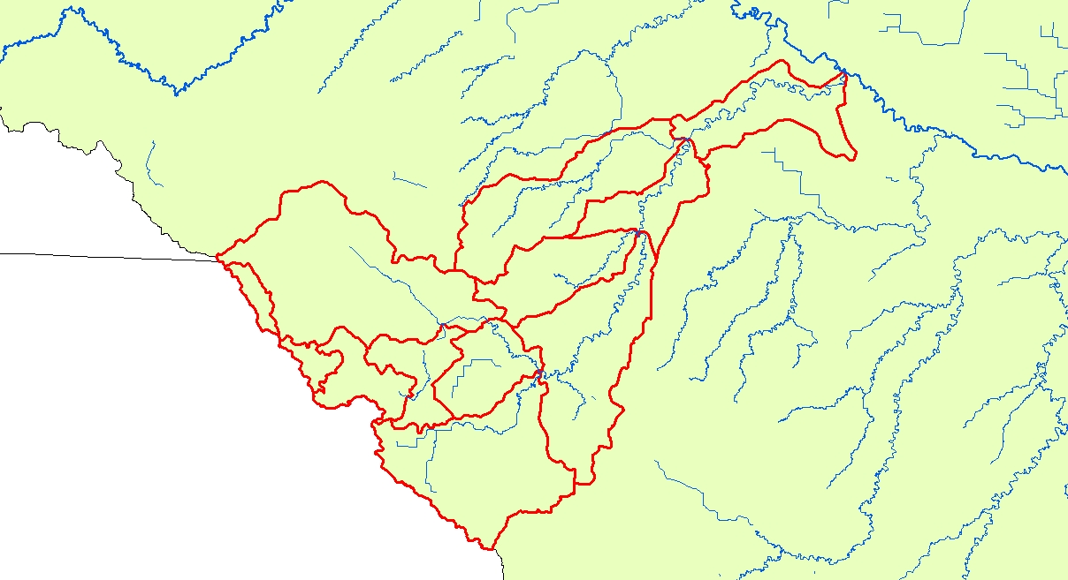

Slide 11
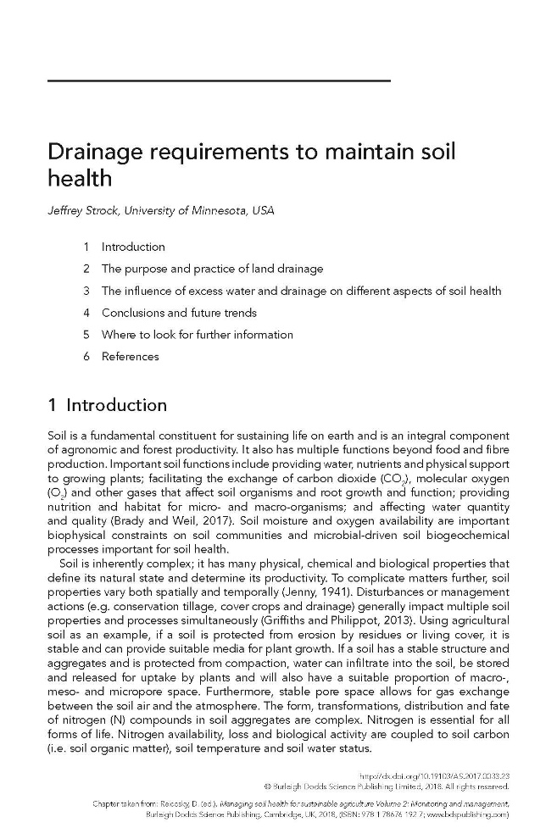

Slide 12
Key Points
Proper water management (aka tile drainage) in the root zone is necessary to maintain adequate soil water conditions for:
healthy plant growth and optimum yield.
healthy soil biological communities and biological function.
There is a need for interdisciplinary collaboration in order to address the complex interactions among soil, water, plant and microbiological realms.
Don’t forget about scale.

Slide 13
Questions?
Thank you!

