Slide 1
Chesapeake Bay Program STAC Workshop: Linking Soil and Watershed Health to In-field and Edge-of-Field Water Management January 23-24, 2020 Morgantown, WV Optimizing Soil and Water Quality Ken Staver
Wye Research & Education Center

Slide 2
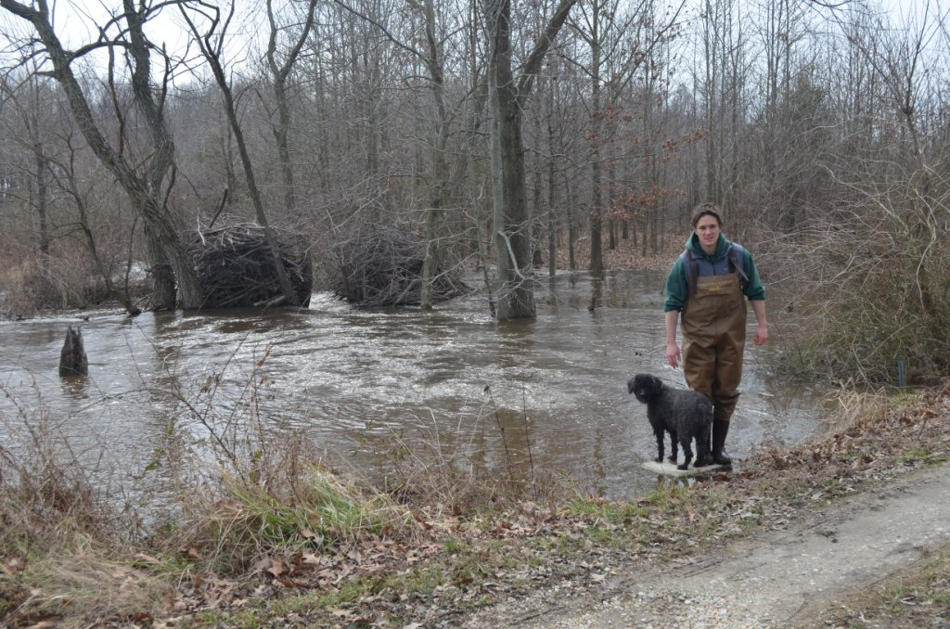

Slide 3
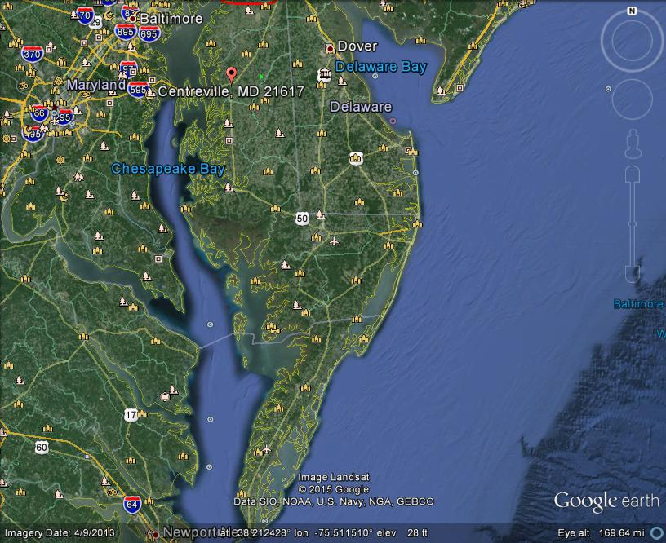

Slide 4
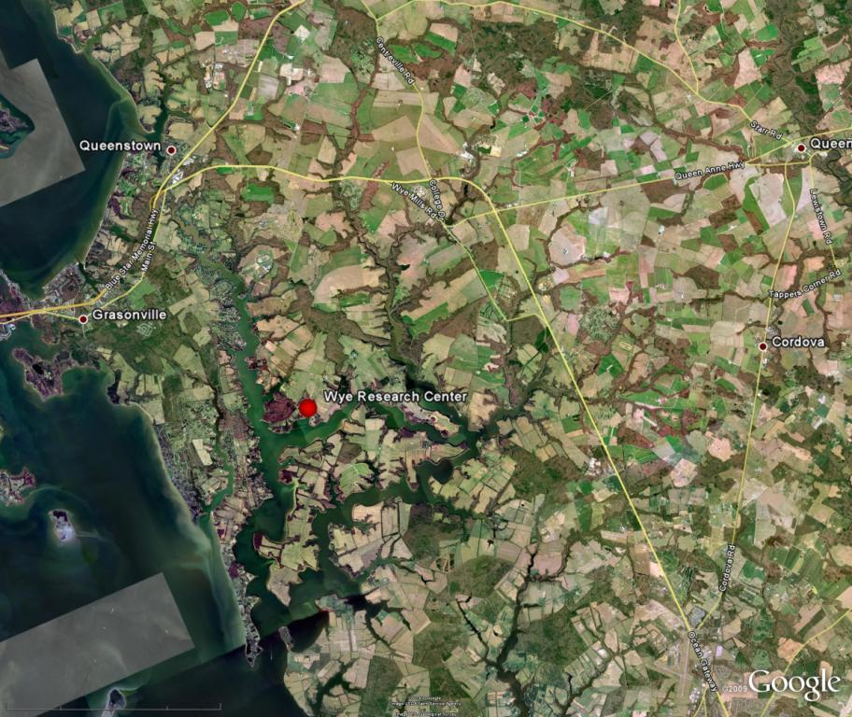

Slide 7
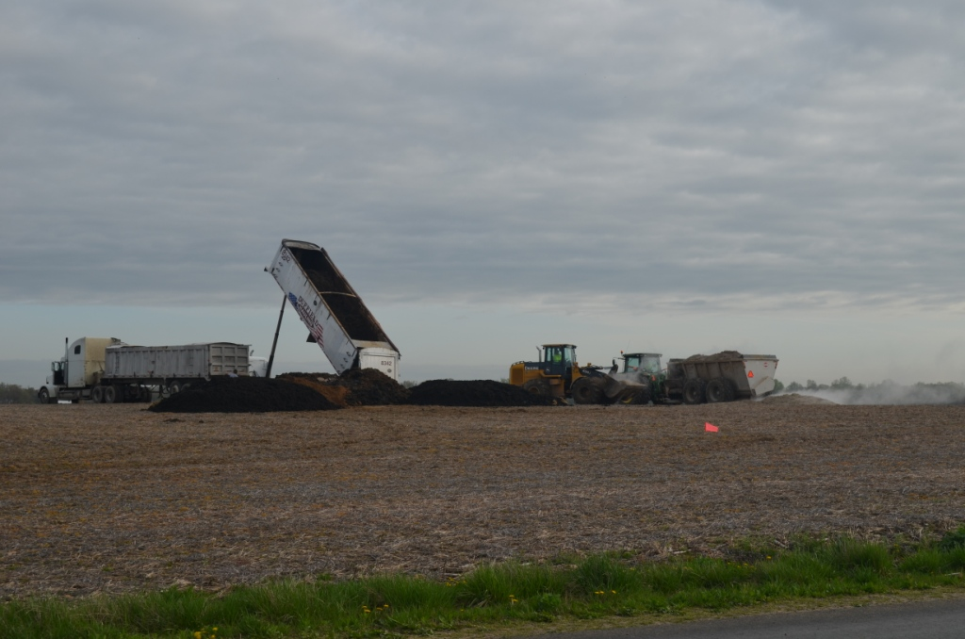

Slide 9
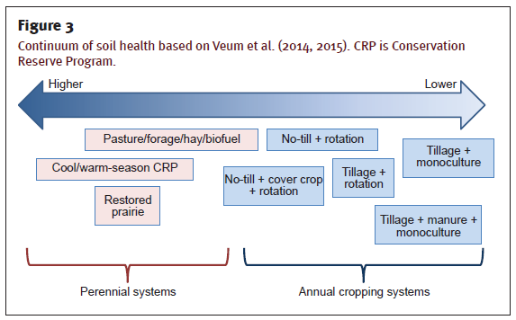

Slide 10
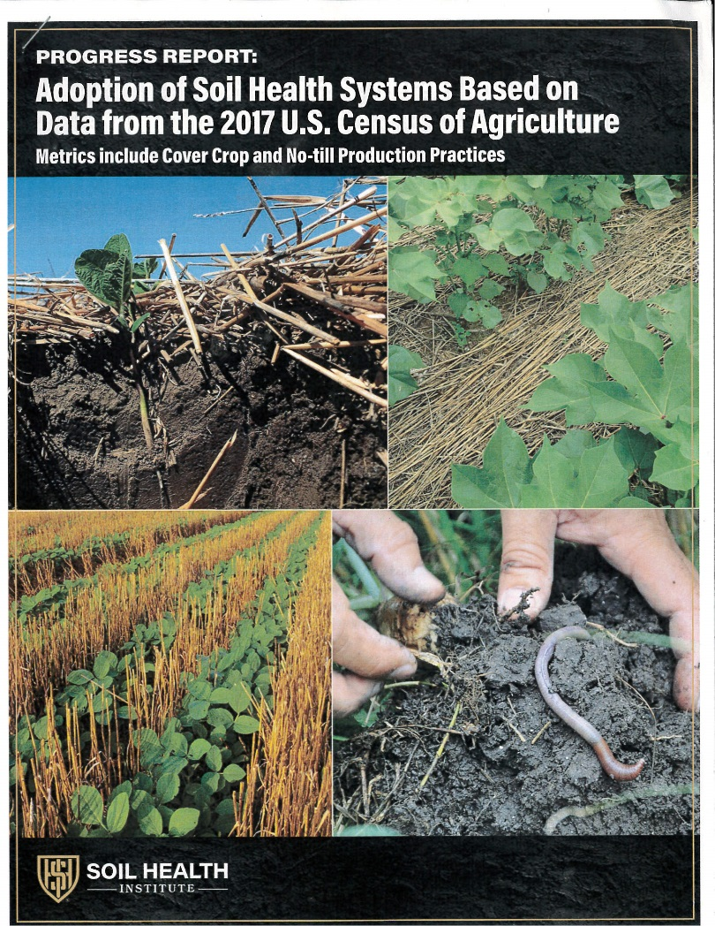
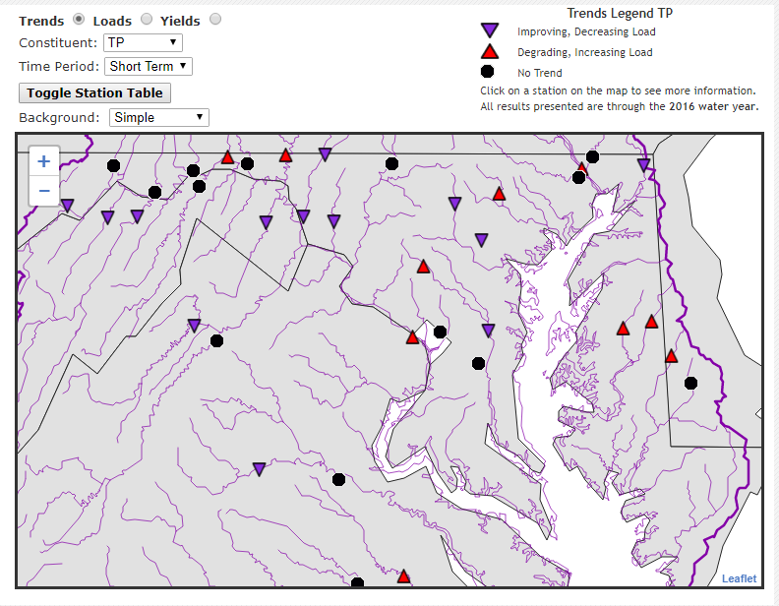

Slide 12
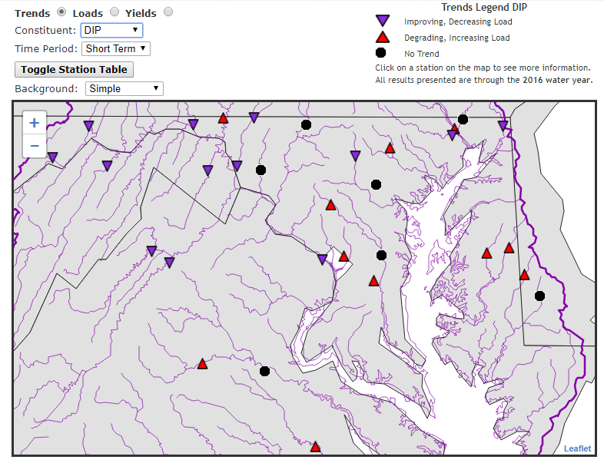

Slide 13
Some Rough Numbers
In the Coastal Plain, approximately 80 % of the N delivered to Chesapeake Bay from crop land moves through groundwater flow paths as nitrate.
~20-30 kg/ha

Slide 15
Karlan et al. JSWC Mar-Apr 2017
“On a broad level, soil health assessment is intended to assess soil functions that relate to multiple ecosystem services, including environmental protection (e.g., water quality). Therefore, crop production , although a critical ecosystem function, is not the sole driver of a valid soil health assessment.”

Slide 19
What we do in agriculture:
Capture and repackage solar energy for economic gain.

Slide 20
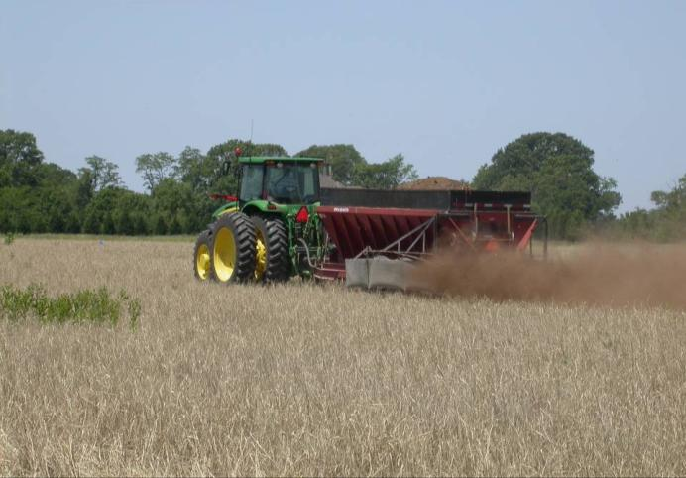
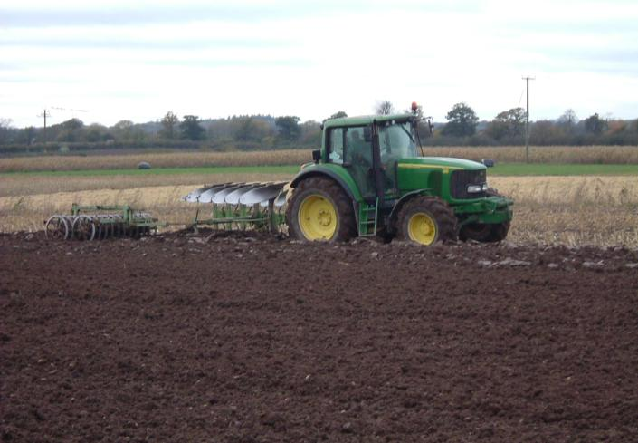
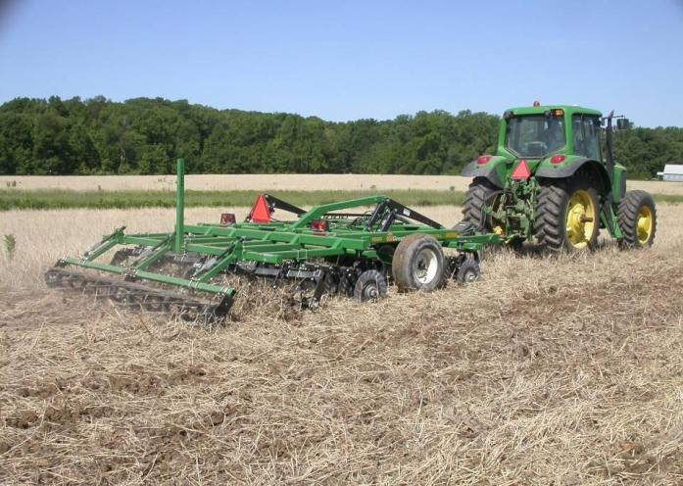
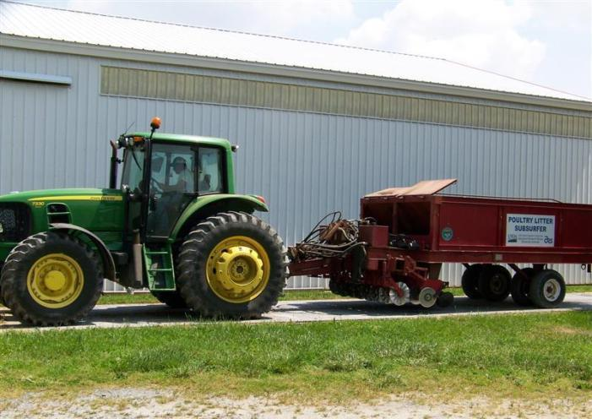
Effects of Tillage Practices on surface runoff of contaminants, specifically estrogens and nutrients
No-Till
Conventional Till
Turbo Till
Sub-surface Injection

Slide 24
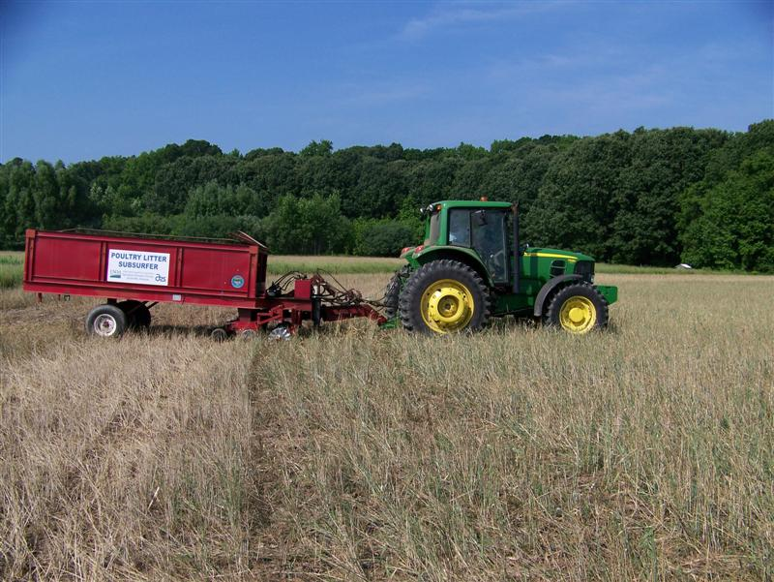

Slide 25
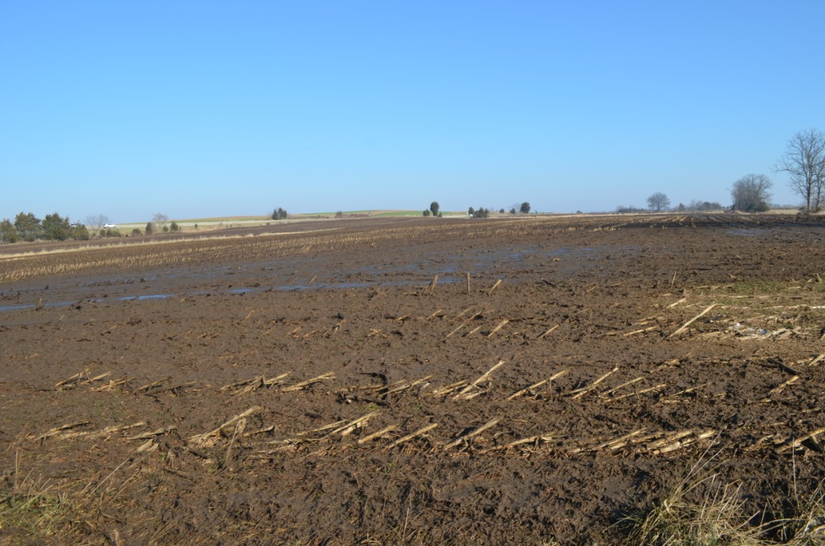

Slide 28
Lessons Learned
Farmers like to be good stewards but the bottom line rules
Implementation has to be high
If it doesn’t pay its own way (NT) there will need to be carrots(CREP,cover crops) or sticks(?)

Slide 29
MDA Nutrient Management News:
Winter 2017
Department modifies NM regs :
“Removing the incorporation requirement for spring and fall manure spreading. Studies conducted by the USDA NRCS show that soil health is improved with little or no soil disturbance other than planting.”

Slide 30
Soil Quality-Water Quality Conflicts
1. No-till and surface applied nutrients can lead to high dissolved nutrient loss.
2. Sacrificing fall N scavenging for cover crop diversity can lead to higher leaching rates.
3. Soil quality benefits have not yet been perceived by most MD farmers to make cover crops cost effective.

Slide 31
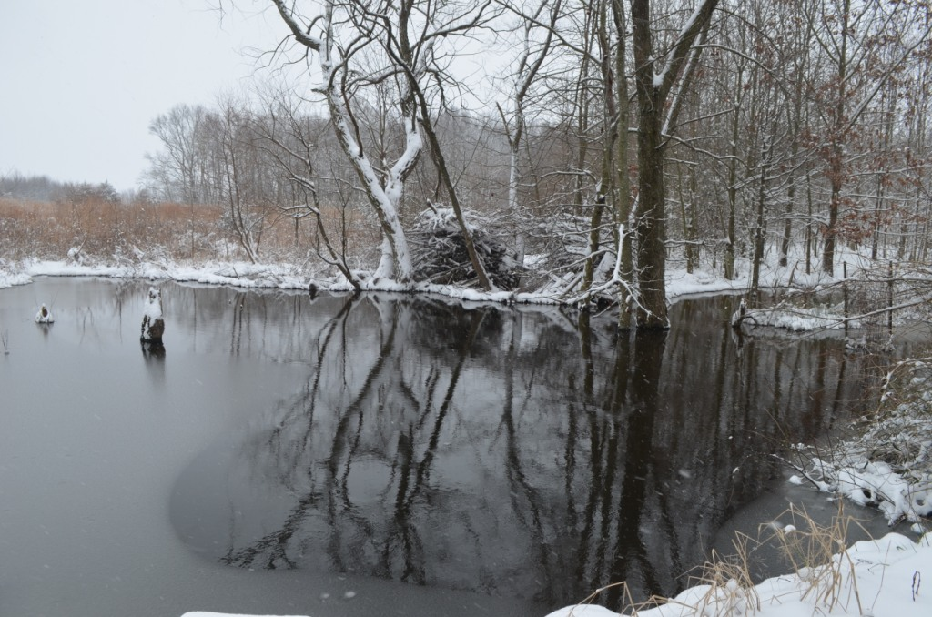
Thank you!

