Slide 1





Convening Event:
Linking Soil and Watershed Health to In-Field and Edge-of-Field Water Management
Welcome and Thank You!
January 23-24, 2020
Erickson Alumni Center, WVU
Morgantown, WV

Slide 2
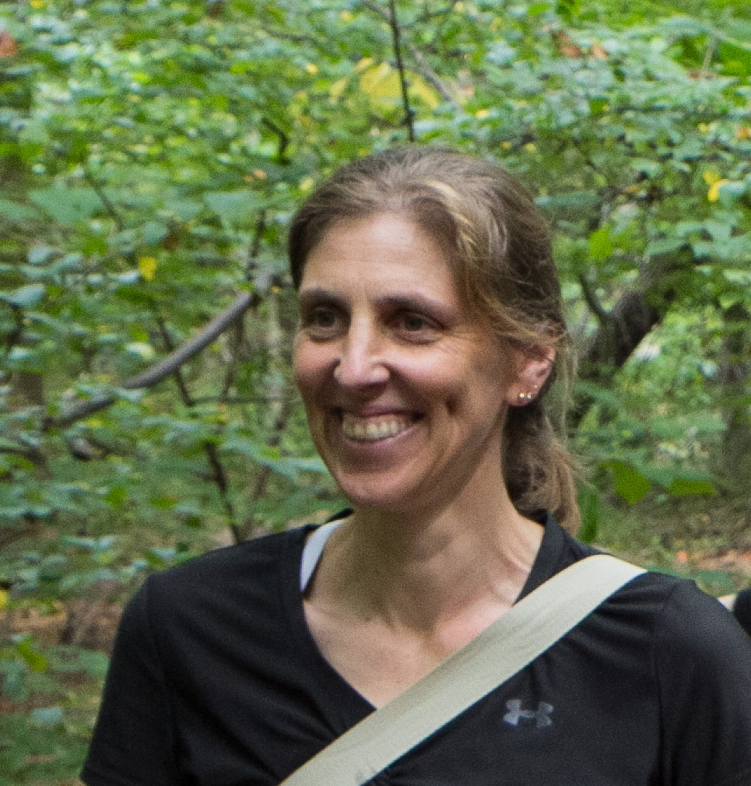
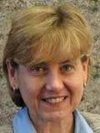
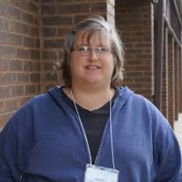
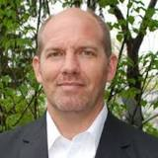
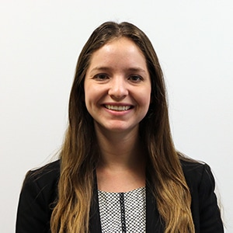
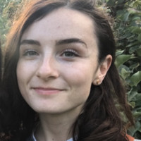
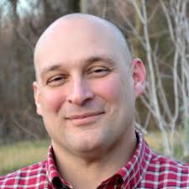
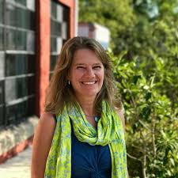
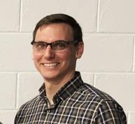
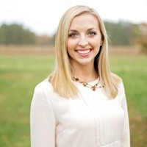
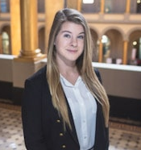
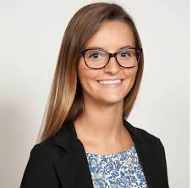
Linking Soil and Watershed Health to In-Field and Edge-of-Field Water Management
Thank you!
Workshop Steering Committee:
Kathy Boomer
FFAR
Jane Frankenberger
Purdue University
Amy Collick
UMES
Jason Hubbart
WVU
Maile Hartsook FFAR
Meg Cole
CBP STAC
Chris Brosch
DE Department of Agriculture
Matthew Ehrhart
Stroud Research
Amy Jacobs
The Nature Conservancy
Lindsay Thompson
Thompson Ag Consulting
Cordelia Hiers
FFAR
Annabelle Harvey
CBP STAC

Slide 3
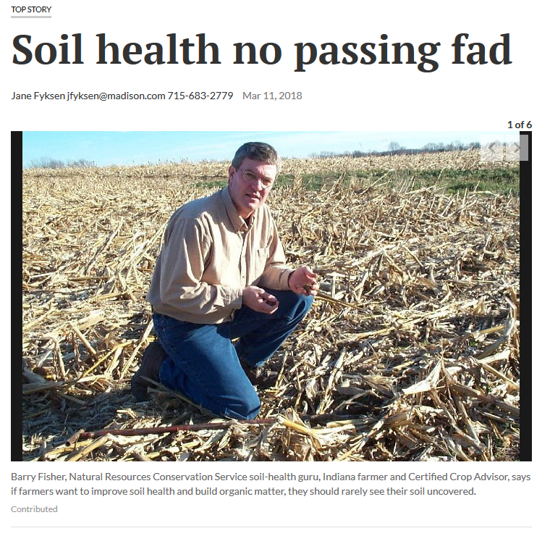
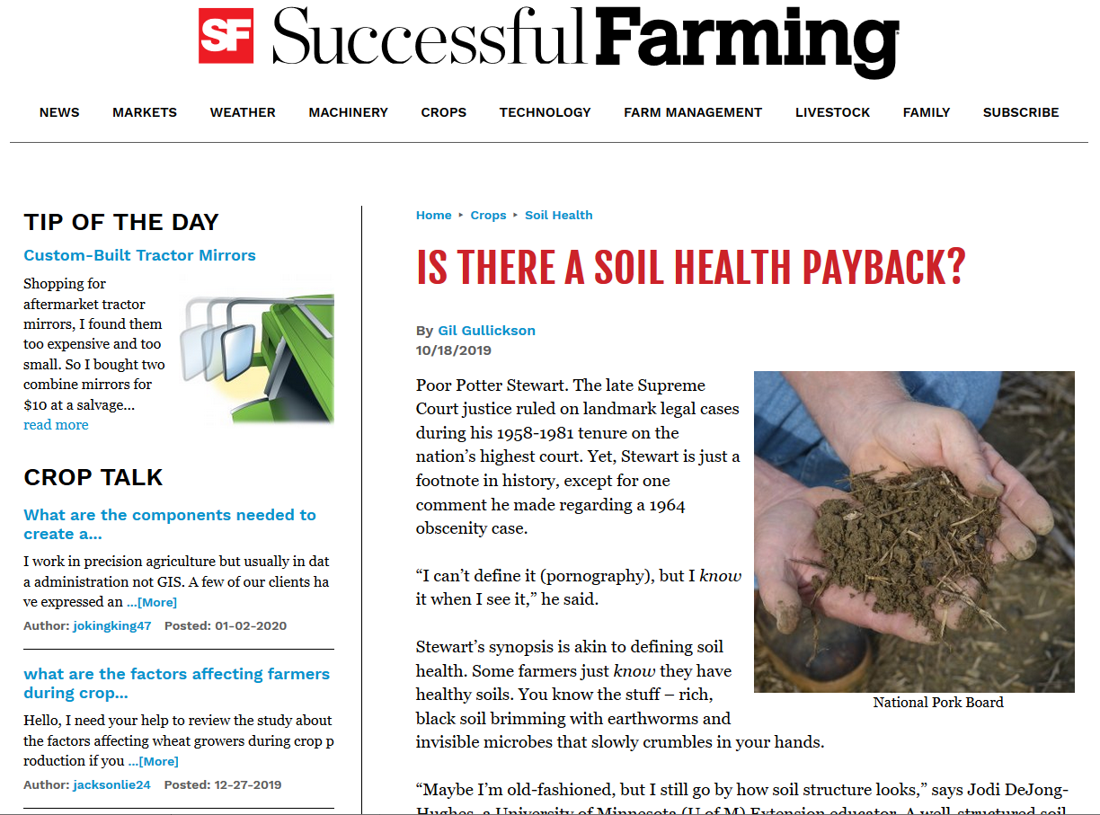
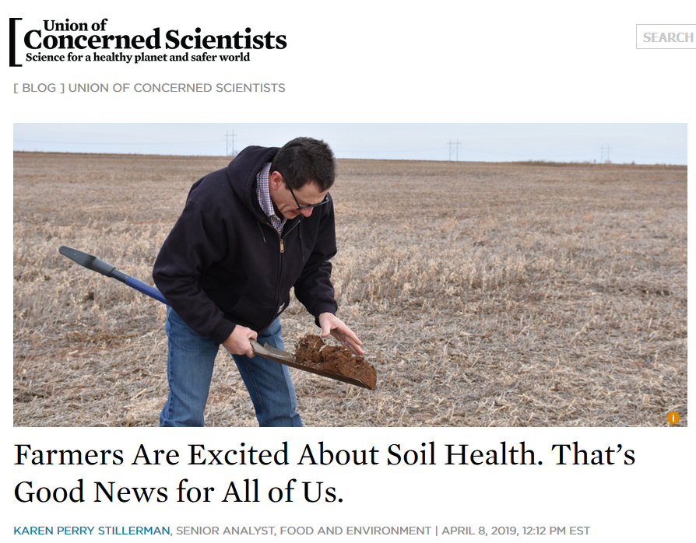
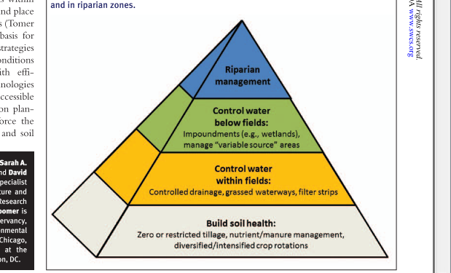
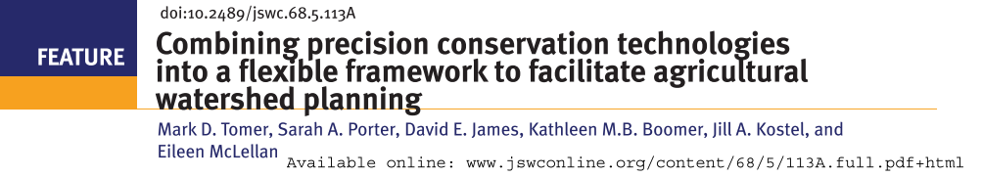
Linking Soil and Watershed Health to In-Field and Edge-of-Field Water Management: Why this Workshop

Slide 4
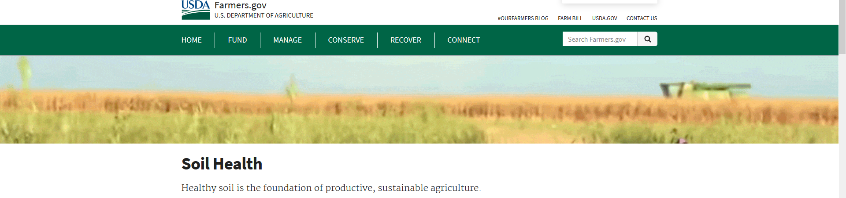
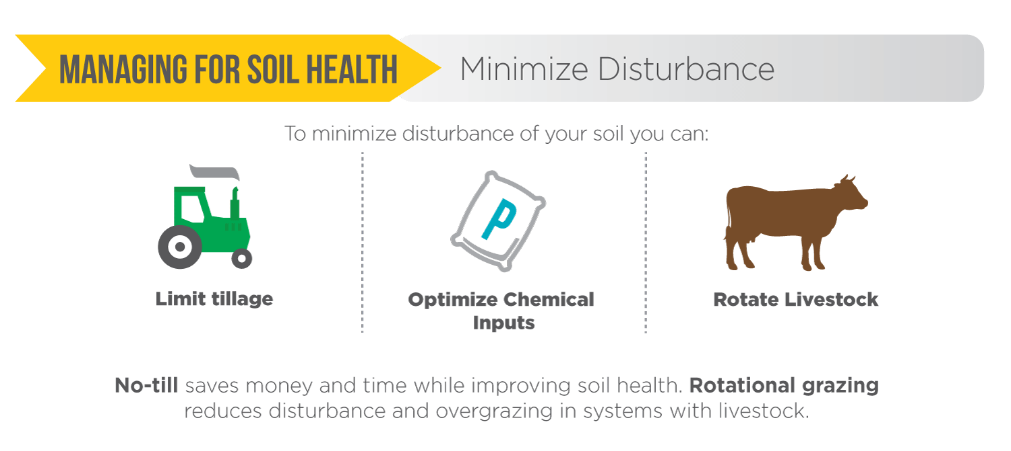
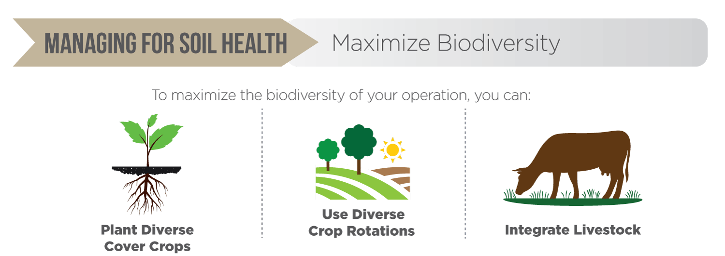
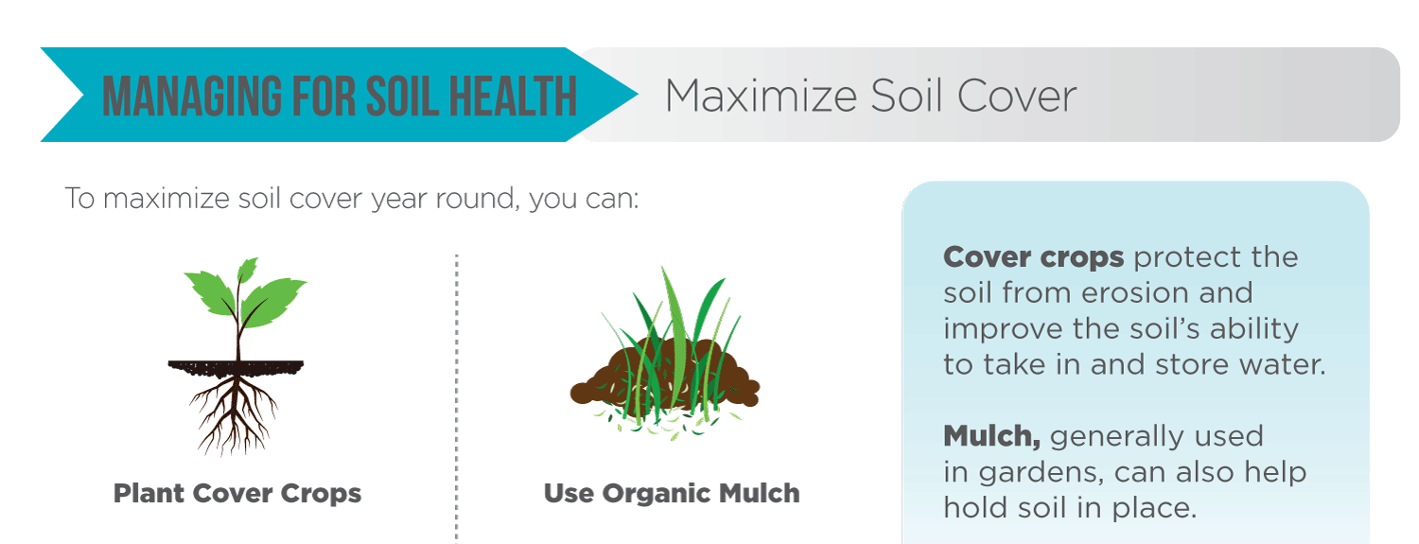
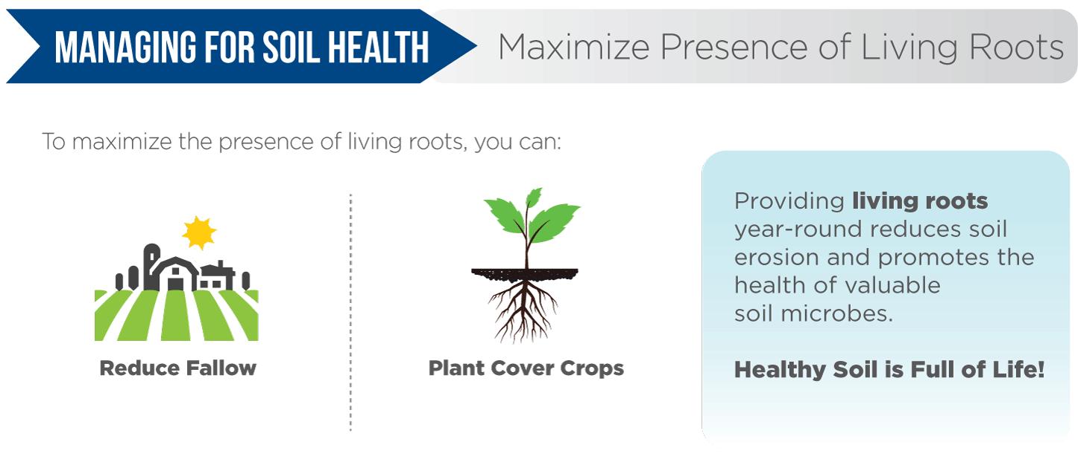

Slide 5
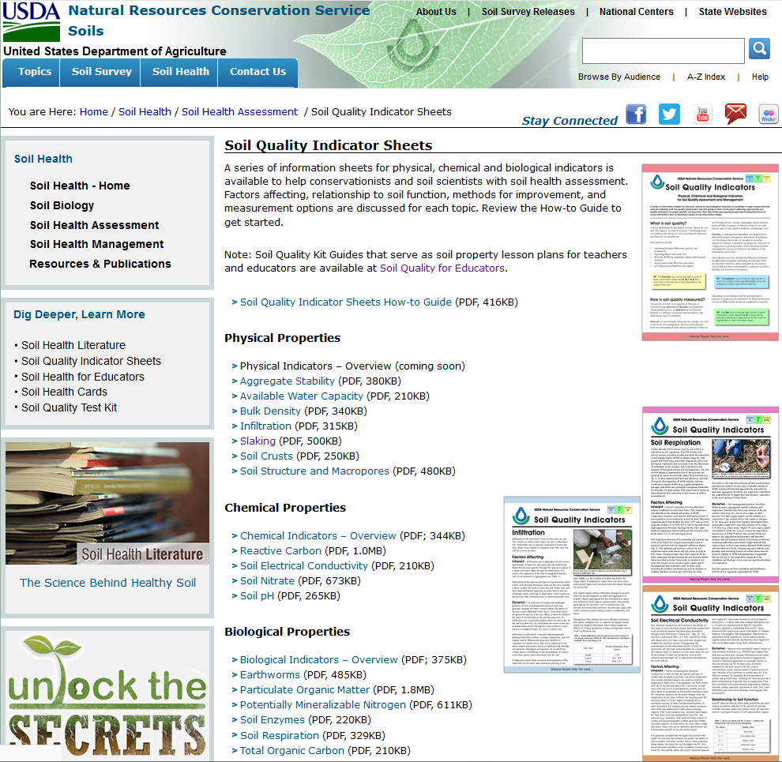
“Soil health, also referred to as soil quality, is defined as the continued capacity of soil to function as a vital living ecosystem that sustains plants, animals, and humans.”
https://www.nrcs.usda.gov/wps/portal/nrcs/main/soils/health/ (accessed 1/2/2019)

Slide 6
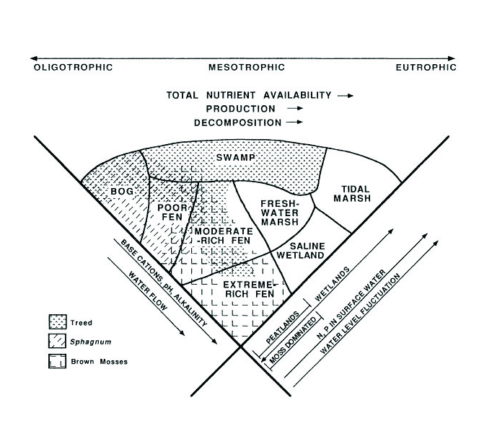
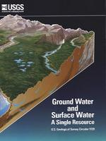
Soil Carbon and Biogeochemistry:
Wetland Scientist Conceptual Model :
Brinson 1993
Ground- and surface- water interactions predictably change along landscape gradients.
Zoltai and Vitt 1995
Winter 1998

Slide 7
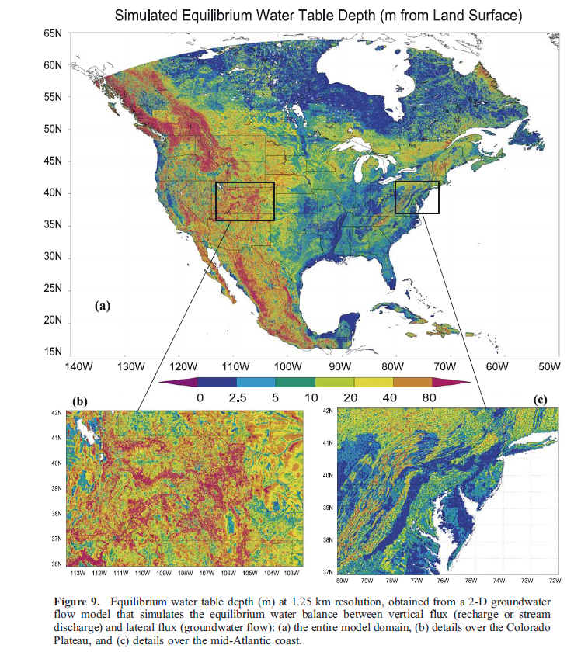
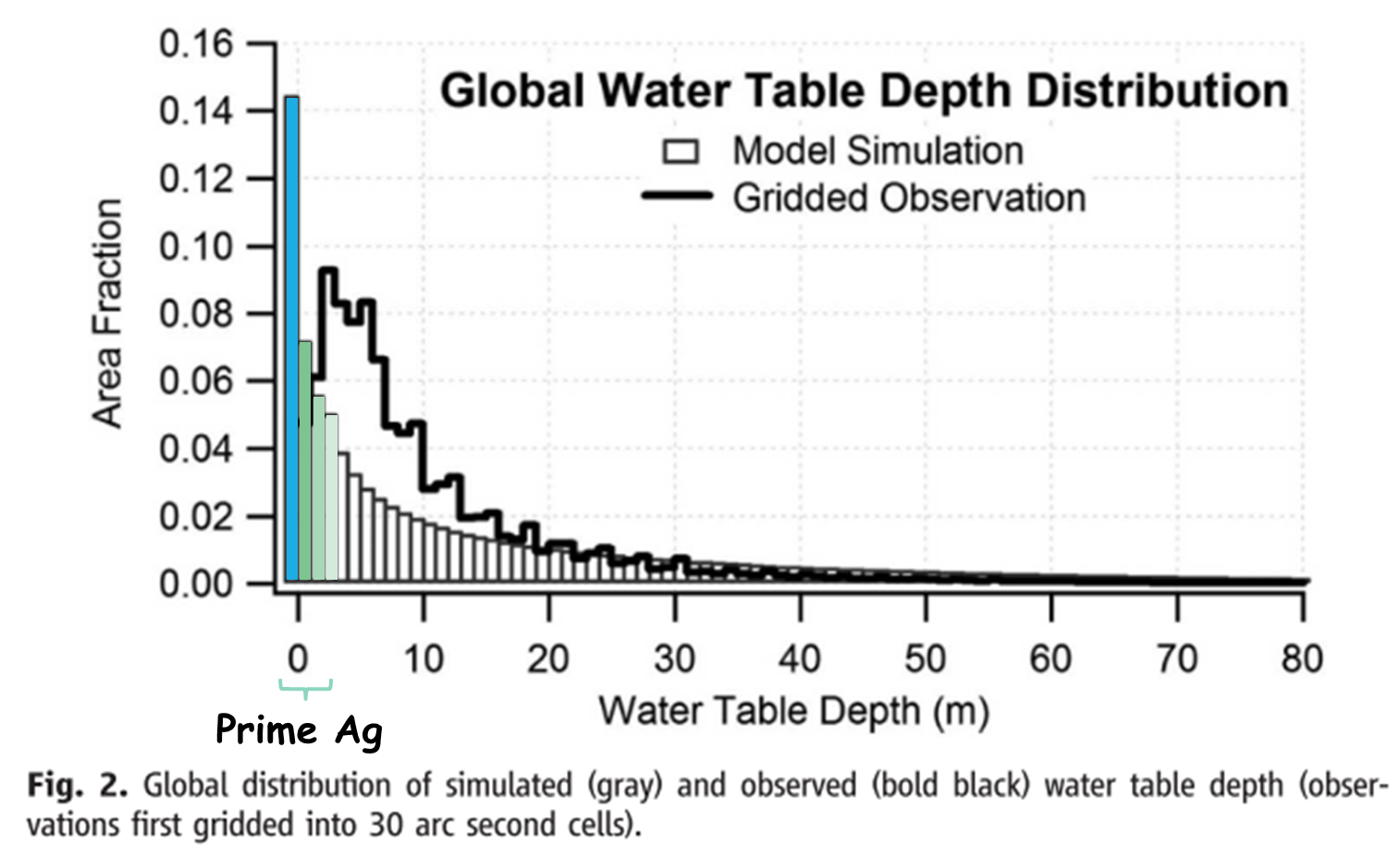
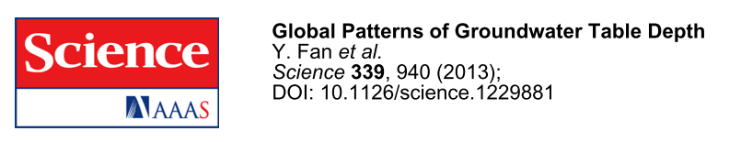
Water Table Controls Distribution of Prime Ag Lands

Slide 8
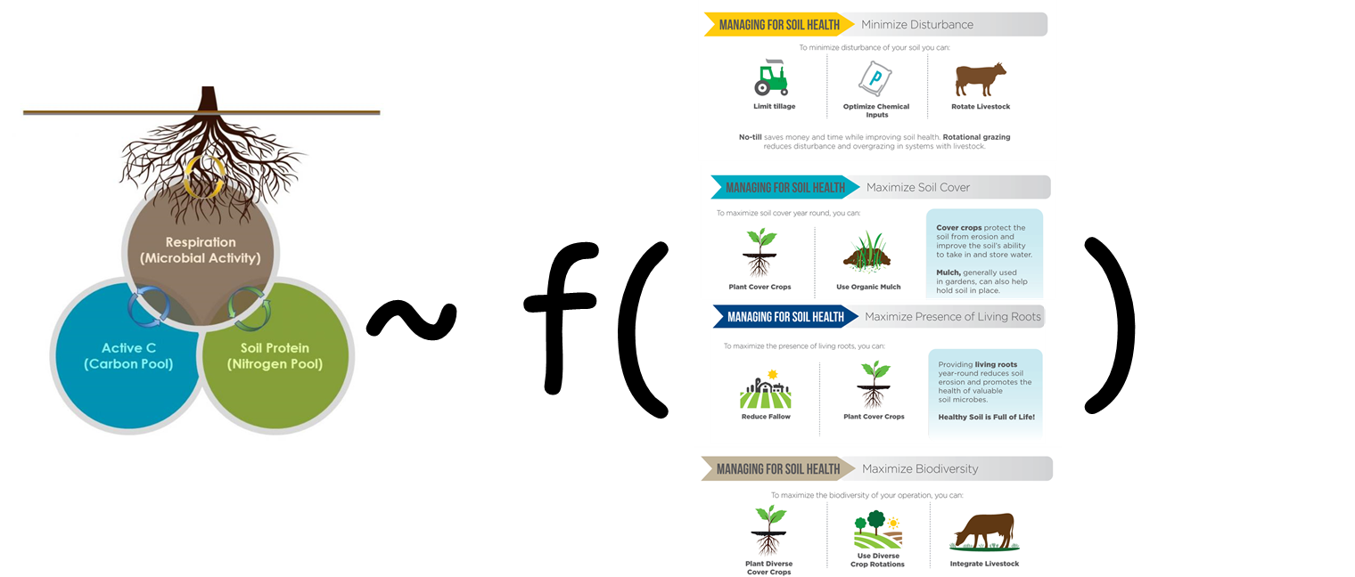
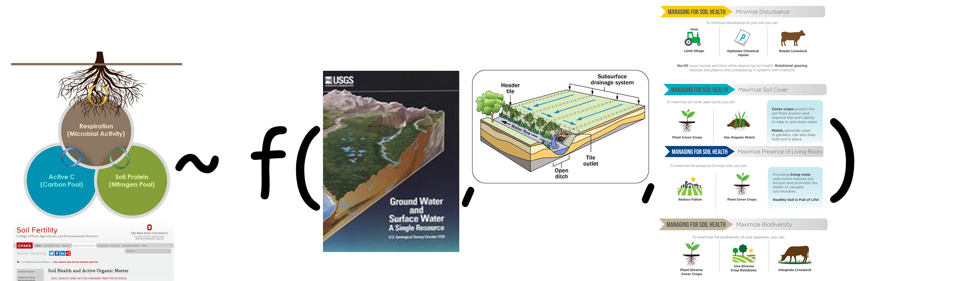
Linking Soil and Watershed Health to In-Field and Edge-of-Field Water Management: Alternative Models
or

Slide 9
Linking Soil and Watershed Health to
In-field and Edge-of-Field Water Management
January 23-24, 2020
Key Questions:
Is there need and capacity for “Precision Drainage”?
Likelihood of creating a win-win: Can shallow groundwater management enhance soil and watershed health, tackle climate change AND maximize crop yields?
What (and where) are most promising opportunities to promote soil and watershed health?
What stakeholder concerns might influence the adoption of advanced water management best management practices?

Slide 10
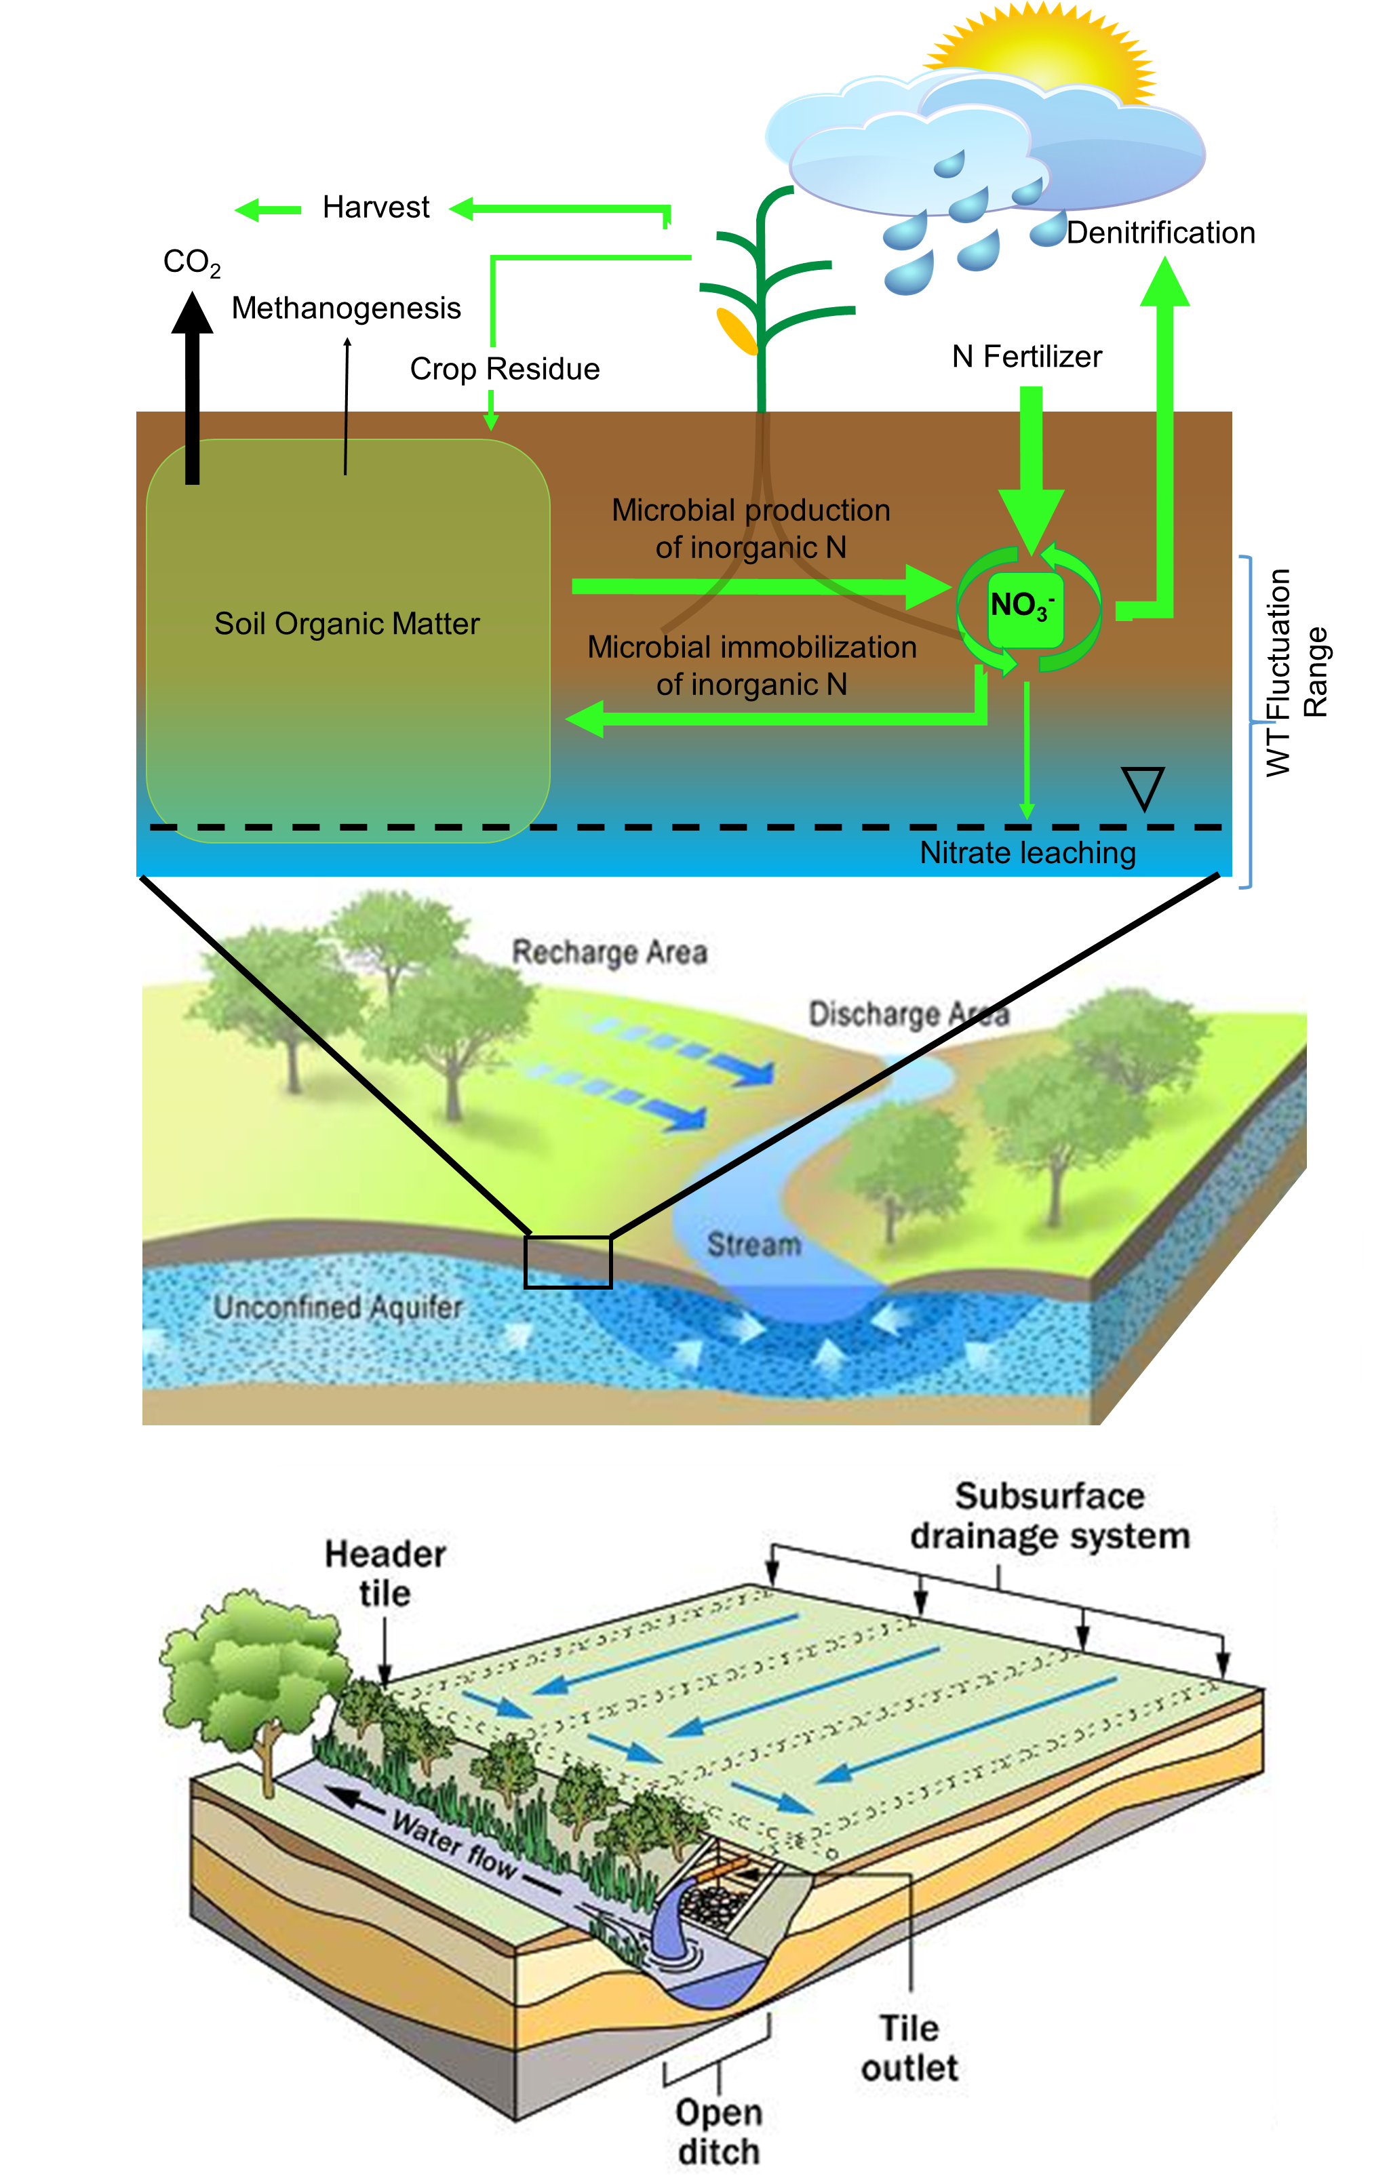
Linking Soil and Watershed Health to
In-field and Edge-of-Field Water Management
Day 1
Session I - Soil Health: State of the Science
Rattan Lal Ken Staver Mark Tomer
Session II - Biogeochemical Conditions and Hydrodynamics Influencing Soil Health in the Vadose Zone
Ryan Stewart Brian Badgley Michael Castellano Sotirios Archontoulis Ray Bryant
Session III - Impacts of Drainage Water on In-field Soil Conditions and Watershed Hydrology
Eileen Kladivko Keith Schilling
Laura Johnson Kathy Boomer

Slide 11
Linking Soil and Watershed Health to
In-field and Edge-of-Field Water Management
Day 2
Session IV: Innovative Drainage Practices to Manage Shallow Water Tables
Jane Frankenberger Richard Cook
Francois Birgand Jeff Strock
Session V: Understanding the Broader Range of Concerns Related to Drainage Water Management
Steve Mirsky Sam Zipper
Chandra Madramootoo Genevieve Ali
Session VI: Bridging the Sessions: Interactive Discussion
Mark Tomer Paul Wolfe Tom Bruulsema

Slide 12
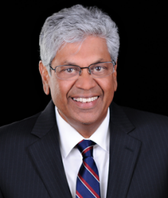
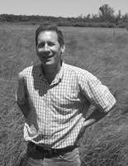
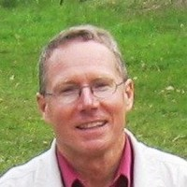
Linking Soil and Watershed Health to
In-field and Edge-of-Field Water Management
Workshop Structure:
Plenaries:
Dr. Chandra Madramootoo,
Bioengineer,
Water Innovation Lab
McGill University
Dr. Christopher Craft,
Wetland Soils Biogeochemist
Indiana University
Dr. Donald Rosenberry,
Near-surface Hydrogeologist
USGS (Colorado)

Slide 13
Linking Soil and Watershed Health to
In-field and Edge-of-Field Water Management
January 23-24, 2020
Targeted Outcomes:
Facilitate cross-disciplinary discussions among experts committed to advancing regenerative agriculture and water security.
Identify critical information gaps that limit capacity to provide water management guidance across diverse landscapes and under changing climate conditions.
Spark collaborations to address critical information gaps.
New ideas, new friendships.

Slide 14
House Rules:
X “We don’t have enough data.”
Share your expectations based on your expert background and experience.
X “No, it doesn’t work like that”
* Well, it could work like that; OR maybe the system responds like this: _____________

Slide 15
Group dinner: the wine bar at vintner valley
7pm
510 County Route 59/2, Burroughs Street, Morgantown, WV

Slide 16
Other Recommended dinner options
Within walking distance
Los Mariachis
Puglioni’s Pasta and Pizza
Ogawa Japenese Restaurant
Ta-Khrai Thai Café downtown area (Drive)
Mountain State Brewing
Olivarios
Table 9
Sargasso
Tin 202

Slide 17
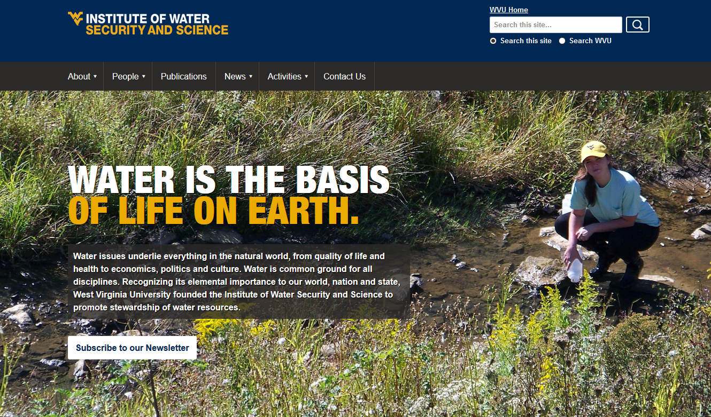
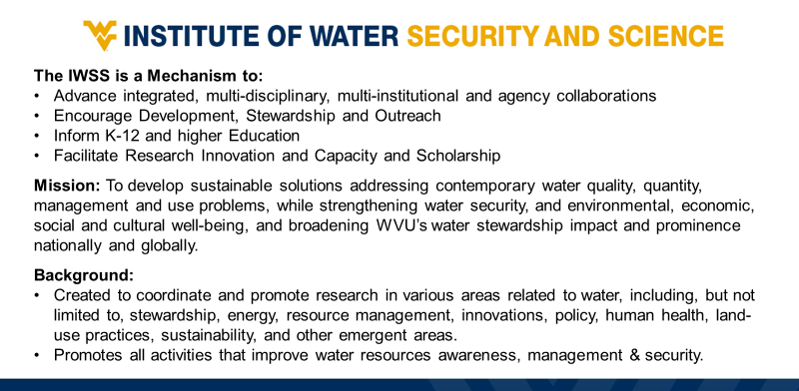
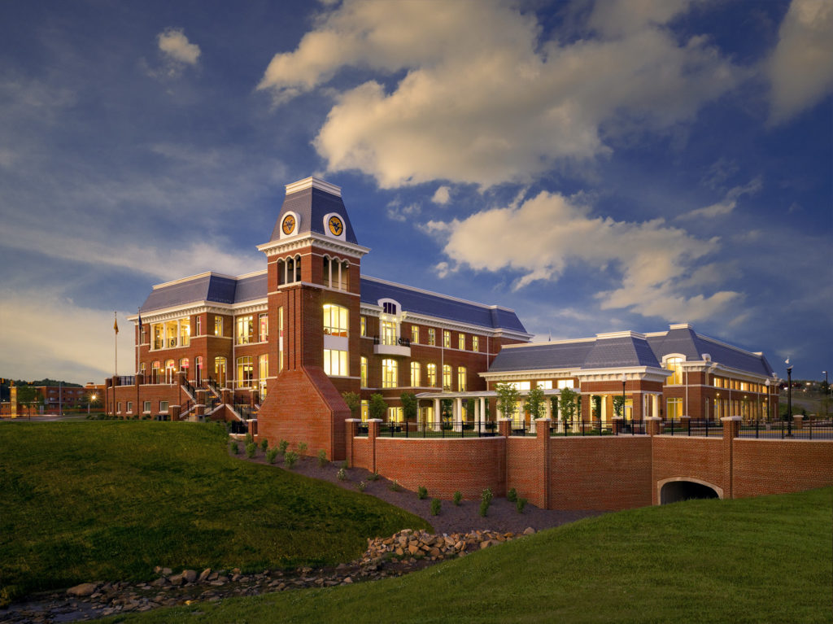
West Virginia University
Erickson Alumni Center

Slide 18
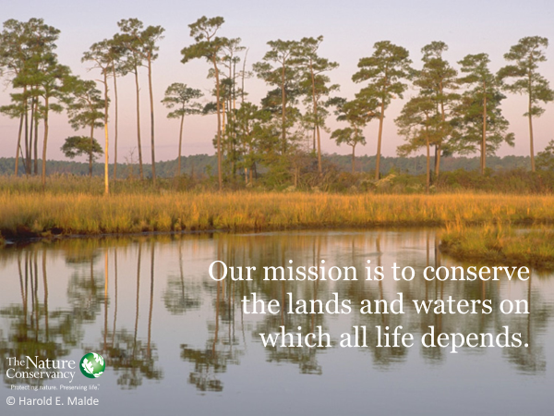
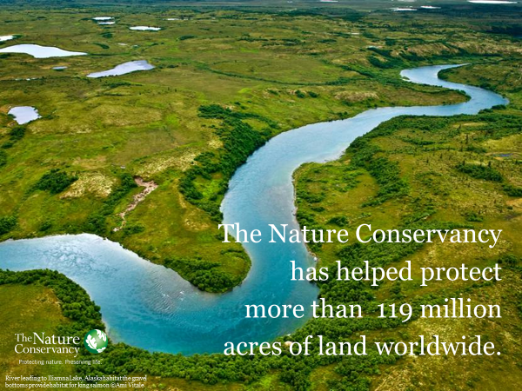
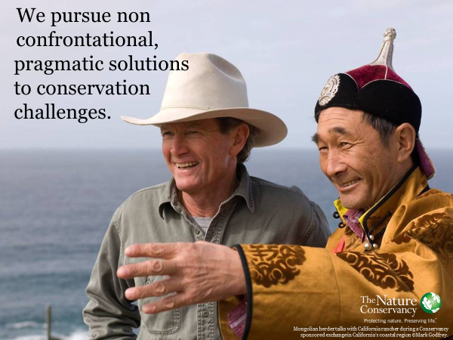
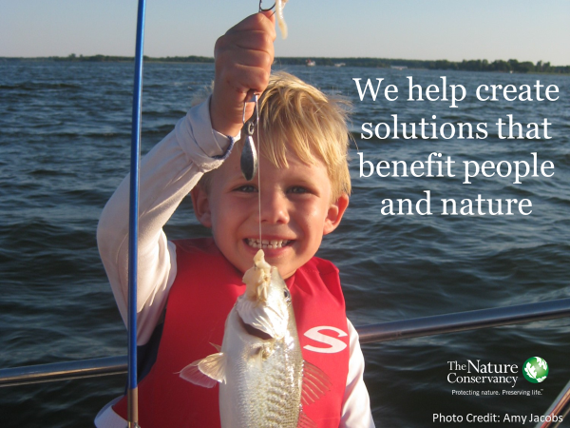
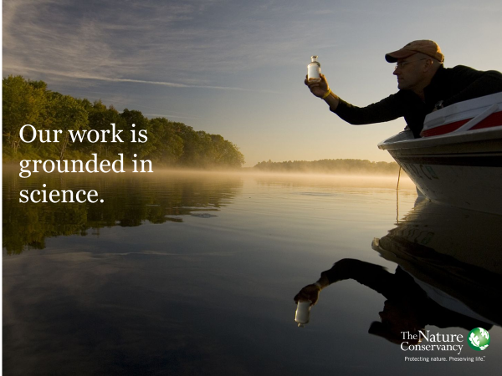

Slide 19
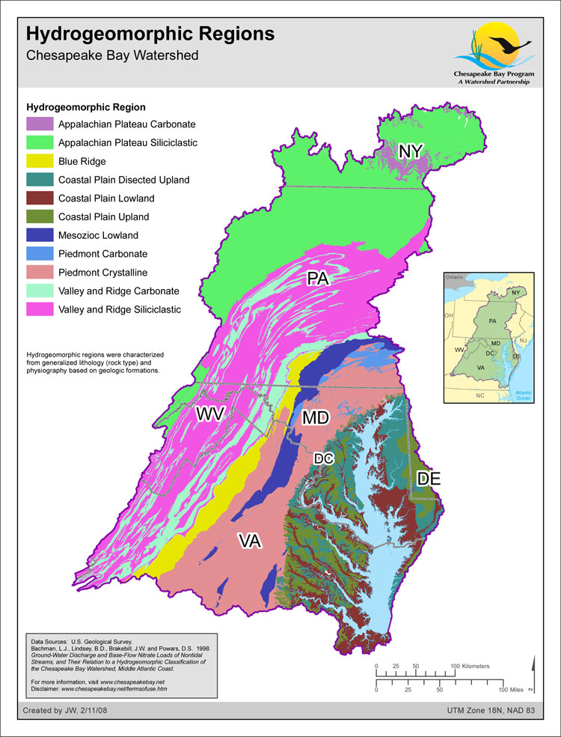
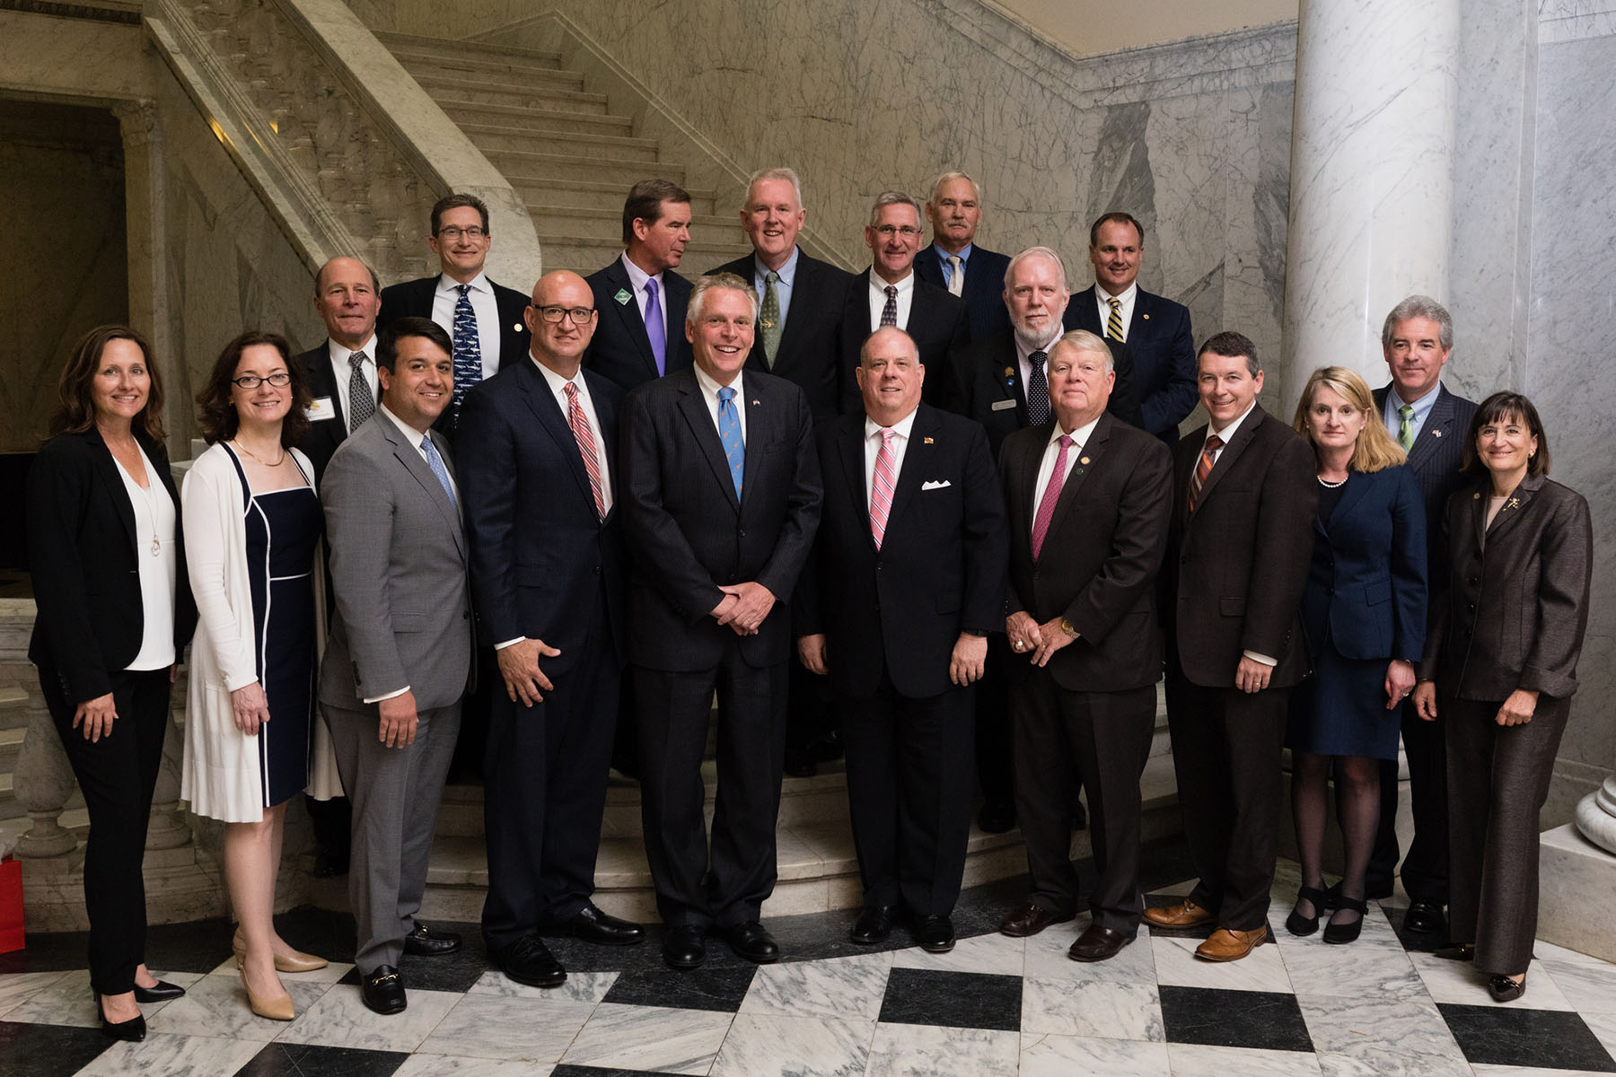
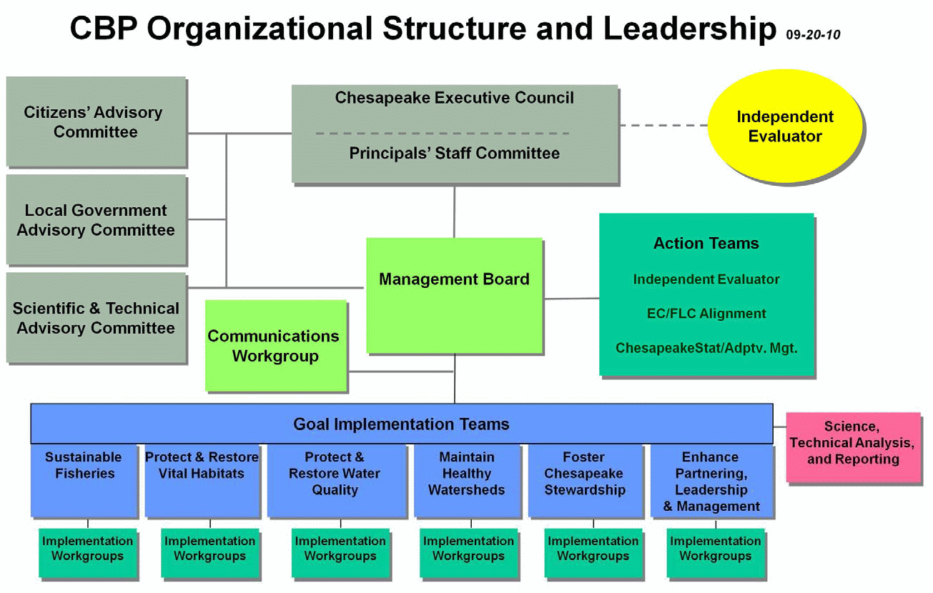
CBP’s Scientific & Technical Advisory Committee (STAC)
Chesapeake Bay Program Partnership:
Nearly 40 state agencies and programs in DE, MD, NY, PA, VA, WV and the DC
19 federal agencies
Approximately 1,800 local governments, represented through the Local Government Advisory Committee
More than 20 academic institutions, represented through the Scientific and Technical Advisory Committee
More than 60 NGO’s, including businesses, non-profits and advocacy groups

Slide 20
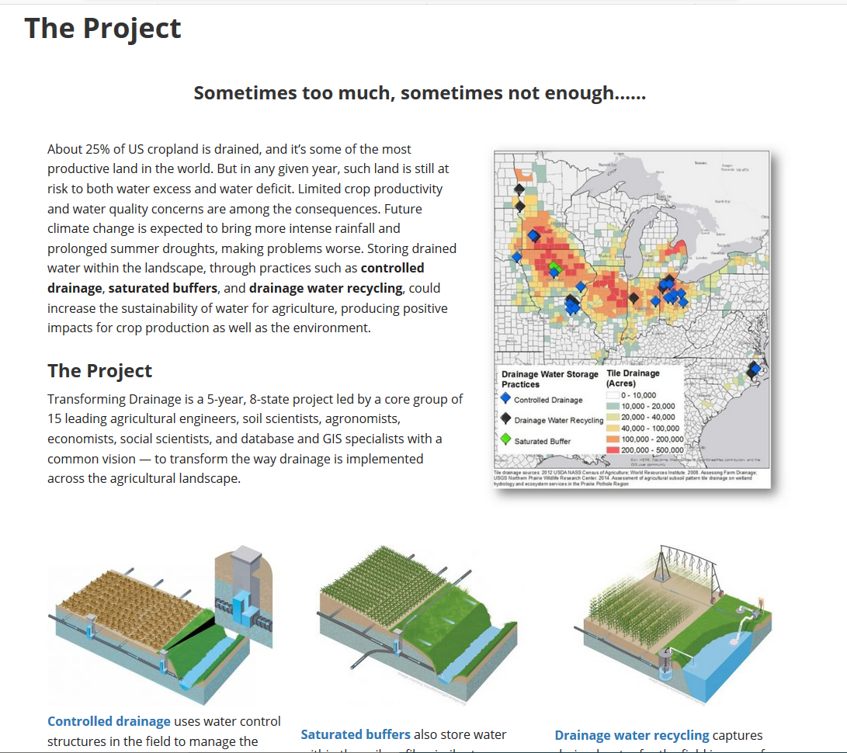

Slide 21
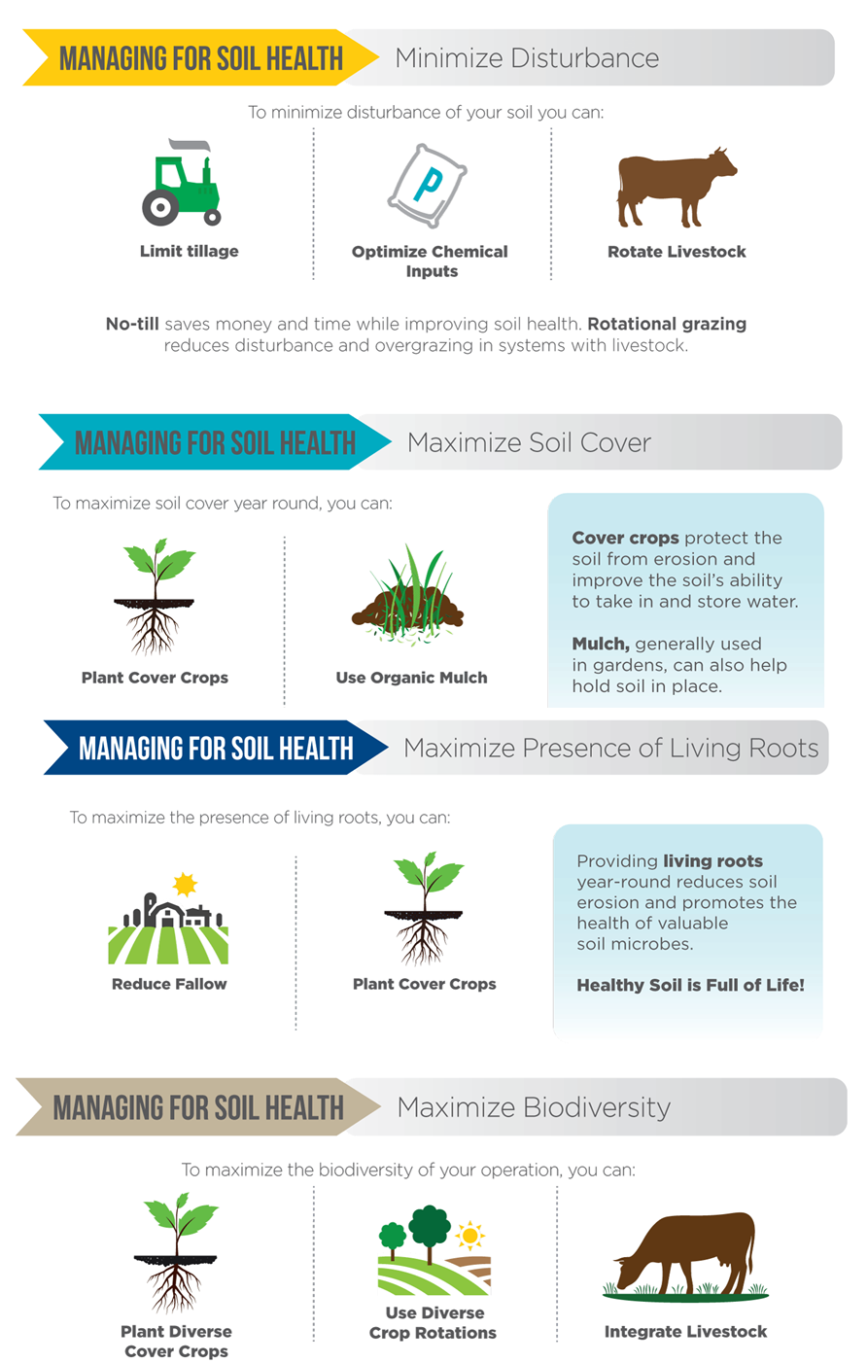
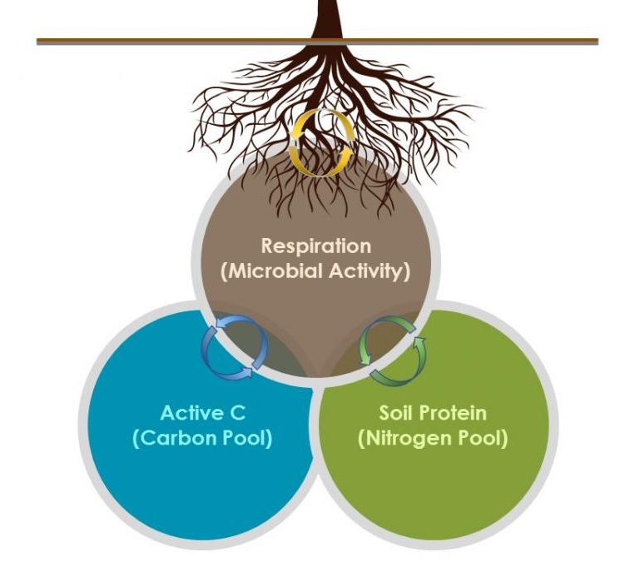
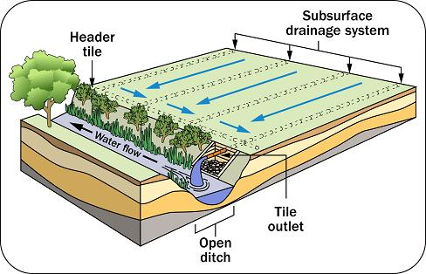
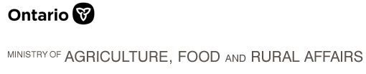

Linking Soil and Watershed Health to In-Field and Edge-of-Field Water Management: Why this Workshop
~ f(
,
,
)

