Slide 1
Water table fluctuations in tiled glacial landscapes
Keith E. Schilling, Ph.D.
State Geologist/Research Engineer
Iowa Geological Survey

Slide 2
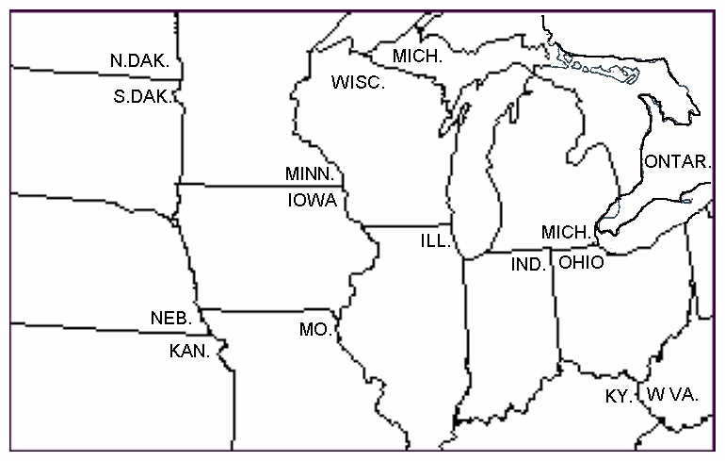
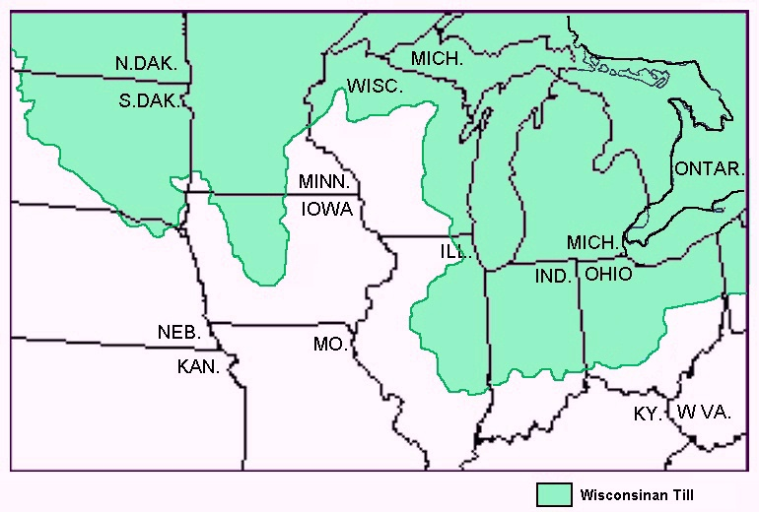
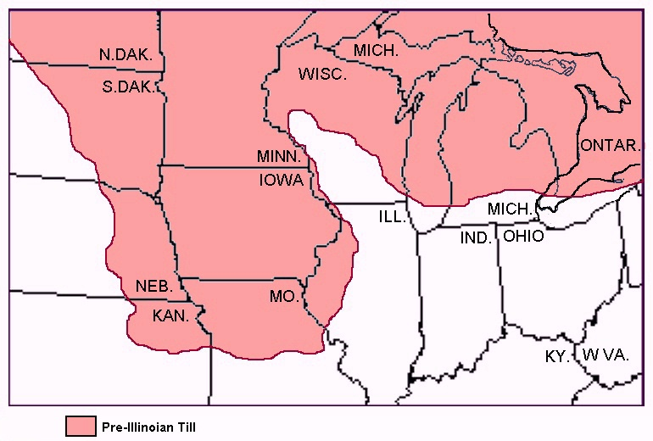
300,000 – 130,000 years
30,000 – 10,500 years
2,500,000 to 500,000 years

Slide 3
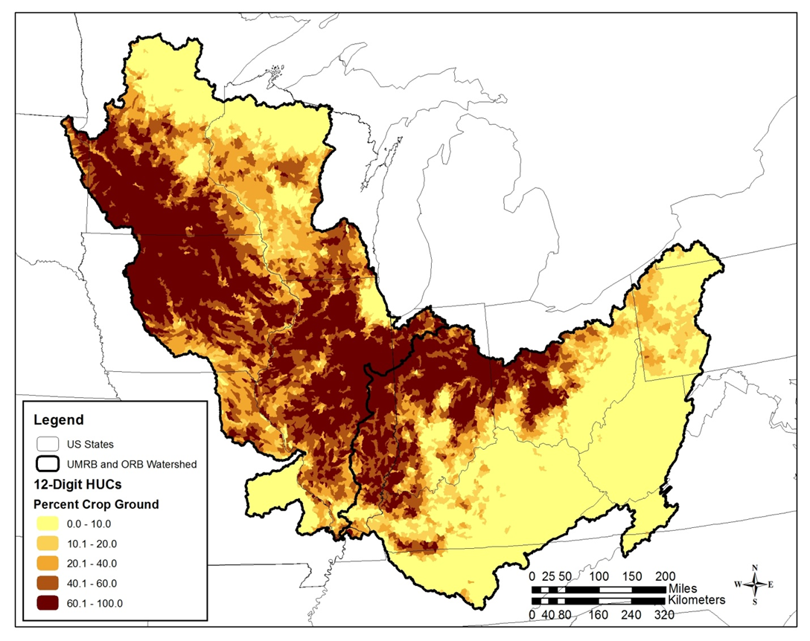
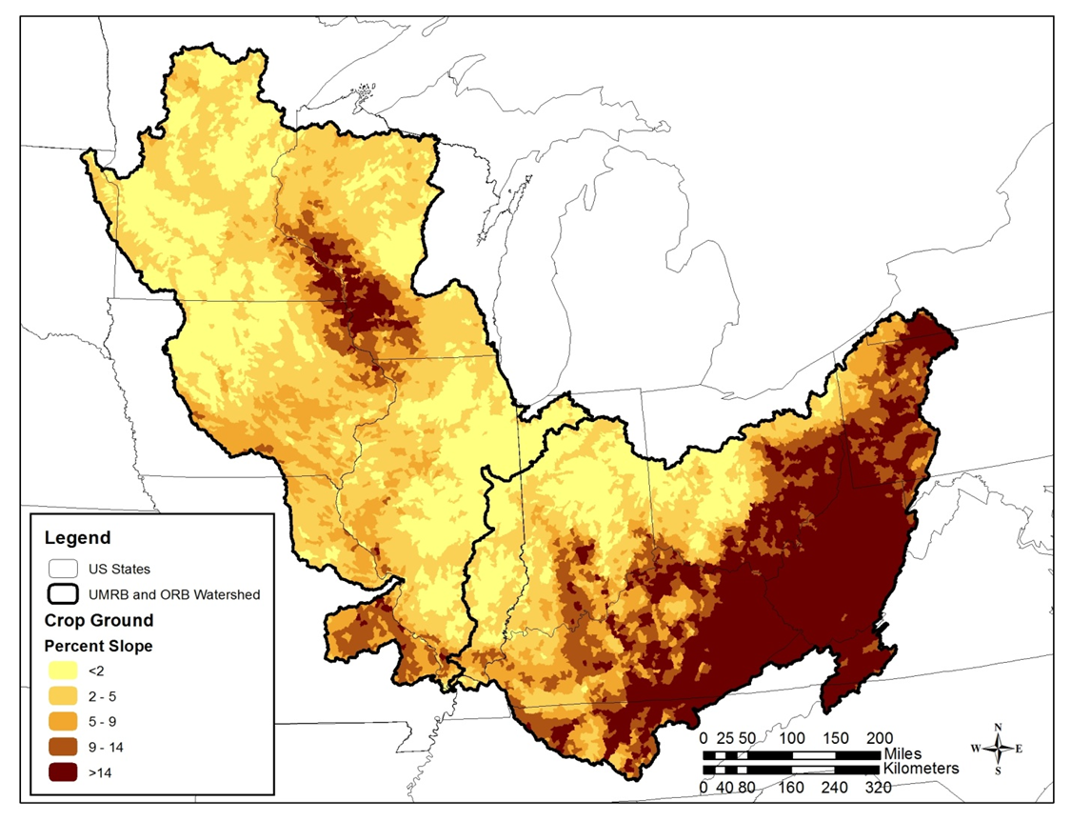
Cropping intensity varies by land slope
Row crop intensity
Slope of cropped lands
Schilling, K.E., C.F. Wolter and E. McLellan. 2014. Agro-hydrologic landscapes in the Upper Mississippi and Ohio river basins. Environmental Management, 55:646-656.

Slide 4
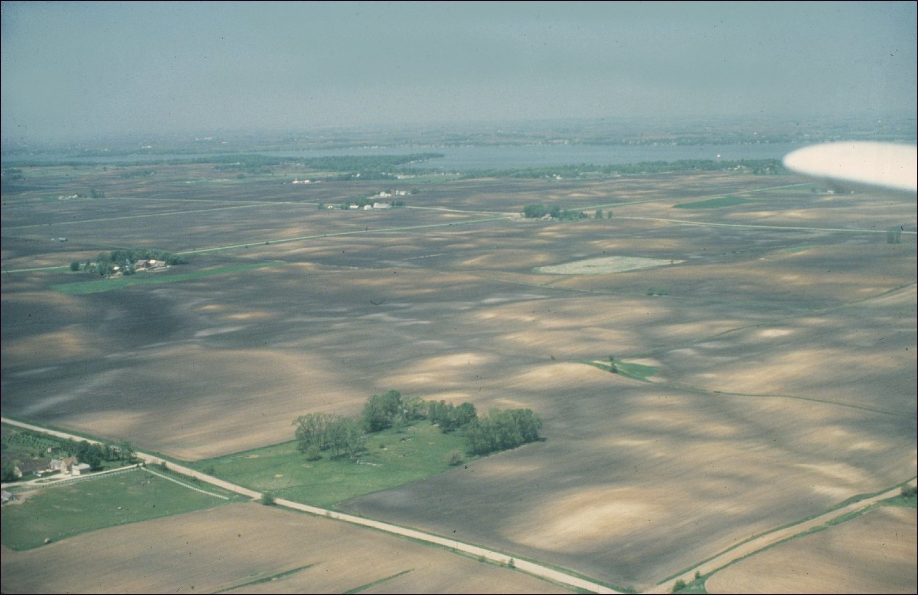
Young glacial landscape - areas of level terrain
Winnebago County, Rice Lake photo by Gary Hightshoe

Slide 5
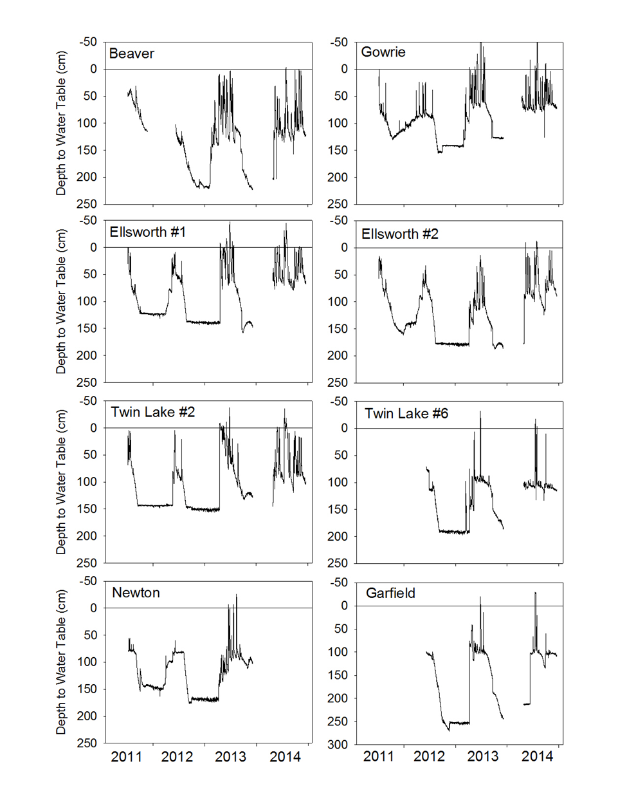
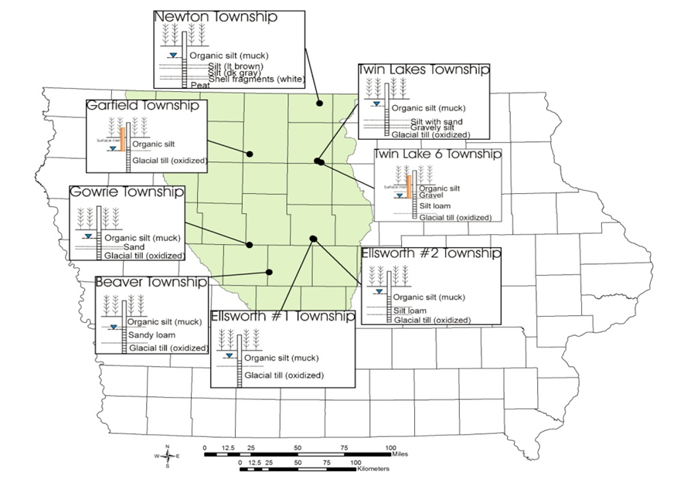
Water tables in Des Moines Lobe

Slide 6
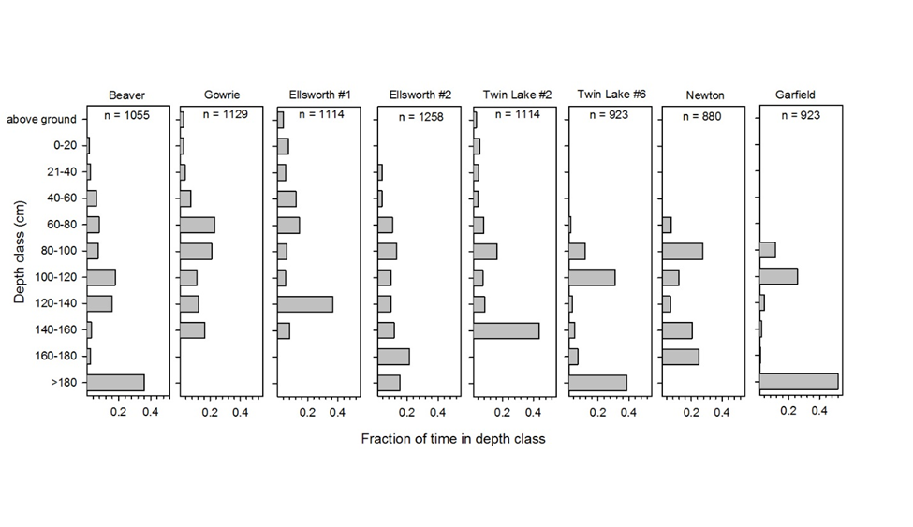
Water table depths in tiled landscapes
High water tables March to July
Water table in tiled farm fields is rarely above tile depth

Slide 7
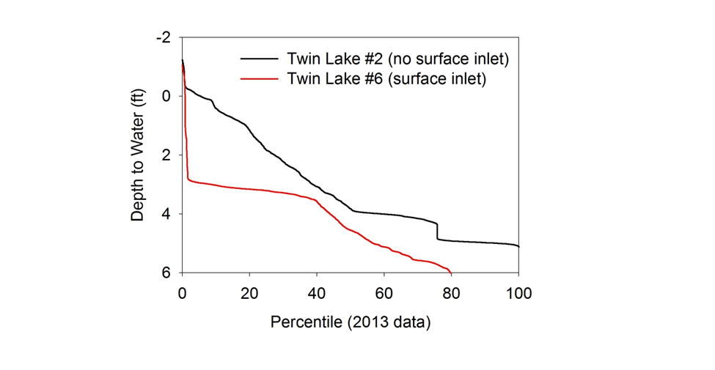
Relation of water table to surface inlets
Drains gradually
Water table rapidly decreased to tile depth
Drains rapidly
Schilling, K.E., P.J. Jacobson, M.T. Streeter, and C.S. Jones. 2018. Groundwater hydrology and quality in farmed wetlands of the Des Moines Lobe, Iowa. Wetlands. 38:247-259

Slide 8
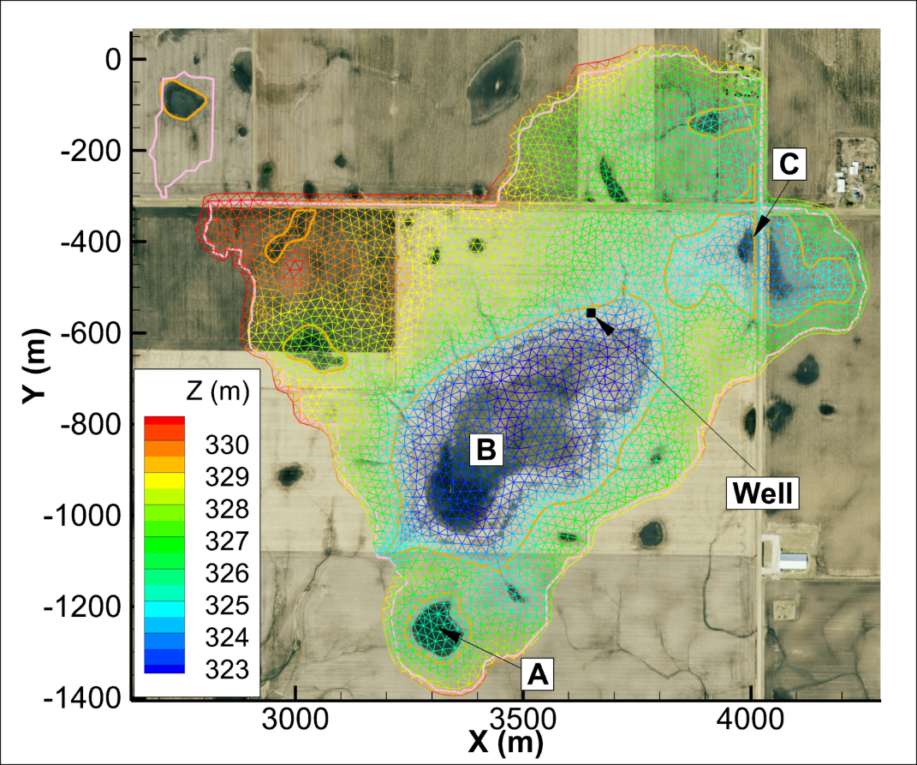
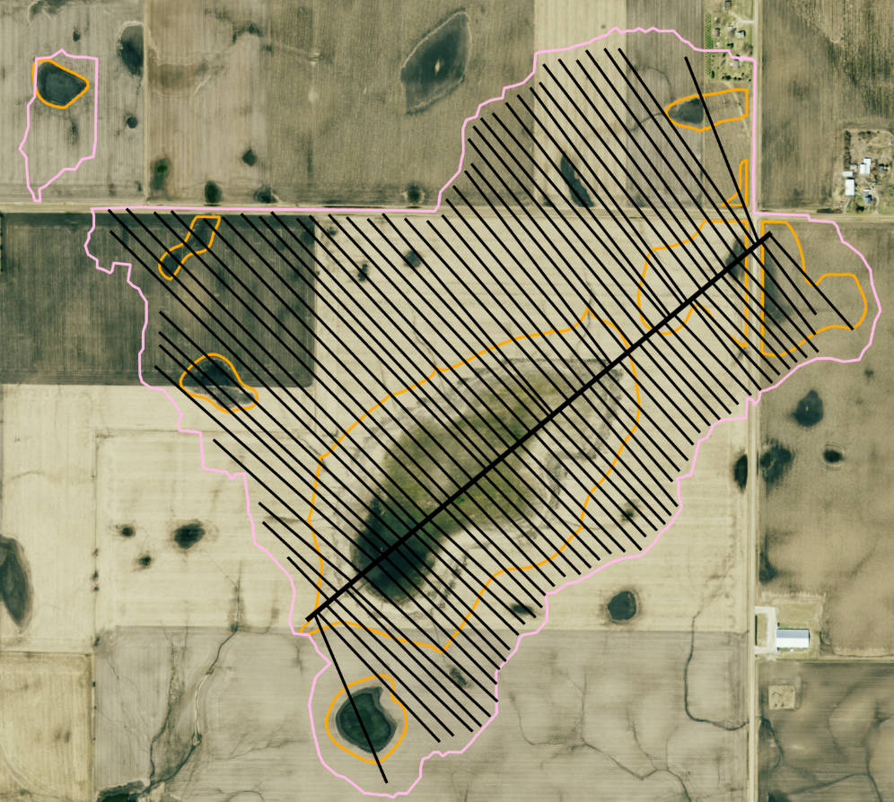
Modeling Connectivity of Drained Potholes
INVESTIGATING HYDROLOGIC CONNECTIVITY of a DRAINED PRAIRIE POTHOLE REGION WETLAND COMPLEX USING A fully integrated, physically-based model
Arenas, A.A., M. Politano, K.E. Schilling and L.J. Weber. 2016. Investigating hydrologic connectivity of a drained Prairie Pothole Region wetland complex using a fully integrate, physically-based model. Wetlands. DOI:10.1007/s13157-016-0800-5

Slide 9
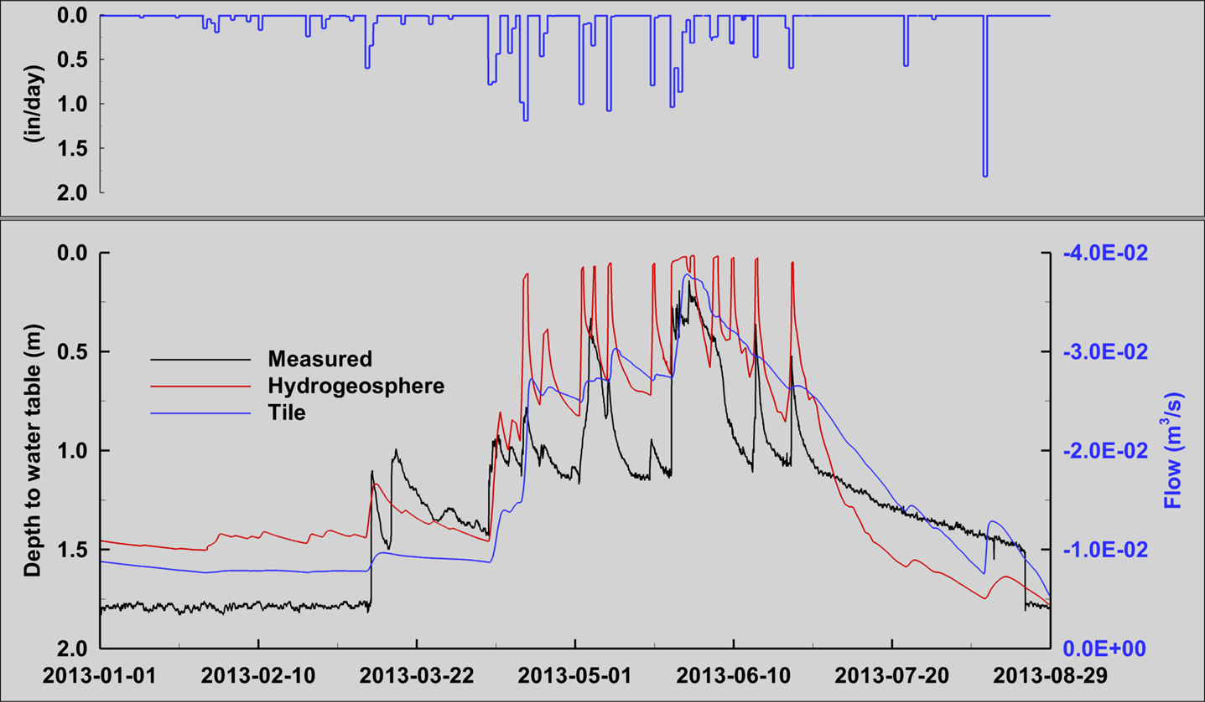
Model calibration

Slide 10
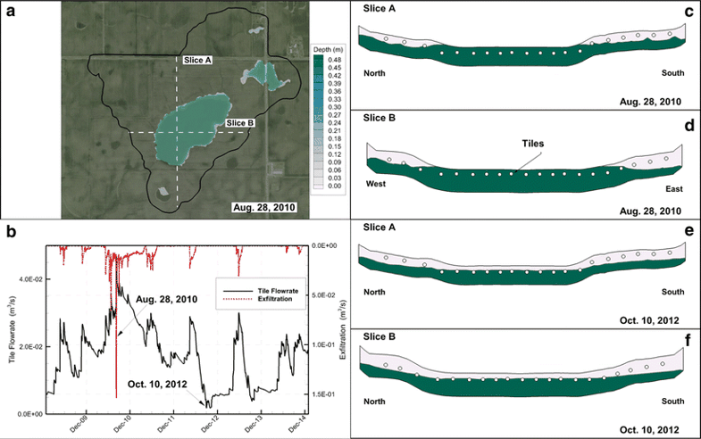
Groundwater rise contribution to ponding
Groundwater will occasionally rise above the ground surface in the pothole depressions during wet periods

Slide 11
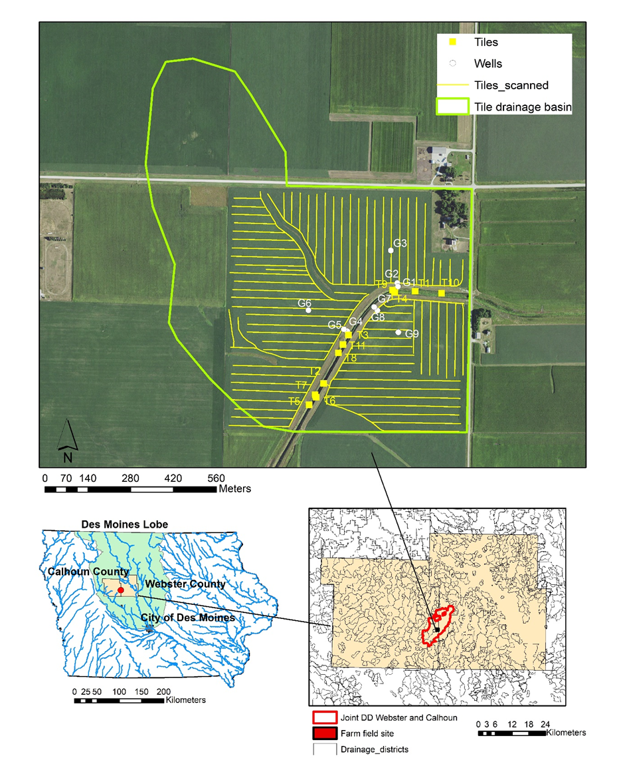
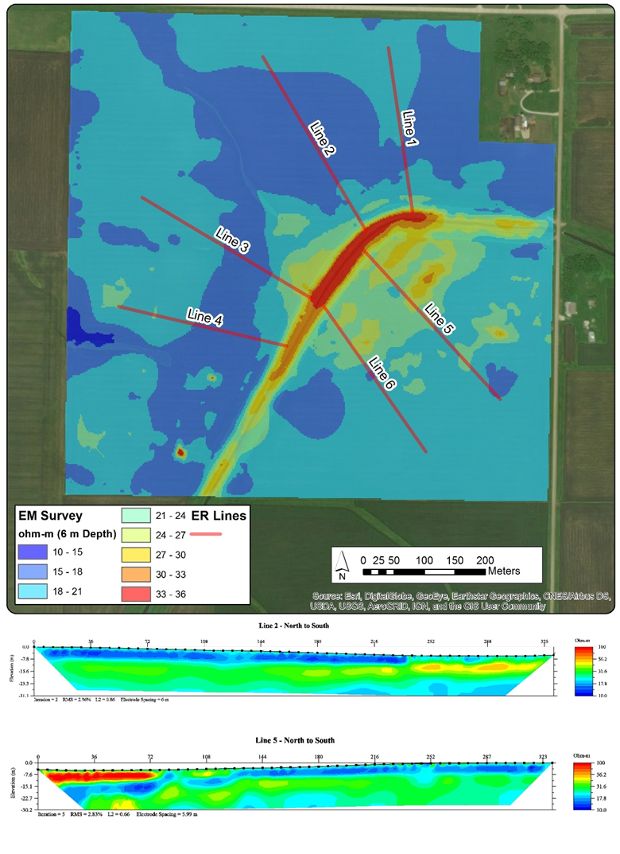
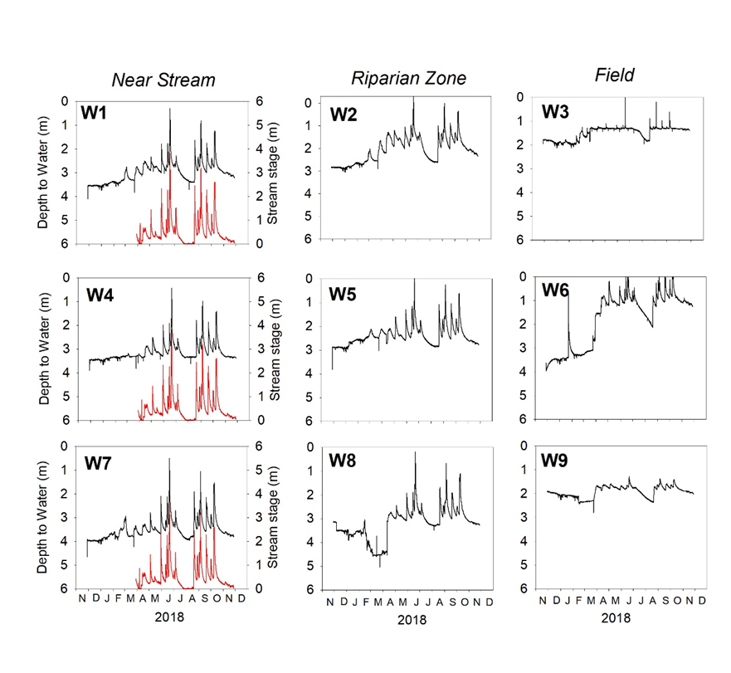
Groundwater monitoring in a tiled field

Slide 12
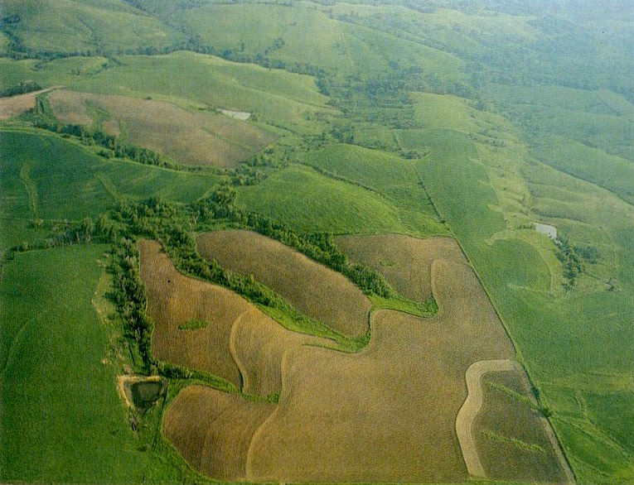
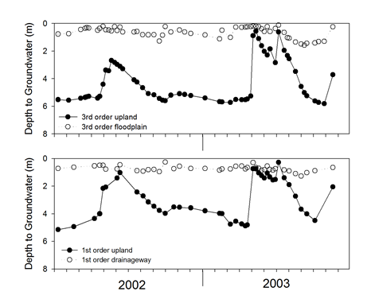
Old glacial landscape - Farming on sloping landscape
Monona County Photo from Land-Use Analysis Laboratory Iowa State University

Slide 13
Water tables in older, sloping landscapes
Narrow range of fluctuation in floodplain
Water table in uplands fluctuates >3m
Schilling, K.E., M.T. Streeter, T.M. Isenhart, W.J Beck, M.D. Tomer, K.J. Cole and J.L. Kovar. 2018. Distribution and mass of groundwater orthophosphorus in an agricultural watershed. Science of the Total Environment 65:1330-1340

Slide 14
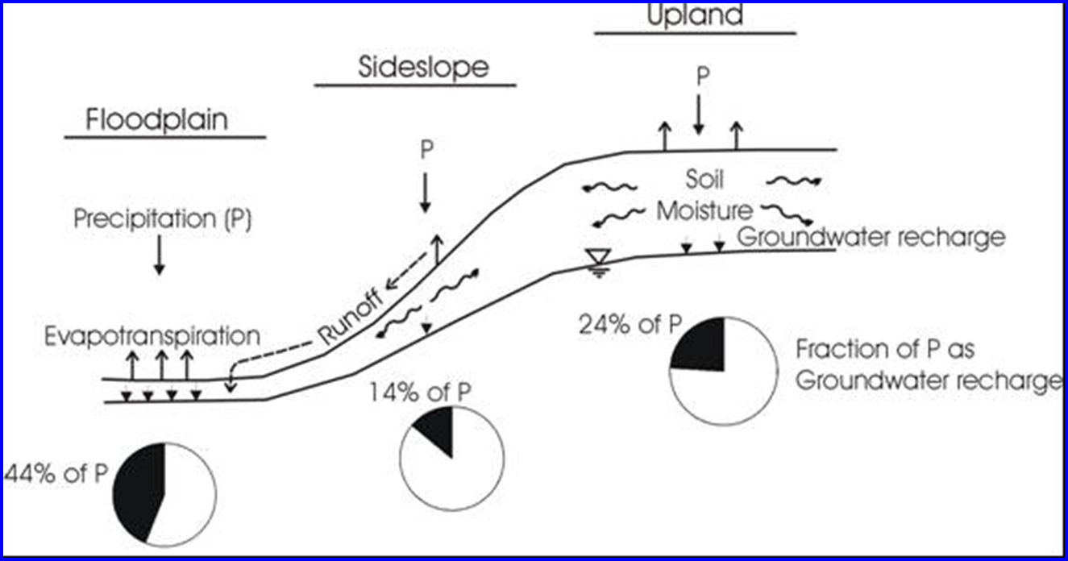
Difference in water partitioning by landscape position
Schilling, KE. 2009. Investigating local variations in groundwater recharge along a topographic gradient. Hydrogeology Journal 17:397-407.

Slide 15
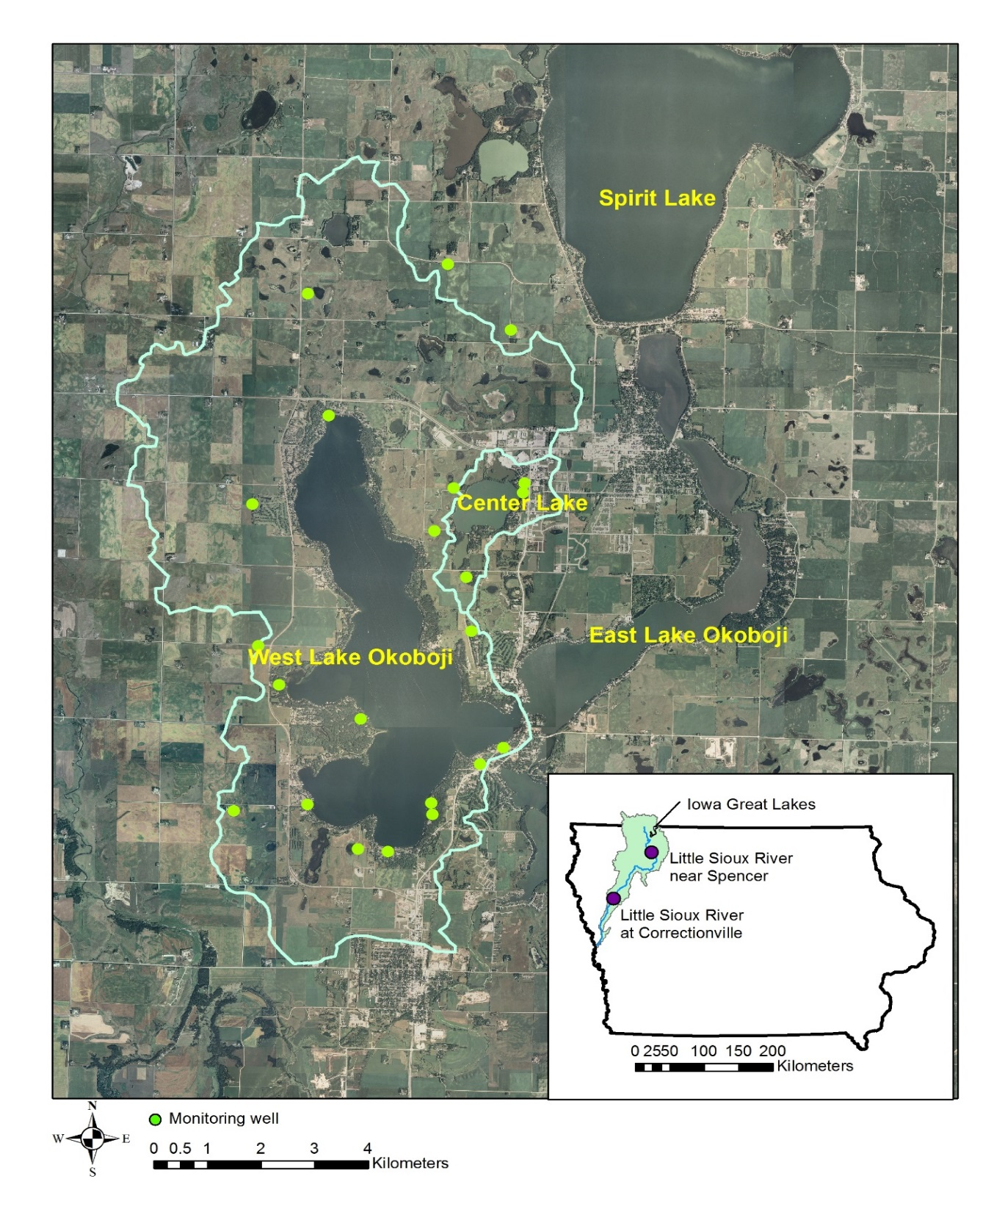
Schilling, K.E., M.T. Streeter, D. Quade and M. Skopec. 2016. Groundwater loading of nitrate-nitrogen and phosphorus to a large glacial lake, Iowa. Journal of Great Lakes Research, 42:588-598

Slide 16
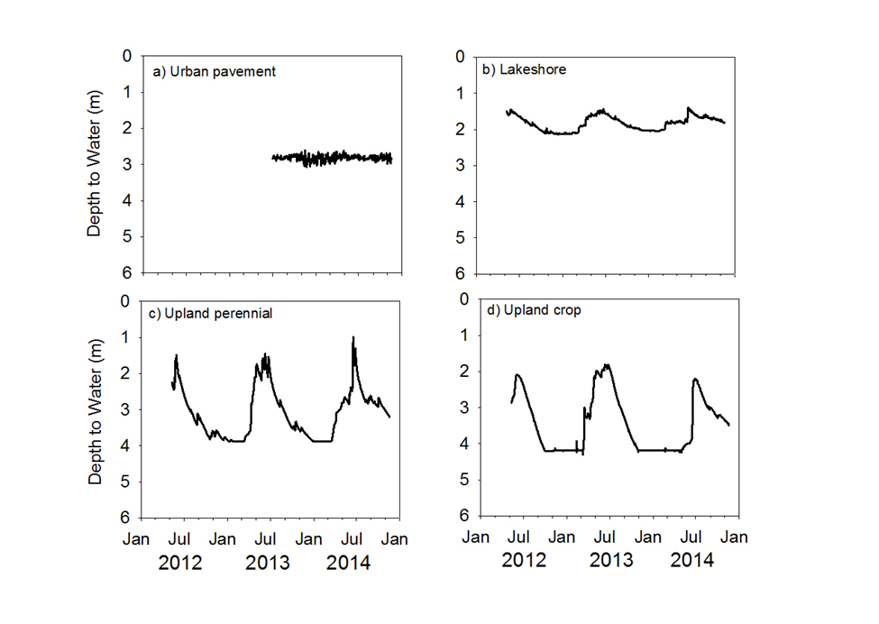
Water table fluctuations – Note the effects of urban pavement on levels
No seasonal trends
Narrow range of fluctuation
Indicates little groundwater recharge occurring beneath pavement

Slide 17
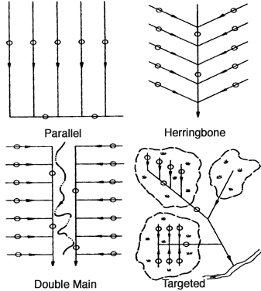
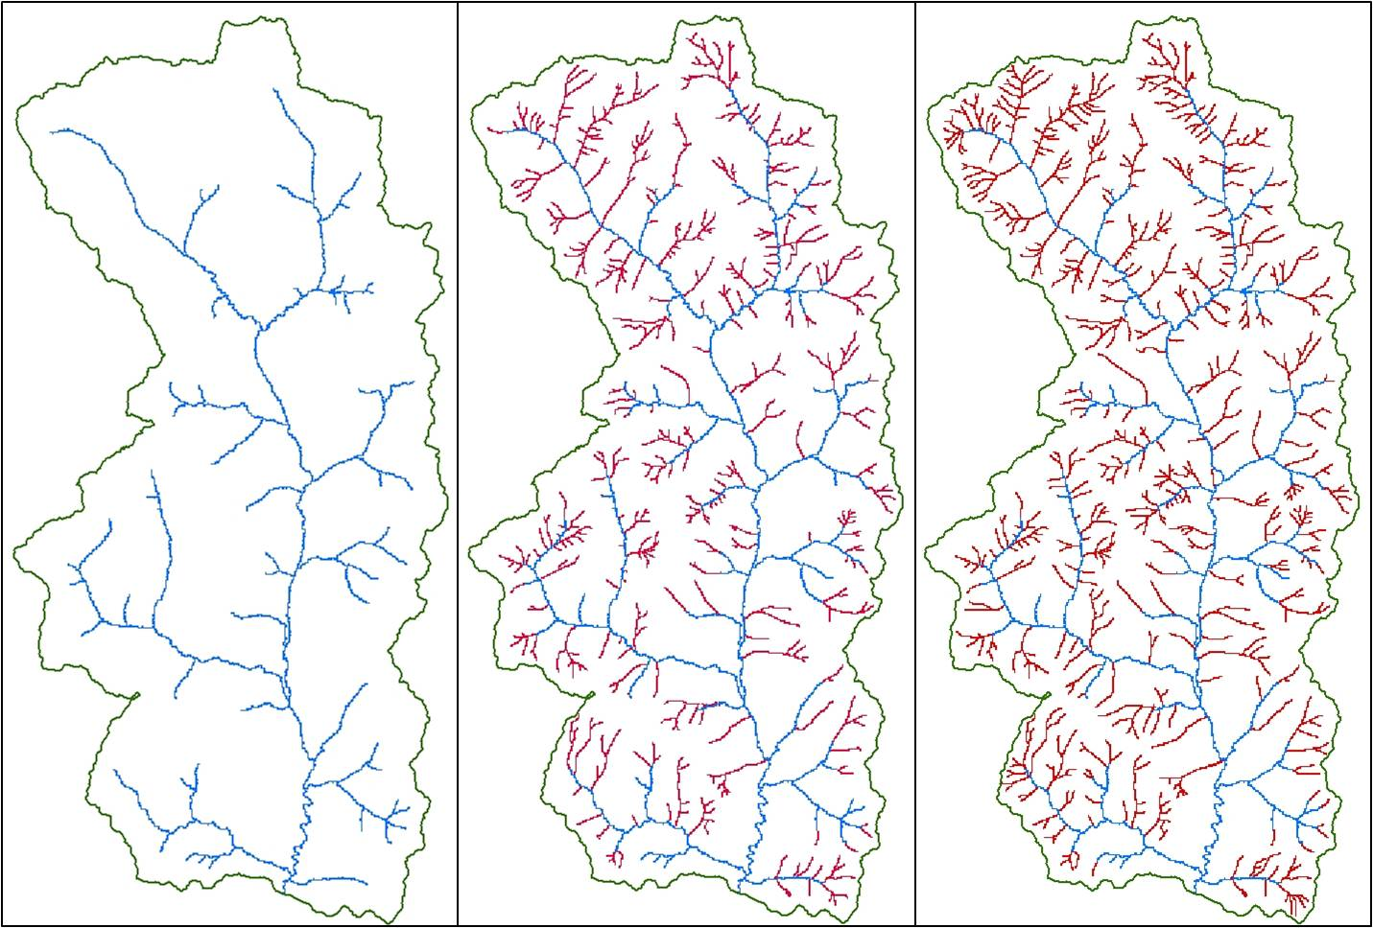
Tiling patterns in young vs old glacial landscapes
Young landscape
Old landscape
Drainage tile in young glacial landscapes is often installed in a variety of patterns
Drainage tiles in older glacial landscapes are often located along grass waterways

Slide 18
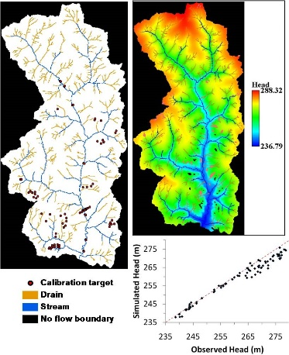
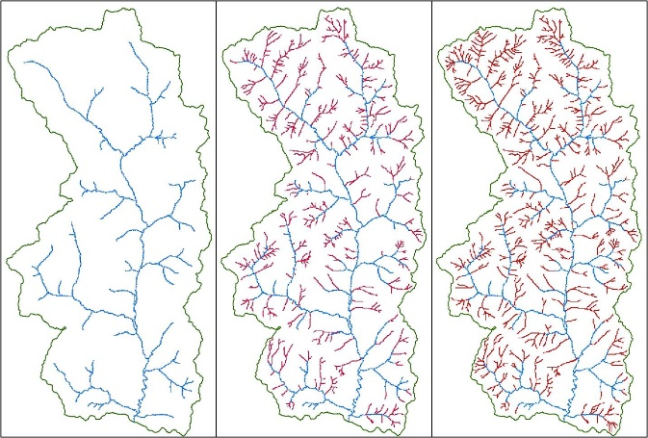
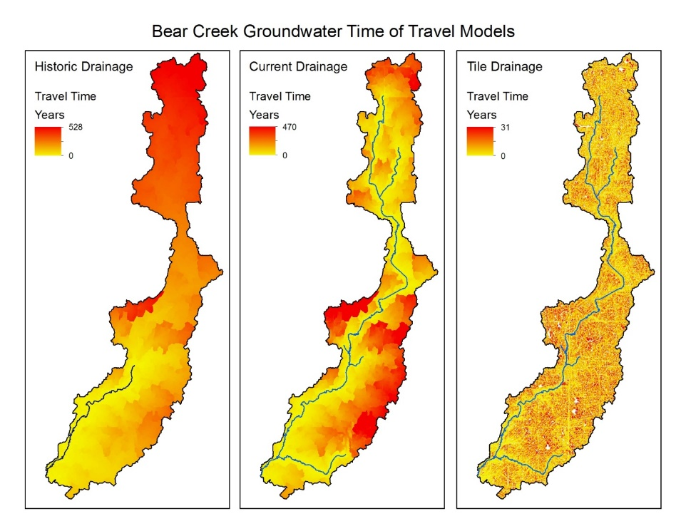
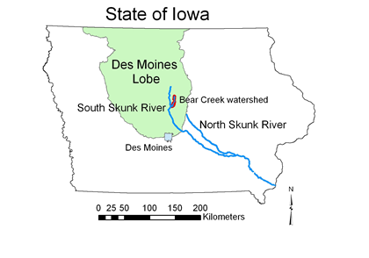
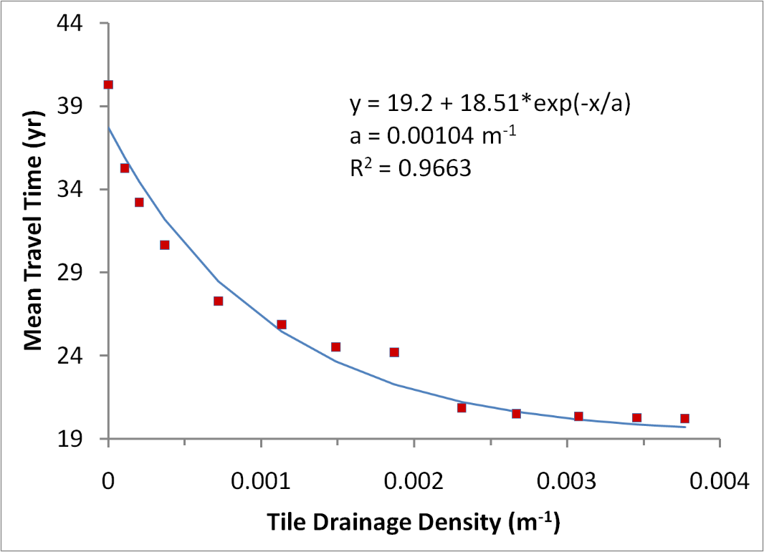
Effects on groundwater travel times and drainage density
Tile drainage decreased travel times and shortened flow paths to streams
Schilling, K.E., C.F. Wolter, T.M Isenhart, and R.C. Schultz. 2015. Tile drainage reduces groundwater travel times and compromises riparian buffer effectiveness. Journal of Environmental Quality, 44:1754-1763
Drainage Intensity | Mean travel time (years) | Drainage density (m-1) | Mean Flow Length (m)
High | 1.07±1.28 | 0.039 | 23.6±21.4
Medium | 2.64±2.88 | 0.010 | 55.5±42.7
Low | 5.57±5.27 | 0.0047 | 110±82.4
Perennial network | 82.5±88 | 0.0006 | 1,527±1215
Pre-settlement | 181.6±134 | 0.00015 | 9,311±8197
Travel time decreased from 40 to 20 years
Schilling, K.E., P. Jindal, N. Basu and M.J. Helmers. 2012. Impact of artificial subsurface drainage on groundwater travel times and baseflow discharge in an agricultural watershed, Iowa (USA). Hydrological Processes, 26:3092-3100

Slide 19
Interesting comparison of Bear Creek (young glacial landscape, intensive drainage) and Walnut Creek (old glacial landscape)
 | Pre-settlement drainage density (m⁻¹) | Current stream drainage density (m⁻¹) | Increase in drainage density | Drainage density with tiles (m⁻¹) | Increase in drainage density with tiles
Bear | 0.00015 | 0.0006 | 4x | 0.010 (med.) | 67x
Walnut | 0.0007 | 0.0011 | 1.6x | 0.0027 | 2.5x
Pre-settlement density in Walnut Creek 5x greater that Bear Creek
Drainage density in Bear Creek today exceeds pre-settlement Walnut Creek, an old glacial landscape that had a 500,000 year head start!

Slide 20
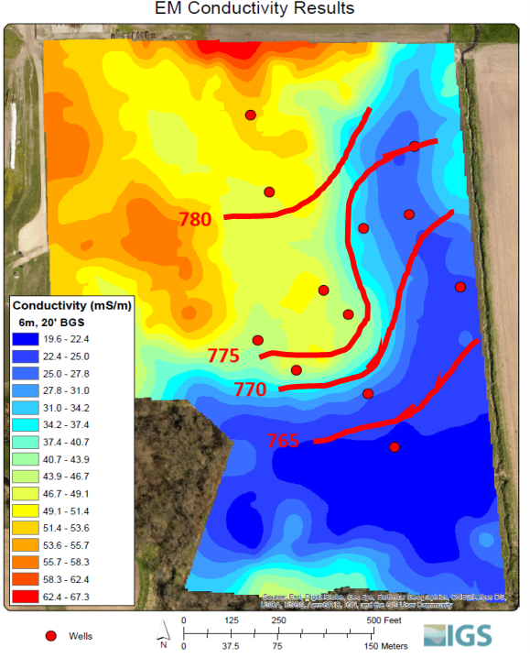
Effects of soil texture on water table levels

Slide 21
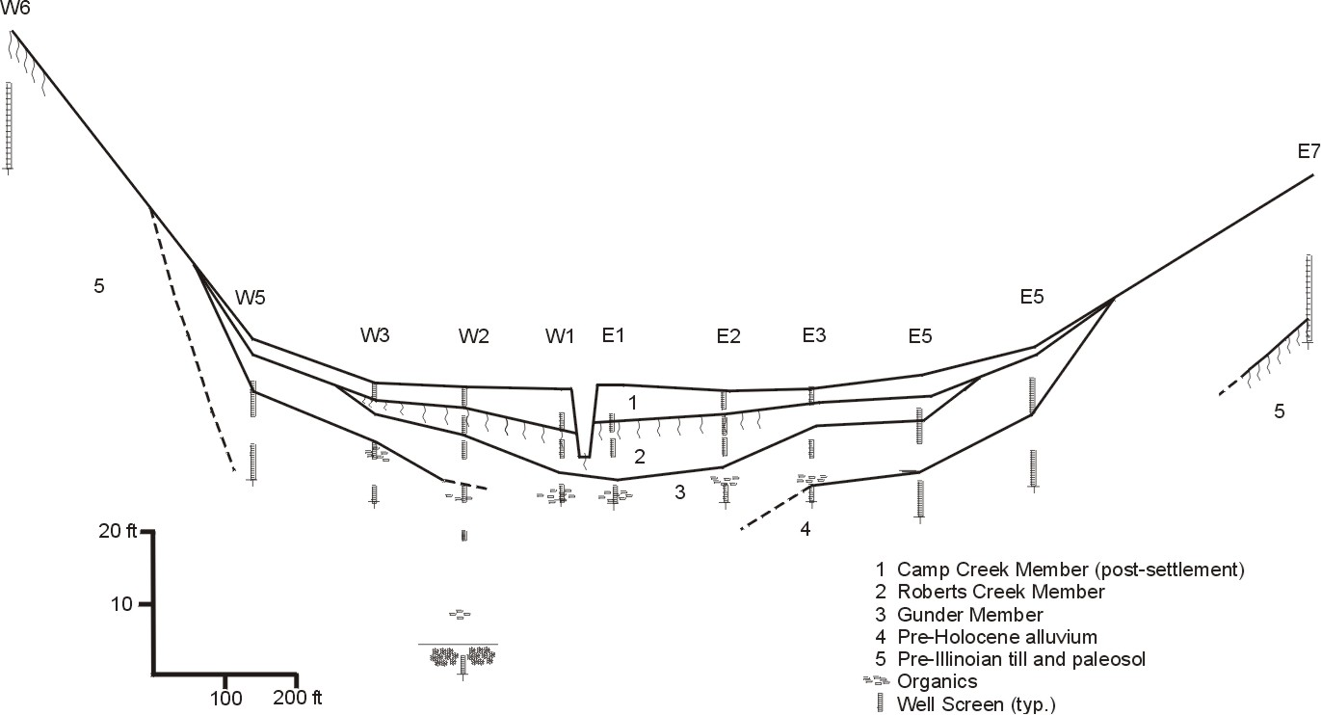
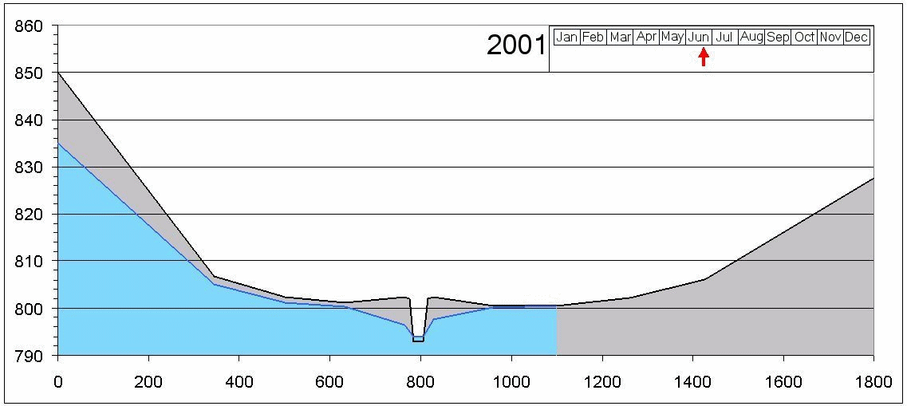
Water table fluctuations near an incised stream
Schilling et al., 2004, J. Hydrol.

Slide 22
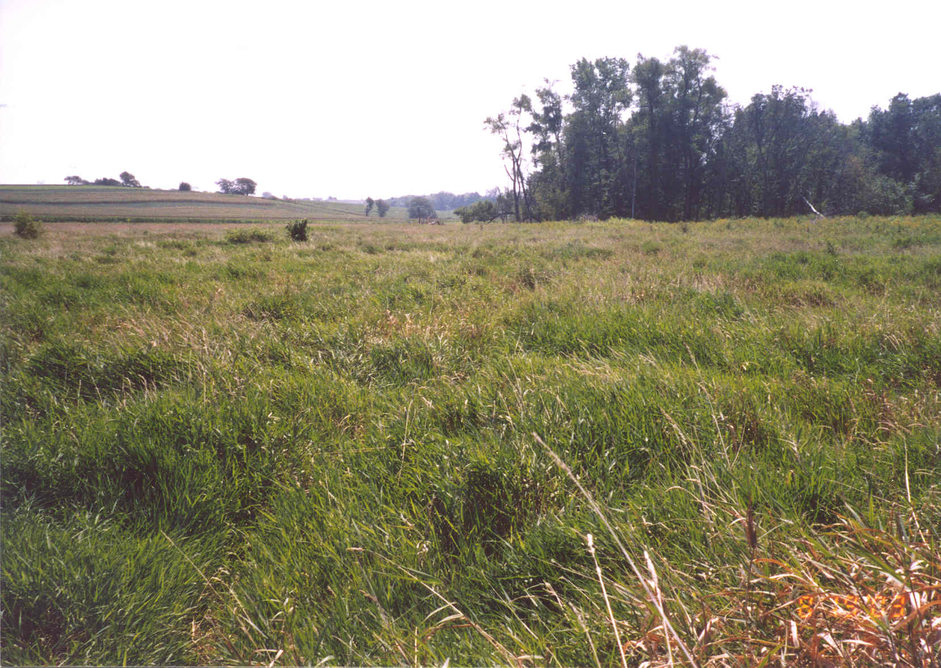
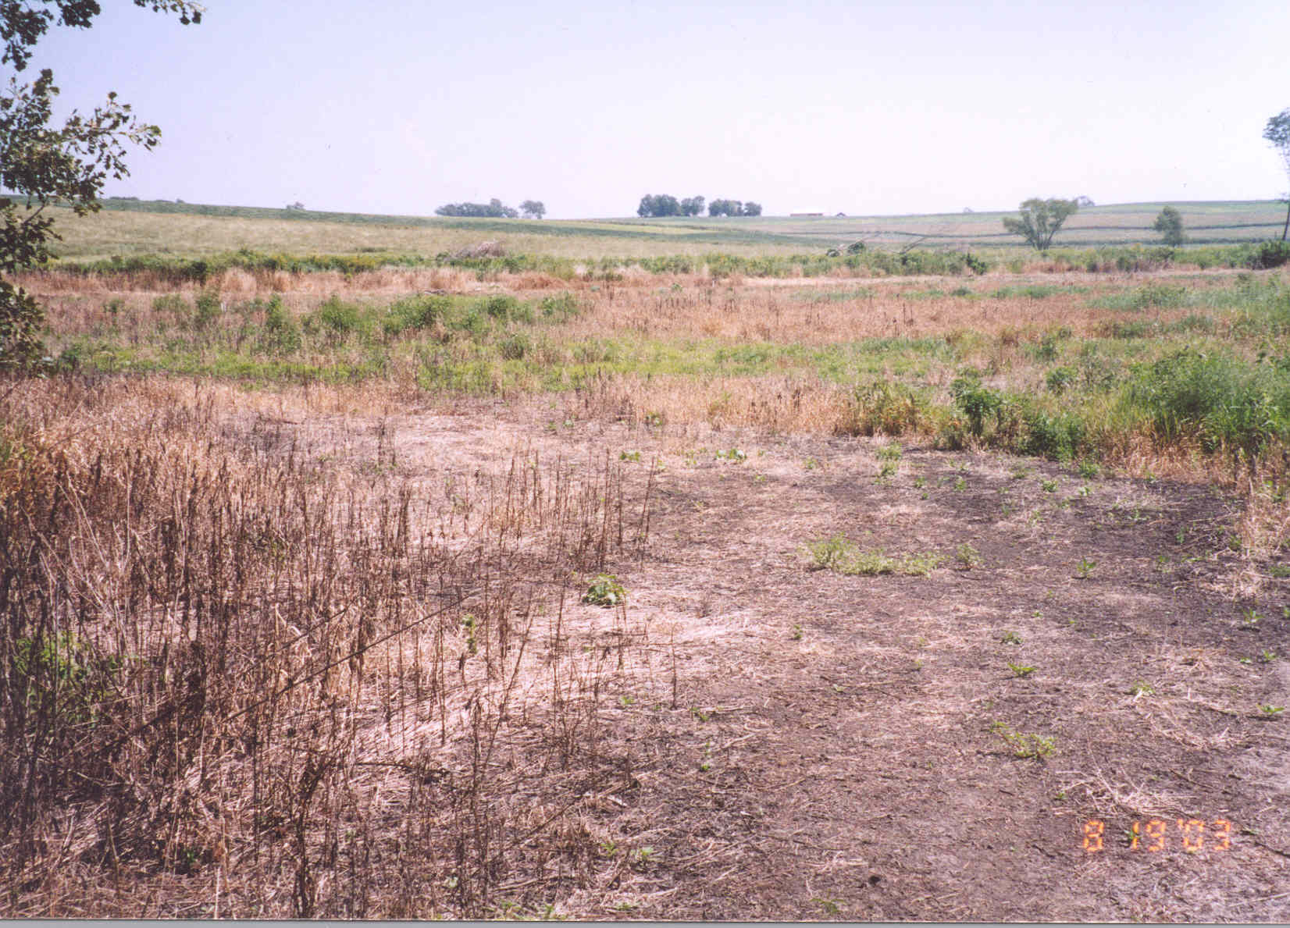
Effect of land cover on water table behavior
Zhang, Y-K, and K.E. Schilling. 2005. Effects of land cover on evapotranspiration, soil moisture and groundwater table and recharge: field observations and assessment. Journal of Hydrology. 319:328-338

Slide 23
NH₄-N Concentrations
NO₃-N Concentrations
No Grass Cover
Grass Cover
Schilling and Jacobson, Biogeochemistry, 2008

