Slide 1
The Foundation for Food and Agriculture Research
This Photo by Unknown Author is licensed under CC BY-SA
Sally Rockey, Executive Director
Foundation for Food and Agriculture Research
West Virginia University
January 23, 2020

Slide 2
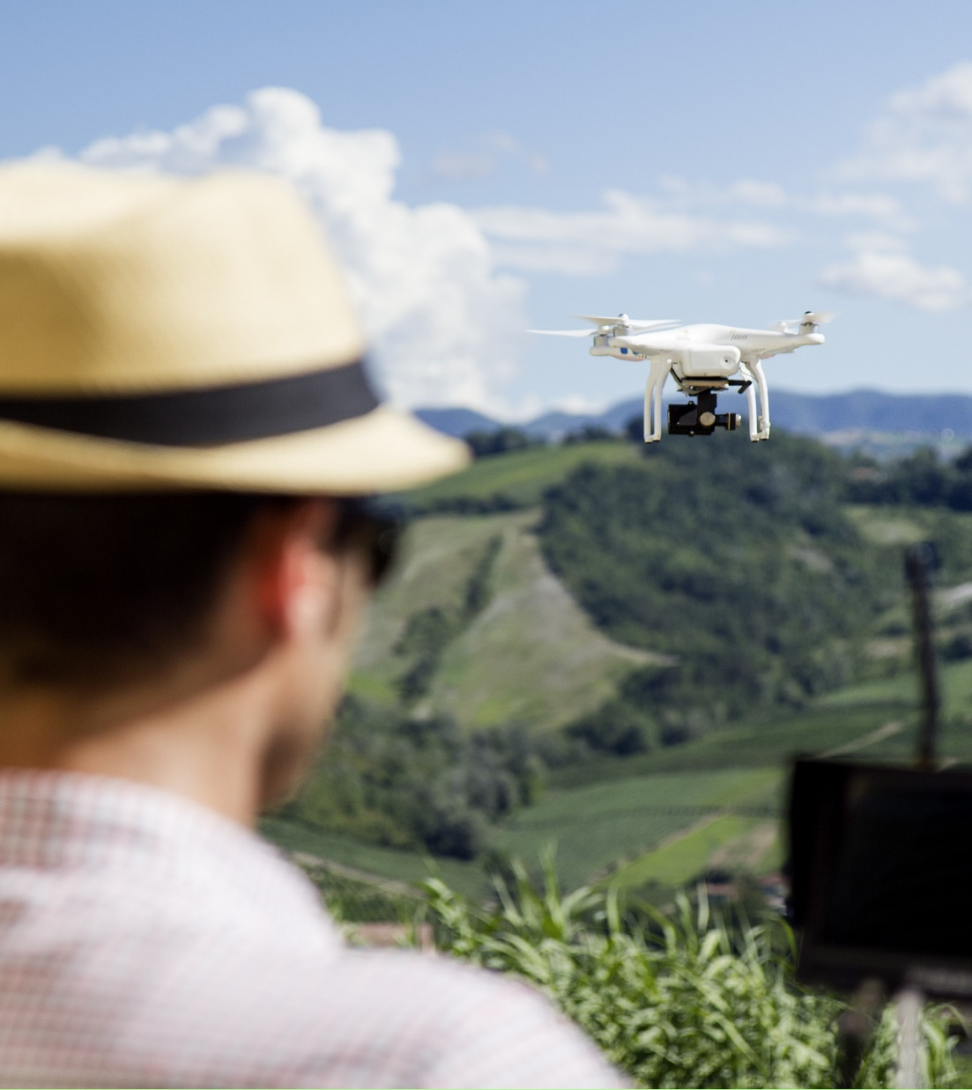
FFAR Mission
We build unique partnerships to support innovative science addressing today’s food and agriculture challenges.

Slide 3
OUR VISION
We envision a world in which ever-innovating and collaborative science provides every person access to affordable, nutritious food grown on thriving farms.
Notes:
How do we achieve this vision? Through public-private partnerships. Problems in food and ag are very complex – we all have to work together to solve them.

Slide 4
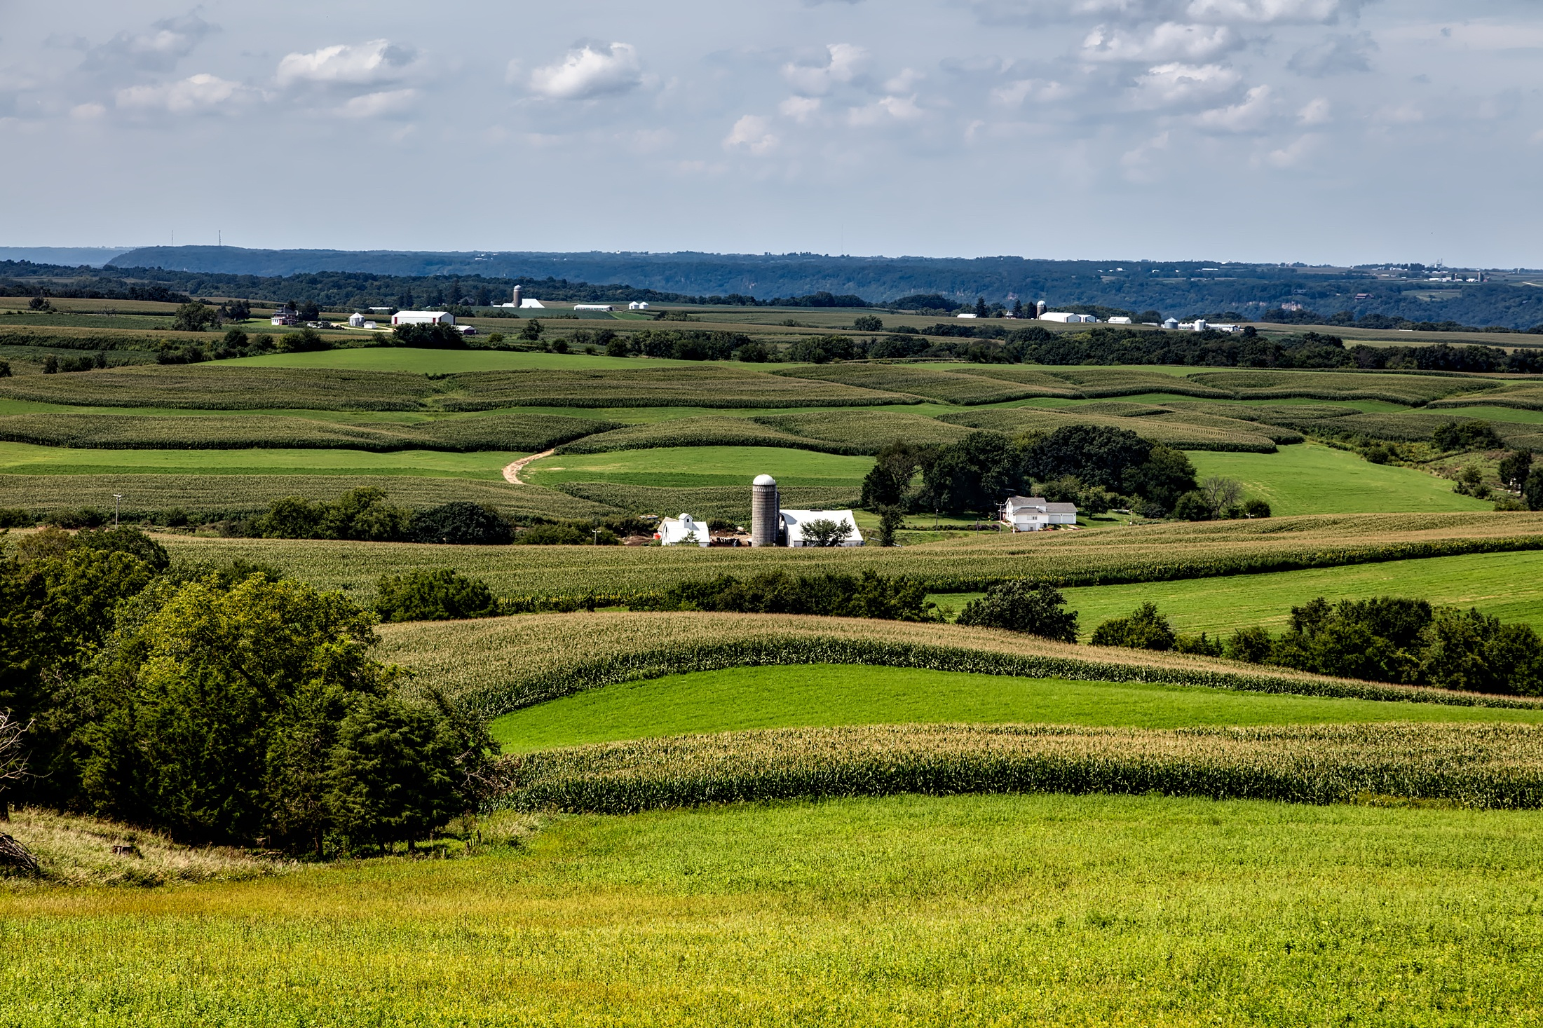
How We Work
$385M
+
$385M
FFAR
Investment
Non-Federal Match
Private-Public Partnerships
“
The model of public private partnership is a really important space that wasn’t previously filled in the US [food and agriculture] R&D world before FFAR.
We build unique partnerships to support innovative science addressing today’s food and agriculture challenges.
”
-FFAR Stakeholder
Notes:
Emphasize our private-public partnerships are built to achieve our vision.
Every $1 we spend is matched by $1 from a funding partner.

Slide 5
Industry and Foundation Partners Include:
Over 340 distinct funding partners!

Slide 6
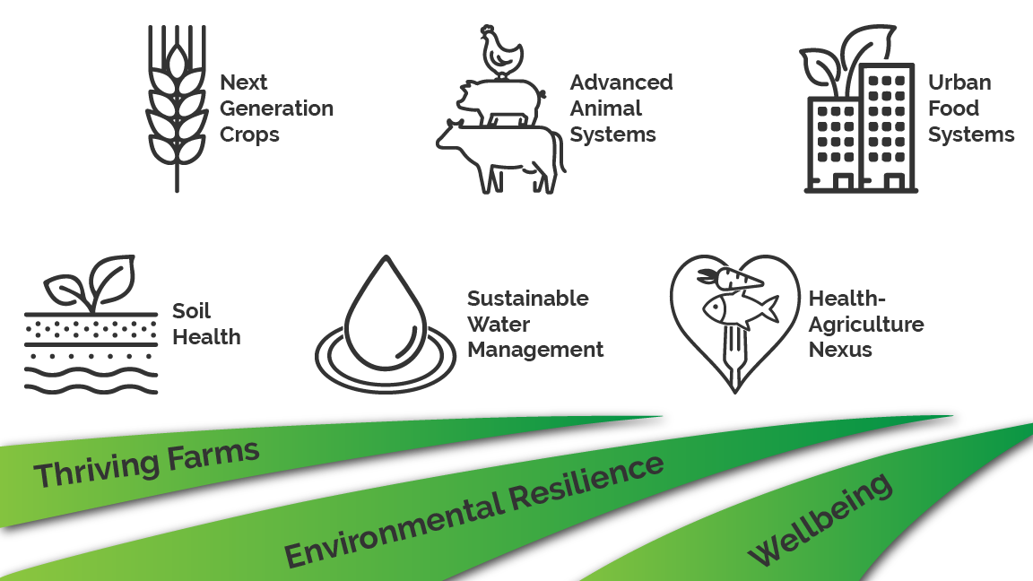
FFAR CHALLENGE AREAS

Slide 7
FFAR Funding Models
FFAR may award funds in four ways:
Competitive Grants
Direct Awards
Prizes
Consortia

Slide 8
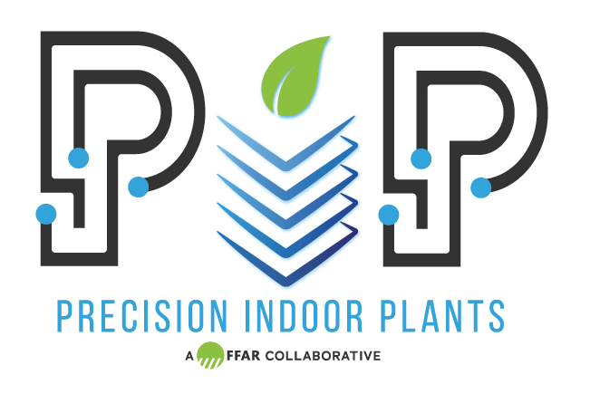
FFAR Consortia
Consortium for Innovation in Post-Harvest Loss and Food Waste Reduction
IRRIGATION INNOVATION
CONSORTIUM
Ecosystem Services Market Research Consortium
Notes:
In 2019, FFAR:
Launched four consortia: Precision Indoor Plants (PIP), the International Consortium on Antibiotic Stewardship in Agriculture (ICASA), the Consortium for Innovation in Post-Harvest Loss and Food Waste Reduction and Ecosystem Services Market Consortium.
PIP is a public-private partnership that produces new, flavorful nutritious crops specially intended for indoor agriculture.
ICASA advances research on antimicrobial stewardship in animal agriculture.
The Consortium for Innovation in Post-Harvest Loss and Food Waste Reduction brings together thought leaders and experts from across the globe to work in tandem with industry and non-profit organizations to address social, economic and environmental impacts from food loss and waste.
Ecosystem Services Market Research Consortium funds the research necessary to pay-for-success ecosystem service market-based program designed to support farmers for best practices that sequester carbon, enhance water quality and quantity.

Slide 9
The Egg-Tech Prize:
Discovering New Technologies for In Ovo Sex Determination
FFAR awarded over 1M to the six winners of Phase One of the Egg-Tech Prize.
Open Philanthropy contributed matching funding for a total prize amount of $2.1M.
Notes:
FFAR and the Open Philanthropy Project teamed up to launch the Egg-Tech Prize. This prize opportunity offers up to $6 million to the firm, group or individual who successfully develops a technology that can accurately and rapidly determine the sex of layer chicks before they hatch.
In November, the Phase One winners were announced. Phase One provides the Seed Funding for Phase Two, the ultimate Prize, that will be announced in 2020. Phase One winners are implementing techniques such as an in ovo microchip-based chemical sensor, fiber optic volatiles analysis and machine learning, multidimensional spectral mapping, and magnetic resonance imaging that leverages artificial intelligence.

Slide 10
SEEDING SOLUTIONS
Open competition once a year
in all Challenge Areas for $1.0m

Slide 11
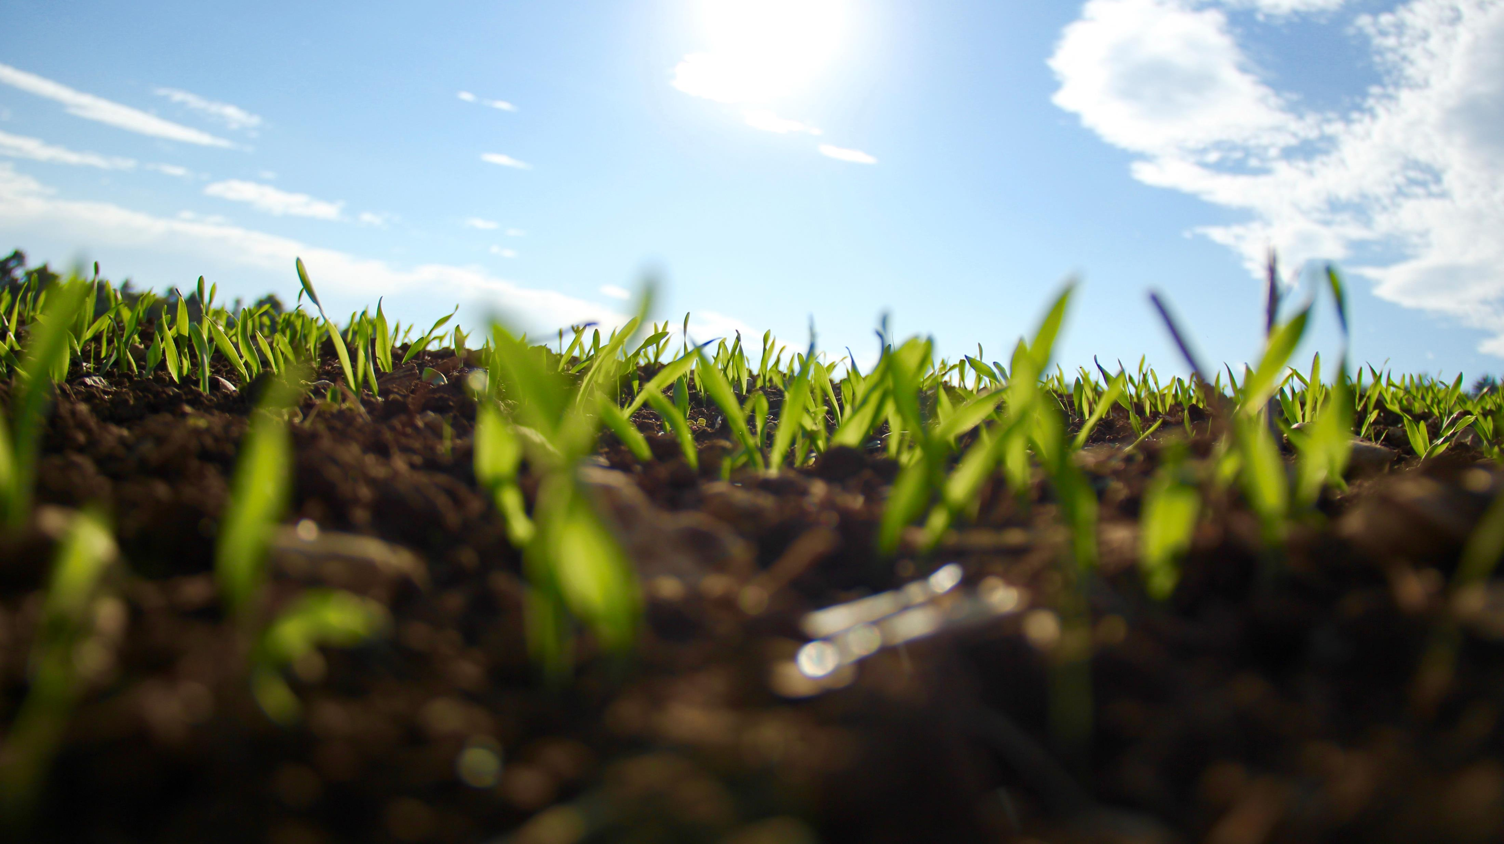
Intersection of Soil Health and Water
Soil Health Institute, Soil Health Partnership, Nature Conservancy, Cover Crops, Convening on grazing and ranch on soil health

Slide 12
Connect with FFAR www.foundationfar.org @FoundationFAR
Let’s work together to use available technology to spur agricultural innovation tomorrow

Slide 13
Thank You
Dr. Sally Rockey
Executive Director
Foundation for Food and Agriculture Research
srockey@foundationfar.org
@RockTalking

