Slide 1
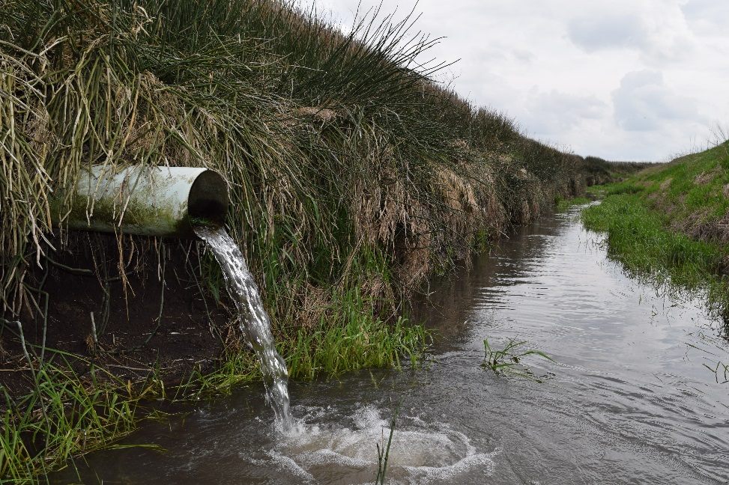
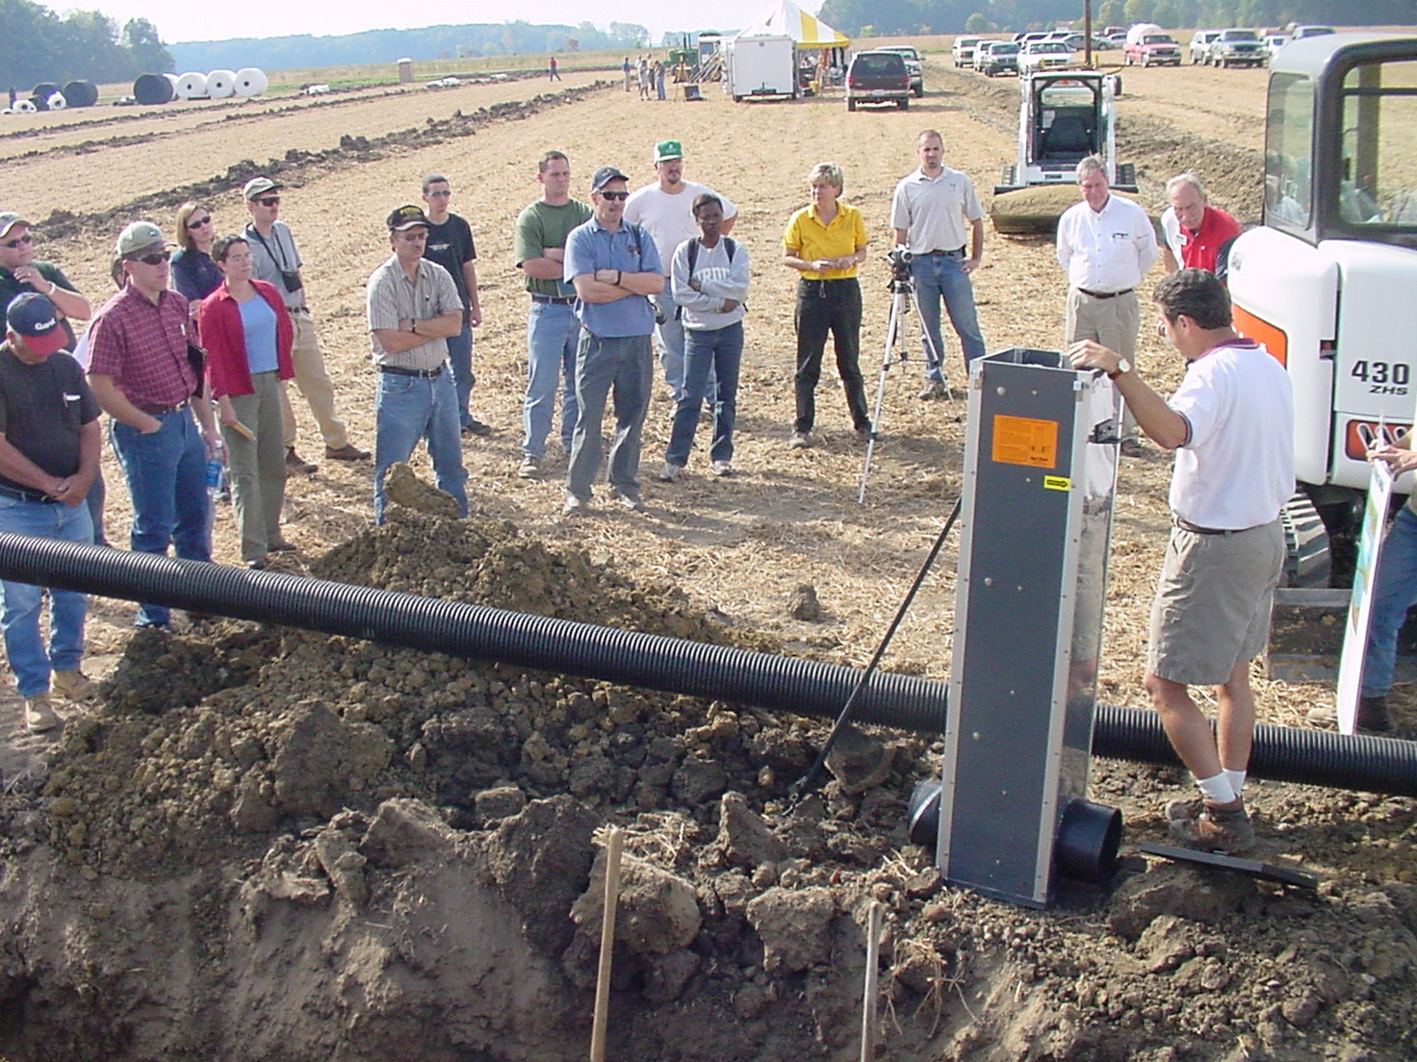
Practices for Managing Water Table Conditions in Artificially Drained Land
Jane Frankenberger
Agricultural & Biological Engineering, Purdue University
Notes:
1

Slide 2
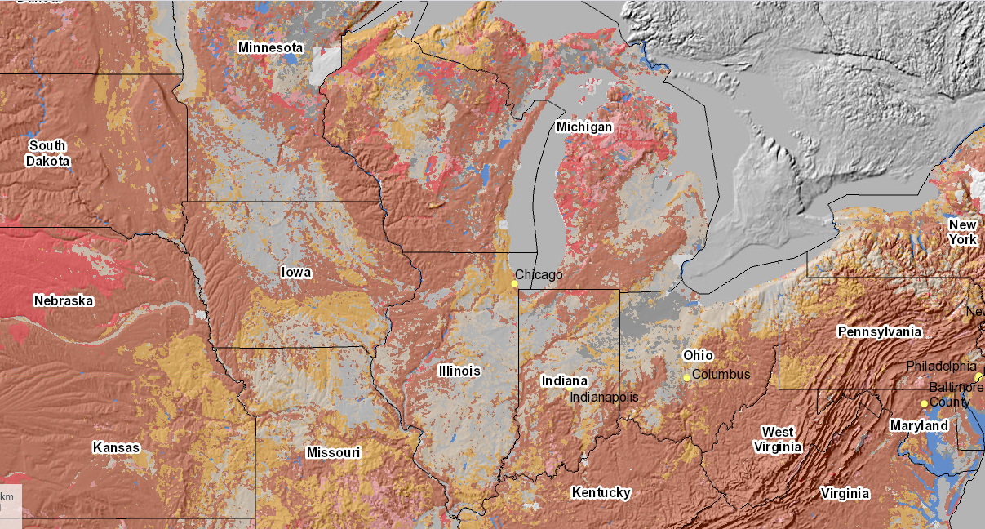
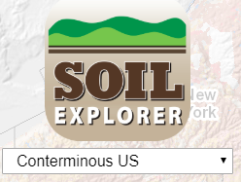
Natural soil drainage class
Thanks to Darrell Schulze
http://soilexplorer.net

Slide 3
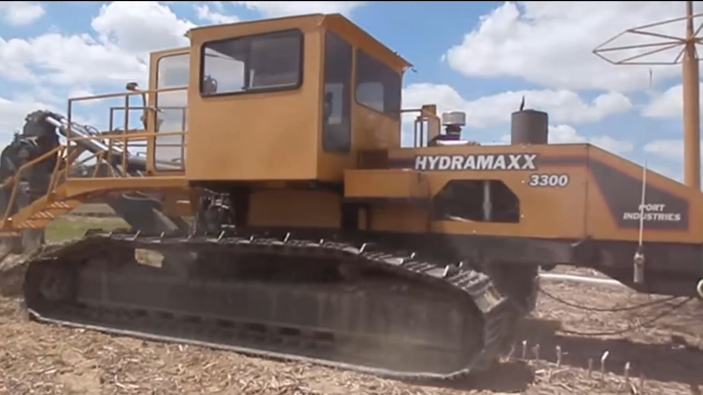

Slide 4
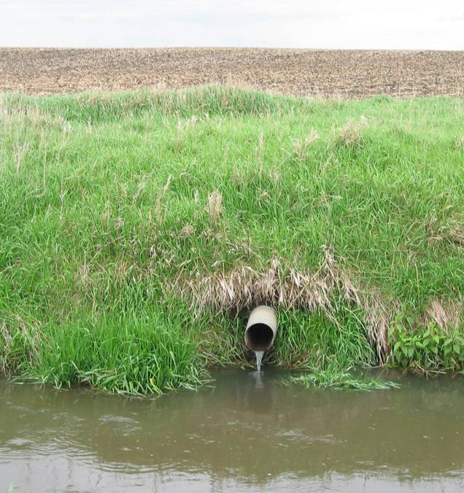
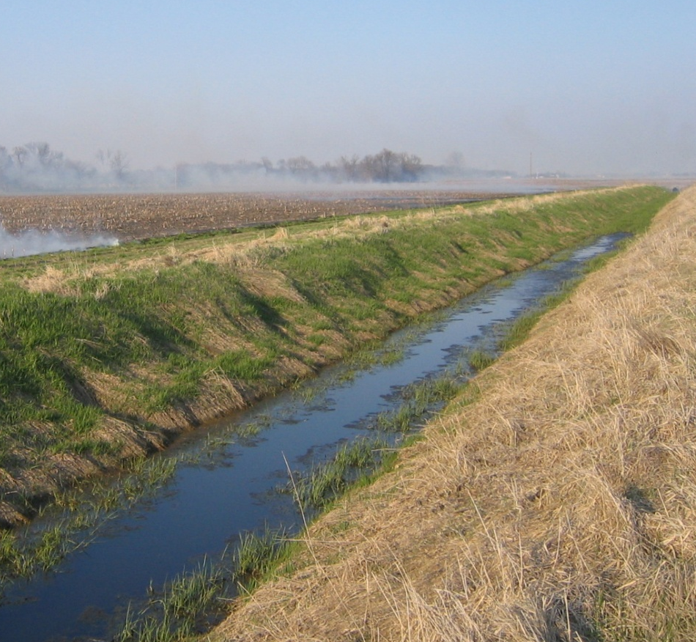
The result is a drainage infrastructure designed for getting rid of excess water as quickly as possible

Slide 5
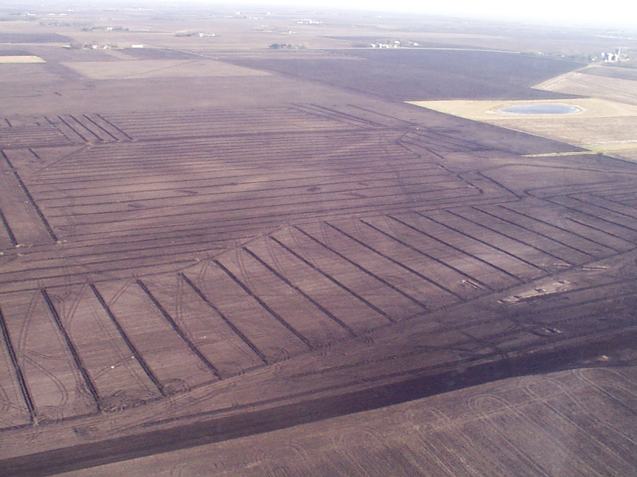
…and fields where water movement is highly modified from the natural topography and drainage patterns.
Photo: Gary Sands

Slide 6
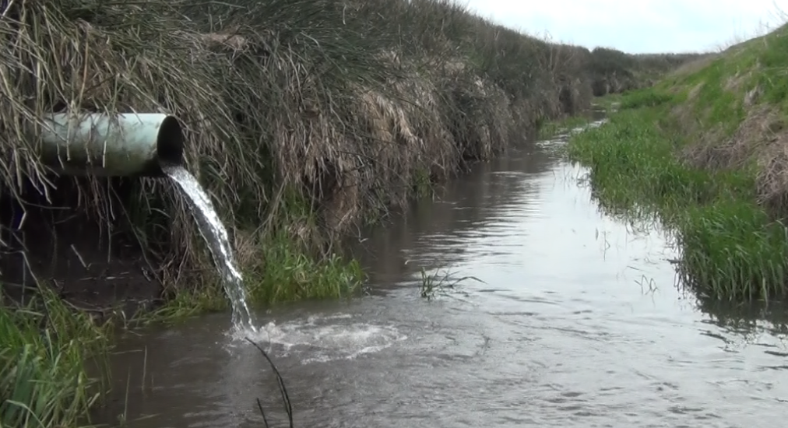
We have known since the 1970s that drainage increases nitrate loss
Nitrate
Phosphorus
Notes:
By combining drain flow and concentration results the researchers can calculate the amount of nitrate and phosphorus loads that are lost through the tile drains in pounds per acre.

Slide 7
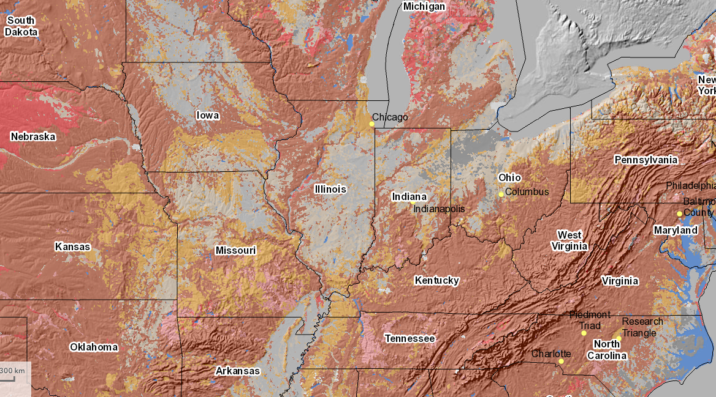
1990s: Pressure built in the Midwest to address nitrate losses causing hypoxia in the Gulf of Mexico
1970s: Gilliam and Skaggs showed that controlled drainage could reduce nitrate losses by 30% to 50%

Slide 8
Conservation practices needed to reduce nitrate loss
Yet, conservation practices commonly promoted emphasized controlling erosion, like residue management, grassed waterways, buffers.
Photo: Gary Sands

Slide 9
The role of drainage in causing Gulf hypoxia was understood, but Midwestern agriculture is highly dependent on drainage.

Slide 10
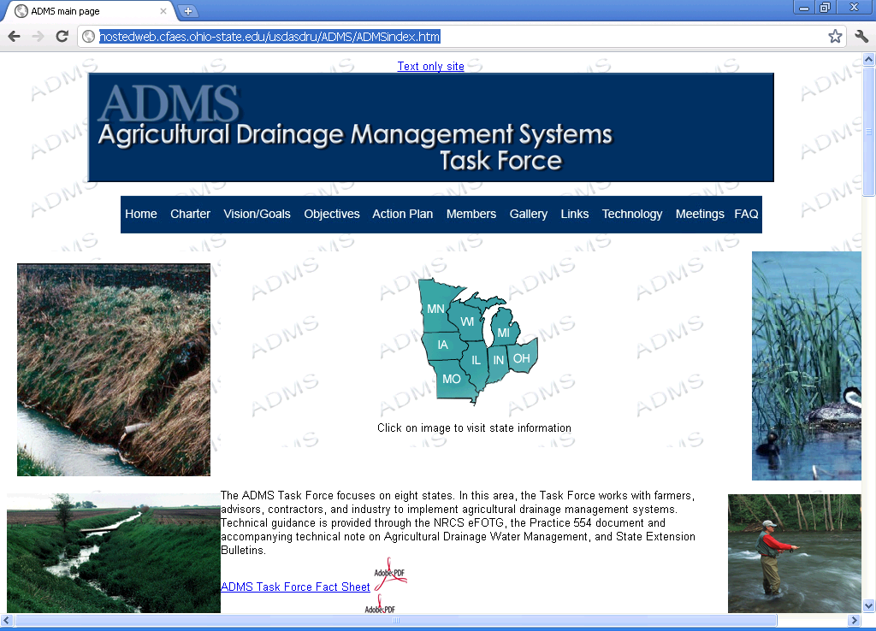
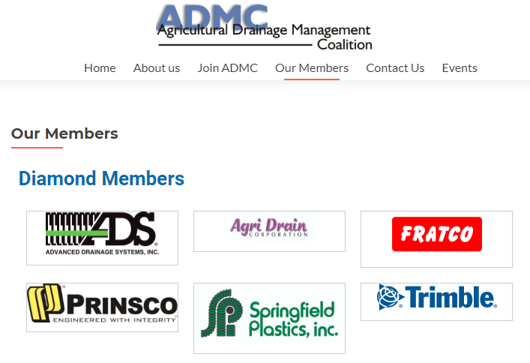
2002: Visionary leaders from industry and NRCS asked: “What would it take to bring controlled drainage to the Midwest?”
Formed the Agricultural Drainage Management Systems Task Force
The drainage industry also formed a group, and met together with the Task Force.

Slide 11
We started implementing and monitoring controlled drainage in the Midwest

Slide 12
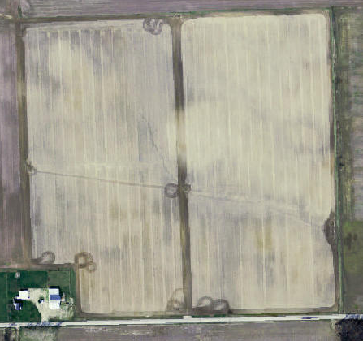
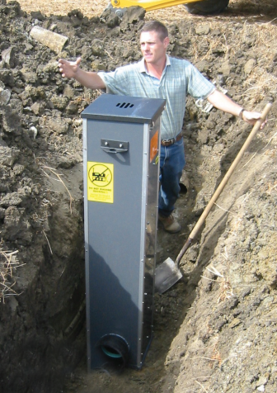
Monitoring controlled drainage at the Davis Purdue Ag Center
NW
Controlled
Drainage
NE
SW
SE
Controlled
Drainage
Notes:
A water control structure (CLICK) was installed in the NW and SE quadrants for controlled drainage, (CLICK) with an additional one in the SE due to the amount of elevation change within the quadrant.

Slide 13
10 Years with sufficient drain flow (bars) and
nitrate concentration (symbols)

Slide 14
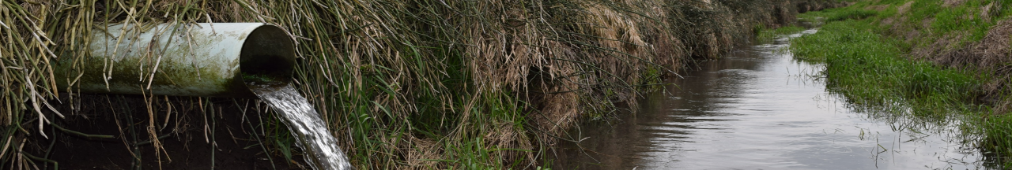
Average Nitrate- N Load
Water Quality Impact
35% Nitrate Reduction
Average Free 26 lb/acre
Average Controlled 17 lb/acre
Notes:
Nitrate load reduction from controlled drainage is the key water quality impact. Over 11 years the average nitrate load for (CLICK) free drainage was 26 lb/acre and the average for (CLICK) controlled drainage was 17 lb/acre.
Controlled drainage decreased nitrate loads by about 9 lb/acre for a 35% reduction.

Slide 15
Average Total Phosphorus Load
No significant change in phosphorus loss
Average Controlled .53 lb/ac
Average Free .49 lb/ac
Notes:
Redo words:
The phosphorus amounts again are very low at this site with an average of only half a pound per acre being lost yearly. This number did not change significantly due to controlled drainage.

Slide 16
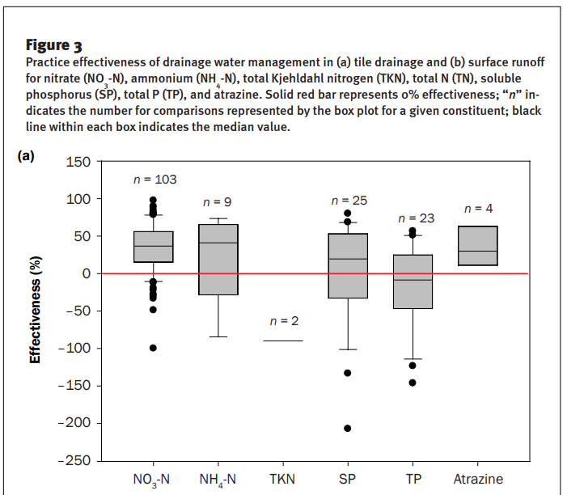
Load reductions from controlled drainage across sites
Smith, D.R., White, M., McLellan, E.L., Pampell, R. and Harmel, R.D., 2019. Using the Conservation Practice Effectiveness (CoPE) Database to assess adoption tradeoffs. Journal of Soil and Water Conservation, 74(6), pp.554-559.

Slide 17
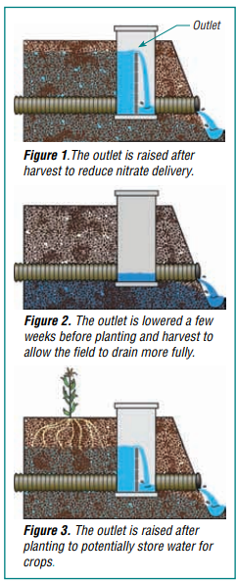
Members of the Agricultural Drainage Management Systems Task Force shared and discussed research, and developed a new USDA-NRCS Conservation Practice Standard #554 “Drainage Water Management”
Terminology note: NRCS chose “Drainage Water Management” rather than “Controlled Drainage” to avoid potential farmer concern about “control”.
Later, NRCS used “drainage water management” for various practices that manage water quality on drained lands.
Image: Purdue University

Slide 18
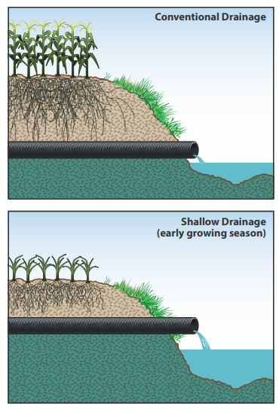
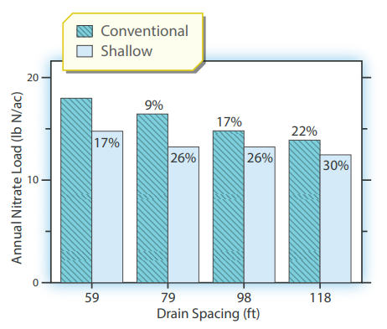
Shallow Drainage Reduce drain depth to 2.5-3.5 feet. Narrower spacing required to achieve the same drainage intensity.
Images from Christianson et al., 2016. Ten Ways to Reduce Nitrate Loads from Drained Cropland.

Slide 19
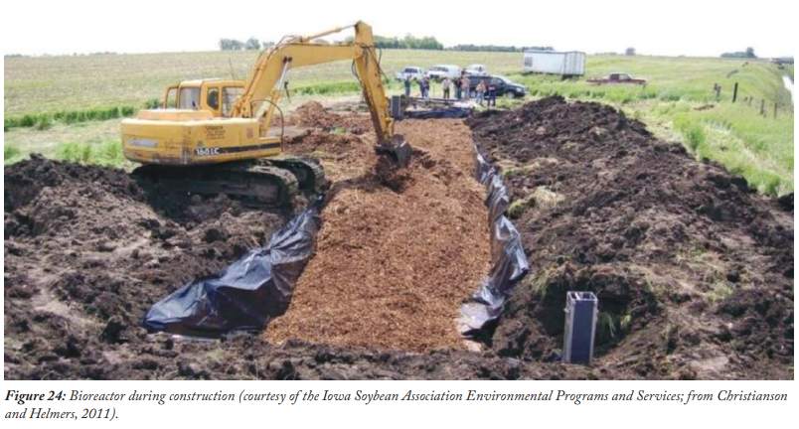
Denitrifying bioreactor (NRCS Conservation Practice Standard 604)

Slide 20
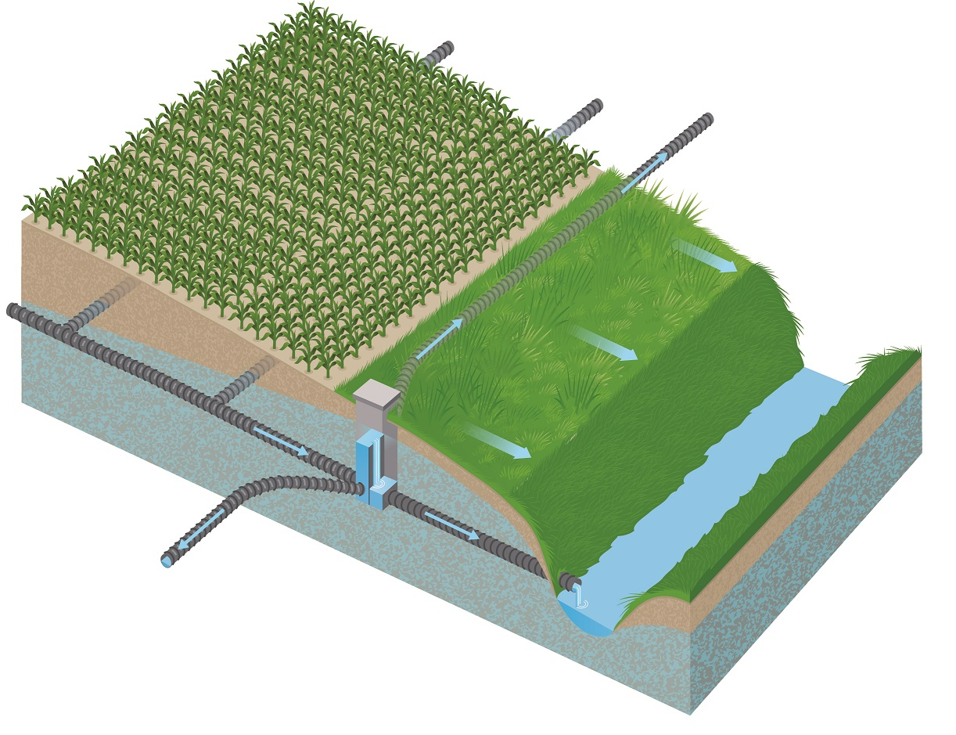
Saturated buffer (NRCS Conservation Practice Standard 605)
Distribution line to saturate buffer
Denitrification
Conventional buffer – Nitrate in tiles is not treated
Nitrate

Slide 21
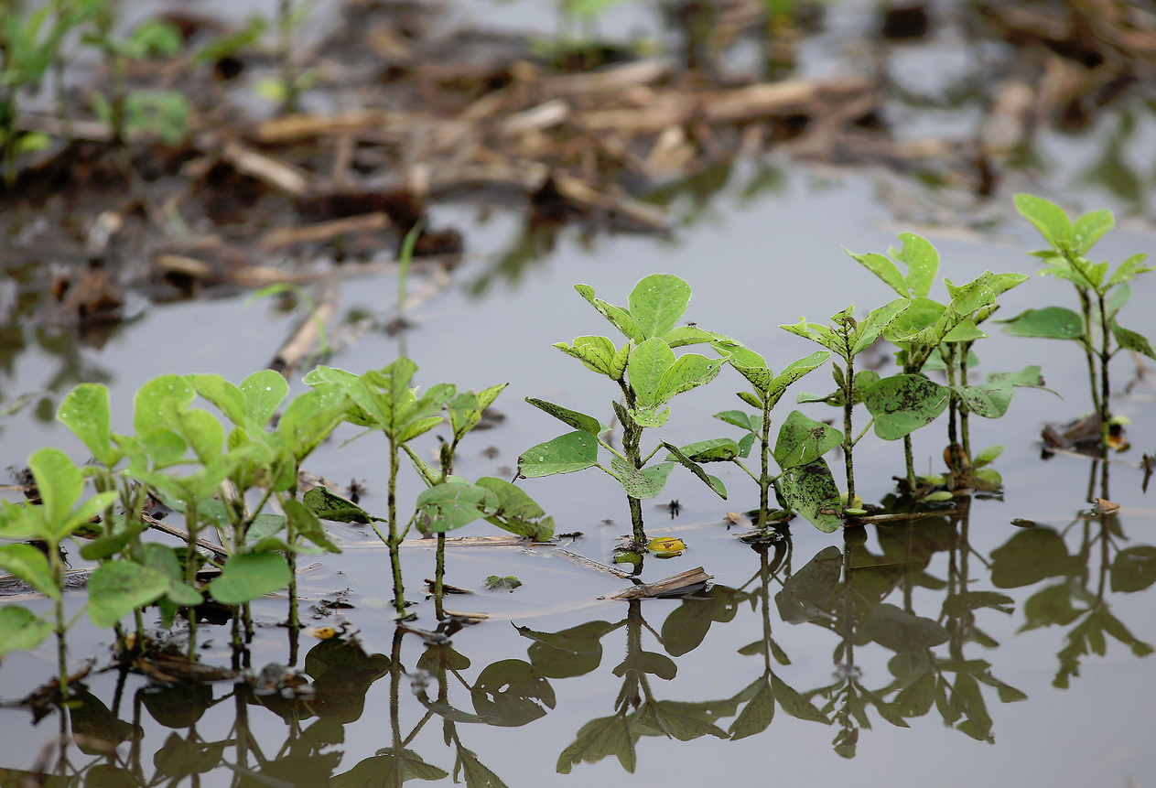
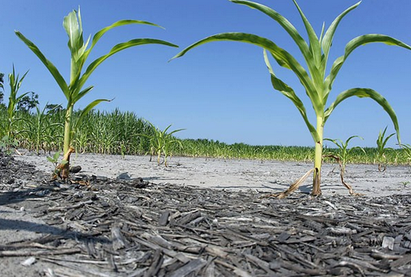
Two water-related problems (Rattan Lal “Two sides of a coin”
Sometimes too little
Sometimes too much
Notes:
So that’s the problem of water excess – the “sometimes too much” on the left. Water scarcity, when there’s too little, is not as obvious in the Midwest, and historically has not been as much of a concern.

Slide 22
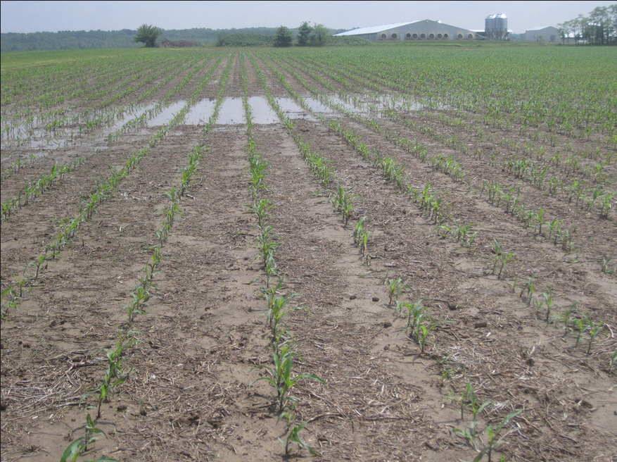
Need for resiliency to climate change
L

Slide 23
Sometimes too much; sometimes too little.
Both intensifying under our changing climate.
Spring: More runoff and nutrient loss
Summer: More drought and crop yield loss

Slide 24
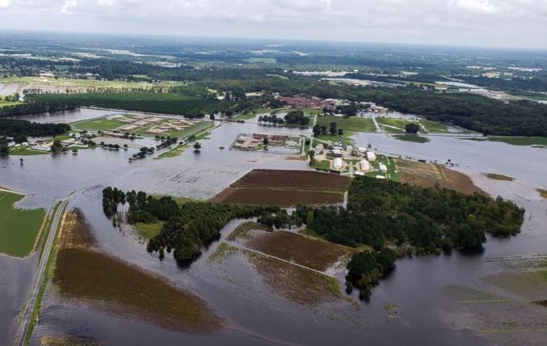
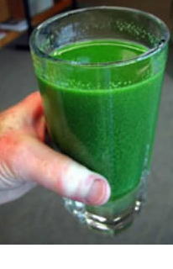
In periods with too much water already, we expect more in the future
More water quality problems
More flooding
Photo: Tom Bridgeman
Photo: Reuters Media from Hurricane Florence, 2018
Notes:
This expected increase in water at already-wet times of the year is a real concern. We can expect more and more severe water quality problems in the future. We also need to expect increases in flooding, which can cause immense damage as we have been reminded of by recent hurricanes and th devastation they have caused.

Slide 25
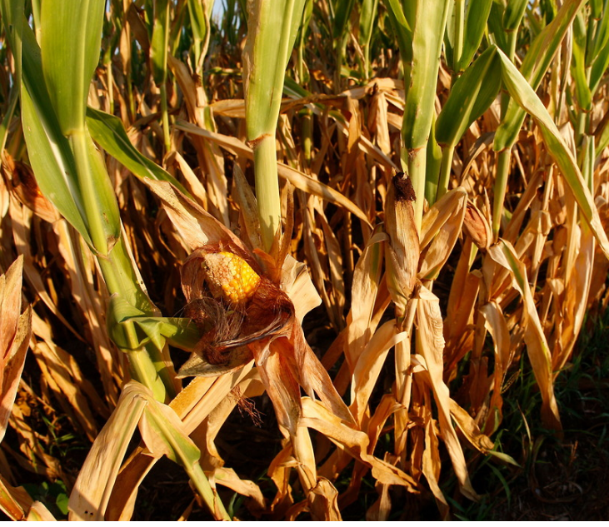
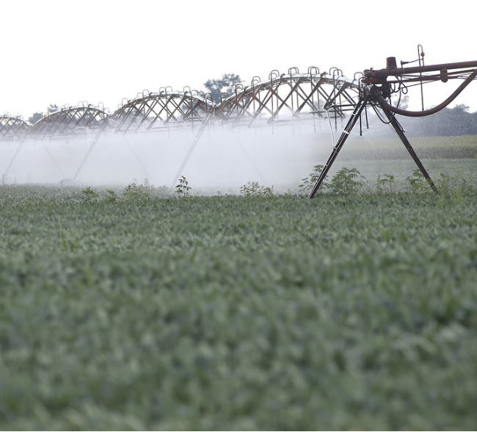
In periods with too little water already, we expect drier conditions in the future
More crop loss
More need for irrigation using potentially scarce water supplies
Notes:
We can also expect more severe problems due to lack of water, since even if precipitation continues the summers will be warmer, causing higher water use by crops. Irrigation is a way many farmers will cope with increased moisture stress in the summer, but water supplies are limited in some locations.

Slide 26
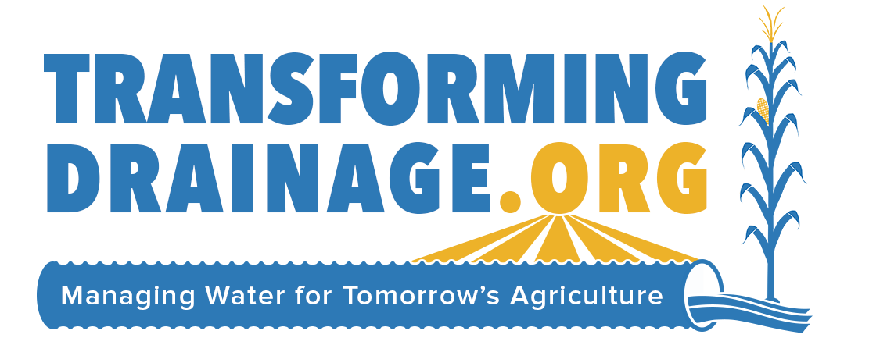
Solution: Storing more water in the landscape
Notes:
A solution for both too much and too little water is to add storage. We need to figure out how to store more of the water from the rich times, to be used in poor or dry times. Our landscape used to have much more storage, before it was drained, and our challenge is to figure out how to keep the drainage we need, while adding storage. This is the focus of a large effort led by Purdue called Transforming Drainage. As we look at managing water for tomorrow’s agriculture, our vision is that our goal would be transformed, from getting rid of as much water as possible as quickly as possible, to storing water as a precious resource for use when we need it.

Slide 27
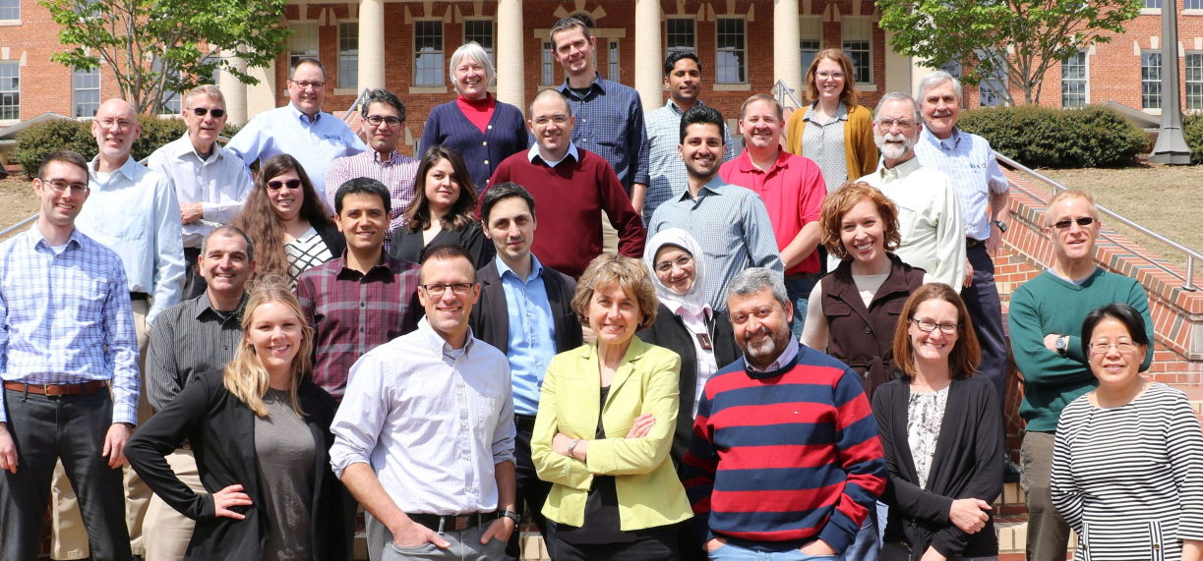
Transforming Drainage Team

Slide 28
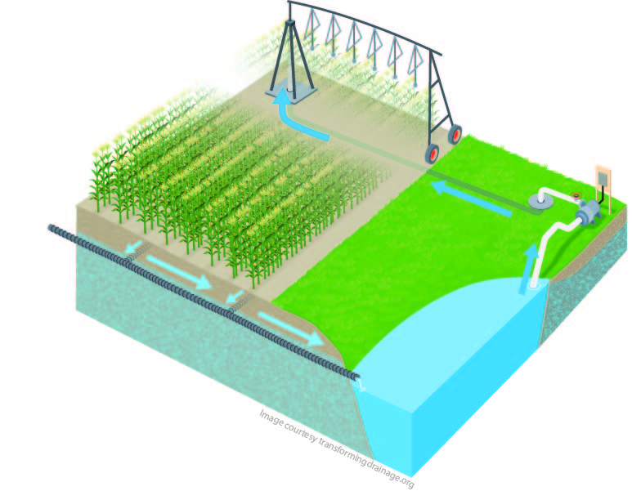
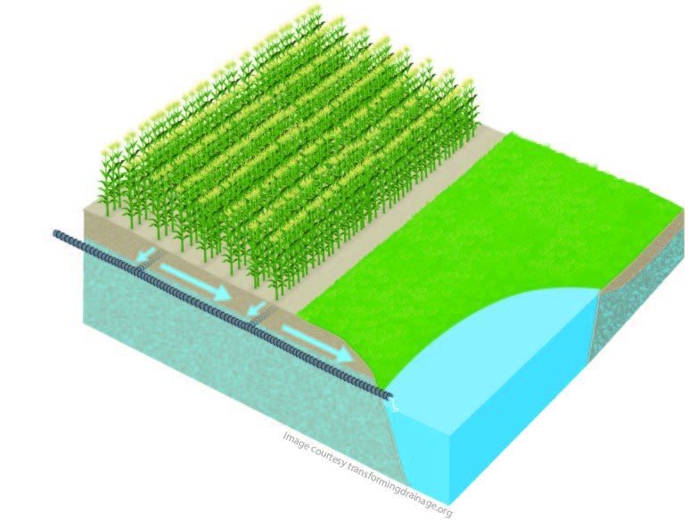
Storing water in ponds or reservoirs: Drainage Water Recycling
Store drained water in a pond or reservoir
and irrigate it back onto crops later in the season
Notes:
One way we can make the water storage have economic value to agricultural production is to recycle the water back onto crops, in what we call drainage water recycling. In this system, tile drains flow into a pond, rather than directly into a ditch or stream to be taken away downstream. The water is then used when the crops need it. Anotehr advantage of this system is that the nitrogen and phosphorus lost in the drainage water can be recycled back onto the crops as well. If they flow downsltream they pollute the water, but applied back on the crops they are an econcomic resource.

Slide 29
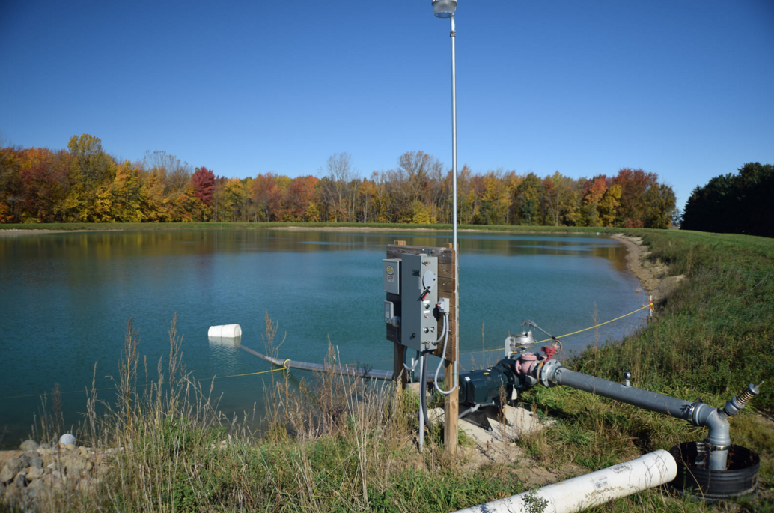
An old idea being analyzed and researched in new ways.

Slide 30
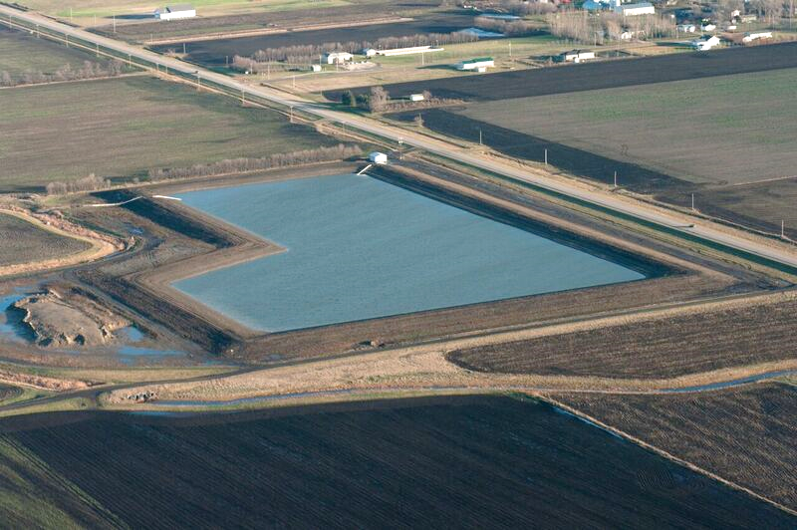
Reservoirs will need to be large.
Photo: JKW Construction, Ltd

Slide 31
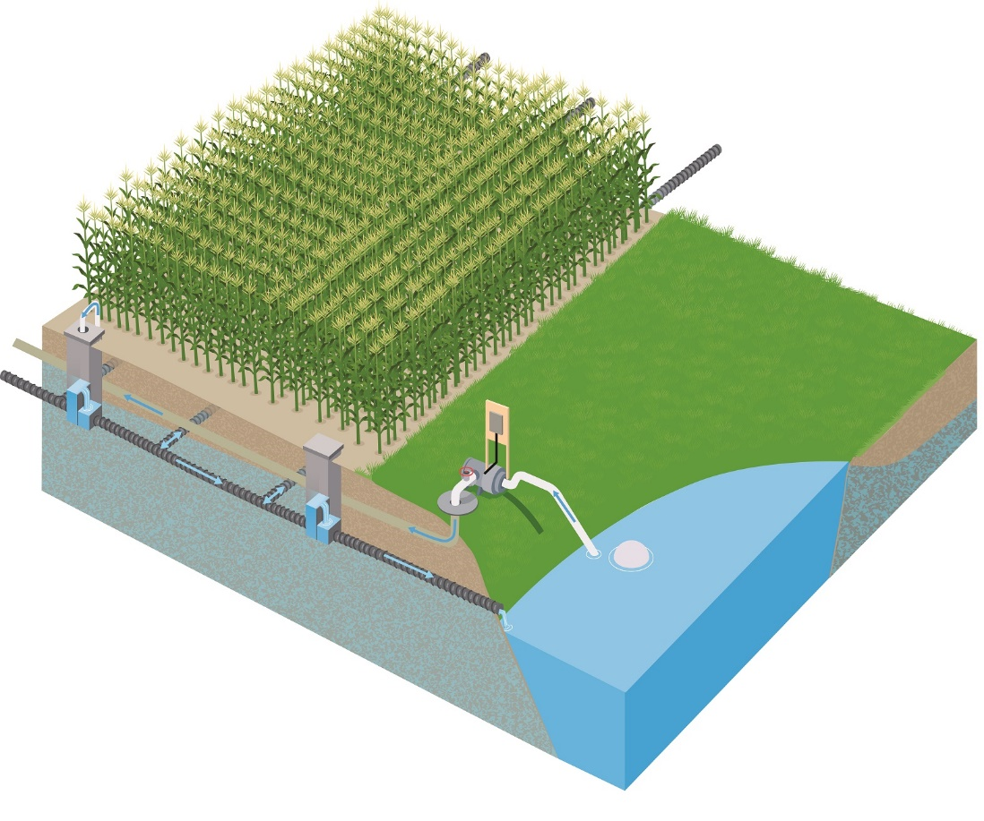
Irrigation can be through a sprinkler, or subirrigation
Subirrigation requires specific site properties
High hydraulic conductivity
Very low slope
Impermeable layer that holds up the water
Where are these found?

Slide 32
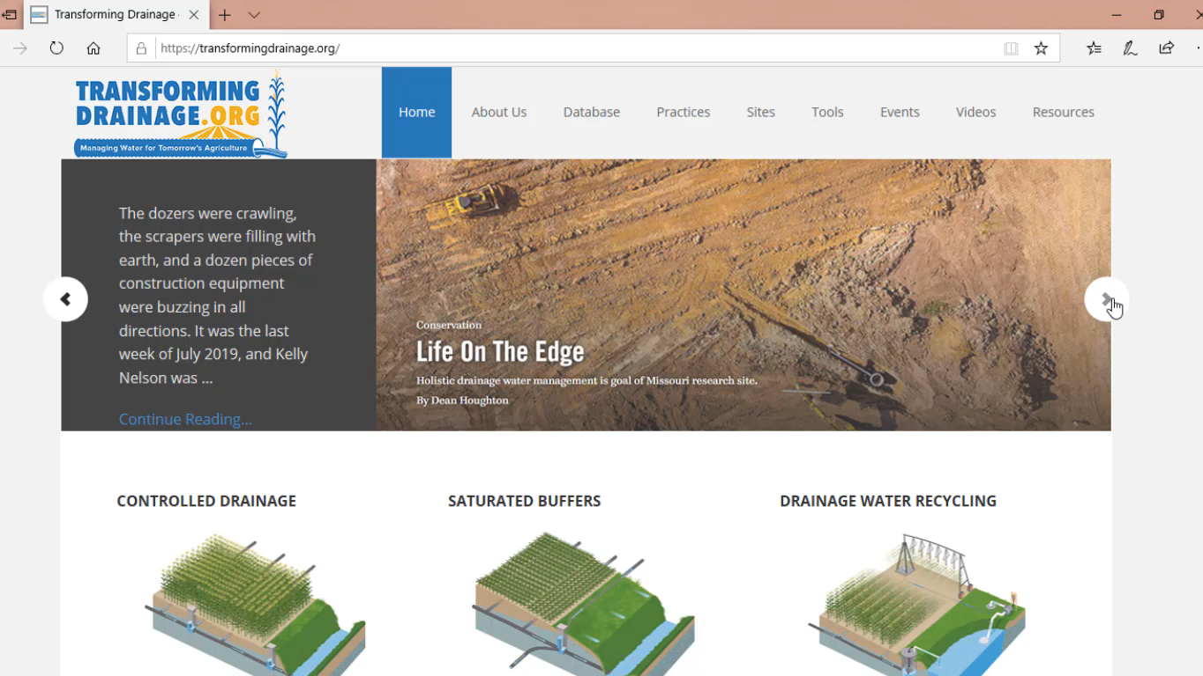

Slide 33
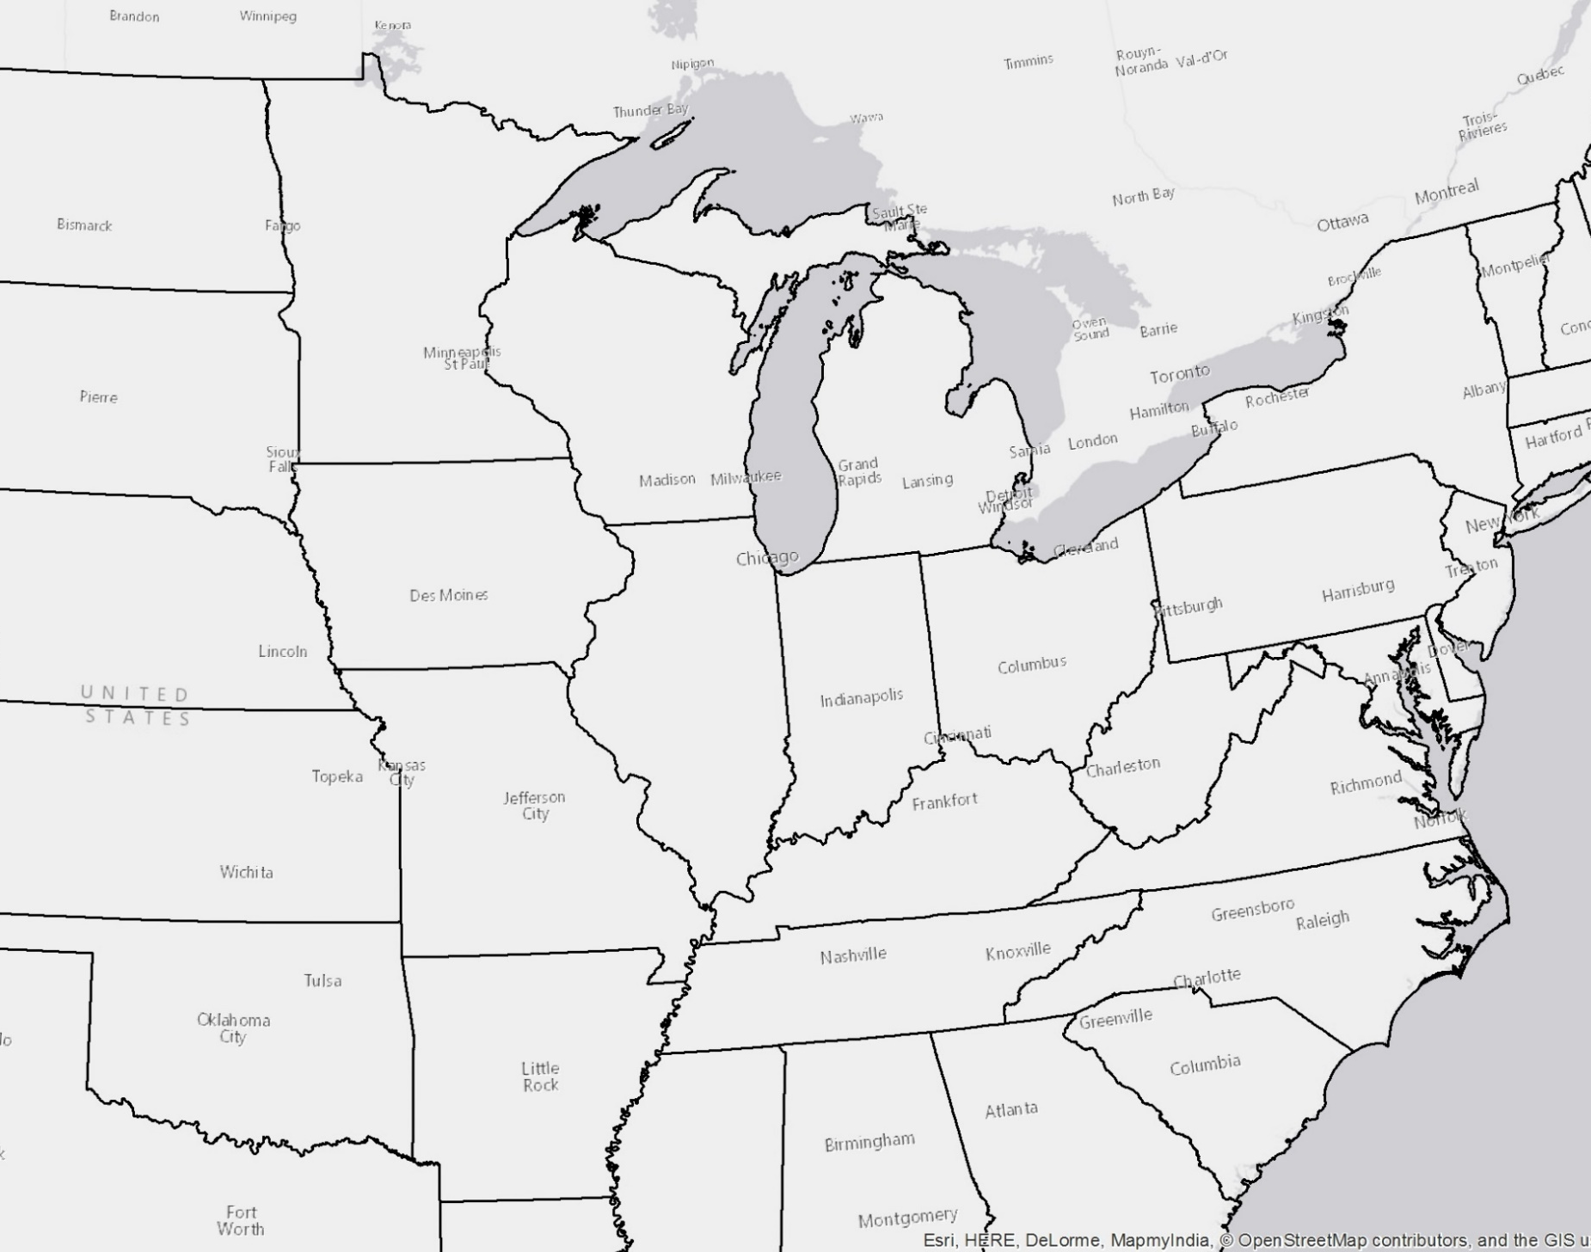
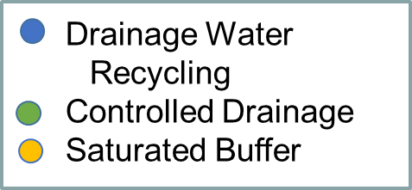

Collected data from drainage storage research sites– Existing, New, Historical

Slide 34
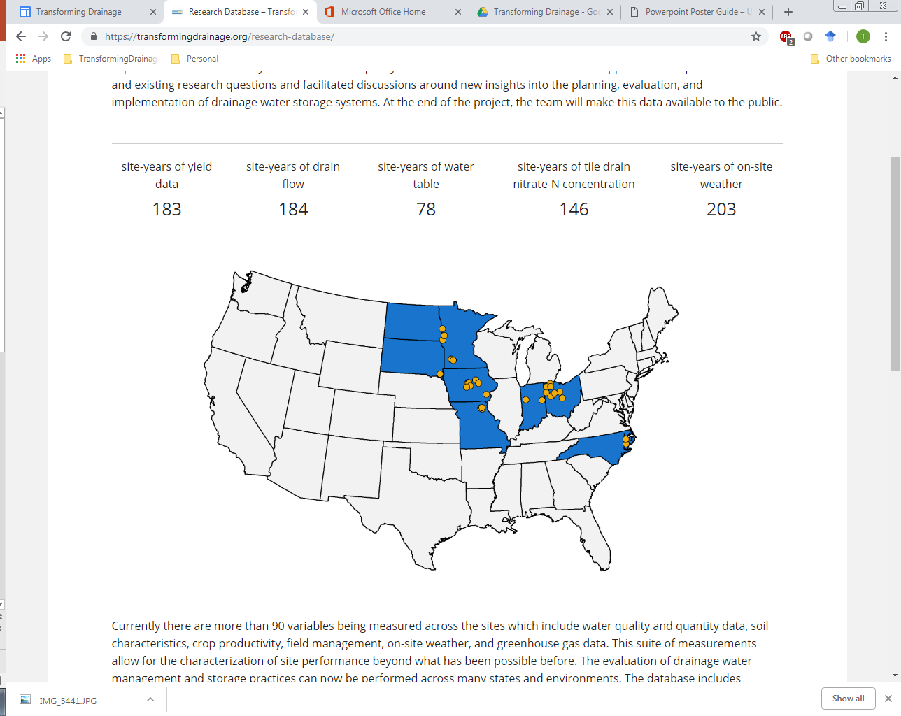
Transforming Drainage Database
SITE-YEARS OF
YIELD
183
SITE-YEARS OF
ON-SITE WEATHER
203
SITE-YEARS OF
WATER TABLE
78
SITE-YEARS OF
DRAIN FLOW
184
SITE-YEARS OF
TILE DRAIN NO3
146
https://transformingdrainage.org/research-database/
Seasonal Tile Flow Patterns

Slide 35
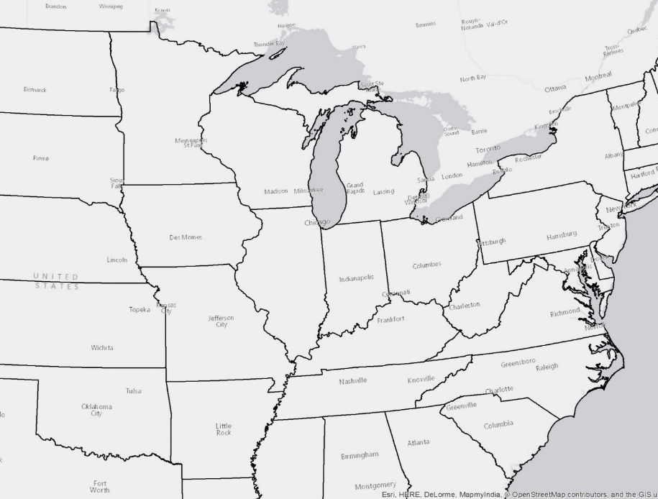


The Transforming Drainage Project is in its final year.
This material is based upon work that is supported by the National Institute of Food and Agriculture, U.S. Department of Agriculture, under award number 2015-68007-23193, “Managing Water for Increased Resiliency of Drained Agricultural Landscapes.

Slide 36
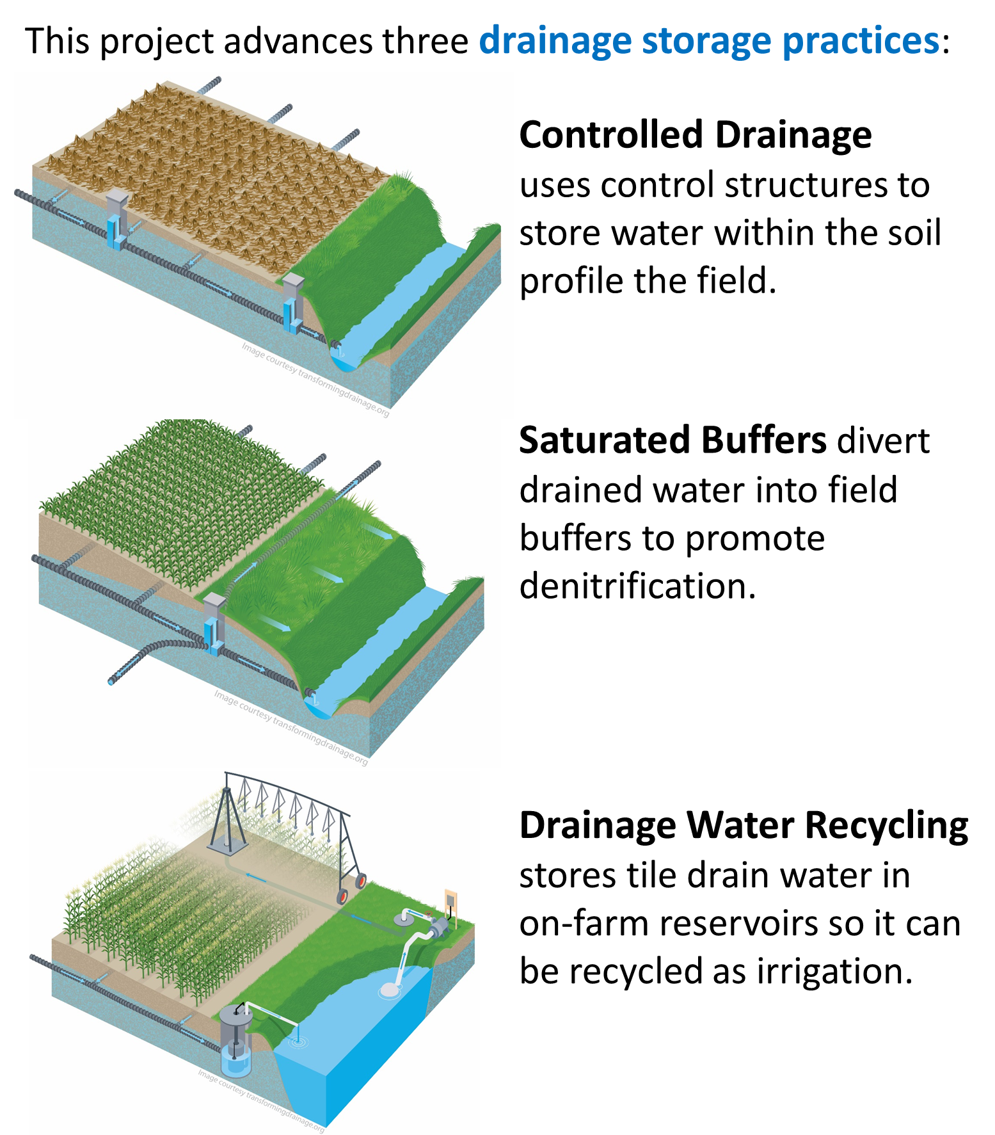
Conclusion: Numerous practices for managing water table conditions in artificially drained land Subirrigation Denitrifying bioreactors

Slide 37
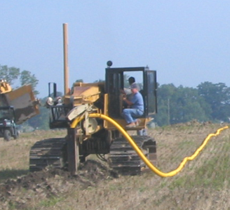
Precision Drainage?
Drainage water management
Agricultural drainage management systems
“Golden Rule of Drainage” (Only drain what and when you need to)
Transforming drainage
Smart drainage
Conservation drainage

Slide 38
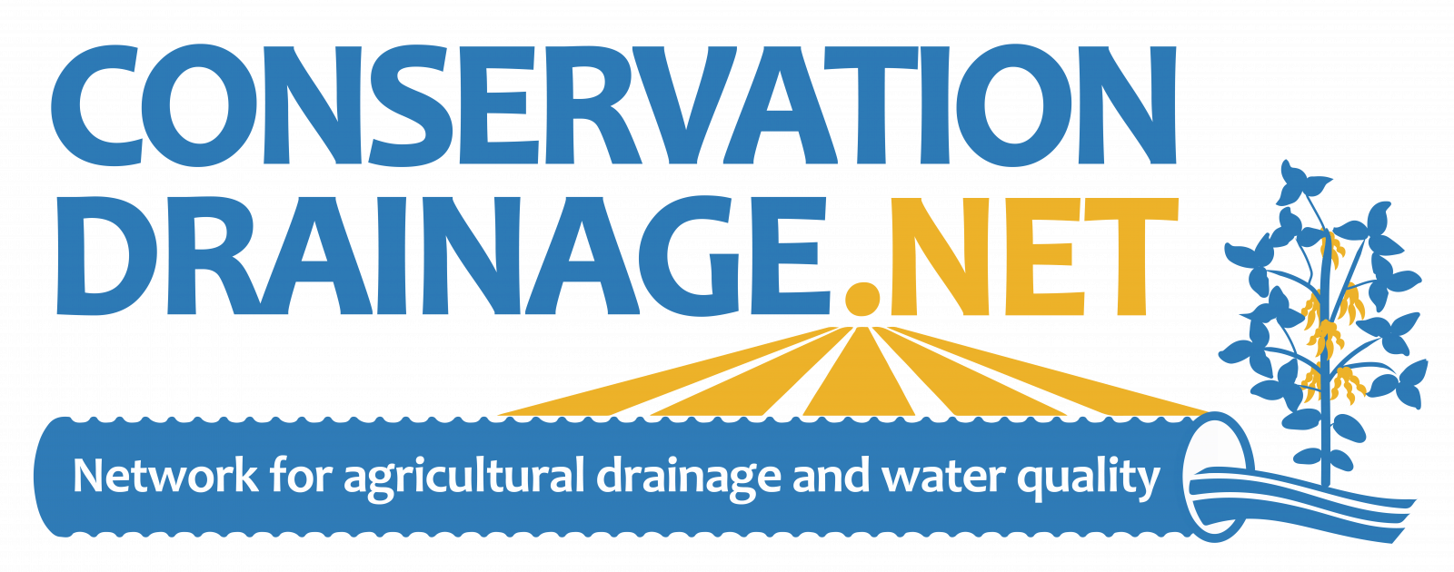
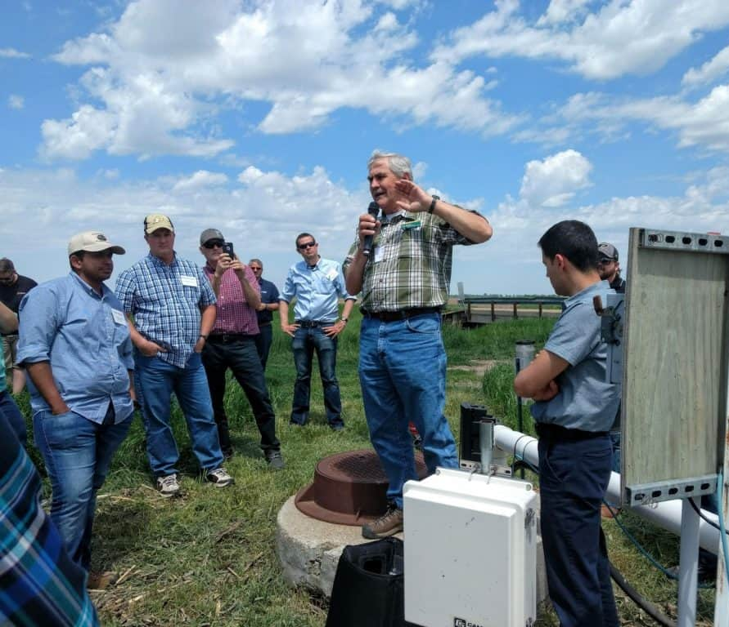
Conservation Drainage Network
The Conservation Drainage Network is a national partnership with the goal of improving drainage practices to reduce adverse environmental impacts while meeting future crop production needs.

Slide 39
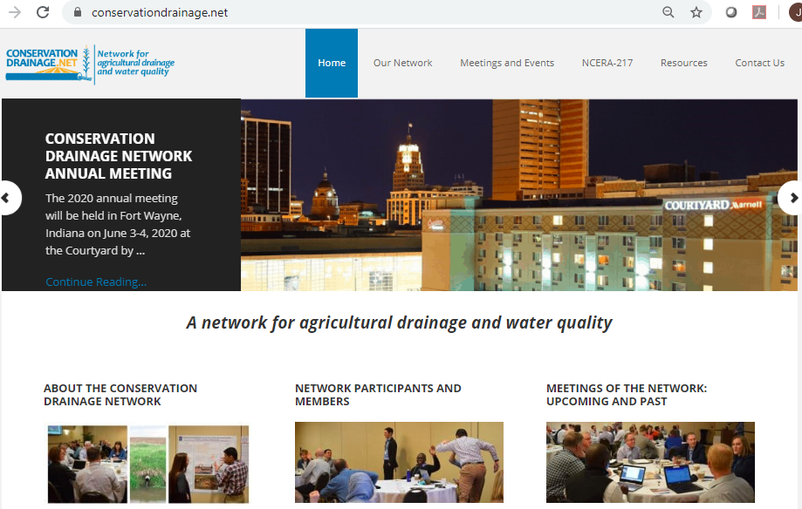
Conservation Drainage Network

Slide 40
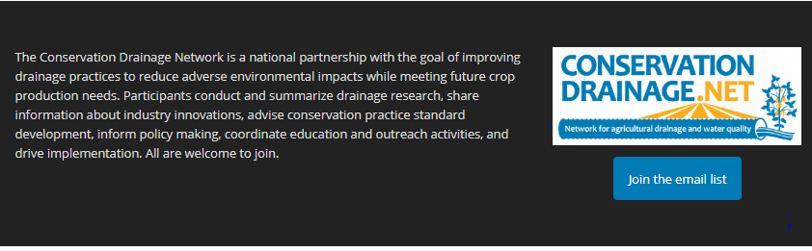
Join the email list (conservationdrainage.net)
Attend the meeting June 3-4 in Fort Wayne, IN

